Slide 1
Hotel De Gregoire
By Gregory Lawrence (2518638)

Slide 2

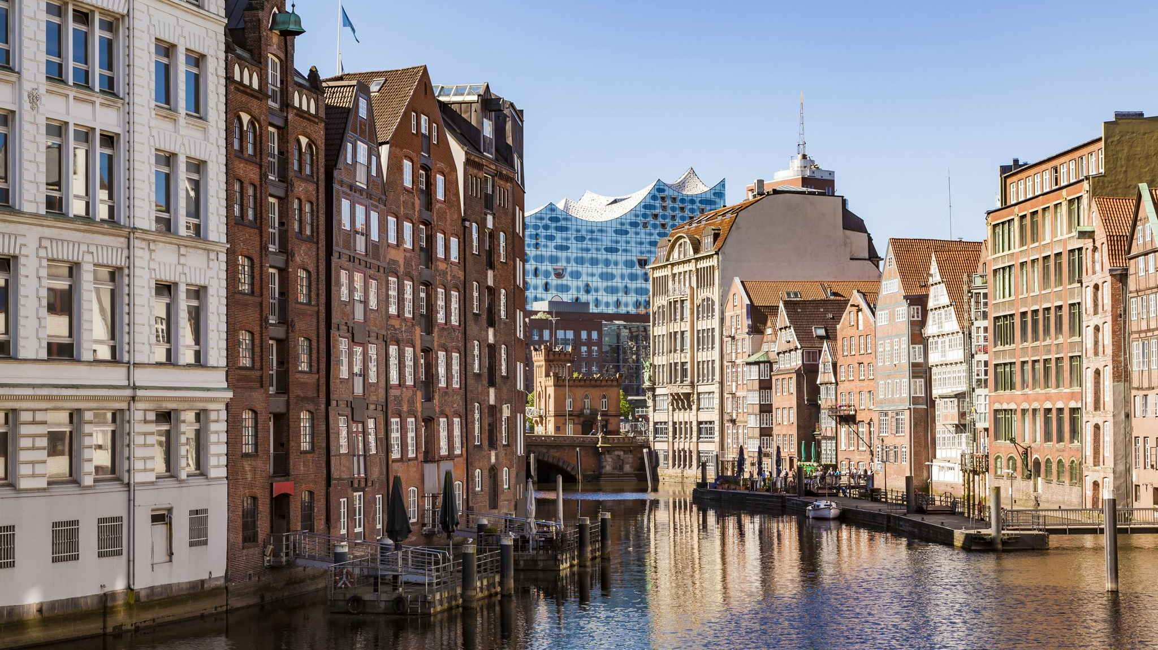
Introduction
In today's presentation I will be talking about Hotel de Gregoire which is going to be a sustainable and eco-friendly hotel. The target market is anybody, however we want to make the hotel more attractive to eco-friendly travellers. The location is around Chertsey area to be closer to Thorpe park which is a very popular UK attraction.

Slide 3
Sustainability strategies
(part of the hotel's design)
Solar panels – These would be a wise and long-term efficient investment because they can reduce hotel energy costs and they provide long term efficiency for power and electricity which hotel guests would be very happy with (Go be solar, 2026).
LED lighting – This is a feature that a lot of modern hotels include as this is another method to reduce the consumption of energy. They often get installed with motion sensors too (OCCA, 2026).
Insulation – Insulation is another one of the best possible sustainability strategies because it will help the rooms remain at a consistent temperature which means less need for airconditioning or heating which reduces the use of energy and electricity (Port Washington, 2025).

Slide 4


Sustainability strategies
(what everyone can do themselves)
Recycling boxes – Nowadays recycling has become a part of what we do to reuse waste that has the possibility of being reused for a good purpose. Each room will have some boxes by their door for different recycling materials. Recycling is something a lot of hotels have started taking more seriously (Lime Pack, 2026).
Food waste – In the kitchen there are massive food waste bins that are used for the food only. The kitchen staff make sure to put all uneaten food in the right bins. However, a lot of hotels use the unused food as staff meals so they can get fed on their break. Hotel de Gregoire will do the same (Earth care, 2025).

Slide 5
Research evidence
After doing research about Solar panels, it would be a bad idea to not invest in getting the solar panels installed because there are so many great benefits to having them. Most buildings have efficiencies of between 20-25% of sunlight energy being absorbed and converted to electricity (Solar reviews, 2026).
Research proves that LED lights last up to 75% longer than typical traditional lights therefore it could in the long term reduce cost and electricity. They also convert 80-90% of the energy used into light (U.S department of energy, N/A).
The U.S department of energy found that insulation reduces the amount of electronic heating used up to 25% and can even save £200 a year which is proof of how insulation reduces electricity (Which?, 2026).

Slide 6
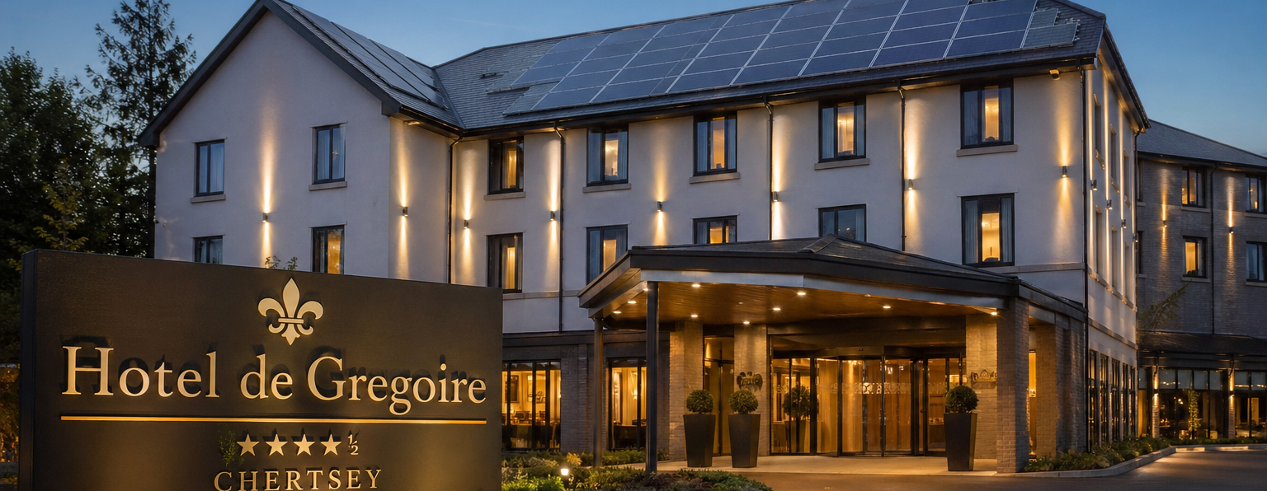
What might the hotel look like?
z

Slide 7
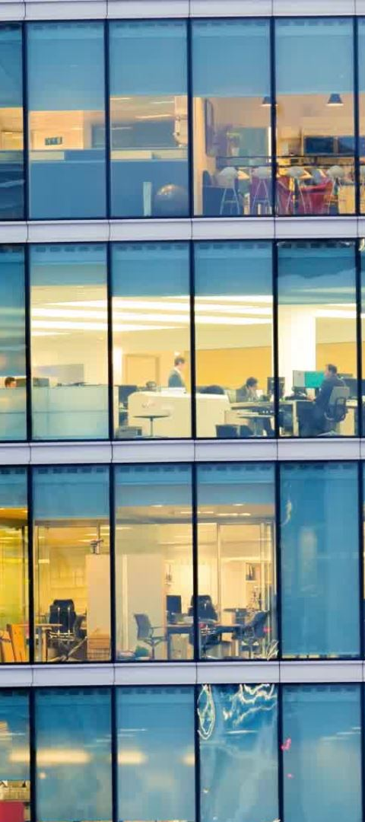
What will the hotel look like? (Description)
The hotel will not be huge to start off with; there will be enough rooms to have plenty of guests.
There will be solar panels on the roof.
There will be glass doors on the entrance.
The walls on the outside will be white.
There will be a big sign with the name of the hotel as well.

Slide 8
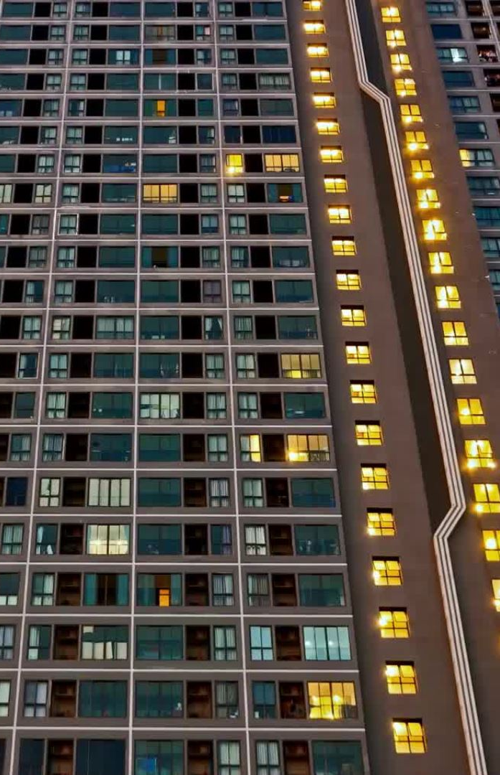
Conclusion
Overall, I believe that building this hotel will bring a lot of good to the environment, as well as being a comfy and warm hotel for guests to stay at when they travel.
Once all the insulation, lighting and solar panels are installed the hotel will become a very eco-friendly hotel that will hopefully catch the attention of conservationists and will be a successful establishment of the industry.

Slide 9
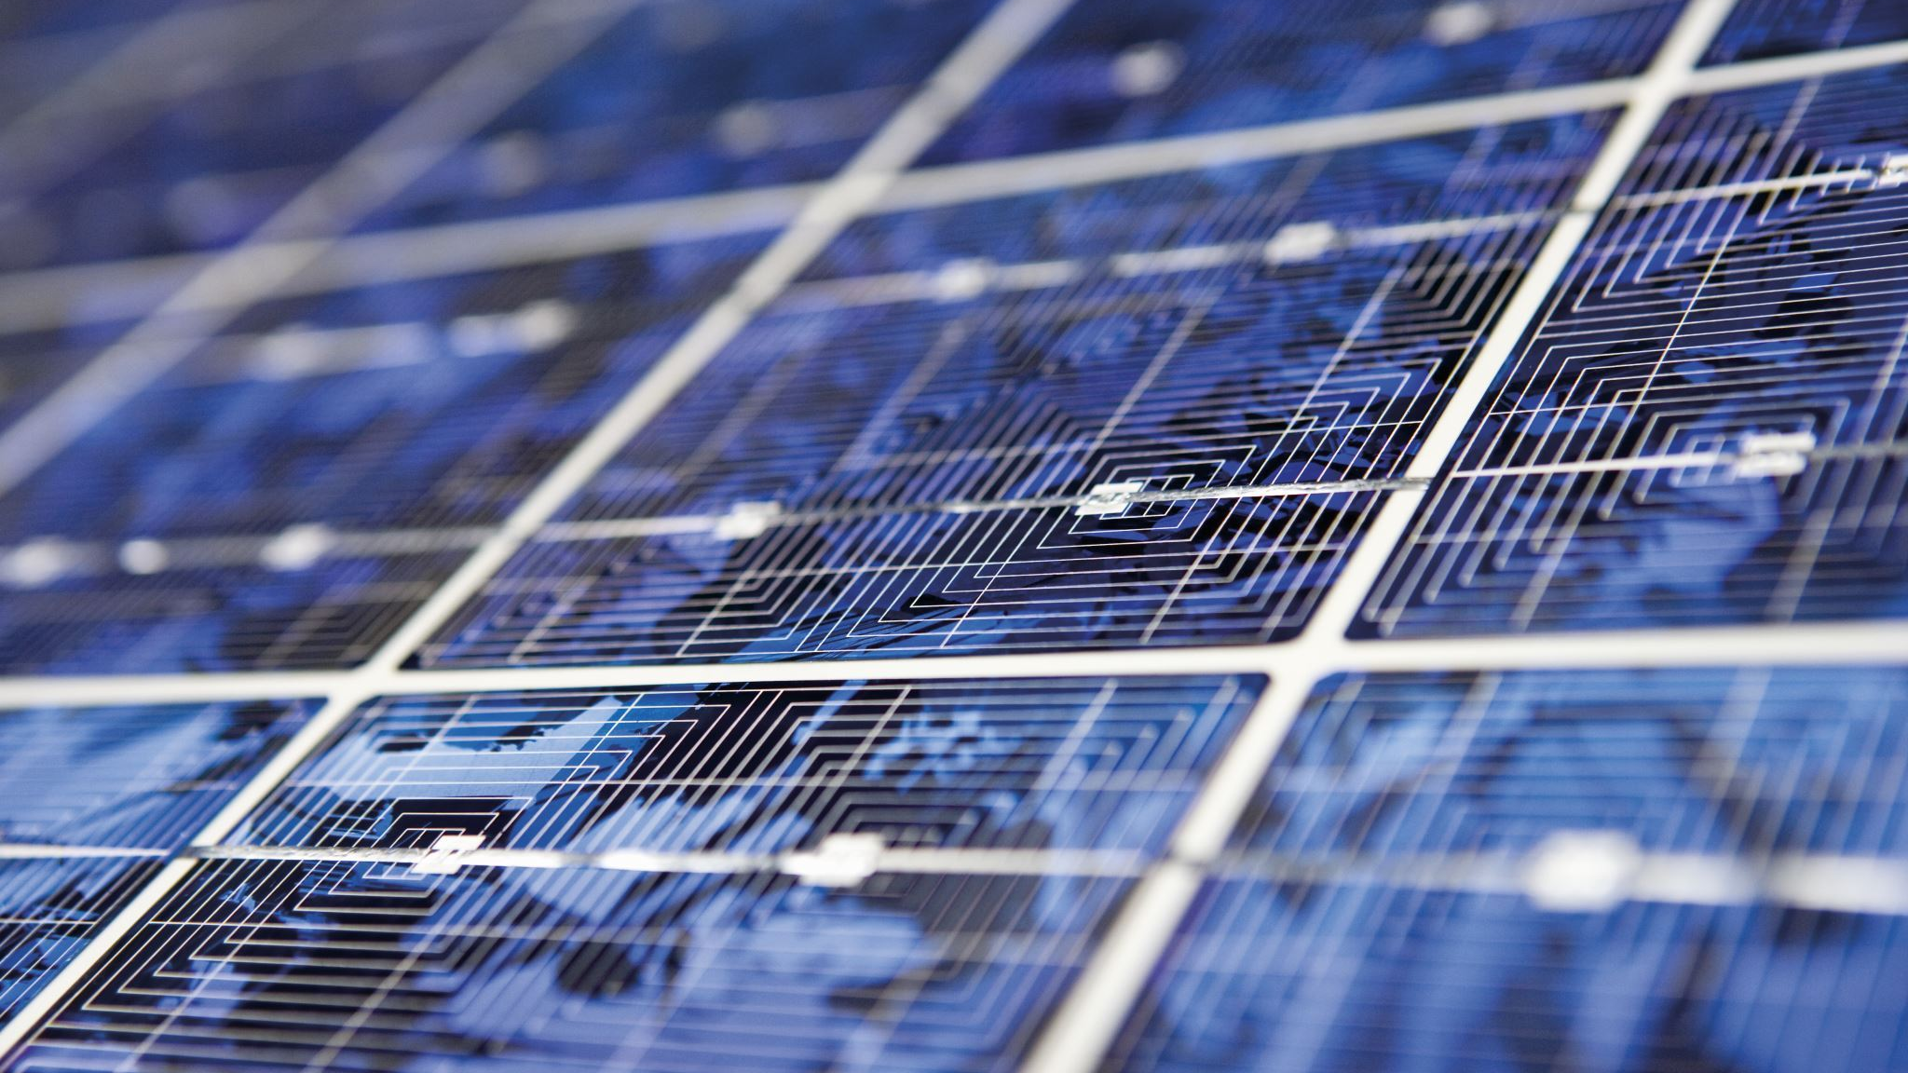
References
Earth care (2025) Food waste management. Available at: https://www.ecepl.com/food-waste-management/ (accessed: 6th May 2026).
Go be Solar (2026) Why solar panels are great for hotels. Available at: https://gobesolar.com/what-are-the-benefits-of-solar-for-hotels/ (accessed: 27th April 2026).
Lime Pack (2026) Recycling. Available at: https://www.limepack.co.uk/blog/hotel-gb/hotel-waste-management-strategies-for-effective-reduction-and-recycling (accessed: 6th May 2026).
OCCA (2026) Benefits of LED lighting. Available at: https://occa-design.com/blog/sustainability-hospitality-hotel-lighting/ (accessed: 27th April 2026).
Port Washington (2025) Insulation benefits. Available at: https://port-washington-inn.com/role-of-attic-insulation-in-hotel-comfort/ (accessed: 27th April 2026).
Solar reviews (2026) Solar panels efficiency. Available at: https://www.solarreviews.com/blog/what-are-the-most-efficient-solar-panels (accessed: 6th May 2026).
US department of energy (unknown date of previous update) LED lights efficiency. Available at: https://www.energy.gov/energysaver/led-lighting (accessed: 6th May 2026).
Which? (2026) Insulation efficiency. Available at: https://www.which.co.uk/reviews/insulation/article/how-to-insulate-your-home-aGWRW8t8YX1j (accessed: 6th May 2026).
Disclaimer – For the photo of what the hotel might look like I did use the help of AI to get inspiration of what the hotel could look like therefore I can't take all the credit for that photo.

