Slide 1

Managing Enterprise
BMSW4011
Student ID: 2323938
Pllumb Mena

Slide 2
Presentation Overview
Slide 3- Product Description
Slide 4- Business Aims and Objectives
Slide 5- Location
Slide 6- Human Resources Strategy
Slide 7- Brief Financial Overview
Slide 8- Marketing Strategies
Slide 9- Marketing Examples
Slide 10- Market Research and Viability
Slide 11- Application of Findings and Viability o the Business Plan
Slide12- Conclusion
Slide 13- References

Slide 3

Bringing the Business Proposition to Life
Product/Service Description
The market study was crucial, involving polls, focus groups, and competitor research.
Ensuring effective poll and focus group questions took significant effort.
Data analysis provided insights into customer preferences and market needs.
Findings showed a strong desire for a cozy coffee place.
Feedback validated the concept and highlighted improvements, such as adding community events and ethically sourced products (Mintel, 2023).
Notes:
Cardiff Brew Co. wants to be the best specialty coffee shop in Cardiff, which is a busy city in the UK. We want to give you the best coffee experience possible by finding fair trade, high-quality beans and a wide range of specialty snacks and pastries. People can enjoy expensive drinks, use free Wi-Fi, and take part in community events like book clubs, art shows, and open mic nights in a cozy, friendly place that we're building. Many people, including students, workers, and locals, like us because we offer both high-quality goods and community service. This makes us stand out from the others in the same field (Kotler and Keller, 2016).

Slide 4
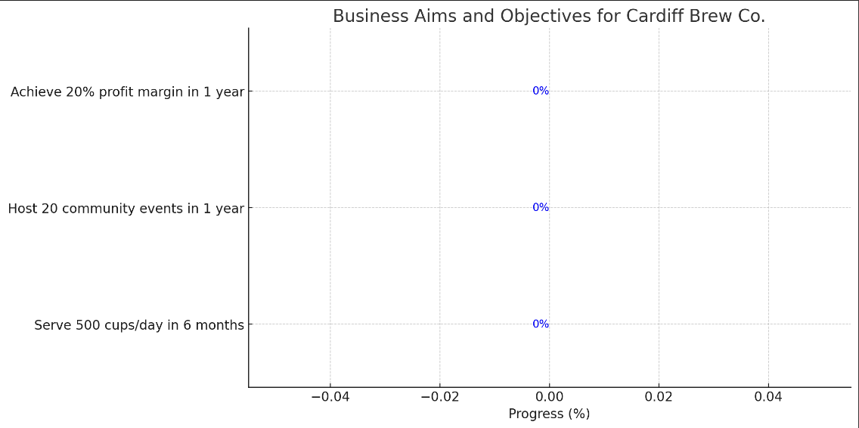
Business Aims and Objectives
Cardiff Brew Co. aims to be the best coffee shop in Cardiff within the first two years.
Objectives:
Serve 500 cups of coffee daily for the first six months.
Hold 20 community events in the first year.
Achieve a 20% profit by the end of the first year.
Main goal: create a space where coffee lovers can meet and talk.
These goals will help us stay on track (Bryson, 2018).
Mission Statement and USP
Mission: Create a community hub for exceptional coffee in a welcoming environment.
USP: The combination of High-quality, ethically sourced coffee, cozy atmosphere, community engagement through network events and music events.
Differentiation: Quality products and community focus will build a loyal customer base (Sinek, 2019).
Notes:
Business Aims and Objectives
In the first two years of business, we want Cardiff Brew Co. to be the best coffee shop in Cardiff. Here are some clear goals we have set for ourselves: serve 500 cups of coffee every day for the first six months; hold 20 community events in the first year; and make a 20% profit by the end of the first year. Making a place where coffee lovers can meet and talk is our main goal. These goals will help us stay on track (Bryson, 2018). What makes our USP stronger than competitors is combining the good quality and ethically sourced products whilst also offering a place of socialisation through everyday casual events as well as bigger events like gigs.

Slide 5

Location
Proposed Location:
Located in the heart of Cardiff city center
Near University and business districts
Attracts students, professionals, and tourists
Ensures steady foot traffic (Cardiff Council, 2024)
Notes:
Proposed Location
The proposed location for Cardiff Brew Co. is in the heart of Cardiff city center, strategically situated near the University and business districts. This prime location is expected to attract a diverse customer base, including students, professionals, and tourists. The proximity to these areas ensures a steady flow of foot traffic, which is crucial for the success of our business (Cardiff Council, 2024).

Slide 6
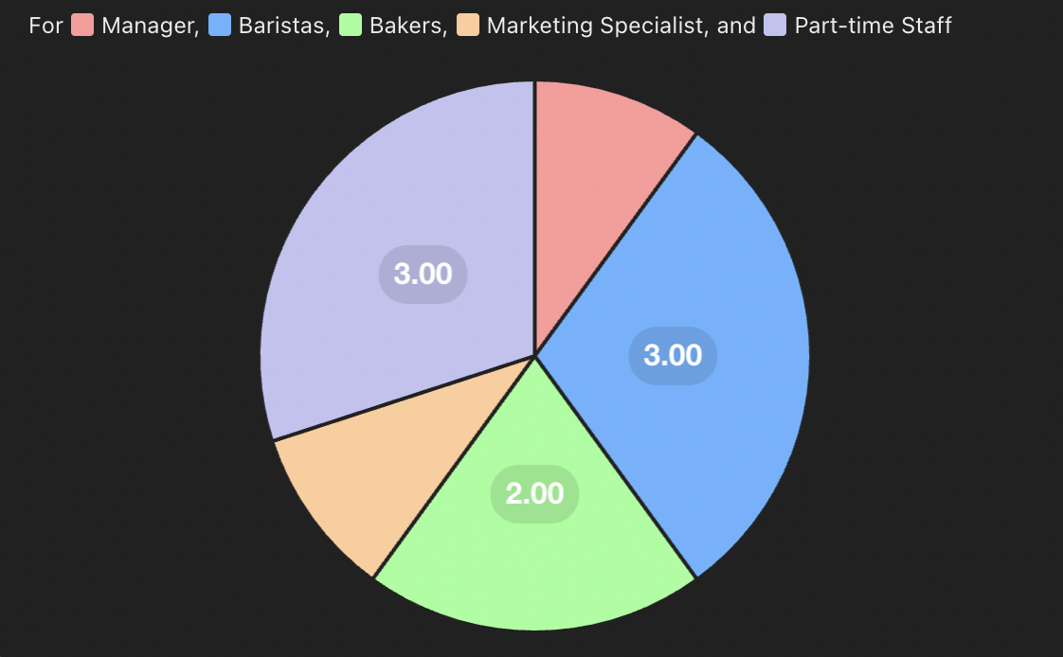
HRM Strategy:
Employ a team of 10 individuals
Includes 1 Manager, 3 Baristas, 2 Bakers, 1 Marketing Specialist, and 3 Part-time staff
Sourced through local job fairs, university career centers, and online job portals
Manager oversees daily operations
Baristas prepare and serve beverages
Bakers ensure a fresh supply of pastries
Marketing Specialist handles promotional activities
Part-time staff support during peak hours (Wilson, 2017)
Notes:
Proposed Location
The proposed location for Cardiff Brew Co. is in the heart of Cardiff city center, strategically situated near the University and business districts. This prime location is expected to attract a diverse customer base, including students, professionals, and tourists. The proximity to these areas ensures a steady flow of foot traffic, which is crucial for the success of our business (Cardiff Council, 2024).
HRM Strategy
Our Human Resource Management (HRM) strategy involves employing a team of 10 individuals. This team will include 1 Manager, 3 Baristas, 2 Bakers, 1 Marketing Specialist, and 3 Part-time staff for weekends and peak hours. Employees will be sourced through local job fairs, university career centers, and online job portals. Each team member will play a crucial role in delivering excellent customer service, maintaining product quality, and promoting the business. The manager will oversee daily operations, baristas will prepare and serve beverages, bakers will ensure a fresh supply of pastries, the marketing specialist will handle promotional activities, and part-time staff will support during busy periods (Wilson, 2017).

Slide 7
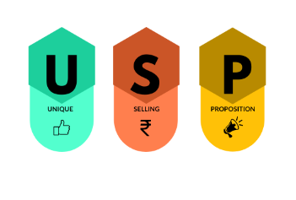
Brief Financial Overview
Steady growth in revenue with controlled expenses ensures profitability by year-end.
Revenue: £10,000 in January, rising to £22,000 by December.
Expenses: £8,000 in January, rising to £10,500 by December.
Net Cash Flow: £2,000 in January to £11,500 by December.
Forecast based on conservative estimates, considering seasonal variations and potential growth (Petty, 2021).
Notes:
Brief Financial Overview
Our financial plan projects a steady growth in revenue with controlled expenses, ensuring profitability by the end of the first year. The 12-month cash flow forecast includes:
Revenue: Starting at £10,000 in January and increasing to £22,000 by December.
Expenses: Starting at £8,000 in January and rising to £10,500 by December.
Net Cash Flow: From £2,000 in January to £11,500 by December.
This forecast is based on conservative estimates and takes into account seasonal variations and potential growth in customer base (Petty, 2021).
Mission Statement and USP
Our mission is to create a community hub where coffee lovers can enjoy exceptional coffee in a welcoming environment. Our unique selling proposition (USP) is our commitment to high-quality, ethically sourced coffee, a cozy atmosphere, and a focus on community engagement through events and collaborations. This combination of quality products and community focus will differentiate Cardiff Brew Co. from other coffee shops in the area and build a loyal customer base (Sinek, 2009).

Slide 8
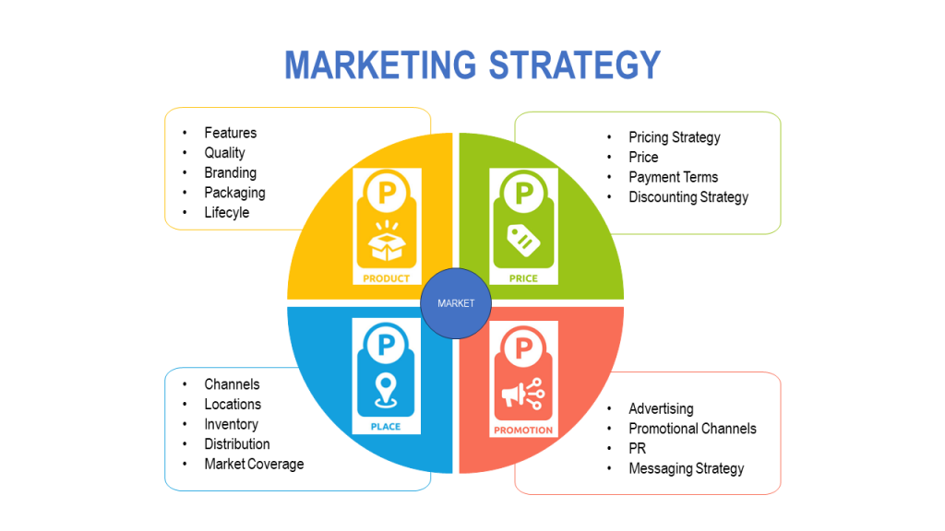
Marketing Strategy and Examples
Marketing Strategy
Uses both traditional and modern methods to reach a wide audience.
Key components: community engagement, loyalty programs, news releases, and promotional events.
Daily social media posts on Instagram and Facebook about products, events, and customer stories to build an online presence and attract followers (Kotler and Keller, 2016).
Community involvement through hosting events and collaborating with local artists to foster belonging (Kotler and Keller, 2016).
Loyalty programs to reward frequent purchases, build trust, and boost sales.
Press releases to local media to publicize launch and events, complementing online efforts.
Offering discounts and free samples during the first month to attract and retain new customers (Chambers, 2020).
Notes:
Our marketing plan uses both old-fashioned and modern ways to get in touch with lots of people. Some of the most important parts are engagement with the community, loyalty programs, news releases, and promotional events.
Social media efforts will be a big part of how we do things. Every day, we'll post on Instagram and Facebook about our goods, events, and customer stories. We want to build a strong online footprint and get people to follow us by making interesting content. Getting the community involved is another important part of our plan. We can connect with the community and feel like we belong by putting on events and working with local singers and artists (Kotler and Keller, 2016).
There will be loyalty programs to keep people coming back and encourage them to do so. We want to build customer trust and boost sales by giving rewards to people who buy from us often. Local media will be contacted through press releases to get the word out about our start and other events. This old-fashioned way of marketing will go well with our online work and help us reach more people. During our first month of business, we will also offer discounts and free samples to bring in new customers and get them to try our goods (Chambers, 2020).

Slide 9
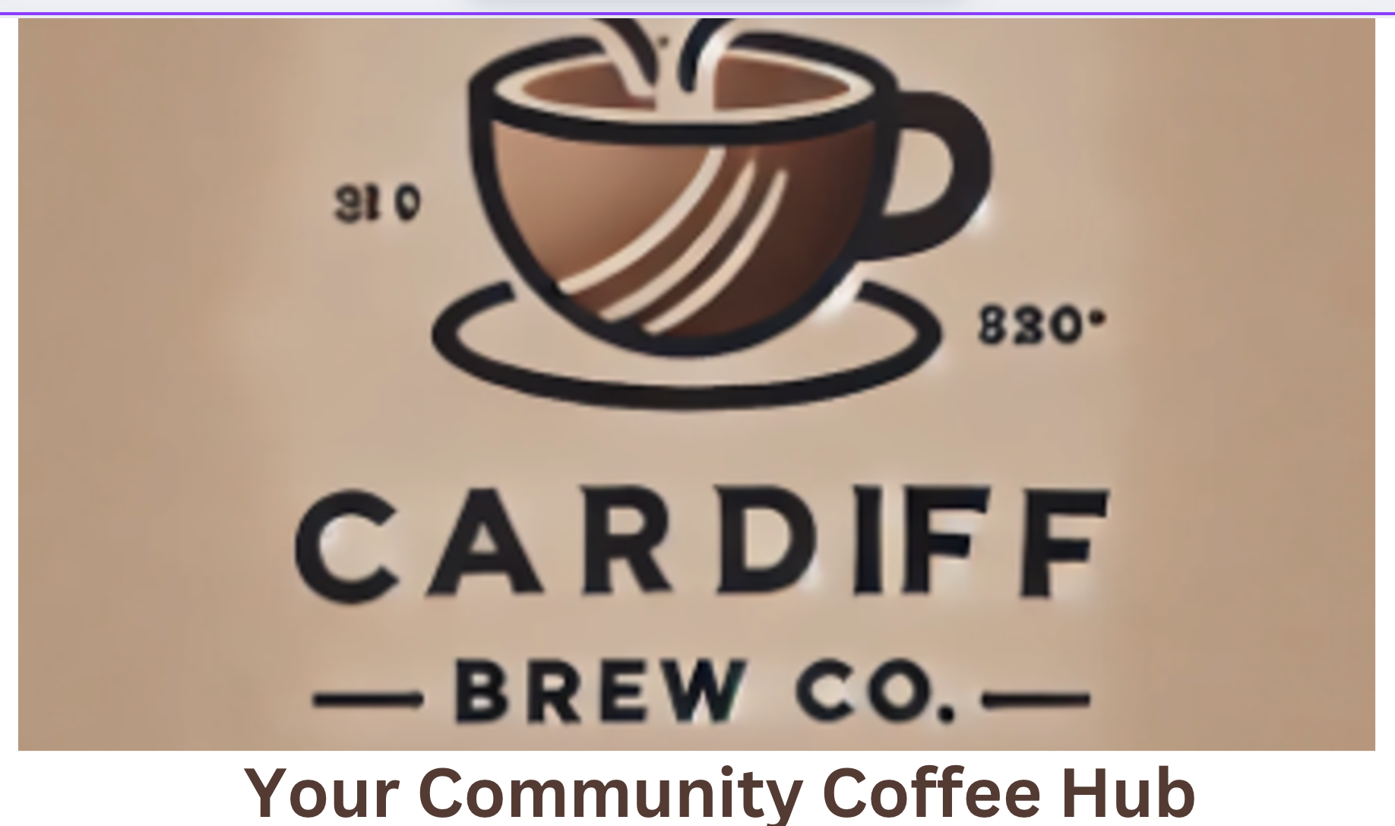
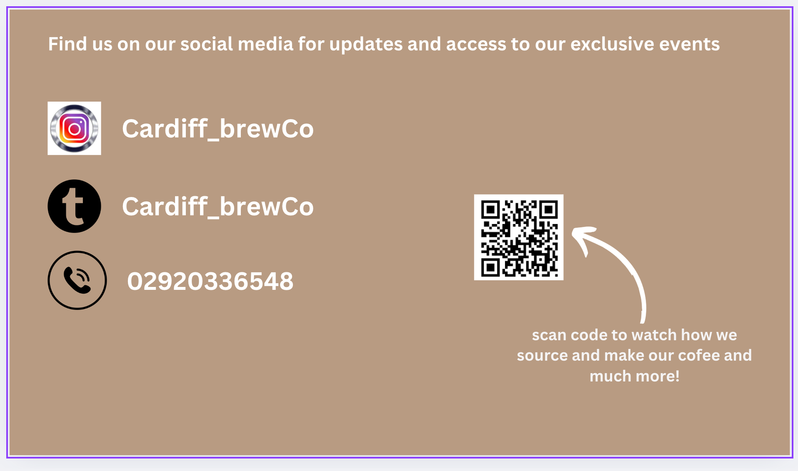
Marketing Examples
Branding: The earth tones and simple design in our branding give it a warm, inviting feel. Our image is a coffee cup with heart-shaped steam coming out of it, which represents our dedication to quality and community.
Business Cards: Our business cards have our logo, contact information, and a short phrase that says "Your Community Coffee Hub." They are intended to match the look of our brand.
Flyers: Our goods, location, and a special opening discount will be printed on flyers that will be passed out in the area.
Blog posts on social media sites: We'll regularly share new menu items, future events, and behind-the-scenes looks at how we make coffee on Instagram and Facebook.
TikTok Ads: Cardiff Brew Co.'s unique qualities, like our ethically sourced coffee and community events, are shown in short, interesting movies on TikTok.
Facebook Posts: To connect with our community, we'll share event details, customer reviews, and special deals on our Facebook page
Notes:
Branding: The earth tones and simple design in our branding give it a warm, inviting feel. Our image is a coffee cup with heart-shaped steam coming out of it, which represents our dedication to quality and community.
Business Cards: Our business cards have our logo, contact information, and a short phrase that says "Your Community Coffee Hub." They are intended to match the look of our brand.
Flyers: Our goods, location, and a special opening discount will be printed on flyers that will be passed out in the area.
Blog posts on social media sites: We'll regularly share new menu items, future events, and behind-the-scenes looks at how we make coffee on Instagram and Facebook.
TikTok Ads: Cardiff Brew Co.'s unique qualities, like our ethically sourced coffee and community events, are shown in short, interesting movies on TikTok.
Facebook Posts: To connect with our community, we'll share event details, customer reviews, and special deals on our Facebook page.

Slide 10
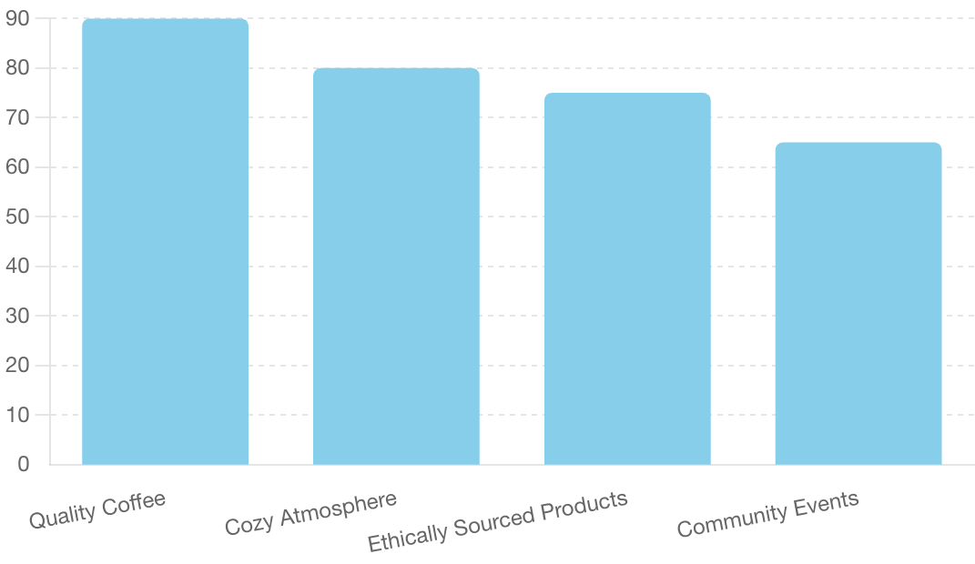
Market Research and Viability
Market Research Conducted
Conducted focus groups, surveys, and competitor analysis.
Surveyed 300 people online in Cardiff and held two focus groups with local coffee lovers.
Analyzed five competing coffee shops in Cardiff (Mintel, 2023).
Key Findings
90% preferred high-quality coffee.
80% valued a cozy atmosphere.
75% preferred ethically sourced products.
65% were interested in community events.
High demand for quality beverages and community engagement.
Competitors lacked a comprehensive combination of high-quality coffee, cozy atmosphere, and community events (Collins, 2019).
Notes:
Market Research Conducted
Our market study was thorough and included focus groups, surveys, and an analysis of our competitors. We surveyed 300 people in the Cardiff area online, set up two focus groups with coffee lovers in the area, and looked at what five competing coffee places in Cardiff had to offer and what customers said about them. The survey questions were designed to gather insights into customer preferences, spending habits, and expectations from a coffee shop. The focus groups provided qualitative data on the specific needs and desires of our target audience, while competitor analysis helped us identify gaps in the market and potential areas for differentiation (Mintel, 2023).
Key Findings
The research revealed several key findings:
Customer Preferences: 90% of survey respondents indicated a preference for high-quality coffee, 80% emphasized the importance of a cozy atmosphere, 75% preferred ethically sourced products, and 65% expressed interest in community events.
Market Demand: The research highlighted a significant demand for a coffee shop that provides not just quality beverages but also a welcoming environment and community engagement.
Competitive Analysis: The analysis of competing coffee shops indicated that while there are several established players, none of them offered a comprehensive combination of high-quality coffee, a cozy atmosphere, and community-focused events (Collins, 2019).
The above graph illustrates the key preferences identified through our surveys, highlighting the importance of quality coffee and a cozy atmosphere for our target customers.

Slide 11
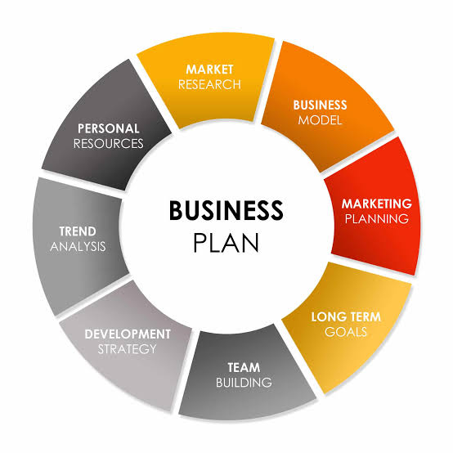
Application of Findings
Emphasizing high-quality, ethically sourced coffee and artisanal snacks.
Selecting a central location near the University and business districts.
Focusing on community engagement and a strong social media presence.
Hiring staff committed to customer service and community involvement.
Viability of the Business Plan
Market study shows strong demand for our unique value proposition.
Positive feedback supports our ability to attract and retain customers.
Financial projections indicate profitability within the first year.
Cardiff Brew Co. is well-positioned to succeed in the competitive coffee shop market (Osterwalder and Pigneur, 2020).
Notes:
Application of Findings
These insights informed several aspects of our business plan:
Product Offerings: Emphasizing high-quality, ethically sourced coffee and a variety of artisanal snacks to meet customer preferences.
Location Choice: Selecting a central location near the University and business districts to attract a diverse customer base and capitalize on foot traffic.
Marketing Strategy: Focusing on community engagement and a strong social media presence to connect with our target audience and build a loyal customer base.
HRM Strategy: Hiring staff with a strong commitment to customer service and community involvement to ensure a welcoming and engaging environment.
Viability of the Business Plan
The market study proved that Cardiff Brew Co. could work by showing that there is a strong demand for our unique value proposition. We're confident in our ability to attract and keep customers because of the good feedback we've gotten about our products and how we work with the community. In addition, the study data and financial projections show that it is possible to make money within the first year. Cardiff Brew Co. is ready to succeed in the competitive coffee shop business because we know a lot about what customers want and how the market works (Osterwalder and Pigneur, 2010).

Slide 12
Conclusion
To sum up, Cardiff Brew Co. is set to become the best place for coffee lovers in Cardiff to go because it serves high-quality, ethically sourced coffee in a friendly, community-focused space. Based on thorough market study, our detailed business plan shows a clear way to achieve success. We are sure that we can reach our business goals and objectives because we have a strong marketing plan, a dedicated team, and a great position.
Notes:
To conclude, Cardiff Brew Co. is set to become the best place for coffee lovers in Cardiff to go because it serves high-quality, ethically sourced coffee in a friendly, community-focused space. Based on thorough market study, our detailed business plan shows a clear way to achieve success. We are sure that we can reach our business goals and objectives because we have a strong marketing plan, a dedicated team, and a great position. The process of building Cardiff Brew Co. has been a great way to learn, improve our business skills, and lay a strong foundation for future projects.

Slide 13
References
Bplans, 2023. Coffee Shop Business Plan. [online] Available at: https://www.bplans.com/coffee-shop-business-plan/ [Accessed 22 June 2024].
Brown, S., 2018. The Complete Guide to Creating a Coffee Shop Business Plan. Coffee Shop Startups.
Bryson, J.M., 2018. Strategic Planning for Public and Nonprofit Organizations. 5th ed. John Wiley & Sons.
Cardiff Council, 2024. Local Business Support. [online] Available at: https://www.cardiff.gov.uk/business-support [Accessed 22 June 2024].
Chambers, S., 2020. How to Start a Coffee Shop. Startups.co.uk.
Collins, J., 2019. Good to Great: Why Some Companies Make the Leap...And Others Don't. HarperCollins.
Kotler, P. and Keller, K.L., 2016. Marketing Management. 15th ed. Pearson.
Mintel, 2023. Coffee Shops - UK. Mintel Market Research.
Osterwalder, A. and Pigneur, Y., 2020. Business Model Generation. John Wiley & Sons.
Petty, J.W., 2021. Financial Management. 15th ed. Pearson.
Notes:
Bplans, 2023. Coffee Shop Business Plan. [online] Available at: https://www.bplans.com/coffee-shop-business-plan/ [Accessed 22 June 2024].
Brown, S., 2018. The Complete Guide to Creating a Coffee Shop Business Plan. Coffee Shop Startups.
Bryson, J.M., 2018. Strategic Planning for Public and Nonprofit Organizations. 5th ed. John Wiley & Sons.
Cardiff Council, 2024. Local Business Support. [online] Available at: https://www.cardiff.gov.uk/business-support [Accessed 22 June 2024].
Chambers, S., 2020. How to Start a Coffee Shop. Startups.co.uk.
Collins, J., 2019. Good to Great: Why Some Companies Make the Leap...And Others Don't. HarperCollins.
Kotler, P. and Keller, K.L., 2016. Marketing Management. 15th ed. Pearson.
Mintel, 2023. Coffee Shops - UK. Mintel Market Research.
Osterwalder, A. and Pigneur, Y., 2010. Business Model Generation. John Wiley & Sons.
Petty, J.W., 2021. Financial Management. 15th ed. Pearson.

