Slide 1


Possible recommendations for the retailer Wilko
Problem Solving and Innovation
BMSW4014
Maria-Lavinia Samis 2311234
Aniko Batki 2313036
Silvia Mita 2310673

Slide 2
SWOT Analysis.(maria)
The weaknesses that Wilko had was that they had too many stores in high- cost that were outdated locations.
The business was financially bankrupt; however the business had the opportunities to sell their company to sell to another British company called THE RANGE and still make some profit of the business.
The company of Wilko before shutting down had the strength that they had mostly everything in their stores so customers would just go in the shop and do their shopping.
The threats that they had was that other companies were coming from different countries and another companies were having better ideas then Wilko.

Slide 3
References for SWOT Analysis (maria)
https://delaunaywealth.com/why-did-wilko-fail-and-what-can-retailers-learn-from-its-collapse/#:~:text=Too%20many%20stores%20in%20high%2Dcost%2C%20outdated%20locations&text=Combined%20with%20the%20low%20profit,financial%20difficulties%20in%20recent%20years.
https://internetretailing.net/wilko-what-went-wrong/
https://www.thesun.co.uk/money/24766266/the-range-wilko-items-even-cheaper/#:~:text=The%20Wilko%20name%20and%20intellectual,the%20chain%20went%20into%20administration.&text=The%20deal%20will%20see%20the,products%20in%20The%20Range%20stores.
https://www.linkedin.com/pulse/wilkos-downfall-why-beloved-uk-retailer-hit-rock-bottom-simon-taylor#:~:text=Supply%20Chain%20Issues%3A%20Wilko%20faced,affected%20the%20overall%20retail%20business.
https://news.sky.com/story/around-12-000-jobs-at-risk-as-wilko-goes-into-administration-12937106

Slide 4
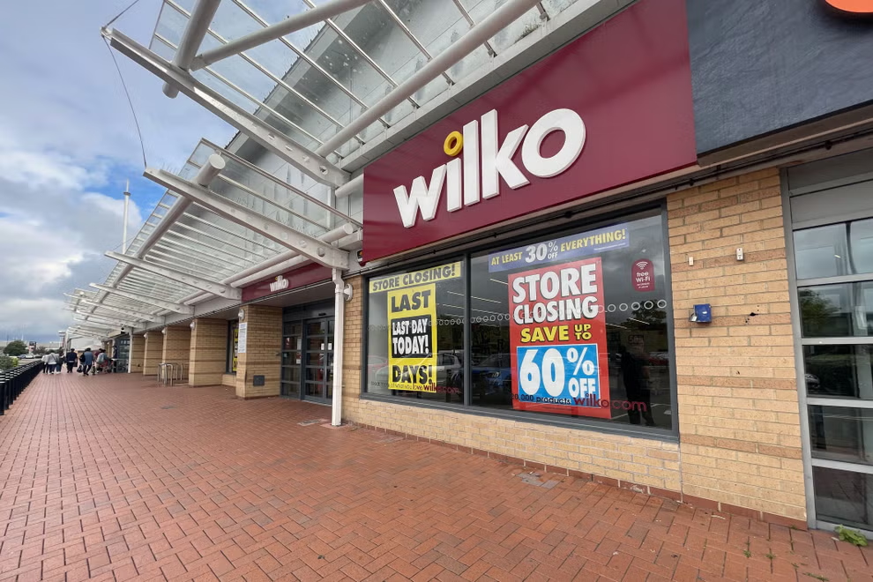
PESTLE Analysis (Aniko)
Political: 9,800 former Wilko employees were paid £42 million by the Government's Insolvency Service (Wise, 2023).
Economic: Large high street premises need to be change by any possible buyer (Smitherman, 2023).
B&M and Poundland took over 122 stores together with 3,200 jobs (Hawkins, 2023).
Social: Tendency to retail park shopping, so Wilko also tried to move some of its locations to these parks (Icon Offices, 2023).
www.independent.co.uk

Slide 5
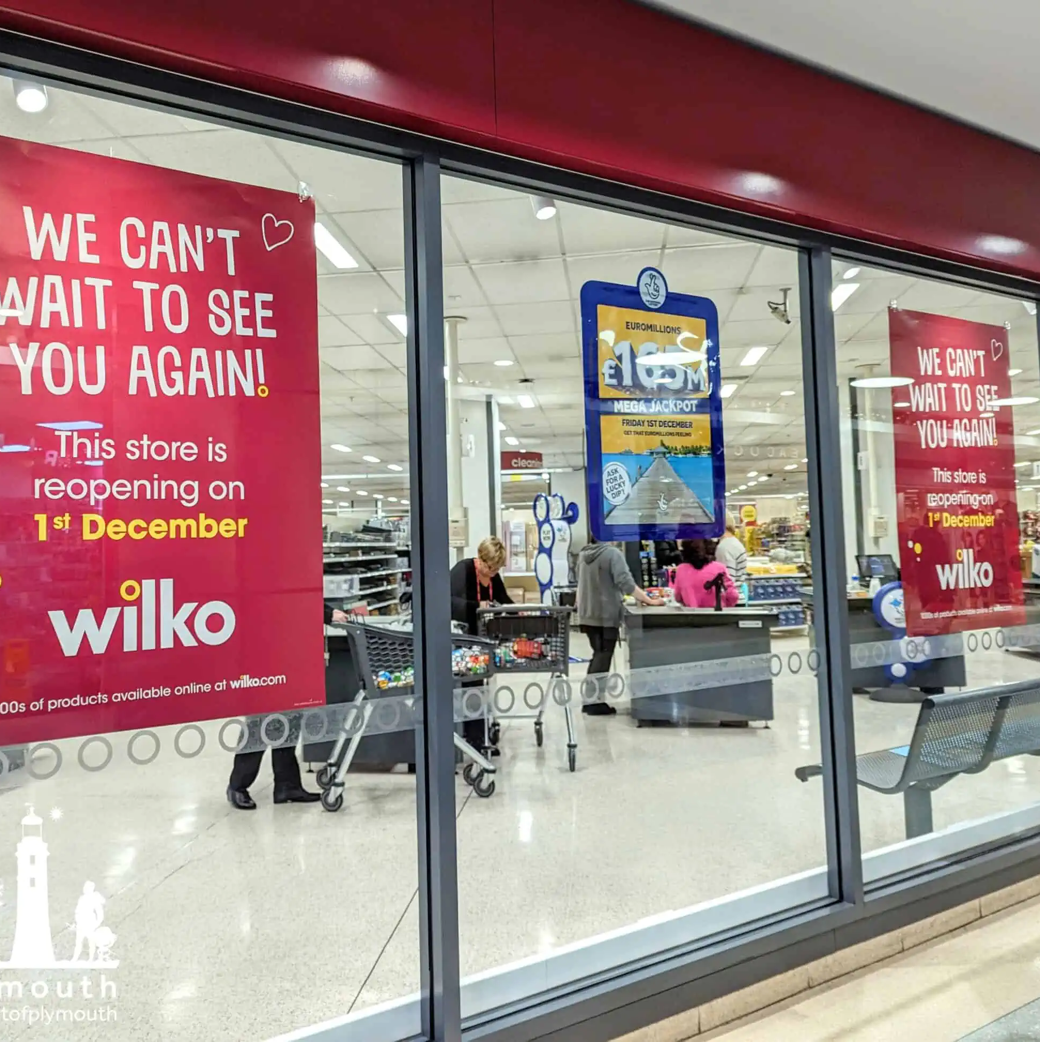
PESTLE Analysis (Aniko)
Technological: The Range will sell Wilko's products in its own stores and online too (Hawkins, 2023).
Wilko offered click and collect to consumers instead of online purchases and delivery options (Smitherman, 2023).
Legal: One of the negative influences of Brexit to businesses is supply chain issues (Icon Offices, 2023). Brexit also opened opportunities such as expanding markets within the UK as well as overseas (Smith, 2021).
Environmental: Chris Dawson reopens Wilko stores in shopping centres and shopping parks. Three stores are opened already in Plymouth, Exeter and Luton, and two more will be opened by 29th March 2024 in St Albans and Rotherham (Cummingham, 2024).
www.oneplymouth.co.uk

Slide 6
PESTLE Analysis References (Aniko)
Cunningham, E. (2024) Wilko is opening 300 new UK stores – here’s the full list of confirmed locations so far. https://www.timeout.com/uk/news/new-wilkos-stores-announced-011824. (Accessed: 10 March 2024).
Hawkins, E. (2023) ‘Del Boy billionaire’ behind the Range saves the Wilko name (but only 36 jobs). https://www.thisismoney.co.uk/money/markets/article-12519487/Del-Boy-billionaire-Range-saves-Wilko-36-jobs.html. (Accessed: 7 March 2024).
Icon Offices. (2023) The demise of Wilko: Has it left a gap in the market? https://iconoffices.co.uk/blog/the-demise-of-wilko-has-it-left-a-gap-in-the-market.php#:~:text=Brexit,they%20even%20reached%20British%20stores. (Accessed: 8 March 2024).
One Plymouth. (2023) Wilko Plymouth reopens Friday 1st December. https://oneplymouth.co.uk/wilko-plymouth-reopens-friday-1st-december/. (Accessed: 10 March 2024).
Smith, K. (2021) Post-Brexit opportunities for UK businesses. https://mooreks.co.uk/insights/post-brexit-opportunities-for-uk-businesses/#:~:text=Overseas%20markets,it%20makes%20their%20products%20cheaper. (Accessed: 9 March 2024).
Smitherman, E. (2023) WILKO HOPE Wilko ‘could be saved’ from closure by rival discount chains eyeing up 300 stores. https://www.thesun.co.uk/money/23439971/wilko-stores-possibly-saved-closure-rival-discount-chains/#:~:text=A%20buyer%20could%20save%20stores,likely%20need%20to%20be%20made. (Accessed: 9 March 2024).
Wise, A. (2023) Nearly 10,000 former Wilko staff paid £42m by Insolvency Service since collapse. https://www.independent.co.uk/business/nearly-10-000-former-wilko-staff-paid-ps42m-by-insolvency-service-since-collapse-b2453108.html. (Accessed: 9 March 2024).

Slide 7


Monitored, reviewed and discuss how these communicated (Silvia)
•Setting up KPIs (key overall performance indicators) for numerous solutions
•Frequent gathering and evaluation of information to screen performance (Momani, Al-Hawar, and Tahat, 2021).
•Making use of technology and gear to display in real-time
•Giving human beings accountability for keeping an eye (Kovalainen, 2020).
•Review sessions with a timetable to assess the success of answers put into location(Vardopoulos et al., 2021).
•Obtaining entry from applicable parties, along with the body of workers individuals and customers
•Figuring out regions in need of development or change in light of evaluation effects(Armstrong, Wilkinson and Cilliers, 2023).

Slide 8
Conclusion (Silvia)
To sum up, this presentation's strategic tips provide a comprehensive approach for improving Wilko's retail operations. In order to preserve its aggressive edge within the retail enterprise, Wilko is setting a excessive priority on the in-shop and online patron experience.

Slide 9
Monitored, reviewed and discuss how these communicated – References (Silvia)
Armstrong, G., Wilkinson, S. and Cilliers, E.J., (2023). A framework for sustainable adaptive reuse: understanding vacancy and underuse in existing urban buildings. Frontiers in Sustainable Cities, 5, p.29.
Kovalainen, J.M., (2020). Market entry strategy to Germany for Case Company Suomen Retkitukku OY.
Momani, A., Al-Hawar, T. and Tahat, S., (2021). A Framework to Diagnose the Business and Evaluate Upgrade Plans in SMEs. Management and Production Engineering Review, 13.
Vardopoulos, I., Tsilika, E., Sarantakou, E., Zorpas, A.A., Salvati, L. and Tsartas, P., (2021). An integrated SWOT-PESTLE-AHP model assessing sustainability in adaptive reuse projects. Applied Sciences, 11(15), p.7134.

