Slide 1
Dissertation proposal

Slide 2

Learning outcomes
Dissertation proposal
Familiarise yourself with the contents of the proposal template

Slide 3
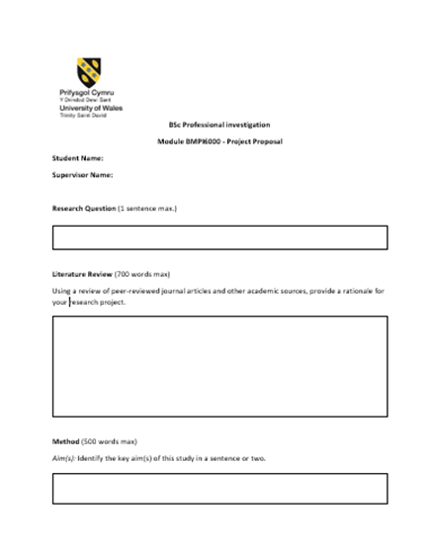
The Proposal Template

Slide 4
The Proposal Document
Assign your dissertation a working title
Provide some background information on the area that interests you, including a brief rationale
Identify the overall aim of your research (i.e. what you are trying to achieve)
Specify the individual objectives required to help you achieve your research aim
Outline how you will carry out your research
Indicate whether or not ethical issues arise from the proposal and if so how you are going to address them
List the literature referred to in producing the proposal ( Ref list/bibliography)
Notes:
The proposal document has a specific role to play
It allows you to assign your dissertation a working title
2. It provides some background information on the area that interests you or intrigues you, including a brief rationale as to why you want to focus on a particular aspect of the Subject area
3. It Identifies the overall aim of your research (i.e. what you are trying to achieve)
4. Allows you to Specify the individual objectives required to help you achieve your research aim
5. You are able to Outline how you will carry out your research (i.e. your methodology and methods e.g. survey, case study, questionnaires, interviews etc)
6. Provides and early Indication of whether or not ethical issues arise from the proposal and if so how you are going to address them to meet the University’s standards. You’ll also have to submit a separate Ethics form.
7. List the literature referred to in producing the proposal ( Ref list/bibliography)
This is a brief document and I have sent you a template to use to assist with covering all the necessary requirements

Slide 5

Why write a proposal ?
Allows the University to determine if your research meets academic standards
Allocation of supervisor
Reassurance that any ethical considerations are addressed early on
Notes:
So why do you need to write a proposal?
Allows the University to determine if your research meets academic standards
Allocation of supervisor
Reassurance that any ethical considerations are addressed early on

Slide 6
Dissertation Proposal - The Title
Choose a subject area
Focus on aspect worth researching
Communicate it in writing
General
Specific
Title
Notes:
Main task of your proposal is to clarify whatever it is that you propose to research.
So where do you start?
At the beginning…….
Pick a subject area that you are interested in /grabs your attention/relevant to your work and course – some of you already have
You then need to focus on a particular aspect of that subject area that you think is worth researching – don’t go too wide on your subject area
You need to then communicate your ideas in writing using the template given to you
To achieve research focus :
Think of the subject areas in general terms
Then home in on a particular aspect of that subject
Do some background reading/research to see if it is worth studying – see how much information you can find on the subject? Is there a lot or hardly any? Are there any gaps that your research will close?
Your title should concisely provide the reader with an understanding/overview/the gist of what you are researching in your dissertation
Think in general terms of your topic
Identify the aspect of that topic that you want to concentrate on
Bring them both together to start compiling your Title
GENERAL – SPECIFIC - TITLE

Slide 7

What your research title should be…
Clear
Focused
Concise
Complex
Arguable
Help you focus your research by providing a pathway through the research and writing process.
Avoid the ‘all about’ dissertation – work towards supporting a specific arguable piece of research.
Notes:
Your research title – which may be a question or written as a statement of intention should be………
Clear – it provides enough specifics that your reader can easily understand its purpose without needing additional explanation
Focused – it is narrow enough that it can be answered thoroughly in the word count and time that you have
Concise – it is expressed in the fewest possible words
Complex – it is not answerable with a simple yes/no but requires analysis of ideas and sources prior to you compiling a concluding answer
Arguable – its potential answers are open to debate by others rather than accepted facts

Slide 8
Examples
Domestic Abuse – General subject
Female offenders and characteristics – Focus area
A critical analysis of the prevalence of female perpetrated domestic abuse and the key characteristics surrounding it - Title
Match fixing – General subject
Methods of preventing it; do they work – Focus area
How effective are the current methods to stop match fixing within UK Football Associations - Title
Notes:
So lets look at some simple examples:
Domestic abuse – general subject
Student wants to look at how much domestic abuse is committed by females against males and whether or not there are any common traits in the offending
Then decide how they will approach it – to get the information/data what is the best course of action – to evaluate, to explore or to analyse
Result : A critical analysis of the prevalence of female perpetrated domestic abuse and the key characteristics surrounding it
Another simple example for UG
Match fixing - general subject
Student wants to look at the different methods of preventing it and do they work are they effective
How to approach it – question or statement
Result : Question – How effective are the current methods to stop match fixing within the UK Football Associations
Think of your own chosen area and break it
Down as illustrated above

Slide 9
Research questions
which social media sites?
How should social networking sites address the harm they cause?
RESULT:
What action should social network sites like facebook and MYSpace take to protect users’ personal information and privacy?
Assumes that harm is proven and or accepted
What type of harm?
To whom?
Age/gender
Notes:
Let’s look at this research question
What do you think?
What would you change and why?
Break it down – social networking - which ones?
Harm – what type of harm?
To whom? – children/adults/gender/age groups/ other groups/ organisations etc etc

Slide 10
Examples:
How can road deaths resulting from drug/drunk driving be prevented?
What effect do different legal approaches have on the number of deaths that result from drink/drug driving within Wales/SWP/rural communities
3. What are the effects on police recruitment from the need to hold a degree?
4. What is/are the most significant effect/s of the current police recruitment criteria on the number of persons recruited from rural Welsh communities.
5. What should the police do about low numbers of hate crime reporting?
6. What are the most effective communication strategies for increasing the number of reported hate crime incidents in DPP/SWP/Wales/ rural communities
Notes:
How can road deaths resulting from drug/drink driving be prevented?
This asks for a ready made solution to the problem and is too wide.
Broken down it could be
What effect do different legal approaches have on the number of deaths that result from drink/drug driving within Wales/SWP/rural communities etc.
2. What are the effects on police recruitment from the need to hold a degree?
Unfocused and too wide – narrowed down to a specific effect, a specific place and a specialist
e.g. What is the most significant effect of the current police recruitment criteria on the number of persons recruited from rural Welsh communities.
What should the police service do about low numbers of hate crime being reported?
Unfocused – too wide.
What are the most effective communication strategies for increasing the number of reported hate crime incidents in DPP/SWP/Wales/ rural communities
This is narrowed down to areas/locations and can be further narrowed to crime types if necessary. This now aims to find possible solutions in order to make informed decisions.

Slide 11
Dissertation proposal – background information
Background reading – support why you want to research your chosen area
Not a comprehensive review of literature on your topic.
Be brief ; be focused
Basic background information supported by literature/sources to justify your proposal
Use Harvard!
BRIEFLY Explain the general topic area
Introduce the specific area that interests you
Explain why you have chosen to research the topic
Notes:
1.Background reading – support why you want to research your chosen area if asked by your supervisor. What have you found from your initial research? What are the gaps in literature/source material? How much information is there out there ?
This is not a comprehensive review of literature on your topic – that will come in your final document.
You only have about 700 words here so be brief and focused about what you are saying and make sure that you reference your sources using Harvard. This is not a requirement to write about the history of your subject – be focused on what you want to research only. Remember to justify your proposal and the need to research your topic

Slide 12
Dissertation Proposal – Research Aim
General statement which originates from your research area
Describes your intentions and what you hope to achieve
Answer the ‘why’, ‘what’ & ‘how’ of your research question
Step 1 – One word – research area
Step 2 - Add other words to clarify the focus of your research
Step 3 – Connect the words to form a sentence
Step 4 – Convert this sentence into a formal research statement

Slide 13
Research proposal – Research Objectives
To address your ‘Research aim’
Consider ‘key words’ – influence depth of study to be carried out
‘Key words’ = Nouns used to indicate the type of study activity linked with the objective
4/5 maximum
Use them to keep you focused in your research
Key words
Identify
Assess
Evaluate
Explore
Outline
Discuss
Analyse
Notes:
In order to realise or address your overall research aim , you have to list your objectives to show how you will get there
Important to consider the key words - NOUNS that you use as these will influence the depth of study that you propose to carry out.
e.g. Identify, evaluate, explore, formulate. A noun is an action word
Which of these words will require more work than others?
Go back to the handout I gave regarding ‘Directive words’ – you will have a longer list of Nouns that you can use.

Slide 14
Difference between Aims & Objectives
Words
Focus
Purpose
Presentation
Notes:
Aim is the destination and objectives are the roadmap!
1. The way they are worded are different :
Aim is wide , while objectives are specific, narrow tasks
2. The focus of them are different
Aim focuses on overall purpose; objectives focus on how to achieve that purpose
3. The purpose of the two are different
Research aims are concerned with the overall findings of the research, which are long term; objectives serve to define short term aims of the research
4. They are presented differently
Research AIMS are written in a sentence or small paragraph; objectives are written in a list

Slide 15
Aim & Objectives - Example
Aim
A key aim within this study is to research and identify the core characteristics surrounding domestic abuse perpetrated by females and the reasons in which they commit such abuse. Moreover, a critical element of this study is to investigate why domestic abuse against male victims goes largely unreported in the UK and the role society plays in the underdeveloped understanding of the crime itself.
Objectives
Distinguish core problems relating to the initial reporting to the police of female perpetrated domestic abuse and the prosecution of such crimes.
Examine the role society plays in the development of stereotypes and ideologies that surround abuse against male victims.
Analyse why females commit domestic abuse against their male partners and distinguish the common characteristics of female abusers by evaluating research material in the form of books, journals, articles, and websites.
Notes:
Here is an example of the Aim and Objectives for a dissertation referred to earlier
Note the Key words used in the objectives ( highlighted in blue) – how deep do you think the research had to be ?
Ask yourself are they ‘doable’ in the time that you have and the literature that is available to you in your chosen topic area?

Slide 16
Top tip - Objectives
1st objective – simple key word e.g. Identify, classify, outline
To give background to your research area
Other objectives – keywords to suggest in-depth research e.g. explore, evaluate, assess critically, analyse, examine, determine
Final objective – keyword that links easily to a concluding activity e.g. formulate, produce, develop, recommend, propose etc.
1st Objective
2nd + objectives
Final objective

Slide 17
Dissertation proposal – Research methods
Research methods = How you intend to do your research
For proposal need to outline briefly.
Collecting empirical data
Literature review
Notes:
How you will gather your data – interviews, questionnaires, experiments, observations etc.
Who will be involved and how selected
Primary/secondary data

Slide 18
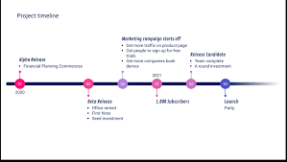
Dissertation proposal - Timeline
Estimate of how long you believe each stage of your research will take
Look at the timeline provided – spread out between Feb and November.
Idea of time to give to each stage
Key submission dates
Overlaps
Not too detailed – can de-motivate you

Slide 19
Dissertation Proposal - Ethics
Ethics is a code of conduct on how we ought to lead our lives
Written in Laws
Unwritten in our philosophical and social beliefs – appear in everyday behaviour
Popular concept that now impacts on many areas of life
Research Ethics:
‘Application of a code of conduct when human participants are the focus of empirical research’ (Biggam, 2015. p.73)
Design of empirical research : Research Ethics!
Ethics form – All to complete
Notes:
What do we mean by ‘Ethics’?
What about ‘Research Ethics’?

Slide 20
Research Ethics – Core Principles
Research Ethics
Transparency
Confidentiality
Voluntary
Do no harm
Impartial
Notes:
Transparency – Purpose of your research should be clearly explained to your participants and also how you will conduct your primary research ( e.g. questionnaire, focus group etc) together with the intended use of the data. Always good to provide an information sheet
Confidentiality – you must respect confidentiality and anonymity of your participants. If you aren’t you may be in breach of Data Protection law or putting people at risk.
Voluntary – participants must not be coerced to become part of your research and should be free to withdraw at anytime
Do no harm – Your research should not put any participant in any danger or risk of harm, neither should you.
Impartiality – if you are connected to the research participants in any way ( e,g, fellow students or relatives) or it could be perceived that you may be biased you need to declare your relationship.
NB - What ethical considerations do you think you will have? And how will you overcome them?
-

Slide 21
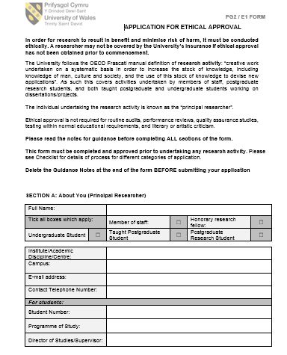
Ethics Form
Must be completed for all dissertations – template on Moodle
Approval granted asap
Ethics panel – if necessary
Vulnerable adults/children; offenders
Consent from Forces if necessary

Slide 22
Dissertation Proposal - Submission
Dissertation Proposal to be submitted by 6/11/26
Ethics form to be submitted by 6/11/26

Slide 23

Cwestyniau/Questions?

