Slide 1
How the works of female writers have influenced the works of male writers:
With a particular focus on how the works of Sappho have influenced love poetry of Roman poets
I tell you someone will remember us in the future - Sappho fragment 2

Slide 2
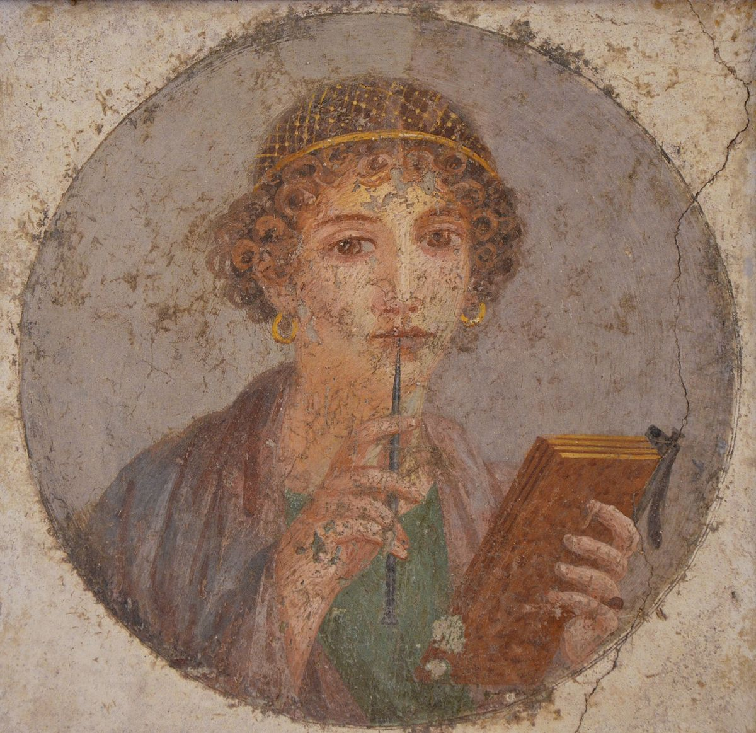
Issues
Where are the female writers?
Sappho was the most famous female greek poet but only fragments survive
Sappho Fresco
Notes:
Evidence they existed, little surviving work

Slide 3
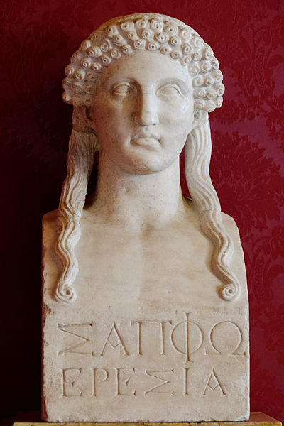
Argument
Sappho had a significant influence on the a whole genre of Roman poetry, namely love elegy
Sappho from Eresos

Slide 4
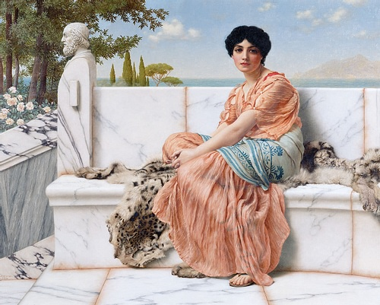
There is evidence of women writers in the ancient world
What evidence is there?
Sappho of Lesbos
Notes:
Stats from the list of writers
Sappho’s body of work
Placing Sappho amongst women writers, women writers among men

Slide 5
The surviving work of Sappho exists as fragments
Honestly, I wish I were dead.
Weeping many tears, she left me and said,
“Alas, how terribly we suffer, Sappho.
I really leave you against my will.”
And I answered: “Farewell, go and remember me.
You know how we cared for you.
If not, I would remind you
...of our wonderful times.
For by my side you put on
many wreaths of roses
and garlands of flowers
around your soft neck.
And with precious and royal perfume
you anointed yourself.
On soft beds you satisfied your passion.
And there was no dance,
no holy place
from which we were absent.”
Sappho fragment 19
“I love the sensual.
For me this
and love for the sun
has a share in brilliance and beauty”
Sappho fragment 9
“Again love, the limb-loosener, rattles me
bittersweet,
irresistible,
a crawling beast.”
Sappho fragment 15
“Sweet mother, I can’t do my weaving—
Aphrodite has crushed me with desire
for a tender youth.”
Sappho fragment 22
Notes:
Subject matter
Confident in sexuality - Plato and love
What do we know about Sappho?

Slide 6
Ancient Critique of Sappho attests to her influence
“How nearly did I see the kingdom of dusky Proserpina and Aeacus passing judgement and the seats set aside for the pious and Sappho complaining on her Aeolian lyre about the girls of Lesbos, and you, Alcaeus, singing in grander mode with your golden plectrum of the hardships at sea, the hardships of exile, and the hardships of war. The ghosts marvel at both of them as they sing songs worthy of reverend silence, but the dense mob, standing shoulder to shoulder, pay more attention to the fights and stories of tyrants banished.”
Hor. Carm. 2.13.21–32
Notes:
Quintilian
Comment on the type of poetry she was writing - talks about love rather than heroic acts
Paired with other author puts her on the same level

Slide 7
Sappho’s influence on Horace
“There your nose will breathe abundant incense, and you will take delight in the music of the lyre and the Berecynthian flute, and the pipe too will not be absent; there, twice each day, boys and tender maidens will in triple time beat the ground with their shining white feet, in the Salian fashion, as they celebrate your divinity.”
Hor. Carm. 4.1.21–8
Notes:
Ovid, one of the great Roman love elegist, was influenced by Sappho.
Forms/features of love elegy - show how Ovid takes features of Sappho into his writing
Direct references to her and indirect references to her work

Slide 8
Sappho’s Influence on Ovid
“What wonder if the age of first down has carried me away, and the years that a man can love? I feared that you, Aurora, would steal him in Cephalus’ place—and so you would do, but that your first prey holds you still. If Phoebe, who beholds all things, beholds him, it will be Phaon she bids continue in his sleep; him Venus would have carried to the skies in her ivory car, but that she knows he might charm even her Mars.”
Ov. Her. 15.87–92

Slide 9
Roman reception of Sappho can be read through references made to her work through the works of Roman poets
How important is her influence on love elegy?
Was her influence overtly praised in the Roman world?
Notes:
The importance of love elegy in the Roman world
A sophisticated Roman audience would be able to understand references to Sappho

Slide 10
To Conclude,
Even though we only have fragments of her work, her influence in Roman poetry shows us the impact she made and her significance as a poet.
The difference in writing is appropriate - her experiences were different to men’s
Her skill was clearly recognised - this opened up a new genre of themes in poetry
We don’t know the exact influence but we can follow the threads of her work through the works of important Roman elegists

Slide 11
Bibliography
Hunter, R. (2019) ‘Sappho and Latin Poetry’, in Thorsen, T. and Harrison, S., Roman Receptions of Sappho, London: Oxford University Press
Hunter, R. (2019) ‘Notes on the Ancient Reception of Sappho’, in Thorsen, T. and Harrison, S., Roman Receptions of Sappho, London: Oxford University Press
Leonard, A. (1996) The Social and Political Context for Obstruction in Roman Love Elegy, Unpublished PhD thesis, University of Georgia
Plant, I. (2004) ‘Attested Women Writers of the Graeco-Roman World’, in Plant, I., Women Writers of Ancient Greece and Rome, Norman: University of Oklahoma Press
Plato, Symposium, W.R.M.Lamb (trans.) 1925. London. Heinemann
Poetry Foundation (2020) Sappho, Available at: https://www.poetryfoundation.org/poets/sappho (Accessed: 28/10/2020)
Sappho, Fragments, D.Campbell (trans.) 1982, London. Heinemann
Thorsen, T. (2019) ‘Newest Sappho (2016) and Ovid’s Heroide’s 15’, in Thorsen, T. and Harrison, S., Roman Receptions of Sappho, London Oxford University Press

Slide 12
Image Bibliography
Godward (1904) Sappho of Lesbos [Painting] Available at: https://www.ancient.eu/Sappho_of_Lesbos/ (Accessed: 28/10/2020)
Unknown, Sappho from Eresos [Bust] Available at: https://commons.wikimedia.org/wiki/File:Bust_Sappho_Musei_Capitolini_MC1164.jpg (Accessed: 28/10/2020)
Unknown, (55-79 CE) Woman with wax tablets and stylus (so-called "Sappho") [Fresco] Available at: https://commons.wikimedia.org/wiki/Category:Sappho_fresco_(from_Pompeii) (Accessed: 28/10/2020)

