Slide 1




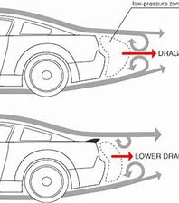
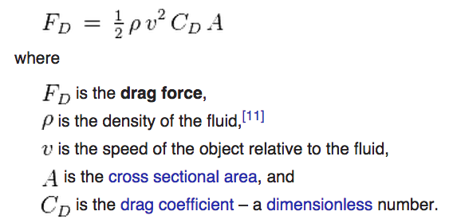
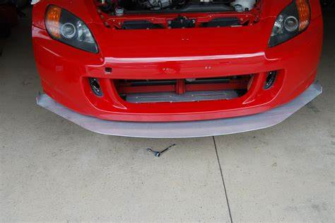
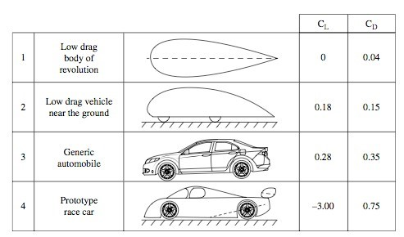
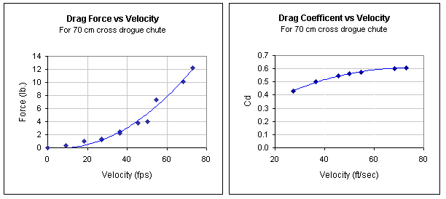
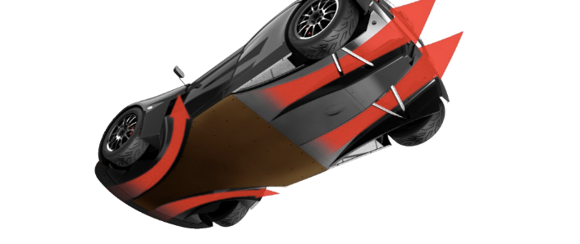
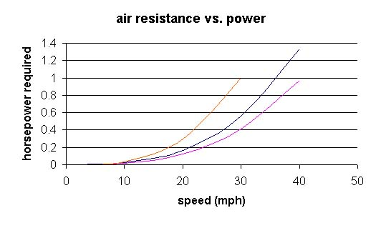
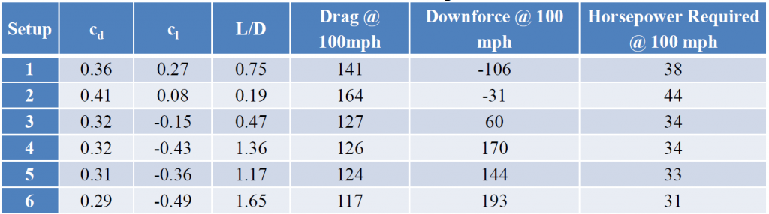


Aerodynamic Principles
Oliver Patrick Courtney
Andrew Noble
School of Engineering
BEng (Hons) Motorsport Engineering
The abilities of race vehicles has vastly improved over time through more complex components and much better build quality.
Due to this race vehicles are now much faster on all areas of the track making aerodynamics a crucial factor to success in competitive motorsport.
The forces in question have become much larger than experienced so specific aero related components have also had to grow in size and complexity to deal with the forces at high speeds
This can be shown in the formula to calculate drag as it directly correlates to area and velocity.
Introduction
Aerodynamics has been at the forefront of development for decades in the motorsport industry with aerodynamics has an effect on all aspects of a cars performance.
The relationship between velocity and the air resistance puts into perspective how important aerodynamics are. As speed increases by a factor of 1 the force created by the resistance increases by factor of 4 which applies for all principles of aerodynamics
This is shown in this graph below.
A spoilers primary objective is to reduce lift and improve levels of downforce. It is able to do this by ‘spoiling’ the air around the rear of the car. This is achieved by increasing the air pressure above the wing and creating an area of low pressure beneath increasing levels of downforce. [1].
This table allows to see the differing levels in aerodynamic capabilities. Cl is the lift coefficient and Cd is the drag coefficient. [3a].
Splitters are key components for downforce on a race vehicle, they also keep the distribution of downforce even from front to back while minimalizing lift. They are often situated at the front of the vehicle as a lip on the bumper.[2].
Diffusers are another important component in improving downforce and reducing lift. The diffuser allows the fast movement of air beneath the vehicle creating an area of low pressure pushing the car downwards [3]
Aspects of Aerodynamics
Aerodynamics can be split up into 3 key areas.
Drag
Downforce
Lift
Drag is the force that acts directly opposite to that of the object in motion. Drag reduction allows for higher top speed and better fuel economy.
Downforce is the pressure exerted by the air flowing over the object forcing it in a downwards motion which played a vital role in the amount of grip a vehicle has and how quickly the vehicle can take corners.
Lift has the opposite affect as downforce. Lift forces the car in an upwards direction decreasing levels of grip and creating instability. Lift, unlike the other two forces is not desired for a race vehicle as it disrupts the vehicles performance.
In reference to figure 1a, the three lines show the difference in required power reach different speeds with different aerodynamic components fitted. The purple line is the most aerodynamic out of all 3 as it reached the highest top speed with the least horsepower required.
This table show how important aerodynamics are in the current world. improvement of Aerodynamics is the most simple way to improve a cars performance as increasing levels of power is much more time consuming and expensive when a simple change or addition of aerodynamic components achieves the same result [1a].
Acknowledgements
https://mechanixillustrated.technicacuriosa.com/2017/03/04/an-introduction-to-automobile-aerodynamics/
https://www.oponeo.co.uk/blog/car-aerodynamics-and-air-resistance#:~:text=%20How%20do%20car%20designs%20work%20with%20aerodynamics%3F,the%20rear.%20This%20allows%20air%20to...%20More%20
https://mygaragestory.net/cars-aerodynamics-heres-need-know/
References
Andrew Noble – Aerodynamic Principles
Netdna-ssl.com. (2020). [online] Available at: http://1a8eua2erhxa2dmmwp4axgod-wpengine.netdna-ssl.com/wp-content/uploads/sites/3/2017/03/Fig-2.jpg
Uaf.edu. (2020). [online] Available at: http://ffden-2.phys.uaf.edu/211_fall2013.web.dir/Jacob_McKenna_Physics/Aerodynamics_files/image002.jpg
Robrobinette.com. (2020). [online] Available at: https://robrobinette.com/images/S2000/Aerodynamics/CFD_Miata_Table.png
Lcs-fast.com. (2020). [online] Available at: http://www.lcs-fast.com/images/Elemental-pics/RP1-floorarrows2.png
Katz, J. (2006). Race car aerodynamics : designing for speed. Cambridge, Ma: R. Bentley.
Physics Forums | Science Articles, Homework Help, Discussion. (n.d.). Physics Forums | Science Articles, Homework Help, Discussion. [online] Available at: https://www.physicsforums.com
cd is coefficient of drag, cl is coefficient of lift, L/D is lift over drag--a measurement of efficiency with larger being better
Wales Institute for Science & Art

