Slide 1

RIVERDALE NURSING
HOME
Name: Sultan Zada Shoukat
Module: Health & Social Care
Module Code:LCHS4001
Lecturer: Dr Redhwan Al-Amri
Date:12/07/26
CARE RELATED DOCUMENTS
MICROSOFT ONE 365 WORD
ADVANTAGES & DISADVANTAGES
CONCLUSION SUMMARY

Slide 2

Topics:
CARE RELATED DOCUMENTS MICROSOFT 365 WORD ADVANTAGES & DISADVANTAGES CONCLUSION QUESTIONS\FEEDBACK
Learning Objectives:
By the end of this slideshow, you will be able to:
Understand key care-related documents and their purpose
Use Microsoft 365 Word to create professional care documents
Identify the advantages and disadvantages of the health and social care sector
Write a clear and effective conclusion
Respond confidently to questions and feedback
REF: NHS England (2023).

Slide 3
WRITING CARE RELATED DOCUMENTS-
Record resident’s care, treatment and progress
Support person-centred care
Improve communication between healthcare professionals.
Ensure continuity and safety of care
Why’s it important?
Helps monitor resident’s health and wellbeing
Reduce communication errors
Support clinical decision-making.
Provide legal and professional evidence of care
REF:
Health and Social Care Act 2008 (Regulated Activities) Regulations

Slide 4

MICROSOFT 365 WORD
Why Microsoft One is used?
Creates professional care documents.
Easy to edit and update information
Supports spelling and grammar check and makes sure punctuality is accurate
Securely stores and shares documents using Microsoft 365.
Enable collaboration and improvements between staff
Features
Templates
Tables
Headers & Footers
Spell check
Auto save
Comments and Track Changes
REF:
Overview of OneDrive in Microsoft 365 - SharePoint in Microsoft 365 | Microsoft Learn

Slide 5
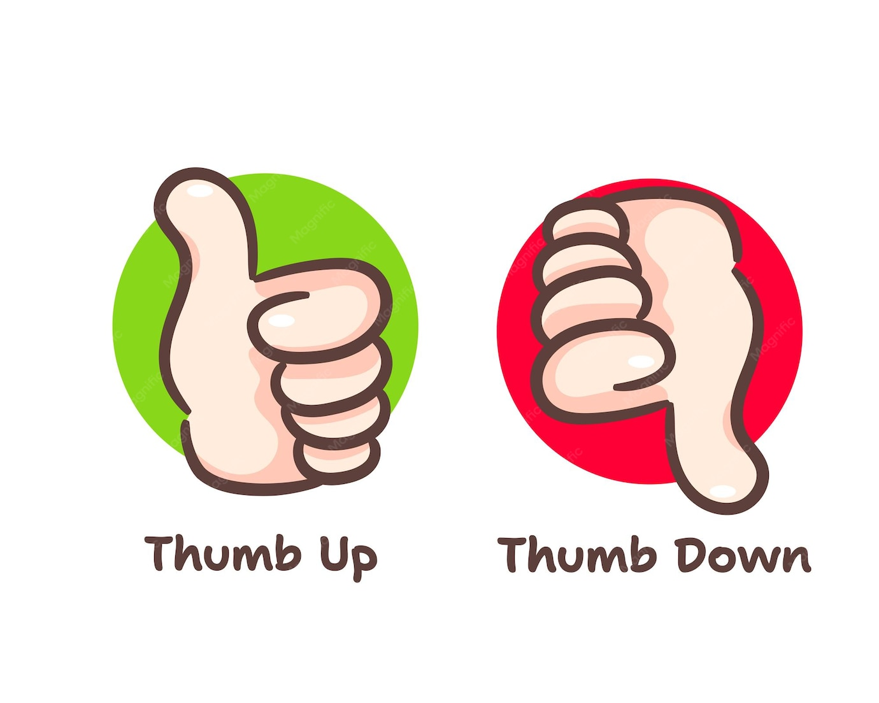
WRITING CARE RELATED DOCUMENTS
Advantages | Disadvantages
Improves Communication | Risk of data breaches if not protected
Easy to update | Human errors can still occur
Creates accurate records | Requires staff training
Supports legal compliance | Technical issues may delay access
Saves time with templates | Dependence on computers/internet
ADVANTAGES AND DISADVANTAGES
REF:
UK Parliament POST brief (2020). Evaluating the integration of health and social care. UK Parliament

Slide 6
CONCLUSION
Accurate care-related documents are essential in health and social care.
Microsoft 365 Word helps create professional, organised, and east-to-read documents
Good documentation improves communication between health care professionals
It supports safe, person-centred care and protects service users through accurate records
Although human error and technical issues can occur, the benefits outweigh the disadvantages.
REF:
Powell, T. & Mutebi, N. (2025).

Slide 7

Any questions?

