Slide 1


Student name: Simona ElenaTofanel
Student ID: 2214990

Slide 2

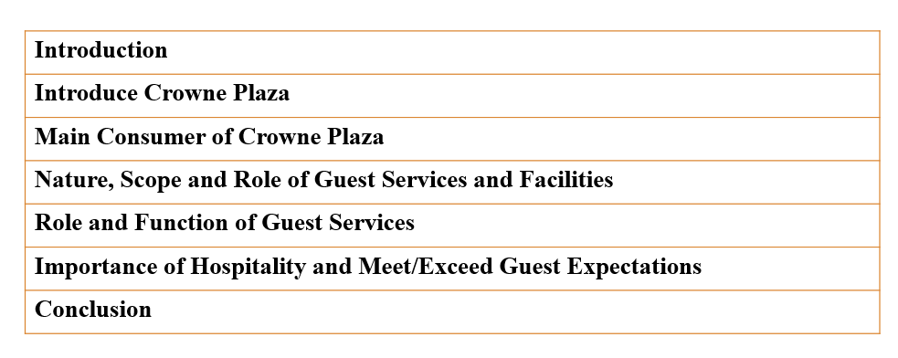

Slide 3

The hotel company that has been chosen for the current presentation is IHG (InterContinental Hotels Group)
The hotel brand that is selected from IHG is Crowne Plaza
This presentation will highlight the primary consumer of this hotel brand
Nature, role and scope, and function and role of guest services in this hotel, would be assessed.
The presentation will further describe the importance of hospitality and meeting/exceeding the guests' expectations.

Slide 4
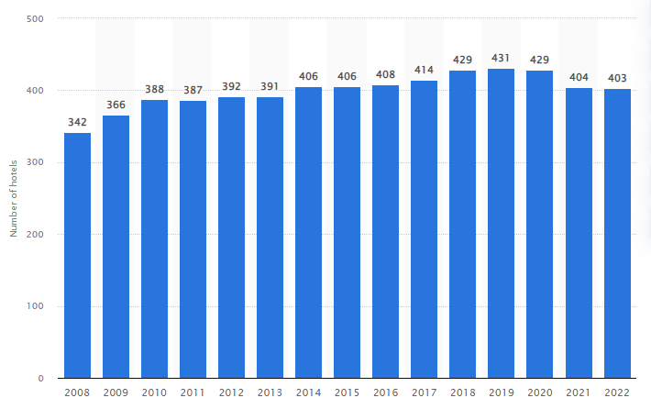
Crowne Plaza is considered a British international chain of upscale and full-service hotels.
The hotel forms part of the IHG family of hotel brands.
This hotel was founded in 1983, and its headquarters is in Denham, UK.
The hotel operates in more than 100 countries all over the world.
Most hotels are located in resorts, near major airports, city centres or coastal towns.
In 2022, it is estimated that Crowne Plaza have almost 403 hotels all over the world.
The number of hotels has reduced compared to the 2021 estimation (Statista, 2023a).
Source: Statista, 2023a

Slide 5

Crown Plaza is a international chain of whole services and expensive hotels in the UK.
The target market of hotels includes leisure and business travel.
The hotel brand caters to business and leisure travellers and the conventions and meetings market.
Crowne Plaza utilises various strategies for attracting consumers towards its brand.
The business mainly targets medium and high-income individuals
The business further caters to modern business travellers or professionals who need proficient and smart services, high-quality accommodation and good facilities (IHG, 2023a)
Source: IHG, 2023a

Slide 6
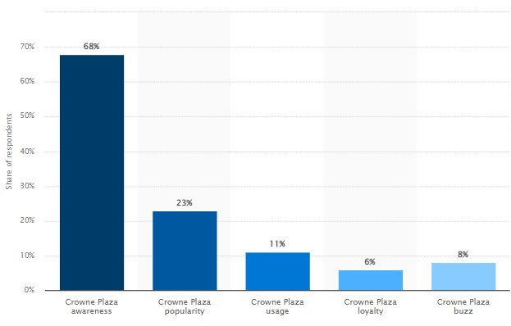
The business has an effective approach through which they increase their awareness which aids in attracting guests (Statista, 2023b)
The hotel brand introduced a new campaign in 2017 named 'We’re All Business, Mostly'.
This Accelerate Program was launched to show that business is committed to fulfilling business travel for modern travellers.
For this program, the business has invested almost $200 million
Source: Statista, 2023b

Slide 7

Crowne Plaza believes that business travel should work better
The hotel brand is ready 24/7 with business-ready spaces and services, premium accommodation
The business offers fresh and fast food that keeps guests connected, restored, productive and rested during their stay
The nature of hotel brand is the flexibility and ease and providing a sophisticated ambience.
The Hotel company provides comfort and an setting that provides high focus on health and well-being of guests
The business aims to develop hotels that will cater to the needs of their guest.
The hotel offers a broad scope of services and facilities involving choices of bars and restaurants to suit the taste of guests.

Slide 8
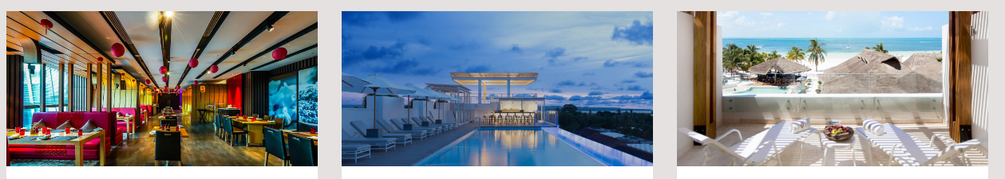
The hotel brand is committed to clarity related to the expectations and norms of its facilities.
Crowne Plaza further offers IHG One Rewards to their members
Through this offer, the guests can earn points, attain benefits and save money
Through their rewards, the business can enjoy almost 25-30% discount (IHG, 2023b).
Source: IHG, 2023b

Slide 9
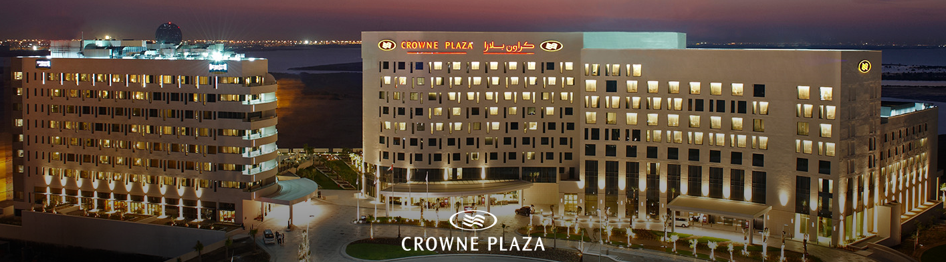
Elite members of this program get access to more perks, such as welcome amenities, bonus points, milestone rewards and more (IHG, 2023d).
The scope of Hotel brand involves various aspects that contribute to its actions and presence in the hotel industry
The hotel is proud to participate in the Hotel Weka Recycling Program, which recycles part of used toiletries.
This will reduce the path of plastic tubes and bottles going to landfills
The hotel brand incorporates sustainability approaches into its operations (Nikolic, 2018)
The scope of the hotel brand includes initiatives planned at minimising consumption of energy, encouraging eco-friendly and social health and well-being, and waste generation (IHG, 2023c)
Source: IHG, 2023c

Slide 10

Crowne Plaza has hired a guest services officer so that they can offer efficient and fast service to guests (Simpao, 2018)
The hotel manager's responsibility is to ensure guests are satisfied with hotel services.
The manager is further responsible for ensuring that guest complaints and requests are fulfilled (Penninga and Chibili, 2019).
The further business focus on team working and team building.
The hotel brand offers courses to train staff and provide effective guest services.

Slide 11
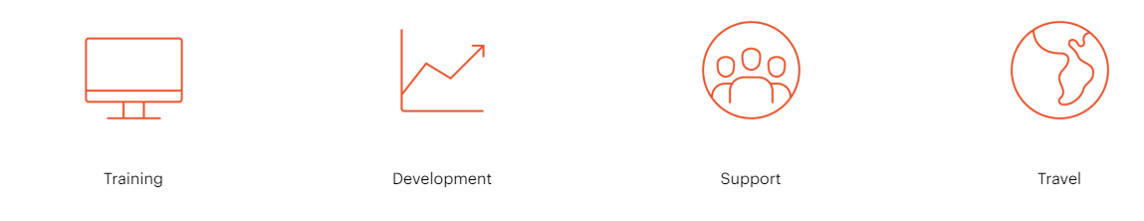
IHG Academy is a training programme that Crowne Plaza has implemented (IHG, 2023e)
This program aid in engaging and motivating staff to offer goods and services.
Crowne Plaza employees further provide an enhanced focus on protecting the privacy of guests.
The hotel brand ensures that personal data is not disclosed by following its privacy policy.
Source: IHG, 2023e

Slide 12

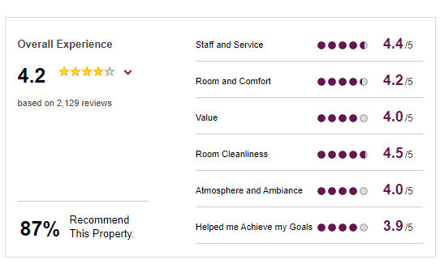
By delivering high-quality services, the Hotel attracts clients and produces more revenue.
Crown Plaza mainly provide training to staff to enhance their hospitality
Through working on guest complaints and reviews, Crowne Plaza works on meeting their expectations.
The hotel reviews are unedited and authentic and are provided by guests that have stayed in a hotel (IHG, 2023f).
Source: IHG, 2023f

Slide 13
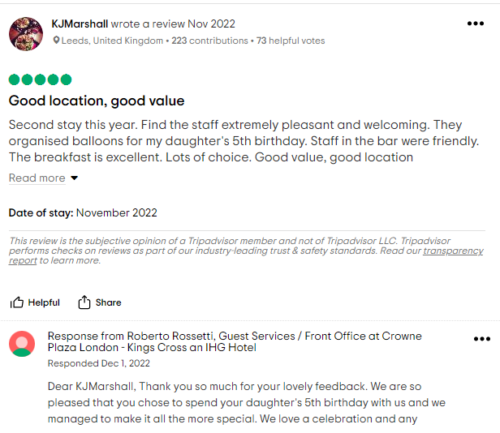
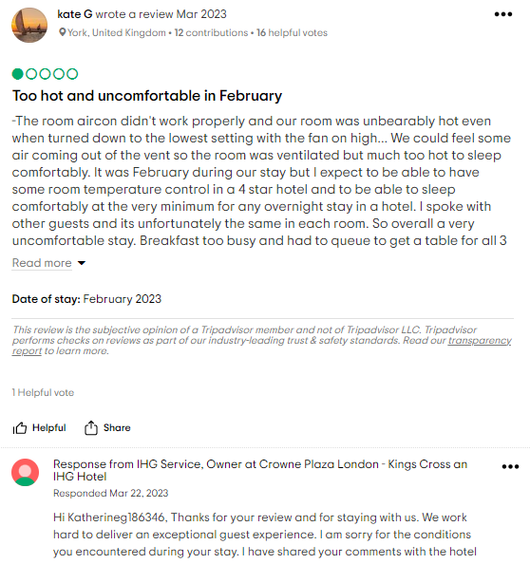
Guests satisfaction is a primary focus of hotel brand
The business is known to communicate with guests and reply to their reviews effectively
The business provides equal focus to negative and positive comments (TripAdvisor, 2023)
The reviews aid the business in enhancing its focus on guest services and meeting its expectations.
Source: TripAdvisor, 2023

Slide 14

Crowne Plaza offers guests a luxurious, comfortable and enjoyable stay.
The hotels are equipped with modern amenities and facilities
The hotel brand offers rewards and points, which can be converted into upgrades and better dining options.
The hotel has hired staff and professionals that have improved knowledge related to guest services.
The business also communicates with guests to resolve their complaints and ensure they are satisfied with hotel guest services.

Slide 15
Thank YOU

Slide 16
References
IHG 2023a. Crowne Plaza® Hotels & Resorts. [Online] Available at https://careers.ihg.com/en/our-brands/crowne-plaza-hotels-resorts/?page=40&brand=crowneplazahotelsandresorts [Accessed on 25 May 2023]
IHG 2023b. Crowne Plaza Deals & Discounts. [Online] Available at https://www.ihg.com/crowneplaza/content/us/en/deals/hotel-offers [Accessed on 25 May 2023]
IHG 2023c. Making business travel work. [Online] Available at https://www.ihgplc.com/en/our-brands/crowne-plaza [Accessed on 25 May 2023]
IHG 2023e. Check In To IHG Academy. [Online] Available at https://careers.ihg.com/en/early-careers/ihg-academy/ [Accessed on 25 May 2023]
IHG 2023f. Reviews. [Online] Available at https://www.ihg.com/crowneplaza/hotels/us/en/reading/reauk/hoteldetail/hotel-reviews [Accessed on 25 May 2023]
IHG, 2023d. Home. [Online] Available at https://www.ihg.com/onerewards/content/gb/en/home [Accessed on 25 May 2023]

Slide 17
References
Nikolić, J., 2018. Possibilities of Non-Financial Reporting in the Hospitality. FINIZ 2018-The Role of Financial and Non-Financial Reporting in Responsible Business Operation, pp.3-9.
Penninga, S. and Chibili, M.N., 2019. The rooms department. In Modern Hotel Operations Management (pp. 118-163). Routledge.
Simpao, K.J.S., 2018. Labour productivity measurement and control standards for hotels. Journal of Service Science Research, 10, pp.25-76.
Statista 2023a. Number of Crowne Plaza hotels worldwide from 2008 to 2022. [Online] Available at https://www.statista.com/statistics/223361/number-of-crowne-plaza-hotels/ [Accessed on 25 May 2023]
Statista 2023b. Crowne Plaza brand awareness, usage, popularity, loyalty, and buzz among hotel customers in the UK in 2022. [Online] Available at https://www.statista.com/forecasts/1335718/crowne-plaza-hotels-brand-profile-in-the-uk [Accessed on 25 May 2023]
TripAdvisor 2023. Crowne Plaza London - Kings Cross an IHG Hotel. [Online] Available at https://www.tripadvisor.com/Hotel_Review-g186338-d195200-Reviews-Crowne_Plaza_London_Kings_Cross_an_IHG_Hotel-London_England.html [Accessed on 25 May 2023]

