Slide 1
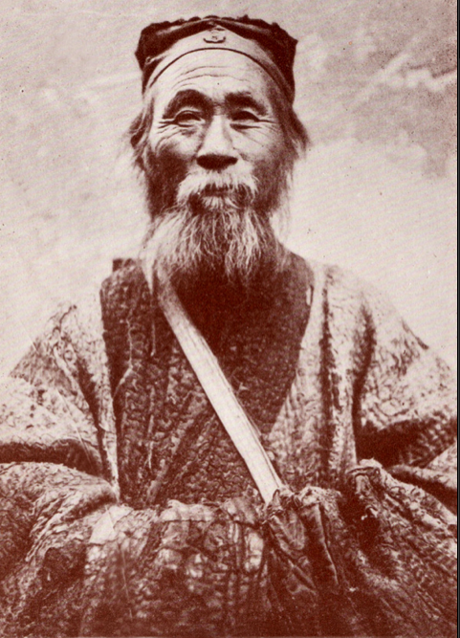
Daoism and Western methods-
A practical understanding.
Cameron Watson
1604872

Slide 2
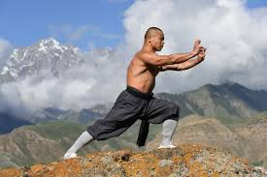
Buddhist Monk practicing Qi Gong

Slide 3
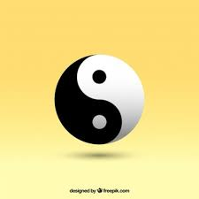
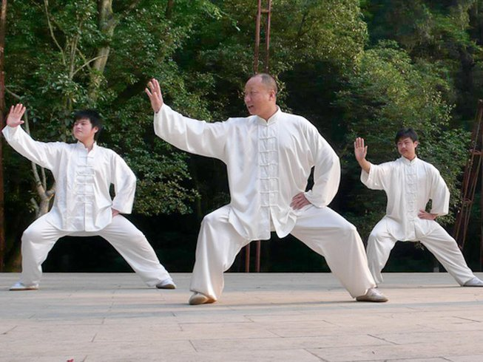
OVerview
The Dao looks at the human body in a Universal context. It looks at the interactions that are in constant flow. Social/environmental/mind/body/spirit.
Western methods tend to study different parts in isolation. Experts in each field, social, environmental, religious and each body part.
This presentation leans toward the understanding nothing can be viewed in isolation.
It is also premised that understanding many of the terms and complexity of the Daoist system by the western mind poses great difficulty.

Slide 4
Thesis
Daoism offers unified ways of viewing the body as part of the cosmos.
Religious, philosophical and practical ways of living.
Inner cultivation through Daoist practices of Taiji and Qi Gong develop self knowledge and the skills to be your own doctor.
Some methods such as the Alexander Technique do complement Daoist approaches
This unified approach is in contrast to most western approaches which view the mind, body, spirit in isolation. Exercise is part of educational curriculum but there is no inner cultivation methods that are comprehensive. Doctors are relied on for health knowledge.

Slide 5
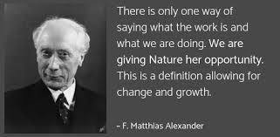
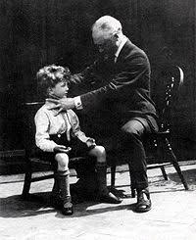
Alexander Technique

Slide 6
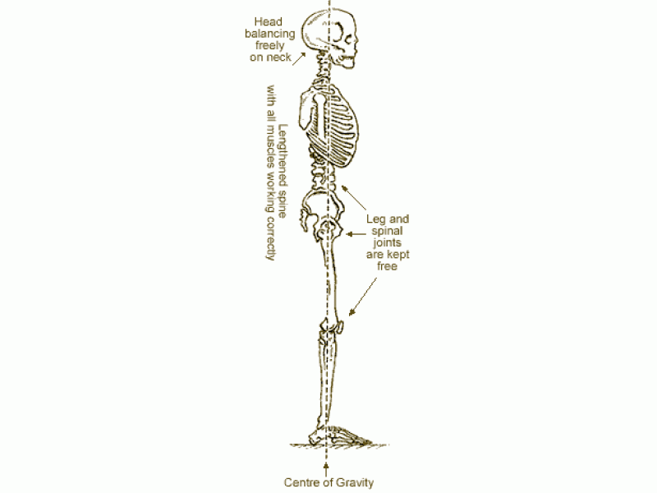
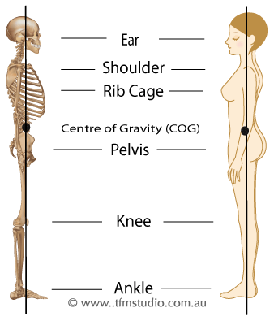
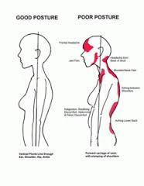
optimal energy flow requires alignment and proper relationship to Gravity

Slide 7
Spine Long and Straight (similar to AT principles)

Slide 8
Otherwise
Energy or Qi (??) gets stuck in areas and becomes too full in others
Impairs breathing and organ functioning (lack of space and contraction of intestines etc)
Creates pressure
Becomes toxic (e.g. like a pond)
Distorts skeletal system / tight joints/ imbalances muscles (too tight/too loose)
Mind busy / distracted / fragmented
Nerves pinched painful
Causes conditions such as headache, insomnia, etc

Slide 9
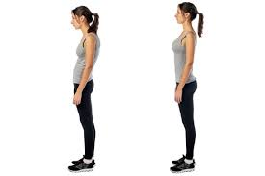
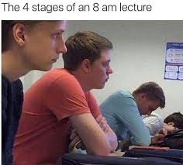
Why does this happen?

Slide 10
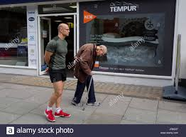
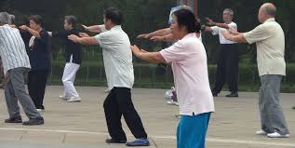
What commonly happens to old people?

Slide 11
Energy-Qi-life force what animates us?
https://www.youtube.com/watch?v=kZ6rXnZi8RY Buddhist monk demonstrating Tai Chi
Fluidity and integration – a structure that is clear of obstruction (including food, meat, cheeses, breads and son leave residues) Sickness is no mystery.
Understanding, attitude, wisdom, beliefs, thought pattern, feeling/emotion, physiology, Exercise, Diet, Rest, Community, livelihood, purpose, environment, Universal laws, natural law, These qualities need to be cultivated and the inner harmony and balance that allows for this is one major focus of Daoism.
We are designed to experience trauma and it to pass thru. Modern humans get stuck.

Slide 12
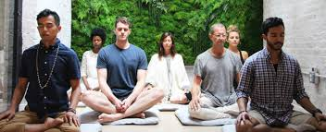
Benefits
Cultivate self knowledge and knowledge of life in general
Becoming your own doctor, health, longevity
Calmer mind, steadier emotions – everything improves

Slide 13
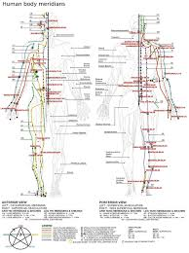
discoveries
In my own case I discovered it is possible to see points
Alleviate pain and sickness in others
Its only thru study we can how out of balance modern humans are.
Without knowing the conditions we cannot work on them.

Slide 14
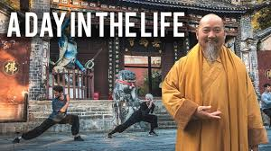
Conclusion
The easiest way for the person from the west to understand the Dao is to practice Tai Chi and Qi Gong.
It is a well-rounded system with safe guards.
Finding a good teacher really helps but they are hard to find.
Studying Daoism and inner cultivation change your life

Slide 15
Bibliography
Alexander, Frederick Matthias, Constructive Conscious Control of the Individual (E. P. Dutton, 1932)
Alexander, Frederick Matthias, Man’s Supreme Inheritance (E.P. Dutton & Company, 1918)
Clark, J. J, The Tao of the West (London: Routledge, 2000)
Kohn, Livia, Introducing Daoism (New York: Routledge, 2009)
Kohn, Livia, The Taoist Experience (New York: State University of New York Press, 1993)
Shaolintemple, Shaolin Chen Tai Chi Kung Fu & Qigong - 少林釋行武大師 Shi Xing Wu <https://www.youtube.com/watch?v=kZ6rXnZi8RY> [accessed 28 March 2019]

