Slide 1

Modernising Business Through Information Systems
LCLM 5004 Managing business information
Student Names:
ALEXANDRU DANCIUC - 2330349
RALUCA Mihaela POPA - 2332370
ALEXANDRU constantin POPA - 2332748

Slide 2

Introduction
In today’s digital economy, businesses rely on information systems (IS) to collect, process, and manage data.
IS support decision-making, streamline operations, and improve customer satisfaction (Laudon & Laudon, 2024).
This presentation aims to explore key IS types, ethical implications, and real-world applications that can support 5togo company.

Slide 3
5togo company
Our consulting team will explore how 5 to go can modernise and scale its operations through the strategic use of information systems.
5 to go is one of Europe’s fastest-growing coffee chains, known for its simple pricing strategy, rapid franchising model, and strong brand identity.
But with expansion comes complexity — and effective information systems can help the company optimise operations, strengthen decision-making, and create an even better customer experience.”

Slide 4

The Role of Information Systems in Business
Information systems integrate people, technology, and processes to support business operations (Stair & Reynolds, 2023).
Improve efficiency by automating workflows and reducing human error.
Enhance decision-making via data analytics and business intelligence.
Provide competitive advantage through innovation and customer insight (Porter, 2021).

Slide 5
Types of Business Information Systems
• Transaction Processing Systems (TPS): Manage routine, day-to-day transactions.
• Management Information Systems (MIS): Transform TPS data into summary reports.
• Decision Support Systems (DSS): Use analytics and models for decision-making.
• Enterprise Systems: Integrate departments via shared databases (O’Brien & Marakas, 2022).

Slide 6
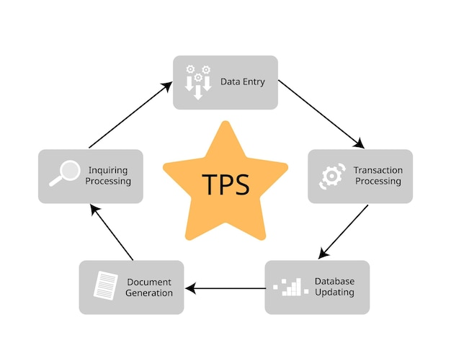
Transaction Processing Systems (TPS)
The Transaction Processing Systems handle foundation of operational data collection.
Functions: Sales tracking, order entry, inventory control.
Benefits: Accuracy, speed, and data consistency.
Limitations: Limited strategic insight (Stair & Reynolds, 2023).

Slide 7
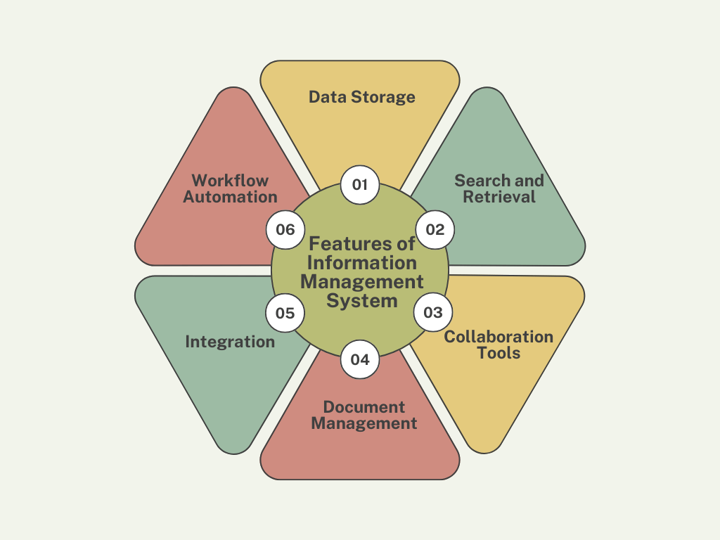
Management Information Systems (MIS)
The MIS Converts data into reports for decision-makers.
Functions: Performance reports, forecasting, budgeting tools.
Benefits: Increases managerial control and coordination.
Limitations: Less flexible for unstructured decisions (Laudon & Laudon, 2024).

Slide 8
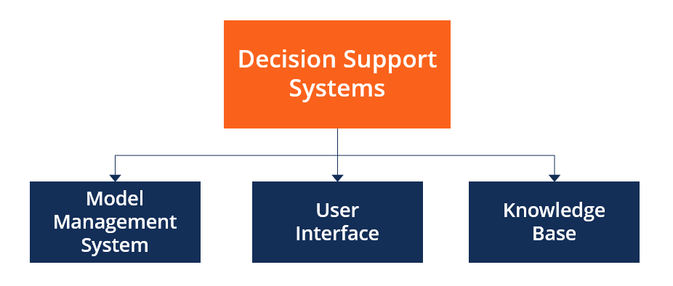
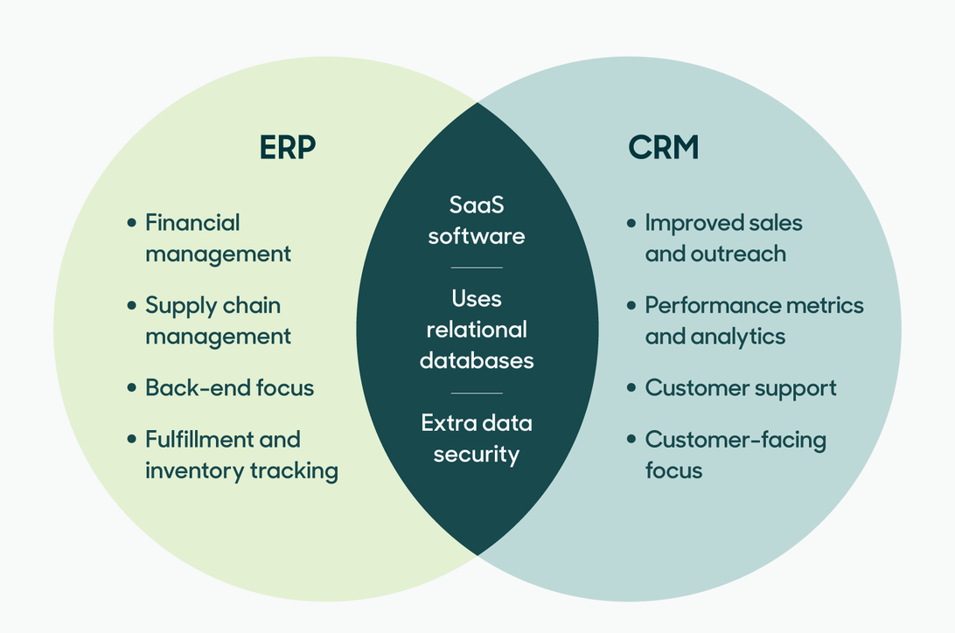
Decision Support & Enterprise Systems
Decision Support Systems (DSS): Combine data, models, and analytics for strategic decisions.
Enterprise Systems (ERP/CRM): Integrate supply chain, HR, finance, and customer data (O’Brien & Marakas, 2022).
Benefits: Real-time insight, cross-department efficiency.
Limitations: Costly and complex to implement (Chaffey & White, 2022).

Slide 9
Comparison of Systems
System | Key Purpose | Benefits | Limitations
TPS | Operational efficiency | Speed, accuracy | No strategic view
MIS | Managerial decisions | Reports, summaries | Rigid outputs
DSS/ERP | Strategic insight | Integration, analytics | High cost, complexity
(Adapted from Laudon & Laudon, 2024; Chaffey & White, 2022)

Slide 10
Ethical & Security Considerations
• Data privacy: Must comply with GDPR and secure customer data (ICO, 2023).
• AI and automation: Risk of bias and opaque decision-making (Floridi, 2021).
• Employee monitoring: Balance performance tracking with trust and well-being.
• Mitigation: Clear policies, staff training, encryption, ethical AI frameworks.

Slide 11
Real-World Case Studies
Amazon: Uses TPS and ERP for supply chain and customer analytics (Amazon Annual Report, 2023).
Tesla: Employs DSS and AI for predictive maintenance and product design.
Marks & Spencer: Integrated CRM to improve customer loyalty (Chaffey & White, 2022).
Takeaway: Integration of IS leads to faster decision-making and better customer satisfaction.

Slide 12

Recommendations
5togo would benefit adopting a hybrid ERP-CRM system to integrate departments and improve customer engagement.
Use DSS tools for data-driven strategic planning and ensure ethical governance through transparent AI and GDPR compliance.
5togo to invest in training and change management to support digital transformation.

Slide 13
Conclusion
In conclusion, information systems play a fundamental role in modern business operations by driving efficiency, enhancing decision-making, and fostering innovation.
Their integration allows 5togoto collect and analyse data effectively, streamline processes, and deliver superior customer experiences.
However, as technology evolves, 5togomust also remain vigilant about ethical and security considerations
By strategically adopting systems such as ERP, CRM, and DSS, and embedding strong governance and staff training, companies can achieve long-term competitiveness and sustainable growth in the digital age

Slide 14
List of references
Amazon (2023) Annual Report 2023. Available at: https://www.aboutamazon.com
Chaffey, D. and White, G. (2022) Business Information Management. 3rd ed. Pearson.
Floridi, L. (2021) Ethics of Artificial Intelligence. Oxford University Press.
ICO (2023) Guide to the General Data Protection Regulation (GDPR). Information Commissioner’s Office.
Laudon, K. and Laudon, J. (2024) Management Information Systems: Managing the Digital Firm. 17th ed. Pearson.
O’Brien, J. and Marakas, G. (2022) Introduction to Information Systems. 17th ed. McGraw-Hill.
Porter, M. (2021) Competitive Advantage in the Digital Era. Harvard Business Review, 99(4), pp. 52–65.
Stair, R. and Reynolds, G. (2023) Principles of Information Systems. 14th ed. Cengage.

