Slide 2
Portfolio and Placement Requirements
Reflective Practice and Reflective Writing

Slide 3
Session Overview
Placement Requirements
Reflection and Reflective Writing
Reflective Journals and how to use these to support you when writing your Summary of Learning.

Slide 4
Placement Requirements
Students must engage in supervised professional practice of 200 hours duration, 50% of which to be face to face with young people.
A minimum of 6 hours of supervision in which students must prepare reflective accounts to guide the sessions.
Include your PDP
Update and include the NOS Evidence Matrix to reflect your learning and development at level 4.

Slide 5
Reflection and Reflective Practice

Slide 6
What do we know about Reflection and Reflective Writing.
Discuss with a partner
What Models of Reflections are you using?
What format do you use for your reflective accounts?
Any Examples from Practice?

Slide 7
Learning from experience
As a student beginning a course of study it would not be unusual to hold the attitude – ‘I’m going to learn a lot over the next few years.
However, I would like to explore during today’s session the idea that we have been student’s all of our lives and will continue to be so.
The ‘course’ that you are on, your ‘area of study’ has been provided by the experiences we have had in our everyday lives.
Our lives are surrounded by learning, the experiences we have from day to day help to shape who we are, how we think and feel, how we act.
It is from these experiences that we have developed our knowledge, attitudes and skills.

Slide 8
The process of Reflection
If then we are learning from our everyday experiences, what is the importance of drawing attention to this process?
Firstly, as informal educators we are concerned with learning, especially the learning that takes place in everyday life.
To have an understanding of the process taking place when people learn from experience can be helpful when thinking about the way we work.
It is also important to have an understanding about the way you learn from your experiences.

Slide 9
The process of Reflection
We do not always learn from the experiences we have.
To have an experience alone, it would seem, is not enough.
We have to engage in certain thought processes in order to learn effectively from these experiences.
Sometimes we do this naturally, other times we do not and miss the opportunity of learning from an experience that may be of importance to our development.
Today then we will look more closely at the process of learning from experience.

Slide 10
The process of Reflection
We are aware then that we have experiences every day from which we may learn.
What happens alongside this experience that enables us to learn from it?
There are many theories that have been written about this subject and you will be introduced to several of these today.
A term that is often used by theorists to describe this process is experiential learning – thus placing an importance on the role that experience plays in the process of learning.

Slide 11
What is reflection and reflective practice?
Reflective Practice has been identified as one of the key ways in which we can learn from our experiences and is recognised as an essential tool for students to make links between theory and practice.
It enables you to develop your knowledge and skills towards becoming professional practitioners.
Essentially reflective practice means taking our experience as a starting point for learning.
By thinking about them in a purposeful way – using reflection and the reflective process – we can come to understand them differently and take action as a result.

Slide 12
The process of Reflection
One of the more well-known theories on experiential learning by David Kolb.
Kolb (1976, 1984) presents us with a model that is comprised of four stages.
The pattern begins with an experience, this could be any event that takes place in daily life, or a piece of practice with a group of young people.
Kolb calls this a (concrete experience). This concrete experience may then lead to a period of reflection (reflective observation) this is when we think about the experience itself. This then leads on to a process of theory making which Kolb calls (abstract conceptualisation). This is when we test out our new theory or understanding in practice. From this we move into another concrete experience.

Slide 13
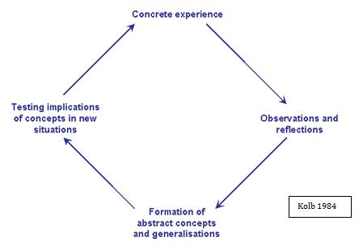
Kolb’s Learning Cycle (1984)

Slide 14
Gibbs’ Model of Reflection
One of the most famous cyclical models of reflection leading you through six stages exploring an experience: description, feelings, evaluation, analysis, conclusion and action plan.

Slide 15
Gibbs' Reflective Cycle was developed by Graham Gibbs in 1988 to give structure to learning from experiences.
It offers a framework for examining experiences, and given its cyclic nature lends itself particularly well to repeated experiences, allowing you to learn and plan from things that either went well or didn’t go well.
It covers 6 stages:
Description of the experience
Feelings and thoughts about the experience
Evaluation of the experience, both good and bad
Analysis to make sense of the situation
Conclusion about what you learned and what you could have done differently
Action plan for how you would deal with similar situations in the future, or general changes you might find appropriate.

Slide 16
The Model – Gibbs..
This model is a good way to work through an experience.
This can be either a stand-alone experience or a situation you go through frequently, for example meetings with a team you have to collaborate with.
Gibbs originally advocated its use in repeated situations, but the stages and principles apply equally well for single experiences too.
If done with a stand-alone experience, the action plan may become more general and look at how you can apply your conclusions in the future.

Slide 17
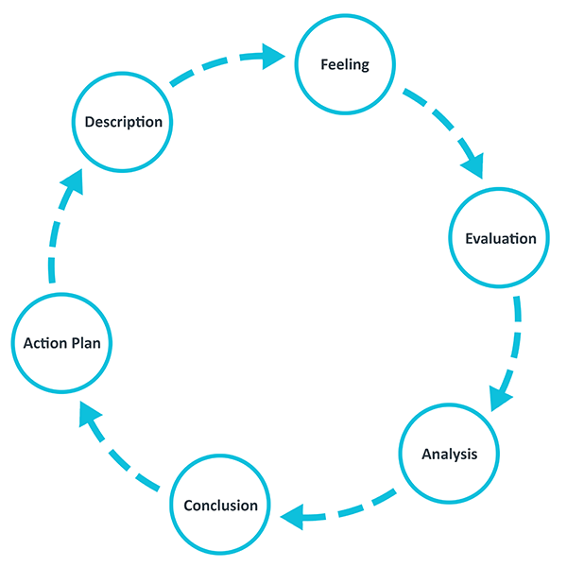
Gibbs’ Model of Reflection 1988

Slide 18
Gibbs’ Model of Reflection 1988

Slide 19
For each of the stages of the model a number of helpful questions are outlined in this ppt.
You don’t have to answer all of them but they can guide you about what sort of things make sense to include in that stage.
You might have other prompts that work better for you.

Slide 20
Description
Here you have a chance to describe the situation in detail. The main points to include here concern what happened. Your feelings and conclusions will come later.
Helpful questions:
What happened?
When and where did it happen?
Who was present?
What did you and the other people do?
What was the outcome of the situation?
Why were you there?
What did you want to happen?

Slide 21
Feelings
Here you can explore any feelings or thoughts that you had during the experience and how they may have impacted the experience.
Helpful questions:
What were you feeling during the situation?
What were you feeling before and after the situation?
What do you think other people were feeling about the situation?
What do you think other people feel about the situation now?
What were you thinking during the situation?
What do you think about the situation now?

Slide 22
Evaluation
Here you have a chance to evaluate what worked and what didn’t work in the situation. Try to be as objective and honest as possible. To get the most out of your reflection focus on both the positive and the negative aspects of the situation, even if it was primarily one or the other.
Helpful questions:
What was good and bad about the experience?
What went well?
What didn’t go so well?
What did you and other people contribute to the situation (positively or negatively)?

Slide 23
Analysis
The analysis step is where you have a chance to make sense of what happened.
Up until now you have focused on details around what happened in the situation.
Now you have a chance to extract meaning from it. You want to target the different aspects that went well or poorly and ask yourself why. If you are looking to include academic literature, this is the natural place to include it.
Helpful questions:
Why did things go well?
Why didn’t it go well?
What sense can I make of the situation?
What knowledge – my own or others (for example academic literature) can help me understand the situation?

Slide 24
Conclusions
In this section you can make conclusions about what happened.
This is where you summarise your learning and highlight what changes to your actions could improve the outcome in the future.
It should be a natural response to the previous sections.
Helpful questions:
What did I learn from this situation?
How could this have been a more positive situation for everyone involved?
What skills do I need to develop for me to handle a situation like this better?
What else could I have done?

Slide 25
Action plan
At this step you plan for what you would do differently in a similar or related situation in the future.
It can also be extremely helpful to think about how you will help yourself to act differently – such that you don’t only plan what you will do differently, but also how you will make sure it happens.
Sometimes just the realisation is enough, but other times reminders might be helpful.
Helpful questions:
If I had to do the same thing again, what would I do differently?
How will I develop the required skills I need?
How can I make sure that I can act differently next time?

Slide 26
Pause Point
What is your thinking around the models introduced so far?
Do you use different models depending on the situation?

Slide 27
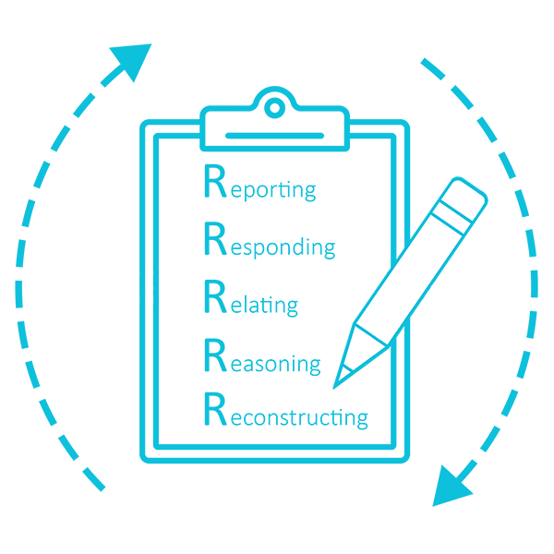
The 5R framework for reflection

Slide 28
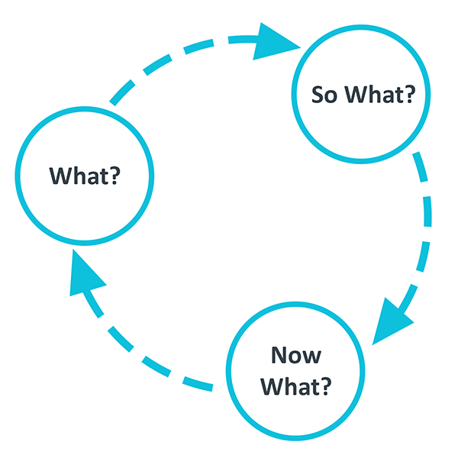

Slide 29
Individual Task – Directed Study
  Using one of the models introduced in today’s lecture, consider a recent critical incident/event or piece of practice you have been involved in and use a model to help you with this reflection.
  In other words write a reflective account ready for supervision.
  Please consider and write a brief paragraph analysing why you use that particular model, and not others.
  Feedback

Slide 30
To Conclude
How can we use today’s learning?
In Practice?
In the Portfolio?
What Theories can we link to today and use in our portfolios?

Slide 31
How can we use today’s learning?
In Practice?
  The Importance of Reflective Practice.
In the Portfolio?
  RA x 10 (6 Supervision Sessions)
  Summary of Learning

Slide 32
The Summary Of Learning Section of the Portfolio:
A summary of your own learning and development identifying ways in which your learning can be applied to your future placement practice. Your summary should be linked to your professional development plan and underpinned to examples from your practice and appropriate literature including the National Occupational Standards for Youth Work (approximately 700 words).
  You can include your Professional Development Plan (PDP) and NOS Evidence Matrix (NEM) in this section the (PDP) and (NEM) evidence matrix will not be counted in the word count.

Slide 33
Pause Point - Any Questions?
How many reflective accounts will I need to write?
How long should these be?
Do I need to link to theory?
References?
DO I SUBMIT THESE?

Slide 34
Pause Point - Any Questions?
How many reflective accounts will I need to write? 6-10
How long should these be? This will vary depending on the account.
Do I need to link to theory? Yes and your supervisor will help with this by directing you to further reading
References? Yes
DO I SUBMIT THESE? NO the Supervisor will see these and provide a grade mark out of a 100% for you.

Slide 35


