Slide 1
Rhetoric and Oratory: Lysias On the Murder of Eratosthenes

Slide 2
Rhetoric and Oratory
In addition to the importance of performance within literature and drama, public speaking played an important role in other areas of ancient Greek life:
  Courts
  Politics
Focus on persuasion, rather than representing a character
  But crossovers in terms of the audience
  And the power of performance

Slide 3
Rhetoric in practice
“Speech is a powerful master … It can stop fear, relieve pain, create joy, and increase pity …
The power of speech has the same effect on the disposition of the soul as the disposition of drugs on the nature of bodies …
words: some cause pain, others joy, some strike fear, some stir the audience to boldness, some benumb and bewitch the soul with evil persuasion.”
(The sophist Gorgias in the Encomium of Helen 8 and 14)

Slide 4
Why this matters: Laws in Athens
These are the skills that a sophist offering teaching in rhetoric can give you
Given Gorgias’ presentation, it is clear why members of this trade would have got short shrift from philosophers like Socrates, Plato and Aristotle…
…but in a direct democracy like 5th century Athens, public speaking is key:
Law making: The Assembly, based on majority vote
Law implementation: key roles in the public process
  Prosecutor
  Defence
  Jury

Slide 5
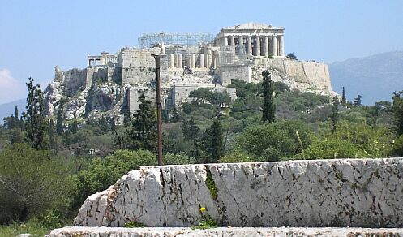
Politics: the assembly
Exact form varied over time and location
In Athens it was made up of adult, male citizens
Was held at the Pnyx
Discussed and made decisions about certain civic business and laws.
  The area that it had the right to cover varied over time periods.
At certain points it had a requirement of a quorum of 6000 for certain types of business.
In a democratic system speeches would be used to persuade the members of the assembly to vote in a particular way.

Slide 6
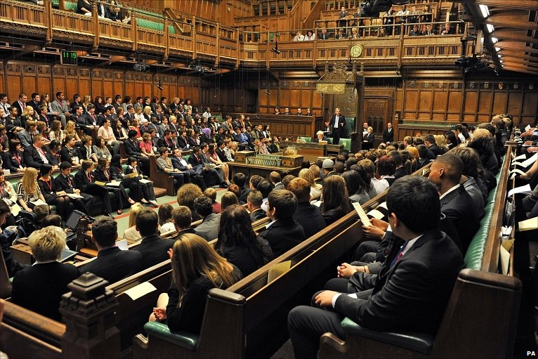

Slide 7
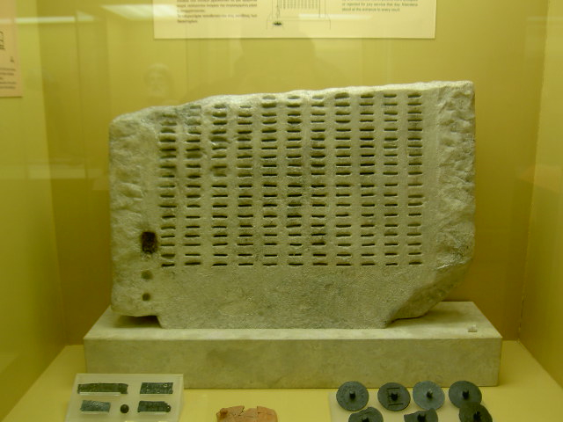
The Courts
The jury would normally have up to 500 jurors, taking part for a small fee
  For some cases, we know of juries of up to 6000 people
  They were not elected on any principles other than being Athenian citizens
  They decided the verdict and voted on the sentence
The magistrate does not advice on points of law, nor did he control the sentence

Slide 8
Trials
Public cases: any individual might bring a case on behalf of the city – any fines go to the city
  What does the individual bringing the case gain?
Private cases: any individual against another – any fines/compensation goes directly to whoever brought the case
Speech by prosecutor
Speech by defendant
Reading of relevant laws (nomoi) and introduction of witnesses
Appeals to the audience (i.e. the jurors!) were often emotional and included material that by our courts would be deemed non-admissible
This is why rhetoric becomes so important

Slide 9
Speech writers
Professional speech writers in antiquity
We know of a range of speech writers from the Classical and early Hellenistic periods
  Some speaking in matters they themselves are involved in, including politics (e.g. Aeschines and Demosthenes)
  Some providing speeches for clients (e.g. Lysias and Isaeus)
There is some evidence that speech writers specialised (or were held up as examples) in certain types of processes

Slide 10
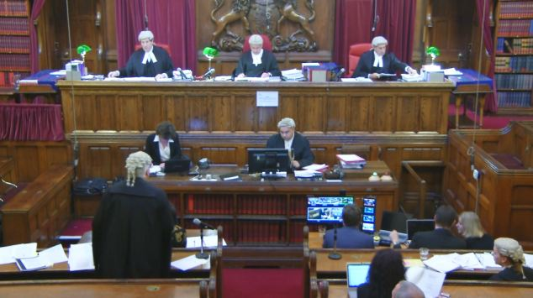

Slide 11
On the Murder of Eratosthenes
This is a private case and we hear the defendant’s speech:
  Euphiletos accused of murdering a man called Eratosthenes, who had been having an affair with Euphiletos’ wife
    It is not certain whether this speech was actually ever given or published as an advertisement to show off Lysias’ skills
Three aims:
  Must show that the law condones the killing of a man caught committing adultery with one’s wife/daughter
  Must show that this is how the murder happened, i.e. that Eratosthenes was in fact caught in bed with Euphiletos’ wife
  Must also show that Eratosthenes had not been tricked to enter the house

Slide 12
Lysias 1
I should be only too pleased, sirs, to have you so disposed towards me in judging this case as you would be to yourselves, if you found yourselves in my plight. For I am sure that, if you had the same feelings about others as about yourselves, not one of you but would be indignant at what has been done; you would all regard the penalties appointed for those who resort to such practices as too mild. (1.1)
Establishes the exchangeability of roles: ‘it might as well have been me’
Makes the audience members part of the defendant’s ‘team’
Promises tension: what might those ‘practices’ be to cause such feelings?
This part of the speech is a proemium and a captatio benevolentiae

Slide 13
Speech structure
Speeches tend to be most complex in two sections
  Captatio benevolentiae / proemium (introduction aimed at gaining the good will of the audience)
  Peroratio (summary of the speech hammering home key points and – again – making sure the speaker has the good-will of the audience)
This often means more complex vocab, more complex turns of phrase, and stylistic features galore
  In the original (whether Greek or Latin) these parts of speeches tend to be most difficult to translate as syntax and grammar are stretched to the max
The main body would be more straight-forward, laying out the events

Slide 14
Citing of Laws
He did not dispute it, sirs: he acknowledged his guilt, and besought and implored that he might not be killed, and was ready to pay compensation in money. But I would not agree to his estimate, as I held that our city's law should have higher authority; and I obtained that satisfaction which you deemed most just when you imposed it on those who adopt such courses. Now, let my witnesses come forward in support of these statements:
[WITNESSES]
Read out also, please, that law from the pillar in the Areopagus.
[LAW]
You hear, sirs, how the Court of the Areopagus itself, to which has been assigned, in our own as in our fathers' time, the trial of suits for murder, has expressly stated that whoever takes this vengeance on an adulterer caught in the act with his spouse shall not be convicted of murder. (Lys. 1.29-30)
What does this tell us about the speaker?
What response is suggested for the audience?
What does this tell us about Eratosthenes?

Slide 15
Not capable of the crime?
I shall therefore set forth to you the whole of my story from the beginning; I shall omit nothing, but will tell the truth. For I consider that my own sole deliverance rests on my telling you, if I am able, the whole of what has occurred. (Lys. 1.5)
The main part of Euphiletos/Lysias’ speech is taken up by the narrative of how Euphiletos married and how he came to catch his wife cheating
  This takes up paragraphs 5-27 or about 40% of the speech
The narrative presents Euphiletos as a simple man who wants to believe the best about everyone (including his wife): he is gullible and falls in the stock-comic role of the clueless cuckold

Slide 16
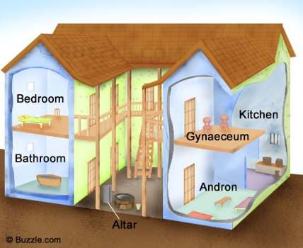
Euphiletos’ character (1.9-14)
Now in the first place I must tell you, sirs (for I am obliged to give you these particulars), my dwelling is on two floors, the upper being equal in space to the lower, with the women's quarters above and the men's below. When the child was born to us, its mother suckled it; and in order that, each time that it had to be washed, she might avoid the risk of descending by the stairs, I used to live above, and the women below. By this time it had become such an habitual thing that my wife would often leave me and go down to sleep with the child, so as to be able to give it the breast and stop its crying. Things went on in this way for a long time, and I never suspected, but was simple-minded enough to suppose that my own was the chastest wife in the city.

Slide 17
Euphiletos character (cont.)
Time went on, sirs; I came home unexpectedly from the country, and after dinner the child started crying in a peevish way, as the servant-girl was annoying it on purpose to make it so behave; for the man was in the house— I learnt it all later. So I bade my wife go and give the child her breast, to stop its howling. At first she refused, as though delighted to see me home again after so long; but when I began to be angry and bade her go, —“Yes, so that you,” she said, “may have a try here at the little maid. Once before, too, when you were drunk, you pulled her about.” At that I laughed, while she got up, went out of the room, and closed the door, feigning to make fun, and she took the key away with her. I, without giving a thought to the matter, or having any suspicion, went to sleep in all content after my return from the country. Towards daytime she came and opened the door. I asked why the doors made a noise in the night; she told me that the child's lamp had gone out, and she had lit it again at our neighbour's. I was silent and believed it was so. But it struck me, sirs, that she had powdered her face, though her brother had died not thirty days before; even so, however, I made no remark on the fact, but left the house in silence.
What does the mention of the slave girl accomplish?
  Counteracts Euphiltos being seen as not masculine enough: he still uses his rights as head of household with the slaves
  Counteracts Euphiletos being seen as too good/stupid/lame to be true: he did things that angered the wife, too (as a good Athenian should?)
How does the mention of makeup work on the audience?

Slide 18
Not just a private matter
So then, gentlemen, not only do the laws acquit me of doing wrong, but they also require me to exact this punishment. It is for you to decide whether they should maintain their authority or become worthless. I believe that all states make laws with this intention that in those instances where we are uncertain, we find out what we ought to do by consulting them. Well then, the laws recommend that in cases of this nature we exact this kind of penalty from wrongdoers. I expect you to come to the same conclusion. Otherwise, you will create such a safe haven for seducers that you will find thieves claiming to be seducers in complete confidence that, if they put forward this excuse for themselves, and claim that this is why they are entering other people's homes, no one will lay a finger on them. Everyone will know that the laws on adultery must be renounced, and that what they have to fear is your vote, because it is the supreme authority in the state. (1.34-36)
Draws the audience on to his side.
The speaker makes agreement with his argument seem like the only safe option.
If they disagree they lay the door open for other types of crimes.
Playing up to the audience, flattering their ego.

Slide 19
To take away
The pre-eminence of Greek oratory in the 5th and 4th centuries BCE is certainly connected to direct democracy
Lysias (459-c. 380) may write court speeches only (as far as our extant 30 speeches tell us) but many of his colleagues are as active in political speaking: e.g. Demosthenes and Aeschines are engaged in a significant debate on Athens’ response to Philip of Macedon
  Demosthenes’ On the Crown from 330 BCE
Others, again work in the overlapping areas of rhetorical theory and philosophy (e.g. Isocrates)
Greek oratory and rhetoric continues to influence the whole of the Classical world well into Roman times: the continued teaching of public speaking in Greece is one of the reasons for well-off young Romans to take an educational trip to Athens

