Slide 1


Basil's Bakery Case Study Analysis
Aline Amorim Pinheiro
Student ID: 2540483
LCLM4004 – Problem Solving and Decision Making
Lecturer: Anniemarie Dufficy

Slide 2

Basil's Bakery is a small independent located in Coventry
2015 Opened
2015 – 2019 Sales Growth
2020 Covid Impact
2021 – 2022 Partial Recovery
2023 Sales
2023 – 2025 Sales Remain 25% lower
Established in 2015
Sales grew steadily until 2019
Sales dropped during Covid-19 lockdowns
Sales remain approximately 25% below 2019 levels
Rising operating costs threaten business sustainability

Slide 3
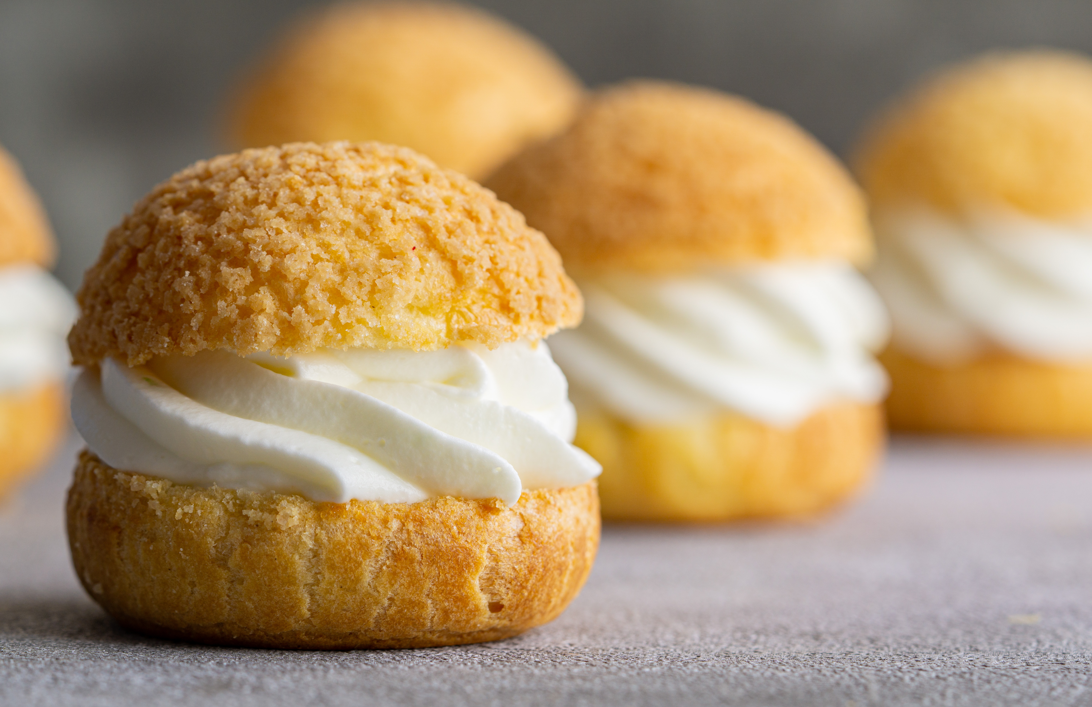
Nature & Scope of the Sales Problem
SALES DECLINE = 25% BELOW 2019
DEMAND-SIDE ISSUE
Reduced footfall
Shop closures
Hybrid working
Job losses
Fewer lunch visits
BUSINESS-SIDE ISSUE
Rising overheads
Higher utility costs
Ingredient volatility
Missed phone orders
No delivery service
(Pione el at.,, 2026)
(Ingham, 2026)

Slide 4
What is PESTEL Analysis?
Political
Economic
Social
Technological
Environmental
Legal
PESTEL is a strategic framework used to analyse the external environment and identify opportunities and threats affecting a business.
(Brooks, Weatherston and Wilkinson, 2011)

Slide 5
Evaluating the PESTEL Framework
✅ ADVANTAGES
Identifies external influences
Supports strategic planning
Simple and widely used
❌ LIMITATIONS
Does not analyse internal factors
Business enviroment changes rapidly
Does not provide solutions
KEY INSIGHT
PESTEL effectively identifies external factors affecting Basil's Bakery; however, it should be combined with the Fishbone Diagram to identify the root causes of declining sales.
(Brooks, Weatherston and Wilkinson, 2011)

Slide 6
PESTEL Analysis of Basil's Bakery
🏛 POLITICAL
Business rates
Local government policies
Small business support
💷 ECONOMIC
Inflation
Rising ingredient costs
Higher utility bills
👥 SOCIAL
Hybrid working
Lower footfall
Fewer lunch visits
💻 TECHNOLOGY
No online ordering
No delivery
Limited pre-orders
🌱 ENVIRONMENT
Organic sourcing
Crop failure
Supply chain risks
⚖ LEGAL
Food safety
Employment Legislation
Compliance costs
KEY INSIGHT
Economic, Social and Technological factors have the greatest impact on Basil's Bakery because they directly affect customer demand, operating costs and business accessibility.
(Brooks, Weatherston and Wilkinson, 2011)
(Pione et al., 2026)

Slide 7
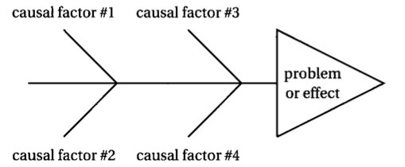
What is Fishbone Diagram?
Definition
A cause-and-effect tool used to identify the root causes of a problem.
Purpose
Identify root causes
Support problem solving
Improve decision making
Benefits
Easy to understand
Organizes possible causes
Encourages systematic analysis
Source: University of Hong Kong (n.d.)
Main Problem:
Declining Sales at Basil's Bakery.
The Fishbone Diagram will be applied to identify the root causes of declining sales
(Sproull, 2018)
(Institute of Leadership & Management, 2007)

Slide 8
Evaluating the Fishbone Diagram
✅ ADVANTAGES
Identifies root causes
Supports problem solving
Easy to understand
❌ LIMITATIONS
Subjective analysis
Does not prioritize causes
Can oversimplify complex issues
KEY INSIGHT
The Fishbone Diagram helps identify the root
causes of Basil's Bakery's declining sales;
however, additional analysis may be required
to determine which factors are most significant.
(Sproull, 2018)
(Pione et al., 2026)
(Ingham, 2026)

Slide 9
Fishbone Analysis of Declining Sales
People Environment Machines
Hybrid working
Fewer visits
Shop closures
Lower footfall
No online ordering
No delivery
Declining Sales
Waiting time
Missed calls
Higher utility bills
Increasing rent
Post-pandemic behavior
Consumer spending pressure
Methods Materials Measurement
Key insights
Declining sales are driven by multiple interconnected causes, particularly changing customer behavior, reduced footfall, technological limitations and rising operating costs.
(Sproull, 2018)
(Pione et al., 2026)
(Ingham, 2026)

Slide 10

Key Findings
✅ Economic Factors are reducing profitability.
✅ Social changes have reduced customer demand.
✅ Technology limitations affect customer access.
✅ Multiple root causes contribute to declining sales.
Key Insight
Basil's Bakery faces both external and internal challenges, meaning that a combination of strategic and operational changes may be required to improve sales performance.
(Brooks, Weatherston and Wilkinson, 2011; Sproull, 2018; Pione et al., 2026; Ingham, 2026)

Slide 11
Brooks, I., Weatherston, J. and Wilkinson, G. (2011) The international business environment: challenges and changes. 2nd edn. Harlow: Financial Times Prentice Hall.
Institute of Leadership & Management (2007) Solving problems and making decisions. 5th edn. Amsterdam: Pergamon Flexible Learning.
Sproull, R. (2018) The problem-solving, problem-prevention, and decision-making guide: organised and systematic roadmaps for managers. New York: Taylor & Francis.
Sophie (2025) 'The Sandwich Revolution: From Humble Sarnie to Hottest Food Trend'. NCASS, 30 July 2025. Available at: https://www.ncass.org.uk/news/the-sandwich-revolution-from-humble-sarnie-to-hottest-food-trend/ (Accessed: 7 October 2026).
Pione, A., Magnin, C., Bozarth, D., Moulton, J. and Alldredge, K. (2026) State of the Consumer 2026: When tech acceleration and cost pressures collide. McKinsey & Company, 22 June. Available at: https://www.mckinsey.com/industries/consumer-packaged-goods/our-insights/state-of-consumer#/ (Accessed: 7 October 2026).
Proctor, T. (2014) Creative problem solving for managers: developing skills for decision making and innovation. 4th edn. London: Routledge.
Ingham, A. (2026) '5,500 small firms urge Reeves to halt "apocalyptic" business rates shock', BM Business Matters, 8 January. Available at: https://bmmagazine.co.uk/news/5500-small-businesses-business-rates-review-reeves/ (Accessed: 7 October 2026).
Microsoft Corporation (2026) Microsoft PowerPoint Stock Images and Icons. Available through Microsoft PowerPoint Stock Library (Accessed: 30 September 2026).
University of Hong Kong (n.d.) Fishbone Diagram. Available at: https://philosophy.hku.hk/think/sci/fishbone1.jpg (Accessed: 30 September 2026).
References

