Slide 2
Today’s Discussion
Building upon our previous discussions on routing protocols, this week we shift our focus to Domain Name System (DNS). We will delve into the operations and functions of DNS, exploring its critical role in translating domain names to IP addresses and facilitating efficient communication across networks.
DNS
Functions
Configurations
Best Practices
Our discussions will encompass the implementation of DNS in a Windows Server environment, covering the setup and configuration of DNS services. We will explore the various components of DNS, including zones, records, and name resolution mechanisms, to gain a comprehensive understanding of how DNS operates within an organizational network.
Before we dive into today's topics, let's briefly recap what we covered so far.

Slide 3

Scan and Share!!!
Notes:
Perfection !!! – Industry Standard

Slide 4




Milestone
Coursework 1:
Choose your Hypervisor based on your research (Q.2.1)
Download (use Evaluation Copy) and Setup your Virtual Machines – as per the topology (Q. 2.2)
Research on IP Address (Based on the Group Discussion earlier)
Use Appropriate IP Addressing Scheme to configure your Network
Test and Troubleshoot (if required) your network.
Research on Routing and Network Services.
Submit your Coursework 1 – 07/03/2025

Slide 5

Milestone
Coursework 2:
Coursework 2 – Walkthrough
Plan to work on your Topology – Gannt Chart !!!
Continue with your Topology – Firewall Rules/ Policies
Installing RRAS Services, AD-DC, DNS, S2S VPN
Configuring DHCP, Mount Second Disk, Export/ Create User Accounts
Work on other Aspects (Sharing Disk Drive, IIS Server, RDS)
Troubleshoot if necessary
Submit your Coursework 2 – 13/05/2024 (Submission prior to 9.00 am before 1st presentation starts)

Slide 6

Action
As we conclude today's lecture on DNS, I trust you equip yourselves with the knowledge and skills necessary to effectively deploy, configure, and manage DNS services in a Windows Server environment. Through practical examples and hands-on exercises, we will strengthen our understanding of DNS operations and its significance in maintaining a robust and reliable network infrastructure.
With this foundational knowledge in place, I encourage you to
Continue your research on Task 1,2 and 3.
Start working on your practical implementation – task 4 – 4.1, 4.3, 4.4 and 4.5
You shall also work on your practical implementation – task 5 – 5.1 and 5.3

Slide 7
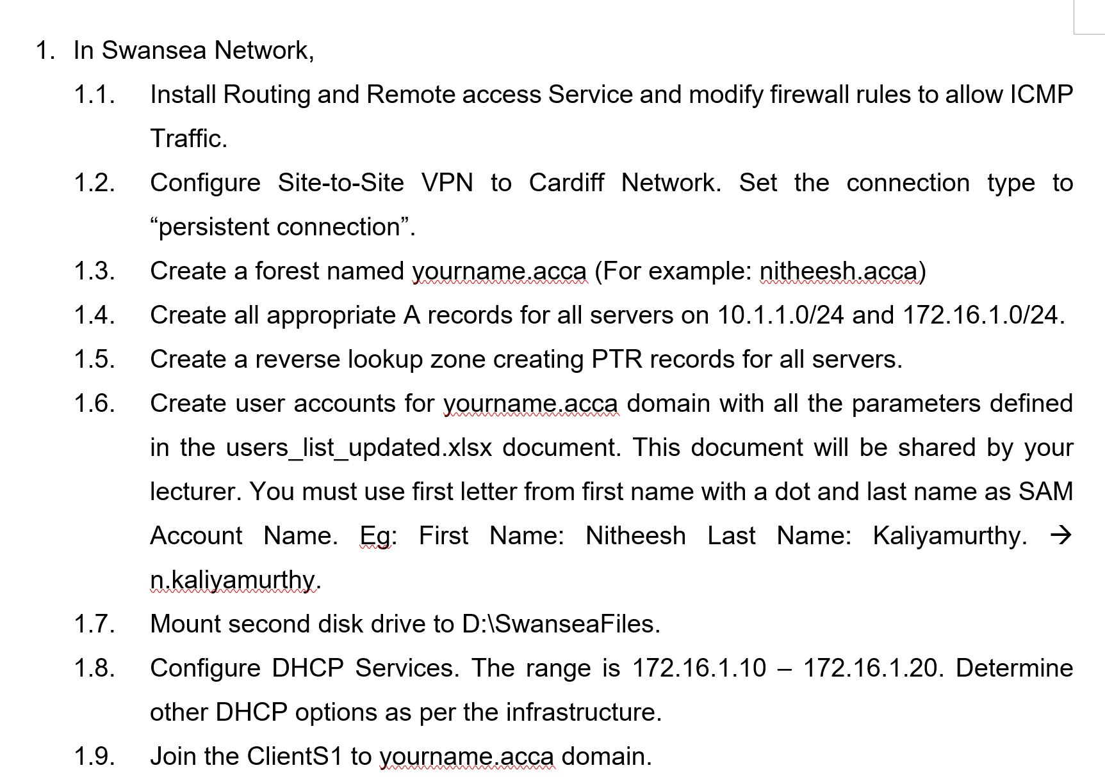

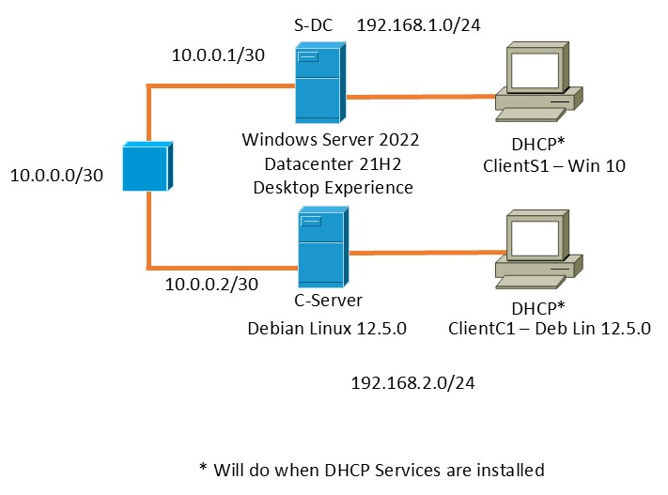



Create a Domain and Promote DC (1.3)
Join Client S1 to the Domain (1.10)
RRAS (1.1)
S2S VPN (1.2)
IP Forwarding in Debian Server (2.1)
S2S VPN – Establish Connectivity between all devices (2.2)
Simultaneously, Firewalls, DNS could be done. (1.4, 1.5, 2.1)
Sharing Disk Drive
Join Cardiff Network to your Domain (both Server and Client) (2.3, 2.5)
IIS Server
Configure DHCP (1.8, 1.10, 2.4, 2.5)
RDS
Mount disk drive to D:\SwanseaFiles (1.7)
User Accounts (1.6)

Slide 8


DOMAIN NAME SYSTEM
Aged concept – From ARPANET age since 1960’s. Knowing names for numbers (here IP Addresses). In 1980’s, DNS was documented in RFC
Portions of the Domain name space and domain name registration are the responsibility of InterNIC (Internet Network Information Centre)
    The name of the domains has labels separated by period. (nos.com)
    Resolves text names (nos.com) into IP addresses
DNS is maintained by Database
      The Database uses client/server architecture
      The network hosts represents server’s name
Name to IP address mapping stored in a database that is distributed amongst many DNS servers
  Its size is unlimited → solving problem of very large host files
  Performance doesn’t degrade as number of servers increases
  Localizes update traffic
DNS – Tree Structure (Hierarchical)
  It is Hierarchical → name queries are passed up a “tree” of DNS servers until resolved
Branch and Leaf
  Each branch is a Root Zone, and Each leaf has 0ne or more resource records
Zone
    Each zone represents a root domain or multiple domains and sub-domains.

Slide 9
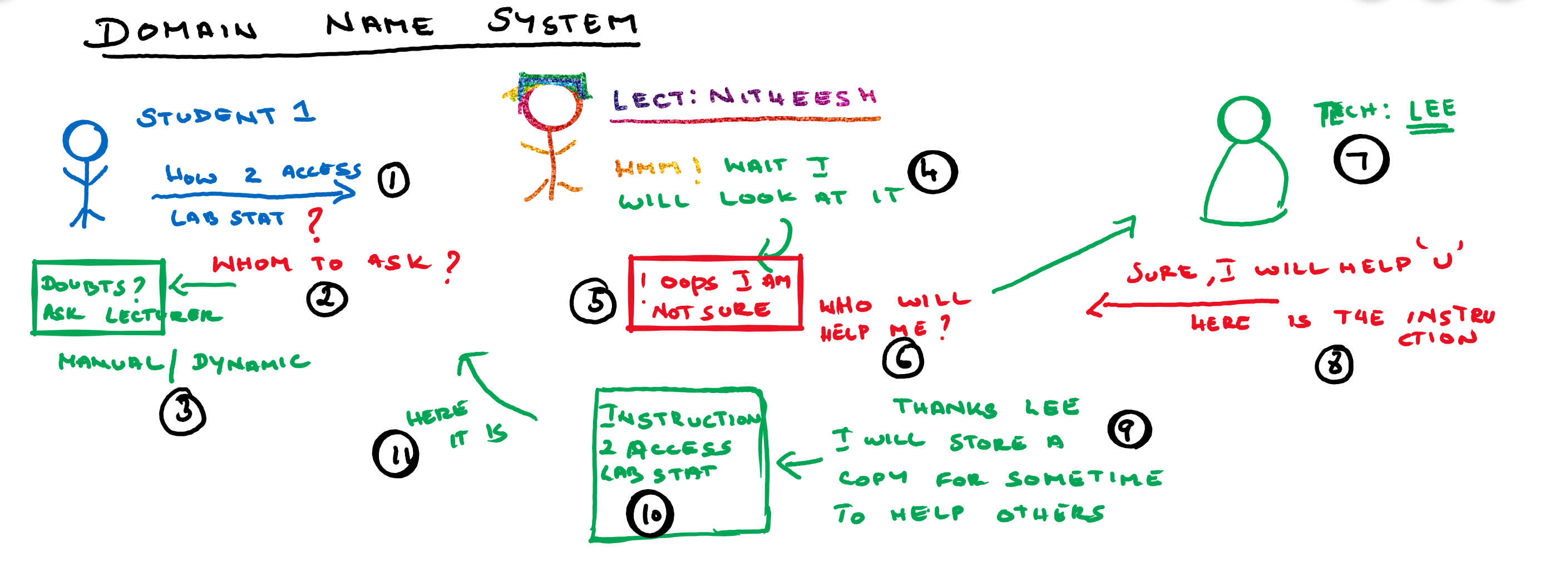
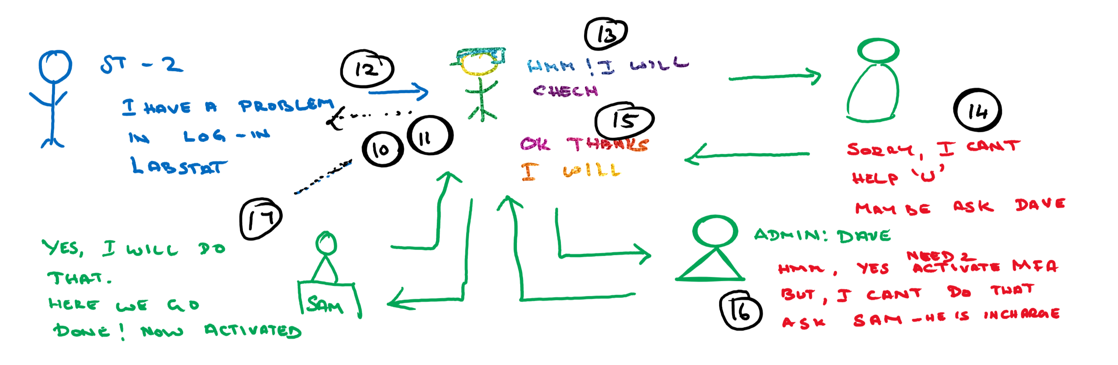

Slide 10
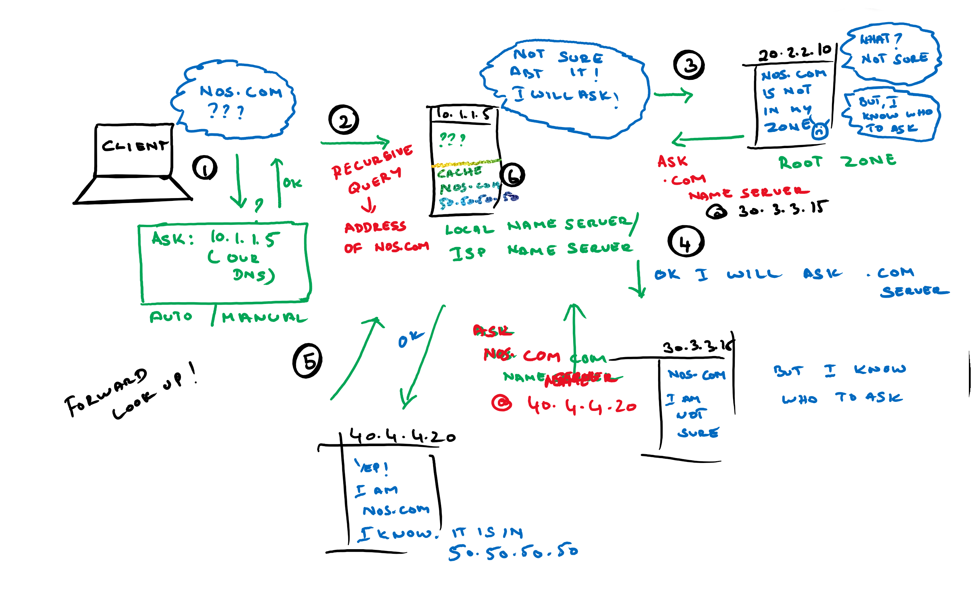
Notes:
Local Name Server/ Resolver

Slide 11
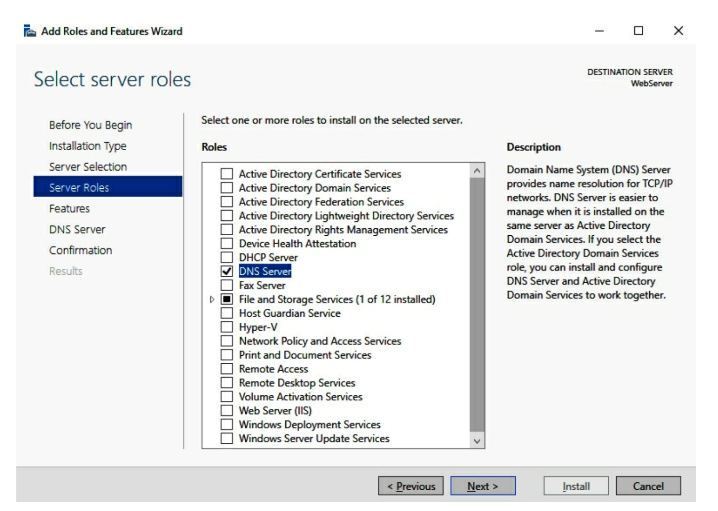
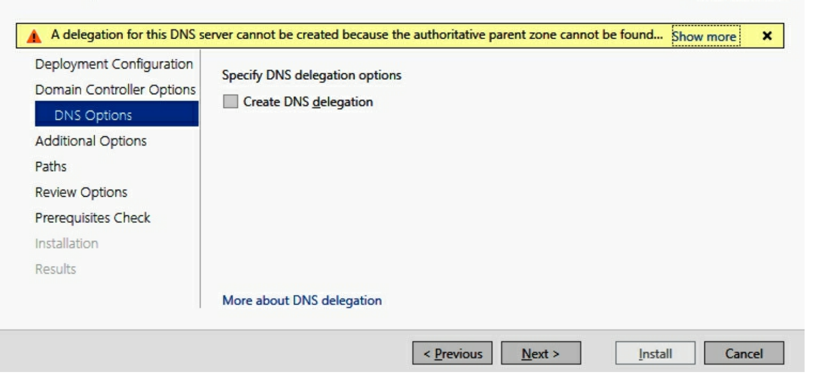
DOMAIN NAME SYSTEM

Slide 12
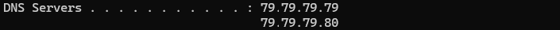
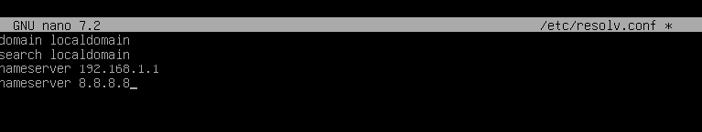
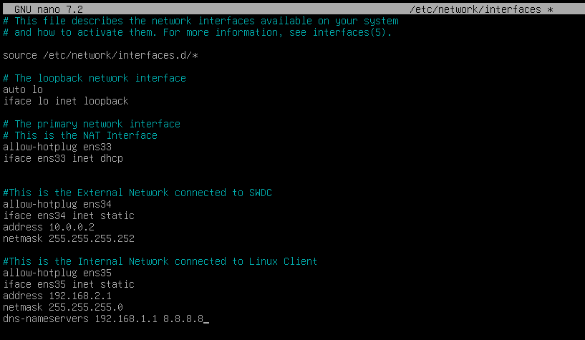
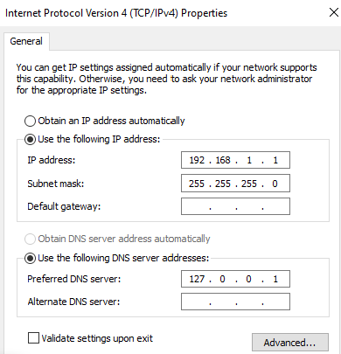
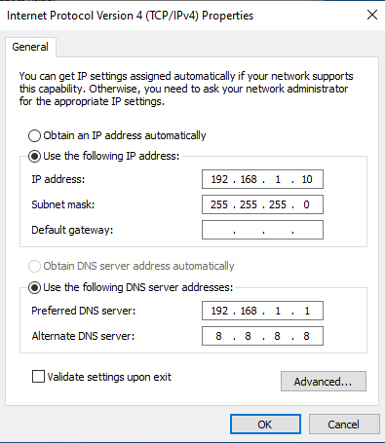

Slide 13



DOMAIN NAME SYSTEM
Network Basic Input/Output System (NETBIOS)
  Windows puts the NETBIOS information within a TCP/IP Packet. But Why?
  To communicate outside my subnetwork.
  That’s OK. But How?
  Using various protocols. Which?
  Name Service – TCP 137, UDP 137
  Session Service (Connection oriented) TCP 139
  Datagram Service (Connection less) UDP 138
DNS is also used to resolve names but, on an Internet wide basis
Name Resolution
Service
Computer44
1
Where is the Computer44 file?
192.168.1.200
2
3
Computer44
Machine must check DNS name resolution before NetBIOS name resolution

Slide 14



DOMAIN NAME SYSTEM
DNS Response update cache
2b
2a
If no entry in cache send DNS Request
DNS Server
Client Resolver Cache/Hosts File
DNS
NetBIOS
Name Cache
WINS
Broadcast
Lmhost File
2c
Client
If no DNS Response, get address from NetBIOS
1
Salescomputer2
What is the
IP address for Salescomputer2?
2
192.168.1.35
3
Host name resolution is the process of resolving a host name to an IP address
Salescomputer2

Slide 15
DOMAIN NAME SYSTEM: namespace
Logical Tree called the domain namespace
Domain is a tree or subtree within the overall domain namespace
  Root domain - root node, unnamed(null) sometimes represented as a trailing period e.g. www.nos.com
  Top-level domain - indicates type of organization or geographical region
  .com is company | .edu is educational | .org is organisation
  Second-level domain - Assigned and registered by InterNIC e.g. nos, uwtsd etc
Subdomain is an additional domain registered with InterNIC
  Large companies can request multiple domains to represent different departments e.g. .batch1.nos.com
Fully Qualified Domain Name (FQDN) is a name which states with absolute certainty the location in the domain name space → maps to an IP address

Slide 16
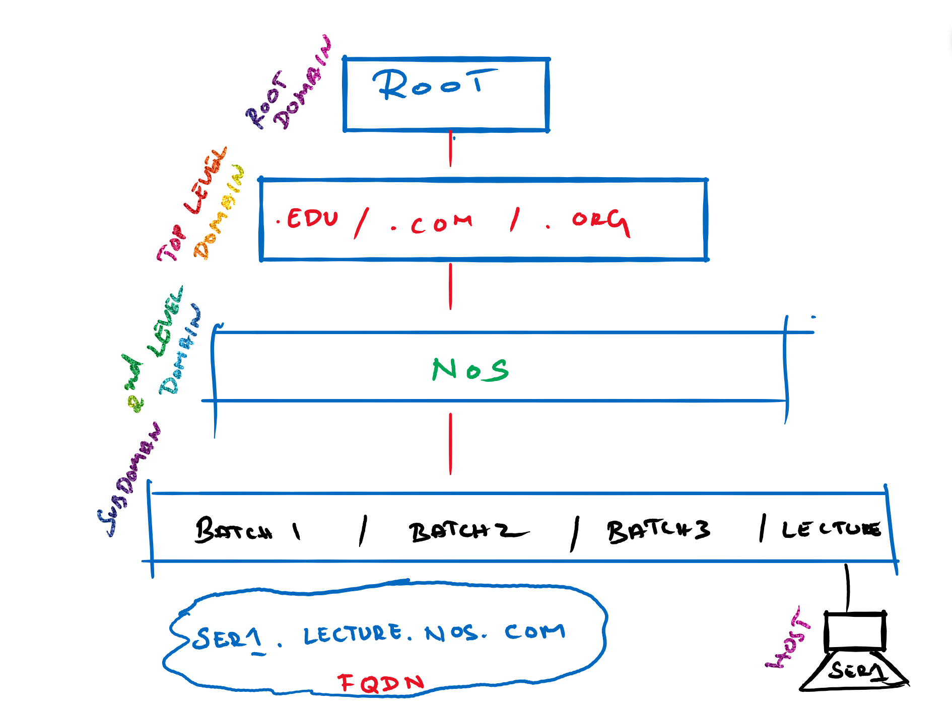

DOMAIN NAME SYSTEM
A host name is the DNS name of a device on a network
A fully qualified domain name (FQDN) is a domain name that uniquely identifies a machine in the domain namespace tree
Machines can have the same names within different domains
  server1.lecture.nos
  server1.batch1.nos
“.” Root
.com
nos
lecture
FQDN
Server1 = 192.168.0.66
server1.lecture.nos
Server1 = 192.168.0.67
Host Name
DNS Suffix

Slide 17
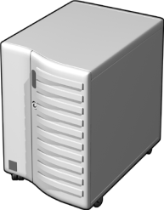








DOMAIN NAME SYSTEM
DNS Clients
DNS Servers
Hosts domain
Resolves name Resolution
requests from clients
DNS database entries
DNS Servers on the Internet
Root “.”
Resource
Record
.com
.edu
Resource
Record

Slide 18
DOMAIN NAME SYSTEM: query
A query is a request for name resolution to a DNS server. Two types of queries: recursive and Iterative
DNS clients and DNS servers both initiate queries for name resolution
An authoritative DNS server for the namespace (i.e. responsible for the domain):
  Check the cache, check the zone, and return the requested IP address
  Return an authoritative, “No”
  Can have more than one authorative DNS server for a domain
  The client/server picks one from the list
  Recorded in the parent domain DNS Servers database as NS records
A non-authoritative DNS server for the namespace (i.e. some other DNS server is responsible for the domain that the host is on):
  Forward the unresolvable query to a specific query server called a Forwarder
  Use root hints to locate an answer for the query

Slide 19




DOMAIN NAME SYSTEM: query
Root hints are DNS resource records stored on a DNS server that list the IP addresses for the DNS root servers that InterNIC maintains on the Internet
System32\Dns\Cache.dns
Cluster of
DNS Servers
Cluster of
Root (.) Servers
An iterative query is a query made to a DNS server in which the DNS client requests the best answer that the DNS server can provide without seeking further help from other DNS servers.
The result of an iterative query is often a referral to another DNS server lower in the DNS tree.
Typically, an iterative query is made by a DNS server to another DNS server when a DNS client makes a recursive query.
Iterative Queries
Root Hints
Recursive query for
lec1.nos.com
Ask .com
Ask nos.com
com
Local DNS Server
nos
Computer1
Authoritative Response

Slide 20




DOMAIN NAME SYSTEM: cache
Caching Table
Host Name | IP Address | TTL
Lect.nos.com | 10.1.1.10 | 28 second
Caching is the process of temporarily storing recently accessed information in a special memory subsystem for quicker access
Server caches answers to all queries (including top-level, second-level, etc) for a given time (TTL)
Can set a DNS domain when configuring forwarding
Like, If you ever need to need to resolve a name for nos domain, then don’t go to the Internet – ask this server (forwarder)
you can define your own domain for your local network using this process
may even override an existing domain
e.g. google.com, for your local network
Iterative Query
Forwarder
Root Hint (.)
Ask .com
Iterative Query
Ask nos.com
.com
Recursive Query
172.16.64.11
Iterative Query
172.16.64.11
Authoritative Response
Recursive query for
mail1.nos.com
WAN
nos.com
Local
DNS Server
Computer1

Slide 21
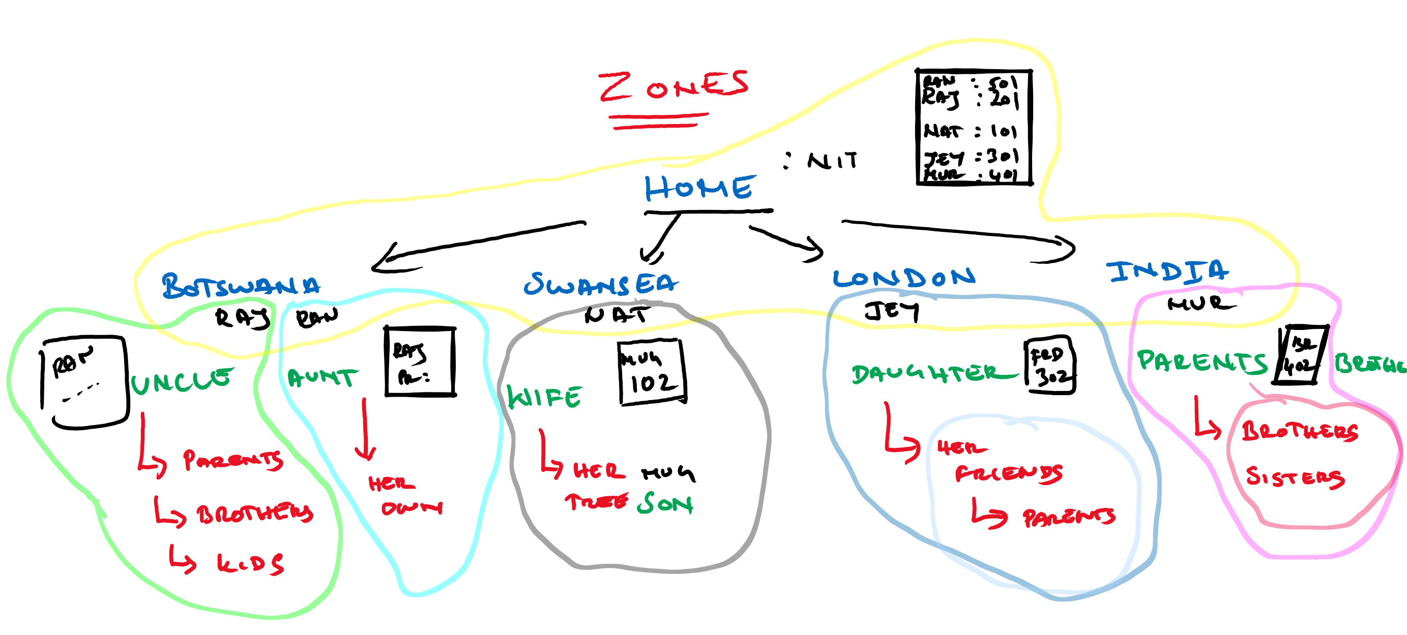
DOMAIN NAME SYSTEM: zones
Zone file is the file on the DNS servers hard drive that contains all the information for a zone and the resource records contained therein. It is an ASCII file if not using Active Directory.
Each zone has its own zone file (when not using Active Directory)

Slide 22
DOMAIN NAME SYSTEM: zones
Domains
nos
One zone multiple domains
DNS Server can also manage multiple zones
batch1
batch2
lecture
Each Active Directory domain needs its own zone (use the same name for DNS domain)
resourcefile
ppt
assessment
Zones

Slide 23


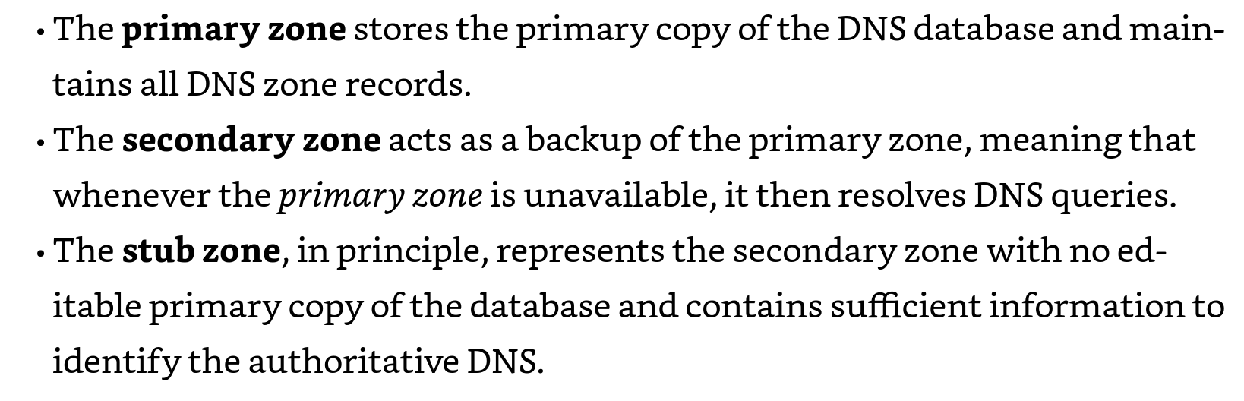
DOMAIN NAME SYSTEM: zones
Start Of Authority (SOA)
1
SOA query for a zone
Secondary Server
2
SOA query answered
3
Entire Zone (AXFR) or Incremental Zone Transfer (IXFR) query for a zone
1
3
Entire Zone (AXFR) or Incremental Zone Transfer (IXFR) query answered (zone transfer)
4
Read/Write
Read-Only
2
4
Copy of Limited records
Primary & Master Server

Slide 24


DOMAIN NAME SYSTEM: DELEGATION
DNS server
The administrator, at the nos.com level of the namespace, delegates authority for lect.nos.com and offloads administration of DNS for that part of the namespace.
lect.nos.com now has its own administrator and DNS server to resolve queries in that part of the namespace/organization
Delegation is the process of assigning authority over child domains in your DNS namespace to another entity by adding records in the DNS database
lect.nos.com
DNS server
lect.nos.com

Slide 25
Summary: So far
Active Directory
Active Directory Structure
Domain Controller
Functional Levels
DNS
  Functions
  Query
  Cache
  Zones
  Delegations

Slide 26

Books Referred: Dauti, Bekim. Windows Server 2019 Administration Fundamentals: A beginner's guide to managing and administering Windows Server environments, 2nd Edition . Packt Publishing.
Links referred in this presentation:
Microsoft Virtual Academy

