Slide 1
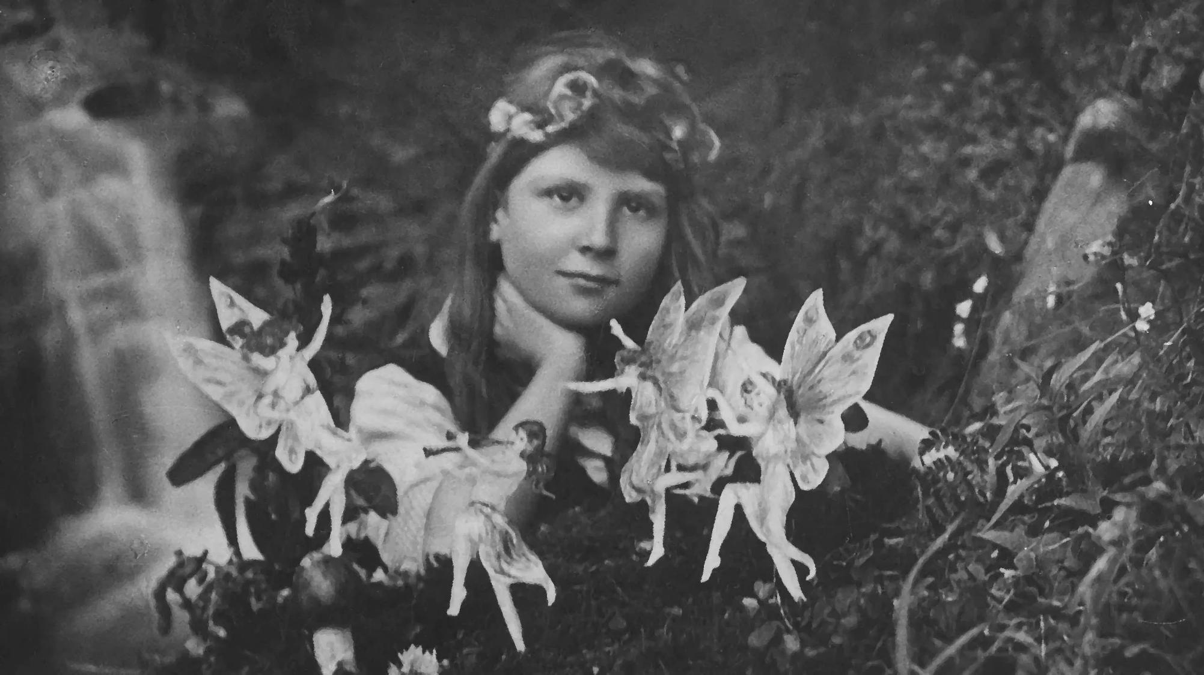
IMAGE ANALYSIS 1 - CONTENT

Slide 2
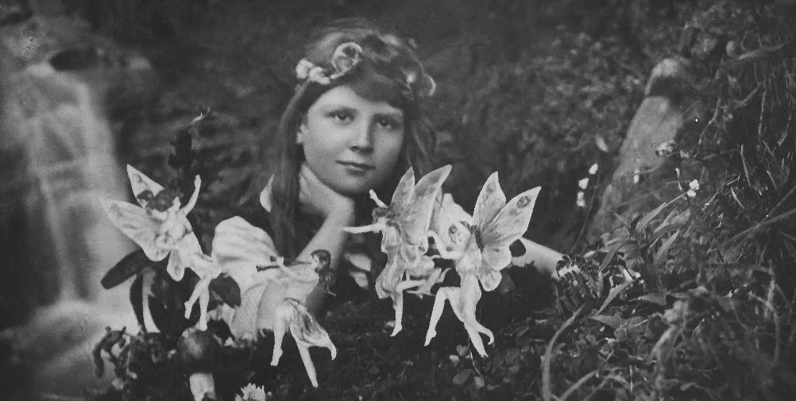
Visual Studies 1
smal
By encouraging us to delve deeper into photographs, visual studies allows us to truly notice, not only the meaning and potential symbolisms behind images, but also their make-up, allowing us to analyse the visual, cultural and historical contexts of photography. Elements such as content, composition and contexts can impact the meaning of photographs. Due to these factors, images can provoke a variety of emotions, thoughts and viewpoints within each viewer depending on the personal experiences, cultural background, knowledge and social context the observer. ​
What I most look forward to whilst studying this module, is to learn what it means to not only look at photographs, but to truly absorb and appreciate art. To not only view images, but to slow down, dissect and appreciate photographs for their intricate details that we as people often overlook as opposed to only noticing the focal points. I feel that not only will doing this better my experience as a viewer of art but also allow me to notice and be intentional with the intricate details of my images too. Visual studies reminds us that like many things in this life, there is often more than what meets the eye, and that this is true with photography. Visual studies is the art of noticing.
This photograph appears to have been shot outdoors in nature, as implied by the surrounding shrubbery, flowers, and the waterfall in the background. A naturalistic location, likely in a woods, perhaps a garden. Baldes of grass of various lengths, shapes and sizes spring into frame on the right side of the image, along with small delicate flowers. The left side of the frame is occupied by a bustling waterfall falling over a rocky surface. The remaining of the background is not too well defined yet still appears to be shrubbery and rocks.
In the centre, a young girl can be seen. She has something in her hair, appearing to be a floral headband. She is poised with a soft gaze, her hand positioned under her chin, as though she's propping her head up in awe of the scene in front of her. At the forefront, multiple white fairies can be seen, and they appear to be dancing, with one playing what seems to be a small musical instrument. The fictionality of fairies aside, the fairies in the image appear particularly artificial in contrast to the lifelike quality of the rest of the image. One fairy does not appear to have wings, yet the remaining three fairies each have their own unique pattern on each set of wings. All fairies appear to be feminine, each with long hair and are wearing dresses.
Images like this show us how imaginative and creative photography can be, not just in a way that allows us to record or capture reality. It reminds us that images can be used as a tool to express imagination, wonder, symbolism, beliefs and ideas.
Cottingley Fairies, 1917. Frances Griffiths and Elsie Wright

Slide 3
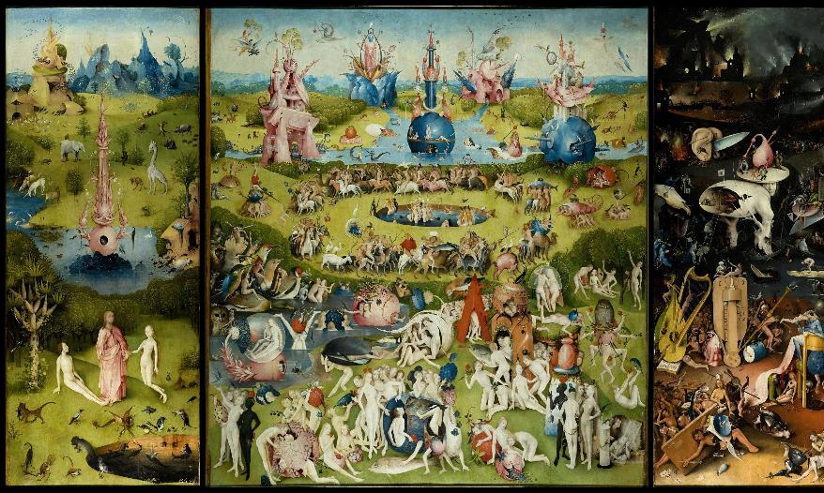
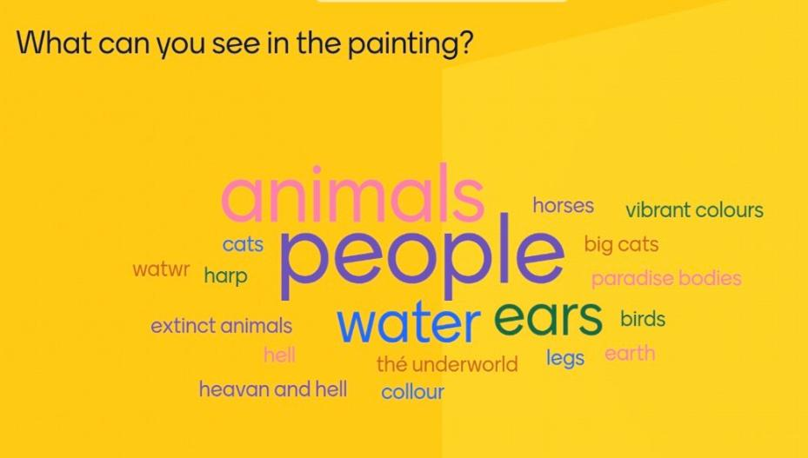
The Garden of Earthly Delights. Hieronymous Bosch.1490-1510.

Slide 4
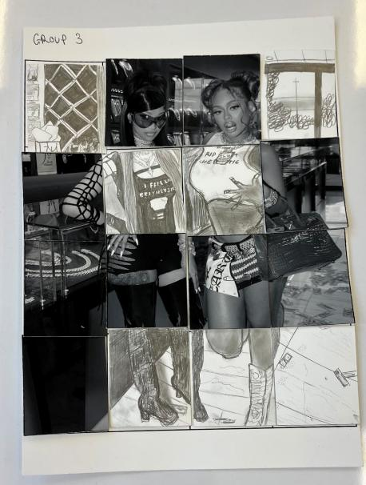

Image Grid
When comparing out grid sketch to the original image, there are similarities, although at the time, I could not quite make out what it actually was that we were drawing.
There was a lot of detail to recreate, various different shades and shapes in which we spent a lot of time trying to accurately imitate through our own sketching. When comparing the image grid with the original photograph, I notice that we did manage to differentiate some of the different shading within our drawing, as opposed to drawing using simply only black and white. We attempted to portray the various shades through different styles of sketching.
There are definitely notable differences between the images, such as lack of colour in our grud, meaning that we needed to portray different shades of colour using only a simple pencil and different shading techniques to display and distinguish the difference between dark and light colours.
When drawing, we knew that there was a lot of detail to sketch if we wanted to make our drawing as accurate to the oroginal photograph as possible.
This task reminded us that when viewing an image, there is so much more to be noticed than simpky the focal point, hence why we were made to sketch it inj blocks ad opposed to viewing and copying the whole image image at once. This method of copying really forced us to play close attention to the intricate and often overlooked details to be seen in photography, not only what is initially eye catching at first glance.

Slide 5
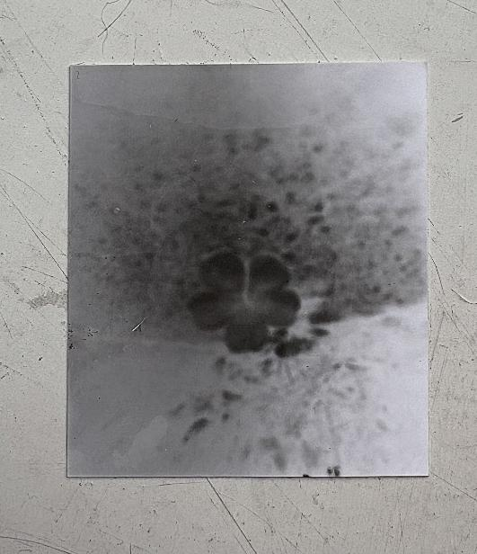
Due to the style and quality of this image, its location of this is unclear. This black and white photograph is murky and faded, with no colour to be seen expect various shades of grey and bursts of black. Dotted around the image, particularly towards the central part, lots of blurry black spots can be seen. There are also blotchy marks, appearing to be discolouration or water stains on the surface.
Upon the surface of the photograph, little dots and lines can be seen, potentially scuffs or scratches.
At first, it's hard to tell what the picture is showing, due to its faded appearance. The top part of the image is slightly darker than the bottom half, which appears to be mostly light grey with black specks.
In the middle area, there are random dark spots and small patches that look like stains or shadows.
The focal point of this image is most definitely the flower shape in the centre, with all five petals dark in colour towards their outsides as the colour subtly fades into a light grey in the centre of the flower. Not much in this image is clear, but the flower shape is distinct. Although as previously mentioned, the location of which this photograph weas taken is unclear, due to the flower shape, it likely could have been shot outdoors.

Slide 6
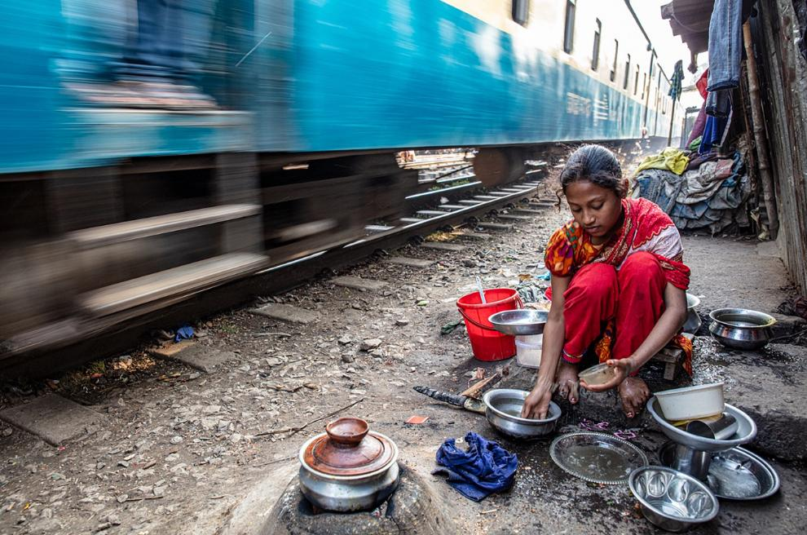
Faces of Resilience, Ingrid Keodood. 2025.
This photograph is shot outdoors in daylight, as suggested by the white sky, the brightness of the image itself and the reflection of light bouncing off the train. The exact location is unclear, it could be in a city or a small village, either way, it appears to be a small street or perhaps a train station of some sort as suggested by the tracks and moving train. It is a very small space, as implied by the very close approaching train and the wall protruding on the right side of the frame, leaving a very little gap from the train and the wall opposite.
In the background, we see a variety of fabrics, which can be seen in various positions, such as built up in piles, hung from what appear to be small lampposts, draped over buildings or construction, or scrunched up on the ground. These fabrics can be seen with a variety of different colours and textures, with the fabrics themselves appearing to be clothes or pieces of clothing.
Other objects can be seen, such as pots and pans laid out on the ground. These pots and pans appear to be empty. A red plastic bucket can also be seen near the centre of the image, alongside another plastic container, and some sort of tool on the ground in front of it. Scattered on the ground are rocks and rubble, maybe some specks of rubbish and fabric too, of various shapes and sizes.
In the top half of the frame, a blue train can be seen rolling along the tracks we see on the ground. Due to the blur of the train, clearly, it's in motion, likely moving very fast next to the figure sat on the ground.
In the centre right of the frame, a figure can be seen. A young girl, dressed in red and orange , barefoot, crouched down over pots and pans. She is sat very close to the moving train, dangerously close. She has what appears to be a small plastic container in her left hand while she touches the silver pan on the ground with her right hand. She is looking down at the ground, somewhat slumped over as she crouches. After analysing, it is apparent that she is the only person to be seen in this image. Scattered on the ground around her, we can see black matter, potentially dirt or ash surrounding her.

Slide 7
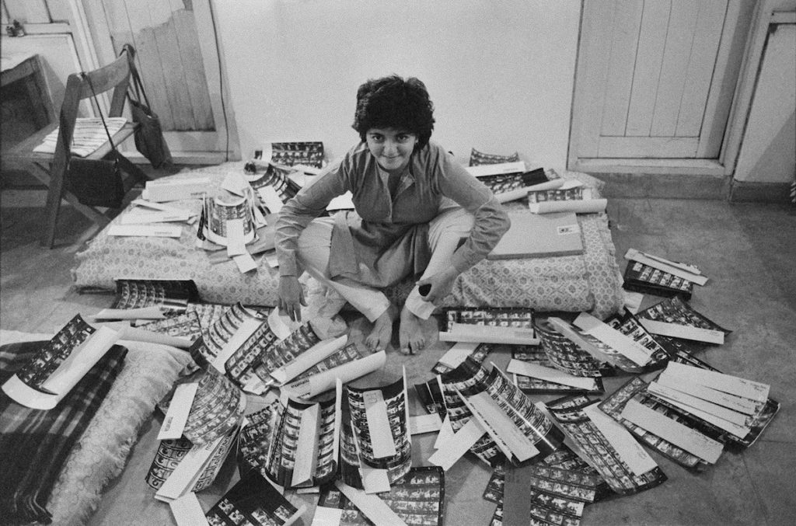
Let's See. Dayanita Singh. 2021.
This photograph is taken indoors. It appears to be in a bedroom of some sort, due to the two mattresses visible within the frame. This room has blank walls and what appear to be two wooden doors on either side of the image. The wall inbetween the two doors is completely blank.
In front of the wooden door in the upper left side of the frame, a wooden folable chair can be seen tucked aside what appears to be a small table, also appearing to be covered by a cloth or piece oif fabric. Placed directly on the chair, a small, striped cloth like item can be seen neatly folded on the seat, like a chair pad or seat cover, perhaps a piece of clothing. On the back of the chair, two handbags are hung either side. The potential contents of each bag are not displayed.
In the frame, we can see two mattresses on the floor, one central to the frame and one matress corner emerging from the lower left side. Each mattress appear to have the same bedding on them, with seemingly identical patterns and details to be seen if observed closely, both with ruffles on the right side of each mattress. On one mattress, there appears to be an object to the right of the figure in the centre. It looks a lot like a laptop, book or folder, although this is unclear. On the other mattress, a plaid blanket can be seen too.
There is a figure sitting central to the frame on the central mattress, looking directly into the camera straight at us. She appears to be a lady with short dark hair, a happy expression, a long-sleeved shirt and white trousers.
Sprawled out around her, are a large amount of what appear to be contact sheets. Due to their small size, what is on these contact sheets is unclear.

Slide 8
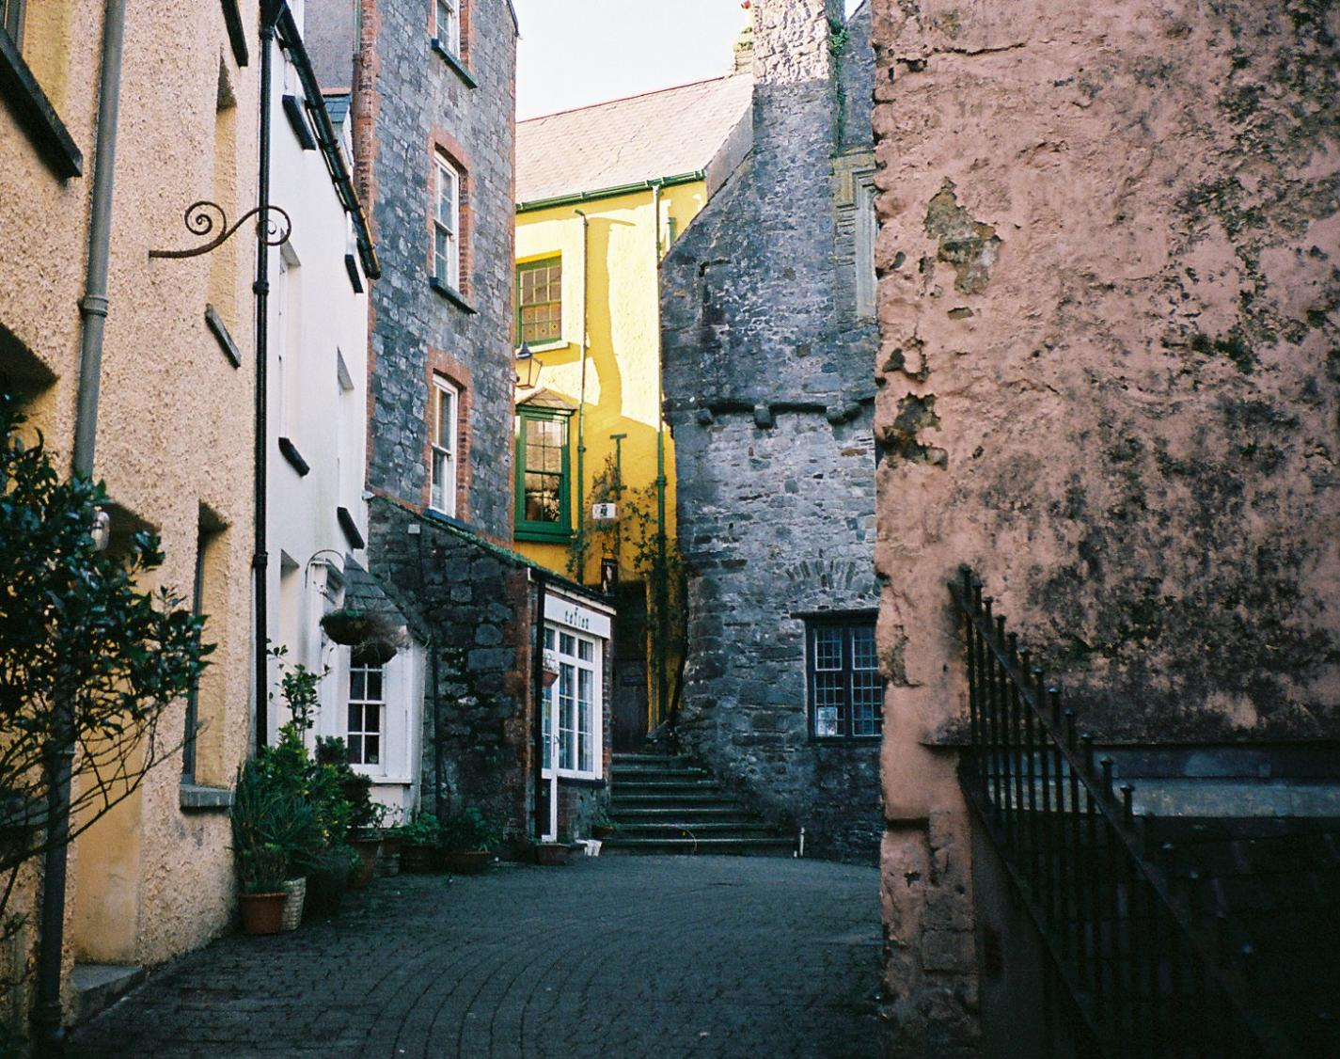
IMAGE ANALYSIS 2 - COMPOSITION

Slide 9
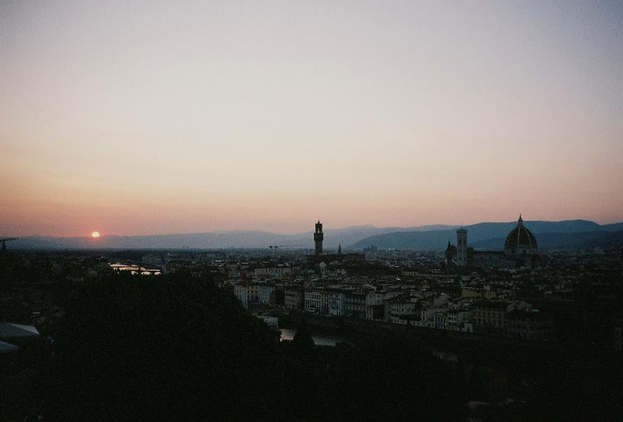
Composition
Composition is about how visual elements are arranged within the frame, typically to create a visually pleasing, meaningful and engaging image. However, some photographers also intentionally break the typical rules of composition for reasons such as creating an off putting, obscure or unique image. Elements of composition typically include focus, colour, line, tone, patterns, balance, eye-level, movement and framing.
When photographing, by using elements such as these, a photographer can be intentional with their image, such as how they want it to come across to a viewer, and can also use elements of composition to tell a story through an image. Not only is composition applicable to photography, but also various other art forms such as music, painting, film, writing and more, to create meaning and even emotion through deliberate organisation of said elements.
Familiarising oneself with and understanding elements of composition is essential as a photographer because it allows us to transform simple images into visually compelling, emotionally engaging and purposeful pieces of art. Understanding composition gives us the tools to create images that are not only visually pleasing, but meaningful and emotionally resonant, hopefully leaving an impression on the viewer.
Understanding composition helps enhance our confidence as photographers and our careers within the industry by giving us creative control and by allowing us to produce better and more meaningful work, in which betters our success and reputation within the industry, specifically regarding our skills and our reputation amongst clients looking for photographers.
Composition can have profound impacts on a photograph, as it influences how the photograph is delivered and perceived, by altering various factors such as the photographs, mood, focus and balance.
In this landscape image of Florence at sunset taken by myself, various elements such as tone, balance and eye level work together to create a calming, reflective and visually harmonious image. The warm toned of the sunset contrast with the darker city below, showing depth to the image, while the balanced placement of the sun and the Duomo on the opposite side of the frame guide the viewers eye smoothly throughout the frame.

Slide 10
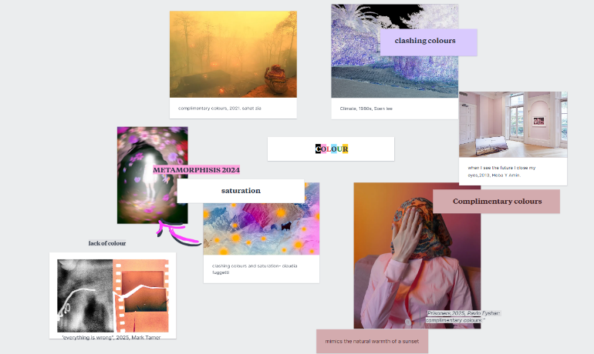
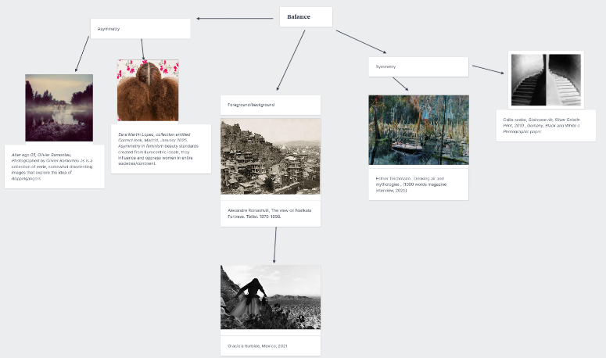
Mood board
Colour
Focus
This group focus on colour as their method of composition. They have a display of images displaying various colours, such as clashing colours, complimentary colours and saturation.
This second group chose focus. They have a display of images, with various examples referring to focal point, hyper focus, depth of field and aperture.

Slide 11
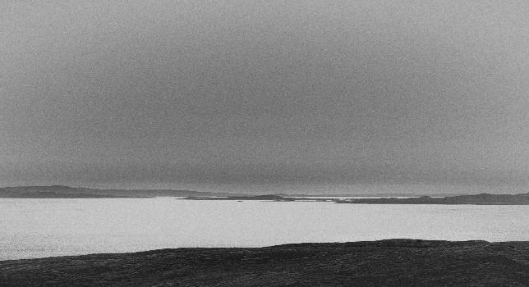
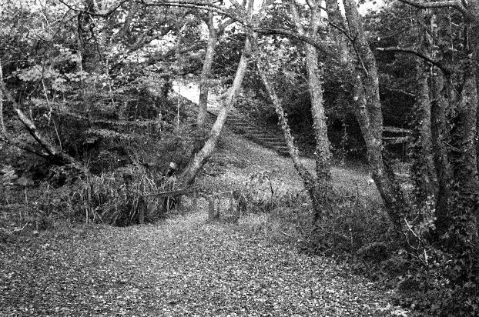
LINE
Leading Line
Leading lines are where natural or constructed lines in an image guide the viewers eye toward a specific point, often the main subject or some form of focal point. Examples can be roads, fences, shadows, branches or architectural elements.
Diagonals
This is where slanted lines can add a sense of motion or direction to an image. These lines can also be both natural or human made and are typically used to draw the viewers eye through the frame in a specific way.
Horizon
Horizon is an element that represents the line, typically horizontal, that helps convey a sense of depth in a landscape, allowing a scene to feel spacious and open.
Eye-line
Eyeline typically refers to the direction a person or subject is looking in the photo. It typically guides where the viewer looks and can potentially show what the subject is focused on or feeling.
Gaia is Here to Stay, 2025. Geralda Odinot

Slide 12
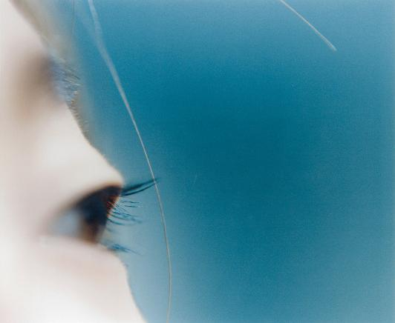
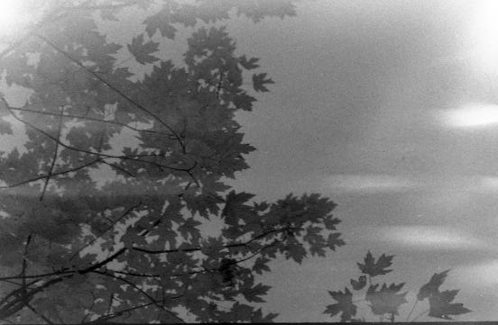
SHAPE
Form – 3D
This refers to how an objects three-dimensional shape is shown in an image. It is created by using a combination of light, shadow and perspective to make subjects appear solid and realistic rather than flat (2-dimensional).
Geometric
Geometric represents how shapes such as circles, squares, triangles and lines are used in an image. These shapes can create a sense of order, balance and strength within in image and are typically human made or architectural structures as opposed to natural occurrences that are captured.
Biomorphic
Biomorphic refers to shapes or forms that resemble living or naturally occurring things, such as plants, animals and the human body. Biomorphic elements are typically used to create a natural and harmonious image.
Negative Space
Negative space is the empty or open area that can be seen within a photograph. It's often plain and uncluttered and is typically used to make the focal point of the image stand out or give the image a sense of balance and simplicity.
Untitled, 2004. Kawauchi Rinko

Slide 13
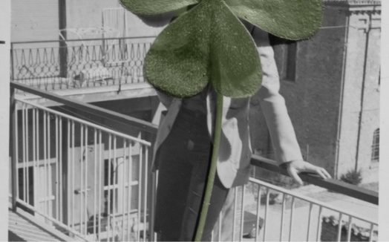
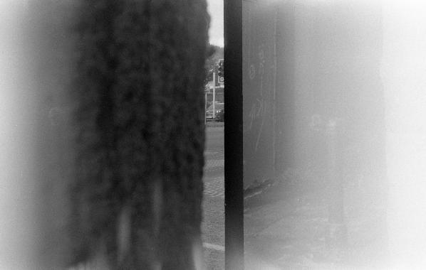
TONE
High Contrast
High contrast refers to images with a strong difference between light and dark areas. Bright highlights and dark shadows can help create a bold, dramatic and eye-catching image. We also use this to add intensity and evoke emotion in photographs.
Low Contrast
As opposed to high contrast, low contrast means that instead of a distinct difference between light and dark, there is a subtle difference between light and dark. Low contrast can be used to create a softer, gentler look.
Monotone
Monotone refers to an image made up of only one colour or hue, along with its shades or tints. It is similar to black and white photography but can use any single colour. Typically used to draw attention to shape, texture and composition rather than colour variety, and can even evoke a specific mood or atmosphere, such as warmth or calmness.
Temperature
Temperature refers to the warmth or coolness within an image, due to its colours, usually controlled by settings in the camera used to capture said image. We can use temperature to set a specific mood within a photo or to create harmony or contrast within the image.
Ouroboros, 2025. Tommaso Moni

Slide 14
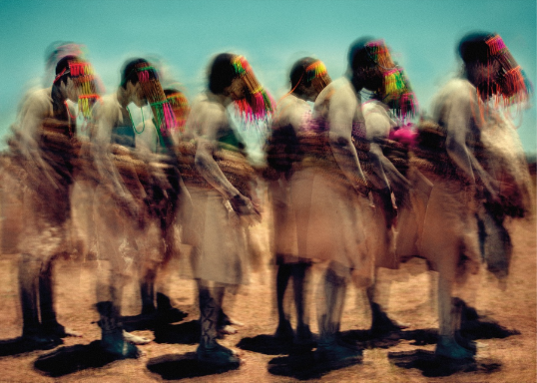
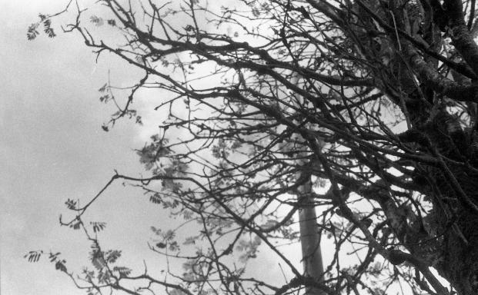
PATTERN
Texture
Texture refers to the visual appearance of the quality of an image. Texture is used in photography to add depth and to draw attention, as images with interesting texture are typically more engaging.
Repetition
In photography, repetition is when lines, shapes or colours are used to create a pattern. We create patterns for reasons such as adding rhythm to an image or even to portray a metaphor.
Pattern-break
Pattern-break is where a repeated pattern is interrupted by something different, such as a different colour, a sudden change of shape or something that stands out from the rest. This is a good way to draw attention to a focal point and to create an interesting photo, typically emphasising individuality.
Film-Grain/Digital-noise
Both film-grain and digital-noise refer to the visual texture or markings that appear in a photograph.
Juxtaposition
Placing images close to one another can help us to build a visual story or draw attention to key elements within a scene.
Motion and Emotion, 2025. Adam Docker

Slide 15
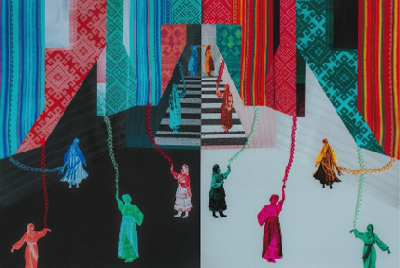
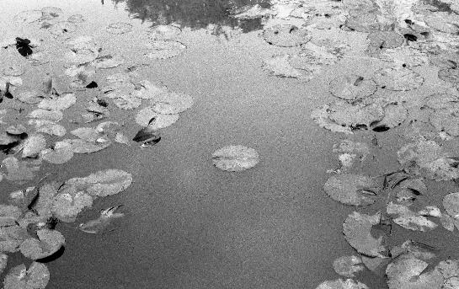
BALANCE
Symmetry
We use symmetry to create a sense of harmony and order within a photograph. We achieve this by mirroring or closely balancing both sides of an image to reflect one another.
Asymmetry
As opposed to symmetry, asymmetry refers to the uneven balance between elements in a photograph, which can allow us to create visual tension and interest. It typically draws the viewers eye across the frame, making the composition feel more natural in comparison to symmetrical imagery.
Foreground/Background
Foreground and background refer to the areas closest to and farthest from the camera. Maintaining balance between the two tends to add depth, context and balance to a photograph.
Identity, 2024. Tany Pototska

Slide 16

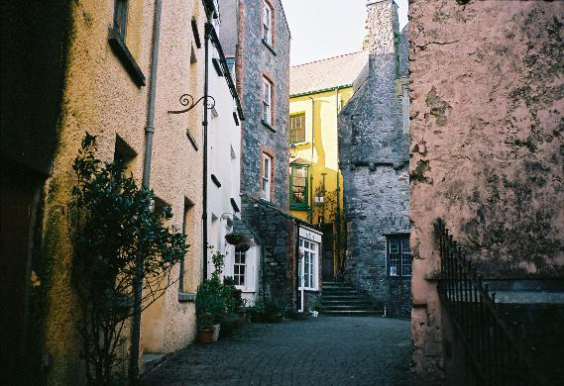
COLOUR
Complimentary Colours
Not only are complimentary colours pleasing to the eye, but they create a strong contrast, balance and vibrancy to a photograph. Complimentary colours are pairs of colours opposite to each other on a colour wheel, and when paired together, can create a vibrant and visually pleasing image.
Clashing Colours
Clashing colours in photography are colours that strongly contrast or conflict with each other. They're used to create visual tension and can make for a bold, eye-catching and striking image.
Saturation
Saturation refers to the intensity of the colours seen within an image, with high saturation making colours look vivid or bold, and with low saturation creating a softer, more natural or muted appearance.
Wall of Nature, 2025. Viet Ha Tran

Slide 17
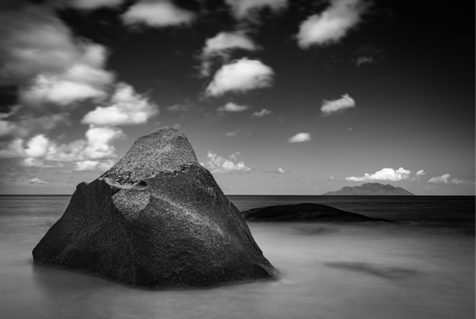
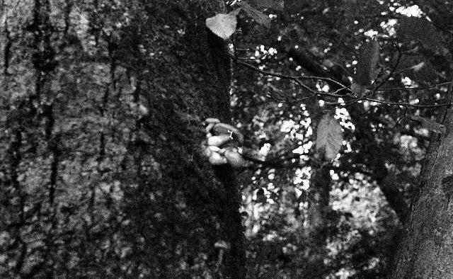
FRAMING
Sub-framing
Sub framing is when the main subject or focal point within an image is framed within another element in the scene, such as a window or doorway. It is a great way to make a photograph more interesting, engaging, artistic and layered.
Rule of Thirds
A popular composition technique involving aligning key elements with the grid lines of a frame to create a balanced composition. This technique makes an image feel more natural and visually appealing to the human eye.
Golden Ratio
A composition principle based on a naturally balanced proportion. This is done by placing key elements along the spiral or grid of a frame, which allows an image to feel more balanced and visually pleasing.
How to Practice Meditative photography, 2025. ArtDoc

Slide 18
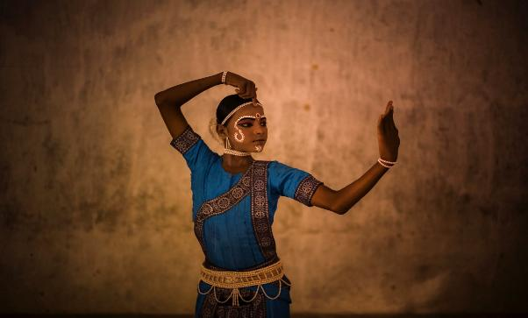
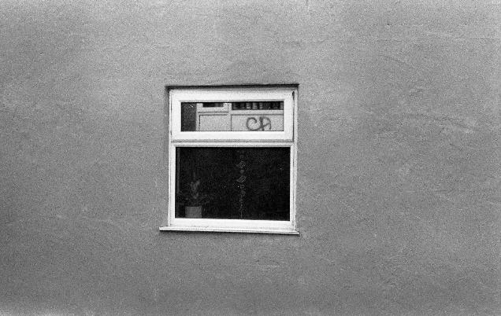
FOCUS
Focal Point
The focal point refers to the main area of interest/element within an image. It is typically the first thing a viewer will notice, and gives the image a sense of clarity, balance and a clearer visual purpose.
Depth of Field
Depth of field is the range of distance that appears sharp and within focus. A shallow depth of field highlights/sharpens the main subject whilst blurring out the background, whereas a deep depth of field keeps most of the image sharp, detailed and in focus. The depth of field can be used to enhance specific elements and add context to a photograph.
Hyperfocal Distance
Refers to the combination of focus and aperture settings that produces the widest depth of field, keeping most of the screen sharp, which adds realism and a sense of depth, though results may vary depending on the lens used.
Gotipua, 2025. Lucas Dragone

Slide 19
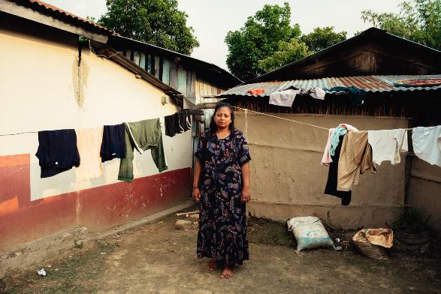
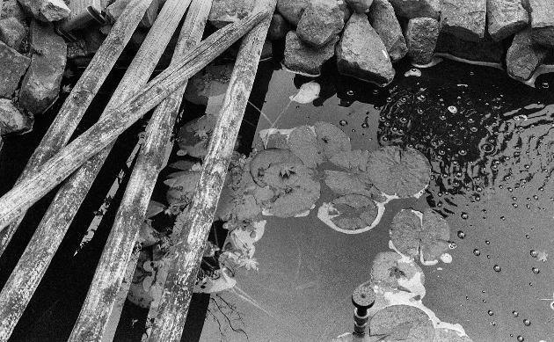
POSITION/VIEWPOINT
Eye-level
A camera angle positioned at the subject's eye height. It creates a natural, balanced perspective that helps the viewer meet the subjects gaze, making the subject easier to connect with.
Above
When a camera is positioned above facing downwards on a subject or scene. This viewpoint can be used to add context or a story to an image, by making the elements in the photo appear smaller or more vulnerable.
Below
On the contrary to above angles, photos taken from a lower angle looking upwards at a scene or subject can be used to make a subject or focal point appear larger, taller, stronger or more powerful, which can evoke emotion and add drama to an image.
Coming Home, 2025. Carolina Ludwig Agudelo

Slide 20

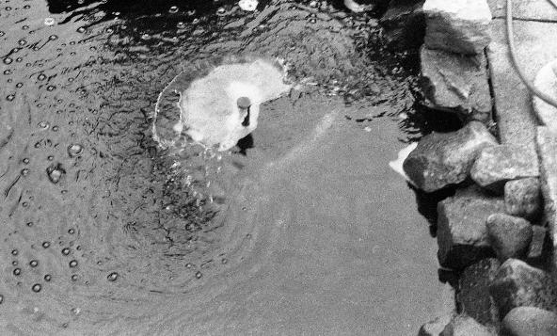
MOVEMENT
Frozen (High Shutter speed)
Using a higher shutter speed allows us to capture a split second of a moment, making subjects appear still and sharply defined. It emphasises detail, and is typically used in sports photography, nature photography or generally when a photographer wants to capture a fast-moving subject in detail.
Blur (Lower shutter speed)
As opposed to fast shutter speed, slow shutter speed gives us that blurry effect, making certain or all elements in a photo appear soft or out of focus. Can convey motion, speed and mood.
Long Exposure
This is where the cameras shutter stays open for an extended amount of time, capturing a movement over the course of this duration. It helps to create effects such as smooth water, light trails or motion blur. Can add an artistic and atmospheric feel to an image, giving it a sense of flow.
Enchanted Nature, 2025. Samuele Quaranta

Slide 21
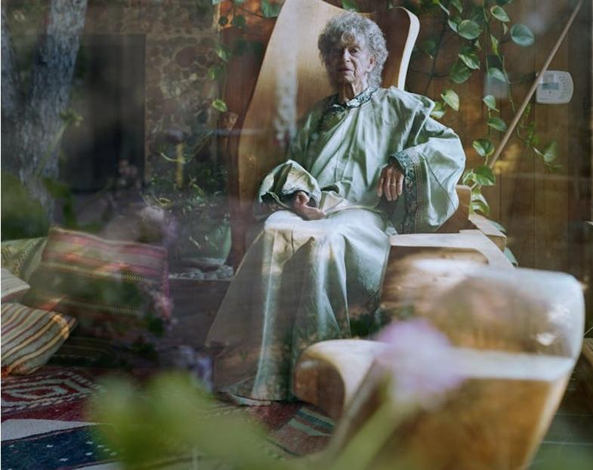
IMAGE ANALYSIS
3 – CONTEXT
Anna. Kentfield, California, 2017. Alec Soth

Slide 22
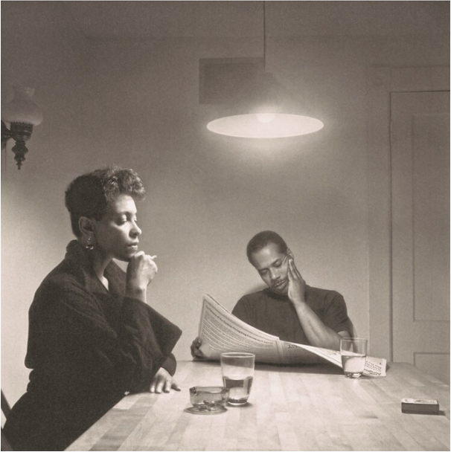
Context - definition
Context helps us to piece together the meaning behind an image. We can piece this together by looking at elements, such as the contents of an image itself but also by considering the range of conditions outside of the photograph. By considering both inside and outside elements of an image, we can better understand the meaning behind a photograph.
When it comes to content and composition, they both work together with context to shape how an image communicates meaning. The content of an image establishes what is visible to the viewer, whilst the composition arranges those elements to guide attention and influence interpretation. These choices can reveal context, by using any subjects included, the angle used and the environment of which the photograph was taken, all hint at the circumstances in why an image was made, such as any potential messages the photographer may be attempting to deliver through the art of photography.
We all interpret photographs differently due to our own individualism as viewers. Our contexts as viewers are typically shaped by our own individual beliefs, knowledge, experiences and culture, all of which can significantly influence how we interpret an image or piece of art. An example of this is how personal experiences can heighten sensitivity to certain subjects. One image can provoke a deep emotional reaction in one viewer and can provoke little to no reaction in the next viewer, depending on each viewers experiences and emotional states as individuals.
Additionally, historical context influences how an image is understood, as overtime, meanings can shift when viewed in different eras or in relation to specific events. Religious and cultural contexts affect how symbols, gestures and subjects are read, often determining what is considered respectful and significant. Social context frames how viewers relate to an image, depending on their class, community values and political views. Personal contexts further shapes interpretation, depending on a person's individual experiences, memories and personal biases.
The meaning of a photograph emerges from the combination of content, composition and context, and both the photographer's circumstances and the viewers own cultural, social and personal backgrounds continually shape how an image is interpreted.
Kitchen Table Series, 1990. Carrie Mae Weems

Slide 23
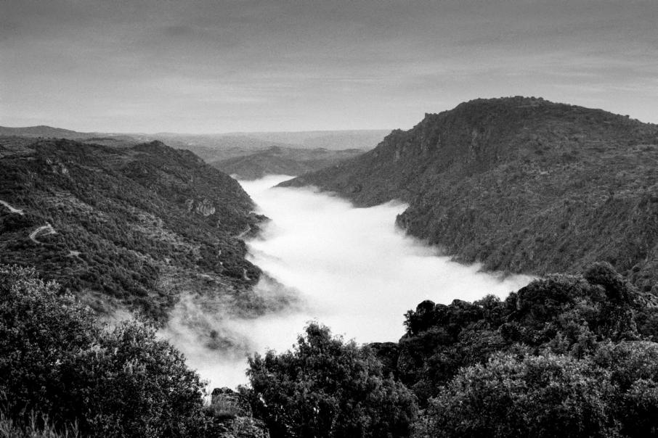
Tras-os-Montos, 2025. Paulo Monteiro
Visible contexts refer to the observable and immediate elements present within a photograph that help us as viewers interpret a scene. It includes the physical environment, such as the location or background which makes it typically obvious to the viewer what the meaning of photograph is, or what it's of. Other details such as props, people and various other visible elements also provide additional clues as to what is happening in the photograph, and what message the photographer is trying to deliver through the image. Visible elements help us to decipher the meaning of an image. When analysing the visible contexts of an image, we typically ask ourselves what the image is communicating, and we as photographers can use visible contexts as tools to communicate quickly with our audience, helping us to better portray what we want to deliver through our art.
Tras-os-Montos, 2025. Paulo Monteiro

Slide 24
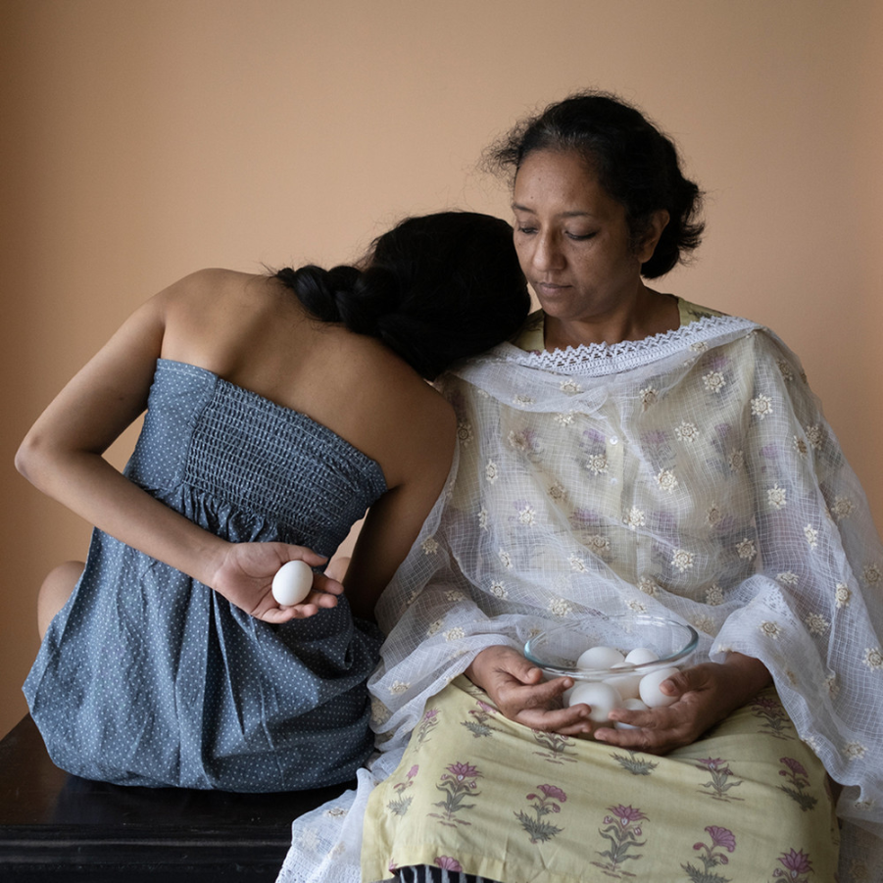
Things I can't say out loud, Riti Sengupta. 2023.
Invisible contexts in photography refer to the layers of meaning that shape a photograph but are not immediately obvious within the image itself. These contexts exist beyond what the camera captures alone. Invisible contexts often guide how a photograph is created and how it should be read, yet they remain unstated, embedded in symbolism, posture, atmosphere and other methods of composition rather than explicit action. They prompt the viewer to look beyond the surface to understand the meaning behind an image, the kind of message the photographer is trying to deliver, such as other tensions, traditions are operating underneath. In order to understand the meaning of an image with invisible contexts, it is useful to learn more about the photographer themselves and seek further information regarding the inspiration behind the shoot/image, as the meaning will be unlikely to work out alone given invisible contexts.
In Riti Sengupta's work, the invisible contexts are deeply personal. Within this photo series "Things I Can't Say Out Loud", Sengupta shares her experience moving back home during the pandemic. During her return, she confronted long-standing frustrations about gender expectations within her family. Her photographs within this series are shaped by emotional friction, by witnessing her mother's exhaustion, and the feelings of pain and resentment that can happen because of living in a family where traditional gender roles are still a prominent tradition.
Social and religious contexts also shape her work, as in many Indian households, across religions, women are expected to carry out domestic labour and accept motherhood as inevitable. These norms, rooted in patriarchal social structures and reinforced through cultural and sometimes religious expectations, create pressure that is rarely talked about, but felt deeply.
Things I can't say out loud, 2023. Riti Sengupta

Slide 25
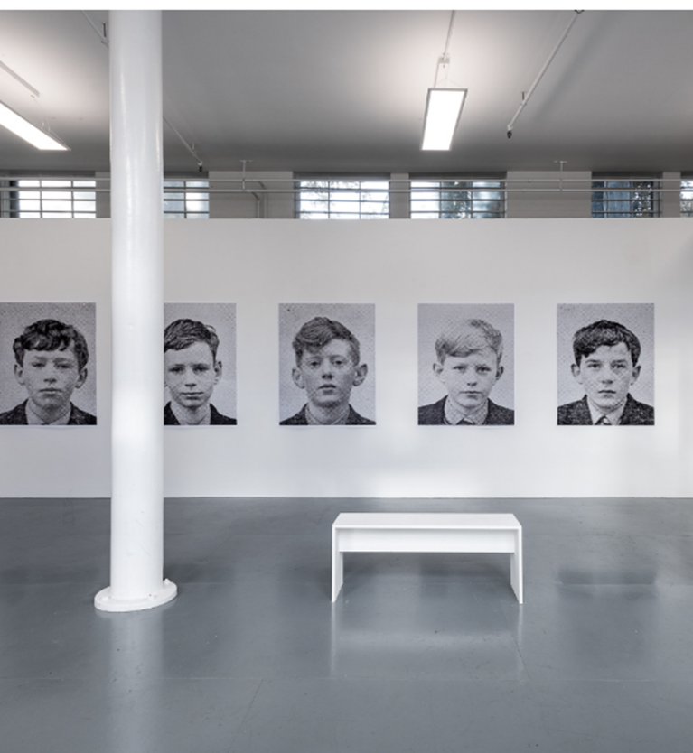
No Country for Young Men, 2021. Martin Seeds
Context derived from the presentation are those shaped not by what is photographed but by how the work is shown to the viewer. Presentation creates meaning through the presentation of a photograph as the presentation of an image takes intention and decision making regarding how it is showed to the viewer. Presentation creates meaning through the decisions that frame and deliver the image, influencing interpretation before the viewer even begin to dissect the visible or invisible contexts of the work itself. For example, an image placed high above facing down on the viewer can evoke different emotions in the viewer as opposed to if the image was shrunk down to a small size and placed on the floor. It's not always about what is seen in the image itself, but the positioning and presentation of the photo can make a difference in how it is perceived.
Featured here are some archival pigment prints of Martin Seeds photography, 'No Country for Young Men' . Martin Seeds is an artist and educator who grew up in Northern Ireland. Having grown up in Northern Ireland, his work is shaped by experiences of conflict, identity and belonging. He expresses his experience of this through his work by exploring the "conflicting experiences of identity, history and culture" (Seeds 2023). By extracting school portraits from the mid 1960s, Seeds here displays an array of images of young boys staring into the camera "unknowing" as "trouble awaits them as surely as night follows day" (O'Hagan 2020).
The presentation of his work in this exhibition add what I believe to be multiple layers of additional context. The enlarged portraits arranged in a quiet, white-walled space produces a contemplative, almost eerie memorial effect. Their repetition emphasises vulnerability and sameness, which makes sense given the time these images were shot. The title itself "No Country for Young Men" highlighting how the country at this time was unsuitable for young people, highlighting a childhood shapes by conflict and political instability.
Additionally, knowing that these images are from the 1960s further enhances our understanding of what was going on at the time,, as these images were taken during a period where Northern Ireland was experiencing "violent tremors" (Seeds 2023). The placement and presentation of these images transform ordinary school portraits into something that resembles to me a memorial and archival display. Due to the plain white walls and empty space, the images also stand out more prominently.
No Country for Young Men, 2021. Martin Seeds. Installation view

Slide 26
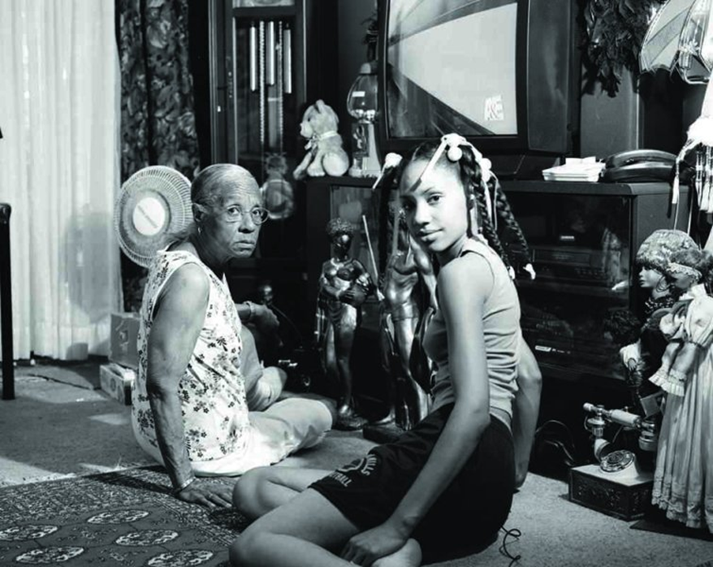
Grandma Ruby and me. LaToya Ruby Frazer. 2005. From the Notion of Family
This photograph captures a moment between a young girl and an older woman sat together in a densely decorated room. The space is rich with personal and cultural history, due to the dolls, figurines, patterned carpets that can be seen, as well as a television set creating a domestic environment that appears lived in and full of memories. The two subjects sit on the floor, turned towards the camera, their gazes direct into the lens. This dual gaze creates a powerful sense of presence, suggesting both familial closeness and displaying their shared awareness of being photographed. The contrast between the girl's youthful appearance and the elder's quiet steadiness highlight's themes of continuity, inheritance and identity, and almost a mirror or parallel between the two.

Slide 27
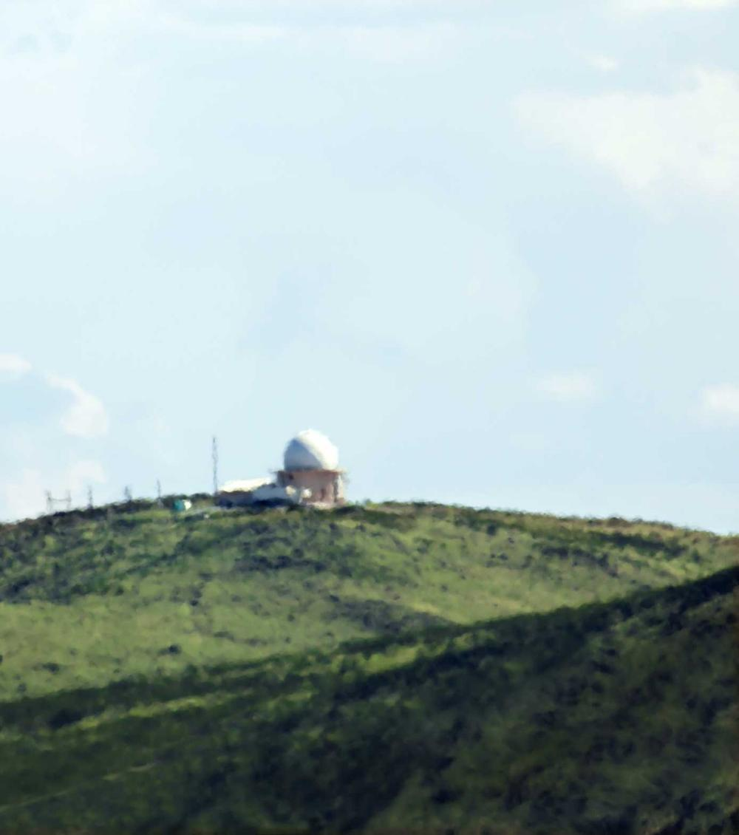
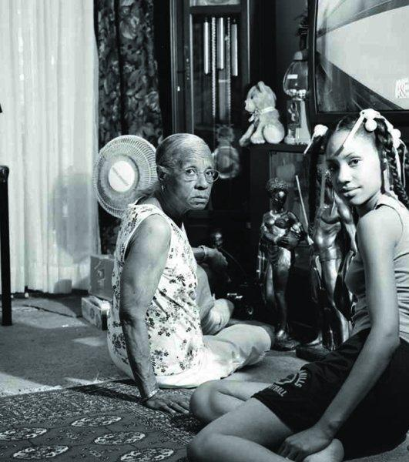
Artwork study

Slide 28
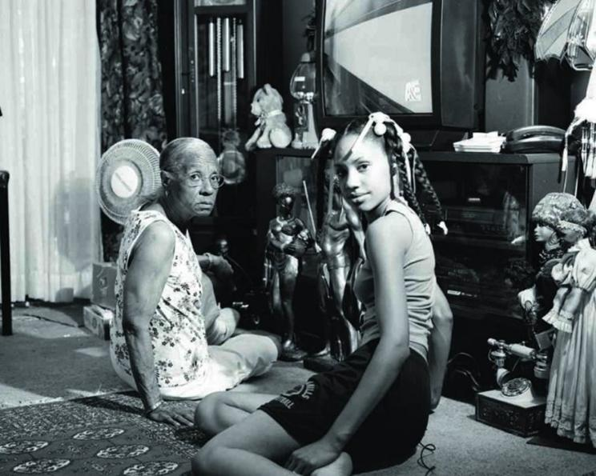
Grandma Ruby and me. LaToya Ruby Frazer. 2005. From the Notion of Family
This photograph is shot indoors, a room of which appears to be somebody's home or living quarters. Two subjects can be seen, a young girl and an elderly woman sat together, their gaze direct into the camera, they know they are being photographed. Many factors suggest this was shot in what was likely to be their home, such as the informal setting and clothing they wear, and their proximity to each other, demonstrating a close relationship. This implies that they are both comfortable and familiar with each other. The room is dense and filled with various objects, such as ornaments, popular household appliances, stuffed animals, figurines, curtains, a rug, all of which suggest a living room/living quarters. The dated television set is a clear indicator that this was likely taken a long time ago. The ornaments also have an old-fashioned appearance, implying an older time. The black and white appearance of this image also amplifies a vintage feel. The title of the photograph itself also clearly hints to what the image is, a young girl with her grandmother Ruby. A small wire or cable can also be seen to the right of the young girl in the frame, although it is not clear what it leads to, what it is in use or why it is there.
After carrying out my own independent research, I better understand this image on a deeper level. The invisible contexts of this image are rooted in family history of the women in the frame. As seen in the image, there are various figurines and antique dolls located around the room. At just a glance, these are just dolls, but after research, I now understand that these dolls are there as a result of family trauma. Grandma Ruby's dolls are not simply decorations, but emotional anchors connected to the murder of her daughter. The author describes her Grandma's Saturday rituals, the way she would tend to the dolls, to cope with her grief, perhaps to cope in painful circumstances. As the author explains, her grandmother's collection began as a way to deal with the loss, revealing how mourning is embedded in the room even if the viewer cannot understand this at first glance. Likewise, the integrational caregiving shapes the relationship between the two subjects within the frame. Knowing that this image was taken by the girl within the frame, the small wire close to her perhaps suggests a shutter release device she is using to take the image, as it disappears off frame toward where the camera is positioned.
As somebody who was raised by my own grandparents, this image resonates with me, as I have had my own personal experiences with growing up in a household with this dynamic. By discovering more about the authors story and her relationship with her grandmother, I feel very similarly to Frazer, as she speaks on her own personal feelings toward her grandmother, the respect she feels for her and her gratitude for having been raised by her. This image, knowing what I now know, evokes both tenderness and sadness within me, especially due to the meaning behind Ruby's dolls. It serves as reminder to me that even when it comes to common objects we as people overlook every day, there is almost always much more to what meets the immediate eye, and it inspires me to approach the world and its intricate details with more curiosity. You never know what items have a story to be told.
The deliberate, staged yet intimate setup of this image creates a context of intentional self-representation rather than passive documentation. The apparent shutter release in her hand blends both portraiture with self-portraiture, as not only is her grandma in the frame, but she, the photographer herself, is also a focal point within the image. With both Frazer and her grandmother staring directly into the lens, it demonstrates mutual awareness and connection with the viewer. This method fosters a sense of intimacy with the viewer and feels much more direct as opposed to if the image was shot with the subjects looking off frame. The interior of this room, crowded with dolls, figurines, patterned textiles and old technical appliances such as the television and home phones creates a context of domesticity, the visual richness reflecting a lived in space. The black and white photography, whether chosen or default, adds a timeless feel. It removes the distraction of colour and emphasises textures. The inclusion of two generations in one frame creates a context of integrational continuity, and symmetry. Finally, their positioning and postures on the floor, such as their slouched, relaxed and unposed body language suggests that tis photo was likely improvised, casual and creates a context of everyday life, grounding the image in realism as opposed to an extravagant, artistic or intentional setup. These methods all work together to frame this image as a self-aware family portrait that communicates memory, loss, resilience, connection and speaks to the deep, complicated relationships between family, particularly families who have experienced great hardship.
https://www.theguardian.com/artanddesign/2018/aug/23/latoya-ruby-frazier-best-photograph-grandma-ruby

Slide 29
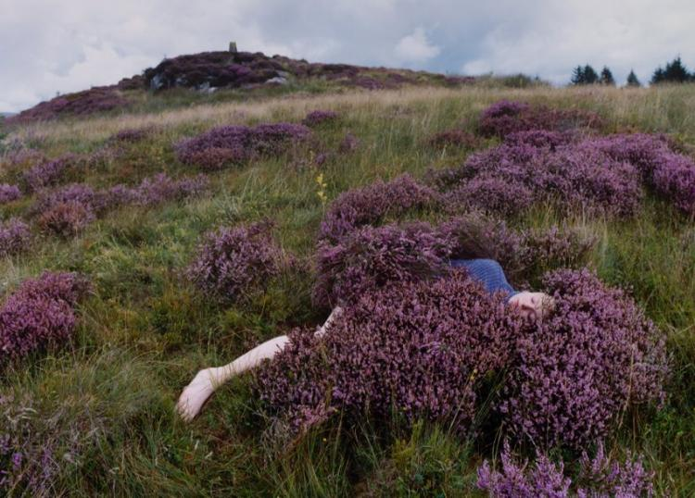
Charly on the moor. Camille Lemoine. From Down Tower Road
This image is shot outdoors on a gloomy day. The location appears to be a field, with bushes of lavender sprouting throughout the grass. The grass itself appears overgrown and wild, suggesting a wild and untamed place I nature. The bushes are bustling with lavender as well as wildflowers growing at random amongst the grass. Trees can be seen in the far right of the frame, as well as a hill on the left side of the frame. Although unclear, the far background, on top of the hill, there appears to be a statue or monument of some sort. This small hill is also covered with fluffy bushes of lavender and grass. In the centre of the frame, a tall but dainty plant can be seen, perhaps a yellow flower. In the foreground of the frame, a figure can be seen laying in a large lavender bush. She is embedded in the lavender, with only her head, right shoulder, leg and foot visible to the viewer. The figure appears to be a young woman, with her eyes closed and a neutral expression on her face, implying calmness and contentment. She wears a blue, woollen jumper and is barefoot.
Although this image shows a figure lying partially hidden amongst a floral bush, by reading the text provided with this series of photographs, I believe that the author is representing the way nature is being threatened today. I believe that the shrubbery around the subject's body resembles the disappearance of naturistic words "In 2007, the Oxford Junior Dictionary had started to replace nature-related words such as ‘acorn’ and ‘heather’ with words such as ‘broadband’ and ‘chatroom’" (Wright, 2025). This image is not just a figure laying in on a field but is a response to the "loss of knowledge" that "risks a loss of meaning" (Wright, 2025). Additionally, the body nestled into the heather suggests physical closeness to the land, speaking to the photographer's own relationship with the place where she grew up. Lemoine explains how she has "been thinking about my work as a way of remembering or preserving this more-than-physical connection we have with the land,” (Lemoine, 2025), and she expresses this through this image, by displaying one who is truly intertwined with the surrounding nature.
The calm, content appearance of the woman lying in the bush also sets the impression that she is comfortable and familiar with this environment. This visible context is confirmed with invisible context, Wright writes on Lemoine's explanation for this shoot, with Lemoine stating that "It was important to me that the locations I shot in were ones that I had grown alongside over the past 20 years.” (Lemoine, 2025), affirming the photographer's connection with the environment. This context is also portrayed by the look of contentment and peace by the demeanour and expression of the subject within the frame.
Not only do I enjoy this image, but I am fond of the entire project. This photographic series does a beautiful job of using visually pleasing images to offer an intimate re-encounter with the natural world at a time where closeness and the overall appreciation for nature is growing increasingly rare. The images don’t just depict beautiful settings, but the style of this image in particular reinforces to me a sense of belonging when it comes to nature, reminding me of the emotional and sensory bonds I made with nature by growing up and making memories outdoors. This series has a dreamlike feel, and makes me feel calm, happy, and inspires me to slow down and reconnevct with nature myself on a more regular basis. I sometimes forget that some of the most joyful and grounding experiences can simply be found outside, this series serves as my reminder to appreciate what we as people often overlook.
Down Tower Road - Photographs by Camille Lemoine | Essay by Sophie Wright | | | LensCulture

Slide 30
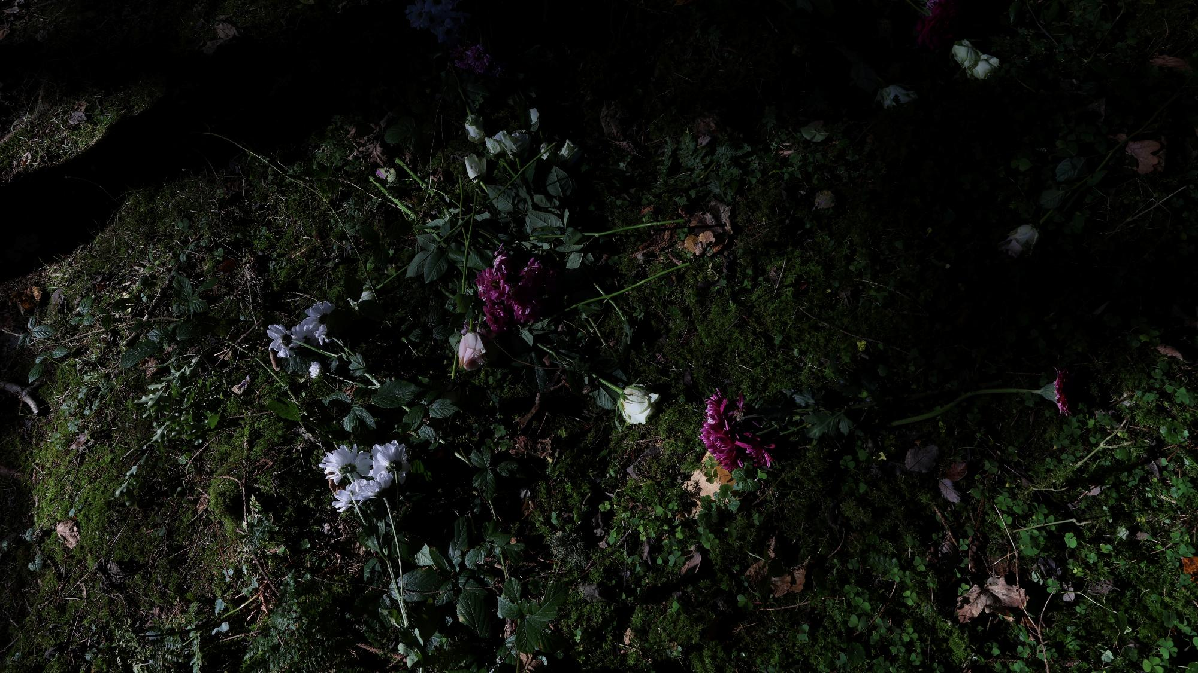
PROJECT CYCLE-
Planning/Documenting

Slide 31
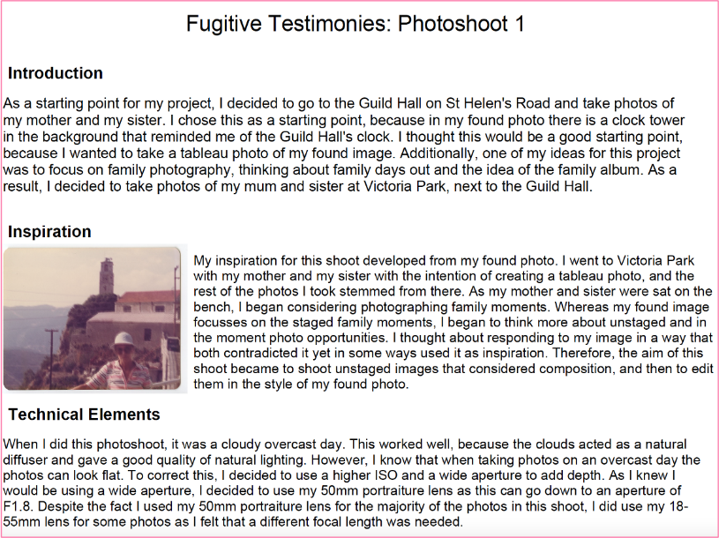
Planning and documenting
Planning a shoot is important because it helps us to clarify clear goals and helps to ensure that everyone involved understands what is required of them in order for the shoot to be successful. When it comes to a shoot, it is important to define certain details as early as possible, such as precisely what equipment will be need, who the subjects are if required, the location, date, time, and the aim of the shoot. Planning is also vital when it comes to preparing for potential challenges and is also essential for efficient organisation. Planning for a shoot is essential if one wants the shoot to run as smoothly as possible, reduce stress, improve efficiency and capture high quality, more consistent results on the day of the shoot instead of being disorganised and hoping for the best.
Alike, planning, documenting a shoot can also be very useful for various reasons. Documenting is good for showing a clear record of what is done during the shoot, how things are done and why certain decisions were made during the shoot. This helps the photographer with continuity and very importantly, reflection later on, which can be used to improve future shoots by learning from any setbacks faced or mistakes made. Documenting can also be useful to those working in teams, it can boost communication and provides evidence for potential clients, such as defining budgets too.
Knowing one's aim is important when planning a shoot, it is useful that a photographer knows their specific aim or goal when it comes to the shoot itself. What message do they want to portray? What vibe are they going to try and curate? If there are symbolisms, how will they display this through the image and by using what contexts? Defining the purpose of a shoot before it takes place helps us to form a direction and further helps us to plan our shoot.
It is also important to know how long a shoot will take, considering not only the shoot itself, but transportation needed to get to a specific shooting location, the time it takes to prepare equipment and hire models. Will the shoot be quick and simple or will it be extensive?
Of course, a shoot cannot take place without obtaining the appropriate kit to do so. This includes not only the camera, but also what lenses will be needed, lighting, tripods, reflectors and whatever other equipment will be necessary in order for the shoot to be a success.
Research is important because it turns a photography shoot from a spontaneous attempt to a controlled creative process.
Correspondence is important because it helps us to combine research, concept and practical choices so that we can make photographs that are effective when communicating their intended messages/symbolism.
Determining the location of a shoot is of course crucial as we need to know where to go to get the shoot started. It is also important to note that the location of a shoot can indeed effect other aspects of planning, such as the equipment that will be appropriate in certain conditions and timescale.
Within this student example, they state clearly their initial intentions for the shoot, the overall goal, the style of images they wanted to create and explain why. Not only do they clearly define their photographic goal, but they also provide details with how they shot their image, by sharing details on their camera settings. They also are specific about the location in which they shot, along with the weather on the day and how they feel it benefitted their shoot.

Slide 32
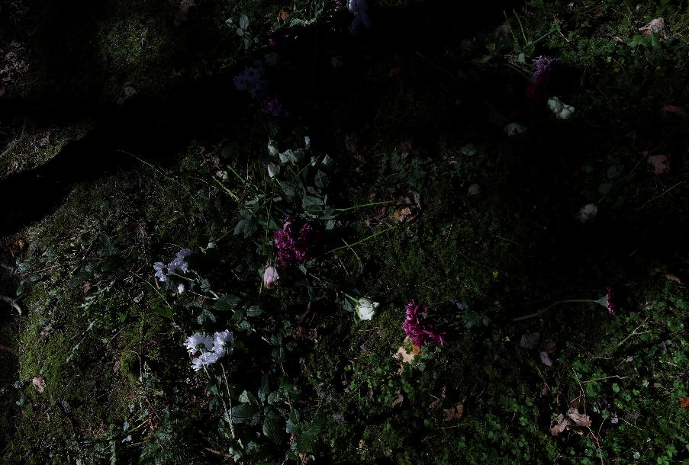
Planning your next roll of film
For my next roll of film, I intend to shoot waterfalls, my reason for doing so is that I would like to better my shutter speed skills on a film camera, so running water will be my subject to practice on. I will experiment with both fast and slow shutter speed to create both blurred and defined water.
Regarding its timescale, it will take a few days from start (collecting and loading my film) to complete the project (develop my film). I will give myself approximately a week to do this. This time frame will allow me to travel to different waterfall destinations, taking the opportunity to shoot in different places at different angles, in different weather conditions.
As for kit, I will be using a film camera, colour film, and a light meter, as I would like some further practice using this device. When it comes to loading my film, I will do so with one of my lecturers so that they can help ensure that I load it correctly for shooting, as I have struggled with loading correctly previously.
For research, I will be researching for various waterfalls in my area, big and small, tall and short, do that I know which location to visit each day.
In order to develop my film, I will use my university developing and dark room to develop, create a contact sheet and enlarge my images so that I can evaluate my strengths and weaknesses.

Slide 33
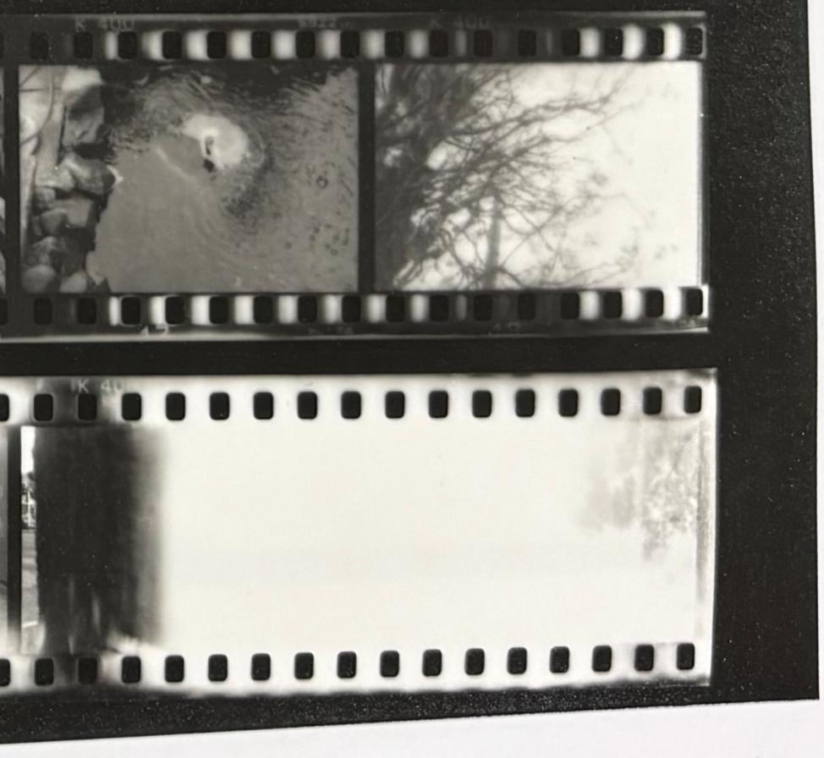
Documenting your roll of film
My roll of film had some promising images but could have been much better overall. I am still yet to master the exposure triangle using film cameras. Planning impacted my work by giving me a clearer sense of direction when it came to what I was shooting. As opposed to previous attempts where I would walk around snapping pictures of any random scene in front of me, I walked around with a clear intention and specific scene in mind to capture. I did achieve my aim by shooting waterfalls and running water, and I also can see now images that were not developed properly.
My technical practice needs a lot more work, but practising and reflecting is what is going to help me strengthen my photography skills overtime.

Slide 34
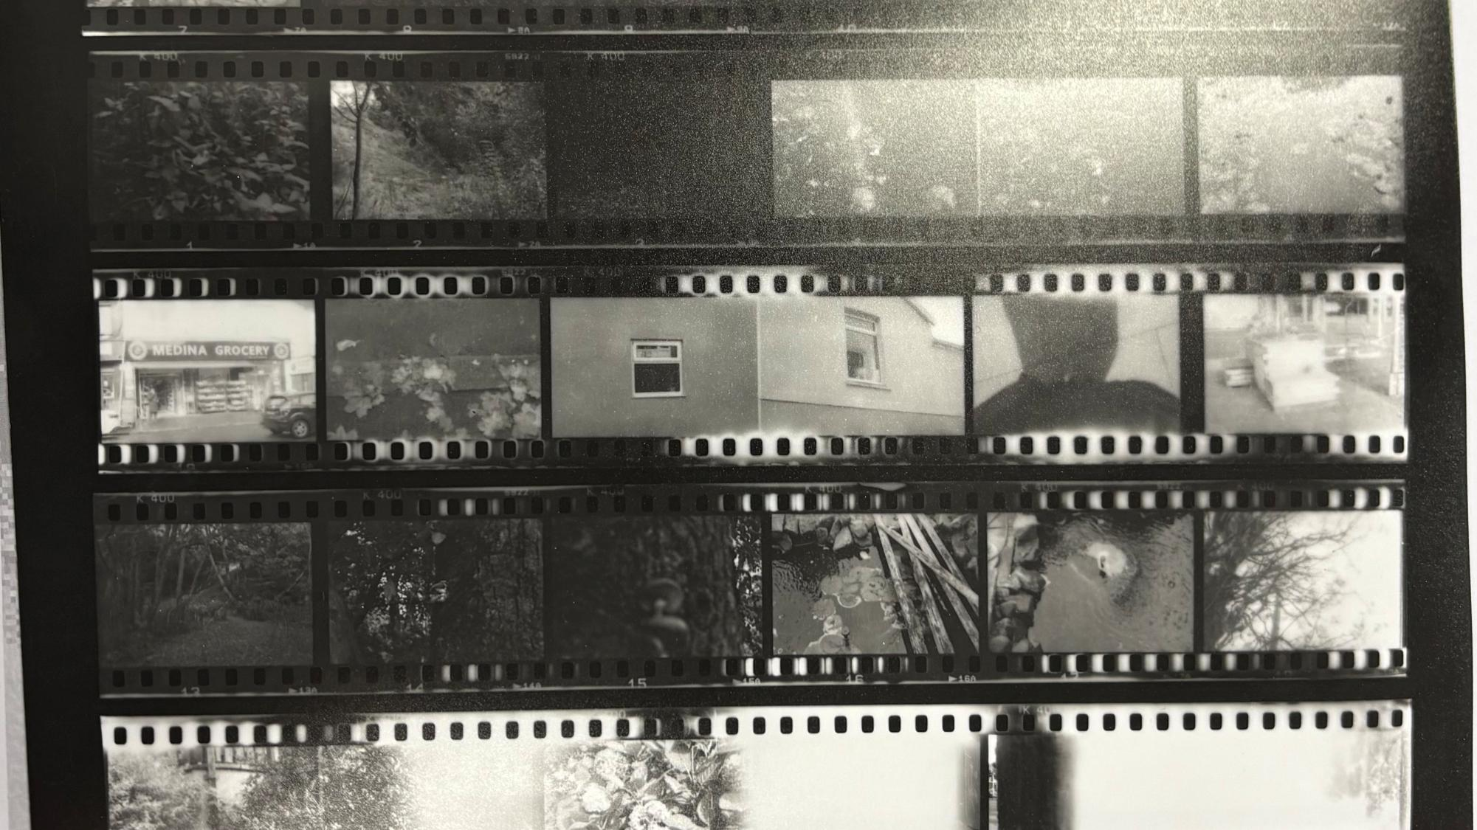
PROJECT CYCLE-
Contact Sheets

Slide 35
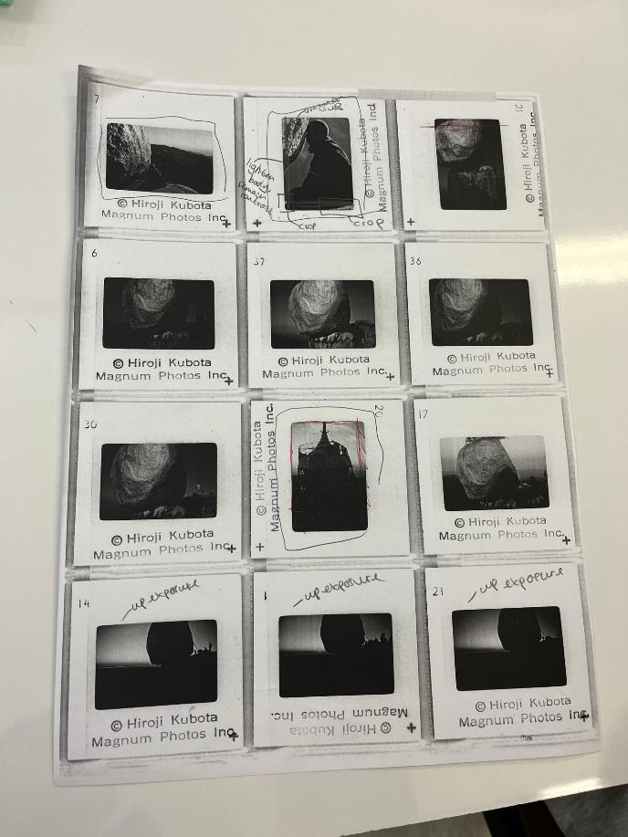
Contact sheets
A contact sheet is a single page that contains multiple images all together on one sheet, typically arranged in rows. It is popular in film photography, when we as photographers place negatives directly onto darkroom paper, expose it to light and create a contact prints. They are also useful in digital photography, to review multiple images at once, of which we do for multiple reasons.
Contact sheets are a good way to compare similar shots and review our work. It helps us to better understand our strengths and areas for improvement when it comes to our photographic skills. It does this by quickly highlighting hat images are sharp, blurred, overexposed, underexposed, and which images need further editing/tweaking to improve the overall quality.
A contact sheet helps us to quickly scan all our images, compare our shots, pick the strongest ones and make note of those in need of improvement. After we mark our favourites, we ten open the full-size versions and edit as we see fit to improve the quality of our images. It makes the selection process more straightforward.
Regarding my roll of film, I found it quite difficult to grasp initially, and I am still learning and yet to master the art of film photography. I knew that I wanted to shoot nature outdoor, however I did not take into consideration how shooting outside would require different exposure settings as opposed to shooting indoors, hence the multiple underexposed images on my contact sheet. I went through two whole rolls of fil before I managed to develop one successfully. The first, I exposed to light before processing. The second, tore in half inside of the camera due to me attempting to unload it incorrectly. The third, although still not perfect, I managed to unload and develop. I am still adjusting to working in pitch black to transfer my roll of fil to the development tanks. Once I had developed my contact sheet, it instantly showed me what I need to work on to better the quality of my film photography in future, such as which frames were underexposed, overexposed and out of focus. Although there were multiple clear images, most of them need additional editing to better their quality.
When it comes to digital and analogue processes, analogue is teaching me the importance of patience, as well as the experience of trial and error. With digital, I find it more straightforward as opposed to analogue. Reasons for this being that the results are immediate, being given the option to shoot manually and receiving prompts from the camera (depending on what camera is being used), having the ability to instantly delete photos I don't like and keep the ones I like. With analogue, the result of my photographs are completely down to me and my photographic skills alone. Analogue also does not give us the option to instantly view our photos after shooting, as these images need to go through the development process before we can even begin to see our work. Due to this, we cannot simple just delete the images we don’t like either, however, this is in itself is useful, as previously mentioned, seeing images we would typically delete on our digital cameras in front of us on our contact sheets forces us to analyse and reflect on our mistakes made when shooting, bettering our understanding of our own skills and weak points as photographers. Analogue is a very practical process, requiring precision and skill, whereas digital photography is more immediate.

Slide 36
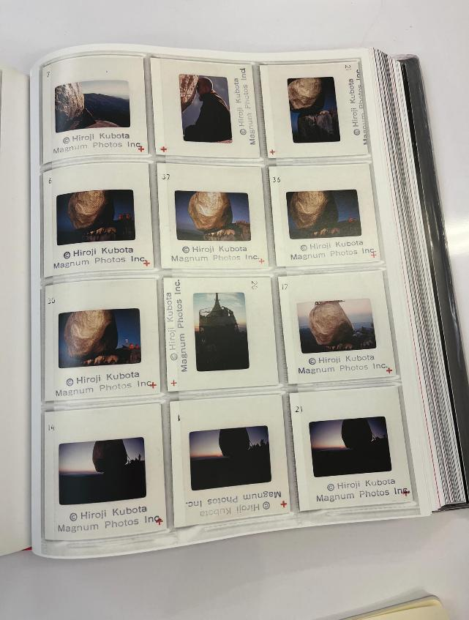
Task 1A
This contact sheet was found in a Magnum photography book. This photographic series is The Golden Rock at Shwe Pyi Daw project by Hiroji Kubota, taken in Kyaiktiyo, Burma. Throughout his career he travelled extensively, documenting landscapes, cultures and iconic sites "Kubota has had exhibitions in cities all around the world " (Magnum Photos, 2016).
Here, it is undeniable that Kubota beautifully captured a prominent landscape, truly capturing the authenticity of the worship the monks have for the rock, as well as the rock itself, which is dazzling and striking in appearance.
The contact sheet here shows various images taken from this shoot, with different angles, composition and perspective. Each image is numbered. The workers at Magnum would once have analysed this very contact sheet and made decisions of their own, such as which has the best composition, which should be featured on a cover, as well as considering which ones will not make the final cut.
Hiroji Kubota • Photographer Profiles • Magnum Photos

Slide 37
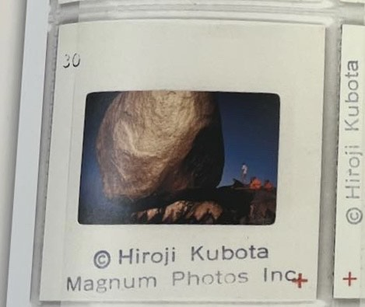
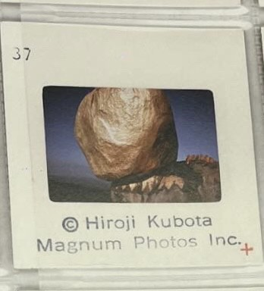
Task 1B
First, describe the image you chose and why you think it is iconic. How does it represent the Photographer's aims. You can discuss why it is technically good, how you would crop and edit it and go into detail about its content and composition.
We chose this image because I think it is the best overall due to its content and composition. Not only is it visually pleasing and striking to the eye making for an engaging and captivating image, but it perfectly captures the scene in its fullest form, with both the rock and the monks visible within the frame, showcasing all beauty that was occurring within this scene in front of the camera.
I believe that this perfectly represents the photographers aims as it captures the way of life of a different culture, displays the monk's worship in practice for us to witness.

Slide 38
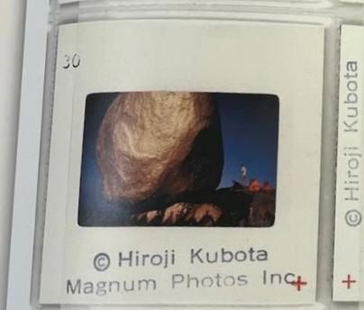

Task 2A
We knew that in order to sell the series, we needed our cover image to be eye catching to the viewer, pique their interest with a captivating and dazzling key image. However, a few of us had different ideas of what captivating should look like. Mia preferred shot 31 as a front cover as she thought it was the most intriguing, however Lily and I both felt that image 37 was a more appropriate choice, as it was more attention grabbing to us. After some debate and evaluation of each other's ideas, we came to an agreement that we were all content with that we felt would work best as a cover image.
Our selection of images tell the story because it captures the way of life these monks experienced
In image 37, it is shot outside in daylight, as confirmed by the bright blue sky above. On the bottom left corner of the frame, a vast green area can be seen, likely to be grass or trees. Small figures can be seen standing as a collective on the right side of the frame, they appear to be dressed in orange robes. The focal point of the image is of course the giant golden appearing boulder/rock. The size of the figures accentuating the vast size of the rock.

Slide 39
Task 2B
This image is already pretty amazing, but if I were to further edit, I would do so through Lightroom Classic. To begin, I would start by enhancing the vibrancy of the rock itself to further enhance its brilliance and make it even more captivating to the viewer. I would then enhance shadows in specific areas, focusing on the rock to further define the different textures, bumps and surfaced it holds. As for the figures, I would use a radial gradient tool to slightly raise the saturation of their clothes, to make them stand out a little bit more, as currently they are getting a bit lost in the image due to their lack of vibrancy. I would then take the removal tool, zoom in and remove any remaining imperfection or blemishes, although I would imagine this would have been done very well already.

Slide 40
PALM Agency
Working as an agency meant we had to not only bring our own ideas and opinions to the table but also hear and evaluate each other's too. Working as a team is often both helpful and challenging to me, as although I enjoy hearing different perspectives to broaden my own understanding, as someone who prefers to work independently it can also be difficult to navigate disagreement within a group that is both beneficial and fair to all people involved. Luckily, the members in my agency were all respectful of my points as I was theirs, and we enjoyed the experience of working in a pretend agency. After some evaluation, debate and compromise within our group, we came to a solid decision of which we were all content with.
My ideal role in this team dynamic would be the photographer, and also the editor. I find the practical and hands on work to be far more enjoyable than written work or theory. Although I understand it is beneficial and necessary to learn and practice the various roles.

Slide 41

Digital contact sheets
To make a contact sheet, you first need to take your developed film and take it to a darkroom. In the darkroom, your chosen image should be inserted into an enlarger. Once the enlarger is on, you should use a focus finder to find the grain on the image. If you can see clear grain through the finder, the image should be well focused. You will then need to make test strips to determine the correct settings needed to create your contact sheet to the best possible quality. Once you have used test strips to determine your ideal aperture and exposure time, you can then make a final print of your contact sheet. After exposing onto darkroom paper, you will then need to carry out the development process to see your final image.

Slide 42

PROJECT CYCLE-
Editing & Evaluating

Slide 43


Editing
Editing is important when creating high quality images as it further allows us to improve our images beyond the camera itself. Editing apps such as Lightroom and Photoshop allow us to experiment and alter both the obvious and intricate details within a photograph that cannot be done on the camera alone, to further enhance an images quality, change its style, for better storytelling, along with various other reasons. Editing allows us to correct blemishes and flaws, emphasise certain subjects or objects, alter the exposure, shadows etc.
Seen featured on this page is a before and after black and white darkroom print. I used both the darkroom facilities and adobe lightroom to edit this film photo. In the darkroom, I used dodging and burning to emphasise certain points of the image.

Slide 44

Evaluating
Evaluation is a crucial stage in our process as photographers because it links directly back to my original plan and intention regarding my work. By evaluating my work at the end of a project, I am able to judge whether the images I captured successfully communicate the messages I want to deliver or portray. This helps ensure that my photography is intentional rather than accidental or spontaneous.
This semester has taught me that mastering the art of photography is not a linear process, it is a cycle of reflection and improvement, and that I have a lot more practice to do and improvements to be made.
There are many practices this course has introduced to me, such as contact sheets and annotating them. This in particular has helped me to hold myself accountable for each and every shot I take and consider how I can improve.

Slide 45


Editing – Darkroom Printing
These images are black and white film images shot on a Pentax film camera, shot with 35mm film. After developing these, I used enlarger 4 in the darkroom to transfer these images from my developed film strip to darkroom paper. Before making my final print, I used test strips to determine the best exposure time and aperture setting for this image. I exposed a strip for 2 seconds at a time, with 5 exposure bursts in total and one overall exposure burst for an additional 2 seconds. After trial and error, I found the right settings.
Although this cannot be seen in the digital versions featured, I used an easel and a pencil to add even borders to the image to better its presentation, which went well. When it came analogue photography, it definitely takes practice in almost every step, as it requires specific skills and steps done right to carry out successfully.
As I am new to analogue, I struggled with mastering the manual camera settings, so some of my images, including this one, was overexposed in some areas. I fixed this however by using dodging and burning, a practice taught to me during a lecture in the darkroom, which is circled. I also used digital editing to bring the overall exposure down, as I felt this made the image appear a little crisper. To finalise, I cropped slightly.

Slide 46

Evaluating
My aim for this first roll of film was to gain a basic feel for film photography by practicing photographing a variety of scenes. Overall, I feel that I achieved this aim, as the process helped me to understand the fundamentals of shooting with film and working more thoughtfully with each frame.
In terms of planning, I planned quite loosely and approached this particular roll in a spontaneous way. Rather than following a strict plan, I captured images as opportunities arose. While this worked well for experimenting and learning, next time I would plan certain shots more carefully, specifically around lighting and exposure.
The shoot itself went well, especially considering it was my first somewhat successful attempt. I initially struggled to load and develop the film, but after failing my first two attempts, I managed to develop some. This, although frustrating at first, was a key learning experience for me.
My selection from the contact sheet is fairly strong for a first roll and makes sense in relation to my aim of becoming familiar with film photography. The printing process went smoothly, and I am satisfied with some of the shots I captured. Through this process, I learned that analogue photography required a high level of precision and patience.
Feedback on my shoot was generally positive with some pointing out the obvious flaws visible in the contact sheet, such as the overexposed images on the bottom strip due to me accidentally ripping the roll while unloading it from the camera and other images that were not great overall dur to overexposure or low quality. My outcomes show new skills in producing analogue photographs. To improve further, I need to develop a stronger understanding of the exposure triangle on a film camera, as I found the film cameras to be quite intimating at first.

Slide 47

EXHIBITION REVIEW

Slide 48

EXHIBITION REVIEW OVERVIEW
Reviewing an exhibition is useful for multiple reasons. Not only is it an enjoyable experience for those who are passionate about art, but it also offers various other benefits. Visiting exhibitions are valuable opportunities to broaden your horizons by perceiving various kinds of work that you might not have delved into before. It also gives aspiring photographers a chance to showcase their work in a public space, bettering their exposure.
It also highlights how the layout of certain photographs can influence the context derived from them. Sequencing, framing, positioning, lighting and space can all influence how we as viewers perceive the photographs. Due to this, exhibitions are a better way to bring photographs to life and give photographers more control regarding how images are perceived.
It is also interesting to see what kind of image attract certain individuals, observing how certain people gravitate towards specific types of work, and it gives an insight into what a person themselves might be like simply by observing the kind of work they're drawn to and impacted by. Some people wander through simply skimming the images, other people can stand and observe a photograph for an extended period of time. Exhibitions highlight how we as people all perceive art in completely different ways.

Slide 49

Words at Work
This sketch focuses on the everyday aggression embedded in service encounters, particularly female service workers. Sketched on a waitress pad, the sketch shows a topless man flexing his arms. Above him, the handwritten line "Hey sweet lips! Do U shock easily?" Sweet Lips (2014), reads as a taunt, combining sexualisation with an implicit threat. A cartoonish emoji drawing can be seen to the right of the sketch, almost as if adding a sense of humour to the uncomfortable and forward remark he is making. The drawings style and roughness seems intentional, this is not caricature for entertainment, it is documentation of the goings on for people who work in these environments. In the context of After the End of History, Magnowska's work reinforces how working-class labour continues to involve the management of male entitlement, where intimation is disguised as banter and power instead of behaviour to be taken seriously.
This sketch speaks to me on a personal level as a woman who has worked part time in customer service for multiple years. Anna Magnowska's work spoke louder to me as opposed to the others as I relate to the experiences she displays within her pop up.
Sweet Lips (2014)

Slide 50

Beautiful Very Good Curvy Brunette (2019)
Bang Tidy (2009)
Angry (2009)
In this grouping, Magnowska brings her sketches together with a single photograph. The two sketches show the faces of men paired with handwritten comments that suggest overheard remarks rather than full or direct conversations. It appears as though these encounters were recorded in the moment and not meant to be refined, as if Magnowska were capturing moments in time and her own personal experiences on paper.
The photograph below shows an indoor space with posters on the walls, including phrases such as "Spanish Senorita Julia" and "Beautiful very good Curvy Brunette Sara", almost as if reducing women to labels while the woman herself remains absent, in fact, there were no women to be seen in any of the photographs featured, despite the fact that this work is about women and the difficulties we face.
A small Union Jack places the scene firmly within everyday British life, relating back to a strong theme in the exhibition itself. By combining drawings with photography, Magnowska paints a picture of objectification through fragments and moments in time rather than single events or a single shoot.
The way of which this work was displayed also speaks volumes, placed in the centre of the room, it stood out from the rest of the exhibition, where the other images were displayed up on the walls. For this reason, this exhibition feels more personal and informal, encouraging exhibition viewers to look closely and slowly, and reinforcing the idea that these experiences come from lived, everyday encounters rather than distant observation.

Slide 51

Eros (2019)
Angry (2009)
Fuckin Waitress (2009)
In this grouping, the photograph is placed central to two sketches. The photograph shows a figure standing centre frame, in where appears to be a lit-up street at nighttime, likely in Soho. The bright signage advertise what appears to be erotic shows and sex shops. The colours are harsh and artificial, dominated by colours reds and yellows, giving the scene a slightly overwhelming and uncomfortable feel. The lone figure of who appears to be male stands with his back turned, small against the glowing signs. Beside this photograph are two sketches, again depicting male faced paired with unwanted comments, drawn quickly and without extensive detail. The rough, immediate drawing style contrasts with the clarity of the photograph, reinforcing the difference between public spaces and personal encounters. Together, these works show how this sexualised urban landscape feeds directly into the behaviour Magnowska records in her drawings, carrying on with the potent patriarchal themes.
Magnowska's approach here feels observational rather than staged, with Magnowska gathering small moments and details instead of telling a clear story through a photographic series alone. By placing photographs amongst her sketches, she shows how the environment and the behaviour she experienced are closely linked. Shown in the middle of the exhibition and combining both photography with real life sketches, it stands out from the rest of the exhibition, where the rest were only photographs and shown on the walls.

