Slide 1

Introduction to the Library:
Post Graduates
Lisa Ellis: Academic Liaison Librarian

Slide 2

My role…
Academic Liaison Librarian for IMH Swansea (SBC & Y Fforwm).
Designing, developing and creating digital and information literacy content.
Library lead for Academic Integrity and Referencing.
Providing specialised library support for staff and students.
Lisa Ellis
Institute of Management & Health (IMH)
Email: l.ellis@uwtsd.ac.uk

Slide 3

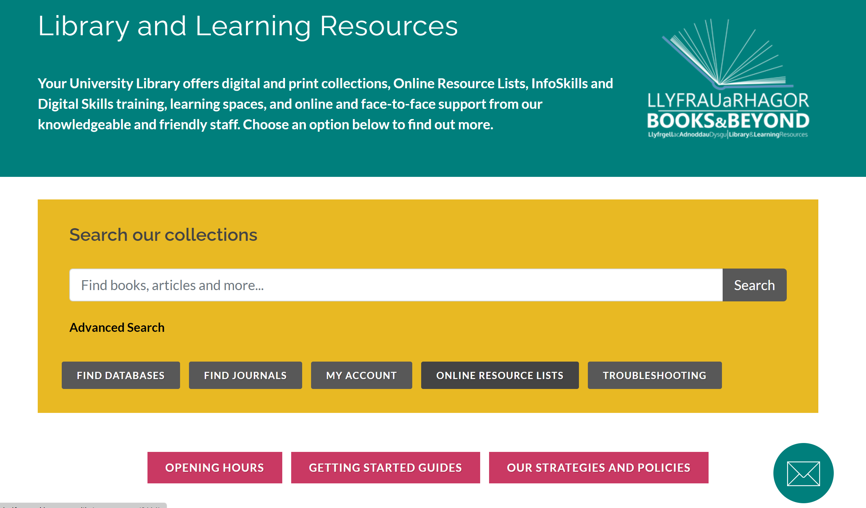
Libraries
4 Physical Libraries
Online Library (24/7)
Swansea: SBC & Y Fforwm
Carmarthen
Lampeter
www.uwtsd.ac.uk/library

Slide 4
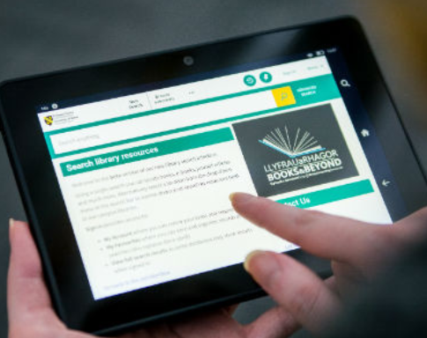
How to access the library resources
Electronic or ebooks and audio-visual resources can be viewed online through the online library 24 hours a day!
Just sign into the library or your online resource list with your Student ID number and password.
Student No: 1234567@student.uwtsd.ac.uk
Password: *********

Slide 5

The library provides FREE access to…
Specialist databases
Ebooks
Ejournals
Visual media, e.g. videos
Newspapers
Conference proceedings
Technical standards
Legal information
Statistical data
Company and industry reports

Slide 6
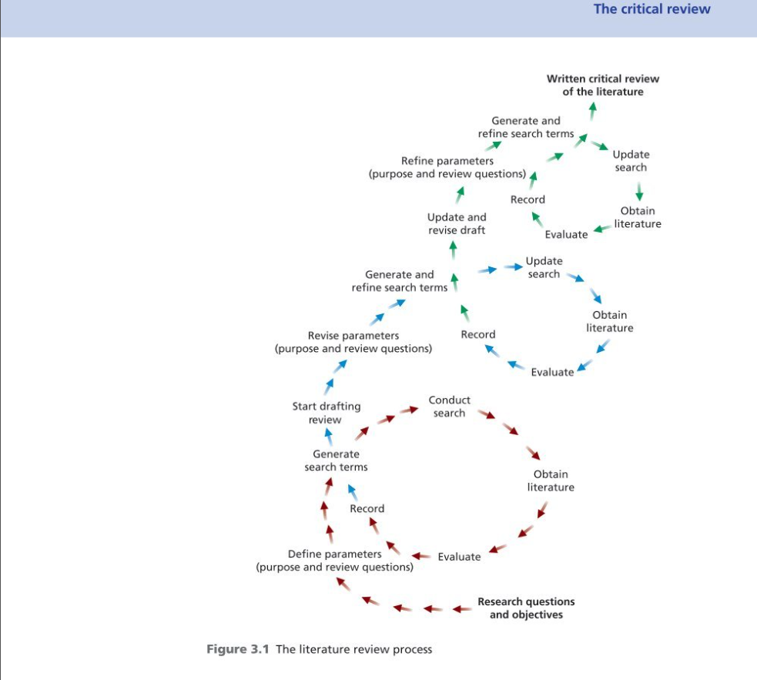
The Literature Review Process
Saunders, M., Thornhill, A., and Lewis, P. (2016) Research methods for business students. 7th edn. Essex: Pearson Education Ltd.
(Saunders, Thornhill and Lewis. 2016, p.73).

Slide 7

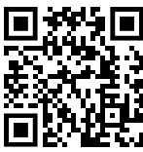
Navigating the library web pages
The library web pages can be found:
https://www.uwtsd.ac.uk/library/
HWB
UWTSD Quick Links
or simply search for UWTSD library from your internet browser
Notes:
So lets take a look...

Slide 8
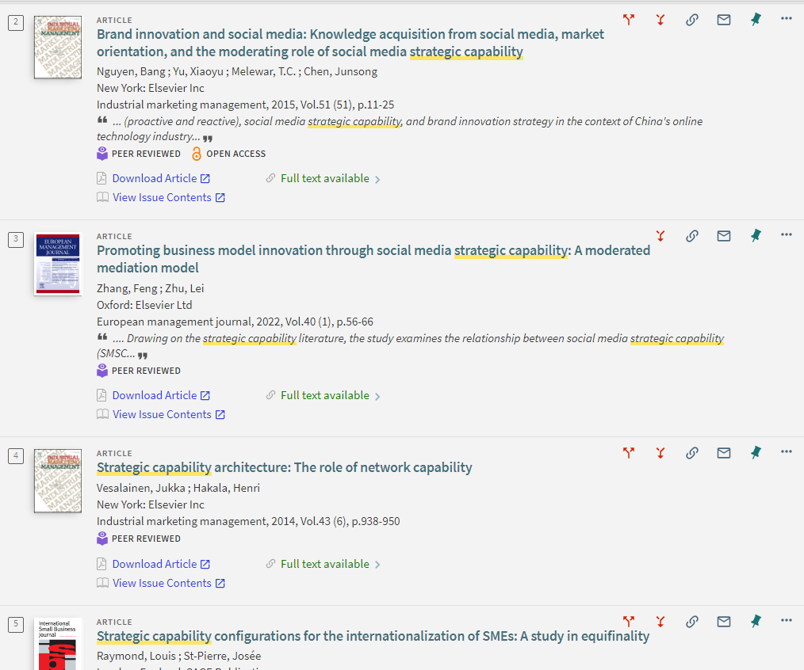
Look for...
Peer reviewed articles
Check for the red arrows – these will give you other sources citing this article, or sources cited in this article
Pin articles to save to your account
Full text online

Slide 9
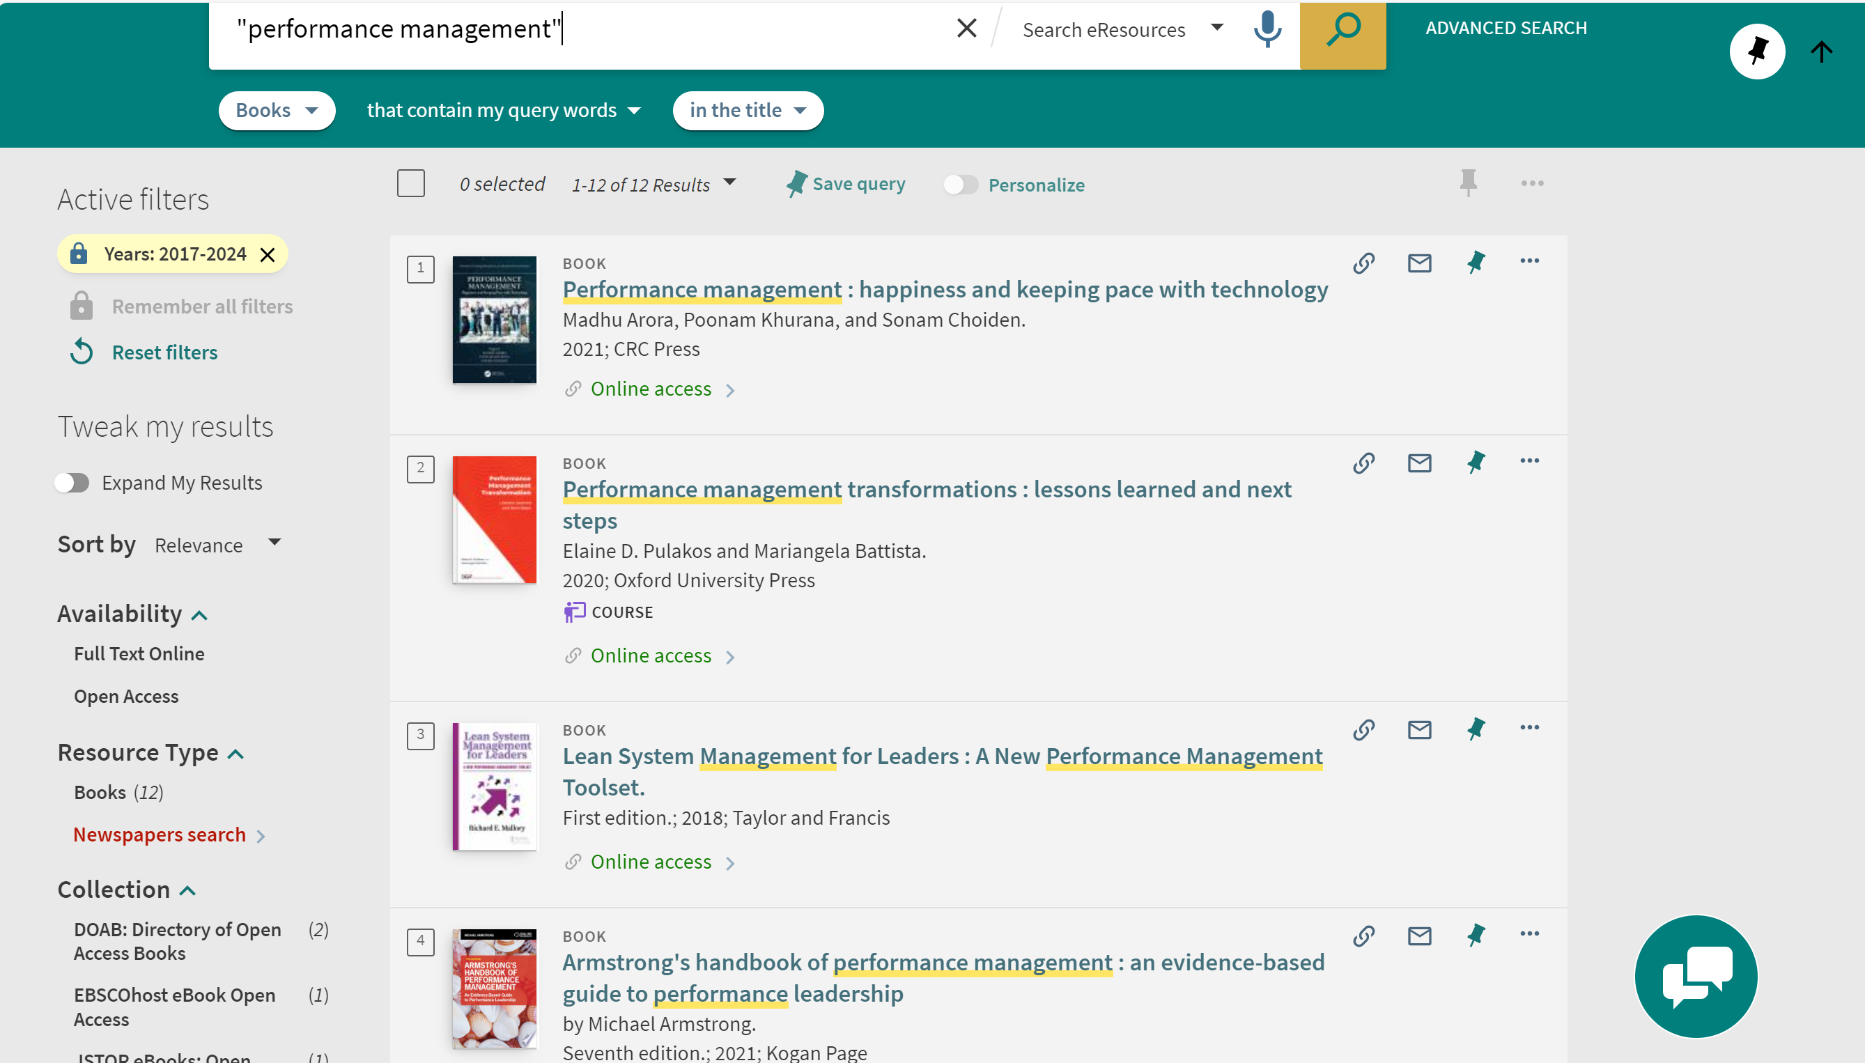
Filters
Link

Slide 10
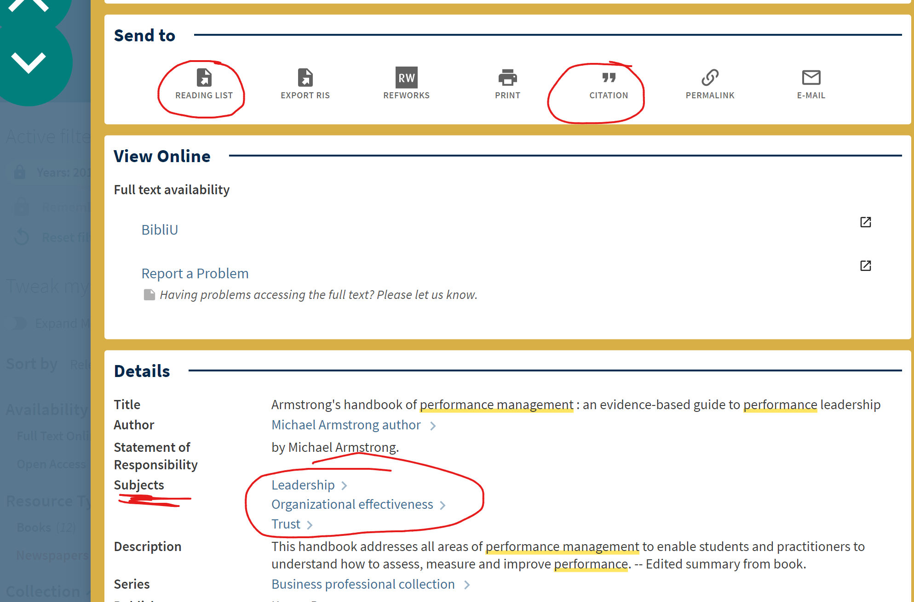
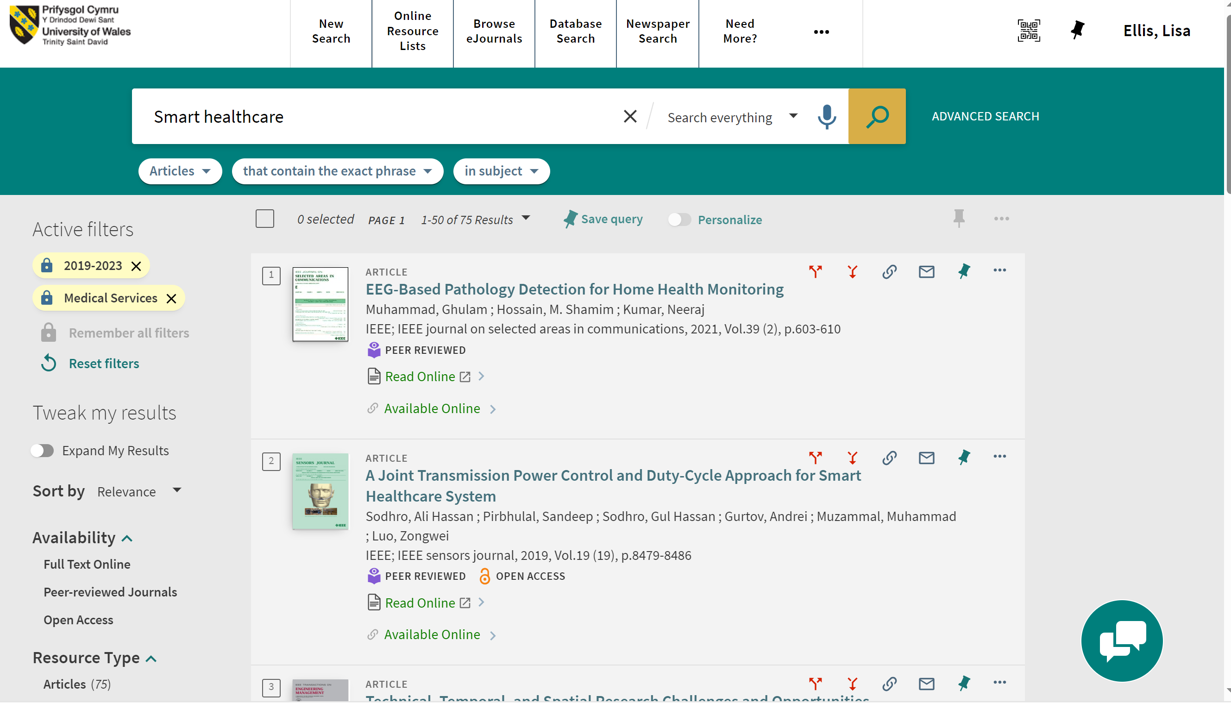
Explore options in the record
Example 1: Subjects
Example 2: using exact subject in filter and in drop down
Link
Link

Slide 11
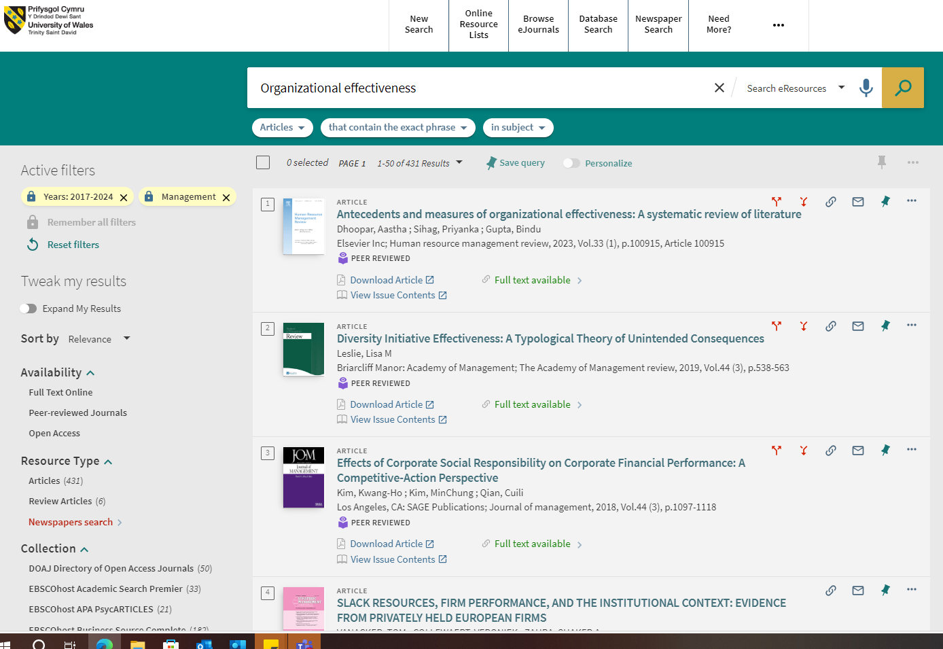
Explore options in the record
Example 1: Subjects
Example 2: using exact subject in filter and in drop down
Link
Link

Slide 12
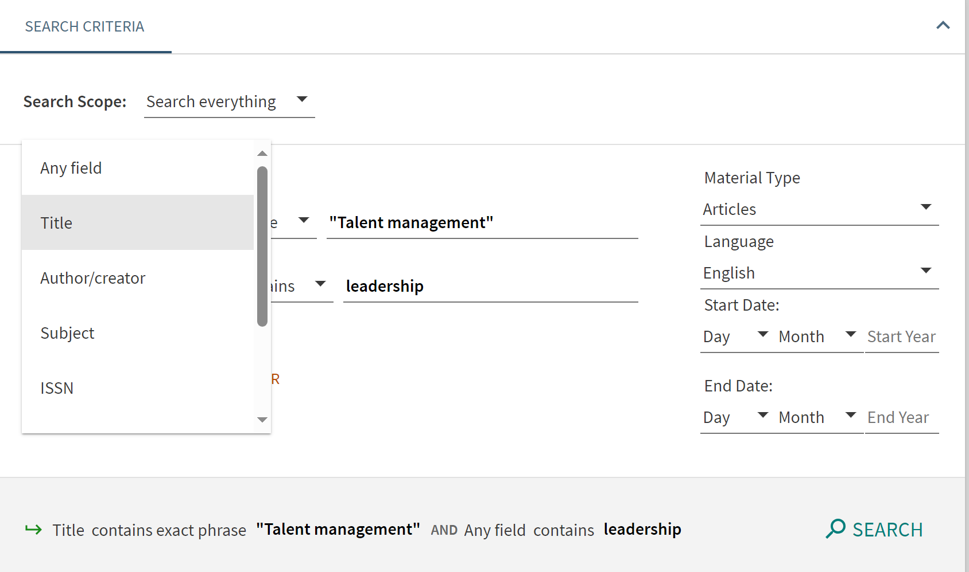
Advanced Library Search
Use "quotations" for phrase searching.
Boolean operators (AND, OR, NOT)
Advanced search to try different combinations.
Use filters to refine by date, subject, etc.
Set alerts.
Library

Slide 13
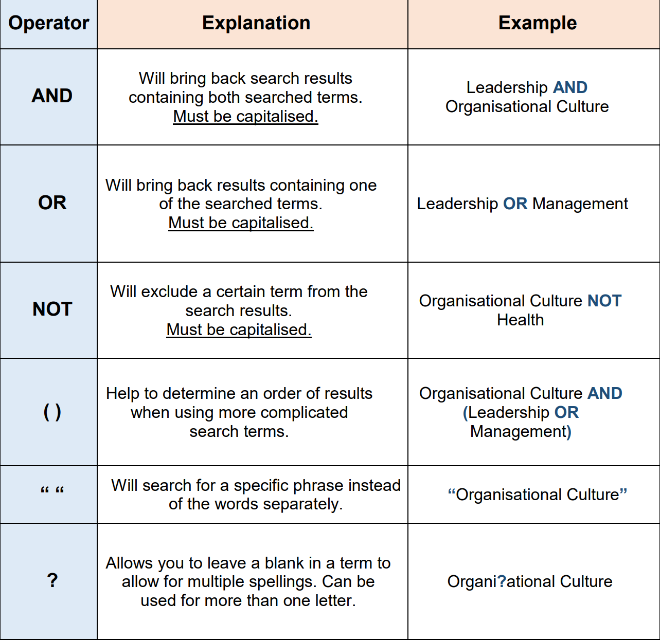
Search Operators
Boolean Operators:
Use to expand or limit results
https://libguides.mdx.ac.uk/ld.php?content_id=32846025
Notes:
https://libguides.mdx.ac.uk/ld.php?content_id=32846025

Slide 14

Tips
Finding a relevant article / book can lead to many more resources.
Note key words / concepts / terminology used
Check cited in and cited by
Locate key journals and authors
Explore subject headings (SH) : Check out SH below the bibliographic details in the catalogue record.
Use filters: date, location, type of resource

Slide 15
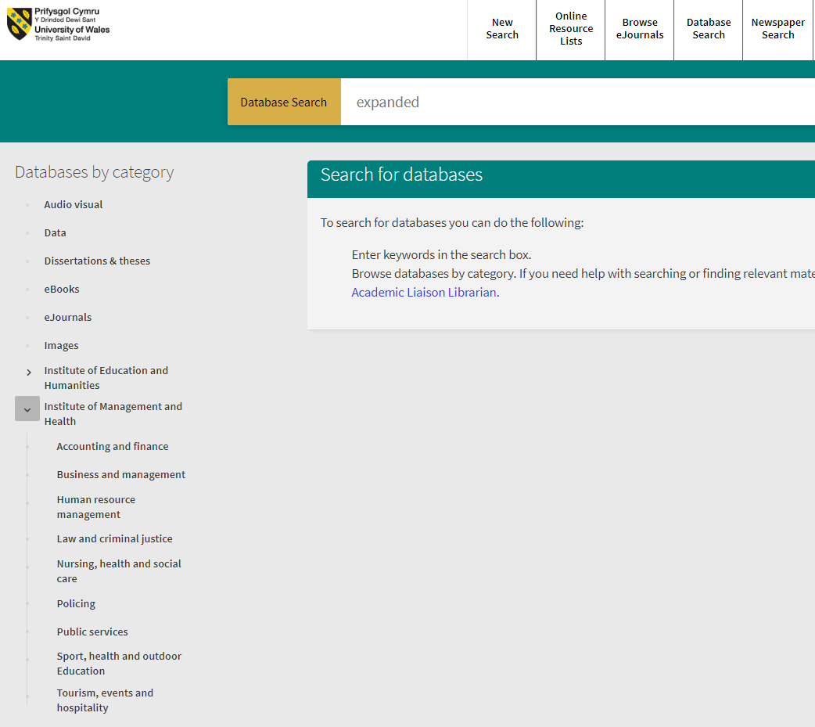
Specialist databases
Subject focussed & academically credible
Accessible via our Database Search and browse by Institute/Subject
Refine your search using filters (date/Language etc.)
Combine multiple keywords (advanced search)
Locate other useful materials by using the ‘breadcrumb trail’ (hyperlinks, reference list etc.)
Create an account to save & organise your favourites
Library

Slide 16
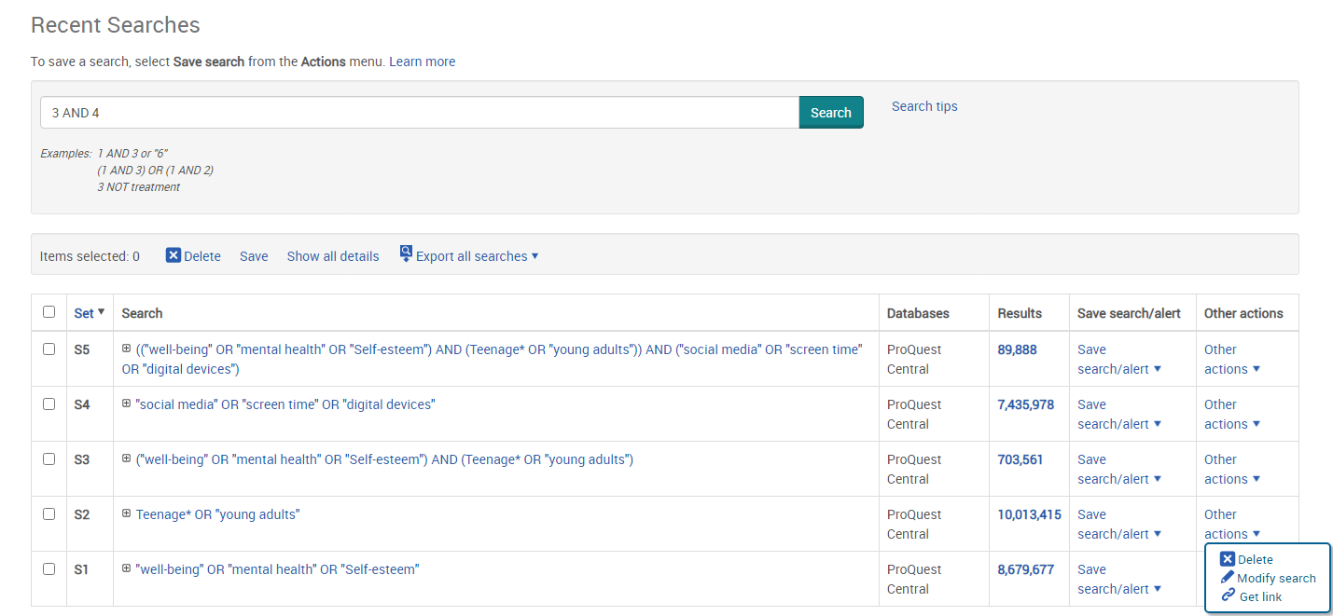
ProQuest keyword search with Boolean operators
Combine searches 3 AND 4
New keyword search and synonyms
Combine searches
Search terms expanded (OR) to include all synonyms.

Slide 17
Summary
Identify key concepts and words
Select suitable resources and databases
Combine with Boolean Operators
Run searches & save your search for future use
Review, refine and repeat as necessary
Record by referencing correctly
Notes:
The search strategy is not linear. You may go through this cycle a few times, before you are happy with your research title and resources. Your title may change as you find new, more interesting angles or topics as you progress in your research.

Slide 18
Useful Databases to explore
Marketline
Business Source Complete
ABI Inform ProQuest
Lexis Plus
ProQuest Central
IGI Global
HS Talks
PsychArticles
LinkedIn Learning
Note: It will depend on your research question. Explore the A-Z database list to find the best databases for your topic.

Slide 19
Useful Databases to explore
Business Source Complete
ABI Inform ProQuest
Marketline
Lexis Plus
ProQuest Central
IGI Global
WGSN
Box of Broadcasts
HS Talks
LinkedIn Learning
Note: It will depend on your research question. Explore the A-Z database list to find the best databases for your topic.

Slide 20
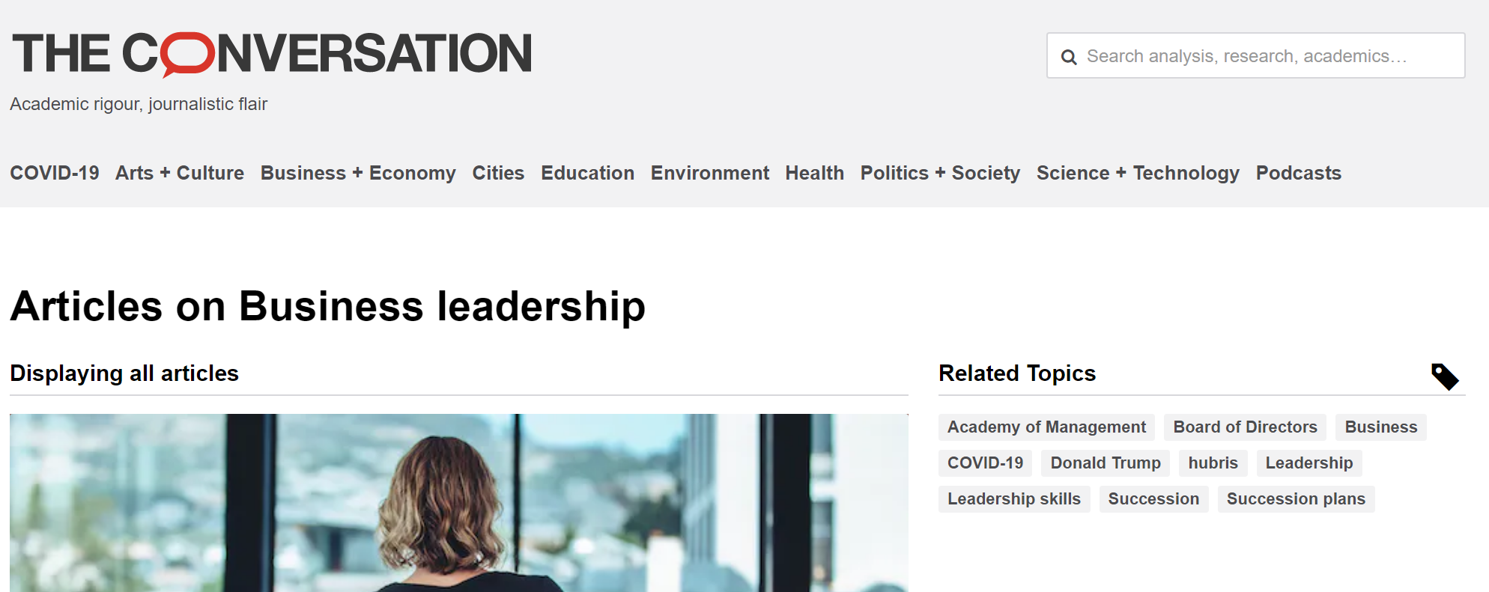
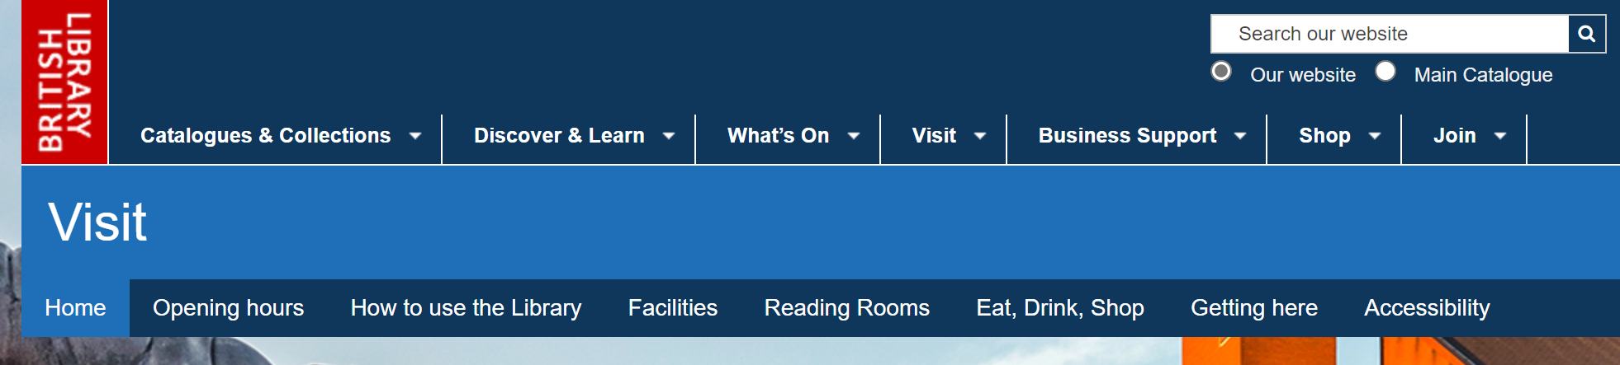
Further Free Resources
British Library Business Portal
The Conversation
A business and management portal with high quality digital content from the British Library's business and management collections.
Free to register and use.
Academic discussion website written in a journalistic style.
Keep abreast of current discussions and research on your subject area.

Slide 21
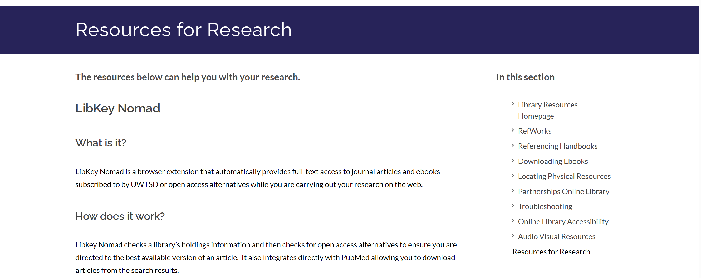
LibKey
Download the LibKey Nomad plugin.
Link your Google Scholar to the library account.

Slide 22
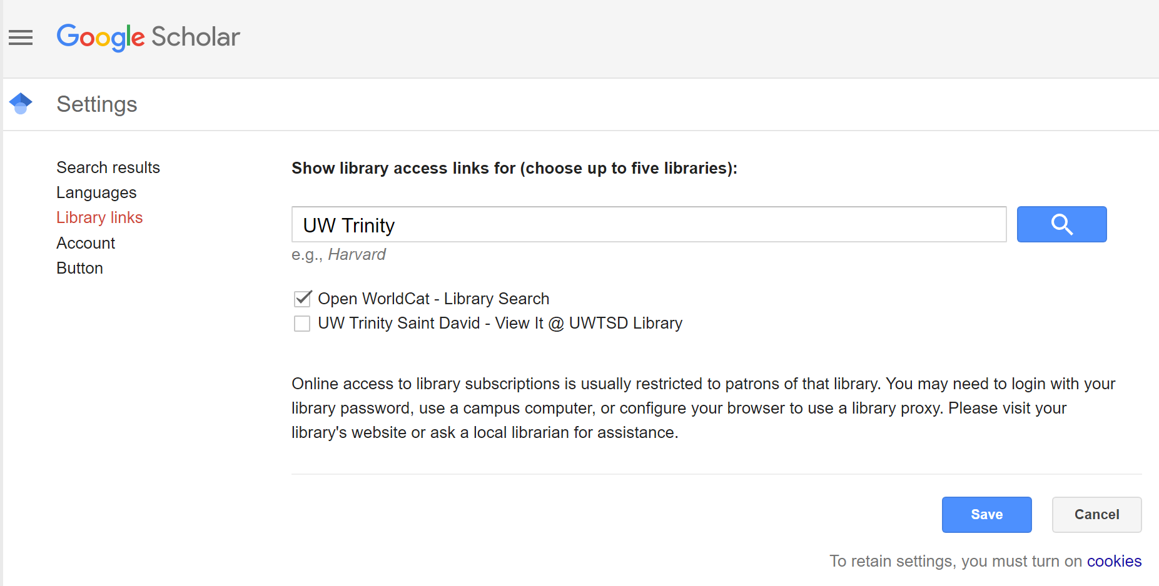
Google Scholar
Search for Google Scholar
Click on site
Click on 3 lines (top left of page)
Choose settings
Click library links
Type in UW Trinity
Click search
Tick the box with View it @ UWTSD
Save

Slide 23
Current awareness
Look for the option to set up email alerts within our library catalogue and databases. You’ll get notified about all the latest news & publications on your research topic!
Browse your favourite academic journals using our Browzine feature, save favourite publications to your bookshelf and be alerted when the latest issue is released.
Set up a Google Alert for your research topic, organisation, leading academics…or even yourself!
See what other researchers and academics are reading via social citation sharing e.g. using RefWorks.
Sign up to The Conversation Business newsletter to receive latest news and research and connect with experts.
Follow and connect with experts on social media, e.g. LinkedIn.
Explore sites such as Connectedpapers.com

Slide 24
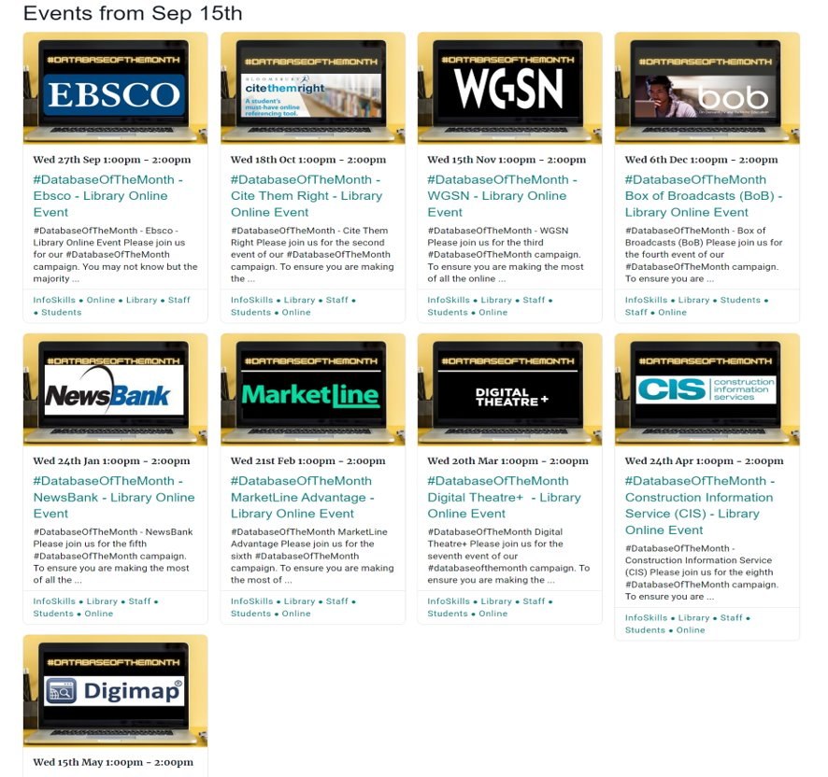
Database of the Month

Slide 25
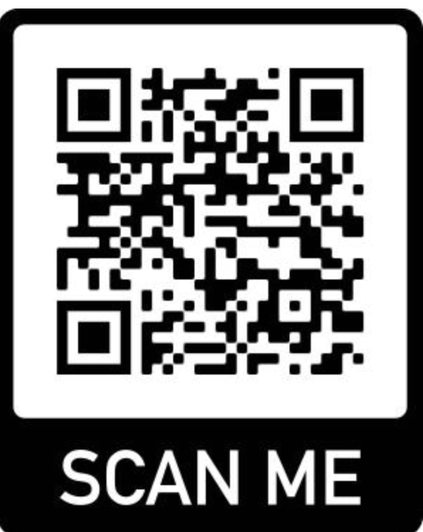
Online resource lists
Prioritised Essential and Further reading and resources recommended by your lecturers.
Easy to use, direct links to live content or loan information.
Accessible via your Moodle course or the library.
Create your own Collection of favourite resources - organise your information and keep details for reference lists.
Resource lists are a starting point – do not limit yourself!
Moodle
Library

Slide 26

Referencing
4 styles of referencing used in UWTSD:
Harvard, APA, IEEE, & MHRA
Guidance and support can be found:
Handbooks
Cite Them Right Database
Referencing Infoskills
Citation Manager:
Sign up to RefWorks (other tools are available).

Slide 27

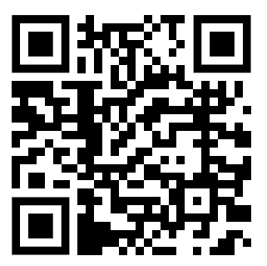
Further support
Available through the Library infoskills webpage.
Hosted on Moodle
New resources being added throughout the year.
Adobe page

Slide 28
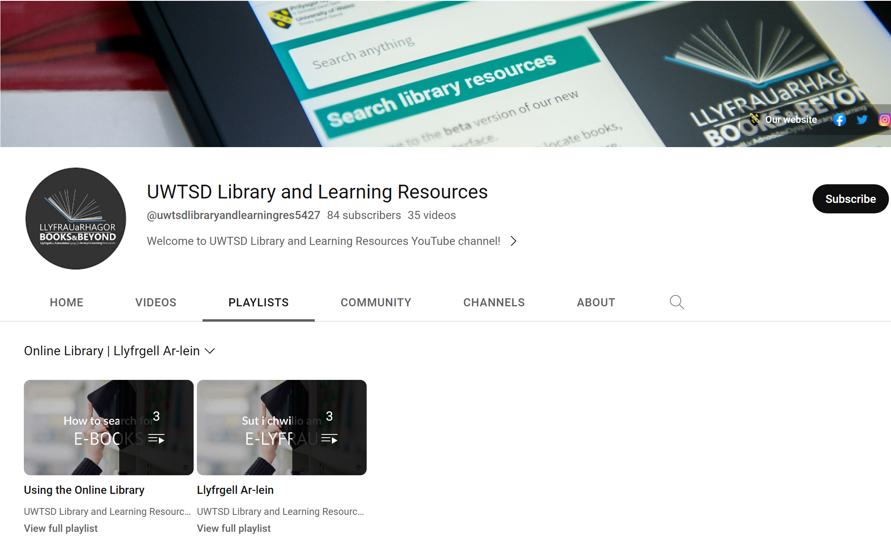
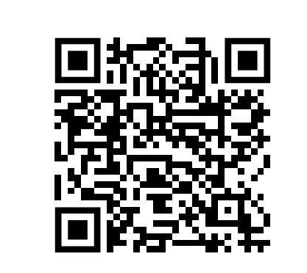
Explore our YouTube videos...
Explore the playlists on our YouTube channel to help you navigate the online library and help you with your research.
https://www.youtube.com/@uwtsdlibraryandlearningres5427/featured

Slide 29

Need More?
Can’t find what you need? Contact us for help.
If we don’t have what you need, you can request it via our NeedMore Service.
You may also be eligible to join the SCONUL Access Scheme if you would like to use other UK university libraries.

Slide 30
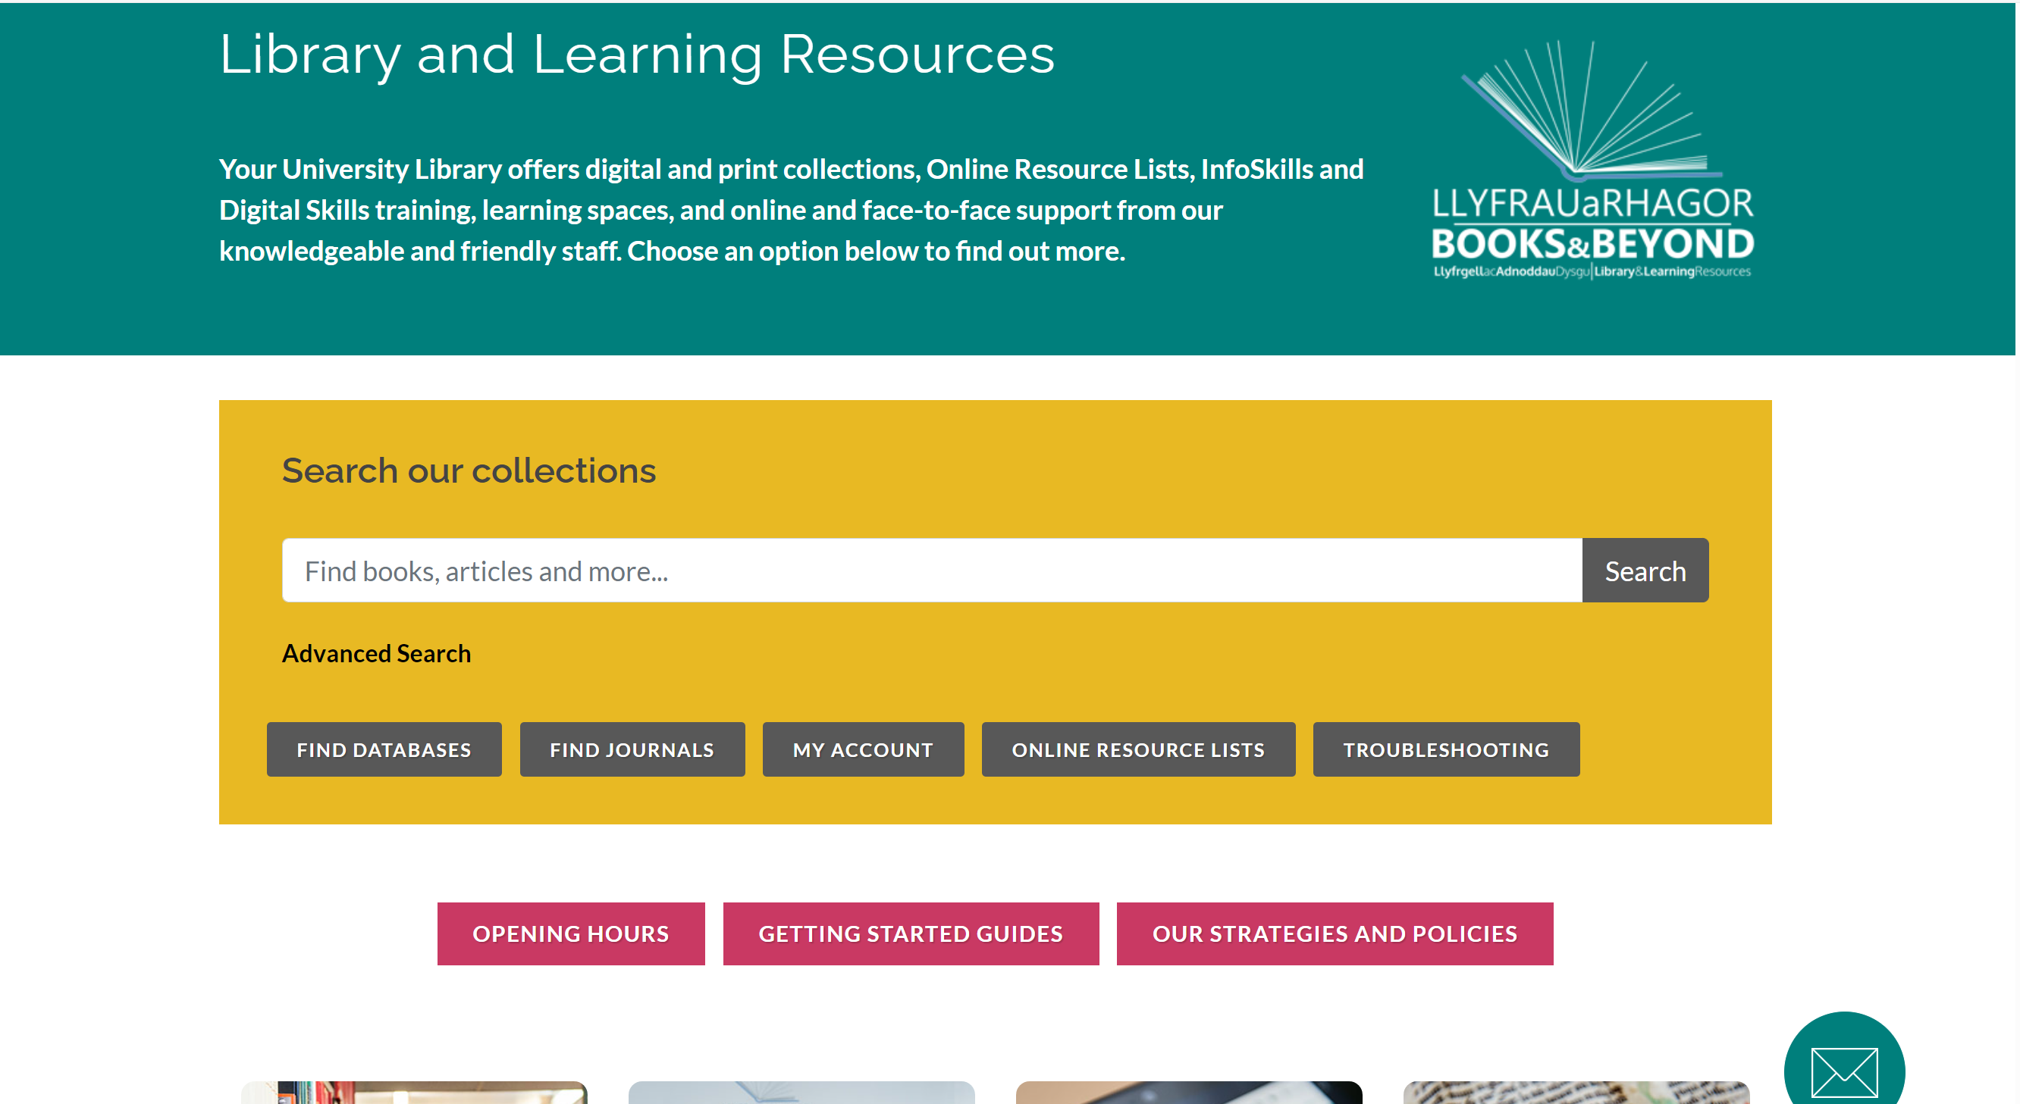
Searching the literature
Get an overview of your research topic by searching our library catalogue
Conduct a more focused search by using one of our specialist databases.
Go to the Database Search feature to view a list of databases relevant to your academic discipline
Search Open Access research articles using Google Scholar, and portals such as CORE.
Don’t forget, you can request items we don’t have via our ‘Need More’ service!

Slide 31

Help is always available...
General queries and help with library loans: library@uwtsd.ac.uk
Library Chat
For search and subject related help:
Lisa Ellis, Academic Liaison Librarian: l.ellis@uwtsd.ac.uk
For help and advice in improving your digital skills:
Jessica Hill, Digital skills advisor: j.hill@uwtsd.ac.uk
Check out our online infoskills programmes to improve your referencing and search technique: Academic and Infoskills

Slide 32

The only thing you absolutely need to know is the location of the library
Albert Einstein
Lisa Ellis
IMH Academic Liaison Librarian
Email: l.ellis@uwtsd.ac.uk
Notes:
Questions

