Slide 1
Part 3
Groups, leadership and management
Chapter 8
Working in groups and teams

Slide 2
Importance and significance of groups
A group is any number of people who:
  interact with one another;
  are psychologically aware of one another;
  perceive themselves to be a group.
  Schein

Slide 3
Group characteristics: Adair
A collection of people who share most of the following characteristics:
  A definable membership
  Group consciousness
  Sense of shared purpose
  Interdependence
  Interaction
  Ability to act in a unitary manner

Slide 4
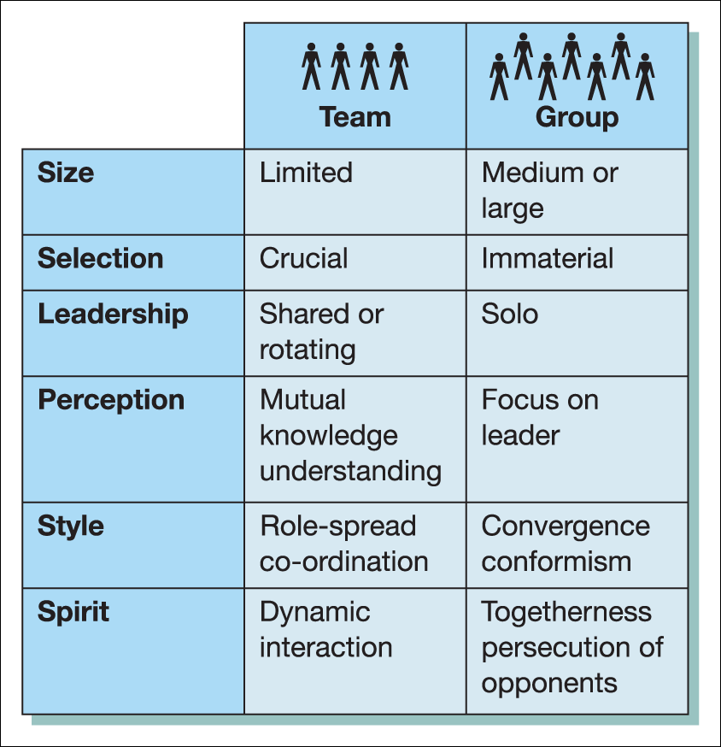
Differences between a team and a group
Figure 8.1 Differences between a team and a group
Source: Belbin, R. M. Beyond the Team, Butterworth–Heinemann (2000). Copyright © 2000. Reproduced with permission from Belbin, www.belbin.com.

Slide 5
Teams are more than groups
‘A group of people working towards common goals and objectives and sharing responsibility for the outcomes. Team building is the process of selecting and grouping team members effectively and developing good working relationships and practices enabling the team to steer and develop the work and reach their goals’.
The Chartered Management Institute

Slide 6
Formal and informal groups
Formal groups
Are created to achieve specific organisational objectives and are concerned with the co-ordination of work activities
Group members have defined roles and the nature of work tasks to be undertaken is a predominant feature of the group
Goals are identified by management and rules and norms established
Tend to be relatively permanent, although there may be a change in the membership of the team
Informal groups
They are based on personal relationships and membership can cut across the formal structure of the organisation
Serve to satisfy the psychological and social needs of group members not related necessarily to the tasks to be undertaken
They appoint their own leader who resolves conflict and reflects the attitudes and values of the group

Slide 7
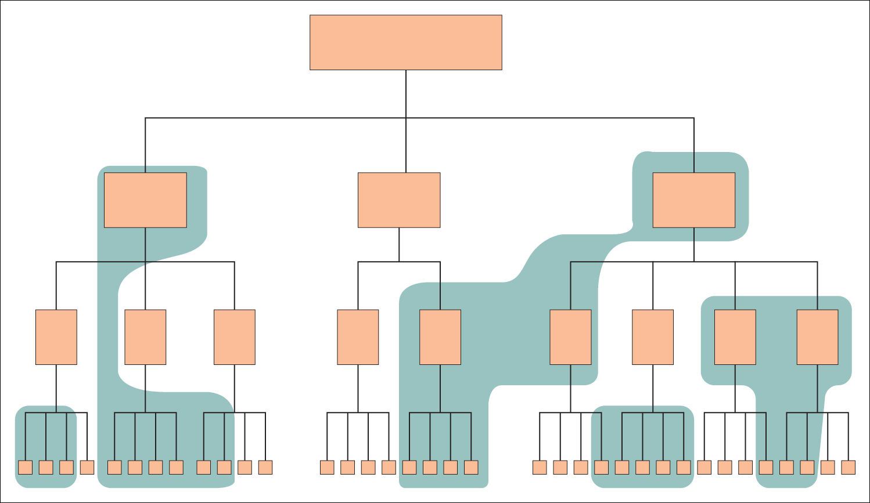
Informal groups within an organisation
Figure 8.2 Examples of informal groups within the formal structure of an organisation

Slide 8
Major functions of informal groups: Lysons
The perpetuation of the informal group culture
The maintenance of a communication system
The implementation of social control
The provision of interest and fun in work life

Slide 9
Reasons for formation of groups or teams
Certain tasks can be performed through the combined efforts of a number of individuals working together.
Collusion between members, e.g. to share unpopular tasks and aid creativity and initiative.
Companionship, mutual understanding and support.
Provide a sense of belonging, identity and status.
Provide guidelines on generally acceptable behaviour.
Offer protection for its membership.

Slide 10
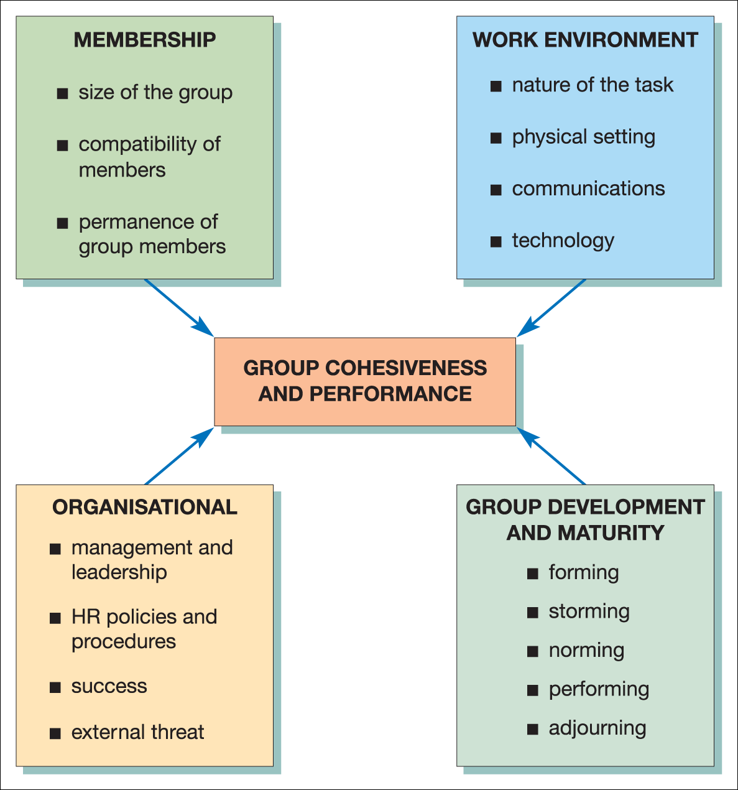
Group cohesiveness and performance
Figure 8.4 Factors contributing to group cohesiveness and performance

Slide 11
Membership factors
Size of the group
  Ideal size appears to be up to 12 members.
Compatibility of members
  Shared attitudes and values help promote cohesiveness.
Permanence
  Cohesiveness develops better if changes occur slowly.

Slide 12
Work environment factors
Nature of the task
  Similarity of tasks or problems
Physical setting
  Physical proximity
Communications
  Ease of communication
Technology
  Nature of technology, task and skills

Slide 13
Organisational factors
Management and leadership
  The importance of fostering mutual trust
HRM policies and procedures
  Equity and fairness
Success
  As a positive motivator
External threat
  May cause internal cohesiveness

Slide 14
Group development and maturity factors: Tuckman
Forming
  Initial formation: the ‘polite’ stage
Storming
  Testing the group: power struggles and conflict
Norming
  Consolidating: standards and guidelines are set
Performing
  The effective operating stage
Adjourning
  Disbanding once the task is complete

Slide 15
Creative leadership and group development: Rickards and Moger
A leader can influence effective team development by:
  building a platform of understanding;
  creating a shared vision;
  a creative climate;
  a commitment to idea ownership;
  resilience to setbacks;
  developing networking skills;
  learning from experience.

Slide 16
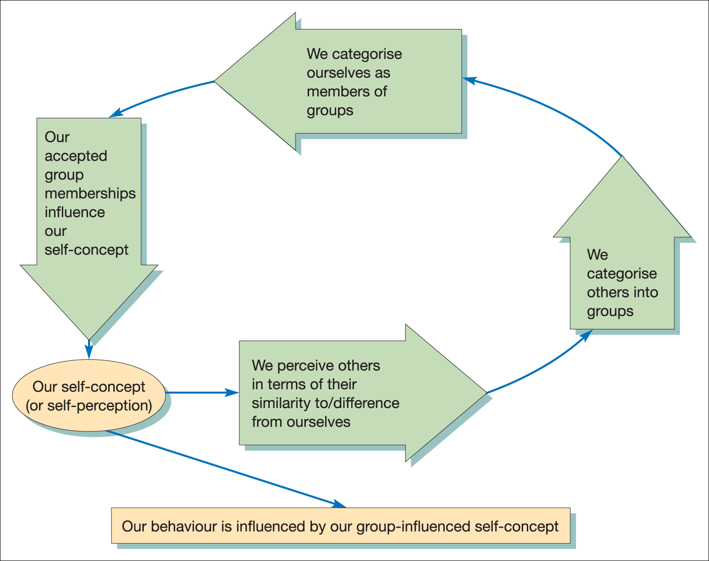
Social identity theory
Figure 8.5 Processes of social and self-categorisation
Source: Guirdham, M. Interactive Behaviour at Work, third edition, Financial Times Prentice Hall (2002), p. 119. Reproduced with permission of Pearson Education Ltd.

Slide 17
Characteristics of an effective work group
A belief in shared aims and objectives
A sense of belonging to the group
Acceptance of group values and norms
A feeling of mutual trust and dependency
Full participation and consensus in decisions
A free flow of information and communication
Open expression of feelings and disagreements
Conflict resolution within the group
Low levels of staff turnover, absenteeism, etc.

Slide 18
Virtual teams
A collection of people who are geographically separated but still work together closely.
The primary interaction among members is by some electronic information and communication process.
Virtual teams can comprise people with different knowledge and be diverse.
They require good leadership.

Slide 19
Leadership and motivation of the virtual team: Garrett
Say hello
Build trust
Recruit with care
Do not rely on email
Encourage dissent
Use technology thoughtfully
Measure outcomes
Use virtual teams to go where the talent is and work more efficiently
Do not say virtual teams ‘aren’t quite the real thing’

Slide 20
Role structure of the organisation
The roles that an individual plays with a group is influenced by a combination of:
  Situational factors – requirements of the task, style of leadership.
  Personal factors – such as values, attitudes, motivation and ability, etc.
Role sets – the range of associations or contacts with whom an individual has meaningful interaction.

Slide 21
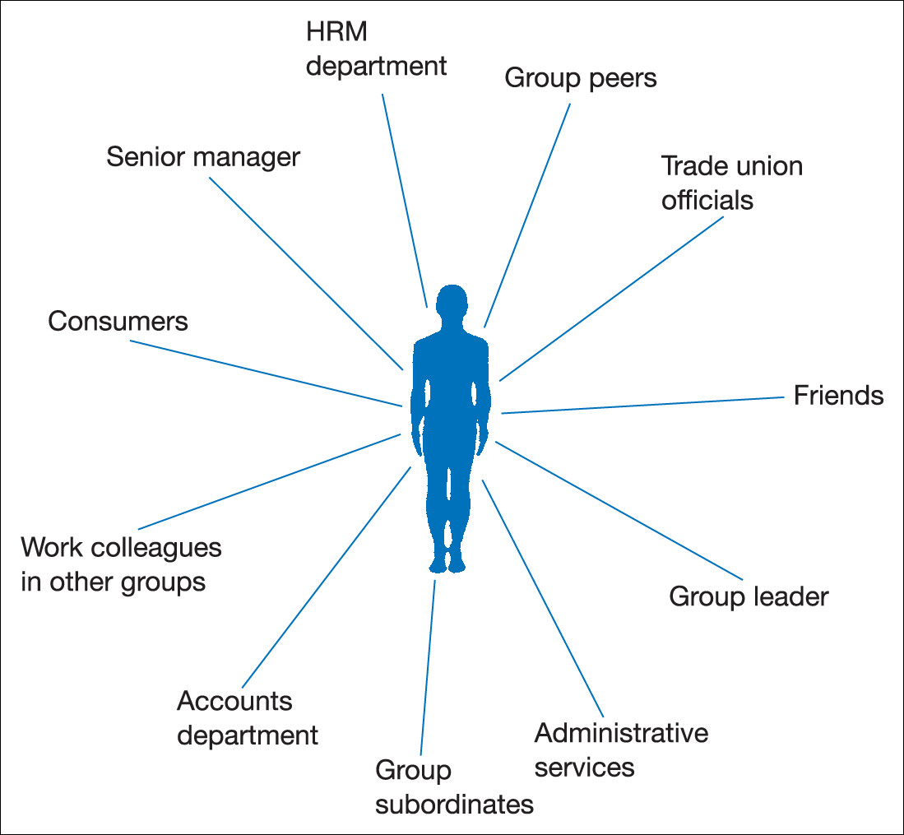
Role set
Figure 8.6 Representation of a possible role set in the work situation

Slide 22
Role conflict
A number of factors can have an impact on the successful performance of individuals in their roles:
  Role incompatibility
  Role ambiguity
  Role overload
  Role underload

Slide 23
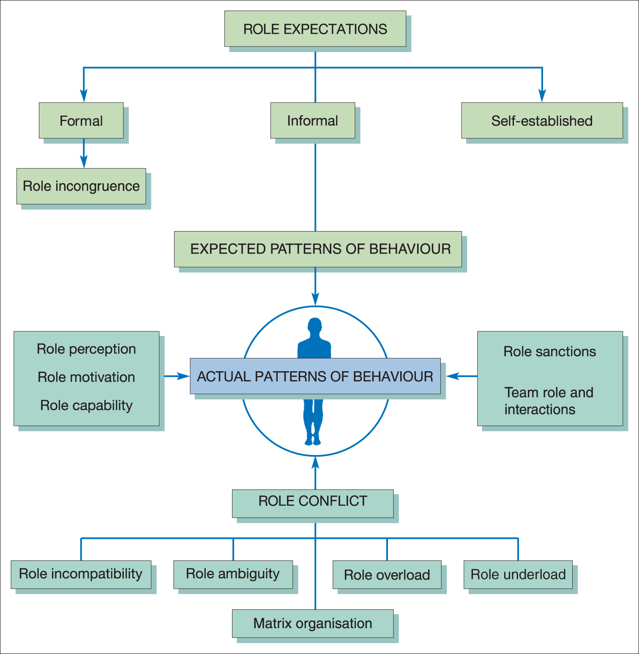
Role relationships and conflicts
Figure 8.7 Role relationships and conflicts
Source: based on Miner, J. B. Management Theory, Macmillan (1971), p. 47.

Slide 24
Individual team roles: Belbin
A team role is a pattern of behaviour, characteristic of the way in which one team member interacts with another whose performance serves to facilitate the progress of the team as a whole. Strength in any one role is commonly associated with particular ‘allowable’ weaknesses.

Slide 25
Belbin’s nine team roles
Plant
Resource investigator
Co-ordinator
Shaper
Monitor–evaluator
Team worker
Implementer
Completer
Specialist

Slide 26
The plant
Team role contribution
Creative
Imaginative
Unorthodox
Solves difficult problems
Allowable weaknesses
Ignores details
Too preoccupied to communicate effectively

Slide 27
The resource investigator
Team role contribution
Extrovert
Enthusiastic
Communicative
Explores opportunities
Develops contacts
Allowable weaknesses
Over-optimistic
Loses interest once enthusiasm has passed

Slide 28
The co-ordinator
Team role contribution
Mature
Confident
A good chairperson
Clarifies goals
Promotes decision- making
Delegates well
Allowable weaknesses
Can be seen as manipulative
Delegates personal work

Slide 29
The shaper
Team role contribution
Challenging
Dynamic
Thrives on pressure
Has the drive and courage to overcome obstacles
Allowable weaknesses
Can provoke others
Hurts other’s feelings

Slide 30
The monitor–evaluator
Team role contribution
Sober, strategic and discerning
Sees all options
Judges accurately
Allowable weaknesses
Lacks drive and ability to inspire others
Overly critical

Slide 31
The teamworker
Team role contribution
Co-operative
Mild
Perceptive and diplomatic
Listens
Builds
Averts friction
Calms the waters
Allowable weaknesses
Indecisive in crunch situations
Can be easily influenced

Slide 32
The implementer
Team role contribution
Disciplined
Reliable
Conservative and efficient
Turns ideas into practical actions
Allowable weaknesses
Somewhat inflexible
Slow to respond to new possibilities

Slide 33
The completer
Team role contribution
Painstaking
Conscientious
Anxious
Searches out errors and omissions
Delivers on time
Allowable weaknesses
Inclined to worry unduly
Reluctant to delegate
Can be a nit-picker

Slide 34
The specialist
Team role contribution
Single-minded
Self-sharing
Dedicated
Provides knowledge and skills in rare supply
Allowable weaknesses
Contributes on only
a narrow front
Dwells on technicalities
Overlooks the ‘big picture’

Slide 35
Critical assessment of Belbin: Aritzeta et al.
Concerns about the theoretical basis of the inventory.
Questions about relationship between personality and team roles.
Lack of clear differentiation between the roles.
Insufficient account taken of the type of task involved.
The influence of variable organisational factors.
Overly reliant on a psychological approach to teamwork.

Slide 36
Benne and Sheats’ classification of team-member roles
Group task roles – select, define and solve problems.
Group building and maintenance roles – the analysis of member functions to ensure group-centred behaviour.
Individual roles – directed towards the satisfaction of personal needs and not related to either the task or functioning of the group.

Slide 37
Sociometry
A method of indicating the feelings of acceptance or rejection among group members.
Sociograms:
  Depict the choices, preferences, likes or dislikes and interactions between individual members.
  Display the structure of the group and record the observed frequency and/or duration of contacts among members.

Slide 38
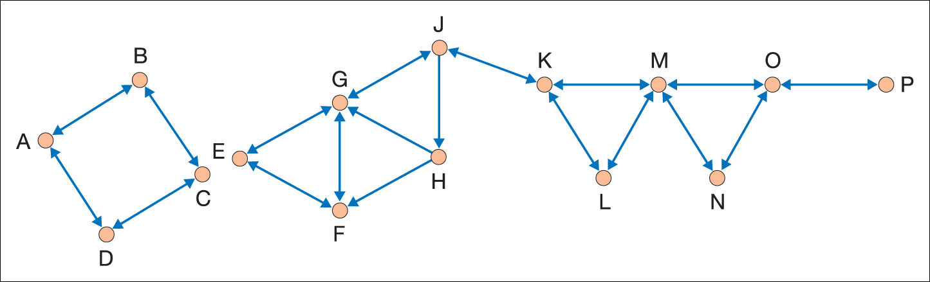
Example of a diagrammatic sociogram
Figure 8.8 A simple illustration of a sociogram

Slide 39
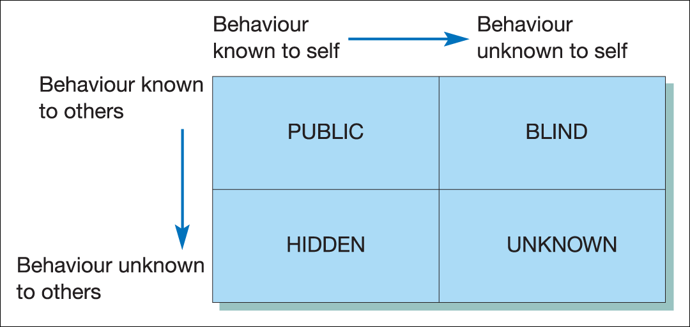
Self-insight and the
Johari window
Figure 8.9 The Johari window

Slide 40
Social loafing
Also known as the Ringelmann effect.
Tendency for individual members of a group to expend less effort than if they were working along.
Total group effort is therefore less than the expected sum of individual contributions.

Slide 41
The risky-shift phenomenon
Instead of taking fewer risks and making safer or more conservative decisions, the reverse is often the case.
Preferences for conformity means that there is a tendency for groups to make more risky decisions than the individual members would.

Slide 42
Groupthink
‘A deterioration of mental efficiency, reality testing, and moral judgment that results from in-group pressures’.
Janis
Groupthink results in the propensity for the group to just drift along, and can be apparent in any organisational situation where groups are relied on to make important decisions.

Slide 43
Brainstorming
Brainstorming or ‘thought showers’ involve the group adopting a...
‘freewheeling attitude and generating as many ideas as possible, the more wild or apparently far-fetched the better’.
Osborn

Slide 44
Procedures for brainstorming
It is based on maximum freedom of expression and informality. Members are encouraged to elaborate or build on ideas expressed by others.
The initial emphasis is on the quantity of ideas, not their quality. No individual ideas are criticised or rejected in the first stage.
There needs to be good recording and reporting of the ideas.

Slide 45
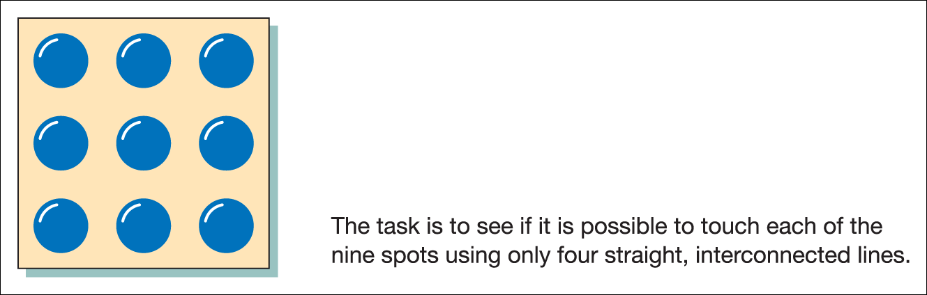
An example of creative thinking
Figure 8.11 An example of creative thinking

Slide 46
Building effective teams
Yukl identifies eight team-building procedures for managers:
  Emphasise common interests and values.
  Use ceremonies and rituals.
  Use symbols to develop group identification.
  Encourage and facilitate social interaction.
  Tell people about group activities and achievements.
  Conduct process analysis sessions.
  Conduct alignment sessions.
  Increase incentives for mutual co-operation.

Slide 47
Autonomous work groups
Emerge from patterns of work redesign and job enrichment. Key features include:
  Specific goals are set but the group decides on the means of achieving them.
  Group members have freedom of choice and discretion over the planning and execution of work.
  Collectively members have the necessary expertise to succeed in the task.
  The level of external supervision is reduced.
  Feedback and evaluation are related to the performance of the group as a whole.

Slide 48
Skills to build self-managed teams
Self-management
Communication
Leadership
Responsibility
Supportiveness of diversity
Feedback and evaluation
Strategic planning
Shaping successful meetings
Resolving conflicts
Enjoyment

Slide 49
The role of team leader
Building successful teams requires effective leadership with an emphasis on trust, clear communications, full participation and self-management.
‘The influence and usefulness of team leaders comes, not from their delivery of traditional supervisory and control methods, but from their ability to lead from the front and in training, coaching and counselling their team members to high standards of performance’.
Gratton

Slide 50
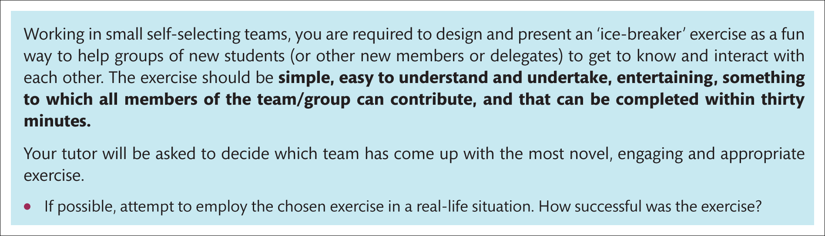
Assignment

