Slide 1
Contemporary Issues in Policing
BMPO 7006
Jon Edwards

Slide 2
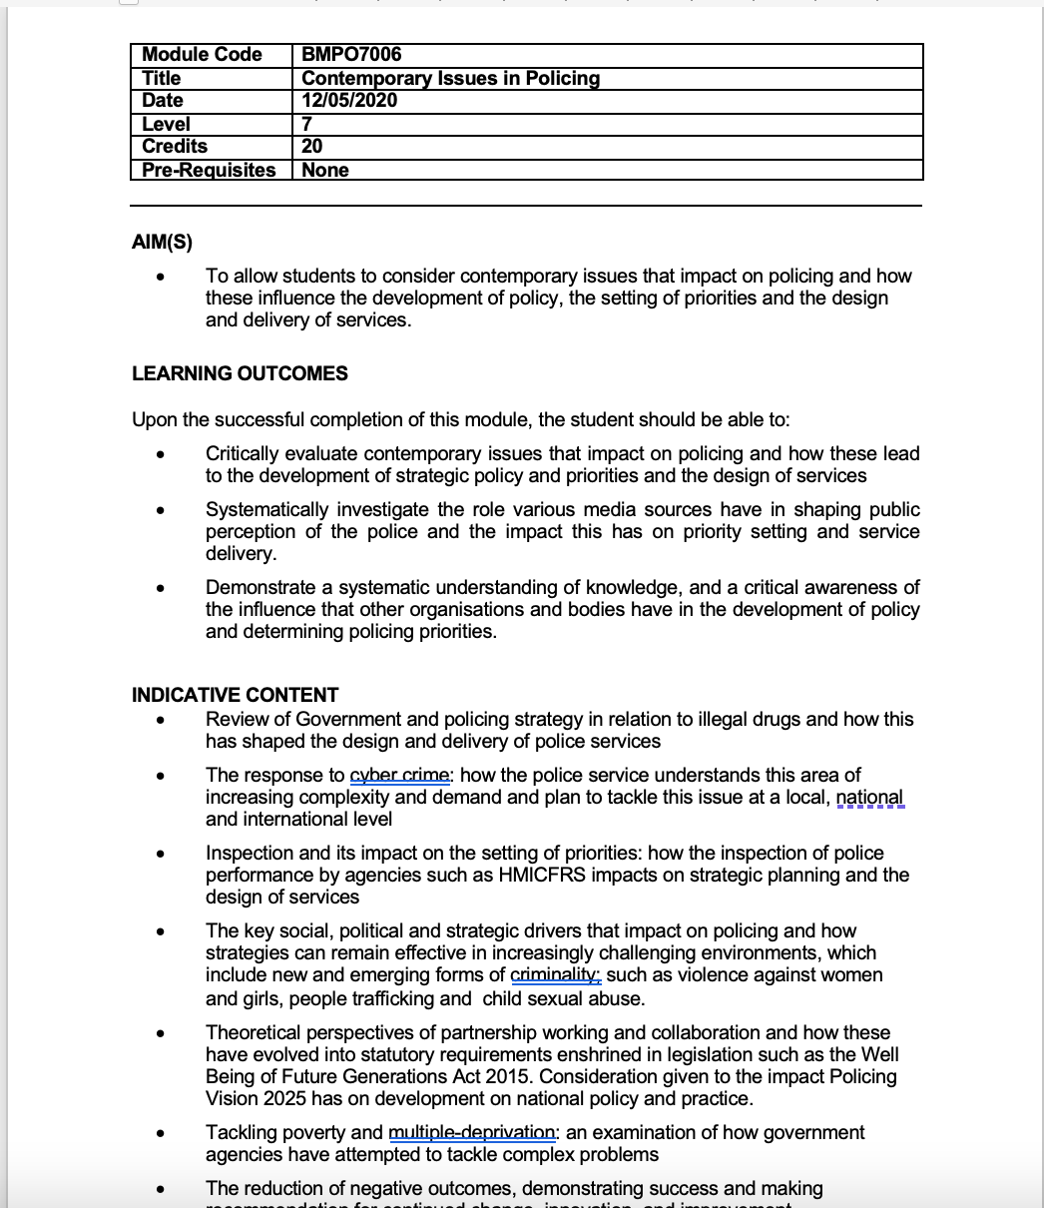
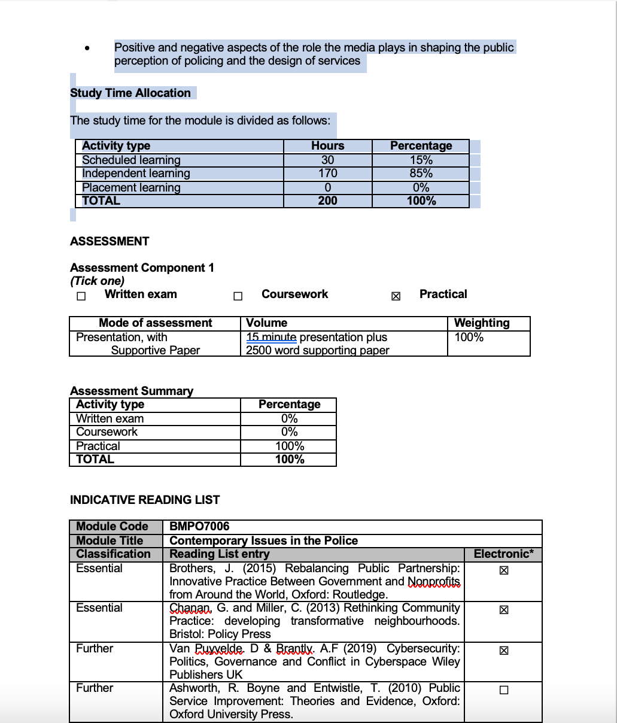
Welcome back!
Module specification

Slide 3
Contemporary Issues in Policing BMPO7006
Proposed Timetable (Draft)
Week & Date | Focus | Areas covered from Module spec. | External speaker?
1 - 17/5 | Introductory week | Overview of the module Assignment brief – Overview of the requirements & Q&A Seminar discussion “Contemporary issues on policing’ | n/a
2 - 24/5 | UK Policing in a global environment | Pre session material – Contemporary challenges in Policing. UK wide policing issues. International Policing issues. | External lecture ACC John Hawkins - Policing Scotland.
3 - 31/5 | Policing & Partnership – A landscape for problem solving? | WFG Act 2015 CDA 1998 | TBC
4 – 7/6 | Contemporary Policing Issues – Vulnerability. | Guest Lecture - Focus on MH. Lecture material will include broader vulnerability including VAWG, CSE & MDS. | Mental Health: a partnership approach – Steve Clarke WAST / WG.
5 – 14/6 | Contemporary Policing Issues – Emerging Crimes | Focus on cyber crime. Lecture including broader issues such as Cyber & Economic crime. | Toby Grainger & Julie Spargo, Cyber Resilience Unit. WG. (TBC)

Slide 4
Contemporary Issues in Policing BMPO7006
Proposed Timetable (Draft)
6 – 21/6 | Contemporary policing issues: Safeguarding our Communities – protecting our communities from harm | Focus on Partners approach to violent crime and serious violence. Other areas covered in lecture material includes illegal drugs, implications of wider social issues such as poverty. | Jon Drake & Lara Snowdon, Violence Prevention Unit.
7 – 28/6 | Fairness, Equality and legitimacy in policing | Fairness, inclusivity & legitimacy issues. | n/a
8 – 5/7 | Policing - public confidence and the role of media | Public confidence & Policing. Community engagement Police relationship with the media Public perception from Media | DCC Claire Parmenter – NPCC Lead Neighbourhood Policing
9 – 12/7 | Performance & Inspection – the route to an efficient and effective service? | Performance regimes/ HMICFRS / Audit Commission | TBC
10 – 19/7 | Concluding session – wash up/ Assessment support. . | Final session in advance of Assessment submission. | n/a

Slide 5
Contemporary Issues in Policing Assessment Guidance
Jon Edwards
17th May 2022

Slide 6
Contemporary Issues in Policing (BMPO 7006) Assignment
Deliver a 15 minute presentation and 2500 word supporting paper.

Slide 7
Where and when is the assessment?
Module Moodle site → Assignment tile – Part 1 and 2
Assessment Submission Points
  Part 1 - Presentation
  FINAL Portal – One submission: Deadline 24th July 2022 @ 23.59.
  Part 2 – Supporting paper
  DRAFT portal – use to check for plagiarism (similarity report). Allowed multiple submissions.
  FINAL portal – ONE submission. Deadline: 24th July 2022 @ 23.59 GMT (UK time)
  LATE portal – for submissions after the deadline (both authorised and unauthorised)
Results published 10am - 22nd August 2022.
Exam Board – September 2022.

Slide 8

Why this assessment?
Aim to measure and promote higher level thinking of how the concepts can be synthesised and applied to different contexts (Kaipa, 2012)
Deliberately broad remit to allow you to focus on an issue that interests you!
The key goal of the assignment is to get you to demonstrate an understanding of the theory and consideration relating to contemporary issues and challenges in policing that impact on how to influence the development of policy, the setting of priorities and the design and delivery of services.

Slide 9
Part 1 – Presentation - What is the assessment?
15 min Presentation – topic broad ranging from issues identified from the course or your independent research.
Format – Powerpoint / Panapto / Teams
Need to provide visual material – supported by video / verbal overview of the material. (NB. Video is voluntary – audio is not!)
Only the 15 mins will be marked – anything after the 15 mins will not be marked.

Slide 10
Part 1- Presentation - What is the assessment?
Below is only a guide – remember this is your work and your opportunity to represent your chosen area and the underpinning literature and issues.
Context – A short overview of the issues being explored.
Critical issues - Why this / these area(s) presents a specific challenge to policing.
Theoretical underpinning - A brief synopsis of the relevant theoretical literature and understanding in this area.

Slide 11
Part 1- Presentation - What is the assessment?
Critical analysis - What do you think the service needs to do to address these challenges? How would you, as a leader within the service, seek to address this challenge / these challenges?
Concluding remarks – A short overview of the presentation bringing together the initial challenge(s) and the underpinning theory with some critical reflection.
References. (this is not included within the 15 mins – BUT MUST be included on the presentation)

Slide 12
Part 2- Supporting paper - What is the assessment?
This part of the assignment links very much to the presentation and in effect is a support piece of academic writing that underpins the subject matter in the presentation. However, this is a separate submission and must be treated as such. What do I mean by this??
I do not want a rehearsal of the verbal material on the presentation only. This supporting paper will allow you to go into more depth and provides an opportunity to explore further the key elements, including the research you’ve done and any critical analysis emerging from that research.

Slide 13
Part 2- Supporting paper - What is the assessment?
Introduction – This presents a summary of what the key issue is and why this has been selected as a particular challenge for policing (200 words)
Overview of the specific policing issue. Identify the policing issue you consider important in the development of future policing paradigm. For example, the issue of stop search as a tactic in the prevention of crime and the impact it has on crime reduction and confidence in policing across the communities. (700 words)
Theoretical explanation. Explain, drawing on theories, why does stop and search generate such significant political and community interest? How does stop search impact on trust and confidence? (700 words)

Slide 14
Part 2- Supporting paper - What is the assessment?
Please note the word count is illustrative only as is the potential structure. You may wish to use this adapt it or develop your own to reflect your area of focus.
Introduction – This presents a summary of what the key issue is and why this has been selected as a particular challenge for policing (200 words)
Overview of the specific policing issue. Identify the policing issue you consider important in the development of future policing paradigm. For example, the issue of stop search as a tactic in the prevention of crime and the impact it has on crime reduction and confidence in policing across the communities. (700 words)
Theoretical explanation. Explain, drawing on theories, why does stop and search generate such significant political and community interest? How does stop search impact on trust and confidence? (700 words)

Slide 15
Part 2- Supporting paper - What is the assessment?
What measures are the service or academia considering to help meet the challenge(s) outlined? In this section the student would demonstrate an understanding and knowledge of the area together with some critical analysis on how this could be addressed by the service (700 words)
Conclusion – This section provides an overview of the content, some of the key highlights from the theory and practice and could sum up in the past, provide a over of the present and a glimpse in to the future (200 words).

Slide 16
Referencing
Harvard Referencing Style
Very briefly:
  In-text we use an author (date) format e.g., Johnson and Smith (2009)
  For more than 2 authors we use ‘et al.’, e.g., Thomas et al. (2007)
  Remember to use the Harvard referencing guide provided by the University if in doubt.
Potentially use a referencing manager (e.g., EndNote).

Slide 17
How do we mark?
The assessment criteria (used in conjunction with the marking rubric)
A successful answer should include the following:
A clear definition of the problem to be addressed
Clear links to theoretical perspectives within policing and more specifically your area of focus.
Critical evaluation / analysis of the challenge(s), the theory and the measures that could be introduced to start to address these challenges. This is an opportunity to demonstrate knowledge and understand and shows the development of your thinking in terms of your area.
Note. All marks are internally moderated, and externally moderated.

Slide 18
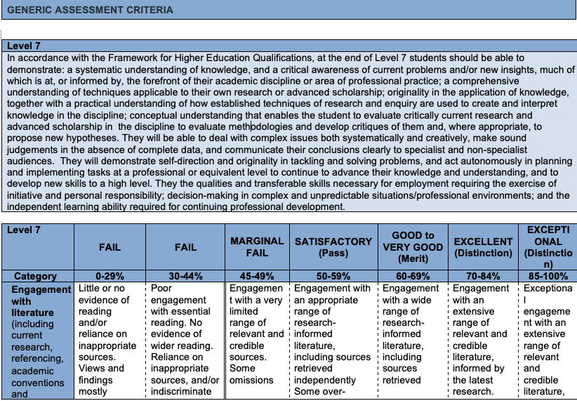
Marking Criteria

Slide 19
How to start?
Plan, draft, write, re-write
Spend time understanding the question
Read through these slides
Read the literature
  Engage with the wider literature (don’t rely on the guided readings)
  Use the lecture articles and directed reading if applicable to your area.
Draft your Supporting paper / Presentation
Construct a well developed argument
Use reliable, peer-reviewed literature
  Published in Journals
  Try to use recent research (within past 5 years) and older theoretical papers
  Compare with marking criteria
You may use your supporting paper to help you shape the focus of your presentation – But please don’t just read large sections of you paper!

Slide 20

Good luck!

Slide 21
Break – 15 mins?

Slide 22
Week 1 - Seminar
Jon Edwards

Slide 23




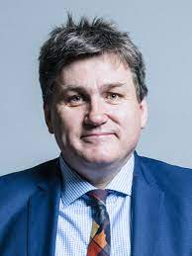
Policing in the 21st Century – Future Challenges – Week 1 seminar
The Future of Policing: what are the challenges facing policing today?
Centre for Policy Studies – Online forum
Chair - Robert Colville - CPS
Lisa Townsend – Surrey PCC
Sir Michael Barber
Rt Hon Kit Malthouse MP – Policing Minister?
Task – Watch the video and come to the session having identified the key issues and discussion points.

Slide 24
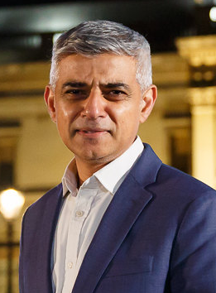


Key issues emerging
Political interference?
MPS Commissioner and Mayor of London – thoughts?
  Independence of Office of Constable vs Power to remove CC (MPS – Commissioner)
  Police Reform and Social Responsibility Act 2011.
  Is policing apolitical? Views?
    Bowling et al (2019) – Policing is by its very nature political and various example of such. Eg 1984 Miners Strike.

Slide 25

Key issues emerging
Independent Review of Policing – Launched 8th March 2022.
Sir Michael Barber.
Outline of Major challenges.
  Culture
  Technology
  Public confidence in Policing – Removing the measure a mistake?
  Changing Face of Policing.

Slide 26
Challenges (continued)
Nature of crime – traditional vs evolving crime types.
Social problems eg Missing persons & Mental health.
Performance – detection rates – proposition that lower detection rates = reduction in public confidence.
Visibility vs detections?
  Honest conversation with the public? DoDG vs Future cyber presence?

Slide 27
Challenges (continued)
Public confidence in policing -impact on underpinning principle of Policing by consent.
Crisis of confidence in Policing?
Role of the media in shaping perceptions?
Sir Michael barber – 3 key challenges
  Capacity
  Capability
  Organsation
  Thoughts?

Slide 28
Other observations
Mission of policing? What is the mission of policing?
KM – 3 priorities
  Clear prioritised mission
    Beating crime plan – If crime goes down rest will follow??? Discuss?
    Excellence in the basics
  Process vs Culture
    Leadership and culture eg Charing Cross – Casey review of MPS; direct entry as a solution?
    Professionalism
  Technology
    Acquisition and use of technology eg Facial recognition
    Digital policing not analogue policing in a digital age

Slide 29
Other observations (cont)
General acceptance that partnership approach needs to be improved! Thoughts?
Structure of Policing
  43 forces
  Local vs National
Collaboration – the benefits and disadvantages?
Linked to public confidence – legitimacy – The Stop / search conundrum? Disproportionality
Serious violence & national security.

