Slide 1

Are UWTSD students confident in using digital skills online?
  Lecturer Neale Haddon
  Yasmeen 2233492
  Amy 2221378
  Module code LCHS4002
Digital skills & Research Methods

Slide 2
Introduction
This PowerPoint presentation is based on a Quantitative research project proposal.
We will be conducting a survey with ethical consideration by discussing with students about their abilities and their confidence on using digital skills online.

Slide 3


Rationale
Are UWTSD students confident in using their digital skills online?
There is a great deal of research that explores the set of skills or competencies that are important and how they should be operationalized for research and practice (Ba et al., 2002; Eshet-Alkalai and Amichai-Hamburger, 2004; Gilster, 1997; Van Deursen, 2010).
This Photo by Unknown author is licensed under CC BY-SA.

Slide 4
Rationale continued...
The reason we are conducting this research, is to find out if students are confident in using Microsoft Apps online. It enables us to use our own research skills to demonstrate our own abilities in using digital skills.
The purpose of this research is to gather enough evidence to back up our claims that the older generation and the students in their second year are more confident than the students who are not.

Slide 5
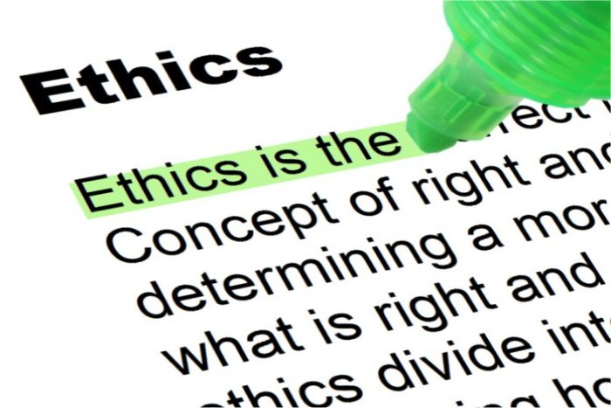
Ethical Consideration
An ethical consideration university students face is plagiarism. According to The Collins Dictionary of the English Language (Hanks, 1979), Plagiarismis ‘the act of plagiarising’, which means ‘to appropriate (ideas, passages, etc) from(another work or author)’. Plagiarism involves literary theft, stealing (by copying) the words or ideas of someone else and passing them off as one’s own without crediting the source.
This Photo by Unknown author is licensed under CC BY-SA.

Slide 6
Ethical Consideration
Another ethical consideration would be confidentiality. Online surveys must be kept confidential and within the parameters of The Data Protection Act. Reassuring students that are participating in a survey, that their responses are strictly confidential can improve the survey response rates.
The Data Protection Act controls how Students information and responses are used.
We will be making sure that the information we are collecting will be fairly used, accurate, stored safely and secure and not kept for longer than needed.

Slide 7

The Proposed Method
The proposed method is to find students who will participate in a Survey to discuss their level on confidence when using digital skills online such as MS Word and OneDrive "An important factor to consider when you need the results from your quantitative study, is to ensure that your study generates evidence of a sufficient quality, which may mean obtaining a high level of evidence"(Grey, Laura, Payne Katherine 2014 Chapter 6 pg 83-36)
This Photo by Unknown author is licensed under CC BY-NC-ND.

Slide 8
The Proposed Method Continued...
To obtain this high level of evidence, We are going to find students of different ages and students working at different levels to try and maintain an even and accurate result.
Here a few questions the survey will include,
Are you confident in using digital skills online?
Do you feel confident using OneDrive?
Do you see the value of using technology online to collaborate?

Slide 9
Hypothesis
We believe that the UWTSD students feel comfortable using their digital abilities. However, given the different ages gaps amongst UWTSD students, we assume the younger generation and the students in their second year will be more confident in using digital skills online.

Slide 10
Reference List
Walker (Ed.). (2014). An Introduction to health services research . SAGE Publications Ltd
Park C (2010) In others peoples words: Plagiarism bu university students-literature and lessons. Pages 471-488
Helsper, E.J. and Eynon, R. (2013) ‘Distinct skill pathways to digital engagement’, European journal of communication., 28(6), pp. 696–713.

