Slide 1
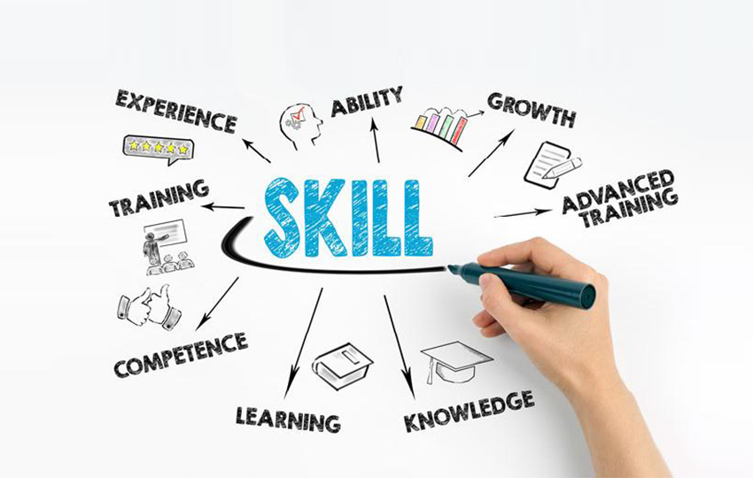
Academic And Employability Skills
ACE Practical Portfolio

Slide 2

Introduction
The health and social care sector is the backbone of every society (Beresford, 2019).
Healthcare units along with physiotherapy centre, nursing homes are health and social service organisation.
A senior support worker is responsible for providing social care services.
Notes:
The health and social care sector is the backbone of every society. It includes all the related organisation who is involved to provide health care services such as hospital as well as healthcare units dentists and physiotherapy centres. In recent years, the importance of the healthcare industry has grown dramatically. As a senior support worker in the healthcare industry, you must be able to cultivate an employability experience that benefits both the employer and the social work element. Employability encompasses a variety of capabilities that are needed to change the corporate atmosphere and social aspects that have evolved as a result of this specific position's portfolio. Working as a senior support worker necessitates understanding how to effectively communicate with other healthcare support staff as well as the will to persevere in the face of adversity. Employability skills must also be learned from previous working interactions. A senior support worker is responsible for providing social care support by regulate all the support staff and manage the entire teams across a cluster of services. Hence, it is essential to choose a career goal to achieve career ambition. For this reason, the study is discussed about the learning experiences in the entire academic seasons and also conclude about the work experiences during the course or work in the health and social care sector. A personal SWOT is also done to understand the key characteristics of the senior support worker. Hence based on the SWOT analysis personal development plan is developed. To prepare the personal development plan academic and job oriented experiences is also considered which is discussed in the reflective part of the presentation.

Slide 3
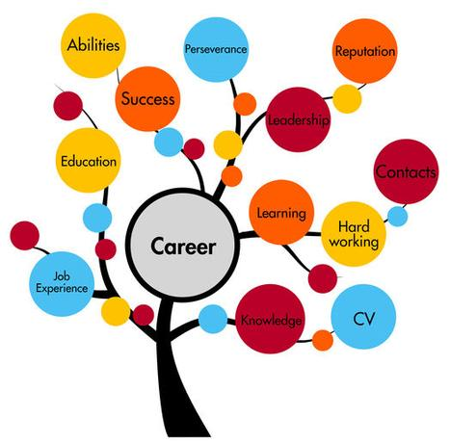
Intended career
Carrier experience
Archive employability skills
Learn excellent communication
Resilience to cope with difficult situations
Future ambition
Short term goal: Join a healthcare charitable organisation
Long term goal: Gather knowledge and apply it to become a more responsible person
Notes:
The entire career experiences are a set of aspect which can be utilized by the individual to achieve the future ambition. In this recent slide, the discussion about the career experiences is formulated and the future career ambitions are identified to set the future goals. Employability refers to a set of skills that are required to improve the organisational culture and social aspects that have arisen as a consequence of this position's responsibilities. A senior support worker is in charge of delivering social care support by supervising and managing all support workers within a cluster of programmes. The job experience which is involved working as a senior support worker includes learning how to communicate effectively with the support staffs in a healthcare unit as well as the will or motive to persevere in the face of adversity within the organisation. Moreover, it is necessary to achieve employability skills through the use of past academic experiences. The future ambition includes two types of goals, the short term goal is to Become a member of a charitable hospital organisation and the long term goal is to gather information and use it to become a more responsible citizen.

Slide 4

Required employment skills
Communication: Good communication skill is needed to integrate the support staffs
Team management: Team management capability is necessary to manage the support staffs
Notes:
The above slide is discussed about the two aspects. The first aspect is related to communication power and the second aspect is related to team management power, which is needed to serve in the health and social care sectors. To incorporate the support staffs, good communication skills are needed. Moreover, In order to handle the support personnel, you'll need to be able to work in a group. Therefore, both the skilled substitute of each other because to manage the support staffs a good communication skill is needed. To improve the service level of senior support workers, proper preparation is needed. This slide lists some of the basic employability skills needed to become a senior support worker. The basic character trait of a senior support worker is preparation and organisation.

Slide 5

Required employability skills
Planning and organising: Planning and organizing is the basic character of a senior support worker.
Technology: Senior support worker must be a technical person.
Notes:
Another two important skills are technological as well as planning and organizing skill which is needed to consume the time within the health and social care organisation. Moreover, appropriate planning is also necessary to enhance the service quality of senior support worker. Some of the basic required employability skill to become a senior support worker is listed on this slide. A senior support worker's basic character trait is planning and organising. A professional employee must be senior support staff. Strong technological skills are needed to integrate the support workers. Furthermore, you must be able to operate as a squad to manage the support staff.

Slide 6

Required employability skills
Problem-solving: It is a unique power that is needed for the senior support worker to manage the workforce
Critical thinking: The critical thinking power can minimise the risk effect within the health and social care organisation.
Notes:
The two characters are described in this slide to understand the job role of the senior support workers in a health and social care organisation. Problem-solving is a special skill that the senior support worker would provide in order to handle the workforce. Critical thinking ability is applied by the senior support worker to think critically to reduce risk in health and social care organisations.

Slide 7
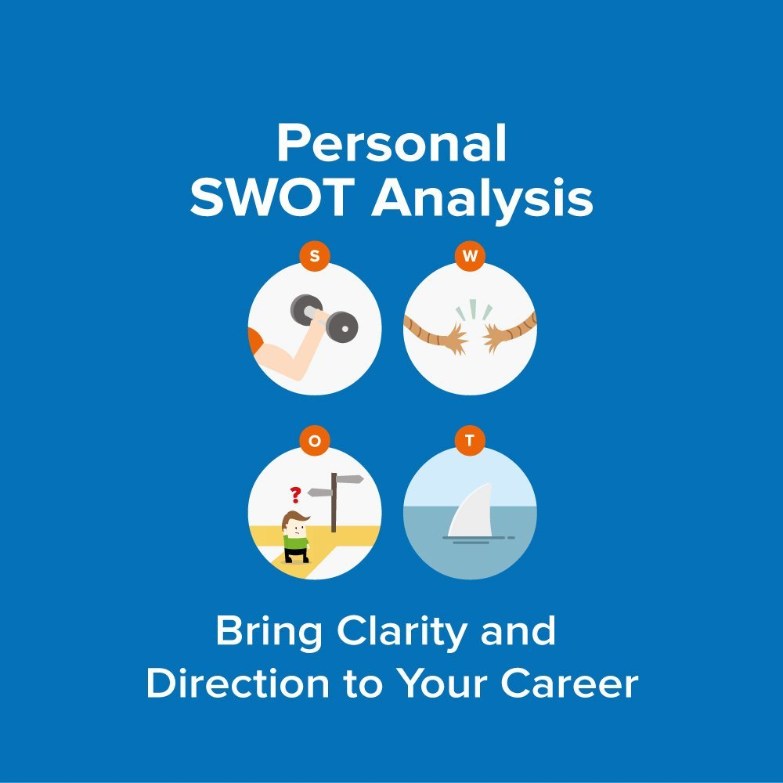
Personal SWOT analysis
Strength: Number skills, writing skills and time management
Weakness: Communicate with people, people management, confidence level (Issayev, Masalimova and Magzumova, 2018)
Opportunity: More support staffs and available training program.
Threats: Stress and rigid work condition.
Notes:
Knowing and comprehending one's Strength, weakness, opportunity, and threats (SWOT) will aid in the development of a career strategy. This is especially helpful if a senior support worker looking for a promotion. The personal SWOT analysis is prepared through the use of past experiences of the senior support worker. Number skills, composition skills, and time management are also strengths, which is experiencing by the senior support worker. Though, the senior support worker also experiencing some shortcomings such as a lack of communication ability. Therefore, it is adversely affected at the time of manage support staffs. Hence, a progressive training program is needed to address those issues.

Slide 8

Time Management tools
Various tools are available to manage time in the health and social care sector
Google sheet and docs: Listing of the task to save the time
Google drive: Save the valuable documents for further use.
Google mail: Notify to the supportive staffs
Notes:
It is essential to utilize the time management tools to minimise the service time. The time management tool provides a flexible work environment to do the task more easily. In the health and social care industry, a variety of time management techniques are available. Some of the time management tool and their usage in the health and social care units are described in the above slide. Google Sheets and Docs can be used to keep track of tasks and save time. Goole drives can also be used to manage time. that the senior support worker is using to save important records for future use. The use of Google mail is gradually becoming more common as a means of notifying helpful workers about current issues. All the tools, which is provided by Goolge LLC. is more reliable than any other tools. The tools provide flexibility and customize option to protect health-related information in an appropriate manner. It can eliminate the manual documentation process in the health care sectors.

Slide 9
Personal development plan
Target | Procedure to achieve | Duration
Enhance communication skill | Through discuss various recent affairs about the health and social sectors with various peoples (Buse, Martin and Nettleton, 2018) | October 2021
Improve Staff Management skill | Through joining in a various training program | November 2021
Enhance confidence level | Through taking more responsibility | November 2021
Notes:
A Professional Development Plan is a written record of self-reflection and progress that often serves as a comprehensive action plan for achieving learning, personal, or career-related objectives. It's normally developed at work or while learning and working by encouraging people to set goals, recognise their strengths and shortcomings, and see where they need to develop. The first goal is to improve leadership skills by addressing current events in the health and social spheres with a variety of people. The strategy is expected to be formulated within the next two weeks and completed between October 2021 and October 2022. It is also important to develop staff management skills by participating in a variety of educational programmes relating to health and social care operations. The proposal will be finalised in the next three to four weeks, and it is planned to be completed by November 2021. The final and most important plan is to boost morale by taking on more responsibilities at work. The proposal will be unveiled in a week and completed by November 2021.

Slide 10

Self-reflection
In my opinion, it is quite difficult as well as attractive to start a carrier as a health and social care worker.
I am experiencing some sort of problems regarding the management of supportive staffs
I can resolve those problems with the help of a prepared Personal development plan.
Employability theories:
A behavioural theory of employability
A trait theory of employability
Notes:
It is important to discuss the past experiences to support the fact of the current study. Starting a career as a health and social care professional, in my experience, is both daunting and appealing. It is also crucial to understand some employability theory to enhance my personality. The behavioural theory of employability focuses on the staff's behaviour to manage them properly. On the other hand trait theory of employability is also focus on the employee's character to improve the behaviour in the workplace. Both of the theories are important to conduct the service operation within the health and social care organisations. I am focused on both theories to improve behavioural performance. I'm having some issues with the supervision of friendly workers, and I'm hoping to fix them with the guidance of a well-prepared personal growth strategy. Moreover, I have learned various topics in my academic sessions that are related to the conduct of the service operation in various organisation. Though, I choose the health and social care sectors because there is a lack of awareness between the people about the health and social care services. Also, I was interested to become a healthcare staff to provide assistance to the individual by promoting health-related services from the beginning of my career. Although, the sector is experiencing a lot of challenges. As I am working as a senior support worker, there has a serious concern about the lack of workforce is present to provide daily basis services. Moreover, the allocation and the collection of the fund to provide health and social services are not adequate to provide assistance to the individual. For example, I was failed to provide adequate health service at the time of the Covid-19 pandemic due to the lack of fund is available for all the individual. Therefore, in my opinion, the interrogation of all stakeholder is needed to resolve this kind of challenges.

Slide 11

Conclusion
The health and social care sector have progressive carrier options.
To work as a Senior support worker various employability skill is needed.
Prepared PDP with the help of SWOT analysis can improve the personality skill of the employees.
Notes:
At the end of the study, it can be concluded that there are innovative carrier choices in the health and social care market. A variety of employability skills are required to serve as a Senior Support Worker. The most commons employability skills are communicative skills, managerial skills, problem-solving and critical thinking skill and at the final stage, the technical skill is needed to become a muster in the health and social care sectors. In order to manage the workforce, the senior support worker must have problem-solving as a special skill. The senior support worker uses analytical thinking skills to think creatively in order to minimise risk in health and social care organisations. Strong communication skills are needed to integrate the support workers. Furthermore, one must be able to operate as a squad to manage the support staff. As a result, all professional substitutes for each other because managing support staffs necessitates strong communication skills. Proper training is needed to increase the quality of service provided by senior support staff. Working as a senior support worker necessitates knowledge about how to efficiently collaborate with other healthcare support staff, as well as the capacity to persevere in the face of hardship. Moreover, it is crucial to managing time to complete the task as a senior support worker more easily. Therefore, using various tame management tool is needed. It is important to make use of time scheduling techniques in order to reduce service time. The time management technique allows for a more flexible work environment, making it easier to complete the job. A multitude of time management methods are available in the health and social care sector. The above slide describes some of the time management tools and how they are used in health and social care settings. Google Sheets is an online spreadsheet programme.In most cases, it is examined that there is a certain type to risk that is also related to the use of those time management tools. The experts who are involved with the building time management tools ignore to protect the valuable data. The latest study also focuses on the preparation of a personal development plan to eliminate the weakness of the senior support staff. Employees' personality skills can be improved by preparing a PDP with the aid of a SWOT examination. A Professional Development Plan is a published record of personality and achievement that also serves as a concise action plan for achieving schooling, family, or career objectives. It's usually developed at work or while learning and practising by assisting individuals in setting goals, recognising their strengths and shortcomings, and identifying opportunities for improvement. The personal SWOT review is created using the senior support worker's previous experiences. The senior support worker has a number of talents, including number skills, writing skills, and time management. The senior support officer, on the other hand, has certain flaws, such as a lack of organisational skills.

Slide 12
Reference List
Beresford, P., (2019) Public participation in health and social care: exploring the co-production of knowledge. Frontiers in Sociology, 3, p.41.
de Freitas, C., (2017) Public and patient participation in health policy, care and research. Porto Biomedical Journal, 2(2), p.31.
Green, G., Boaz, A. and Stuttaford, M., (2019) public participation in health care: exploring the co-production of knowledge. Frontiers in Sociology, 4, p.73.
Martin, D. and Nettleton, S., (2018) Conceptualising ‘materialities of care’: making visible mundane material culture in health and social care contexts. Sociology of Health & Illness, 40(2), pp.243-255.
Masalimova, A. and Magzumova, R., (2018) SWOT-ANALYSIS OF PROFESSIONAL-PERSONAL COMPETENCE OF ECONOMISTS IN MEDICAL ORGANIZATIONS. Georgian medical news, (276), pp.1143-1153.

Slide 13


