Slide 1

ECHC7001
Advanced Research Methods
Module Lead: Andrea Williams
Notes:
NOTE:
To change the image on this slide, select the picture and delete it. Then click the Pictures icon in the placeholder to insert your own image.

Slide 2

Learning Aims for this week: w/c 28th September 2020
Introduction to the Advanced Research methods Module
Overview of assessment schedule and marking criteria
Module structure: Blended learning - Asynchronous and synchronous learning.
Starting your Research Journey: Choosing a research topic
Managing your time and adapting in times of uncertainty
Group & Online Contracting and Teams etiquette
Module and Assessment expectations
Notes:
NOTE:
To change the image on this slide, select the picture and delete it. Then click the Pictures icon in the placeholder to insert your own image.

Slide 3
Consider for a moment….. Your feelings about being back and adapting to a new way of Blended Learning

Slide 4
Group Contract

Slide 5
Module Aims
To apply practice to research.
To consolidate areas of specialist knowledge.
To communicate research
To provide learners with the opportunity to extend their knowledge of a chosen subject within the parameters of the programme.

Slide 6
Learning Outcomes
Upon the successful completion of this module, the student should be able to demonstrate the ability to:
Extend a systematic understanding and critical awareness of topics which are informed by the forefront of the discipline of counselling/psychotherapy.
Evidence a critical awareness of the history of ideas; the cultural context, social and political theories that inform and influence the practice of counselling and psychotherapy.
Critically identify appropriate methodology that can be identified for dealing with complex problems or those of an unfamiliar or unpredictable nature.

Slide 7
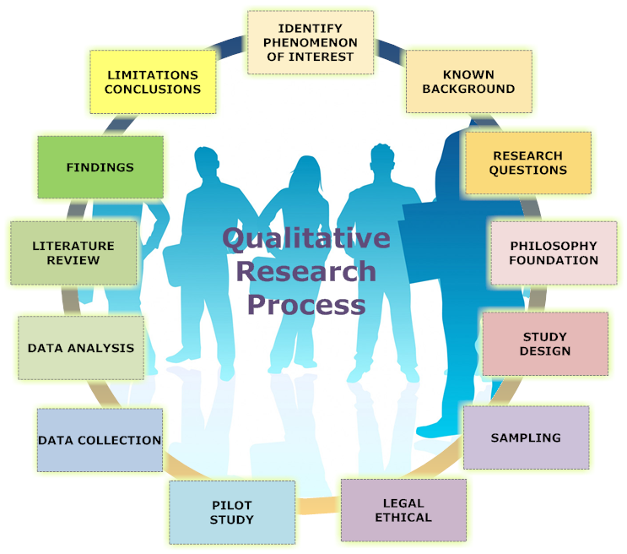
Module Content
The Research process: Planning your research
Formulating a research question
Research design, methods and methodology
Electronic research and
Research Ethics
Research participants/co researchers
Gathering and analysing data
Writing and publishing research

Slide 8
Assessment Component 1
Practical: Project Proposal (20 minutes)
Submission Date: 01.12.2020
Assessment Component 2
Practical assessment: Pilot Study (1 hour)
Submission Date: 02.02.2021
Assessment Component 3
Coursework: Critical Evaluation of Research process (2000 words)
Submission Date: 16.3.2021

Slide 9

Synchronous v Asynchronous: Can you tell the difference?

Slide 10
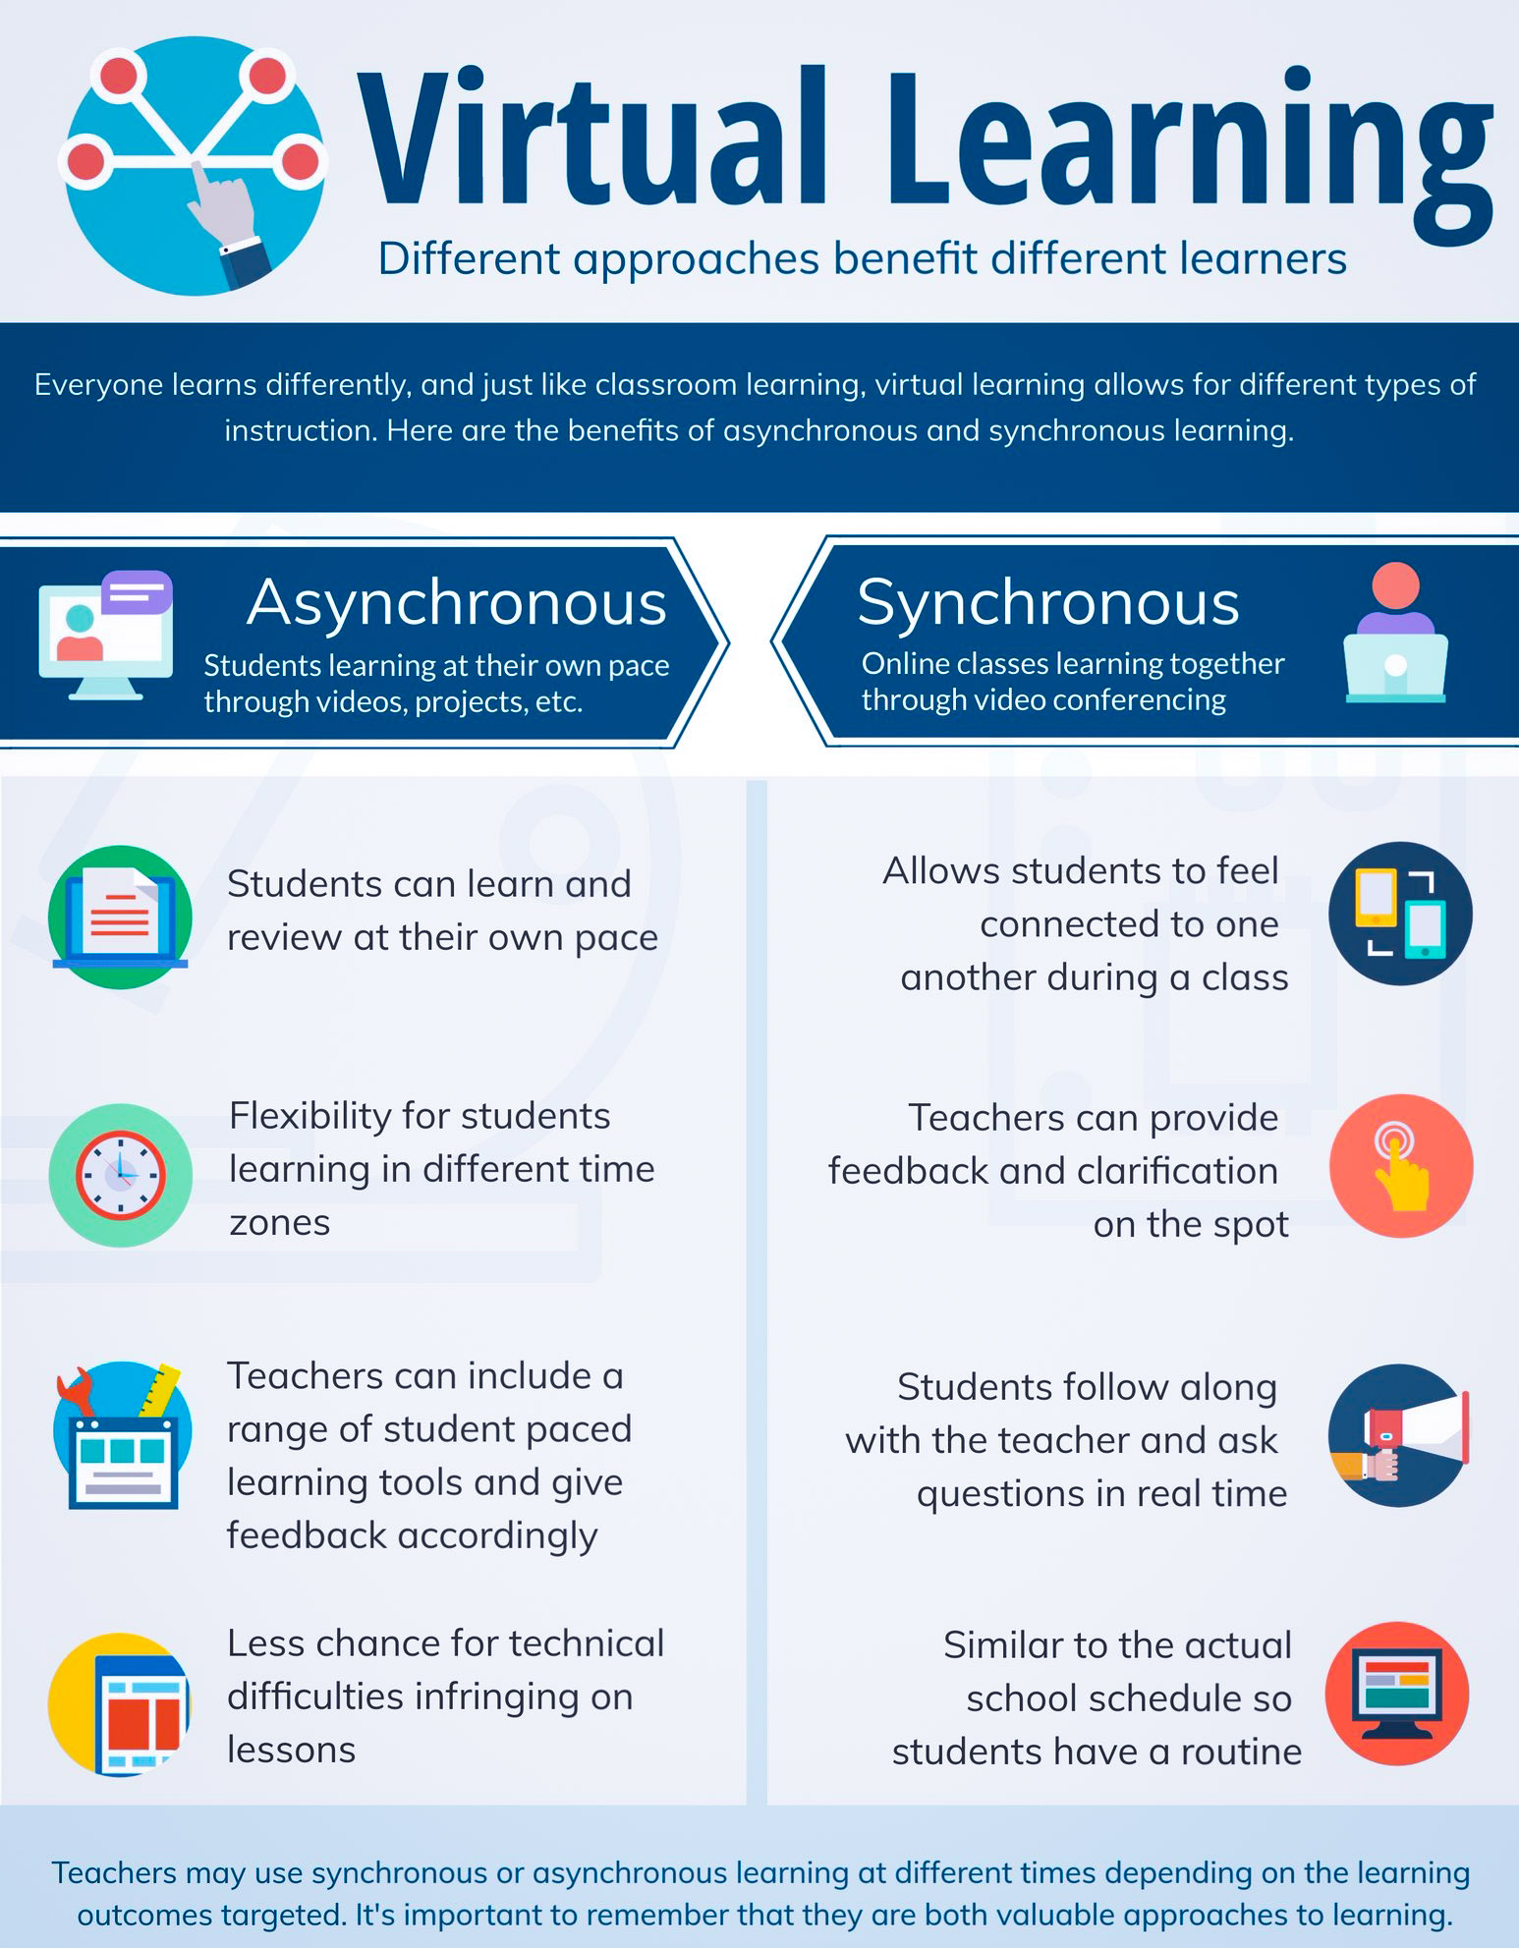

Slide 11
BLENDED LEARNING SCHEDULE
Synchronous Learning
Asynchronous Learning
Pre recorded power point
Face to Face Synchronous Learning
Interactive
Videos
Online resources
Microsoft Teams
IQ Campus
Experiential workshops

Slide 12
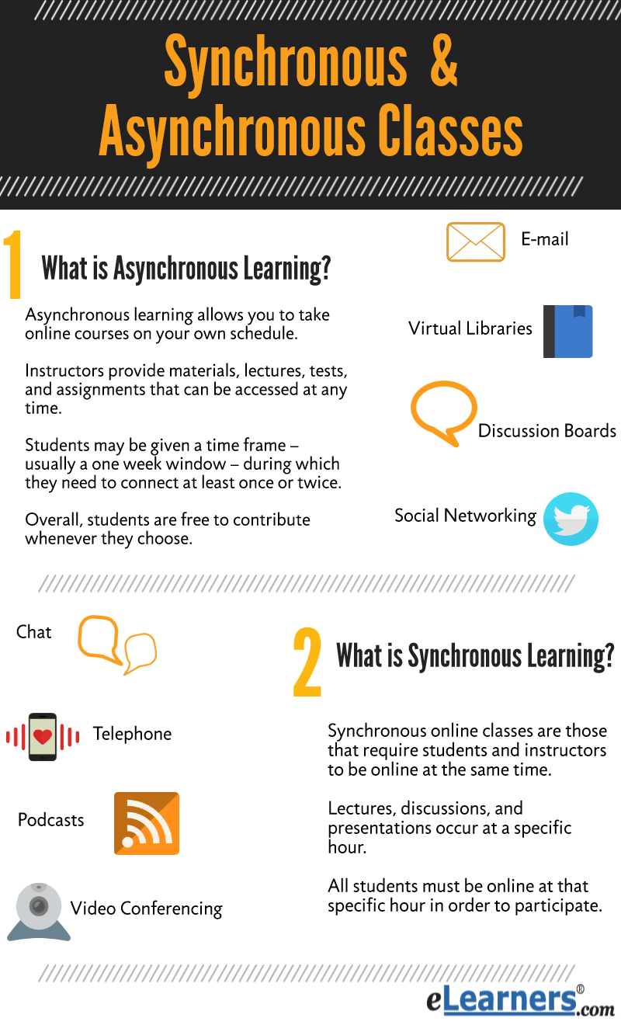
Module Structure
30 credit module delivered over semester 1 and 2 | Hours
Scheduled learning: Synchronous and Asynchronous Delivered over 20 weeks. 10 weeks in semester 1 10 weeks in semester 2 | 100
Independent learning | 200
Weekly Scheduled Learning Plan Monday 11:00 to 15:00 Online Tuesday 12:00 to 14:00 on Campus (Alternate Tuesdays. W/C Tuesday 6th October 2020)
 | 300

Slide 13
Managing your time and adapting in times of uncertainty
Group & Online Contracting and Teams etiquette
Notes:
NOTE:
To change the image on this slide, select the picture and delete it. Then click the Pictures icon in the placeholder to insert your own image.

Slide 14

Key Dates 2020-21
Semester 1: 21st September 2020 – 22nd January 2021
Teaching Commences w/c 28th September 2020
Reading Week: w/c 26th October 2020
Assessment Component 1: 1st December 2020
Christmas Break: w/c 14.12.2020
Semester 2: 25th January 2021 – 17th July 2021
Assessment Component 2: 2nd February 2021
Reading Week: w/c 21st February 2021
Assessment Component 3: 16th March 2021
Easter Break: 29th March to 16th April 2021
Dissertation Submission: 11th May 2021

Slide 15

Library Resources
Subject Librarian: Samantha Scoulding
Useful links:
Library website: www.uwtsd.ac.uk/library
Library YouTube Channel: https://www.youtube.com/channel/UCYeVXnLfNshZ6iKd7Bm3yiw?view_as=subscriber
Dissertation Skills online session: https://uwtsd.ac.uk/library/infoskills/getting-started-with-your-dissertation/
Search strategy handout: https://uwtsd.ac.uk/media/uwtsd-website/content-assets/documents/library-and-learning-resources/infoskills/building-a-search-strategy.pdf
Digital Commons Network: https://network.bepress.com/
UWTSD Research Repository: https://repository.uwtsd.ac.uk/

Slide 16
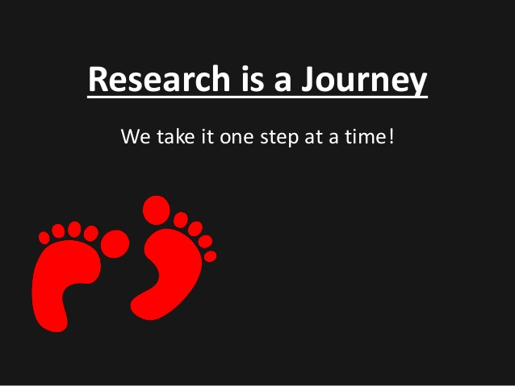
Starting your Research Journey: Choosing a research topic.

Slide 17
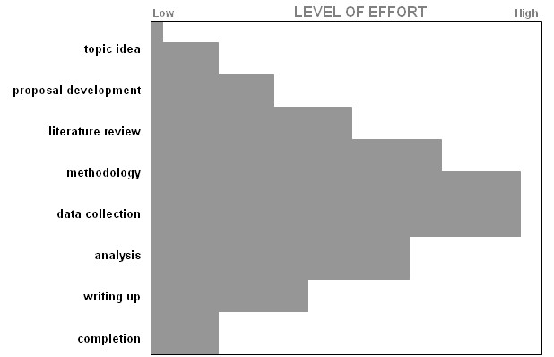
CYLCH OES TRAETHAWD HIR DISSERTATION LIFE-CYCLE
Cyfnod cysyniadol/ Conceptual phase
Cyfnod beirniadol/ Critical phase
Cyfnod gweithredu/Action phase
Cyfnod dadansoddol/ Analytical phase
Cyfnod creadigol/ Creative phase

Slide 18
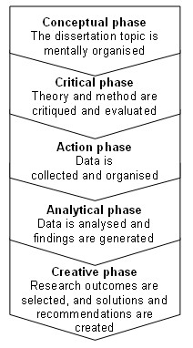
CYFNODAU TRAETHAWD HIR DISSERTATION PHASES

Slide 19
List the steps you need to take to get started on your research journey

Slide 20
Managing your Time
Start early.
Set aside adequate time.
Adhere to a timeline.
Work with a strong mentor (or supervisor, in the UK system).
Choose a research topic that genuinely interests you.
Keep the project simple yet innovative.

Slide 21
REFLECTION
  Consider how long you need to set aside each week?

Slide 22
REFLECTION
  Consider the barriers you might experience?
  What do you need to put in place?

Slide 23

Prepare an action plan today!

Slide 24
Research Ethics
UWTSD: Student Regulations 2020-21
UWTSD: Research Ethics and Integrity Code of Conduct
BACP: Ethical Guidelines for Research in the Counselling Professions
BERA: British Educational Research Association
BERA: Ethical Guidelines
BPS: Code of Ethics and Conduct
Please read and consider in preparation for next week

Slide 25
Reading in Preparation for Next Week
Staines, G, M. (2019) Social Sciences Research, Research Writing and Presentation for Students. London: Rowman & Little Publishers. Chapter 1 (online)

Slide 26
Reading
Andrews, G. (2017) How to write a master's dissertation. Ebook and free on Kindle. This will only take you about an hour to read and gives you the basics of the format and content of a dissertation
Cooper, M. (2008) Essential Research Findings in Counselling and Psychotherapy: the facts are friendly. London, Sage.
Cooper, M. Et al (2010) Person-Centred and Experiential Therapies Work: A Review of the Research on Counselling, Psychotherapy and Related Practices. Ross on Wye, PCCS.
Glatthorn, A.A. and Randy, L.J. (2005) Writing the winning thesis or dissertation. Online
Harper, D. (2012) Qualitative research methods in mental health and psychotherapy: a guide for students and practitioners, Oxford: Wiley-Blackwell. Online
McLeod, J. (2011) Qualitative Research in Counselling and Psychotherapy. 2nd Ed. London: Sage
Pyrczak, F. (2014) Evaluating Research in Academic Journals: A Practical Guide to Realistic Evaluation. Taylor & Francis. Online
Staines, G, M. (2019) Social Sciences Research, Research Writing and Presentation for Students. London: Rowman & Little Publishers. Online
Willig, C. (2008) Introducing Qualitative Research in Psychology. 2nd Ed. Berkshire: Open University Press.
Wodak, R (2009) Methods of Critical Discourse Analysis 2nd Ed. London: Sage.

Slide 27
What do you need to put in place to prepare yourself for the next level of your professional and personal learning journey?

Slide 28
QUESTIONS?

