Slide 1
Defenders, Conquerors, and Vanquished
Lecture 16: Alexandria

Slide 2
Centralized Royal command economy
Inventory of the royal domain . . . Everything connected with it was delivered to Phoinix the chief treasurer in year 28, in the month of Thoth of the king who was victorious over the Philopersian king when he entered Syria. His scribes and district officials compiled it, from Elephantine to the Mediterranean, in detail nome by nome, altogether 36 provinces.
Demotic Ostrakon from Thebes 258 BC

Slide 3
Command Economy
They declared and reported concerning the water (noting) when the basins (are full) and the flooded fields are green, enumerating their water sources and levees. A census of Egypt was ordered, specifying field by field, their irrigation possibilities, their location, their arable portions, their relation to the property of their protector gods, their common borders with the fields of the benefices themselves and of the royal fields, specifying area by area the size of the parcels and the vineyards, noting when the fields and areas are dry – likewise the pastures – and the water channels, the fields that are free and vacant . . . Specifying orchard by orchard the trees with their fruits, the gardens, . . . The list of leased parcels with their equipment . . . And in addition their taxes, the total of the expenditures for the welfare of Egypt and its sublime freedom, of its cities and of its temples.
Burstein 97

Slide 4
Payment of 1/6 of produce (apomoira) for the royal cult of Arsinoe II. Greek Papyrus
[King] Ptolemy [to all the] strategoi, [hipparchs], officers, nomarchs, [toparchs], oikonomoi, antigrapheis, royal [scribes], Libyarchs and chiefs of police, greetings. We have sent you copies of the [ordinance which] requires payment of the sixth to (Arsinoe) Philadelphus. [Take care therefore] that these instructions are carried out. Farewell. Year 23, Dius 2 (= Nov.-Dec. 263 BC). [All those who ] have vineyards or orchards, [whatever] their tenure, shall all give to the agents of Satyrus, [and to] the accountants appointed as agents of Dionysodorus, [nome by] nome] a written statement, drawn up by themselves, or their managers, or [those cultivating] their property, from year 18 to [year 21], (indicating) the amount of produce and to which temple they used to give the sixth, and the annual amount. Similarly the priests (shall make a statement) from which property they used to receive (the sixth) and the annual amount of wine or money. Similarly the royal scribes and the . . . shall give . . . written statements of these.
Austin no. 235 (296 2nd ed)

Slide 5
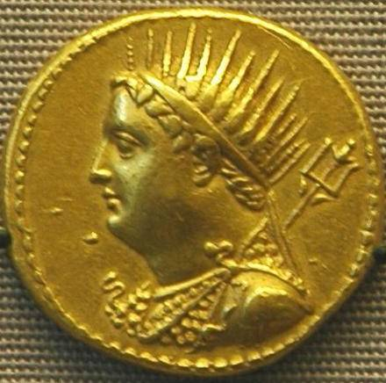
Royal monopoly on coinage
Demetrius to Apollonius greetings. It is well if you are in good health and everything else is as you wish. As for me, I am devoting myself to what you wrote me to do: I have received 57,000 (drachmas?) of god, which I minted and returned. We would have received many times as much, but as I have written to you before, the foreigners who come here by seas, the merchants, the forwarding agents, and others, bring their own fine local coins and the trichrysa, to get them back as new coins, in accordance with the ordinance which instructs us to taker and mint them, but as Philaretus does not allow me to accept them, we have no one to refer to on this matter, and are compelled not to accept them. The men are furious because we refuse the coins at the banks . . . . and they cannot send their agents into the country to purchase merchandise.
P. Cairo Zen 59.021; BD 102; Austin 238/299

Slide 6
The native Egyptians
Rosetta Stone (196 BC):
King Ptolemy (V) . . . Has conferred benefits in many ways on the temples and their staffs and on those subject to his rule, as he is a god from a god and goddess just as Horus, the son of Isis and Osiris, the defender of his father Osiris, he has assigned to the temples revenues in money and grain . . . With good fortune it has been resolved by the priests of all the temples in the land that all the honours belonging to king Ptolemy, the eternal, beloved of Ptah, god Epiphanes Eucharistos, and likewise those of his parents, the gods Philopatores, and of his grandparents, the gods Euergetai [and] those of the gods Philadelphoi and those of the gods Soteres shall be increased greatly. . .

Slide 7
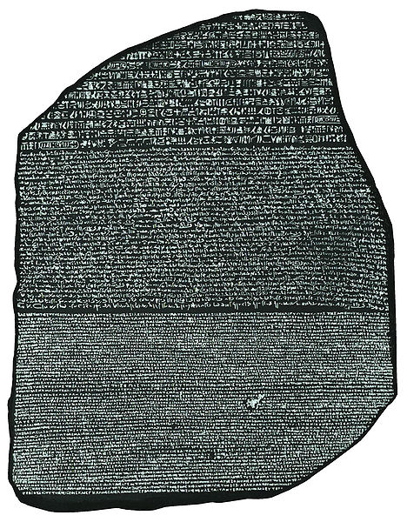
The Rosetta Stone
Hieroglyphic
Demotic
Greek

Slide 8
Ptolemy II and Ptolemaic Culture

Slide 9
Theocritus Idyll 17.121-134
This man, alone of men of the past and of those whose still warm footprints mark the trodden dust, has established fragrant shrines to his loving mother and father; within, he has set them glorious in gold and ivory to bring aid to all upon the earth. Many are the fattened thighs of cattle that he burns upon the bloodied altars as the passage of months proceeds, both he and his noble partner, than whom no better wife embraces her young husband in halls, loving with all her heart her brother and her husband. In this manner too was accomplished the sacred marriage of the immortals whom Queen Rhea bore as kings of Olympus: it is one bed that Iris, to this day a virgin, prepares for Zeus and Hera, when she has cleansed her hands with perfumes.

Slide 10
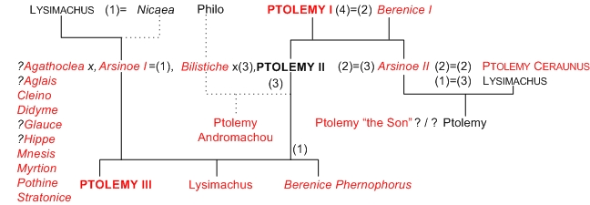
Marriage

Slide 11
Arsinoe II
Married to Lysimachos c. 300
Conspires against Agathokles and he is killed in 283/2
His widow Lysandra and her brother Ptolemy Keraunos flee to Seleucus
Seleucus defeats Lysimachos at Korupedion in 281
Keraunos assassinates Seleucus and crowned king of Macedon
Arsinoe flees back to Egypt
Marriage to Ptolemy II (c. 279)

Slide 12
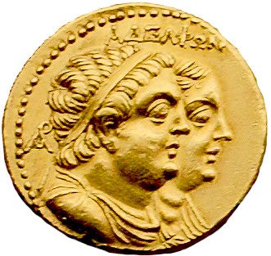
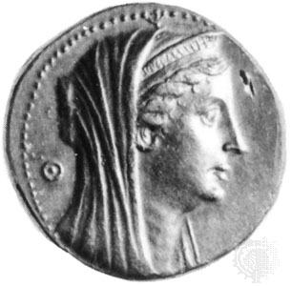
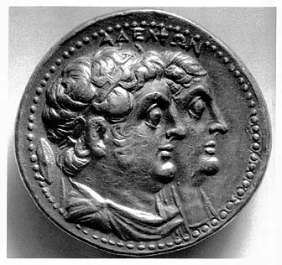
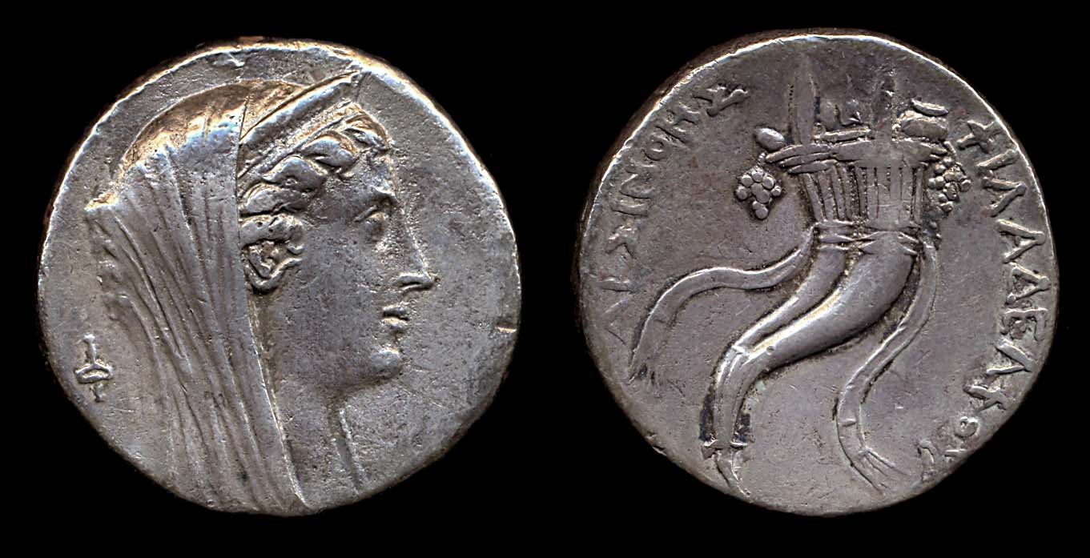
Joint Rule

Slide 13
Alexandria: Landscape and Harbours
Since Alexandria and its vicinity form the largest and most important part of this work, I must begin with them. The coast from Pelusium as one sails towards the west as far as the Canobic mouth is about 1,300 stades long (c. 227.5 km); this is what I have called the base of the Delta. From there to the island of Pharos is a further 150 stades (c. 26.25km)Pharos is an oblong island, very close to the mainland, and forms with it a harbour with two entrances. The shore has the shape of a bay, as it has two promontories jutting out into the sea; between these lies the island which closes the bay, for it stretches lengthwise along the shore.
The western entrance does not offer easy access, though it does not demand so much caution. It too forms another harbour, that of Eunostus as it is called; it lies in front of the closed harbour which was dug out artificially. The harbour which has its entrance on the side of the tower of Pharos which I have mentioned is the Great Harbour, while the (other harbours) lie continuously with it in their recess, being separated from it by the embankment called the Heptastadium. This embankment forms a bridge stretching from the mainland to the western part of the island, and leaves only two passages into the harbour of Eunostus, which are bridged over. This work formed not only a bridge to the island but also an aqueduct, at least when the island was inhabited.

Slide 14
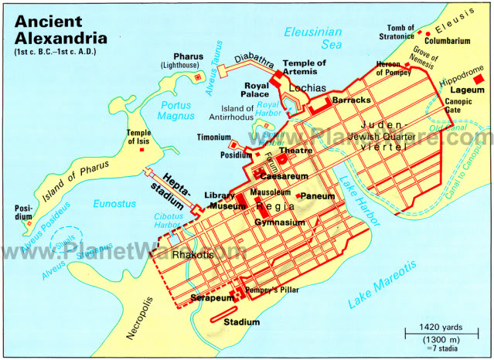

Slide 15
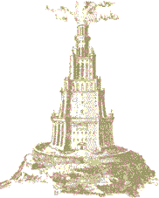
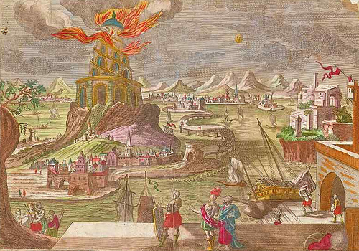
Pharos
Of the extremities of Pharos the eastern one lies closer to the mainland and to the promontory which faces it (this promontory is called Lochias), and this makes the entrance of the harbour narrow; in addition to the narrowness of the channel there are also rocks, some under water and others above, which at all times roughen the waves that strike them from the open sea. The extremity of the islet (Pharos) is also a rock, washed all round by the sea, with on top of it a tower magnificently built of white stone, several stories high, which bears the same name as the island. This was dedicated by Sostratus of Cnidus, a ‘friend’ of the kings, for the safety of sailors, as the inscription declares. For since the coast was harbourless and low on both sides, and also had rocks and shallows, those who were sailing there from the open sea needed a tall and conspicuous sign to enable them to make straight for the entrance of the harbour.

Slide 16
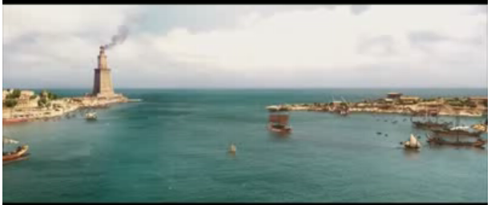
Oliver Stone’s reconstruction of the Lighthouse

Slide 17
Alexandria: City
The shaper of the area of the city is like a cloak (chlamys); the long sides of it are those that are washed by the two seas, and have a diameter of about 30 stades (c. 5.25km) while the isthmuses form the short sides, each of them 7 or 8 stades wide and cut off on one side by the sea and on the other by the lake. The whole city is criss-crossed with streets suitable for the traffic of horses and carriages, and by two that are very wide, being more than 1 plethrum (c. 30m) in breadth; these intersect each other at right angles. The city has magnificent public precincts and the royal palaces, which cover a fourth or even a third of the entire city area. For just as each of the kings would from a love of splendour add some ornament to the public monument, so he would provide himself at his own expense with a residence in addition to those already standing…. All however are connected with each other and with the harbour, even those that lie outside it.

Slide 19
Population
Diodorus estimate 300,000 “free” inhabitants (Diodorus 17.52.6)
Total population 500,000
O ye gods, what a big crowd! However are we to get through this crush, and how long will it take? Ants, numberless and immeasurable! You’ve conferred a great many benefits on us, Ptolemy, since your father (Ptolemy I) went off to join the gods. Nowadays no criminal harms the passer by, sneaking along in Egyptian fashion.
Theocritus Idyll 15

Slide 20
Festivals
GORGO
Praxinoa, do come here. Before you do anything else I insist upon your looking at the embroideries. How delicate they are! and in such good taste! They’re really hardly human, are they?
PRAXINOA
Huswife Athena! the weavers that made that material and the embroiderers who did that close detailed work are simply marvels. How realistically the things all stand and move about in it! they’re living! It is wonderful what people can do. And then the Holy Boy; how perfectly beautiful he looks lying on his silver couch, with the down of manhood just showing on his cheeks, – (religioso) the thrice-beloved Adonis, beloved even down below!
Theocritus Idyll 15, 77ff.

Slide 21
Festivals
…also twenty-six Indian zebus entirely white, eight Aethiopian, one large white she-bear, fourteen leopards, sixteen genets, four caracals, three bear-cubs, one giraffe, one Aethiopian rhinoceros. Next in a four-wheeled cart was Dionysus at the altar of Rhea, having found refuge there while being pursued by Hera; he had on a gold crown, and Priapus stood at his side, with a gold ivy-crown. The statue of Hera had a gold diadem. Then there were statues of Alexander and Ptolemy, crowned with ivy-crowns made of gold. The statue of Goodness which stood beside Ptolemy had a gold olive-crown. Priapus stood beside them also wearing an ivy-crown made of gold. The city of Corinth, standing beside Ptolemy, was crowned with a gold band. Beside all these figures were placed a stand for cups, full of gold vessels, and a gold mixing-bowl of fifty gallons capacity. Following this cart were women who wore very rich robes and ornaments; they bore the names of cities, some from Ionia, while all the rest were the Greek cities which occupied Asia and the islands and had been under the rule of the Persians; they all wore gold crowns. In other carts, also, were carried a Bacchic wand of gold, one hundred and thirty-five feet long, and a silver spear ninety feet long; in another was a gold phallus one hundred and eighty feet long, painted in various colours and bound with fillets of gold; it had at the extremity a gold star, the perimeter of which was nine feet.”
Athen. 5.201c-e

Slide 22
Alexandria: Museum
The Museum also forms part of the royal palaces; it has a covered walk, an arcade with recesses and seats and a large house, in which is the dining hall of the learned members of the Museum. This association of men shares common property and has a priest of the Muses, who used to be appointed by the kings but is now appointed by Caesar.

Slide 23
Museum
In the populous land of Egypt there is a crowd of bookish scribblers who get fed as they argue away interminably in the chicken coop of the Muses.
Timon of Phlius: Athen. 1.22d

Slide 24
Museum
Organisation of books:
Tables of persons eminent in every branch of learning, together with a list of their writings or Tables (Pinakes) – Callimachus
120 books
  Table of Orators,
  Table of Philosophers
  Table of Lyric Poets
Notes:
Table of Orators, Table of Philosophers, Table of Lyric Poets, etc. Each author was listed alphabetically with a short biography and a list of titles of their works and for good measure the total number of lines in each work.

Slide 25
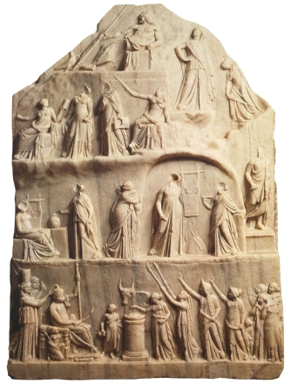
Homer
Create a definitive edition of Homer
Homeric commentaries

Slide 26
Alexandria: Sema
The so-called Sema (tomb) is also part of the royal palaces; this was an enclosure in which were the tombs of the kings and of Alexander. For Ptolemy son of Lagus got in ahead of Perdiccas and took the body from him when he was bringing it down from Babylon…. He gave it burial in Alexandria, where it now lies, though not in the same sarcophagus. The present one is made of glass, while Ptolemy placed it one made of gold.

Slide 27
Alexander’s Body
Meanwhile, the Persians were fighting, since they wanted to take the king to Persia and worship him together with the god Mithra. And the Macedonians wanted to take him to Macedonia. To this, Ptlomeos said: "there is an oracular shrine of the Babylonian god. I shall get an oracle from him as to where we should take the body of Alexander." And when he was asked, the god of the Babylonians answered thus: "I personally give you an order which is advantageous to you all. There is a city on the Nile, near the streams of Oceanus, which has five very fertile kingly fields near the land of the Amazons; it is called Memphis. Take your son who has become one of the gods there and put him to rest, for he, the horned king, has become a cause for rejoicing," Thus did the divine oracle answer. And then Ptlomeos took him to Egypt and made a leaden slab for him and poured upon him mnesiotas honey and hipatic aloe; and the body was embalmed with incense and oil and put upon a mule cart and taken to Egypt. And when they reached Pellas [se. Pelusium], the Memnians [sc. Memphites] came forth with trumpeters to meet at the altars in their accustomed way. And they took him to Memphis near Sesonchousis [sic], the world-conquering demigod. A voice issued forth saying: "take him to his city which he himself built. For wherever that man's body be, that place shall have no surcease from war and from turmoil, for he is a child of war.” So at that time, Ptlomeos made a grave for him in Alexandria, which is still called Alexander's Body. And he put him there with splendid honor, since Alexander had requested that this be done. For the city was called by his name and is destined to rule all others.
Alexander Romance (Armenian version, Wolohojian trans)

Slide 28
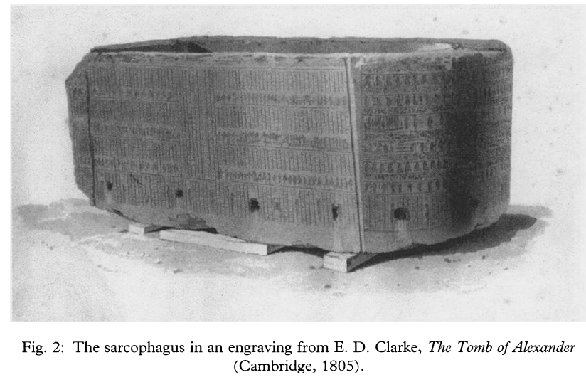
The Tomb of Alexander
Original Resting Place: Memphis
  “From the Time when Antigonus crossed to Asia, and Alexander was laid to rest in Memphis”
  Parian Marble FGrH 239 B 11
Chugg, A. “The Sarcophagus of Alexander the Great?” Greece & Rome Second Series, Vol. 49, No. 1 (Apr., 2002), pp. 8-26

Slide 29
Alexandria: Harbour
In the Great Harbour at the entrance on the right there is the island and the tower Pharos, and on the other side are the rocks and the promontory Lochias with the royal palace. As one sails into the harbour there are on the left the inner royal palaces, which are joined to those on the Lochias and have groves and many colourful lodges. Below these lies the artificially dug harbour which is not visible and is the private property of the kings, and Antirrhodos, a small island in front of the dug harbour which has both a royal palace and small harbour. They gave it this name as being a rival of Rhodes. Above it lies the theatre, then the Posideum, a kind of headland jutting out from the so-called Emporium and the store houses…

Slide 30
Alexandria: Necropolis and Summary
Beyond the canal only a little of the city is left. Then there is the suburb Necropolis in which are many gardens and tombs and installations suitable for the embalming of corpses. Within the canal there is the Serapeum and other ancient precincts which have been virtually abandoned because of the construction of new buildings at Nicopolis; for example there is an amphitheatre and a stadium and the quinquennial competitions are celebrated there, while the old building have fallen into neglect. In a word, the city is full of dedications and sanctuaries; the most beautiful building is the Gymnasium which has porticoes over a stade (c. 175 m) in length. In the middle of the city are law-courts and the groves. There is also the Paneium, an artificially made height, conical in shape and resembling a hill, and ascended by a spiral stair. From the top one has a panoramic view of the whole city lying below…

Slide 31
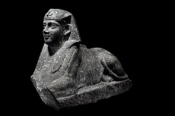
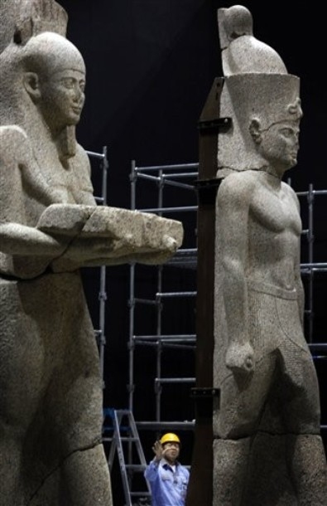
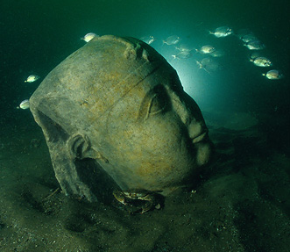
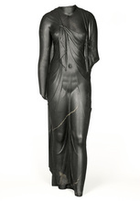
Egyptian Elements?

Slide 32
Follow-up Reading
Errington, R.M. (2008) A History of the Hellenistic World 323-30 B.C. Blackwell. pp. 40-45, 59-62, 143-161
Koenen, L. "The Ptolemaic King as a Religious Figure." In Images and Ideologies: Self-Definition in the Hellenistic World, edited by Bulloch, Berkeley: University of California Press, 1993. 25-115.
Erskine, A. “Culture and Power in Ptolemaic Egypt: The Museum and Library of Alexandria” Greece & Rome Second Series, Vol. 42, No. 1 (Apr., 1995), pp. 38-48.

