Slide 1
Welcome to MA
3D Computer Animation
Production Management – ADGD7005
Nabeel Masih
Lecturer VFX and Animation
n.masih@uwtsd.ac.uk
Session 3

Slide 2
Next week - Working in 3D Animation post Production
Compositing
2D visual effects (VFX)/motion graphics
Colour correction
Final output
Reference:
3D Animation Essentials Andy Beane
https://www.youtube.com/watch?v=v8GUsI8vJu4
Making of " The Incredibles"
https://www.youtube.com/watch?v=r45EvRlrNZU
A head modelled by hand in
Autodesk Maya with polygons

Slide 3
Next week - Working in 3D Animation post Production
Compositing
2D visual effects (VFX)/motion graphics
Colour correction
Final output
Using Production Tools
Gantt Charts
Production Boards
Shot Sheet
Model-Tracking Sheet
Lighting/Rendering–Tracking Sheet
Folder Management and Naming Conventions
A head modelled by hand in
Autodesk Maya with polygons

Slide 4
Working in 3D Animation post Production
Postproduction is the completion and output stage of a 3D animation project, but again this can mean different outcomes for different industries. The entertainment industries use this stage to really make a project stand out through visual effects and colour corrections.
The postproduction stage is where you can make a project that once looked amateurish look professional instead.
A head modelled by hand in
Autodesk Maya with polygons
Notes:
You may have heard the saying fix it in post, and as much as I hate to admit it
as a 3D artist who would like to have the production stage be perfect every time,
sometimes fixing things in postproduction is more cost-effective than committing
hours of rendering time to fix a shot.
Clients often change their minds mid-project, and a production that is in progress
cannot just start over. So it will usually come down to the postproduction
artist to have to make these fixes at the end of a production
For instance, many
feature films do not start out as 3D stereoscopic films, but become 3D stereo
films because the production companies think that type of film will make more
money.
Starting with a nonstereoscopic film and adding the 3D stereo effect
can be difficult and time-consuming. The postproduction team must be able
to troubleshoot a solution to meet just about any want or need of the client, as
long as the client is willing to pay extra for it.

Slide 5
Working in 3D Animation post Production
Compositing
The postproduction artist can layer all of the imagery created and filmed to make a final output image. This layering can be a simple task with only a few layers to manage, or it can become a complex task with hundreds of layers matched together. The imagery can be all 3D generated images; 3D and 2D graphics mixed; or 3D, 2D, and live-action film plates.
A head modelled by hand in
Autodesk Maya with polygons

Slide 6
Working in 3D Animation post Production
2D Visual Effects/Motion Graphics
2D visual effects and motion graphics are often mixed into the compositing stage. The compositor and 2D visual effects artists can be the same artist, but at some studios they are not.
A head modelled by hand in
Autodesk Maya with polygons
Notes:
The lighting artist may complete the initial composite for
a shot and then pass the pre-comp on to the 2D visual effects artist to work on
and finalize. The 2D visual effects artist will add effects that are much simpler to
achieve at the end of a project in a 2D application than in a 3D application. The
following are examples of such effects:

Slide 7
Working in 3D Animation post Production
The 2D visual effects artist will add effects that are much simpler to achieve at the end of a project in a 2D application than in a 3D application. The following are examples of such effects:
Sparks, Pixie dust, Dust, Rain drops, Background replacements, Camera shake, Green-screen removal Rotoscoping
Notes:
A motion-graphics artist uses the same techniques as a 2D visual artist, and again
may be the same artist as the 2D visual effects artist. But the motion-graphics artist’s
job is to create the graphical design elements of a shot if needed. This type of
work can be seen in film title sequences and in television station bumpers.

Slide 8
Working in 3D Animation post Production
Colour Correction
Colour correction, also known as colour timing or colour grading, is when the entire project is adjusted to make sure all imagery colour is consistent and matches the final output source. All 3D animation projects are worked on as individual shots.

Slide 9
Working in 3D Animation post Production
Colour Correction
Colour correction, also known as colour timing or colour grading, is when the entire project is adjusted to make sure all imagery colour is consistent and matches the final output source. All 3D animation projects are worked on as individual shots, and then looked at in sequences and finally as a whole project.
Notes:
A shot is created
every time the camera changes, and there are thousands of shots in a feature
film. Each shot needs to be corrected to achieve the look of the film. Color correction
can be very artistic and highly technical at the same time.

Slide 10
Working in 3D Animation post Production
Colour Correction
Colour correction can be very artistic and highly technical at the same time. It takes an expert eye and lots of practice to become good at colour correction. shows a before-and-after example of colour correction.
Notes:
A shot is created
every time the camera changes, and there are thousands of shots in a feature
film. Each shot needs to be corrected to achieve the look of the film. Color correction
can be very artistic and highly technical at the same time.

Slide 11
Working in 3D Animation post Production
Colour Correction
A shot before (left) and after (right) colour correction
Notes:
A shot is created
every time the camera changes, and there are thousands of shots in a feature
film. Each shot needs to be corrected to achieve the look of the film. Color correction
can be very artistic and highly technical at the same time.

Slide 12
Working in 3D Animation post Production
Final Output
The final output of 3D animation can come in many different forms: film, video, Internet, rapid prototyping, 3D stereoscopic film and print media.
Each of these output types have different workflows and technical limitations, but the most common output type is digital video that can be played on the computer or Internet.
Notes:
The largest technical limitation to thistype is colour correction because not everyone’s computer and monitor is calibrated
and will look different. More on this topic in Chapter 3, “Digital Imaging and Video.”

Slide 13
Working in 3D Animation post Production
Final Output
The largest technical limitation to this type is colour correction because not everyone’s computer and monitor is calibrated and will look different.

Slide 14
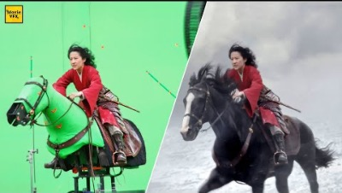

Slide 15
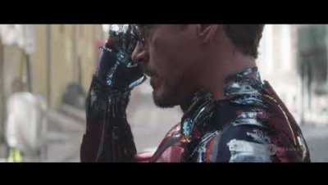

Slide 16
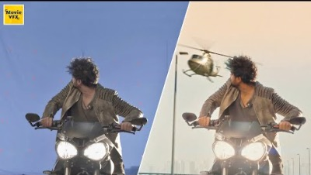

Slide 17
Next week - Using Production Tools
Using Production Tools
Gantt Charts
Production Boards
Shot Sheet
Model-Tracking Sheet
Lighting/Rendering–Tracking Sheet
Folder Management and Naming Conventions
Reference:
3D Animation Essentials Andy Beane
https://www.youtube.com/watch?v=v8GUsI8vJu4
Making of " The Incredibles"
https://www.youtube.com/watch?v=r45EvRlrNZU
A head modelled by hand in
Autodesk Maya with polygons

