Slide 1

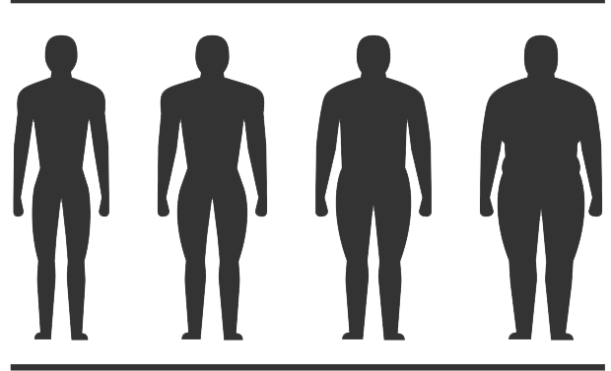

The relationship between body mass index and hand grip strength in collegiate rugby players.
Taliesin Fargeot 1701295

Slide 2
What does recent literature say?
WHAT WE ALREADY KNOW
WHAT WE NEED TO FIND OUT
WHAT ARE THE STRENGTHS AND WEAKNESSES

Slide 3
Hypothosis:
A SIGNIFICANT RELASTIONSHIP BETWEEN BMI SCORE AND HAND GRIP STRENGTH
HYPOTHOSIS
NULL HYPOTHOSIS:
NON-SIGNIFICANT RELASTIONSHIP BETWEEN BMI AND GRIP STRENGTH

Slide 4

METHOD
WHO: UNIVERSITY OF WALES TRINITY ST DAVID MALE RUGBY UNION TEAM.
AGE RANGE: 18 - 25
HOW MANY PARTICIPANTS: 15+
CONVENT SAMPLE: TO FIND A GROUP OF PARTICIPANT WHO WILL BE AVAILABLE FOR TESTING
INCLUSION: UNIVERSITY OF WALES TRINITY ST DAVID MALE RUGBY PLAYER
EXCLUSION: NONE RUGBY UNION PLAYERS. UPPER LIMB INJURED PLAYERS OR IN REHABILITION PHASE ON RETURN TO PLAY

Slide 5
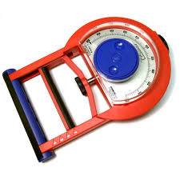
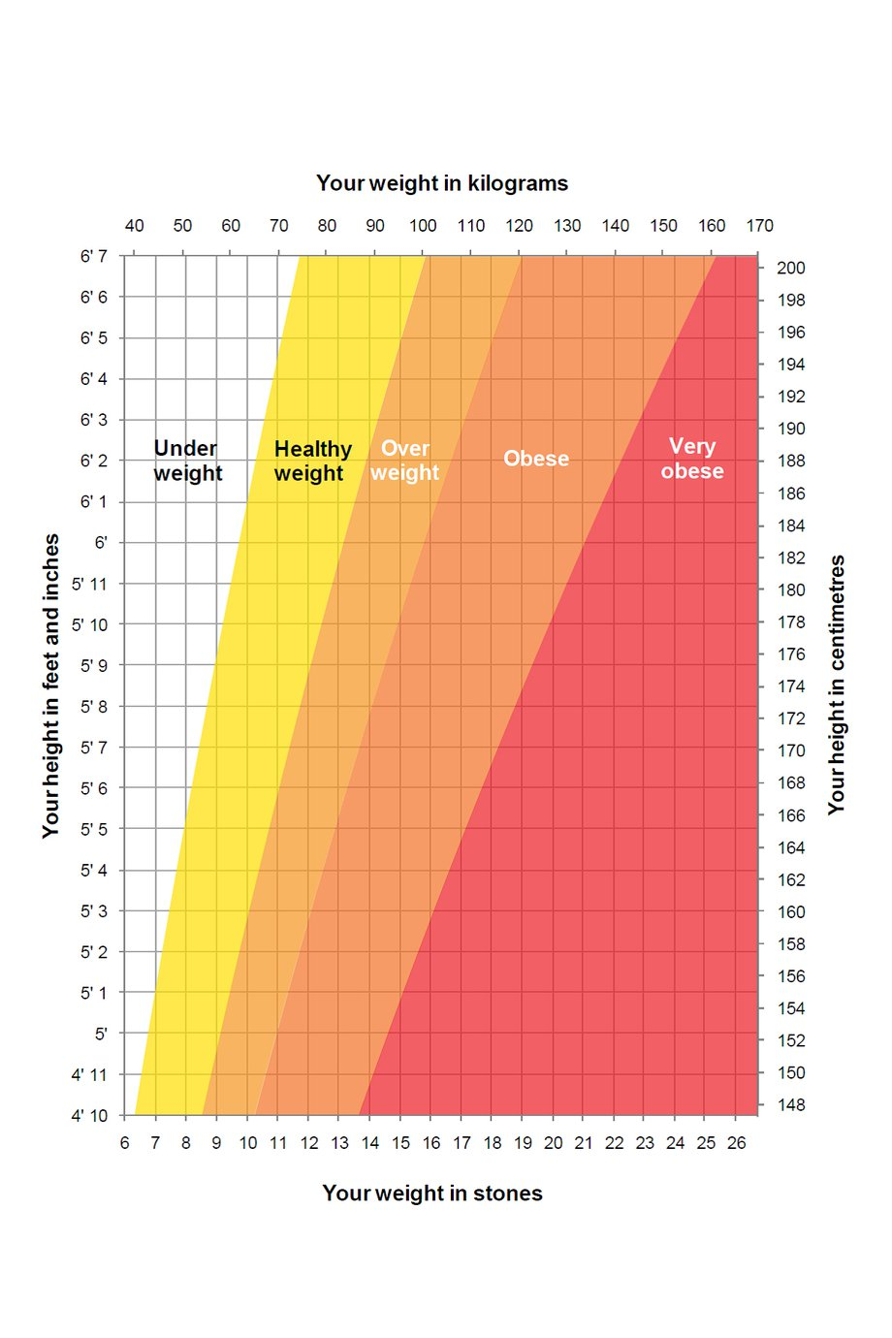
PROTOCOL
T.K.K. 5001 GRIP-A hand grip dyanometer as used in testing.
BMI chart, 2018
(National health service, 2018)

Slide 6

DATA ANALYSIS

Slide 7

ethical considerations
INFORMED CONSENT – PARTICIPANT INFORMATION SHEET
RISK ASSESMENTS
RISKS OF INJURY
FIRST AID
SHARING RESULTS

Slide 8
Proposed timeline
LITERATURE REVIEW: > 50 DAYS
METHOD: > 30 DAYS
RESEARCH PROPOSAL: > 30 DAYS
ETHICAL APPROVAL: > 21 DAYS
DATA COLECTION: > 14 DAYS
DATA ANALYSIS: > 14 DAYS
REPORT: > 21 DAYS
FINAL SUBMISSION : 8TH MAY.

Slide 9

Research limitations
LACK OF PARTICIPANTS READILY FIT AT TIME OF TESTING
AVAILABILITY OF EQUIPMENT DURING PROPOSED TESTING TIMESCALE
AVAILABILITY OF STUDENT RUGBY PLAYERS AROUND THEIR UNIVERSITY TIMETABLE

Slide 10
REFERENCES
Baechle, T. (2008). Essentials of strength training and conditioning. Champaign, Ill: Human Kinetics.
Binns, A., Gray, M. and Glenn, J. (2016). Hand-grip Strength Relates to Total-Body Muscle Strength Among Older Adults. Medicine & Science in Sports & Exercise, 48, p.687.
Blomkvist, A., Andersen, S., de Bruin, E. and Jorgensen, M. (2016). Isometric hand grip strength measured by the Nintendo Wii Balance Board – a reliable new method. BMC Musculoskeletal Disorders, 17(1).
Harbo, T., Brincks, J. and Andersen, H. (2011). Maximal isokinetic and isometric muscle strength of major muscle groups related to age, body mass, height, and sex in 178 healthy subjects. European Journal of Applied Physiology, 112(1), pp.267-275.
nhs.uk. (2018). Healthy weight. [online] Available at: https://www.nhs.uk/live-well/healthy-weight/ [Accessed 14 Dec. 2018].
Hornsby, W., Gentles, J., MacDonald, C., Mizuguchi, S., Ramsey, M. and Stone, M. (2017). Maximum Strength, Rate of Force Development, Jump Height, and Peak Power Alterations in Weightlifters across Five Months of Training. Sports, 5(4), p.78.
Hébert, L., Maltais, D., Lepage, C., Saulnier, J., Crête, M. and Perron, M. (2011). Isometric Muscle Strength in Youth Assessed by Hand-held Dynamometry. Paediatric Physical Therapy, 23(3), pp.289-299.
Massy-Westropp, N., Gill, T., Taylor, A., Bohannon, R. and Hill, C. (2011). Hand Grip Strength: age and gender stratified normative data in a population-based study. BMC Research Notes, 4(1), p.127
Otto, W., Coburn, J., Brown, L. and Spiering, B. (2012). Effects of Weightlifting vs. Kettlebell Training on Vertical Jump, Strength, and Body Composition. Journal of Strength and Conditioning Research, 26(5), pp.1199-1202.
Whiteley, R., Jacobsen, P., Prior, S., Skazalski, C., Otten, R. and Johnson, A. (2012). Correlation of isokinetic and novel hand-held dynamometry measures of knee flexion and extension strength testing. Journal of Science and Medicine in Sport, 15(5), pp.444-450.
Wind, A., Takken, T., Helders, P. and Engelbert, R. (2009). Is grip strength a predictor for total muscle strength in healthy children, adolescents, and young adults? European Journal of Pediatrics, 169(3), pp.281-287.

