Slide 1

Name: Laszlo Suba
Student number: 2419719
Programme: Cert HE Business Skills for the Workplace
Module: Enterprise and Entrepreneurship (LCLM4006)
Assignment: Individual Presentation
Lecturer: Charles Obinwa

Slide 2

Overview of Lumispell Ltd
Specialist epoxy & resin bound flooring solutions
Serving residential, commercial & industrial clients
USP: Custom-made designs + eco-friendly aggregates + durability
Lean management: Founder-led + Marketing/Admin support
Legal format: Private Limited Company (Ltd)

Slide 3

Legal format
What it means: Lumispell Ltd is registered as a Private Limited Company in the UK.
Ownership: Owned by the founder(s); shares are not available to the public.
Liability: Personal assets are protected; financial risk is limited to the business.
Compliance: Must follow UK company law, file annual accounts, and pay corporation tax.
Benefits: Professional image, legal protection, and easier access to business funding.

Slide 4
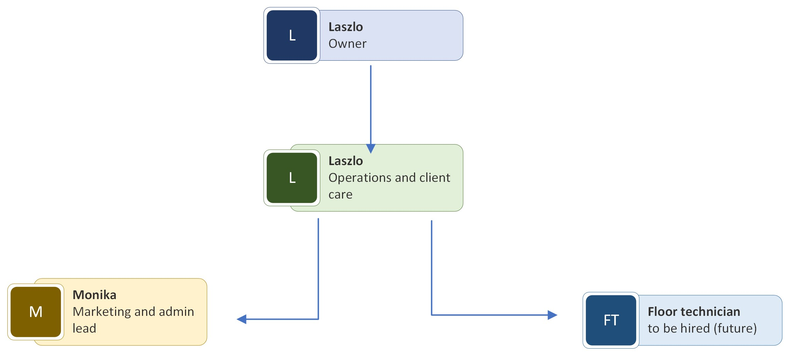
Management structure

Slide 5
Environmental Analysis (PESTEL)
Political: UK construction regulations, CSCS compliance, housing & infrastructure investment
Economic: Inflation & material costs; growth in home improvement & refurbishment markets
Social: Demand for sustainable, bespoke flooring; remote working drives home upgrades
Technological: Advances in resin chemistry, eco-materials, digital marketing tools
Environmental: Recycled aggregates, sustainability credentials, reduced waste vs. carpets/tiles
Legal: Building regulations, insurance, health & safety compliance

Slide 6
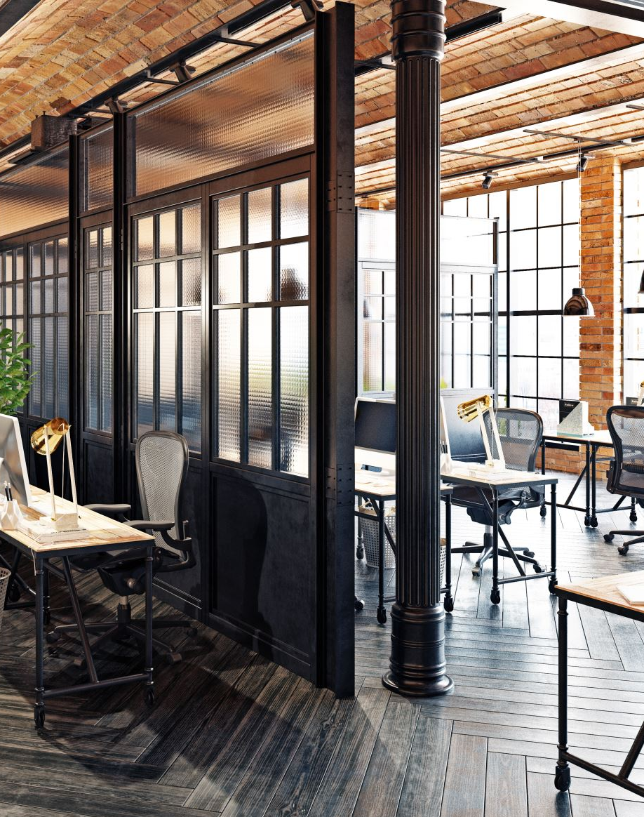
Marketing Strategies
Target Markets:
  Residential homeowners (durable, custom-made flooring for kitchens, garages, driveways)
  Commercial clients (restaurants, showrooms, offices, durability, hygiene, design flexibility)
Branding: Craftsmanship, sustainability, family-run authenticity
Pricing: Competitive with premium custom-made options
Promotion: Social media (Instagram/TikTok), website case studies, trade shows, builder partnerships
Customer Engagement: Consultations, site visits, CRM, referrals & online reviews

Slide 7

Funding & Start-up Costs
Funding required: £15,000
Sources:
  Personal savings (commitment, reduced reliance on external finance)
  UK Start-Up Loan (manageable repayment terms)
  Potential angel investors (capital + strategic support)
Allocation of funds:
Tools & machinery: £6,000
Materials: £4,000
Marketing & branding: £2,000
Insurance & compliance: £1,500
Transport & administration: £1,500

Slide 8
Conclusion
Lumispell Ltd: durable, custom-made, sustainable flooring solutions
Strong alignment with market trends & customer needs
Clear strategy: branding, customer engagement, financial planning
Positioned for trust, growth & community impact

Slide 9

Thank you!
Any questions?

