Slide 1
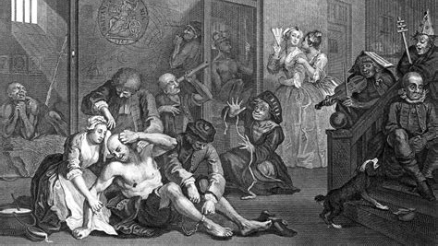
The great confinement and disciplining the unruly

Slide 2
Nervous or mad?
From the late 17th century onwards there was a growing interest and absorption in the intricacies of the brain and the nervous system.
The language of “the nerves”

Slide 3
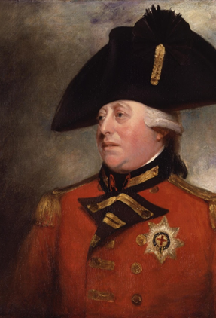
King George III (1738-1820)
King George III was the third Hanoverian King of Great Britain.
It was during his reign that Britain lost the American Colonies.
Britain did however emerge to become the leading power of Europe.

Slide 4
King george iii
Was insistent that he was not mad or ill
In his extreme bouts of madness George displayed delusional and violent behaviours.

Slide 5

Fit to rule? How Royal illness changed the world
Look at the link provided on Moodle: I'd like you to watch from minute 37-49.
This discusses George III's illness and provides some evidence for the cause of his bouts of madness.

Slide 6
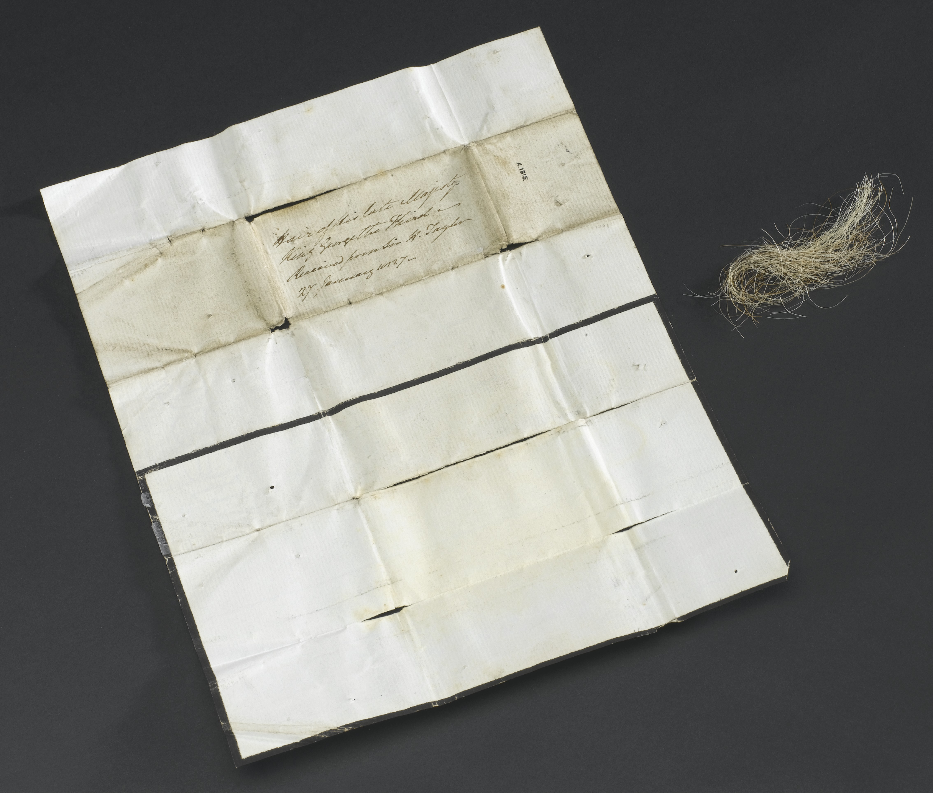
Treatment of king George
Treatment of psychiatric patients during this time was often harsh and the treatment of King George can be seen to be no different to those in the asylums.
George’s doctor at the time Francis Willis commented:
“As death makes no distinction in his visits between the poor man’s hut and the prince’s palace, so insanity is equally impartial in her dealings with her subjects. For that reason, I made no distinction in my treatment of persons submitted to my charge. When, therefore, my gracious sovereign became violent, I felt it my duty to subject him to the same system of restraint as I should have adopted with one of his own gardeners at Kew; in plain words I put a strait waistcoat on him”
Notes:
Herbal treatments were often complex, but may well have damaged the patient further. George III was given regular doses of James’ Powders, a treatment heavily laced with arsenic
Laboratory investigations have shed light on the king’s mental health. Among the Science Museum’s medical collections is an envelope containing hair taken from George III’s head after his death. Analysis found it to be laden with arsenic at a concentration over 300 times that considered toxic. Arsenic is a poison known to trigger porphyria. A likely source of arsenic was James’s Powders, a common medicine regularly given to George. Researchers concluded the arsenic from the medication treating his illness actually made it worse.

Slide 7
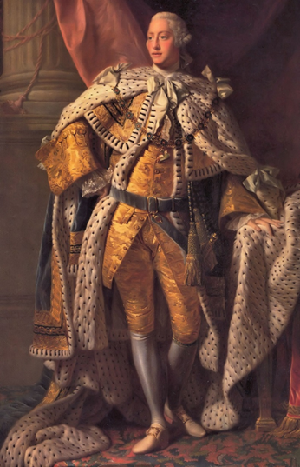
Treatment of king george iii
The Countess of Harcourt states
◦“The unhappy patient…was no longer treated as a human being. His body was immediately encased in a machine which left no liberty of motion. He was sometimes chained to a stake. He was frequently beaten and starved, and at best was kept in subjection by menacing and violent language.

Slide 8
Question
Why do you think the madness of King George III was so important at this time?

Slide 9
Question
One of the reasons why the state of the King’s mental health was so important was because it made it acceptable to be unwell.
It became fashionable to decry “my nerves”.
Literature and creative works often depicted images of young men demonstrating melancholia.

Slide 10
Rise of the asylums
However, there developed a need to confine the mad and the dangerous, to remove them from society.

Slide 11
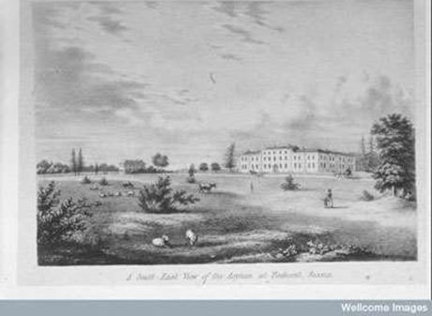
Conditions inside the madhouses
The quality of the private madhouses ranged from squalid to a network of houses with pleasant gardens and living conditions.
The squalid houses were often overcrowded and were often designed to get in as many people as possible to get as much profit from them

Slide 12
Asylum design
There were three types of asylum design that developed across the period:
The first was ‘conglomerate’ design.
There was the ‘corridor’ design.
Finally, there was the ‘pavilion’ type.

Slide 13
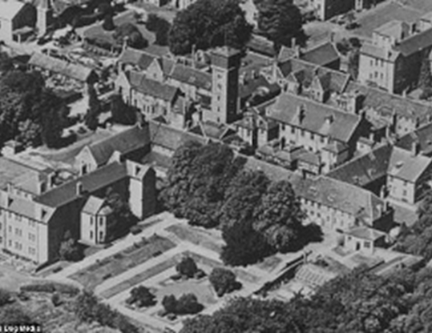
Suffolk county lunatic asylum

Slide 14
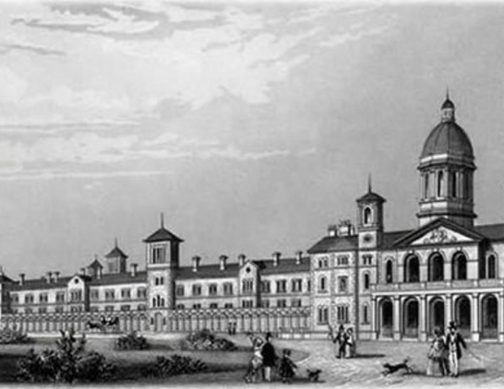
Colney hatch asylum

Slide 15
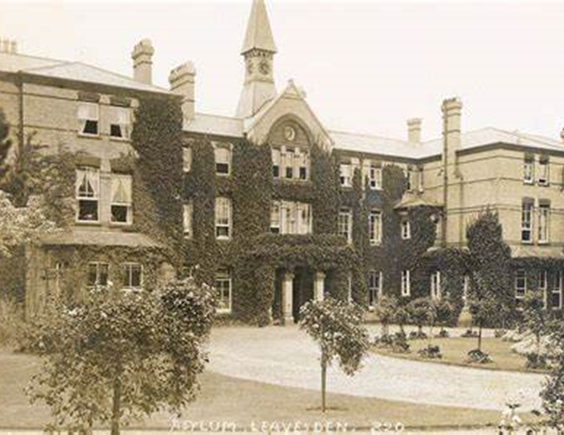
Metropolitan District Asylum

Slide 16
Inside the Asylum
Numbers inside the asylum increased exponentially.
More and more people were certified as insane and admitted to the asylums.
Due to there being lack of care, support or cure very few people left these hospitals.

Slide 17
Bethlam
Over-worked and undermanaged staff, including the keepers and attendants had fallen into the habit of keeping the challenging inmates in strait-waistcoats or chained to the wall.
The building was crumbling and in a state of disrepair.

Slide 18
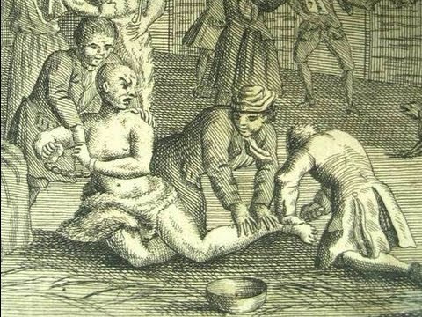
Bethlam cont..
Edward Wakefield on visiting Bethlem noticed:
Poorly clothed patients, shivering with cold
Chained to the wall, in one case a patient was chained to the wall by an iron ring riveted around his neck.

Slide 19
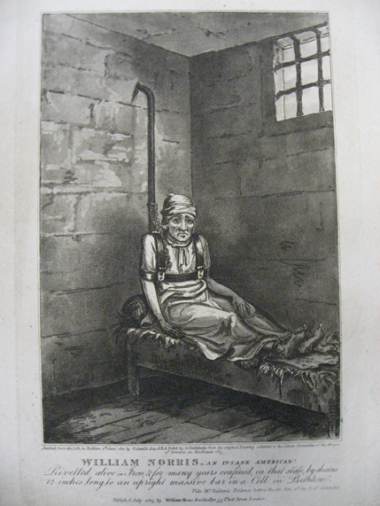
James norris
Captured the attention of the public in 1814 when he was discovered in Bethlem.
He was mechanically restrained and in poor health, having been in isolation for more than ten years.
He was restrained after violent episodes and restrained in this device.
No less than 6 members of parliament visited Norris and each maintained that he was rational, quiet and capable of coherent conversation.
Following the publication of this image and the interest it generated, Norris was released from his restraints, yet remained in Bethlem. However due to the conditions he had been kept in, he died a within a few weeks of his release, either of pneumonia or tuberculosis.

Slide 20
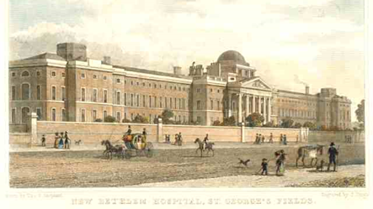
Conditions in Bethlam, Southwark
Inmates became desperate to curry favour with the keepers
The keepers would often set the inmates on each other for their own amusement
Vicious beatings
Anyone who tried to appeal for justice would have their outside visits refused.

Slide 21
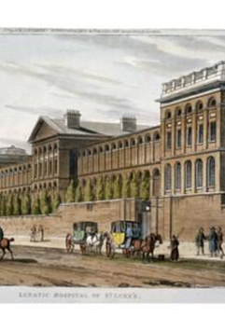
St luke's hospital
The public visibility of madness prompted medical interest in the question of what it really was: what caused madness and what could cure it?
St Luke’s Hospital was set up as a rival to Bedlam. It did not allow visitors public visitations

Slide 22
Enlightened and progressive private madhouses
Even before the development of the York retreat in the 1790s, there is evidence that the private madhouses would often treat their patients with kindness and consideration, with only limited use of restraints.
However, we must be mindful that not all private institutions were working equally or with the same standard of care for all patients….

Slide 23
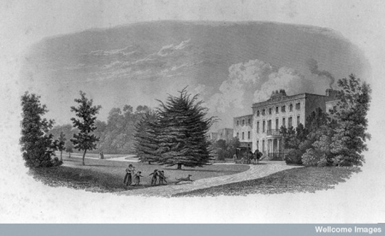
Edward long fox
Brislington House: His long term project where he could practice his ideas of treating mental disorders.
Purpose built
It met the needs of those with differing mental health needs but also catered for the needs of the upper class and elite.
Furnished and equipped on a lavish scale.

Slide 24
Who was admitted to the state institutions?
Had to demonstrate that they were mad.
There would be some fees
Some would be sent by parishes
There would be a form of certification

Slide 25
QUestions
Were these hospitals a dumping ground for the unwanted, undesirable and troublesome in the early modern period?
'The 18th century was a disaster for the insane'. Do you agree?

Slide 26
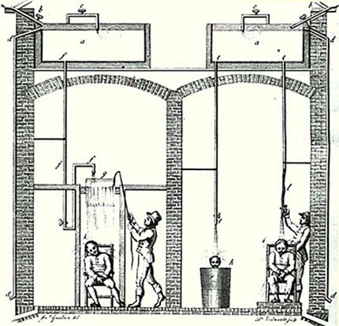
Disciplining the unruly

Slide 27
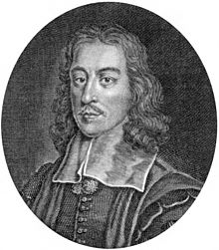
What to do with the mad?
Losing the mind and the passions that could be released!
Thomas Willis (1621-75)
Starting to move away from the humoral explanations.

Slide 28
‘To correct or allay the furies and exorbitancies of the Animal Spirits…requires threatenings, bond, or strokes as well as Physick. For the Mad-man being placed in a House convenient for the business must be so handled by the Physician, and also by the Servants that are prudent, that he may be in some manner kept in, either by warnings, chidings, or punishments inflicted upon him to his duty, or his behaviour, or manners. And indeed for the curing of Mad people, there is nothing more effectual or necessary than their reverence or standing in awe of such as they think their Tormentors…Furious Mad-men are sooner and more cured by punishments and hard usage, in a strait-room, than by Physick, or Medicines.

Slide 29
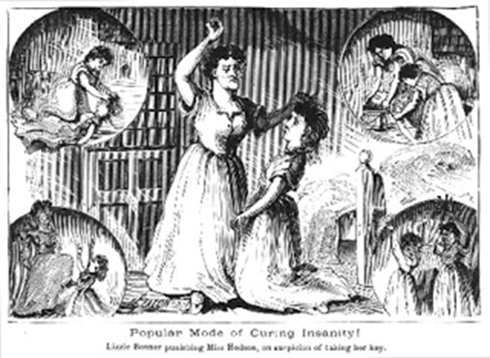
Willis’s ideas were embraced by society physicians.
Lucrative new market

Slide 30
Physician and Governor of Bedlam, Nicholas
Robinson
It is Cruelty in the highest Degree not to be bold in the Administration of Medicine. [Only] a Course of Medicines of the most violent Operation [would suffice] to bring down the Spirit of Stubborn Persons [and] reduce their artificial Strength by compulsive Methods.

Slide 31
New treatments were developed
Machinery was developed to instil fear and shock in the patients.
The Chinese Temple, Joseph Guislain:
“It consists of a little Chinese temple, the interior of which consists of a movable iron cage, of lightweight construction, which plunges down into the water descending in rails, of its own weight, by means of pulleys and ropes. To explose the madman to the action of this device, he s led into the interior of the cage, one servant shuts the door from the outside, while the other releases a brake which, by this manoeuvre, causes the patient to sink down, shut up in the cage, under the water. Having produced the desired effect, one raises the machine again.”

Slide 32
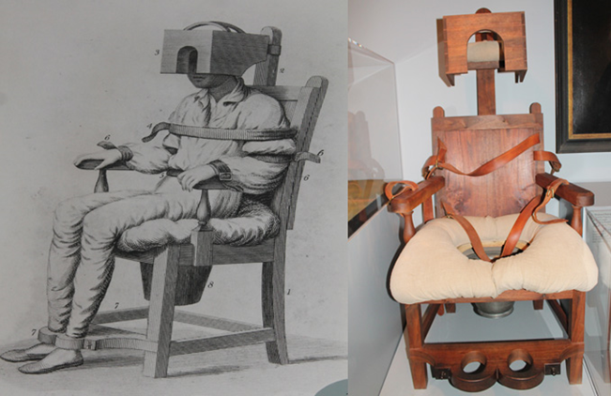
Benjamin Rush – The tranquiliser
Notes:
The Tranquilizer
I have contrived a chair and introduced it into our [Pennsylvania] Hospital to assist in curing madness. It binds and confines every part of the body. By keeping the trunk erect, it lessens the impulse of the blood to the brain. By preventing the muscles from acting, it reduces the force and frequency of the pulse, and the position of the head and feet favours the easy application of cold water o ice to the former and warm water to the latter. Its effects have been truly delightful to me. It acts as a sedative to the tongue and temper as well as to the blood vessels. In 24, 12,6 and in some cases in 4 hours the most refractory patients have been composed.. I have called it the tranquilizer.

Slide 33
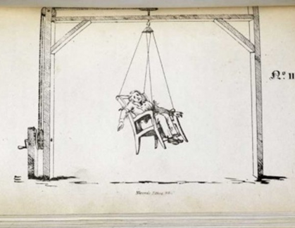
Other inventions
Erasmus Darwin (Charles Darwin’s grandfather) suggested a swinging motion might bring the insane back to sanity again.
This was taken up by Joseph Mason Cox (1763-1813) who developed the swinging chair.

Slide 34
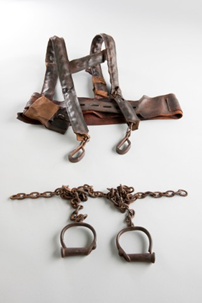
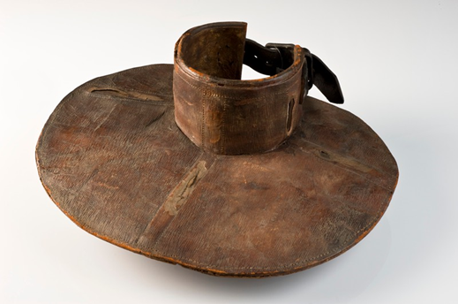
restraints
Images from Science Museum, London

Slide 35
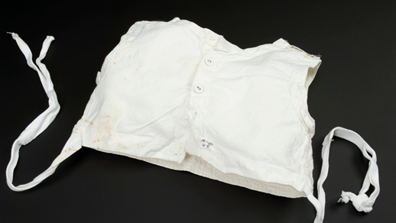
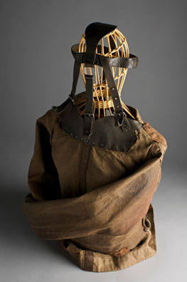
Restraints (20th Century)
(Science museum, London)

Slide 36
Thoughts?
What were the benefits of these treatments, what might have been the limitations?
Why do you think we are now seeing more scientific reactions to madness?

Slide 37
Other viewpoints
1795 we start to see signs of what will eventually become known as ‘Moral Treatment’.
John Ferriar (1761-1815) –physician to the Manchester Asylum
Thomas Bakewell (1761-1835) Keeper of a madhouse in Staffordshire
◦Felt that there was a need to stir the madman’s ‘moral feelings’.

Slide 38
Tuke and Pinel
William Tuke, Quaker, tea and coffee merchant. (1732-1822). Founded York Retreat
Phillipe Pinel (1745-1826) possibly liberated the insane at Saltpetriere and Bicetre, Paris

Slide 39
What were the causes of madness?
We’ve taken a look at the treatment of lunatics, but spend some time considering the interpretations of madness, what did contemporaries believe to be the causes of madness?

Slide 40
Summary
During this lecture we’ve taken a look at the asylum development and how the inmates were treated within the walls of each asylum.
We’ve also considered some of the treatments that were developed for mad patients at the time.
You may wish to start thinking about the historical treatment of men and women at this time and how it differed for each. This will feed into your essay – if you choose to take this topic.

