Slide 1















Fresh Flavors, Local Vibes
Urban Green Café
Business and Web Management
By Benafsha Ahmadi

Slide 2

Introduction
Urban Green Café is a modern café
It offers organic and locally sourced food
It promotes eco-friendly and healthy living
This presentation shows how to build its online presence

Slide 3

Target Audience
Age group: 20–45
Young professionals and families
Health-conscious customers
Environmentally aware people
People who enjoy social café experiences

Slide 4
Logo Design
Green colours to represent nature and freshness
Leaf or plant symbol for eco-friendly image
Simple and clean modern design
Shows sustainability and quality

Slide 5
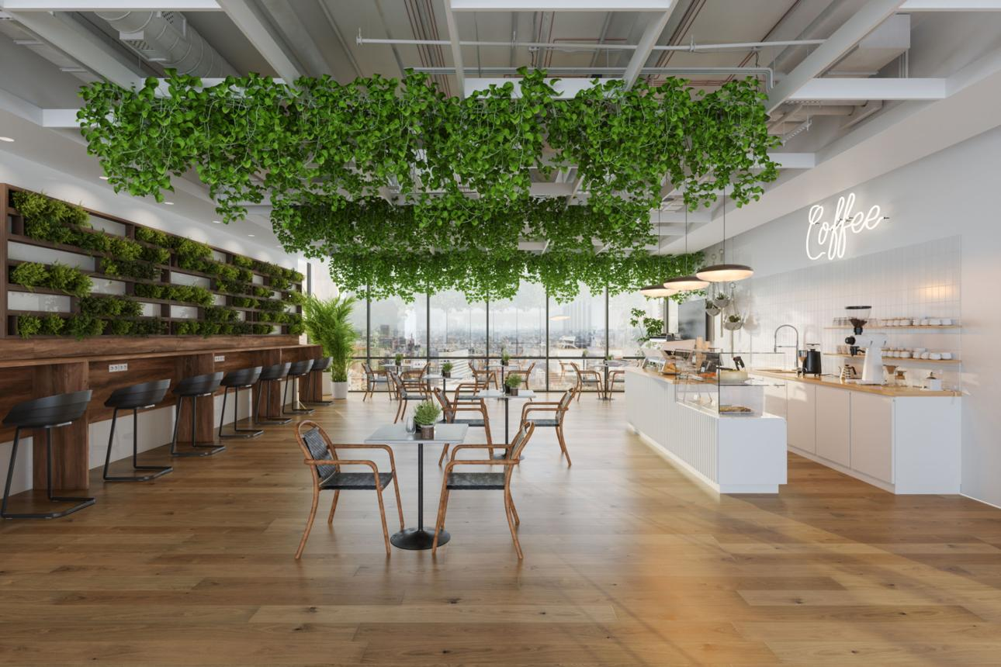
Brand Story
Urban Green Café was created to promote healthy living
It uses organic and locally sourced ingredients
The café supports sustainability and eco-friendly practices
It provides a friendly and relaxing environment for customers

Slide 6

Social Media Strategy
Use Instagram, TikTok and Pinterest
Share photos and videos of food and drinks
Post behind-the-scenes content
Share customer experiences and reviews
Collaborate with influencers

Slide 7

Content Marketing
Blog posts about healthy food and lifestyle
Share recipes and menu updates
Send newsletters to customers
Promote seasonal offers
Educate customers about sustainability

Slide 8
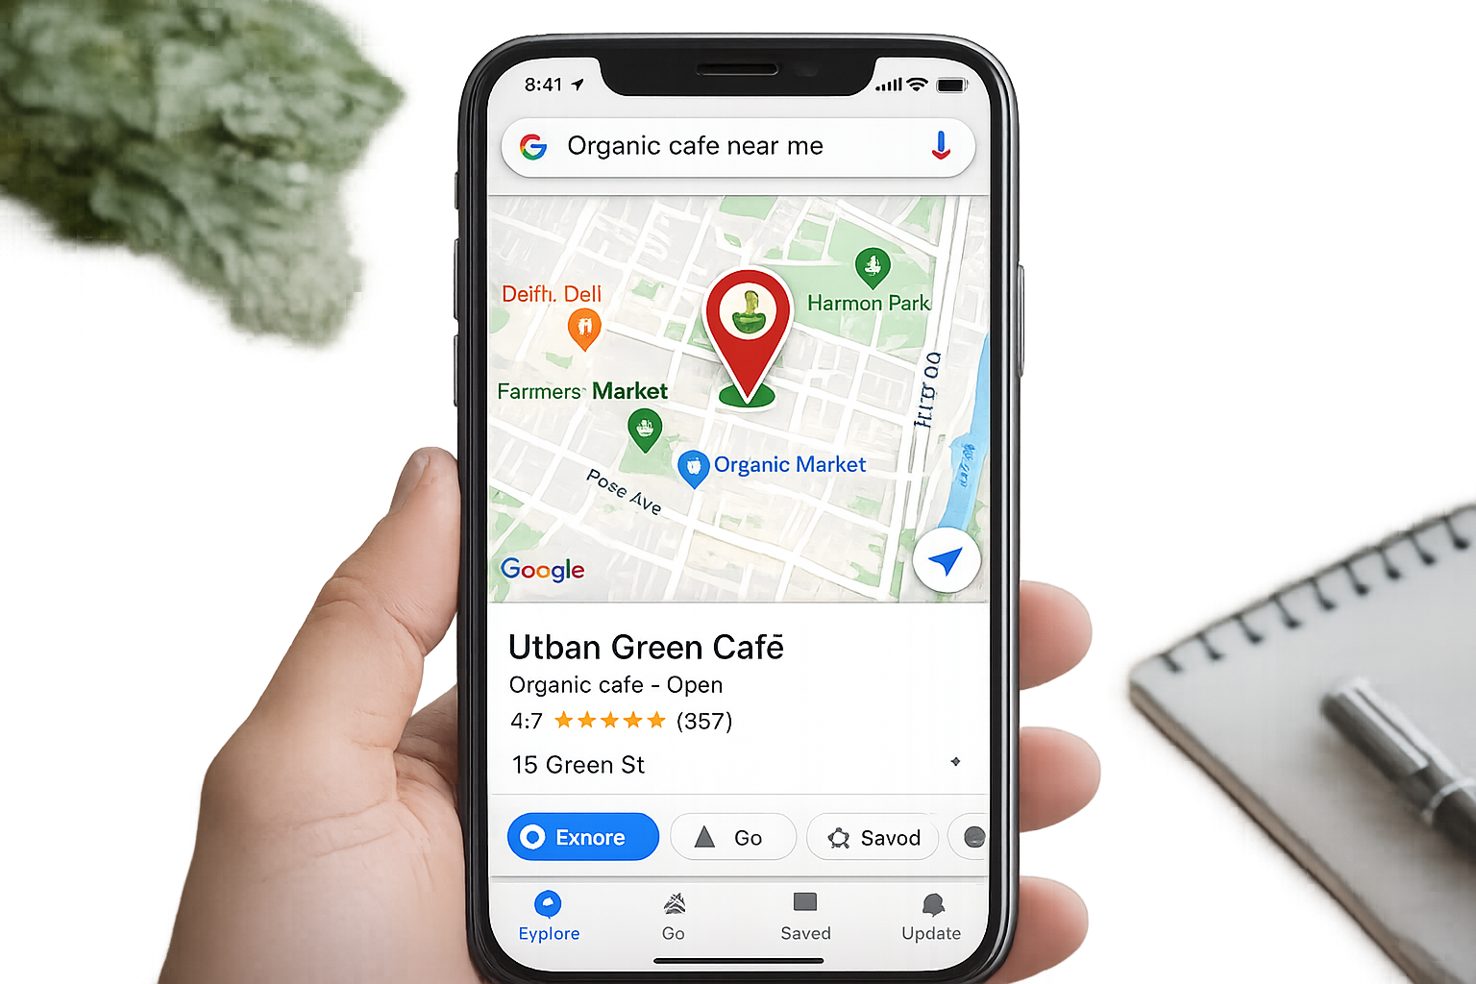
SEO Strategy
Use keywords like “organic café” and “eco-friendly coffee shop”
Create and manage Google Business profile
Add location and contact details
Update website regularly
Use clear titles and descriptions

Slide 9
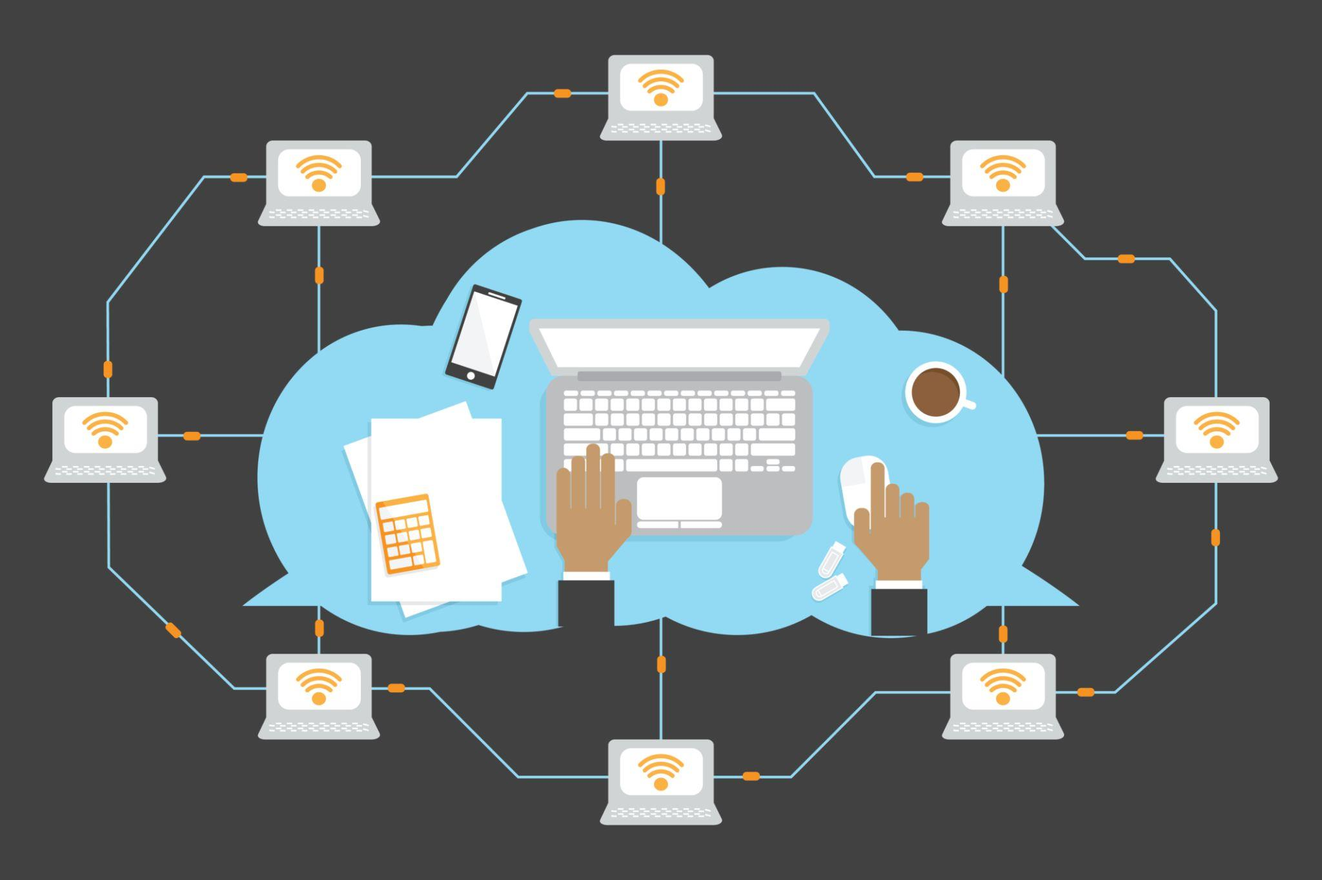
Cloud Computing
Stores data online instead of on one computer
Can be accessed from anywhere
Helps manage website and business operations
Provides backup and data protection

Slide 10


Security Measures
Use strong passwords for accounts
Install SSL certificate for website security
Protect customer data and privacy
Update systems and software regularly
Use antivirus and firewall protection

Slide 11

Conclusion
Strong branding creates a clear identity
Marketing strategies help attract customers
Cloud computing supports business operations
Security measures protect data and customers

