Slide 1
M6X01888
Energy & waste
Lara Hopkinson, Senior lecturer

Slide 2
Todays topics
Energy mix:
  Current UK energy mix
  Types of energy
  Issues?

Slide 3
UK energy mix
According to Energy UK:
For 2015:
  Natural gas – 30%
  Coal – 23%
  Oil – 1%
  Nuclear# – 21%
  Renewables* – 25%
  TOTAL = 100%
  #Through fission
  *Includes wind, wave, hydro, biomass, solar

Slide 4
Renewables contribution
Source: Energy in the UK, 2016, p

Slide 5
gas
Combined Cycle Gas Turbines (CCGT)
32GW gas generating capacity
CHP is also important
Gas Generation Strategy (2012)
  Gas continues to play key role in energy mix
  Help to deal with intermittency from renewables

Slide 6
Gas Generation strategy
Key points to note:
  Gas-fired power stations relatively cheap & quick to build
  Capacity need ~9GW this decade
  ~26GW by 2030
  New capacity for demand PLUS replacing end of life plant
  Carbon Capture & Storage (CCS)

Slide 7
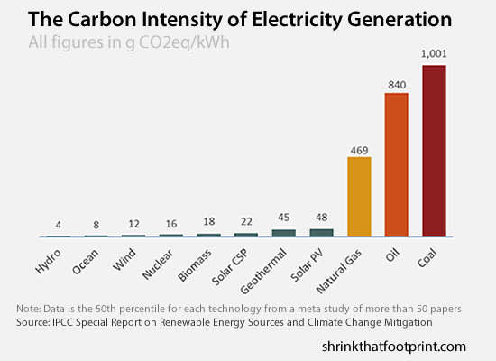
Carbon intensity

Slide 8
Carbon intensity
Symbol | Fuel type | Carbon intensity (gCO₂/kWh)
CCGT | Combined cycle gas turbine | 360
COAL | Coal | 910
NUCLEAR | Nuclear | 0
WIND | Wind | 0
OIL | Oil | 610
OTHER | Other | 300
Adapted from: www.gridcarbon.uk

Slide 9
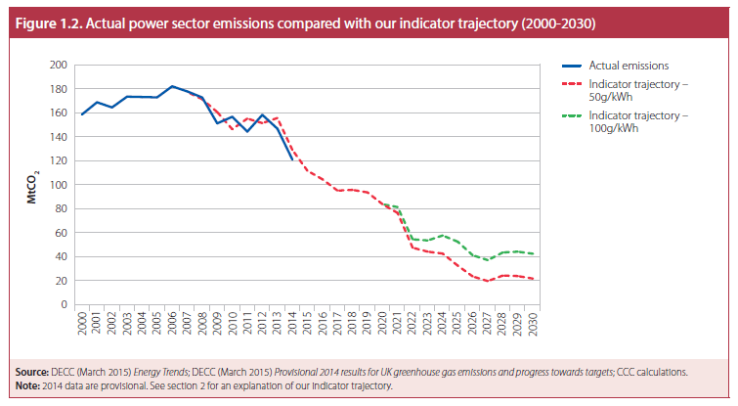
Power sector decarbonisation
Powers within the Energy Act 2013
Source: www.theccc.org.uk

Slide 10
Security of supply
According to “UK Risk Assessment on Security of Gas Supply” (Sept 2016):
  UK has strong gas security position
  Import capacity & storage infrastructure PLUS indigenous gas production
Source: DUKES, 2016 Ch4

Slide 11
Developing shale gas resources
Large quantities known to exist
Unknown what fraction can be produced
Method of extraction needs to be “economic & safe”
Factors that contribute to successful production
Source: Gas Generation Strategy, p54

Slide 12
Shale gas
Mostly composed of methane
According to the British Geological Survey:
  UK has abundant shale reserves (~1300 trillion cubic feet)
  Distribution is not well known
  Significant areas known (NW England)
  Considered an ‘unconventional’ gas

Slide 13
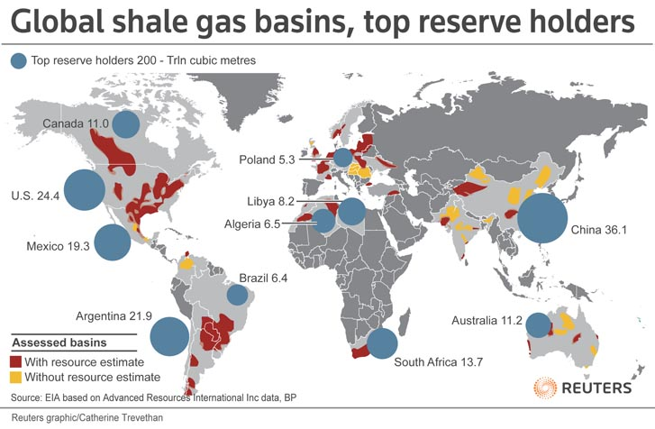
Shale gas reserves

Slide 14
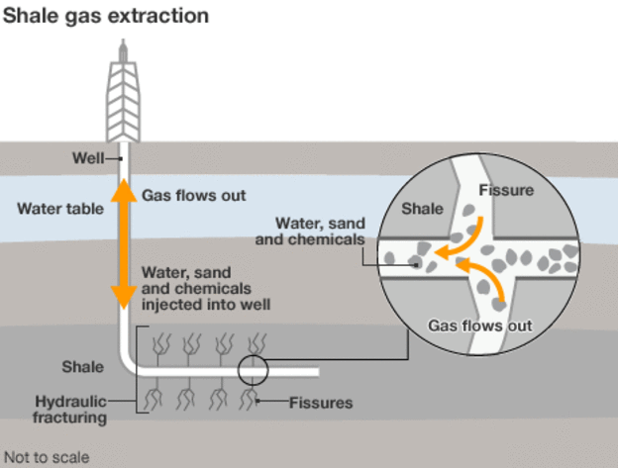
Shale gas extraction
Source: www.bbc.co.uk

Slide 15
Issues / concerns
Water use
Sand / proppant use
Chemical use
Health concerns
Water pollution
Air pollution
Waste disposal
Seismic activity

Slide 16
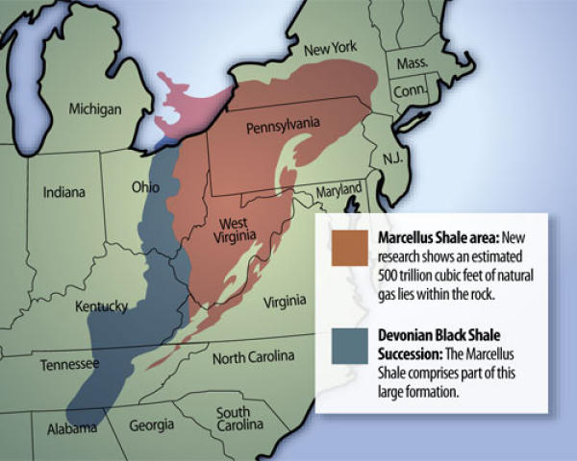
Marcellus shale map
Source: www.marcellusshales.com

Slide 17
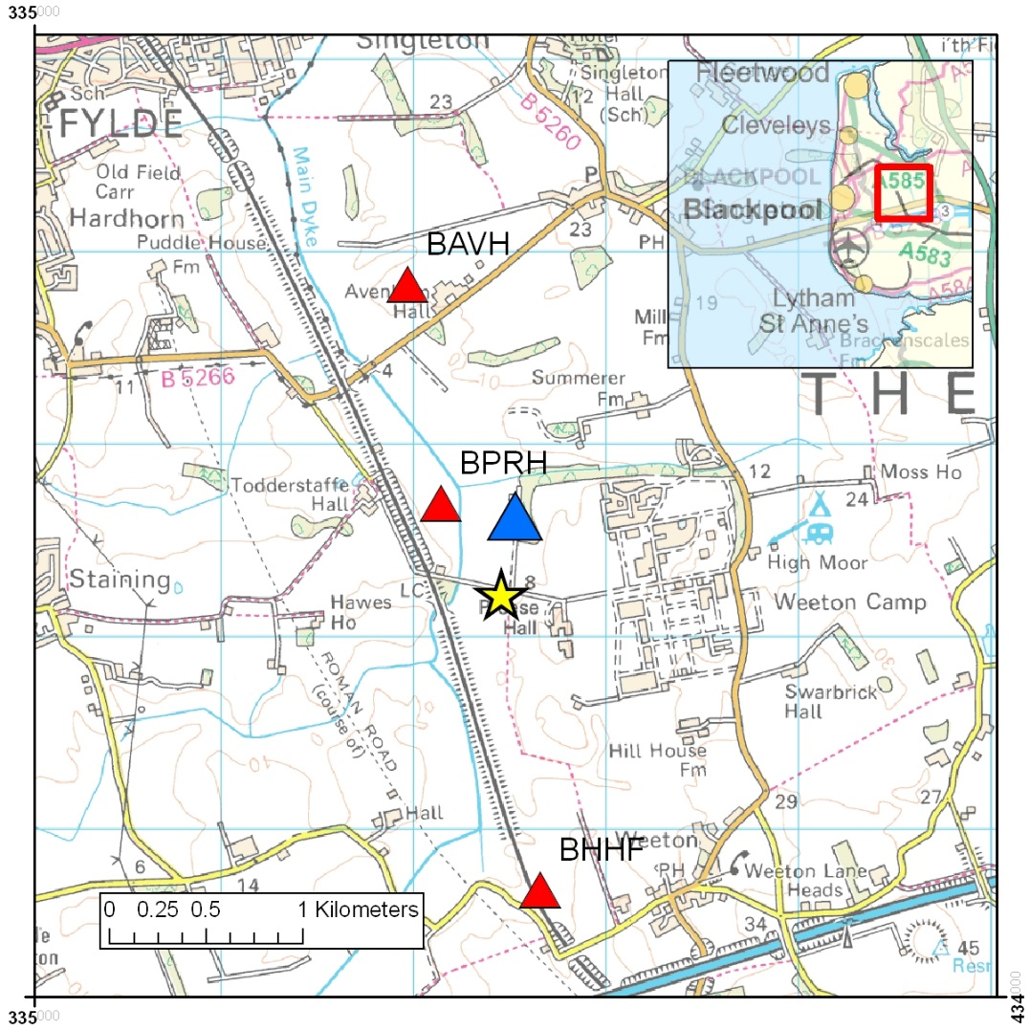
Seismic activity, uk
Source: British Geological Survey

Slide 18

Mixed messages?

Slide 19
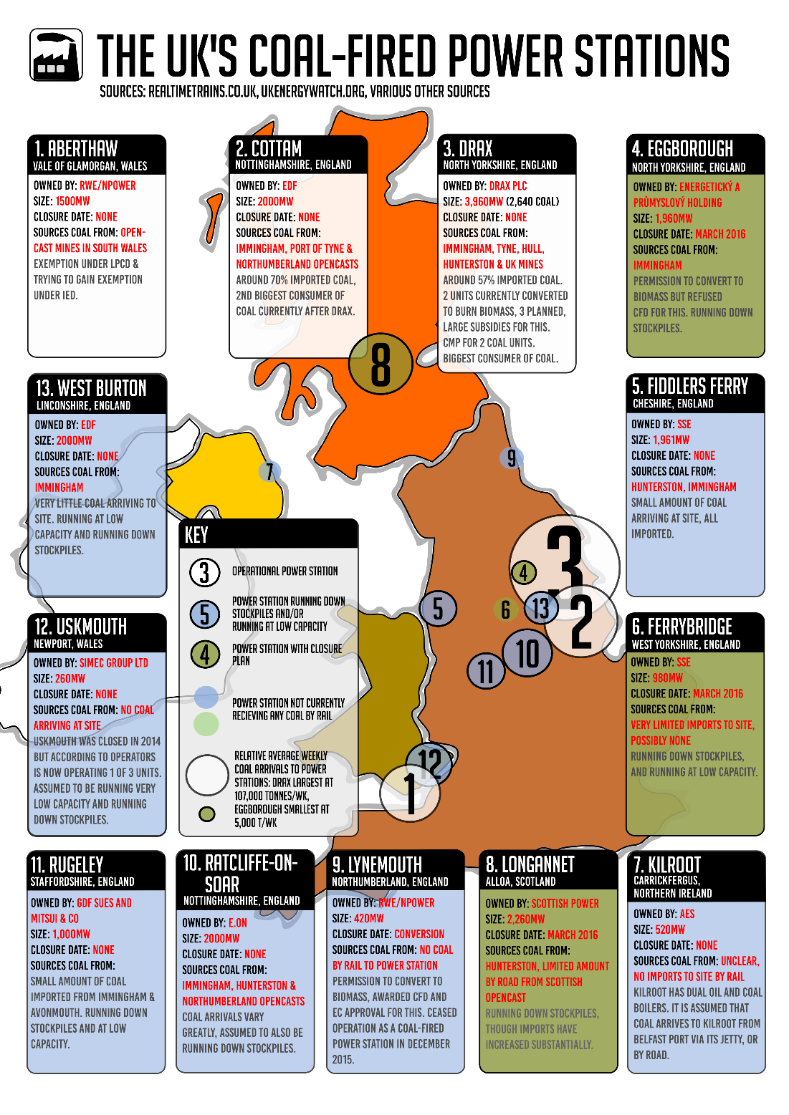

coal
Still forms part of UK energy mix (23%)
9 working coal powered stations
2015 announcement: closure of remaining plant by 2025
Source: www.coalaction.org

Slide 20
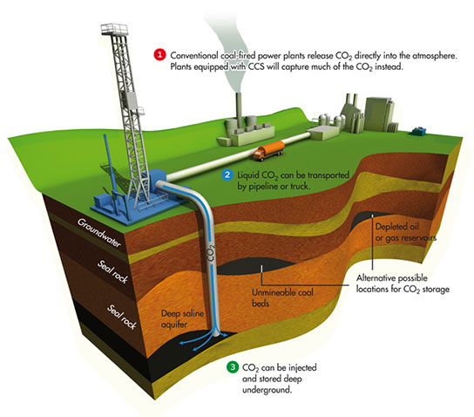
Carbon capture & storage
Source: www.transitionnetwork.org

Slide 21

CCS - capping
Source: British Geological Survey

Slide 22

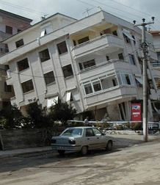
Will co₂ leak?
Source: British Geological Survey

Slide 23
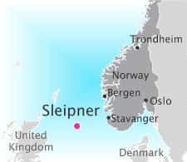
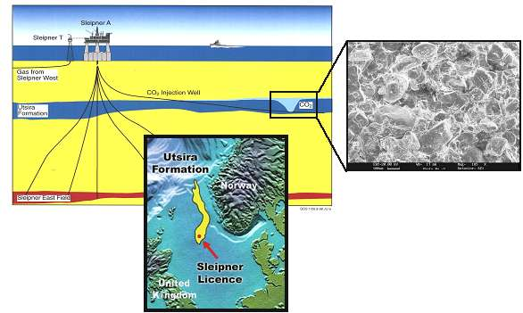
Ccs demonstration site
Norway – Sleipner gas field
Sources: Statoil / British Geological Survey

Slide 24
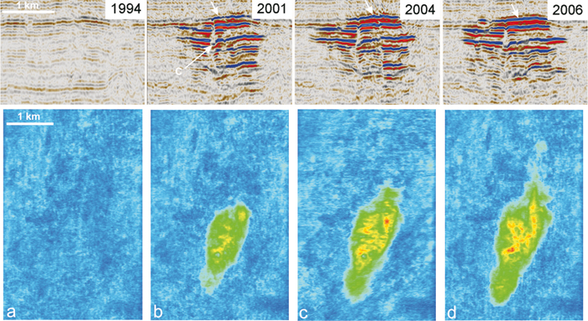
CO₂ storage @ sleipner
Source: British Geological Survey

Slide 25
nuclear
Plans for ~25% energy to be supplied by 2025
Half of existing plant will close by 2025
Development:
  First nuclear programme – Magnox
  Second nuclear programme – Advanced Gas-Cooled Reactor (AGR)
  Third nuclear programme – much debate; settled on Pressurised Water Reactor (PWR)

Slide 26
Current nuclear plants
Plant | Type | Present capacity (MWe net) | First power | Expected shutdown
Dungeness B 1&2 | AGR | 2 x 520 | 1983 & 1985 | 2028
Hartlepool 1&2 | AGR | 595, 585 | 1983 & 1984 | 2024
Heysham I 1&2 | AGR | 580, 575 | 1983 & 1984 | 2024
Heysham II 1&2 | AGR | 2 x 610 | 1988 | 2030
Hinkley Point B 1&2 | AGR | 475, 470 | 1976 | 2023
Hunterston B 1&2 | AGR | 475, 485 | 1976 & 1977 | 2023
Torness 1&2 | AGR | 590, 595 | 1988 & 1989 | 2030
Sizewell B | PWR | 1198 | 1995 | 2035
Total: 15 units |  | 8883 MWe
Graph of UK electricity generated and supplied

Slide 27
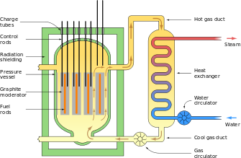
Magnox

Slide 28
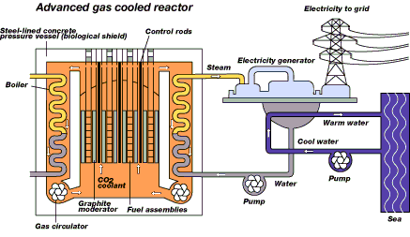
AGR
Source: Scottish Nuclear

Slide 29
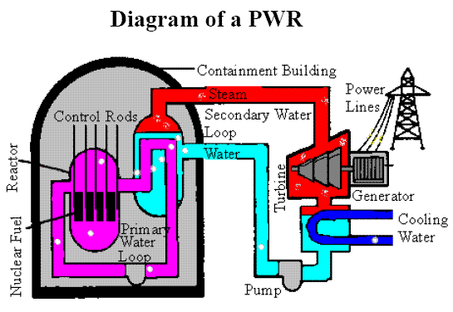
PWR
Source: Geocities

Slide 30
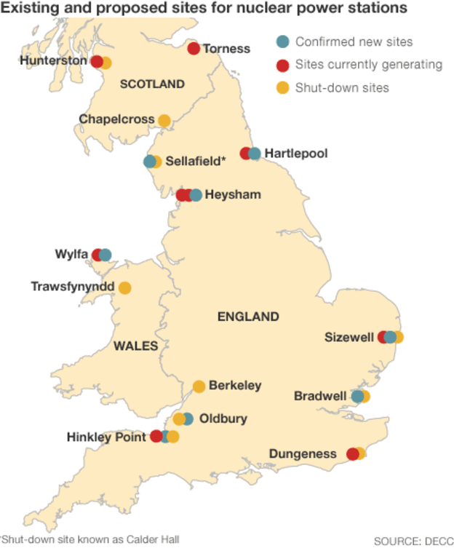
Nuclear map uk
Source: DECC

Slide 31
Nuclear waste
Exempt waste & very low-level waste
Low-level waste
Intermediate level waste
High level waste
Mining & milling
Conversion, enrichment and fuel fabrication

Slide 32
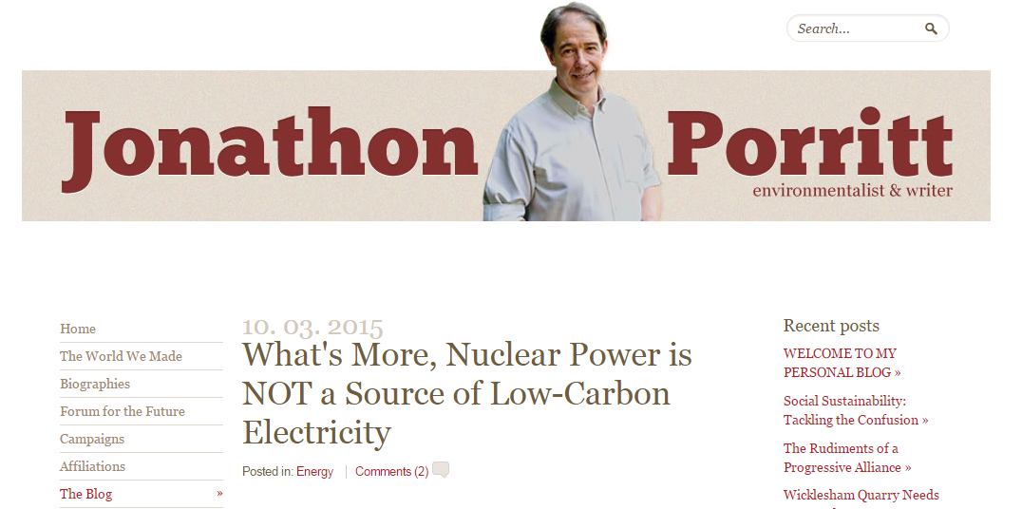
Is nuclear low carbon?
CCC – 6g CO₂ / kWh electricity unit
By 2030, all electricity should be less than 50g CO₂ / kWh
Range of figures – 3 – 200g CO₂ / kWh

Slide 33
thorium
Hailed as ‘future fuel’
Requires greater R&D
Previous test sites:
  300 MWe Thorium High Temperature Reactor (THTR) at Hamm-Uentrop, Germany – 1983-89
  40 MWe Peach Bottom HTR in the USA – 1967-74
  330 MWe Fort St Vrain HTR in Colorado, USA – 1976-89
  thorium-fuelled light water breeder reactor in Shippingport, USA – 1977-82

Slide 34
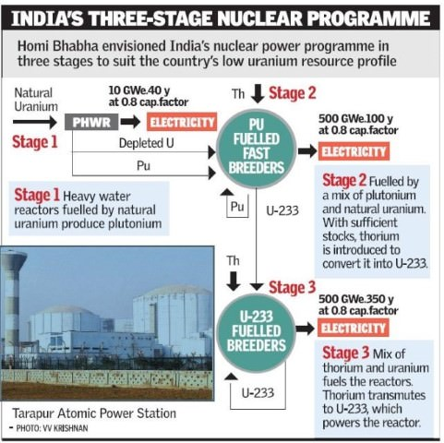
Source: Insight on India, Nov 2015

Slide 35
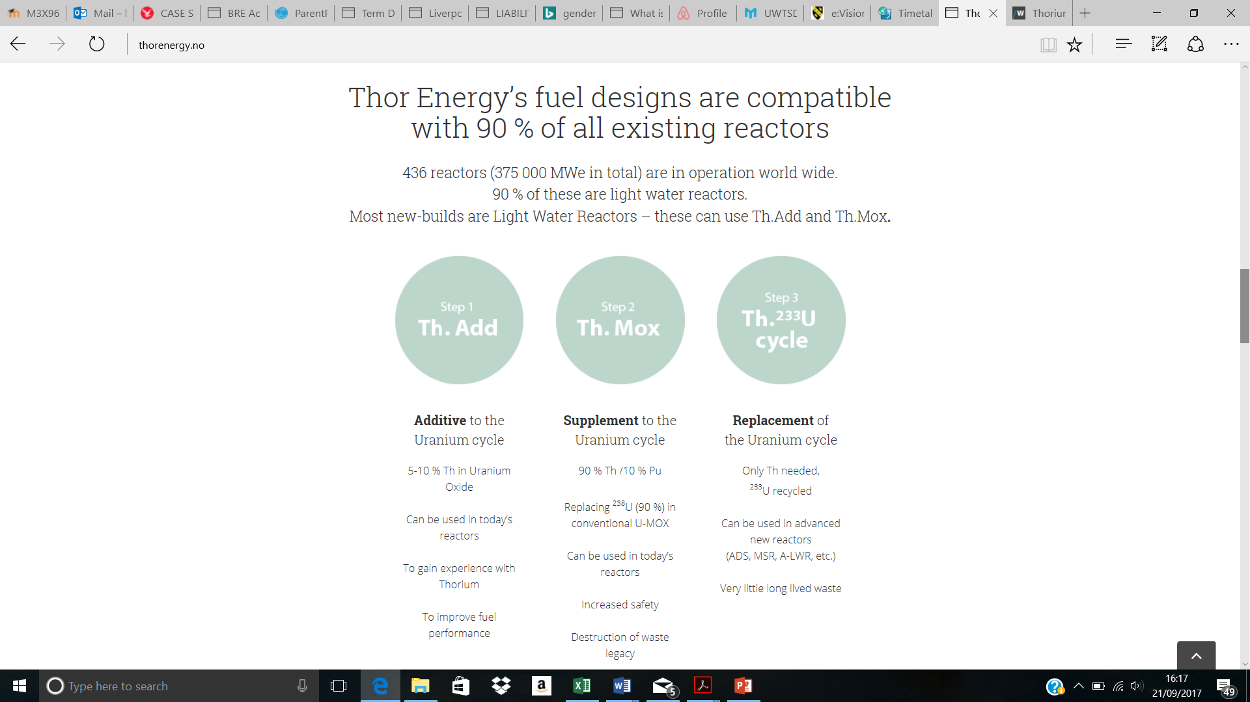
Thor energy

Slide 36
renewables
Number of different sources:
  Wind (27%)
  Bioenergy (28%)
  Marine, wave & hydroelectricity
  Solar
Source: UK energy statistics bulletin, March 2016

Slide 37

Tidal lagoons
Source: Marine Energy Pembrokeshire

Slide 38
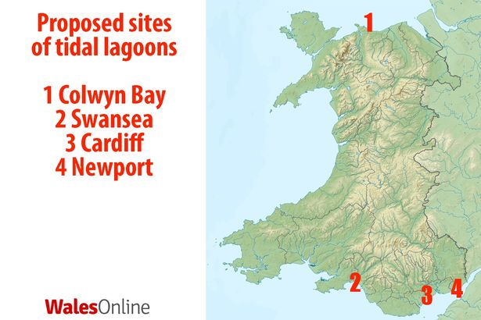
Future plans?

Slide 39
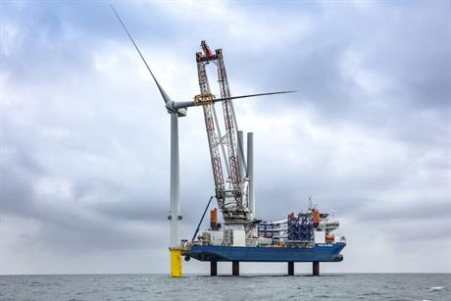
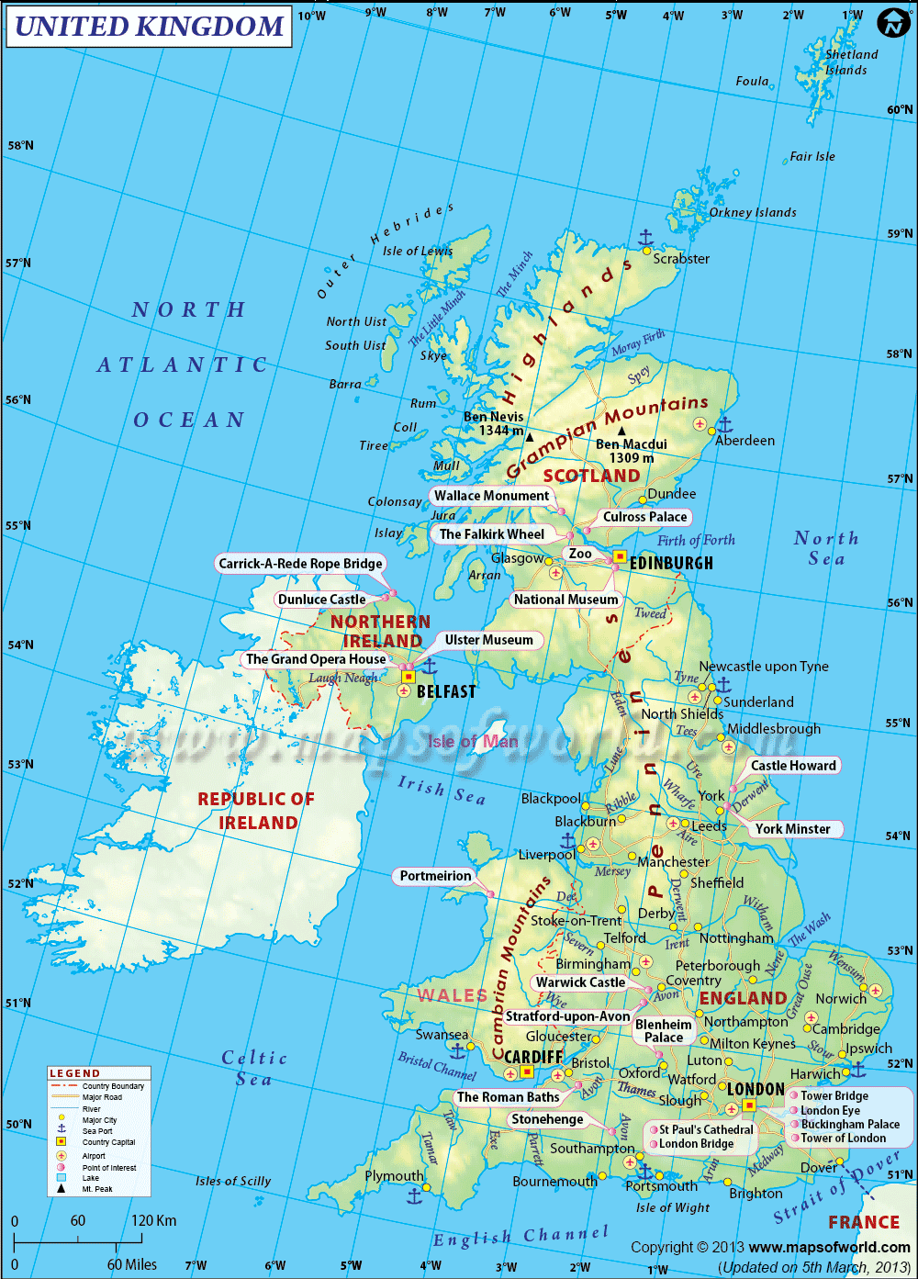

Proliferation of offshore wind?
Source: WindPower Offshore

Slide 40

Feed in tariff
Source: www.edie.net

Slide 41
Useful sources
British Geological Society(www.bgs.ac.uk)
Energy UK (www.energy-uk.org.uk)
Chartered Institute of Water and Environmental Management (www.ciwem.org)
US Environmental Protection Agency (www.epa.gov)
Science (www.science.sciencemag.org)
Energy & Carbon (www.energyandcarbon.com)
World Nuclear Association (www.world-nuclear.org)
The Ecologist (www.theecologist.org)
Energy Savings Trust (www.energysavingstrust.org.uk)
Windpower Offshore (www.windpoweroffshore.com)

