Slide 1
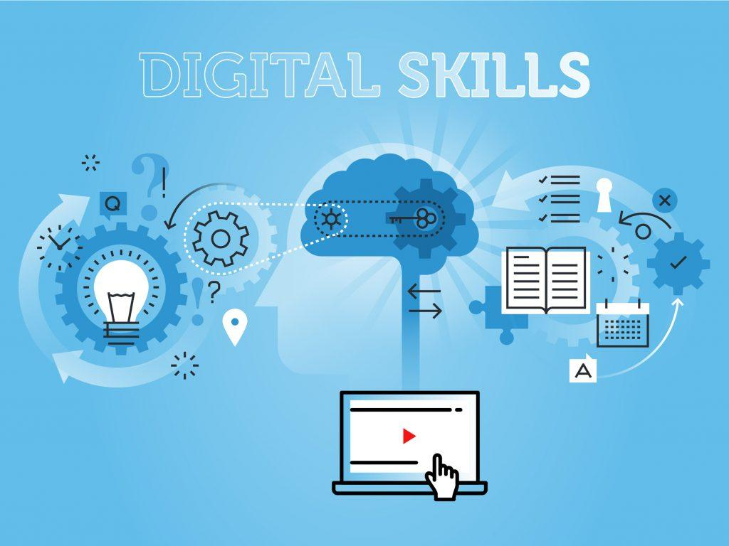
Module code-LCSH4002
Module title: Digital skills and research methods
IMPORTANCE
OF DIGITAL SKILLS IN
STUDYING AND IN WORK
Group member- Asos Abdolla
Nazma Latif
Student number-2223216
2222410
Date of submission-20th February2023
Lecturer-Dami Pokubo

Slide 2
CONTENT TABLE
Introduction
Research question
Literature reviews
Ethical consideration
Methods
Results
Conclusion
Reference list

Slide 3

INTRODUCTION
What are Digital skills?
They are capability that will enhance collaboration, encourage learners to reengage with educating the digital tools which are most essential key for today's knowledge economy.(Alexander J. A. M. van Deursen,2014)

Slide 4
According to a basic digital skills survey of 9,000 people. In 2018 report found that in the UK:
11.3 million people (21%) lack the full basic digital skills
4.3 million (8%) have no basic digital skills at all
5.4 million working adults (10%) are without basic digital skills
people with a registered disability are 4 times as likely to be offline
28% of those aged 60+ are offline

Slide 5
Research question
In this research we focused on:
Which Digital skills do UWTSD student think is the most important?
The aims of this study to show that how student in UWTSD think about digital skills?

Slide 6
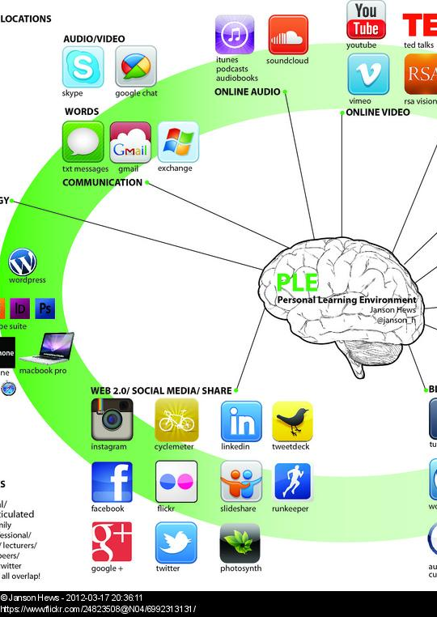
Literature reviews
The fast pace of technological changes and the presence of technologies in all aspects of life and workplaces new demand to everyone. (2019)And we now live in digital age and constantly changing the nature of our relationship with technologies. Nobile(2016)

Slide 7
FIVE ESSENTIALS OF DIGITAL SKILLS
• Communicating
• Handling information and content
• Transacting
• Problem Solving
• Being safe and legal online
​

Slide 8
Are UWTSD student using One Drive to save their documents?
the following slide will show
that One Drive is very important for student project to keep them safe and share them only to whom they want.

Slide 9

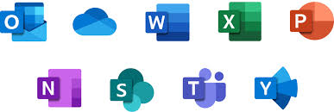
One Drive | Share Point
Microsoft's cloud storage and synchronization service that store all your file securely in one place. | Microsoft's original workspace that lets you create and share knowledge ,content and application across organization.
Only the owner has the access rights to view ,edit ,or share the document. | All members of the team can find and edit document .and team members can work on them from their own device.

Slide 10
Methodology
During this research we have looked at primary, secondary and quantitative research.
Primary research involves gathering data that has not been collected before and it is your own research.
Secondary research is information gathered from previously conducted studies.
Quotatives research is the process of collecting and analysing numerical data.
.
We will be using a questionnaire ,which will be sent to fellow students ,for the purpose of our research
It will therefore be primary quantitative research.
Questionaries
Research Methods
Test Marketing
Focus groups
Telephone surveys
Key:
Blue=Quantitative primary methods
Green=Qualitative methods
Experiments
Interviews

Slide 11
Ethical considerations
“Ethics helps us decide what we should do and why''
- Barett et al(2016,P7) -
During research there are various factors we must consider:
Issues | Solutions
Loss of data/GDPR | Data will be stored on password protected devices
Reputational damage of participants | Participants will be anonymous
Informed consent | All participants will be aware of the purpose of the research before agreeing to join
Bias | Will report results in a non-partial and factual manner

Slide 12
Ethical issues and definitions:
Issue | Definition
Voluntary participation | You participants are free to opt in or out of the study at any point in he
Informed consent | Participants know the purpose, benefits, risks and funding behind the study before they agree or decline to join
Anonymity | You don’t know the identities of the participants. Personally identifiable data is not collected
Confidentiality | You know who the participants are but keep that information hidden from everyone else. You anonymise personally identifiable data so that it can’t be linked to other data by anyone else.
Potential harm | Physical, social, psychologically and all other types of harm are kept to an absolute minimum
Results communication | You ensure your work is free of plagiarism or research misconduct and you accurately represent your results.

Slide 13
References
Dijk, & Deursen, A. J. A. M. van. (2014). Digital Skills Unlocking the Information Society. Palgrave Macmillan US. https://doi.org/10.1057/9781137437037
Government Publication(2019)essential-digital-skills-framework at https:// www.gov.Uk (06 February 2023).
Nobile. (2016). Book Review: Digital tools for qualitative research [Review of Book Review: Digital tools for qualitative research]. Research on Social Work Practice, 26(7), 836–837. SAGE Publications. https://doi.org/10.1177/1049731516656058

