Slide 1
Module: BMSE5000D
Design Thinking & Co-Production

Slide 2
Online Learning ​
Session 4

Slide 3
Agenda:
Making sense of complex or “messy” situations
Framing, and reframing problems
Taking the next steps

Slide 4

Empathy is key!
Unclear goals
The messy situation
Unclear goals
Multiple causes
Many symptoms
Contradictions
Conflicting needs

Slide 5
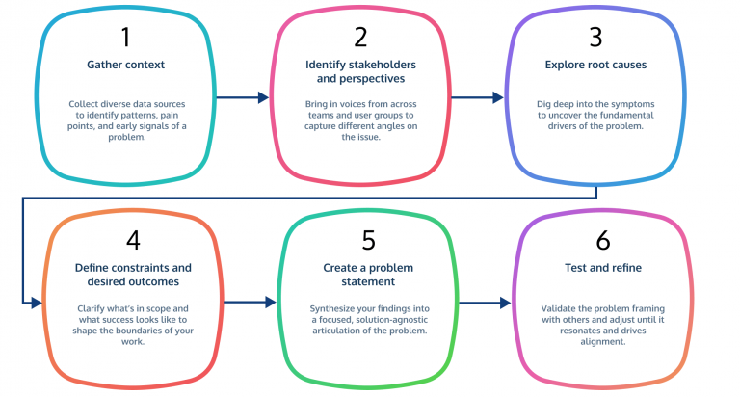
Problem Framing Theory
(Schön & Rein, 1994)
Identify patterns/ themes
Notes:
The Double Diamond is a widely recognized framework for innovation and problem-solving, popularized by the British Design Council in 2005. It breaks down the creative and analytical process into four distinct phases: Discover, Define, Develop, and Deliver.
The defining characteristic of the model is its emphasis on "designing the right thing" before "designing the thing right". It alternates between divergent thinking (opening up to explore broadly) and convergent thinking (narrowing down to focus and commit)

Slide 6
Exploring Perspectives through Reframing Matrix
A reframing matrix is a problem-solving tool that examines a central issue from multiple perspectives to generate innovative solutions (Morgan, 1993)

Slide 7
Creating a Reframing Matrix
The challenge/Problem
Perspective 1
Perspective 2
Perspective 3
Perspective 4
The public – how do they view the challenge?
What positive/negative impacts does it currently present?
Council? – are they aware of a problem?
Will they be looking at it from a monetary view?
Local businesses – they will be looking at how it impacts them and their customers
Community groups, Infratsructure etc.
How will they view the issue?
Challenges often involve multiple stakeholders with differing experiences, values, and priorities.
The reframing matrix encourages participants to map the different perspectives, helping teams recognize how different groups perceive a problem, what they consider important, and what assumptions underlie their views.
Find the themes!!

Slide 8
Consolidation and Root cause:
Explore each quadrant of the matrix, and note recurring themes, ideas, and underlying causes.
Identify any biases and constraints
List alternatives views of what could be
Combine and Synthesize!!

Slide 9
How can we combine and reframe to express our challenge:
There are four key elements we need to identify:
The Problem/ Challenge
Why it matters – the impact and effect if can have beyond its initial framing
What is currently missing?
What is a way to look forward?

Slide 10
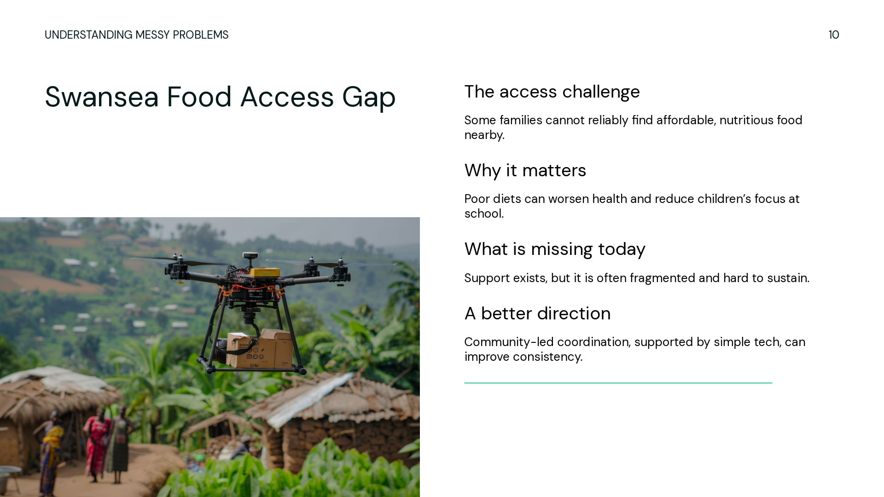
Problem Statements
In Swansea, many low-income families lack access to affordable and nutritious food, leading to poor health outcomes and educational disadvantages for children. Despite existing programs, there is insufficient coordination and sustainable solutions to ensure consistent access. Developing a community-driven model that leverages technology and local resources could improve food accessibility and overall well-being.
A Problem Statement is a concise description of an issue or challenge that requires attention. Explaining why the issue matters, who is affected, and the gap an innovative approach could fill

Slide 11
Problem Statements
In Swansea, many low-income families lack access to affordable and nutritious food, leading to poor health outcomes and educational disadvantages for children. Despite existing programs, there is insufficient coordination and sustainable solutions to ensure consistent access. Developing a community-driven model that leverages technology and local resources could improve food accessibility and overall well-being.
A Problem Statement is a concise description of an issue or challenge that requires attention. Explaining why the issue matters, who is affected, and the gap an innovative approach could fill

Slide 12
Key Components of a Problem Statement
The challenge – A clear explanation of the issue, e.g., lack of access to clean water
Who is affected – Identifying who experiences the problem, e.g., rural families, marginalised groups
Impact of the problem – Consequences or why it matters, e.g., health risks, economic inequalities
Evidence or context – supporting data or observations that illustrate the nature, scale and scope of the problem
Opportunity for change – Current solutions are insufficient/ don’t exist, highlighting a need for innovation
This, allows us the framework to create new ideas…

Slide 13


Slide 14
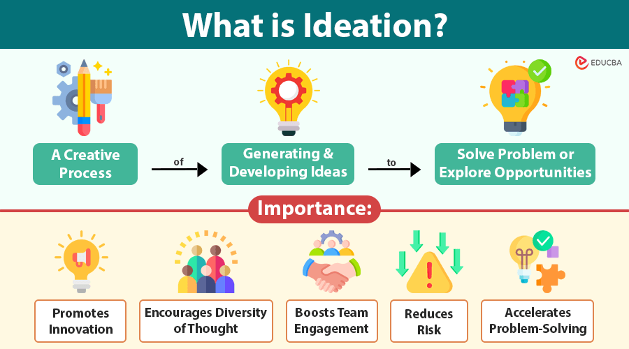

Slide 15

?
?
What is the impact
The challenge
?
What can we come up with…?
BRAINSTORMING
What’s currently available
Who is affected
It is our time to ask – How Might We…?

Slide 16
HOW
We do not know the answer so this opens us up to explore alternatives, instead of jumping straight in

Slide 17
MIGHT
Emphasises that there is more than one right idea and encourages exploration

Slide 18
WE
It is a collaborative effort, requiring teamwork and collective thinking

Slide 19
HOW MIGHT WE
“How might we” statements end with a phrase or question relating to the challenge

