Slide 1
Interim Viva

Slide 2

An Investigation into How Fitness Applications Motivate Their Users
This Viva will consist of:-
Aims and Objectives for the project
The Literature review
Findings from the literature review
Screen Designs
Project Plan

Slide 3

Aims and Objectives
Aims
To Evaluate How Fitness Applications Motivate Their Users
Objectives
Conduct an in-depth literature review into:- fitness in the UK, methods of working out, what is motivation, what is gamification and the current tools available
Design and implement the fitness application
Evaluate the system and whether the application motivates its users
Critically evaluate the success of the application based on the users results
Analyse any future developments of the application and how they can be implemented

Slide 4
What Source Materials Were Used?
Journals
Articles with accredited authors
Studies
Websites

Slide 5
Literature Review
Literature Review Topics
Fitness in the UK
Methods of Working Out
What is Motivation
What is Gamification

Slide 6
Source 1 – Fitness in the UK
Over 64.3% of adults in the UK are over weight or obese
GP’s can give advice such as diet plans and simple exercise plans to patients, but this may not motivate the to succeed
Over 10% of people in Britain hold a gym membership which is over 5.7 million and is on the rise
These numbers are only increasing year on year
There is a need shown here by doctors and GP’s for an app that can both instruct users but also motivate users to continue
Notes:
This suggests that over 64.3 percent of adults within the UK are overweight, this is a massive percentage of the population which shows that fitness and nutrition are both massive problems that need to be dealt with. this source is good as it comes from a reputable source being the UK parliament, as well is fit for purpose as it talks directly about the information that is needed. This source is also very current as it was published in 2020 which means that the information inside is usable.

Slide 7
Source 2 – Methods of working out
Males prefer exercises that build the physique such as push ups, squats and chair dips the most
This allows them to build the look that they are after
Females prefer exercises for the lower body with the performance of the exercise being the biggest factor squat, jumping jacks and step ups the most
This allows them to be able to sculpt the different aspects of the body
All exercise programs should start with cardio and then follow with either body weight or weighted exercises
Notes:
There are many different methods that people can use when they are working out, weights, body weight and cardio vascular exercises Kiemute Oyibo and Julita Vassileva state “Males prefer push-up, squat, crunch, plank, and chair dip the most, with effectiveness being the most important driver” (4) This suggests men prefer the upper body exercises which are effective for them and gives then the ‘look’ that they want to achieve from these exercises, this is interesting and may show the motivation and the reasoning behind men working out with such methods. Whereas, Kiemute Oyibo and Julita Vassileva also state “females prefer squat, crunch, jumping jack, step up, and plank the most, with ease of performance being the most important driver” (5) This suggests women prefer the more lower body exercises which will allow them to sculpt the look that they want, this is shown as the exercises that were suggested were focused on what they wanted which was the development of the physique. This source is good for the project as all of the information fits in within the sections. This source is also credible as it was published in 2020 so the information is very current and can be used within the project.

Slide 8

Source 3 – What is motivation
There are three type of motivation:-
Needs – what people need to survive
Wants – what people want
Goals – what people want to achieve
Motivation is greatest when a challenge is set to the user such as complete a weeks worth of workouts which will entice them to complete the workouts
Notes:
Another question that needs to be asked it what motivation is open.edu states that “motivation is a ‘driving force’ through which people strive to achieve their goals and fulfil a need or uphold a value.” (8). This then suggests that motivation is what allows a person to be able to accomplish the goals, there are 3 very important words that can be taken from this the first is needs, this then suggests these are the things that hey people need to survive in the short term or long term future, then are the values to the person which could be things such as family health or wealth. The last word to be taken from this is goals, this is probably the most important and usually the most difficult to complete as these are sometimes personal things that may annoy the person such as weight issues or other issues such as them feeling to small which would motivate them to make changes. This last word is especially relevant when considering fitness which is how not seeing results would spur a person to download a fitness app to see if this could give them structure which would get them the results that they want.

Slide 9
Source 4 – What is gamification
Gamification is the use of game elements in non game contexts
Such as a levelling up system in a fitness application
This is where the user is rewarded for the work and gets points which can allow them to level up, this can then be shown to friends or posted on a leaderboard
That gamification is a massive part of other fitness applications in motivating people
In my app every time a workout is completed the user will receive points that they can use to level up
Notes:
Another source from Salvador et al states “it showed that the reasons for using them were to have the achievement of fitness goals and the enjoyment of being able to share the results obtained with their contacts, so gamification could have a direct relationship with their use.” (12) This suggests that the gamification side of the applications allows users to get gratification from sharing their achievements with their contacts, this allows them to show their level and compare it to their friends. This shows how the how gamification gives users something to be proud of once they have finished a task. This source is good as the information links to the topic and all works within the project, this source is also recent as it was published in 2020 so the information is current.

Slide 10
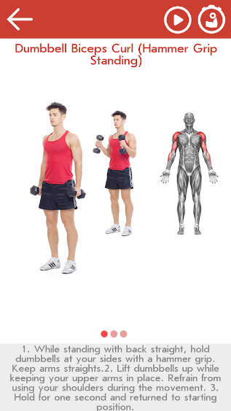
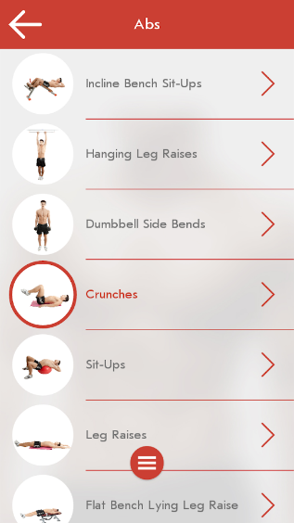
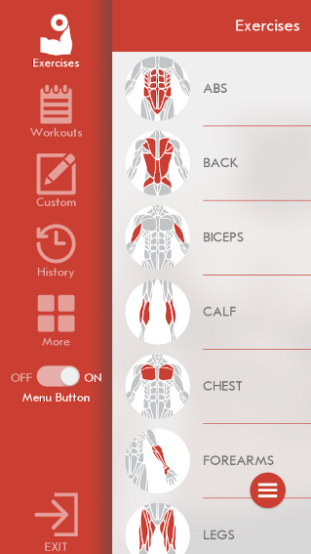
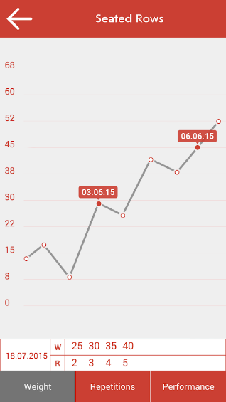
Current Tools Available
Fitness and Bodybuilding by vgfit.com
https://play.google.com/store/apps/details?id=softin.my.fast.fitness
Strengths | Weaknesses
Very Simple menu | Some parts are paid elements
Very good videos for exercises | Diet plans are too complicated
Can create custom workouts

Slide 11
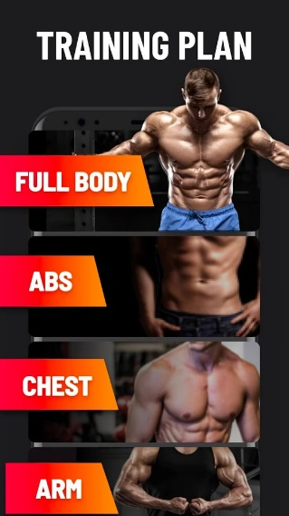
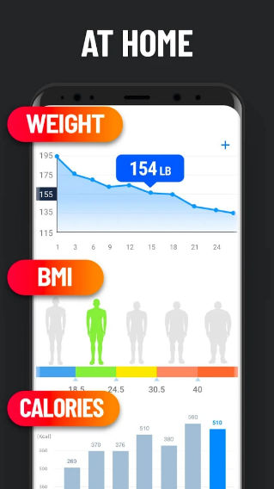
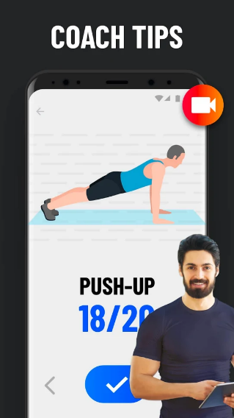
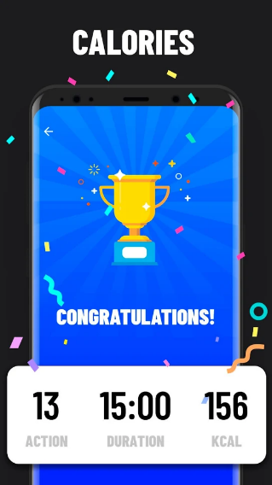
Current Tools Available
Home Workout - No Equipment by Leap Fitness Group
https://play.google.com/store/apps/details?id=homeworkout.homeworkouts.noequipment
Strengths | Weaknesses
Simple menu | Paid application
Very good tips for exercises | Plans are too complicated not concise
 | No videos for exercises

Slide 12
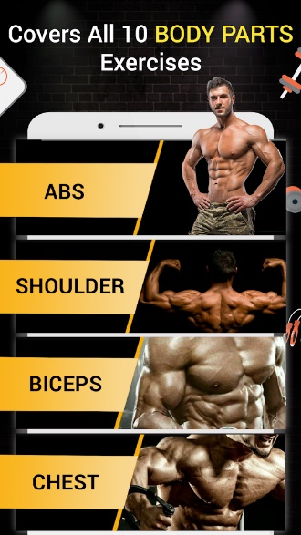
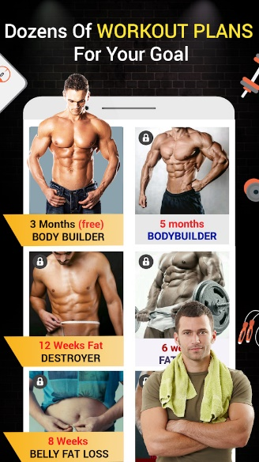
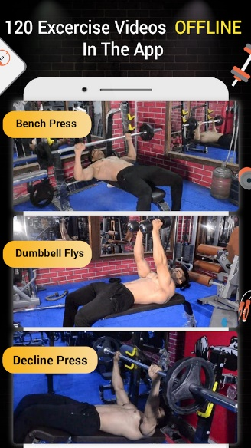
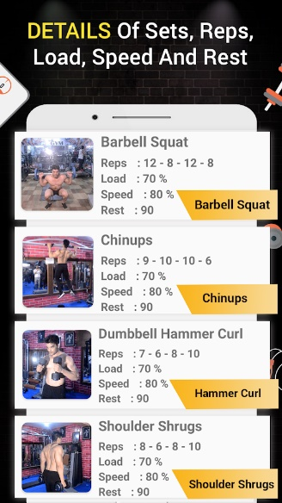
Current Tools Available
Pro Gym Workout
https://play.google.com/store/apps/details?id=com.workout.workoutb
Strengths | Weaknesses
Very good menu | Paid application
Very good videos for exercises | Plans are too complicated not concise
Very good detail for exercises

Slide 13
Discussion of Findings
There is a need for a fitness application to motivate individuals
Obesity is a massive problem which the NHS only has a simple solution which does not encourage motivation
Gamification is the best way to motivate users
There are 3 main types of motivation needs, wants and goals
Most fitness application are paid
Notes:
From the research that was conducted, there have been some conclusions that have been found, one of which has come from the fitness in the UK section of the project. This has shown that there is a real need for these apps for motivation as there are more and more people who are becoming obese and morbidly obese each year which is putting stress on the NHS, GP’s are also doing their bit by giving people plans to help them lose weight but with little effect whereas an application with some elements of gamification may entice the user to follow the plan. Another conclusion is that many of the people who will use the application may be new gym goers so simple, intermediate and advanced workouts will be needed for each type of user. Another conclusion is the motivation that the users may have and how the application can then entice the users to then hit their goals, it was researched and the 3 types of motivation being needs, wants and goals were discovered and then gamification may be the way to do this, as similar applications use a level system that will entice the users and keep them returning to claim their rewards. For the solution to this problem a fitness app will be created to bridge the gap between the current features that they offer, one major difference is that the fitness app will be completely free which is a major difference between the other apps which have been discussed as a lot of these are paid applications. Some of the features from the other app which will be implemented is the simple list order from the apps with videos which will be implemented.

Slide 14
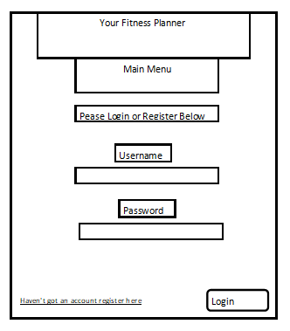
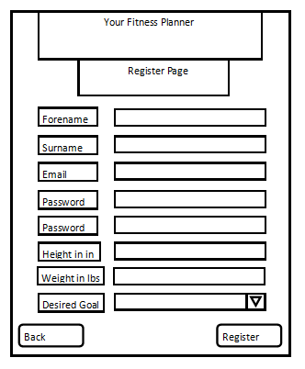
Screen Designs

Slide 15
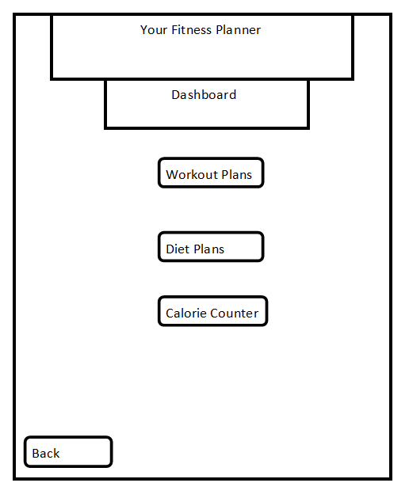
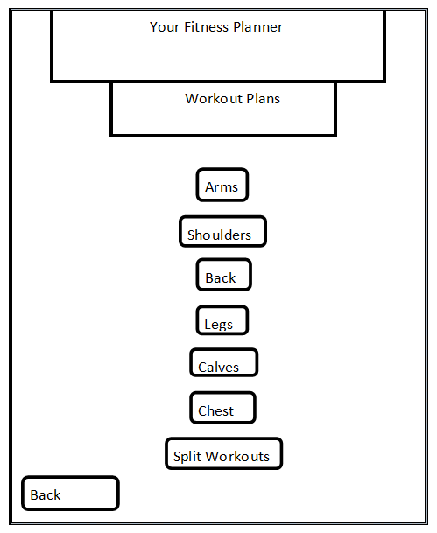
Screen Designs

Slide 16
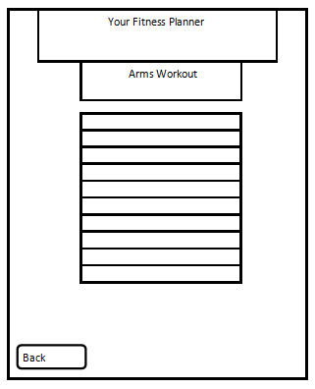
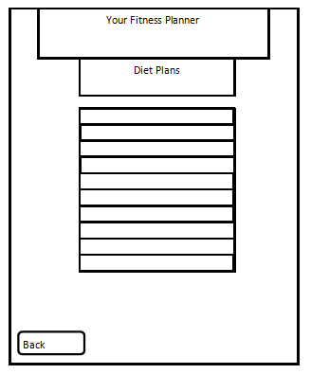
Screen Designs

Slide 17
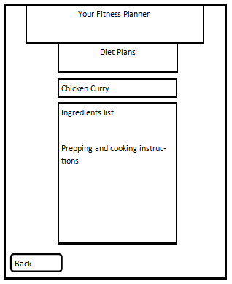
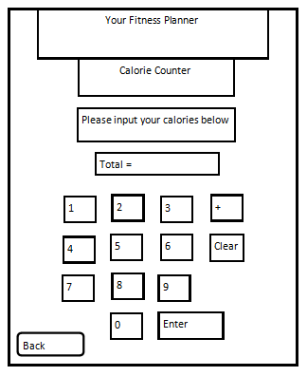
Screen Designs

Slide 18
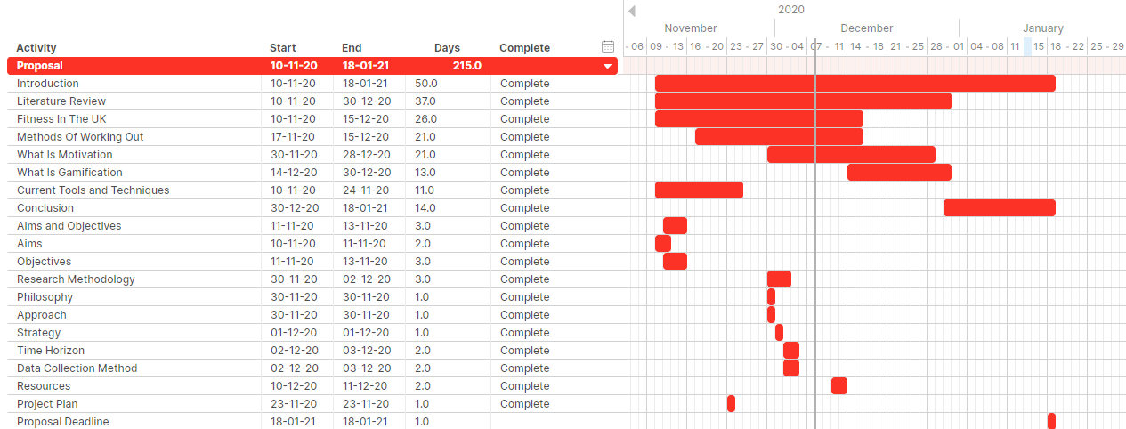
Project Plan – Proposal

Slide 19
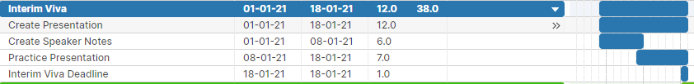
Project Plan – Interim Viva

Slide 20
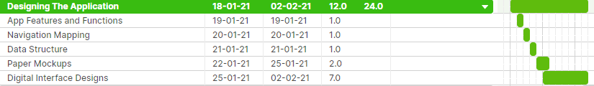
Project Plan – Designing The Application

Slide 21
Project Plan – Creating The Application

Slide 22
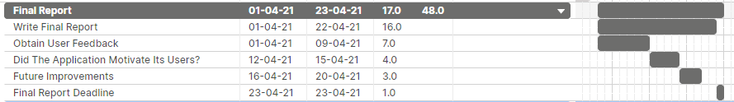
Project Plan – Final Report

Slide 23
Project Plan – Final Viva

Slide 24
Project Plan – Exhibition

