Slide 1
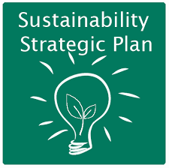
What Part does Sustainability Play in Strategic Management?

Slide 2
The Comprehensive Business Case for Sustainability
by Tensie Whelan and Carly Fink
October 21, 2016 Harvard Business Review
Suggests a sustainability business case for the 21st century corporate executive

Slide 3

1. Driving competitive advantage through stakeholder engagement

Slide 4
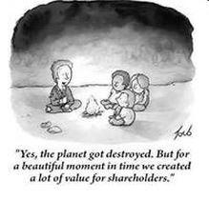
Traditional business models aim to create value for shareholders, often at the expense of other stakeholders.

Slide 5

Sustainable businesses are redefining the corporate ecosystem by designing models that create value for all stakeholders, including employees, shareholders, supply chains, civil society, and the planet.

Slide 6

Through regular dialogue with stakeholders and continual iteration, a company with a sustainability agenda is better positioned to anticipate and react to economic, social, environmental, and regulatory changes as they arise.

Slide 7

2. Improving risk management

Slide 8

In a study on climate change data and corporations on the US, 8,000 supplier companies (that sell to 75 multinationals) reported on their level of climate risk. 72% said that climate change presents risks that could significantly impact their operations, revenue, or expenditures.

Slide 9
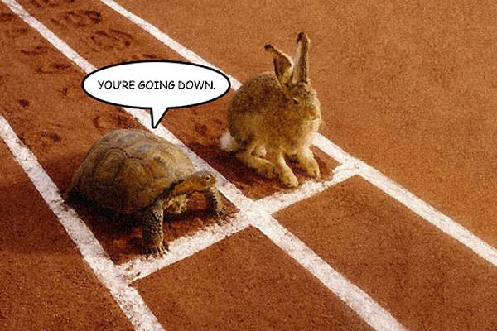
Unlike traditional forms of business risk, social and environmental risks manifest themselves over a longer term, often affect the business on many dimensions, and are largely outside the organisation’s control. Managing risks therefore requires making investment decisions today for longer-term capacity building and developing adaptive strategies.

Slide 10

3. Fostering innovation

Slide 11

Investing in sustainability is not only a risk management tool; it can also drive innovation. Redesigning products to meet environmental standards or social needs offers new business opportunities.

Slide 12

Facing strict regulation on chemical release and competition from flowers from Africa, the Dutch flower industry developed a closed-loop system that grows flowers hydroponically in greenhouses, lowering risk of infestation and reducing the use of fertilizers and pesticides. The system also improves product quality by creating regulated growing conditions. Their innovative system has increased productivity and quality, reduced environmental impact and costs, and increased global competitiveness

Slide 13

4. Improving Financial Performance

Slide 14
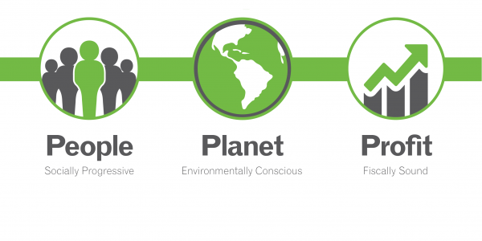
Many business leaders have the erroneous perception that one can have profits or sustainability, but not both. This probably has its roots in Milton Friedman’s 50-year old, but still influential, thesis that the only business of a business is profit as well as a hangover from the 1970s and 80s, when low quality, high priced environmental products failed in the market and early socially responsible investing delivered low returns. That conventional wisdom has now reversed.

Slide 15

In addition to the financial benefits that accrue from increased competitive advantage and innovation as discussed earlier, companies are realizing significant cost savings through environmental sustainability-related operational efficiencies

Slide 16

5. Building Customer Loyalty

Slide 17

Companies are skeptical about consumer interest in sustainable products – especially where willingness-to-pay is concerned. Some of that is self-inflicted, as early on companies tended to increase “sustainable” product prices substantially and in some cases sold inferior products (e.g. pricy natural cleaning products that did not work).

Slide 18

However, a shift is occurring in the minds of consumers. Today’s consumers expect more transparency, honesty, and tangible global impact from companies and can choose from a raft of sustainable, competitively priced, high quality products. In fact, one study found that among numerous factors surveyed, the news coverage regarding environmental and social responsibility was the only significant factor that affected respondents’ evaluation of a firm and intent to buy.

Slide 19

6. Attracting and Engaging Employees

Slide 20

Corporate sustainability initiatives aimed at improving performance and proving value to society can increase employee loyalty, efficiency, and productivity and improve HR statistics related to recruitment, retention, and morale.

Slide 21

Research is finding that 21st century employees are focusing more on mission, purpose, and work-life balance. Companies that invest in sustainability initiatives tend to create sought-after culture and engagement due to company strategy focusing more on purpose and providing value to society.

Slide 22
Environmental Sustainability in Business: A Case Study
https://clickv.ie/w/rnFg

