Slide 1
Student Name: J’avyon Johnson
Student Number: 2419047
Lecturers Name: Mucahit Ozden
LCLM4004Problem Solving and Decision Making
Component 1: Green Haven Florists

Slide 2

Presentation Overview
Overview of the Green Haven Florists case
Identification of key organizational problems
Application of analytical framework:
5W2H model
PESTEL framework
Cause-and-effect (Fishbone) analysis
Summary of key findings

Slide 3

Green Haven Florist Overview
Green Haven Florists is an independent flower shop established in 2016
Located in Norwich, United Kingdom
Specializes in bespoke floral arrangements for:
Known for eco-friendly packaging and sustainable practices
Built a strong local reputation through personalized service and community engagement.
Walk-in customers
Weddings and events
Corporate Clients

Slide 4
5W2H Analysis – Green Haven Florists
What? | Where? | When? | Who? | Why? | How? | How Much?
What effect is it having? | Where is the problem occurring? | When was the problem first noticed? | Who is impacted by the problem? | Why is the problem happening? | How serious is the problem? | How much money is being lost?
Declining customer satisfaction levels | In-store customer service interactions | Over the past 6-12 months | Existing and returning customers | Outdated digital and POS systems | Delay in fulfilling customer orders | Decline in repeat operational costs and waste
Reduced repeat purchase rates | Online ordering and payment system | During peak seasonal demand (e.g., Valentine's, Mother’s Day | Frontline retail staff | Inefficient inventory and order processing methods | Stock shortages and product waste | Increased operational coasts and waste
Operational inefficiencies affecting service delivery | Inventory and stock management processes | During peak promotional or high-volume sales period | Business owners and management | Increased competition from online and local florists | Inconsistent service quality and customer experience | Loss of market share to competitors
Source: SuperEnginee.net (2024)

Slide 5
Problems Facing Green Haven Florists
Root problem:
30% decline in in-store sales over the past 12 months
Key contributing factors:
Reduced high-street footfall (external)
Increased competition from online florists and national chains (external)
Rising costs of flowers and sustainable materials (external)
Outdated website and limited online presence (internal)
Limited marketing activity and reliance on word-of-mouth (internal)
Nature and scope of the problems:
Combination of internal and external pressures
Limited control over market conditions and competition
Greater control over digital presence and marketing capability

Slide 6
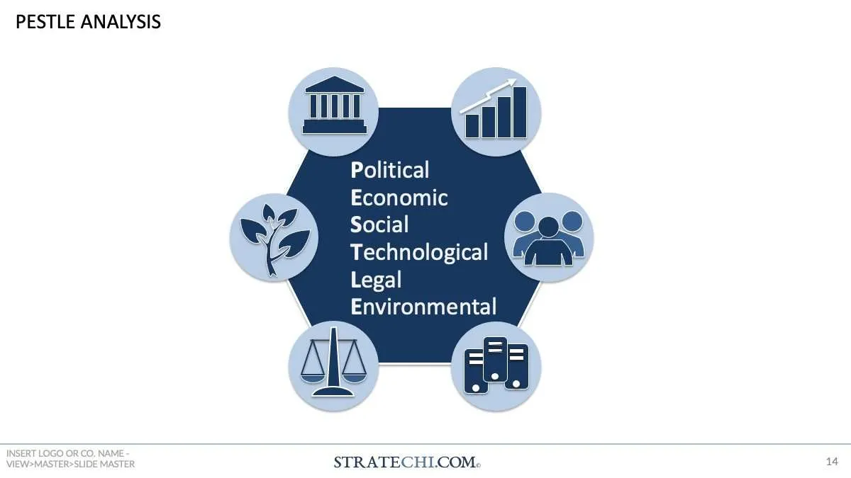
Critique of the PESTLE Framework
What is PESTLE?
  A strategic analysis tool used to examine the external macro-environment
  Considers Political, Economic, Social, Technological, Legal and Environmental factors.
Why and how is it used?
Used to identify external influences affecting an organization
Helps businesses understand opportunities and threats beyond their control
Benefits of the PESTLE framework
Provides a structured and systematic external analysis
Encourages awareness of wider environmental factors
Useful for strategic planning and decision-making
Criticisms of PESTLE:
Can be descriptive rather than analytical
Does not priorities key factors
Can become outdated in dynamic environments
Excludes internal organizational factors
Evaluation:
Most effective when combined with internal analysis tools
Source: Oxford College of Marketing Blog (2026)

Slide 7
PESTEL Analysis- Application to Green Haven Florists
Political Factors | Economic Factors | Social Factors | Technological Factors | Legal Factors | Environmental Factors
Import regulations affecting flower supply and pricing Trade and customs changes impacting overseas suppliers | Inflation increasing costs of flowers, energy and materials Reduced discretionary spending by consumers | Shift towards online shopping and home delivery Growing consumer preference for convenience and subscription | Competitors utilizing e-commerce platforms Increased use of social media marketing in the sector | Employment legislation increasing staffing costs Supplier compliance and contract obligation | Demand for sustainable and eco-friendly products Higher costs associated with sustainable packaging
Source: VCMO (2026)

Slide 8
Critique of the cause and Effect (Fishbone) Model
What is the Cause-and-Effect Model?
A visual problem-solving tool used to identify the root causes of a specific problem
Also known as the fishbone diagram, due to its structure
Why is it Used?
To move beyond surface-level symptoms
To support systematic identification of underlying causes
Where/How is it Used
Commonly used in quality management and operational improvement
Causes are grouped into categories to support structured analysis
Benefits of the Fishbone model
Encourages logical and structured thinking
Supports team discussion and idea generation
Helps distinguish root causes from symptoms
Criticisms of Fishbone model
Relies on subjective judgement
Does not priorities cause by impact
May oversimplify complex or interconnected issues
Source: IONOS UK (2026)

Slide 9
Methods
Machines
People
Inefficient order processing system
Limited online ordering functionality
Lack of staff training
Inconsistent customer service
Poor inventory management processes
Outdated POS system
Deline in customer satisfaction
Short shelf life of floral stock
Lack of performance monitoring
Seasonal demand fluctuations
Inconsistent flower quality from supplier
No customer feedback system
Increased competition from online florists
Materials
Measurement
Environment
Source: Lean out the box(2024)

Slide 10
Summary of key Findings
Operational weaknesses: Inefficient processes and inconsistent service are reducing customer satisfaction and repeat sales.
External Market Pressures: Seasonal demand and increased competition create revenue instability.
Limited Digital Capability: Weak online systems place the business at a competitive disadvantage.
Lack of Performance Measurement: The absence of structured feedback limits strategic improvement and informed decision-making.

Slide 11
References
SuperEngineer (n.d.) 5W2H – How to describe a problem in a clear and effective way? Available at: https://www.superengineer.net/blog/tools-5w2h (Accessed: 15 February 2026).
VCMO (n.d.) What is PESTEL analysis? Available at: https://www.vcmo.uk/resources/glossary/what-is-pestel-analysis (Accessed: 15 February 2026).
Oxford College of Marketing (n.d.) What is a PESTEL analysis? Oxford College of Marketing Blog. Available at: https://custommapposter.com/article/what-is-a-pestel-analysis-oxford-college-of-marketing-blog/2835 (Accessed: 15 February 2026).
IONOS editorial team (2023) Fishbone diagram: Solving problems properly. IONOS UK Startup Guide. Available at: https://www.ionos.co.uk/startupguide/productivity/fishbone-diagram/ (Accessed: 15 February 2026).
LeanOutsideTheBox (2024) Ishikawa fishbone diagrams: A proven method for problem-solving. LeanOutsideTheBox. Available at: https://leanoutsidethebox.com/ishikawa-fishbone-diagrams/ (Accessed: 15 February 2026).

Slide 12

Thank you For Listening!
For any question feel free to ask

