Slide 1
The importance of creative movement

Slide 2
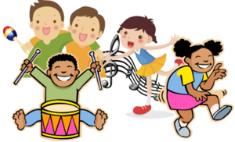
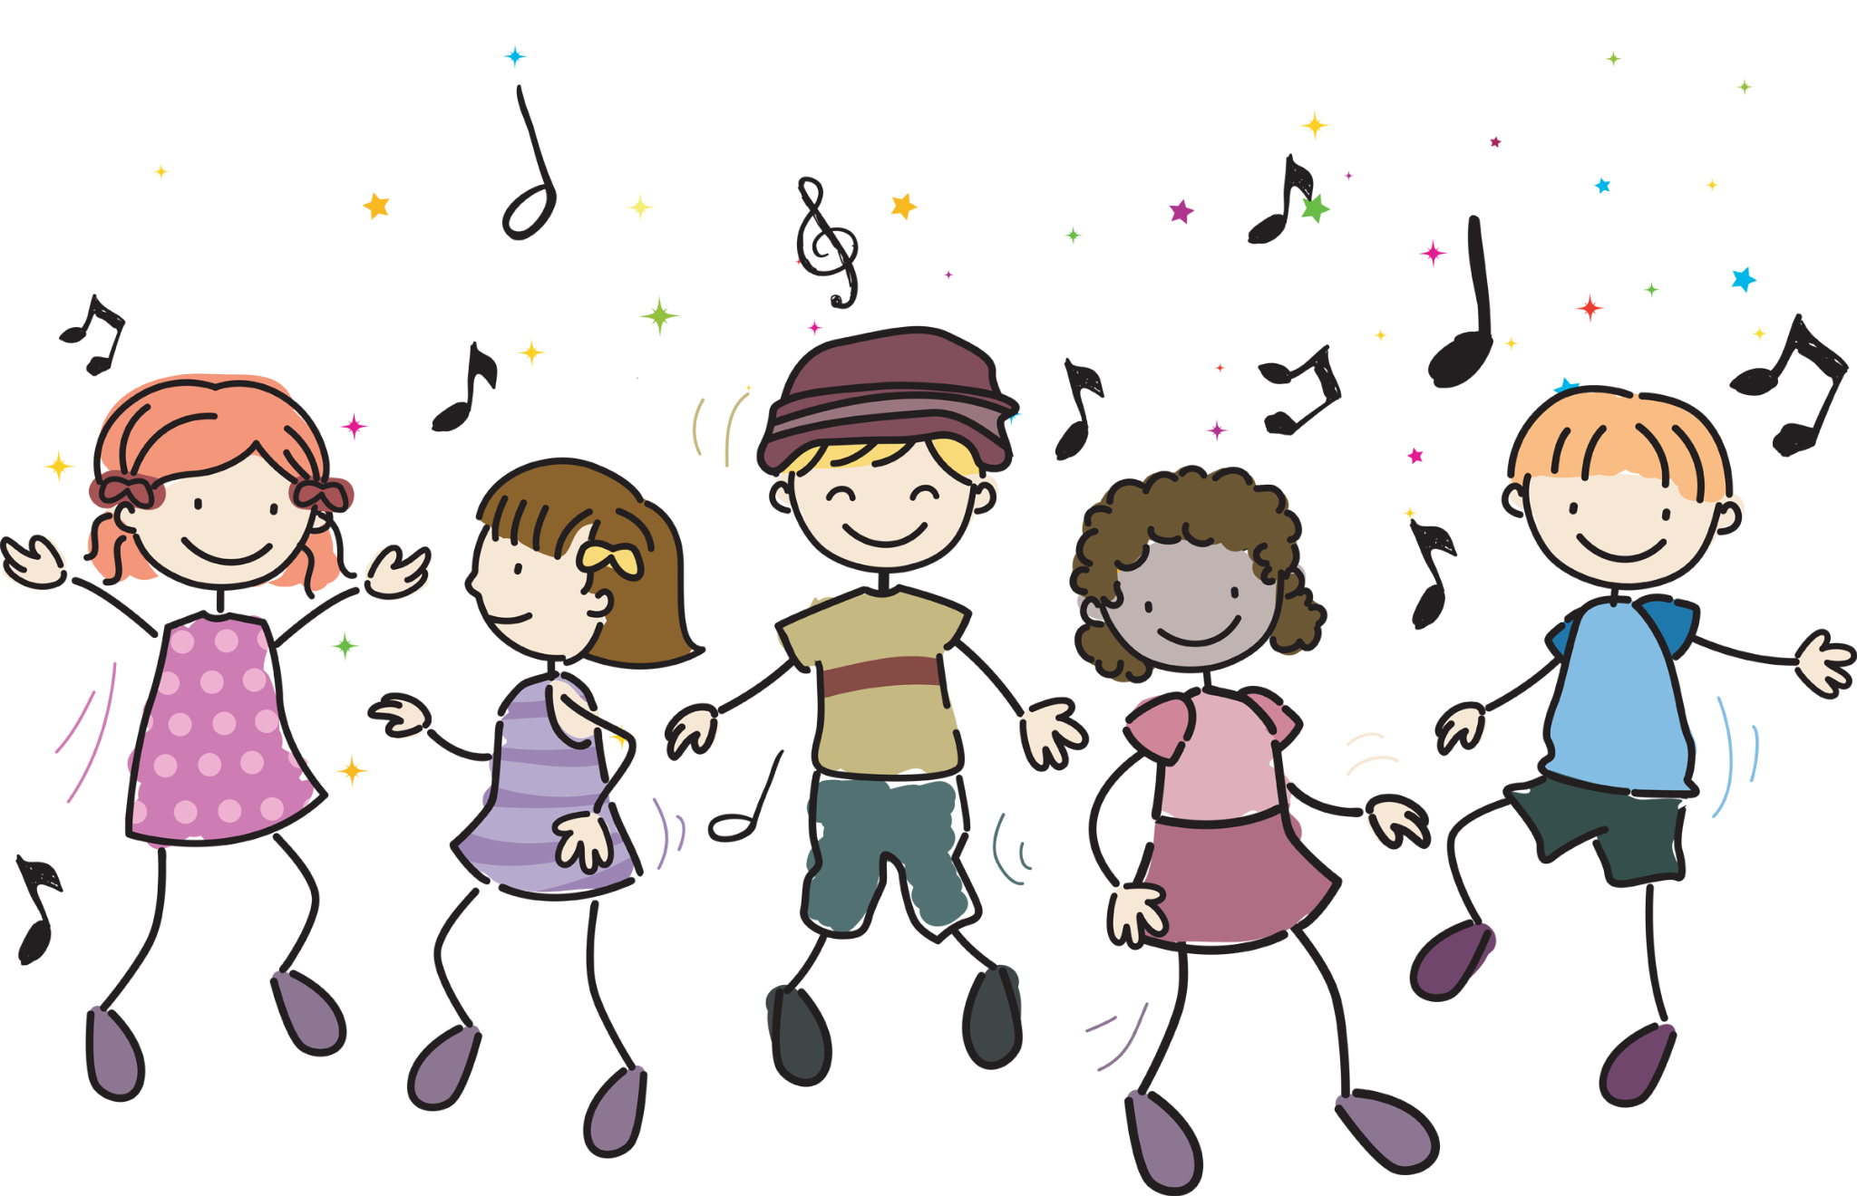
What is creative movement?
Why is it important ?
Creative movement uses body actions to communicate a specific image such as the wind or a story-line and even emotions , it is created through a dance , music or drama as its source of self expression.
Using creativity enhances a child’s physical skills and engages their energy and natures their creativity
Process of understanding themselves and the world they live in through activities.
Sensory skills through visulation, touch and hearing.
Helps understand the body language of others around.
Includes daily fiitness and fun

Slide 3
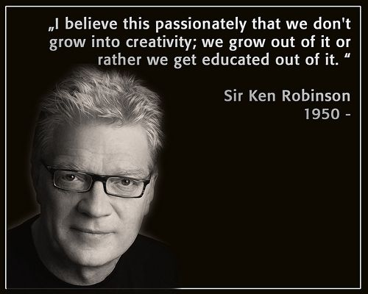
Sir Ken Robinson
“Creativity is as important as literacy”
“children are born creative and have an extraordinary capacity for innovation”
“If you’re not prepared to be wrong, you’ll never come up with anything original. And by the time they get to be adults, most kids have lost that capacity. They have become frightened of being wrong,”
Sir Ken Robinson states the importance creativity holds and implies schools are degrading the importance of creativity for other subjects

Slide 4
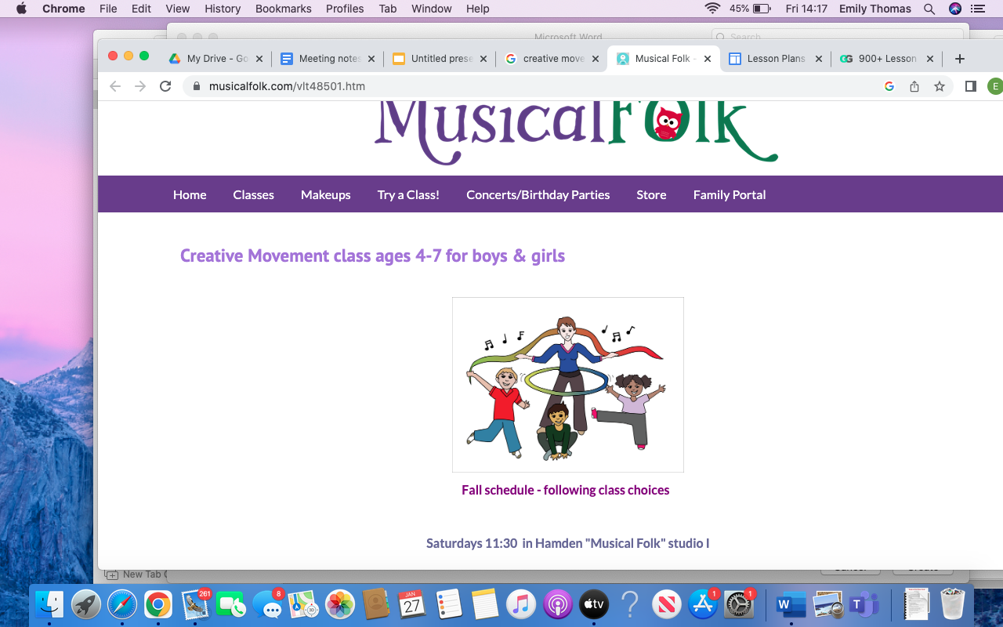
Creative movement through year groups
Foundation years (age 3-5)
Opportunity to become story-tellers through various movements.
Some may dance to music being played, others will clap and some will run free spirited.
Include various different movements each session to embrace their comfort zones.
Include wiggling , rolling , jumping and balancing

Slide 5
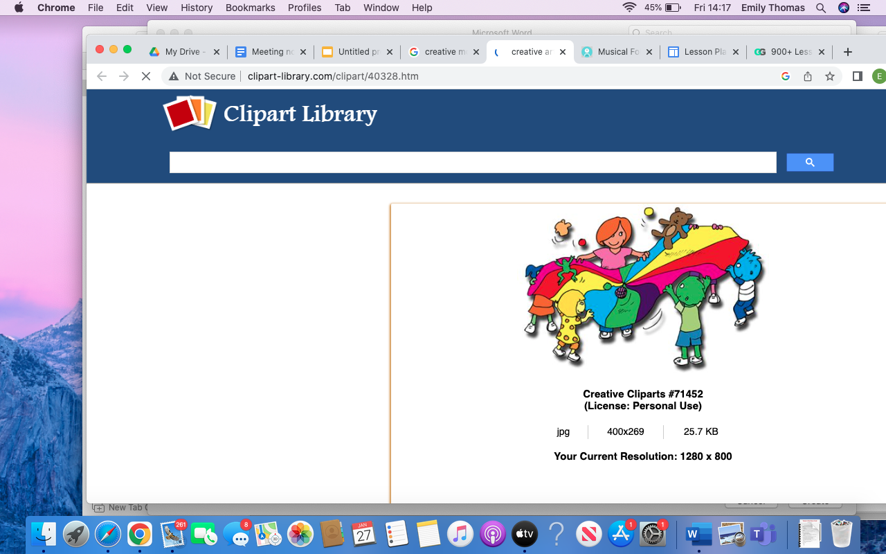
Creative movement through year groups
Year 3 and 4
Attempt to re-act out a short story through movements.
Learn short new dances - with a theme
Imply various equipment such as hula hoops , parachute , laminated cards and so on.
Simple effective games ,
Include short running bursts that conclude movement e.e weaving.
Bean bags
Include various shapes and sizes of balls e.e tennis,dodgeball

Slide 6
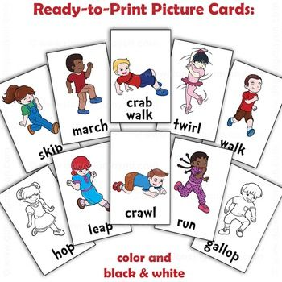
Creative movement through year groups
Year 5 and 6
Set out numerous cards with certain movements - create the picture chosen.
Throwing and catching
Juggling - learn the hand movement step by step.
Re-create games such as tag through animals
Jumps and leaps

Slide 7
Who can promote creative movement
Parents
Encourage creative, open-ended activities
Let them explore new surroundings.
Engage new sounds for their creativness to come and play.
Promote new objects , engage with their touch
Teachers
Pe lessons
Follow a creative classroom theme
Choose a layout to enhance movement
Create certain movements for certain requirements.

Slide 8
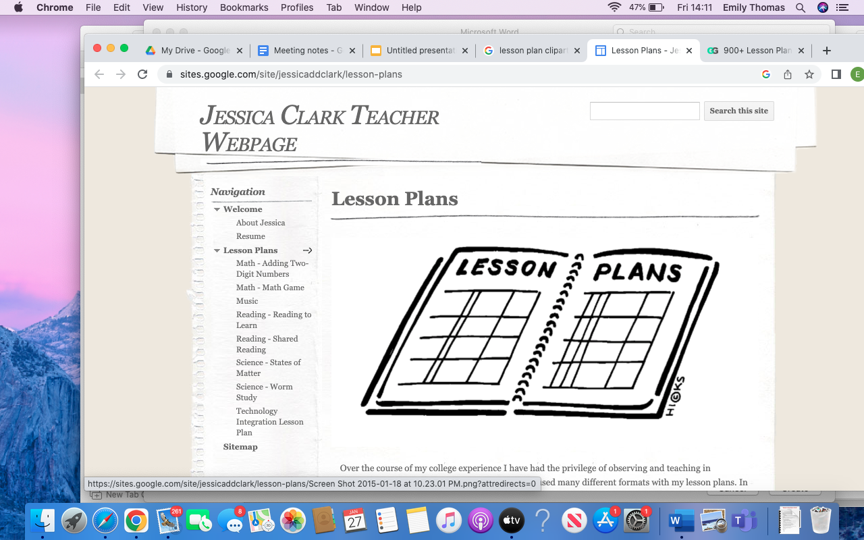
Lesson plan
Used either indoor or outdoor
Weather dependant

Slide 9
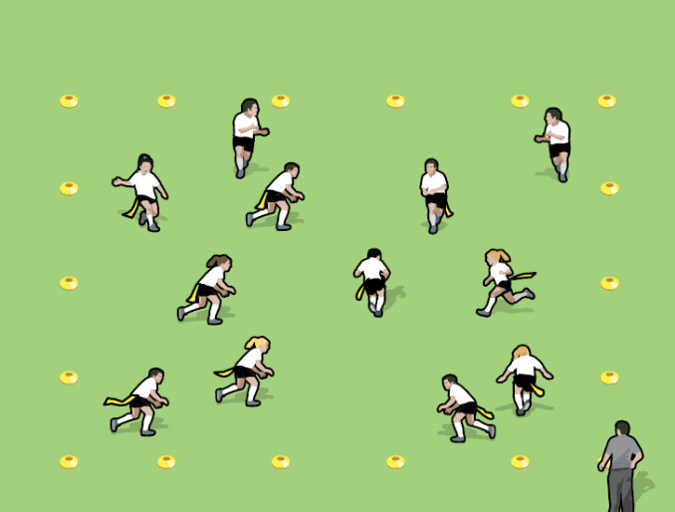
Warm up
Lion - Avoid
Game - Donkey tail (10 minutes )
Objective -
engage animal similarity movement
Creating movement and avoiding the ‘lions’
Twisting and turning
Aware of Personal space
Warm up the body ready for the main activities
Small area
Switch the lion every game

Slide 10
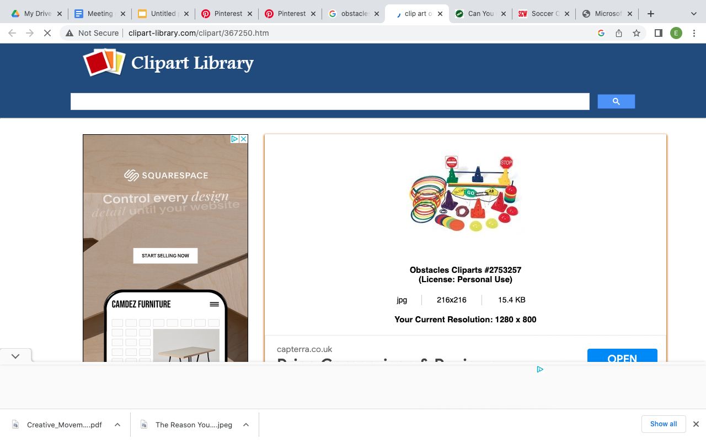
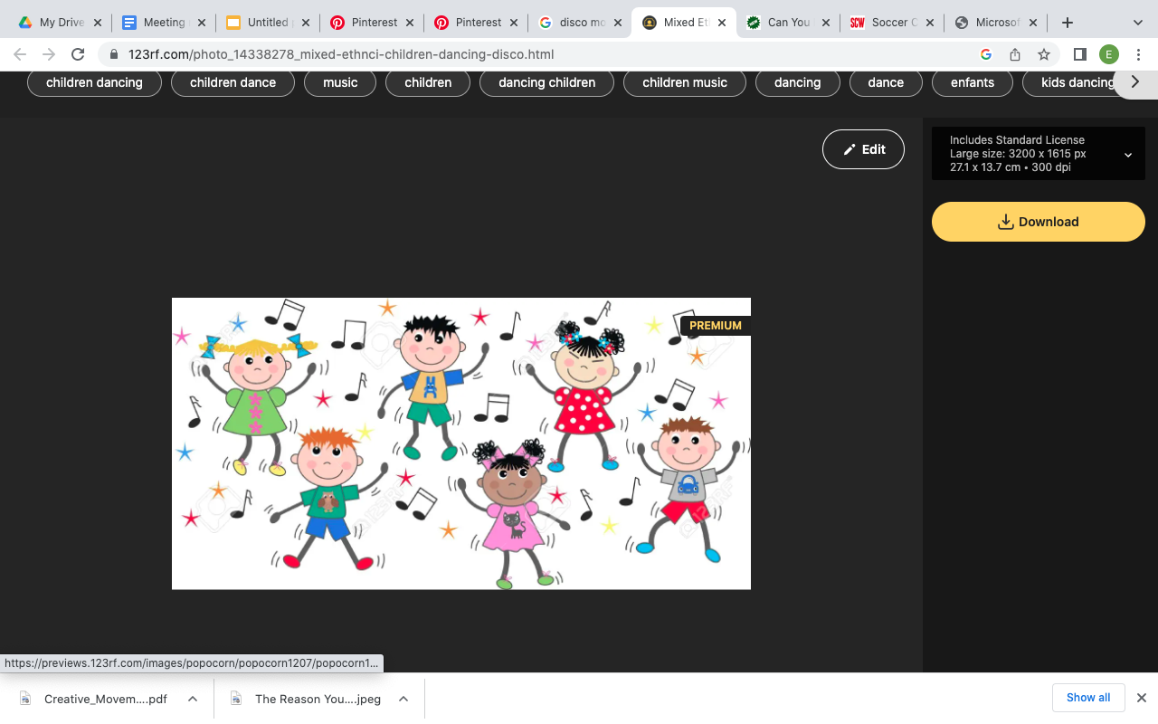

Theme
Games with purpose
Weather
Obstacles
Disco
Reasoning -
Create the 3 themes in each corner of the room , creating a pathway to the next
Each theme has a activity to complete before moving forward
Complete the activity only through creative movement

Slide 11
Main focus
3 activities
Start the session by introducing the dice for the weather e.e running through the rain , until everyone has re-created the dice the activity isnt complete
Moving forward to the obstacles , avoid the obstacles , aim is to find picture cards of animals, and move forward as that animal if one obstacle has been touched the game re starts.
The disco (elimination game) - 30 seconds to create a statue using a flashcard pictures , when the music stops you stop. Last one standing wins the course.

Slide 12
How to make sure the session is going positively
Time management
Set up before
Make sure its set up in order of activities
Engage with the children , motivate and reassure and encourage each individual
Refers to Robinsons statement of how important creativity is and making sure creative movement has time in a session to full-fill childrens confidence.
Fitness and fun

Slide 13
Effectiveness of this session plan
Brings out character in each individual.
implies the importance of confidence and encourages stigma to reach out of their comfort zones
discover new creative movements in themselves
Relates back to Robinsons statement that creativity is important
Reaches fitness through games and activities
Teamwork is effective to this plan

