Slide 1
Certificate of Higher Education
Business Skills for the Work Workplace
Academic Skills
(LCLM4001)
Week10- Revision and Task 3

Slide 2
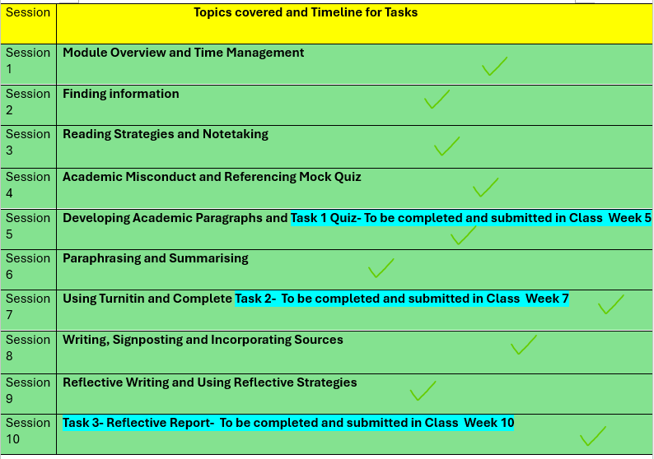

Slide 3
Last week’s recap
We did the following:
Discussed Reflective writing
Using reflective models
Incorporating sources
Notes:
https://uwtsd.display.vevox.com#/present/618050/EZOK7OOVCXYUX5ZTTUG0

Slide 4
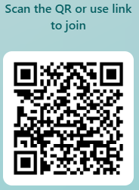
Module Evaluation Survey
Scan the QR Code above or click here to complete the survey

Slide 5


Slide 6

Today’s session
The session will be a general
1- Revision of all we have learned for this term week 1-9. Q&A
2- Complete and submit Task 3- Reflective Report

Slide 7
Task 3 – Revision
Return to Moodle and download the assessment Specification.
Read it with a focus on Task 3 – Reflective Essay Writing. Read the instructions properly and make sure that you are clear on the expectations of the task.
Your lecturer will answer any questions that you may have.

Slide 8
Time for Task 3 – 2hrs
Return to Moodle week 10
Download the Reflective Report template
The lecturer will provide resources that you will have to incorporate into your reflective report
Complete your Task 3 independently and Submit on Turnitin
Best wishes

Slide 9
Break

