Slide 1

Dr Brett Aggersberg

Slide 2


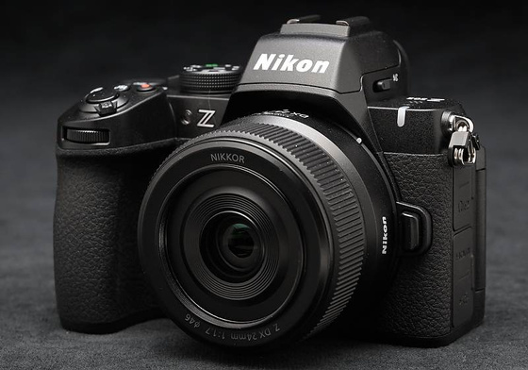

brett_aggersberg

Slide 3


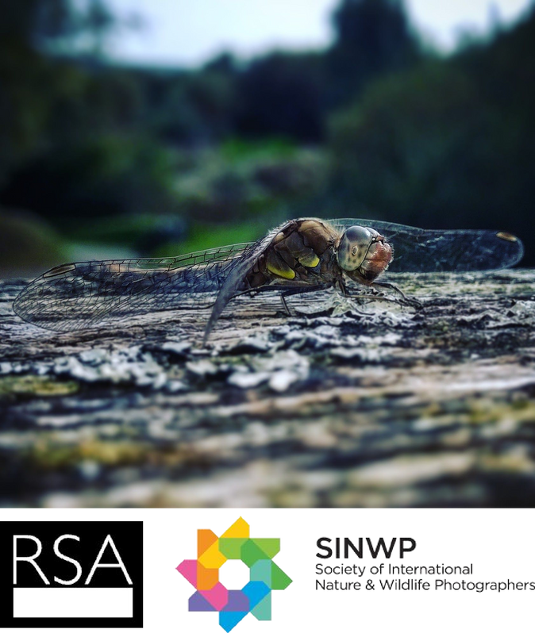

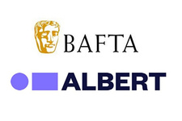


Experience
BSc Multimedia
MA Visual Communication
PhD In Fine Art and Photography Filmmaking in Industry for 25 years Freelance Photographer and Filmmaker Adobe Creative Educator
Societies of International Wildlife & Nature Photographers
Director of International media Festival of Wales
Industry Consultant for CBFF

Slide 4
What’s My Practice?

Slide 5

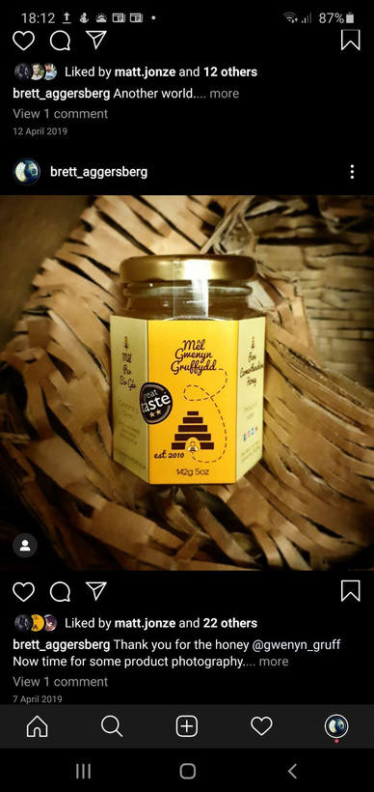

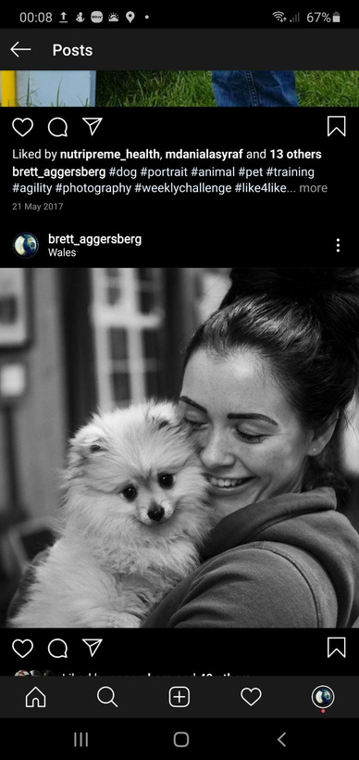
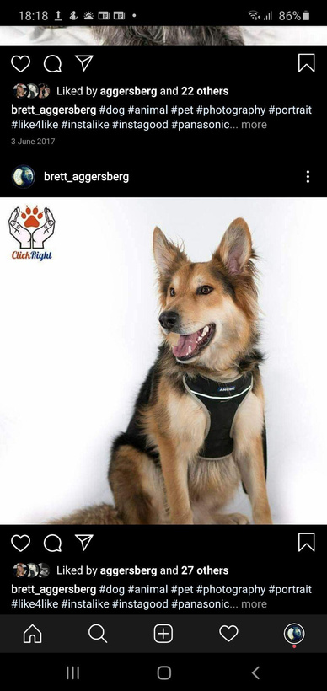

Slide 6
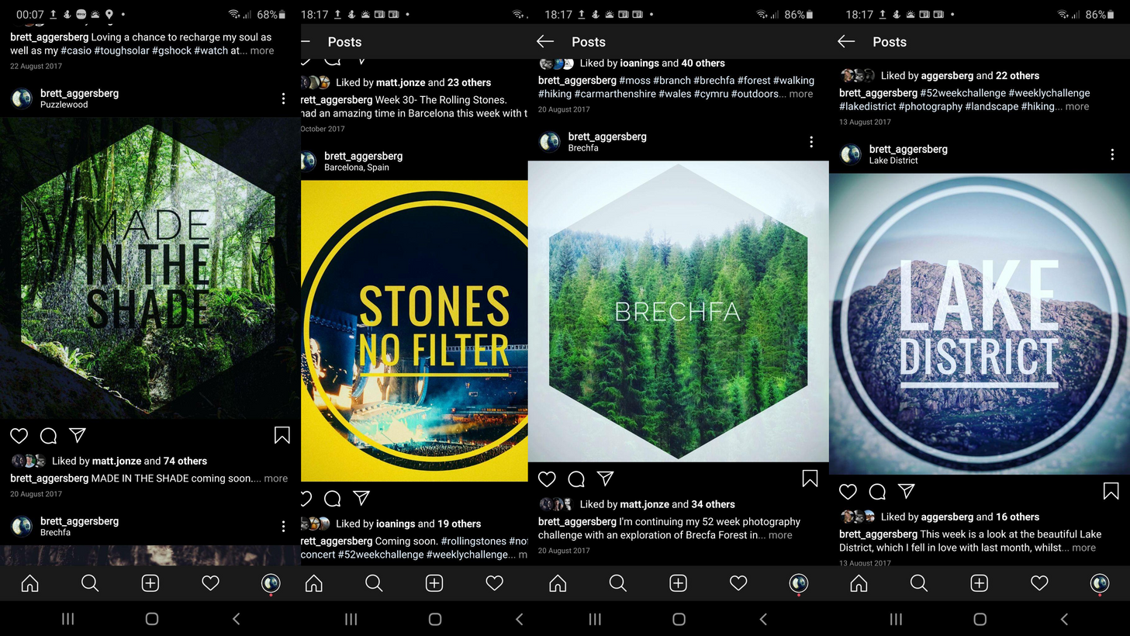

Slide 7
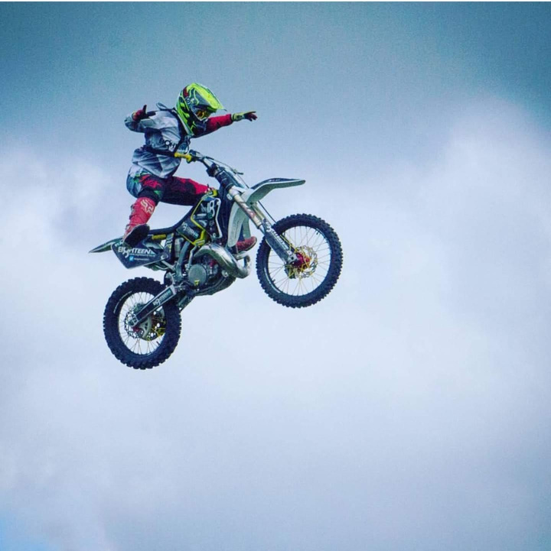

Slide 8
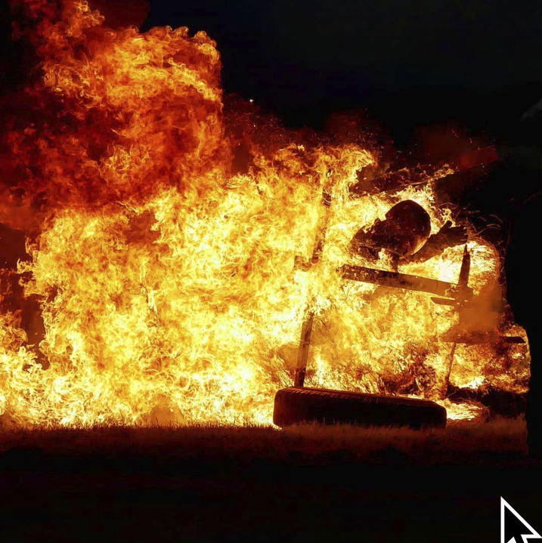

Slide 9
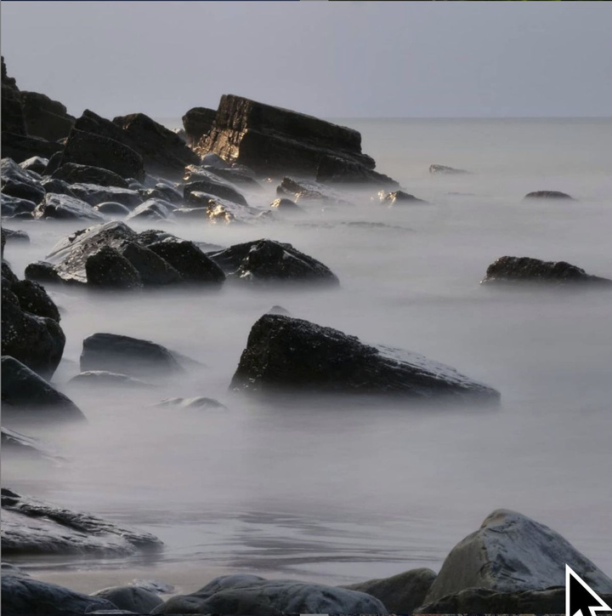

Slide 10
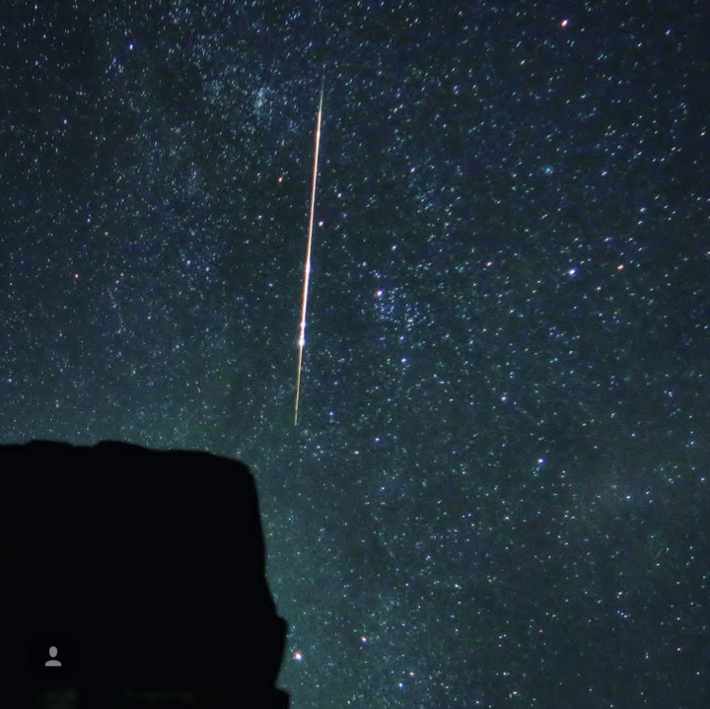

Slide 11
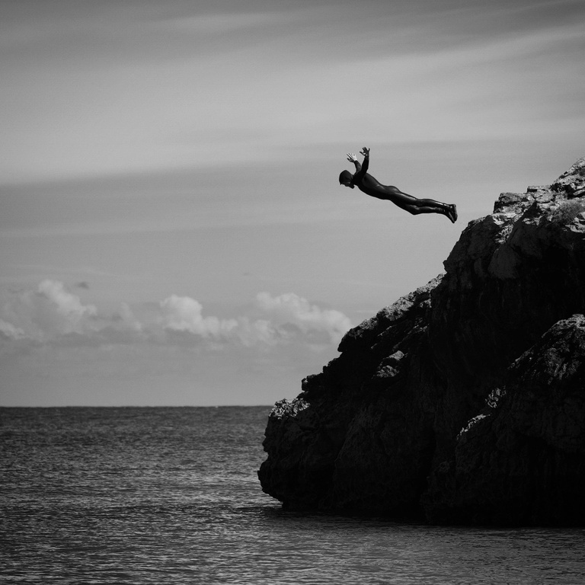

Slide 12
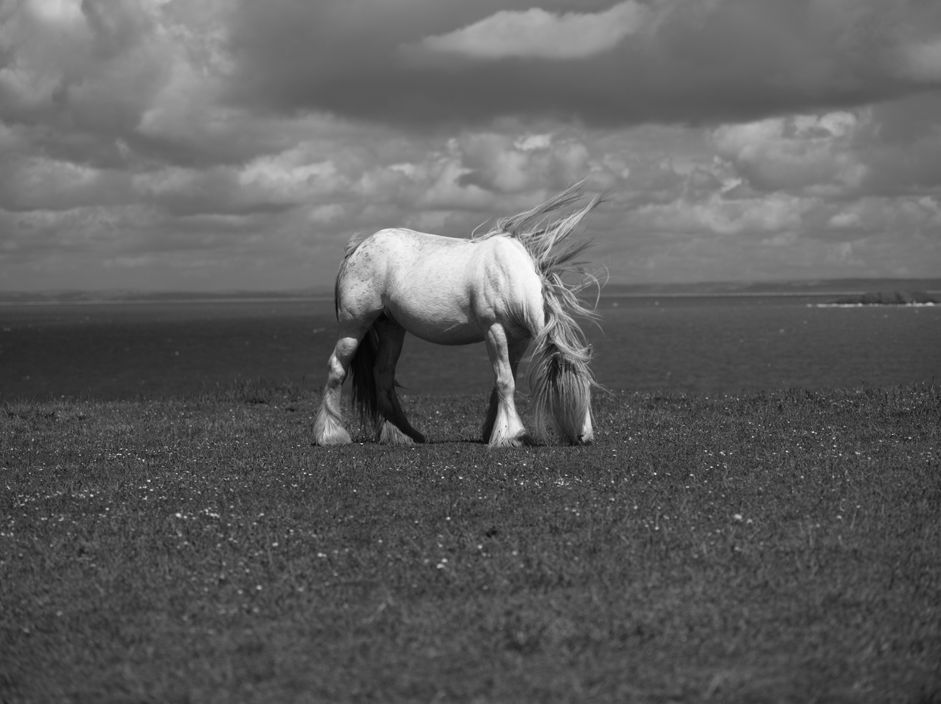

Slide 13
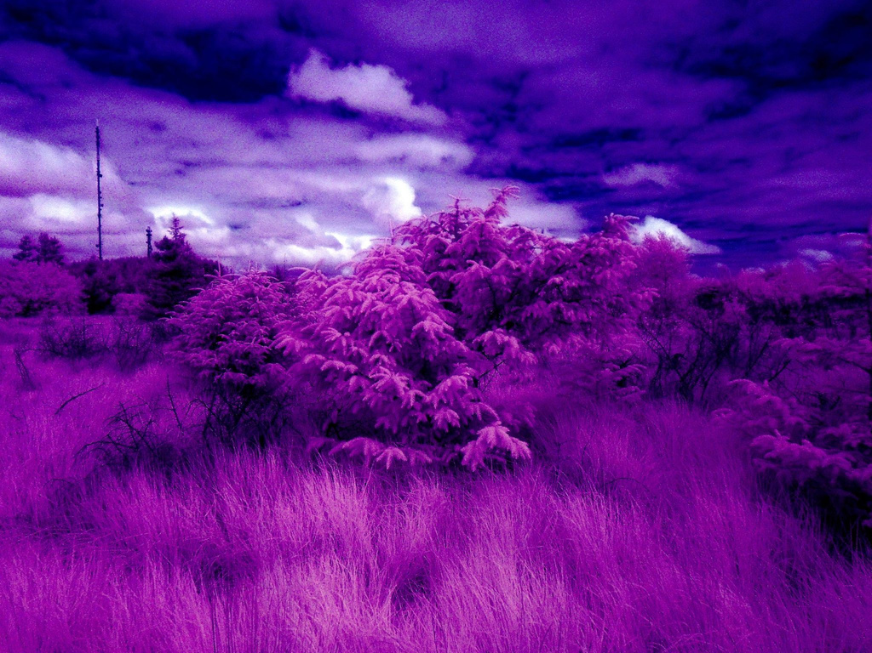

Slide 14
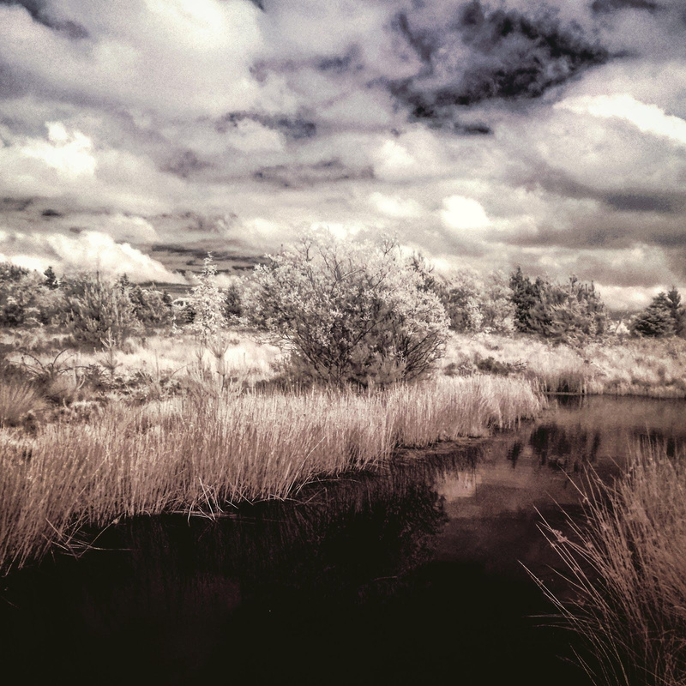

Slide 15
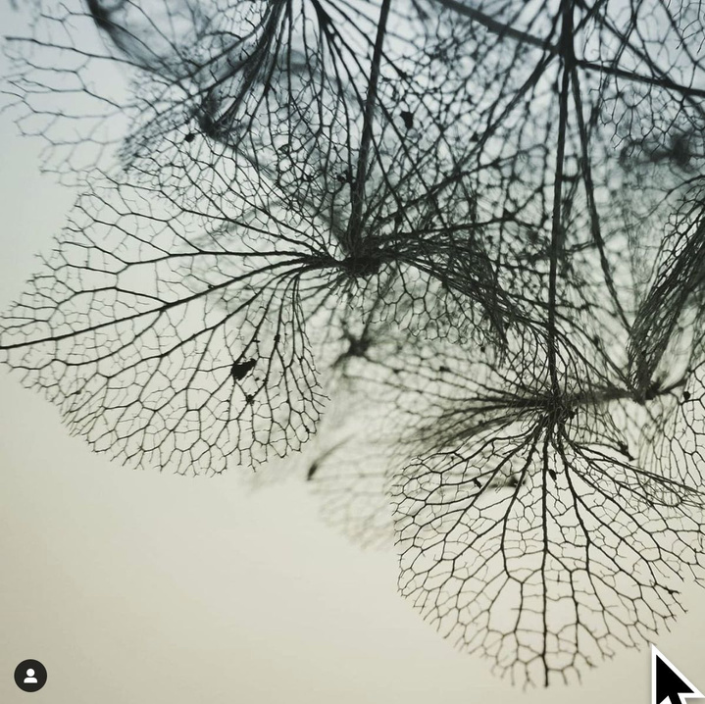

Slide 16
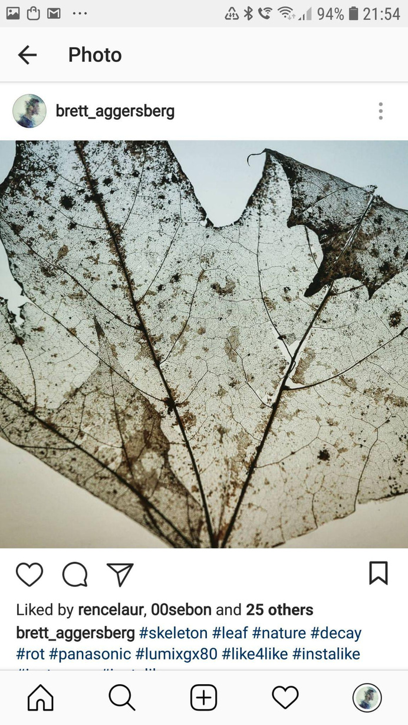

Slide 17
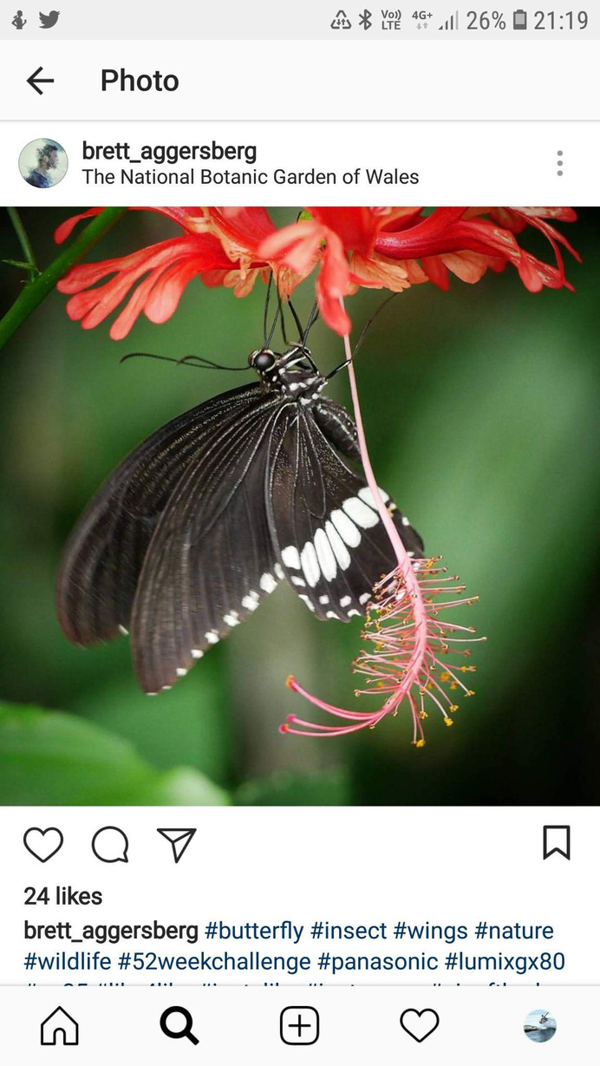

Slide 18
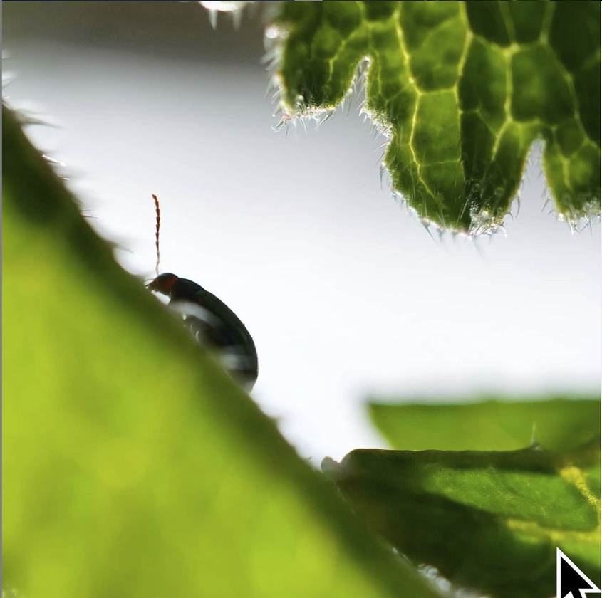

Slide 19
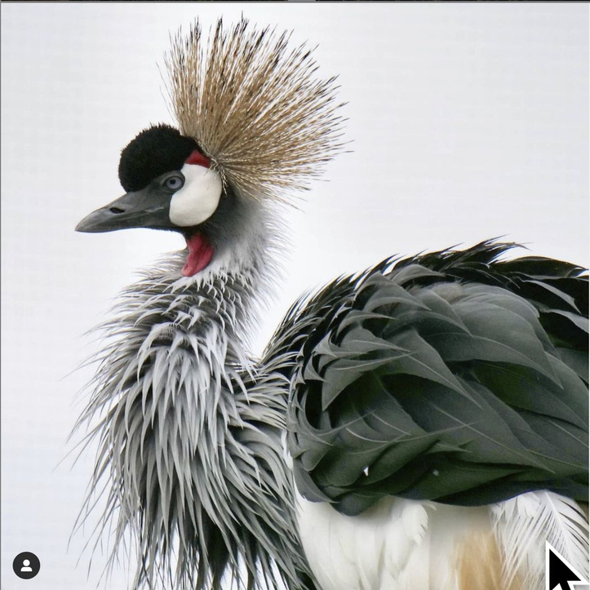

Slide 20
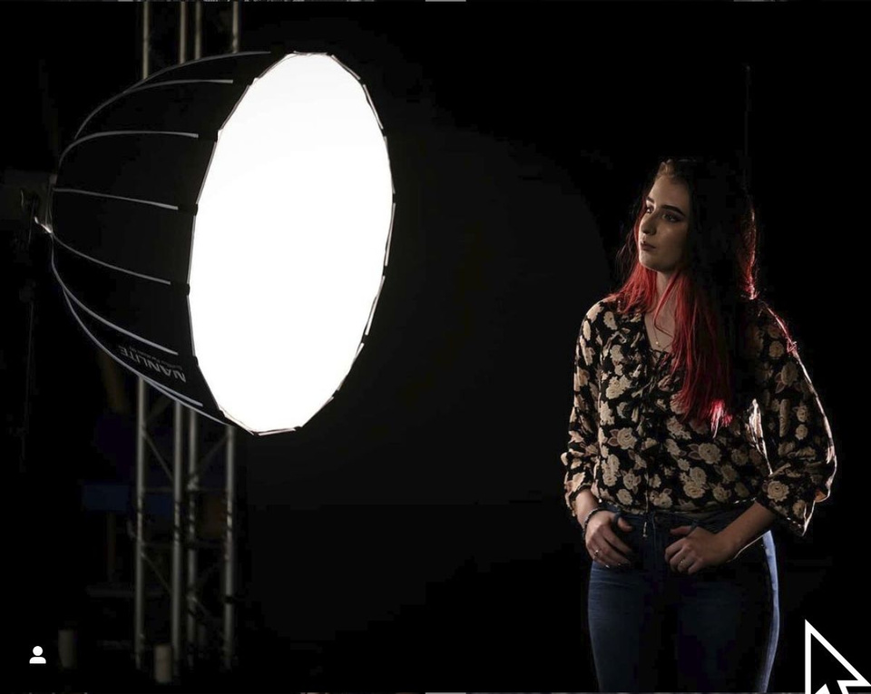

Slide 21
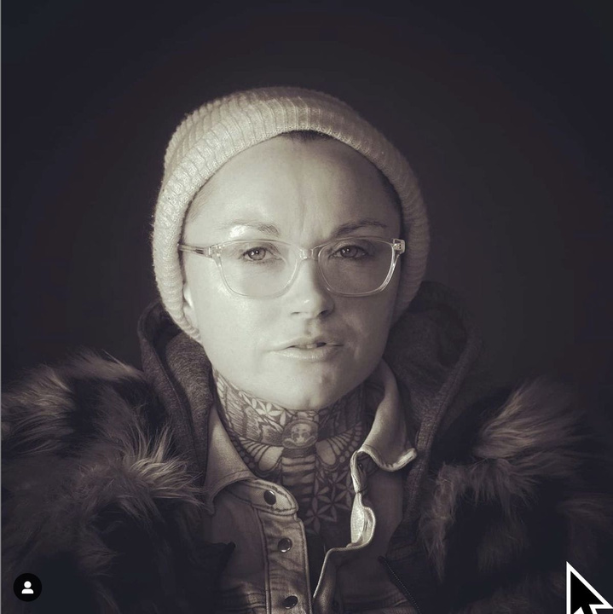

Slide 22
Portfolio Samples

Slide 23

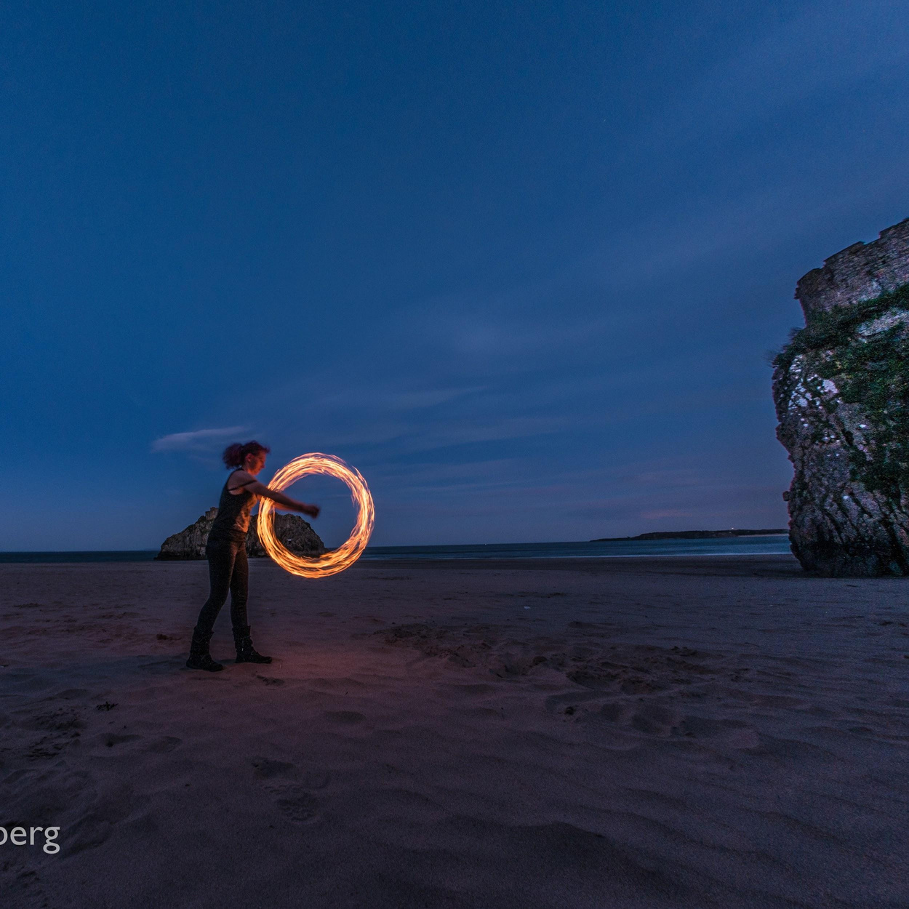

3.2s, ISO 200

Slide 24
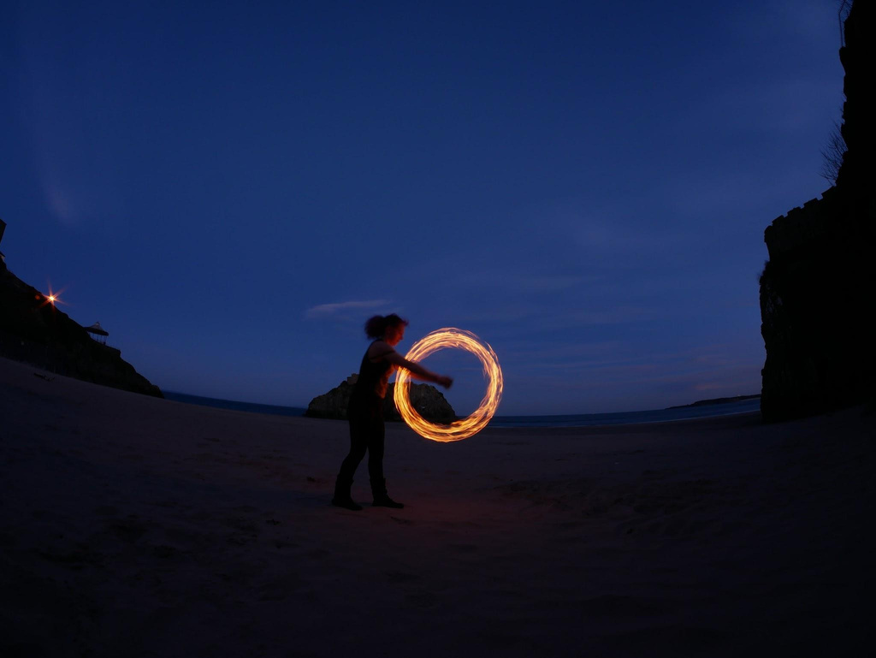

3.2s, ISO 200, f.9-11?, 7.5mm

Slide 25
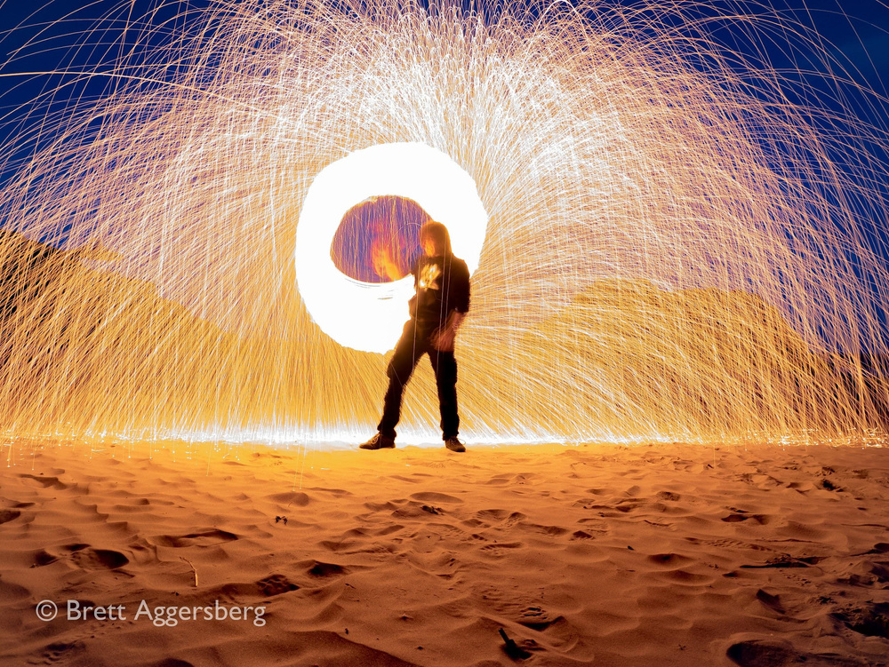

Slide 26
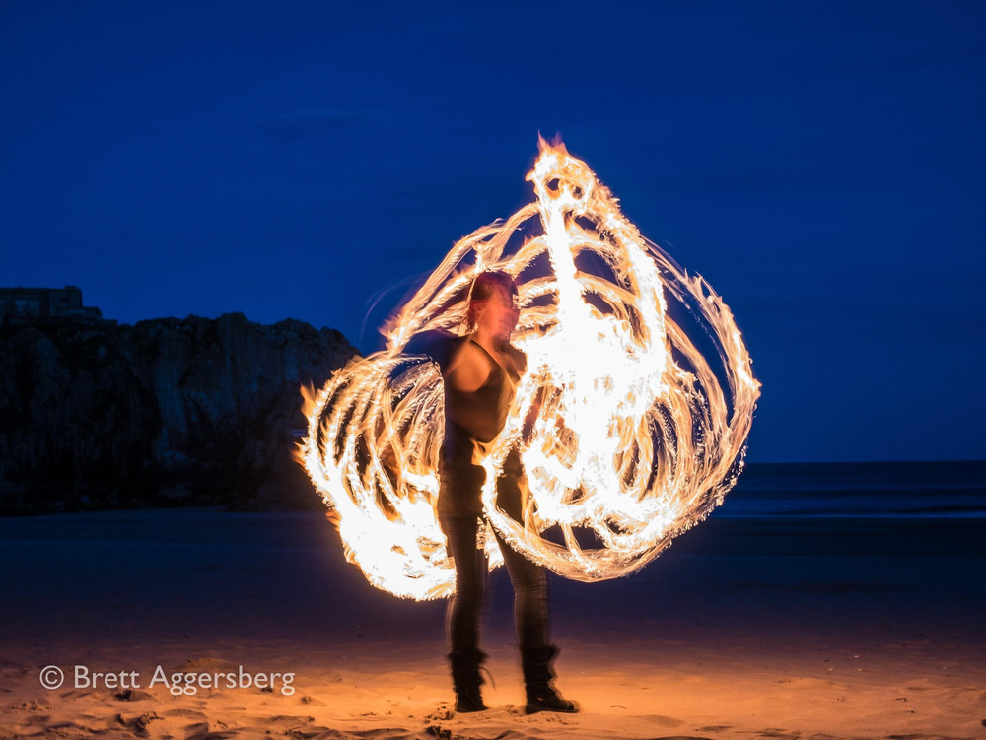

Slide 27
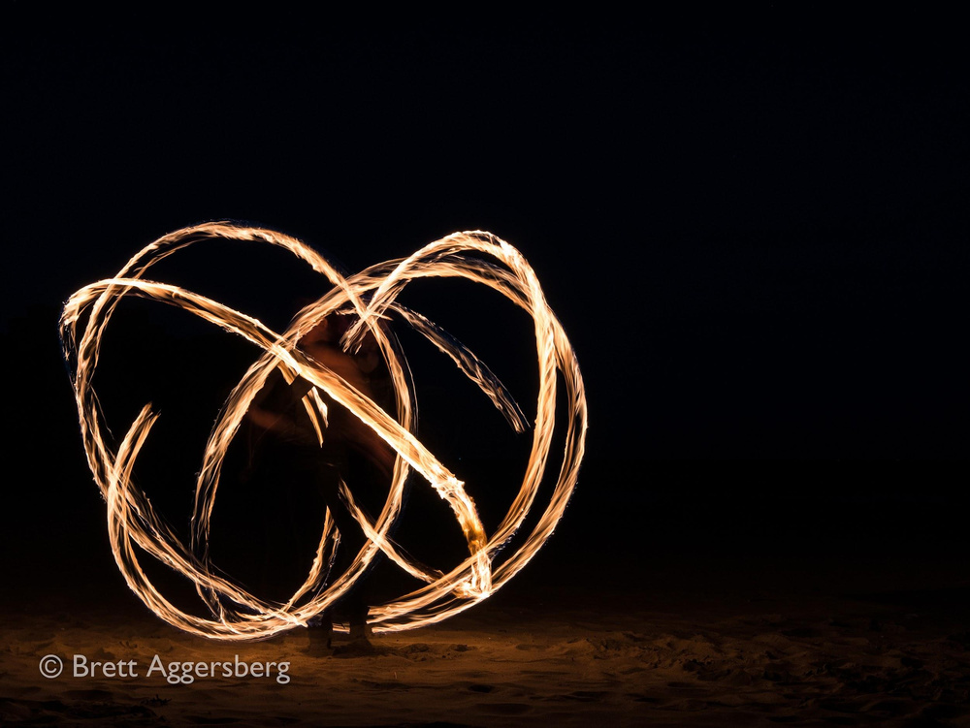

Slide 28
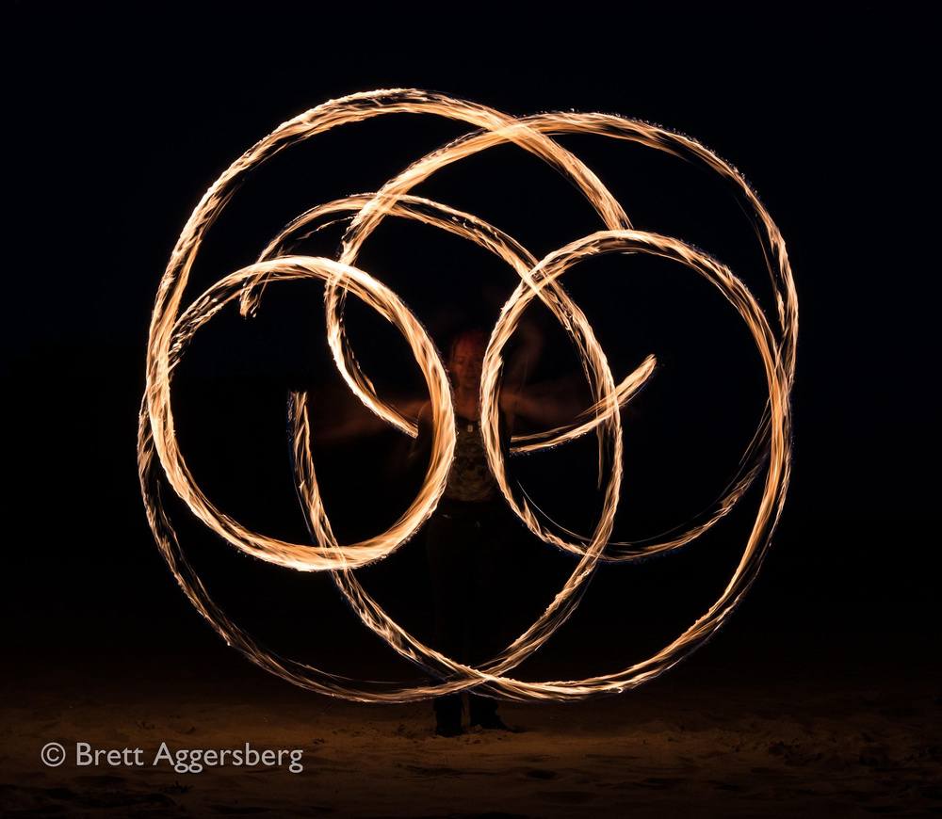

3.2s, ISO 200, f.9-11?

Slide 29

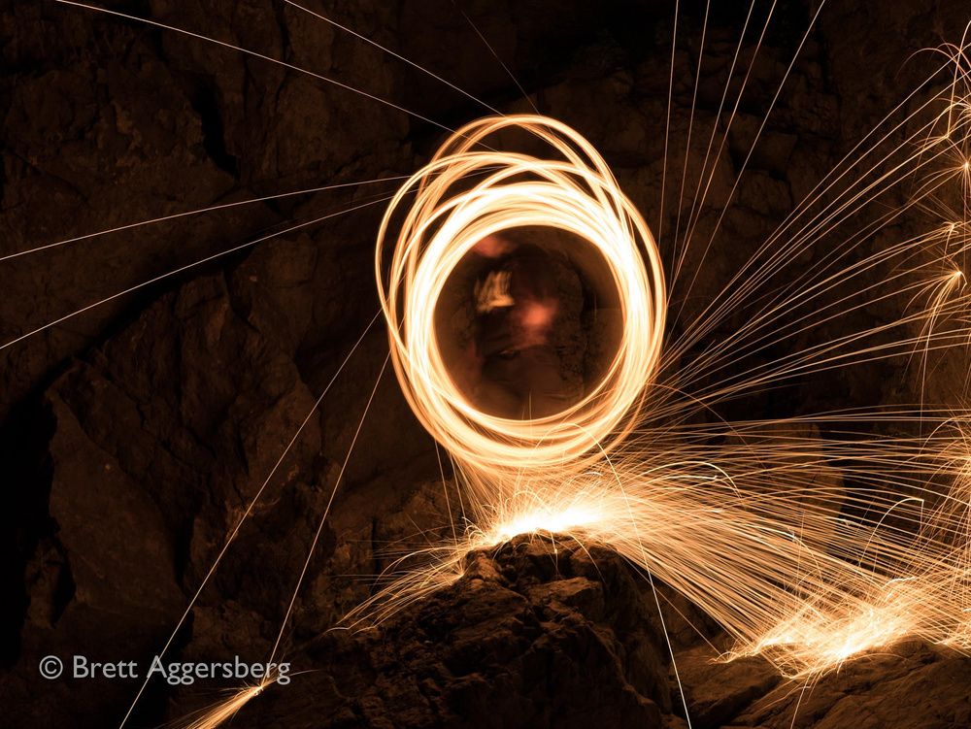

Slide 30
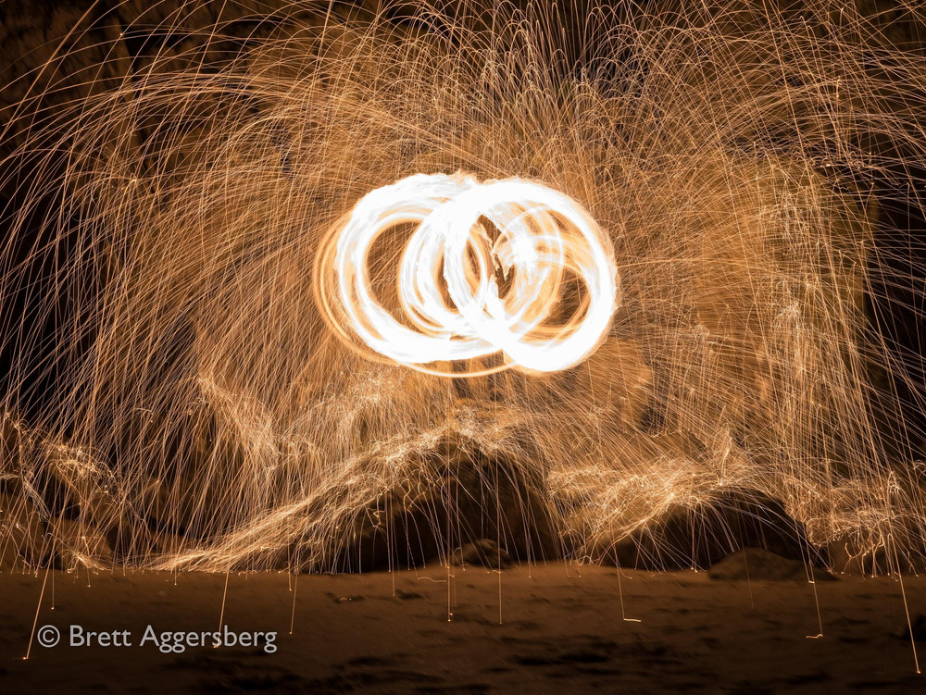

Slide 31
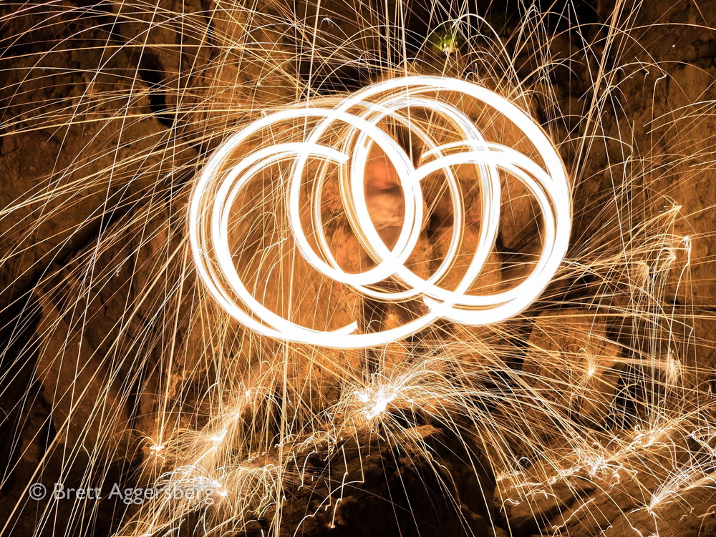

Slide 32
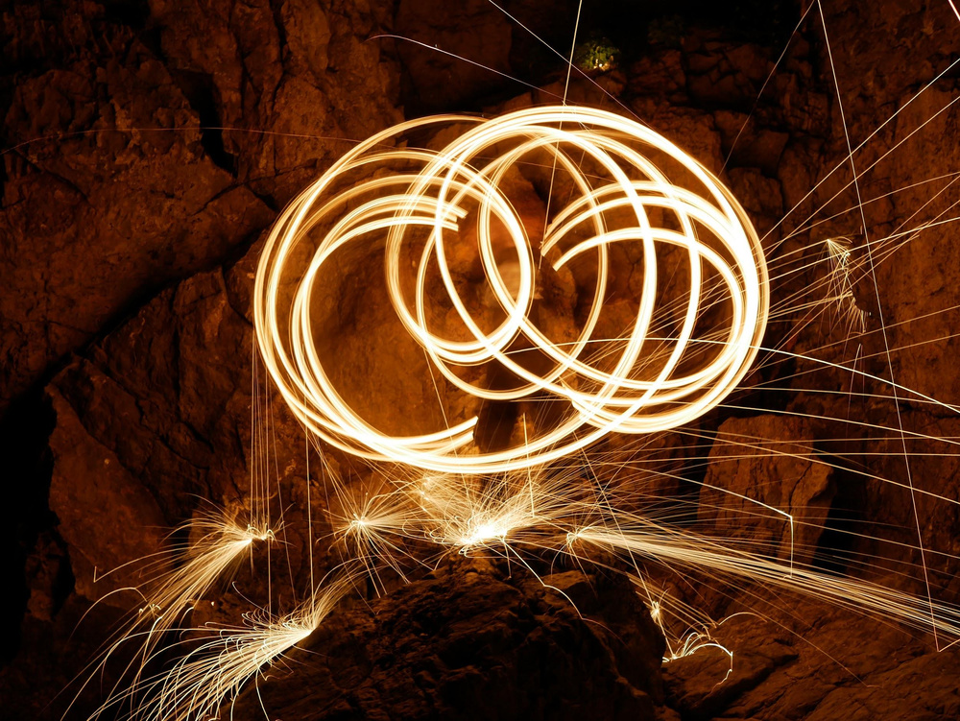

Slide 33
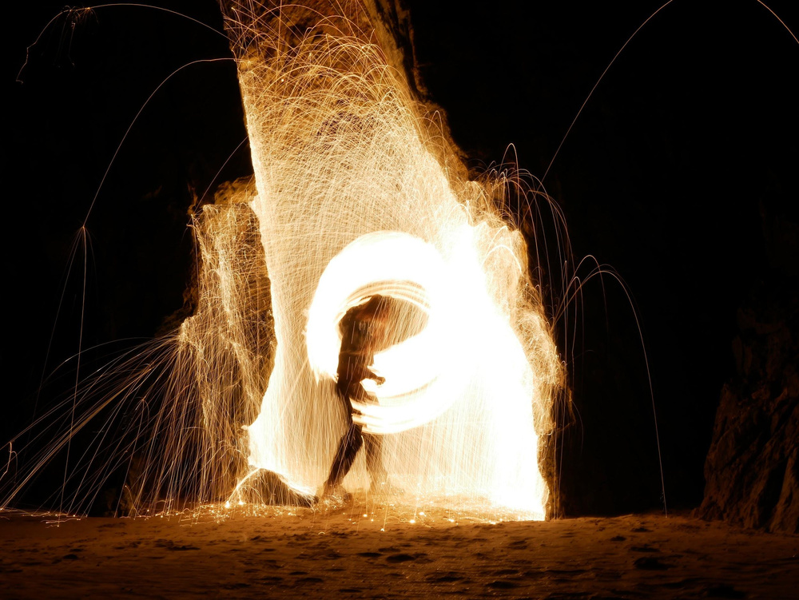

10s, ISO 200, f.13, 25mm

Slide 34
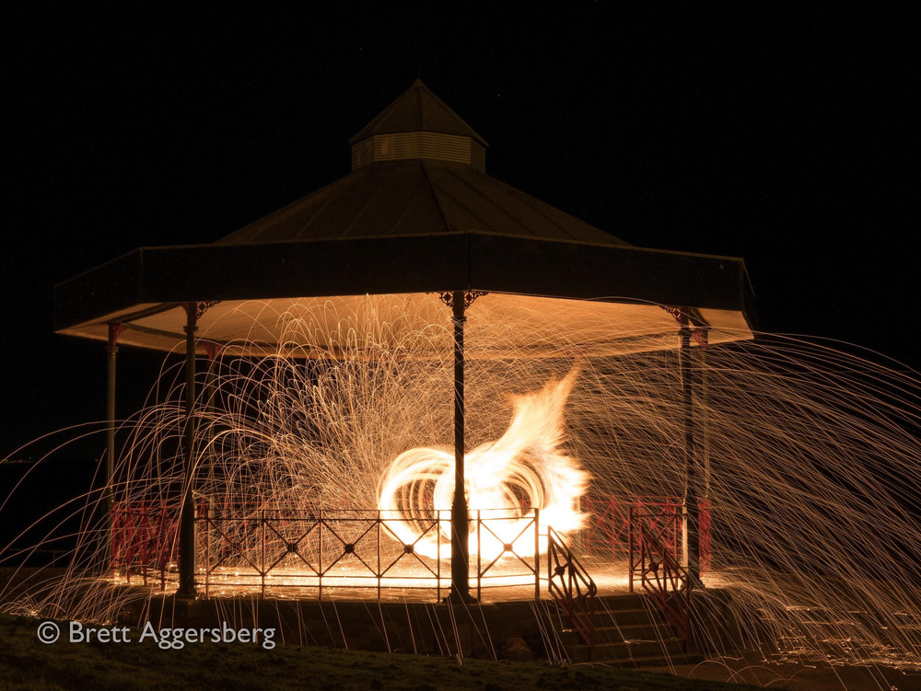

Slide 35

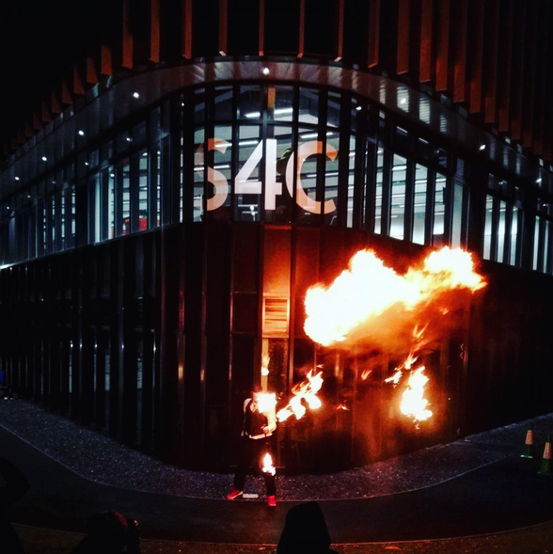
Photographing Firespinning
A Guide

Slide 36

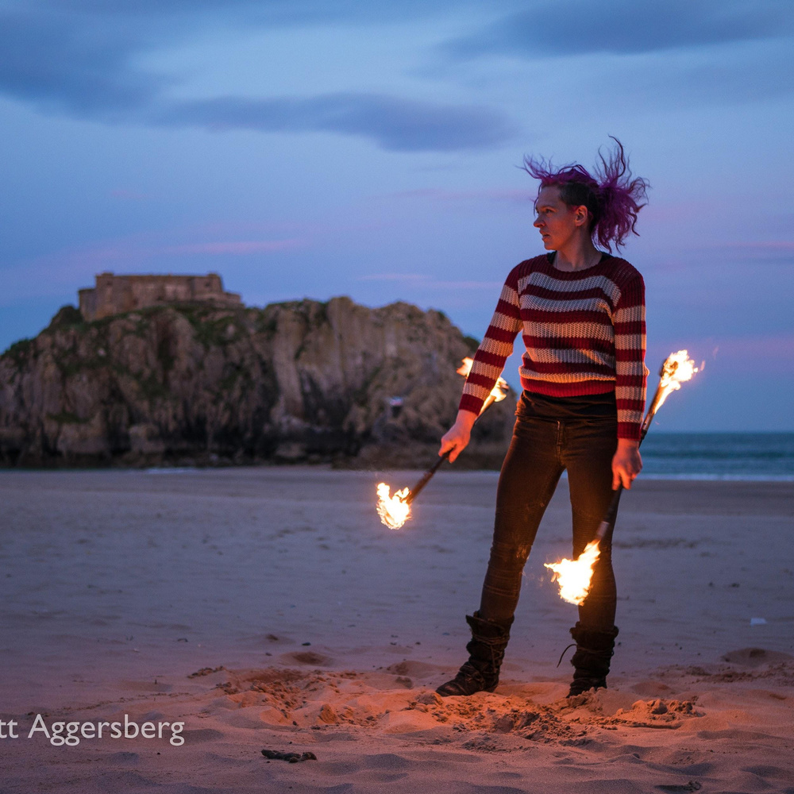

What is Firespinning?
Controlled burning on Poi's, swords, and other objects that are spun or moved in a performative manner.
Smoke Bombs can also be used
for dramatic effect.

Slide 37
Photography Skills

Slide 38

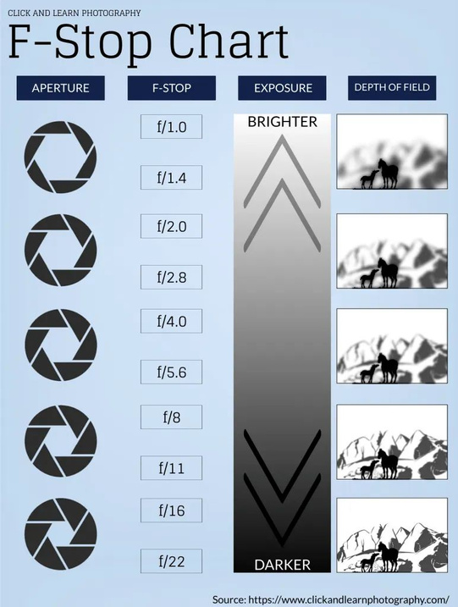
How to...

Slide 39

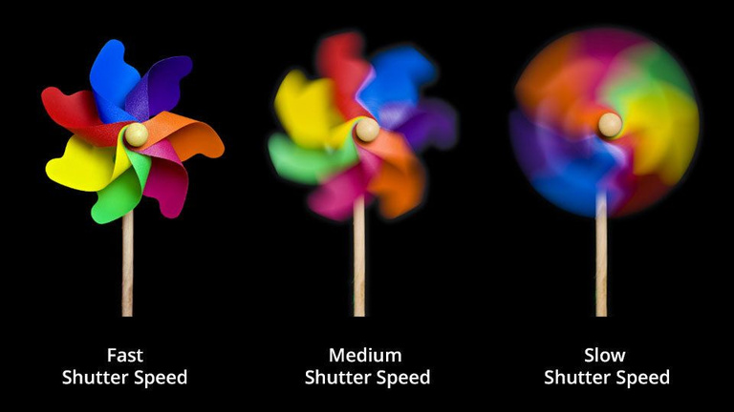

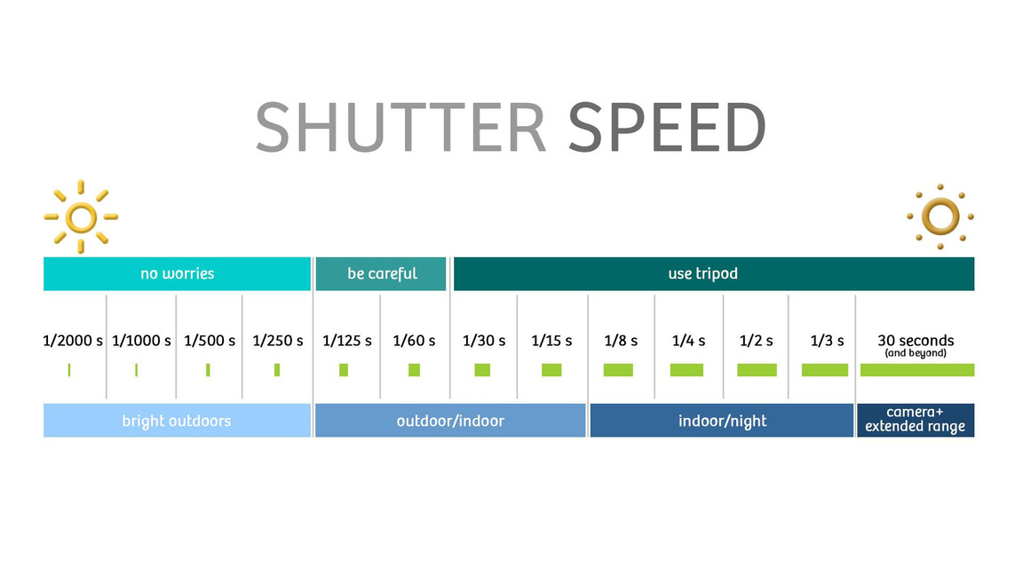
How to...

Slide 40

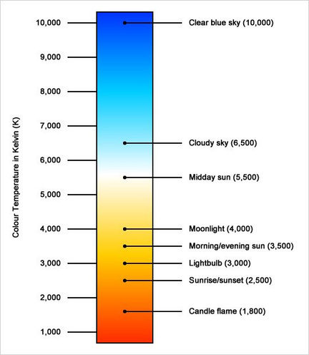

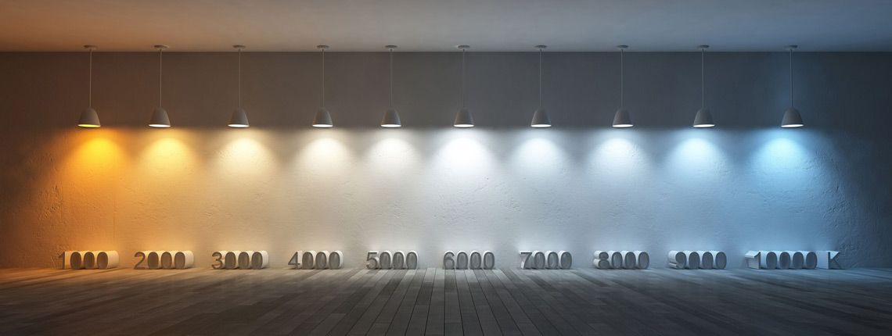
How to...

Slide 41

How to...
Put your camera on a tripod, and set your exposure using manual mode. Aim for a shutter speed of around eight to 15 seconds (10 is about right for most of the actions)– there’s no harm in underexposing the background for dramatic effect (I find the steel wool burns for about ten seconds).

Slide 42

How to...
Set your camera to manual focus, focus on the person doing the steel wool spinning, and use a small aperture (f8-16: f11 is about right for most cameras) to compensate for any focusing errors. As this is a kind of landscape photo you’ll no doubt want the entire scene in focus anyway.

Slide 43

How to...
Set your focus manually using a light shone on or held by the performer. You can can use auto- but it must be locked once set. The depth depth of field caused by f11 will help you with focus.

Slide 44

How to...
Shoot Raw so you can make fine adjustments to colour temperature and exposure in post-processing. In the meantime, set white balance to daylight – that will help the camera record the colours accurately.

Slide 45

How to...
● ● ●
Set up in daylight; Start shooting in twilight (blue hour); Check your images and experiment with length of exposure.

Slide 46
Firespinning Samples

Slide 47
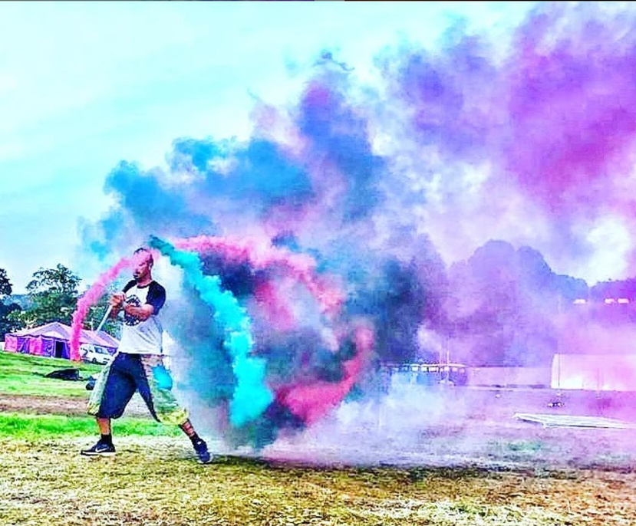

Slide 48
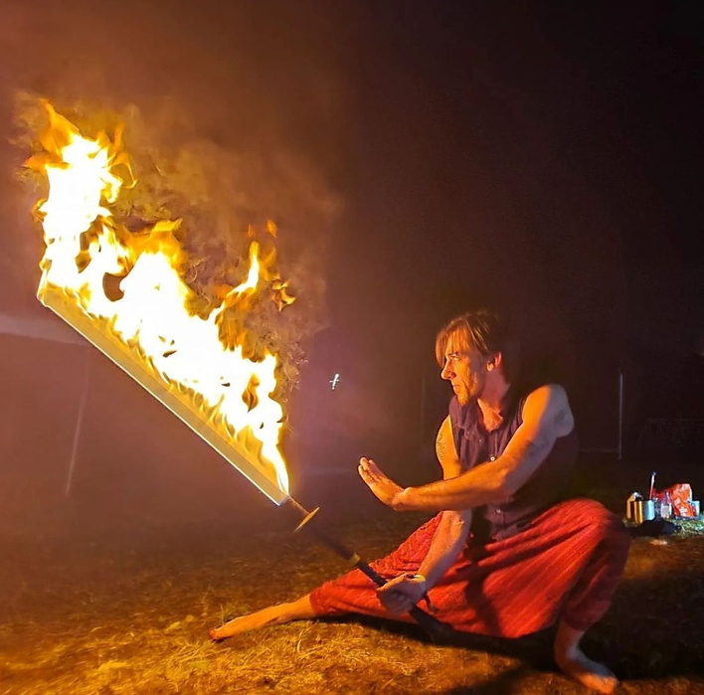

Slide 49
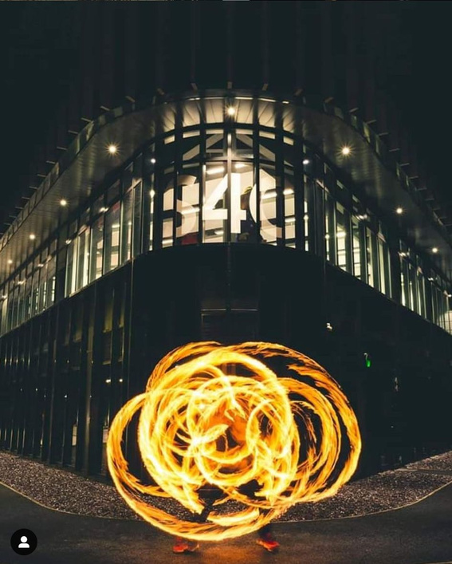

Slide 50
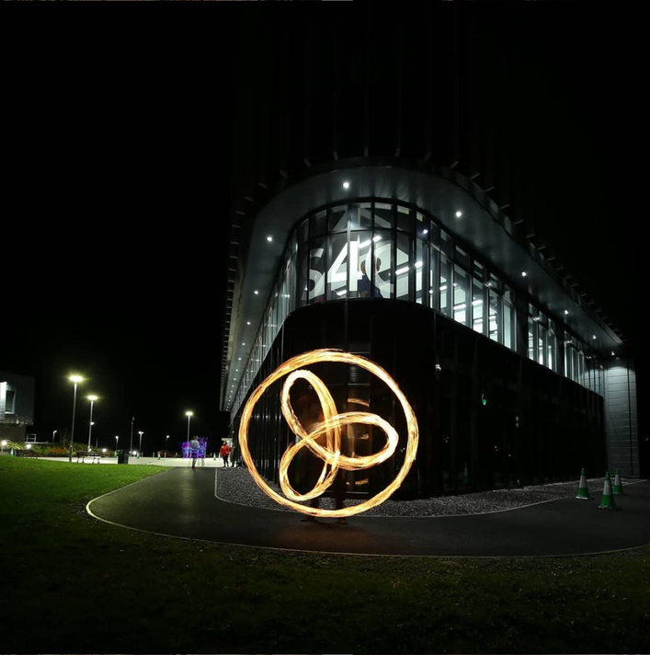

Slide 51
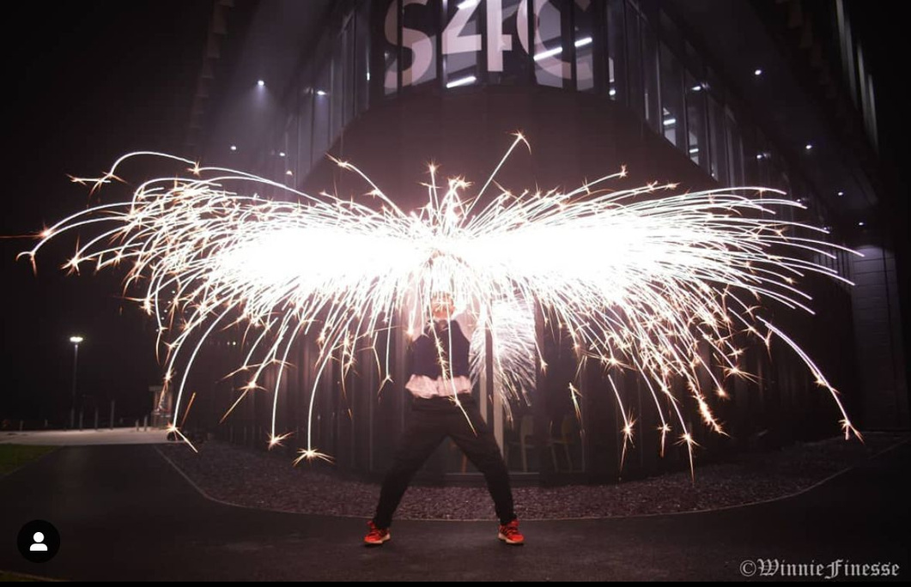

Slide 52
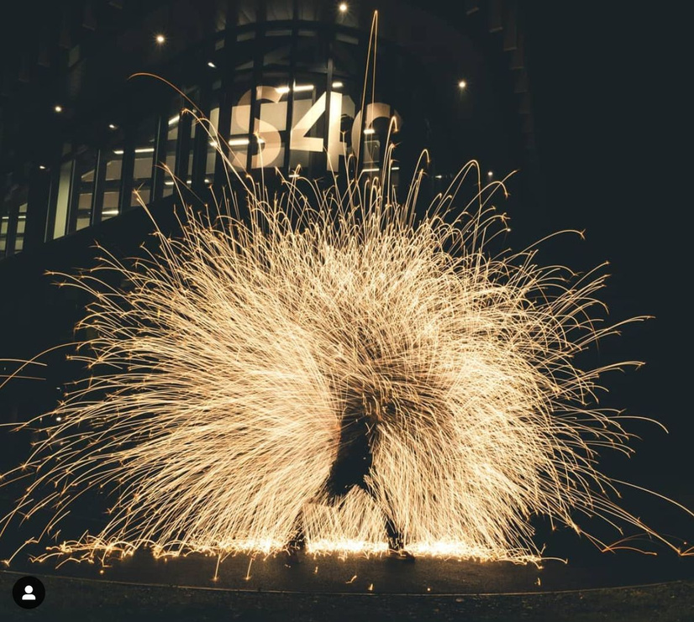

Slide 53
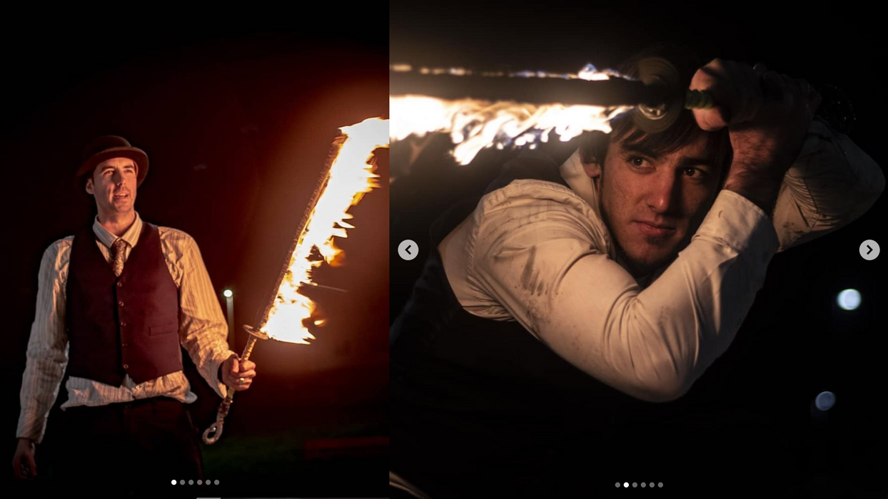


Slide 54
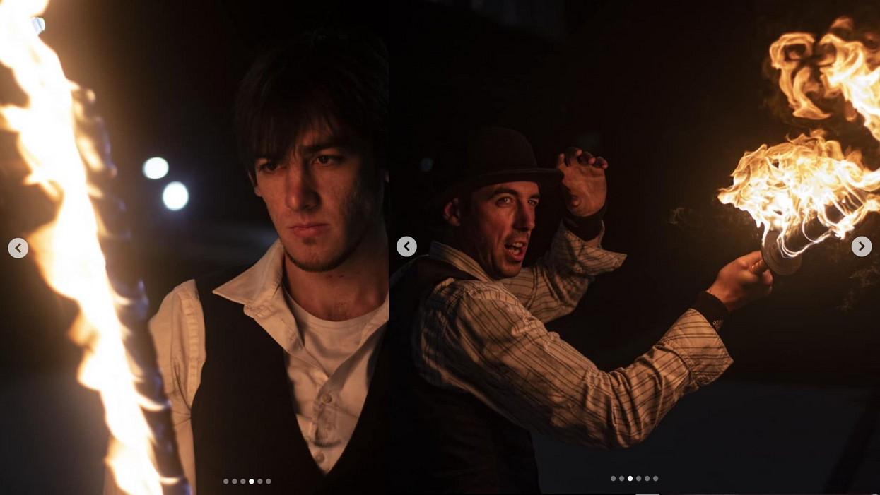


Slide 55
The Plan

Slide 56
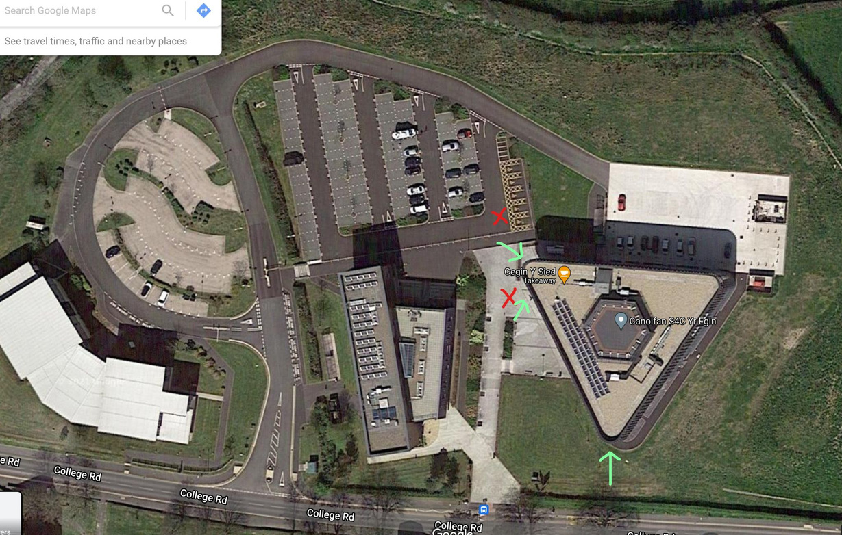

Slide 57






Slide 58




Slide 59


Slide 60


6:30pm start
uwtsd_ﬁlmandmedia pembrokeshireﬁrespinners
Tag us onInstagram
Tag PFS on Instagram

