Slide 1
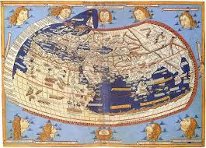
Reframing the World: The Emergence and significance of global history
Introduction to Global History
HPPH4010

Slide 2
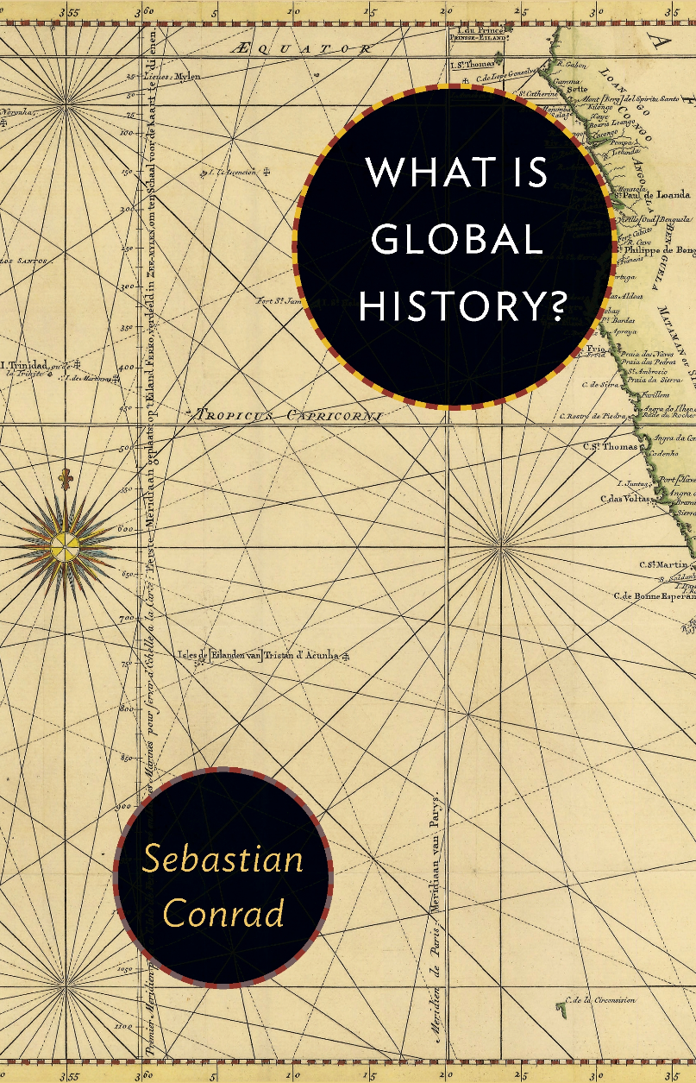
What is global history?
No single, unequivocal definition.
But, it can be broadly said to concern historical analysis of phenomena, events and processes that span the “globe” (what is global is open to definition, just as what is local).
Circulation of things, peoples and ideas are key subjects.

Slide 3
Given the lack of a singular definition there are various ways Global history can be approached.
Global history as the history of everything:
In theory everything that happens on the planet falls under this, but often either a synthesis global reality at particular time or sometimes the history of the world tout court.
  Big history – from the Big Bang to the present.
  Sometimes thematic focus, concepts, institutions, products...
As the history of connections:
Most popular in recent scholarship – general emphasis that no society or peoples lived in isolation.
  Mobility and interaction are main focus. History of entanglements.
  Does not need to be planetary, dependent on subject matter.
History based on the concept of integration:
Focus on regular and sustained patterns of exchange, and on systemic integration;
  not just sporadic cross-”border” exchange, which is ubiquitous in human history.

Slide 4
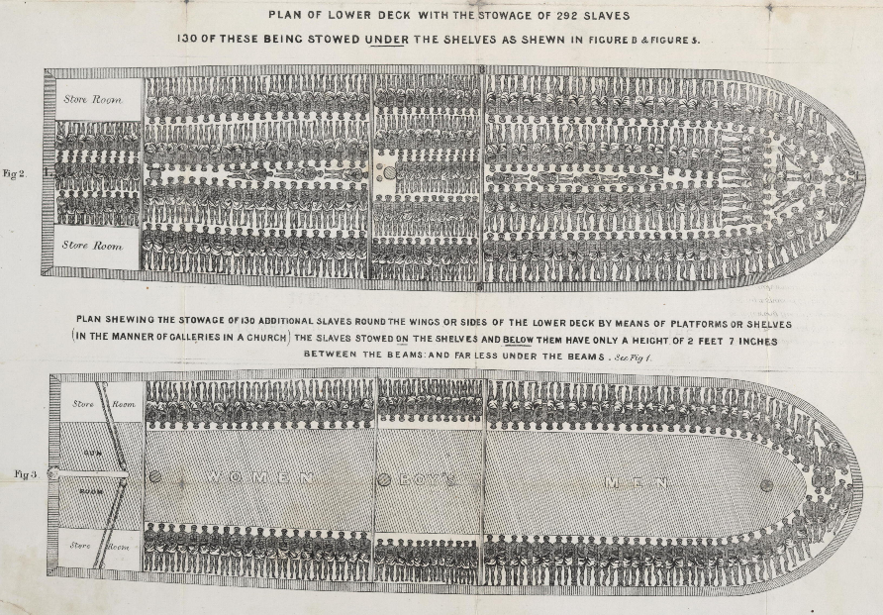
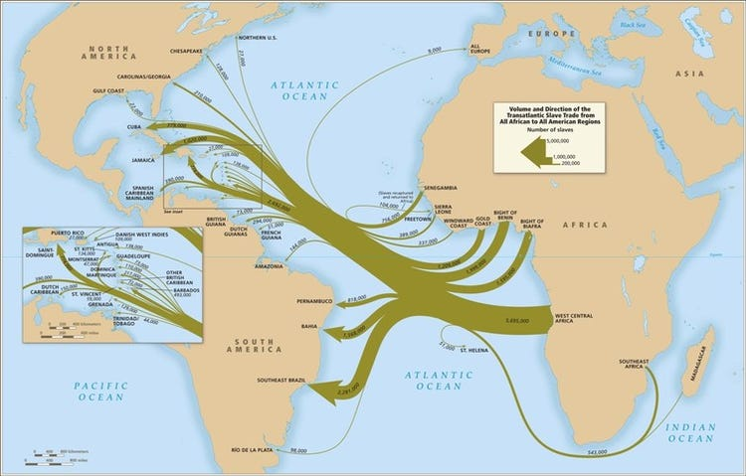
What is the point of it?
Multiple perspectives for looking at the Atlantic slave trade:
Social history (the working conditions; formation of communities);
Gender history (perspectives on families, childhood, sexuality, masculinity);
Economic history (productivity rates, standards of living, macroeconomic impact of slavery on plantation production);
These experiences can also be placed in a global context – the creation of the transatlantic trade, its repercussions on societies in western Africa, the Atlantic slave trades connection to slave routes in the Sahara and Indian Ocean.
It is both an object of study (such as gender history or the history of slavery).
And also a particular way of looking at history, a perspective (methodology; means of analysis).
It is one perspective among many – a heuristic device that allows us to pose questions and generate answers that might be different in other approaches.

Slide 5
Does global have to be planetary?
As a perspective on history, global history does not have to encompass the entire globe or planet.
  Not least because this would be impractical. Consider a gender studies research, attempting in one study to encompass the lived experiences of all women, men and children throughout the planet and history.
The aim is not to write the total history of the planet. Global history is not synonymous with macro history.
More often studies take a smaller frame - a demarcated space, but with an awareness of global connections and structural conditions.

Slide 6


Why has it become popular?
The current zeitgeist
Post-Cold War era world; September 11th (2001).
More social diversity, increase in migration.
Globalization as a concept through which we understand our present world.
  (increasing interest in its “origins”).
Networks and entanglements seen as fundamental for modern social development.
Increasing dissatisfaction with “national histories” – histories of discrete, confined areas.

Slide 7
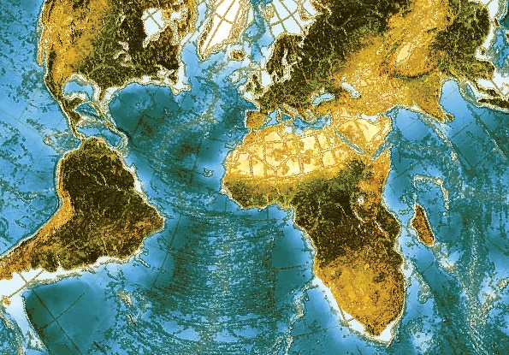
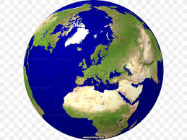
What does a global historical perspective seek to challenge?
The 19th century a key period in the development of the disciplines of the social sciences and humanities.
  Era of the Nation-State.
Territories as bounded containers for “peoples” and “cultures”.
Eurocentrism.
  Developments in other societies read through the concepts and terminology particular to Europe.
Exogenous (external causes and origins) and endogenous (internal).

Slide 8
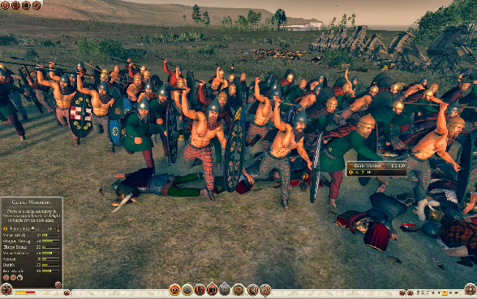
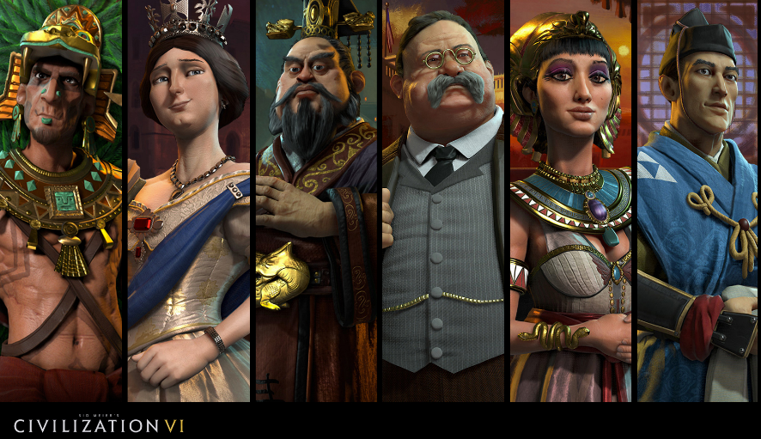
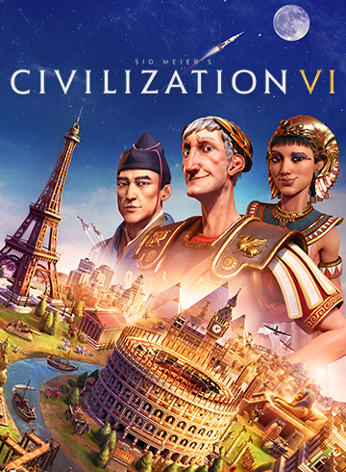

Popular perceptions of the histories of countries and civilisations
Popular conception is often of “monads”, nations and civilisations in isolation.
  For example, text books in China have tended to exclude China when talking about world history.
Groups or civilisations can be reduced to tropes.
Celtic warriors in Rome total war series

Slide 9
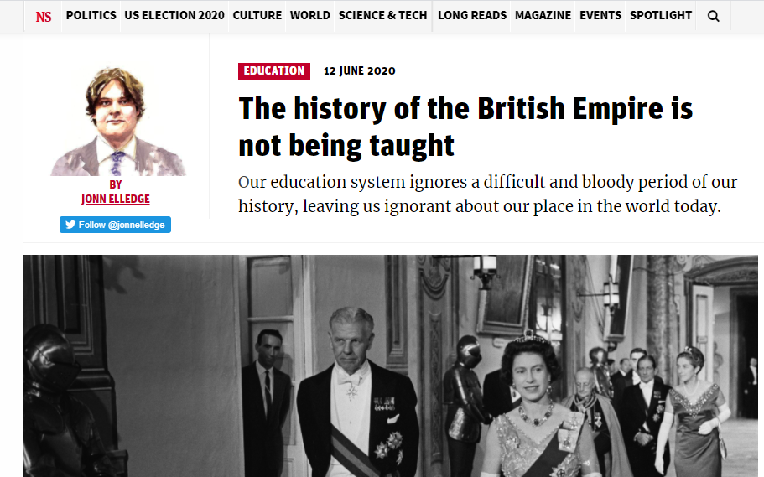

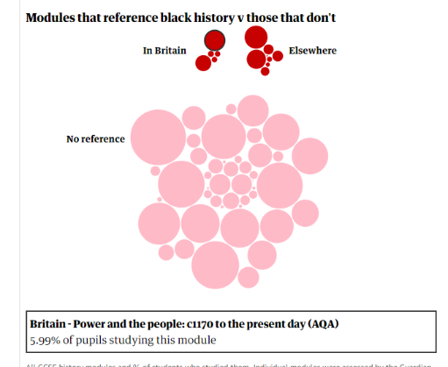



History in the UK school curriculum
There are frequent controversies about what should be covered, and what is or is not being covered.

Slide 10

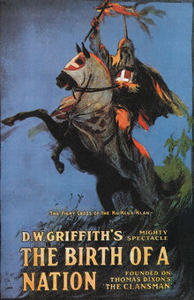
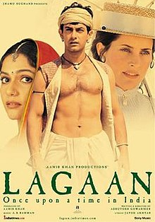
Nationalism in the Cinema
Lagaan: Once Upon a Time in India (2001)
The Birth of a Nation (original title The Clansman), and 1915 silent film drama.

Slide 11
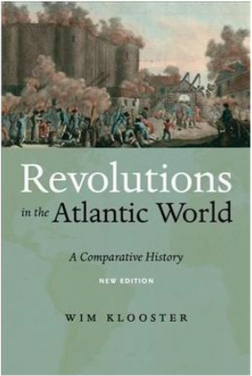

Global History: one approach among many
It is not the only way to approach history, and its suitability will vary from context to context.
Its strengths: mobility, exchange, connectivity, and processes which transcend boundaries.
Alternatives (among others)
Transnational history
World history (and big history)
Comparative history
History of globalization

Slide 12
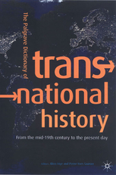
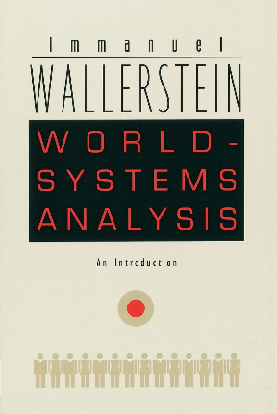
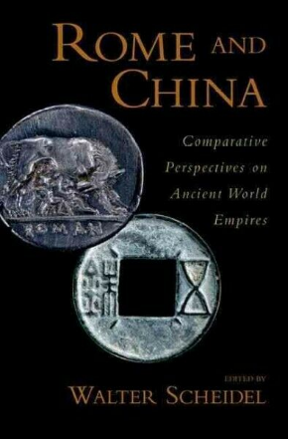
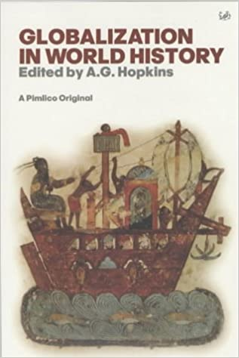
Alternatives
Transnational history
World Systems Theory (Analysis)
Comparative history
History of Globalization

Slide 13
Universal History vs. World History vs. Global History
Some older world histories tended to combine comparisons of civilisations, with attempts to find links between them (processes of “diffusion”).
Contrast, global history emphases connections, and terms like exchange, intercourse, links, networks and flows (emphasis on fluidity and volatility).
Universal and World History sometimes treated as interchangeable terms.
  Universal history is perhaps the older of the two terms.
  However, Karl Lamprecht (unsuccessfully?) tried to distinguish World history as the history of European expansion, and universal history as that of humankind

Slide 14
The Origins of Universal History

Slide 15
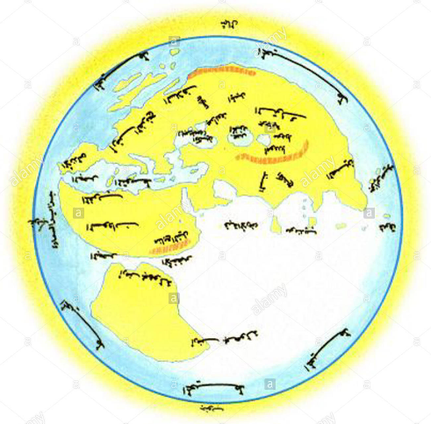
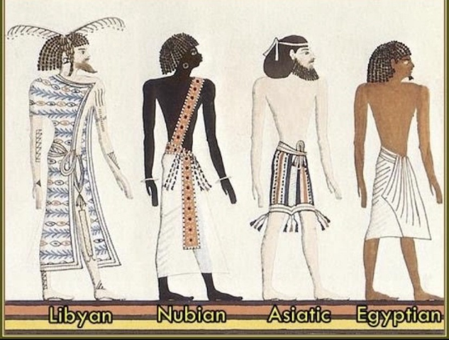
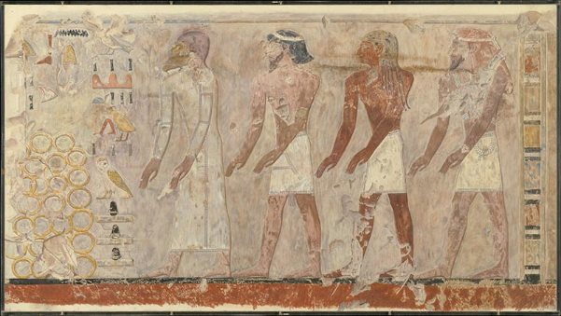
Conceptualising the world
Many peoples and societies have long been interested in their place within the “world”.
  Although this is not straight-forward and universal.
    Different traditions in Europe, Islamic world, China, South Asia, etc.
“Universal” history is an early feature of historiography, both in antiquity and the “medieval” world.
  Herodotus (5th century BC), Polybius (second century BC), Sima Qian (2nd to 1st century BC), Abu’l-Hasan Ali al-Masudi (10th century AD), Ibn Khaldun (14th century AD).
Reconstruction of Abu’l-Hasan Ali al-Masudi’s description of the world.
Representation of foreigners in Pharaonic Egypt

Slide 16
Parameters of perception
The understanding of the “worlds” inhabited by various societies (including immediate neighbours and distant peoples).
The nature, origins, habits and customs, institutions, territory, flora and fauna, etc. were often understood within the framework of one’s own cultural perceptions
“The common people are tall and virtuous like the Chinese, but wear hu (‘Western’) clothes. They say they originally came from China, but left it.” –Weilüe 11.
“The ruler of this country is not permanent. When disasters result from unusual phenomena, they unceremoniously replace him, installing a virtuous man as king, and release the old king, who does not dare show resentment...” – Weilüe 12.

Slide 17
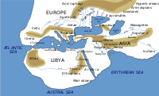
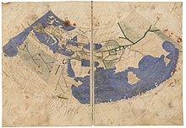
Oikoumene – a case study
Graeco-Roman notion of the Οἰκουμένη or Orbis terrarium.
  hē oikoumenē gē – literally “the inhabited earth” – however, may be better to understand it as the known world.
Inner and an outer space - eschatiai or “most distant lands”.
Notion of Antipodes developed since Aristotle – Crates of Mallos, paired oikoumenē in the North and South with those in western hemisphere.
Artist depiction of Herodotus’ Oikoumene
Representation of Ptolemy’s Oikoumene

Slide 18
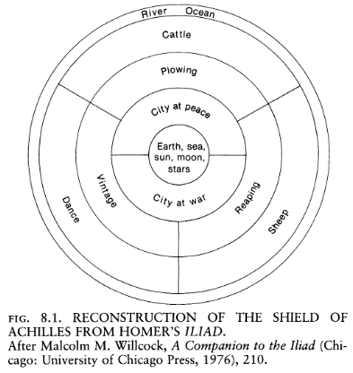
Early Greek “Geography”
geographia – terms that appears with Eratosthenes of Cyrene (3rd C BC) – phusiologia – historia.
Ancient geography as a literary genre (though specialist studies did exist).
The “river Ocean” representing the physical embodiment of peirata gaiēs “boundary of the earth” – critique of this idea by Herodotus.

Slide 19
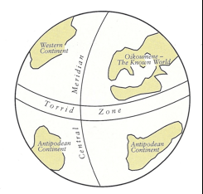
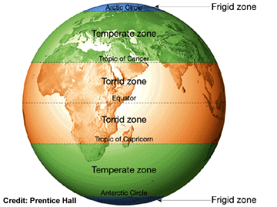
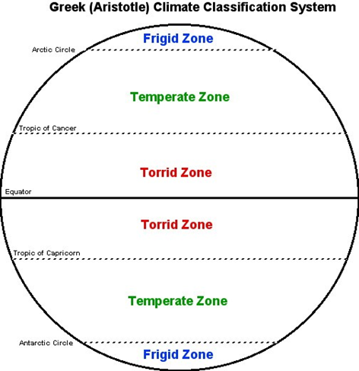
“The limits of the zones can be defined by circles drawn on both sides of the equator and parallel to it, namely, by two circles which enclose the torrid zone, and by two others, following upon these, which form the two temperate zones next to the torrid zone and the two frigid zones next to the temperate zones… Now they call "temperate" the zones that can be inhabited; the others they call uninhabitable…” – Strabo Geog. 2.5.3.
Crates of Mallos

Slide 20
The Centre and Periphery
“The most outlying nations of the world have somehow drawn the finest things as their lot, exactly as Greece has drawn the possession of far the best seasons. As I have lately said, India lies at the world's most distant eastern limit; and in India all living creatures four-footed and flying are much bigger than those of other lands, except the horses…” - Herodotus 3.106.
Nature run’s riot at the end of the earth:
  “The proverbial expression about Libya, that “Libya always brings forth some new thing,” has been coined because of the tendency for even heterogonous creatures to interbreed there. On account of the paucity of water, different species encounter each other at the few places which posses springs, and there interbreed.” – Aristotle Gen. Animal. 746b7-13 – (cf. Diodorus Siculus 2.51.2-4).

Slide 21
Subjects covered in this module and assessments

Slide 22
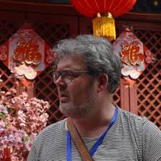
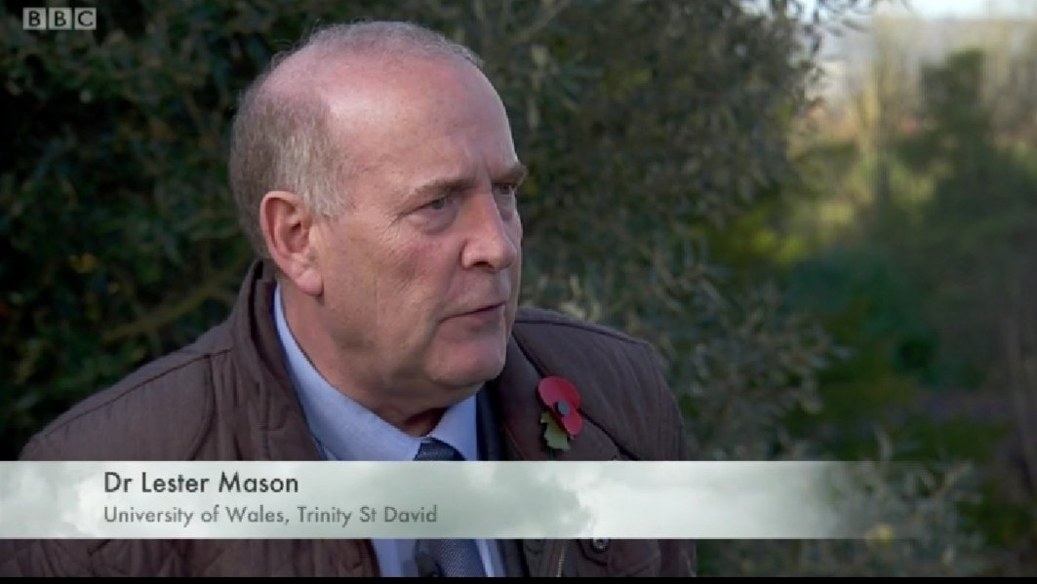
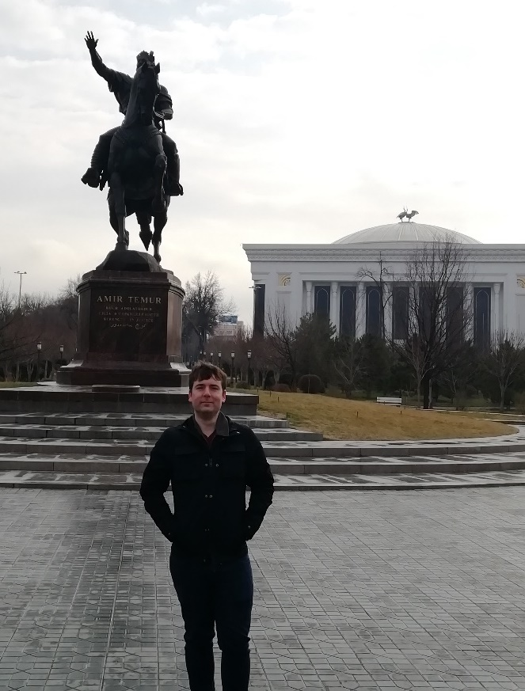

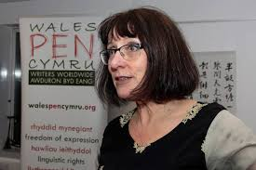
Module Team
Thomas Jansen, Chinese Studies
Lester Mason, Modern History
Quentin Drew, Archaeology
Matthew Cobb, Ancient History
Jeni Williams, Creative Writing

Slide 23
Week 1: Introduction to Global History:
Greco-Roman conceptualisation
Global History from a Chinese perspective
Universal vs Nation-State - perspectives in the modern era
Archaeological approaches to universal human roots
Global History and literature
Week 2: Empires and World systems - ‘Core-Periphery’ confrontations, including:
Core-Periphery models in the Ancient World
Global confrontation through history
World Religions and Global History
The Atlantic and Indian Ocean Worlds – trade, migration, and the Diaspora
Week 3: ‘The Great Divergence’ - The West vs The Rest:
Controversies and confrontation
Commerce and industry – Protectionism or Free trade?
Globalisation – identifying modern and historical contexts
Literature in a ‘modern’ globalised world
Week 4: Heritage and the presentations:
Communications technology and globalisation
‘Glocalisation’ – local agency in a global context.
Heritage and Global History
Poster presentation – details to be announced

Slide 24
Assessments
Assignment One: 6th DECEMBER 2020, by 23.59hrs.
  Gobbet (Source Analysis) - 1000 word critical analysis of a short primary source text or image or extract of literary text or short poem related to the main course themes. (25% Weighting).
Assignment Two: 20th DECEMBER 2020, by 23.59hrs.
  Short Essay or commentary - 1000 words based upon multiple choice list (25% Weighting).
Assignment Three: TO TAKE PLACE DURING W/C 14th DECEMBER 2020
  Power point Presentation - 15 Minute presentation worth 2000 words (50% Weighting).
    Students within a specific discipline will present on a topic related to global history or on a topic relating to globalisation from the field of literature / archaeology/ Creative writing etc. Students will need to present to both staff and peers.

Slide 25
Bibliography
Conrad, S. 2016. What is Global History? Princeton University Press.
Kossok, M. 1993. ‘From Universal History to Global History’, in B. Mazlish and R. Buultjens (eds.), Conceptualizing Global History, Routledge: 93-111.
Sommer, M. 2013. ‘OIKOYMENH: longue durée perspectives’, in M. Pitts and M. J. Versluys (eds.), Globalisation and the Roman World: World History, Connectivity and Material Culture, Cambridge University Press: 175-197.

