Slide 1

CROSS-CULTURAL NEGOTIATIONS: ESTABLISHING A STRATEGIC PARTNERSHIP BETWEEN POUNDLAND UK AND ALIBABA GROUP
Student name: Elena Dineva
Student number: 2226629
Lecture: Afzal Munna

Slide 2
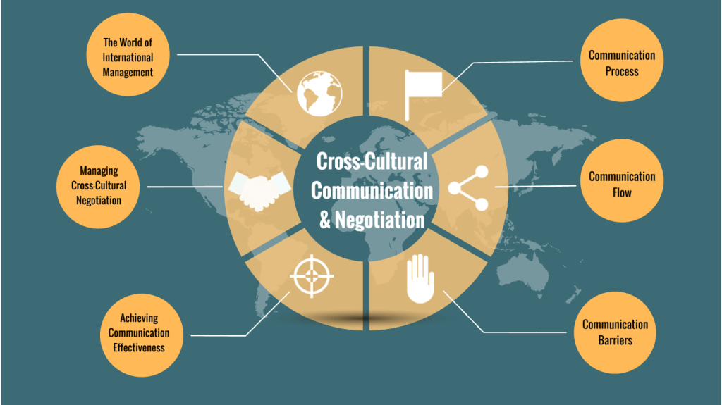
Presentation Outline
In this presentation we will go through actual case of cross-cultural negotiations between Poundland UK & a Chinese firm
Introduction to cross-cultural negotiations and key focus areas.
Understanding cultural differences in business between the UK and China.
Negotiation strategies to overcome cultural barriers effectively.
Importance of trust, communication, and business etiquette in negotiations.
Adaptability and cultural awareness for long-term partnership success.
Notes:
In this presentation we will go through actual case of cross cultural negotiations between Poundland UK & a Chinese firm. It is essential to understand cultural differences when it comes to building a successful joint strategy. In an effort to address how cultural elements affect negotiations and strategies to overcome these challenges we will explore. Success depends on having trust, being able to communicate well, and having the correct business etiquette. Then you will learn to cover the adaptability and the cultural awareness. They are seeking to get a mutually beneficial deal while adhering to local norms. With these strategies, the Chinese firm can work with Poundland for a long time and for profit.

Slide 3
Understanding Culture and Its Elements
Culture influences beliefs, behaviors, and decision-making in business.
Cultural elements include language, customs, values, and social norms (Yeung, 2021).
High-context vs. low-context communication styles affect business interactions.
Hierarchical structures and power distance shape decision-making processes.
Cultural differences impact trust-building and negotiation approaches.
Notes:
Business culture has an impact on communication, leadership and of course, how decisions are made. Language, customs and values as well as the norms of the business are key cultural elements. The difference here mainly is high context cultures which emphasise on implicit communication while low context cultures place emphasis on the direct communication. Rely also on hierarchy has an effect on authority and the decision making power which is important for negotiations. There are trust building approaches for each culture, and therefore, it’s important to know how to gain credibility in each culture. Poundland recognises these cultural elements and can therefore deal with negotiations effectively, with a view to maintain respectful and productive relations with possible Chinese partners.

Slide 4
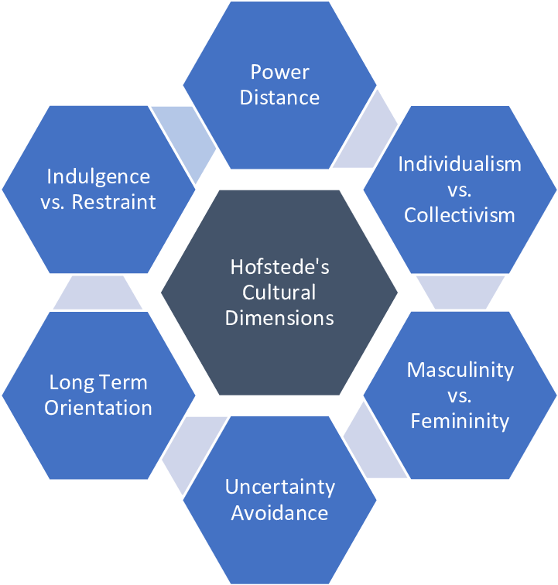
Hofstede’s Cultural Dimensions Theory
Power distance: China values hierarchy; UK favors a flatter structure.
Individualism vs. collectivism: China is collective; UK prioritizes individual success (Suradji, Futaqi, and Hudi, 2024).
Uncertainty avoidance: China embraces ambiguity; UK prefers structured approaches.
Long-term orientation: China focuses on future; UK seeks quick results.
Indulgence vs. restraint: China values discipline; UK balances pleasure and work.
Notes:
Cultural Dimensions Theory developed by Hofstede discusses the main differences in UK and China. The UK has a flatter corporate structure than China, which has a high power distance or hierarchy is respected. In China the culture is very collectivist and putting the group harmony first, in the UK the culture is success of the individual. Chinese businesses are more adapted to dealing with uncertainty in the approach, whereas UK businesses tend to prefer areas of structured decision making. The UK businesses tend to be more short term oriented, just in about a gaining term, whereas China does the long term orientation. Knowing those differences are really important for effective negotiation as it enables Poundland to adjust its approach and to make stronger business contacts in China.

Slide 5
Key Cultural Differences Between the UK and China
Decision-making in China is hierarchical, requiring senior-level approvals.
Relationship-building is essential before business discussions begin (Soto Setzke et al., 2023).
Chinese communication is indirect; UK professionals prefer straightforward discussions.
Negotiation pace in China is slower, requiring patience.
Formality and respect are expected in business interactions.
Notes:
Business negotiations are impacted quite significantly by cultural differences between the UK and China. In China, there is a strict hierarchy, and in order to make a decision, one must have the approval of higher senior executives and UK companies have power in the hand of the middle management. Before talking about business, you are supposed to build personal relations, or, “guanxi.” Chinese professionals tend to communicate indirectly to adapt with the UK’s direct communication style for building harmony. Because of careful deliberation, negotiations in China take much longer and so need patience and persistence. Also, in Chinese business culture, when doing business with potential partners, formality and respect are very much valued and it is very important to have etiquette and courtesy.

Slide 6
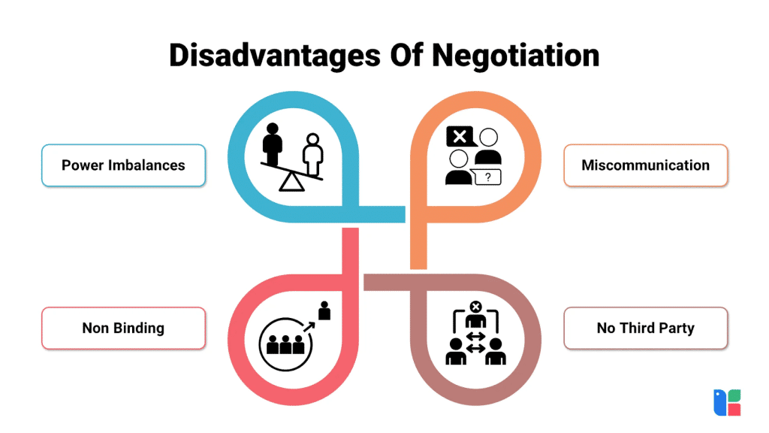
Impact of Cultural Differences on Business Negotiations
Miscommunication can arise from indirect communication styles.
UK’s directness may be perceived as aggressive by Chinese partners.
Decision-making delays in China may frustrate UK business professionals.
Different negotiation expectations can lead to misunderstandings.
Trust-building takes longer in China than in the UK (Snihur, Zott, and Amit, 2021).
Notes:
Business negotiation can be tough due to cultural differences. If UK professionals are used to direct communication, it may lead to misinterpretations with indirect communication in China. The UK approach may seem too direct to Chinese partners, but in the same way. Failures in China’s hierarchical decision making process often occur and UK businesses have to prepare for it. China’s negotiation style of preferring consensus over confrontation can result in misunderstandings. It takes a number of interactions to build trust and reach agreements in China. By paying attention and responding to these differences, Poundland should be able to carry out well negotiated negotiations.

Slide 7
Chinese Business Culture: Challenges to Overcome
Patience is required due to prolonged negotiation processes.
Guanxi (relationships) is crucial for business success in China.
Formality and protocol are highly valued in business meetings (Rejeb et al., 2025).
Negotiation strategies focus on long-term gains, not short-term wins.
Saving face (mianzi) is essential in discussions and decision-making.
Notes:
Many challenges exist for Poundland when operating in the Chinese business culture. Time is also needed during negotiations — patience and persistence required. Business success is, in fact, all about guanxi, or relationship building. Progress is often easy if you are not linked personally to people. Formalism and respect are the main things that characterise a meeting. Unlike UK based firms that keep the interests of the business short term, Chinese businesses are interested in long term benefits. One of the important things is to maintain "Mianzi," face, and public disagreements and aggressive tactics must be avoided. Understanding the challenges of adapting the culture will help Poundland develop a strategy that fits in Chinese culture and makes the negotiation process easy.

Slide 8
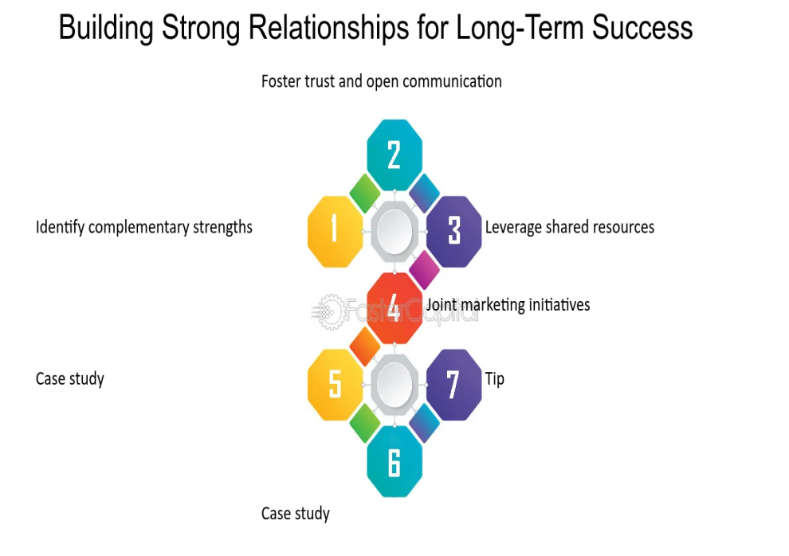
Cross-Cultural Negotiation Strategies
Research and understand Chinese cultural expectations before negotiations.
Build strong personal relationships before discussing business terms.
Show patience, as negotiations take longer in China (O’Dwyer, Filieri, and O’Malley, 2023).
Avoid aggressive tactics; focus on mutual respect and collaboration.
Adapt negotiation style to align with Chinese business etiquette (Ayanponle et al., 2024).
Notes:
To negotiate with Alibaba, that must understand its business culture and business strategy. Trust starts to depend on guanxi and Alibaba places more value on strong relationships than right now. Alibaba being a hierarchical decision process of management, it is important to respect with the key people. Being patient comes naturally when negotiating with Alibaba. Alibaba is more inclined toward larger long-term partnerships that suit both sides where there is an exchange of good and services. Poundland can maintain a solid ground for business relationship with Alibaba Group by concentrating on win-win collaboration.

Slide 9
Building Trust and Long-Term Relationships
Trust is built through repeated interactions and consistency (Bonavita and Borgonovo, 2021).
Personal relationships (guanxi) are essential for successful business deals.
Face-to-face meetings strengthen trust and credibility (Mohanty, 2021).
Gifts and hospitality are common in business relationships.
Long-term commitment is valued over short-term gains.
Notes:
It will be based on trust on working with Alibaba Group. Unlike short term transaction transactional business models, Alibaba prefers long term stable relationship. Building guanxi (personal connexions) with Alibaba’s key executives is a way to strengthen trust and credibility. Alibaba likes the partners who have the commitment, reliability and a shared objective. Regular meetings are required both online and offline to encourage collaboration. Rather than just maximising profits or maximising cost cutting, Alibaba likes to partner with companies, both of which they can profit from. To do this, Poundland can develop a mutually beneficial partnership with Alibaba Group by showing it a common commitment to success.

Slide 10

Effective Communication in Chinese Negotiation
Use indirect language to maintain harmony and avoid confrontation.
Pay attention to body language and non-verbal cues (Burström et al., 2021).
Silence is a negotiation tactic; do not rush responses.
Respectful titles and formal greetings are essential (Mancuso, Petruzzelli, and Panniello, 2023).
Avoid saying “no” directly; offer alternative solutions instead.
Notes:
Good negotiations with Chinese firms are dependent on effective communication. Chinese professionals however differ from the UK’s approach in that they don’t adopt a direct approach, however they use indirect language in order to preserve harmony and avoid conflict. It is important to understand non verbal cues such as pauses or facial expressions. Rushed responses often prevent the benefit of silence at the end of a discussion for the simple reason that silence more often represents genuine consideration than disagreement. Formal and respectful address of counterparts through titles and greetings is also an important part of the treatment. In addition, you should not reject an offer straight blatant, instead, you should suggest other solutions. Poundland should be able to adjust to the communication styles and promote a positive negotiation environment by working together.

Slide 11
Negotiation Tactics and Business Etiquette
Expect lengthy negotiations with multiple rounds of discussions (Chauhan et al., 2022).
Hierarchical structures require addressing senior executives with respect.
Avoid pressuring for quick decisions; patience is necessary (Mamabolo and Lekoko, 2021).
Negotiations emphasize win-win outcomes rather than competition.
Formal business attire and respectful gestures are expected.
Notes:
UK practise of negotiations differs greatly from the practise in China. Patience is what’s required when it comes to business deals as they generally need multiple rounds of discussion. There is a hierarchy in place, and then accordingly, it is important to address senior executives with utmost respect, as the approval of them is required. The opposite is true of the Chinese, who are used to making it all happen quickly, so use pressure tactics is recommended not. The emphasis is on a win approach, in which short term benefits count less than coming to an arrangement for long term rewards. Formal attire and a respectful body language enhances credibility and professionalism, and put Poundland in place to clinch a deal at favour.

Slide 12
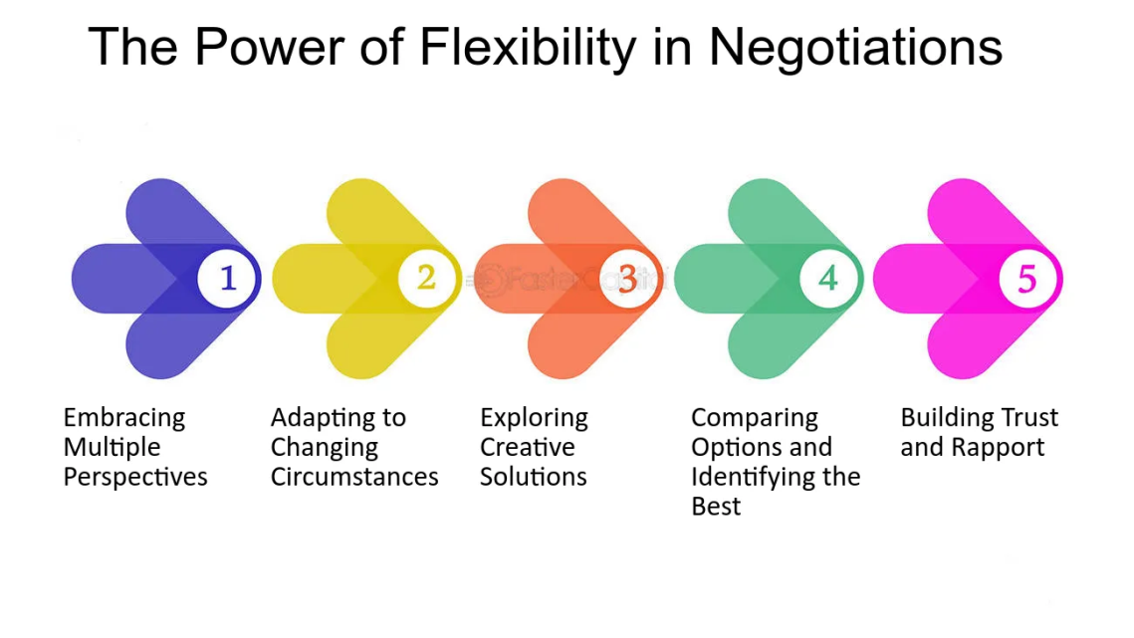
Adaptability and Cultural Awareness for Success
Understanding Chinese traditions strengthens business relationships.
Flexibility in negotiation styles improves collaboration.
Showing respect for Chinese customs builds trust (Kutlay and Öniş, 2021).
Learning basic Mandarin phrases enhances rapport.
Cultural training helps employees navigate cross-cultural business environments (Dentoni, Pinkse, and Lubberink, 2021).
Notes:
Successful negotiations require a basic degree of cultural awareness and adaptability. So, knowing Chinese traditions and the cultural customs goes a long way assisting a company into good business relationships. Having flexibility in negotiation styles helps make it smoother discussions and collaboration. Not demonstrated respecting Chinese custom, as shown in acknowledging hierarchical structure, and maintaining formality of the language, makes trust. It's really just learning basic Mandarin phrases for such things as greetings can leave a good impression on people and show commitment to cultural understanding. By providing cultural training for Poundland’s employees, they will be prepared to deal successfully with cross cultural negotiations with Chinese firms, and thereby lead to the development of more effective working relationship with Chinese firms.

Slide 13
Conclusion and Key Takeaways
Cultural differences impact business negotiations significantly.
Relationship-building is essential for successful partnerships in China.
Patience and respect improve negotiation outcomes (Ghobakhloo et al., 2021).
Adapting communication and negotiation styles fosters collaboration.
Cultural awareness enhances long-term business success (Garrido-Moreno, Garcia-Morales, and Martín-Rojas, 2021).
Notes:
Finally, concluding, to successfully develop in its strategic partnership with Alibaba Group both will need to develop relationship building, flexibility and a long-term perspective. Rather, in Alibaba’s business culture, trust, patience, mutual benefits, and not immediate profits, are stressed. To undertake better negotiations with Alibaba, it is important to know the hierarchical structure and the decision making of Alibaba. Poundland should respect Chinese business etiquette and Chinese communication norms to develop a long and strong relationship with Alibaba. In this case, it is a win-win strategy that can benefit both companies to use the strength of each other in order to have a successful and sustainable expansion in Chinese market.

Slide 14
References
Ayanponle, L.O., Awonuga, K.F., Asuzu, O.F., Daraojimba, R.E., Elufioye, O.A. and Daraojimba, O.D., 2024. A review of innovative HR strategies in enhancing workforce efficiency in the US. International Journal of Science and Research Archive, 11(1), pp.817-827.
Bonavita, L. and Borgonovo, G., 2021. Omnichannel Maturity Framework: Italian Retail mapping and cluster analysis.
Burström, T., Parida, V., Lahti, T. and Wincent, J., 2021. AI-enabled business-model innovation and transformation in industrial ecosystems: A framework, model and outline for further research. Journal of Business Research, 127, pp.85-95.
Chauhan, C., Kaur, P., Arrawatia, R., Ractham, P. and Dhir, A., 2022. Supply chain collaboration and sustainable development goals (SDGs). Teamwork makes achieving SDGs dream work. Journal of Business Research, 147, pp.290-307.
Dentoni, D., Pinkse, J. and Lubberink, R., 2021. Linking sustainable business models to socio-ecological resilience through cross-sector partnerships: A complex adaptive systems view. Business & Society, 60(5), pp.1216-1252.
Garrido-Moreno, A., Garcia-Morales, V.J. and Martín-Rojas, R., 2021. Going beyond the curve: Strategic measures to recover hotel activity in times of COVID-19. International Journal of Hospitality Management, 96, p.102928.
Ghobakhloo, M., Iranmanesh, M., Grybauskas, A., Vilkas, M. and Petraitė, M., 2021. Industry 4.0, innovation, and sustainable development: A systematic review and a roadmap to sustainable innovation. Business Strategy and the Environment, 30(8), pp.4237-4257.
Notes:
Kutlay, M. and Öniş, Z., 2021. Turkish foreign policy in a post-western order: strategic autonomy or new forms of dependence?. International Affairs, 97(4), pp.1085-1104.
Mamabolo, M.A. and Lekoko, R., 2021. Entrepreneurial ecosystems created by woman entrepreneurs in Botswana.
Mancuso, I., Petruzzelli, A.M. and Panniello, U., 2023. Innovating agri-food business models after the Covid-19 pandemic: The impact of digital technologies on the value creation and value capture mechanisms. Technological Forecasting and Social Change, 190, p.122404.
Mohanty, S., 2021. An Analysis of Factors Affecting Consumer Behaviour: A Case of E-Retailing in Goa (Doctoral dissertation, Goa University).
O’Dwyer, M., Filieri, R. and O’Malley, L., 2023. Establishing successful university–industry collaborations: barriers and enablers deconstructed. The Journal of Technology Transfer, 48(3), pp.900-931.
Rejeb, A., Rejeb, K., Appolloni, A., Zailani, S. and Iranmanesh, M., 2025. Navigating the landscape of public–private partnership research: a novel review using latent Dirichlet allocation. International Journal of Public Sector Management, 38(2), pp.213-237.
Snihur, Y., Zott, C. and Amit, R., 2021. Managing the value appropriation dilemma in business model innovation. Strategy Science, 6(1), pp.22-38.
Soto Setzke, D., Riasanow, T., Böhm, M. and Krcmar, H., 2023. Pathways to digital service innovation: The role of digital transformation strategies in established organizations. Information Systems Frontiers, 25(3), pp.1017-1037.
Suradji, M., Futaqi, S. and Hudi, M., 2024. Strengthening the Capacity of Social Welfare Institutions for Service Quality to Orphans, the Elderly and the Disabled. ABDIMAS: Jurnal Pengabdian Masyarakat, 7(1), pp.314-324.
Yeung, H.W.C., 2021. Regional worlds: from related variety in regional diversification to strategic coupling in global production networks. Regional Studies, 55(6), pp.989-1010.

Slide 15


