Slide 1
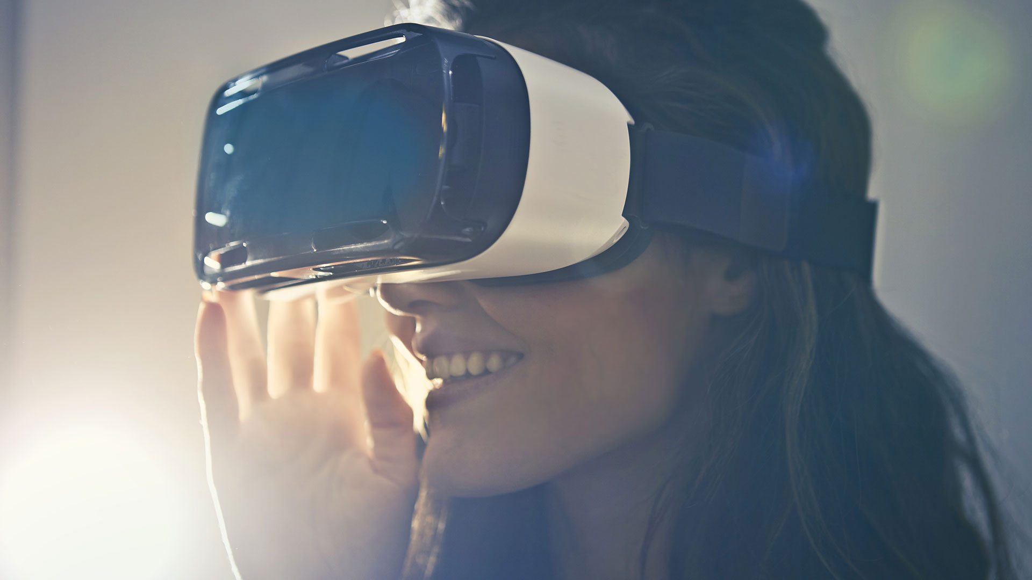

Strategies for Effective Communication in a Business Setting
BMSW4002 Effective Team Working and Communication
Name of the Student:Laszlo-Levente Rozgonyi
Student Id:2027402
Course Name:Effective team working and communication BMSW4002

Slide 2
Table of Content
Introduction | 3
Analysis and Implementation of the Theories used by the Organisation relating to the Models of Communication | 4
Utilisation and Recommendations of Communication Channel used and need to be used by the Organisation | 6
Identification of Different Types of Barriers that can Prevent Effective Communication among Organisation and their External Stakeholders | 8
Analysis of the Impact of Effective Communication on the Organisational Business Process | 9
Conclusion | 10
References | 11

Slide 3

Introduction
Excellent interaction among a group will develop a shared goal between teammates.
Successful teams recognize that group communication increases organisational effectiveness.
Strong group interaction will build comprehension.
Workers grasp the expectations for their job.
Notes:
All productive teams have to grasp the value of communication process since it is fundamental to their performance. Excellent interaction among a group will develop a shared goal between teammates that will help them to attain their objectives. Regular pleasant contact may assist team members build a feeling of belonging and enhance connections. Successful teams recognize that group communication increases organisational effectiveness (Freitas and Almendra, 2021). As workers grasp the expectations for their job, they will be more inclined to call out for support when they require it and the group will grow more competent. In this aspect, in the case of Unilever, within the organisational culture, strong group interaction will build comprehension and that understanding will generate strong connections within the workplace.

Slide 4

Analysis and Implementation of the Theories used by the Organisation relating to the Models of Communication
Unilever's sender is in charge of ensuring that the data is delivered.
Encoding is the process of transforming a concept into a format that can be sent.
The channel of interaction refers to the infrastructure used to transport data from a source or broadcaster to a decoder or receiver
Notes:
The organisation should utilise the Shannon Weaver’s Model of Communication in order to build and strong communication system within the team of Unilever.
Shannon Weaver Model of Communication
Sender (Information Source): Unilever's sender is in charge of ensuring that the data is delivered (Al-Qaysi, Mohamad-Nordin and Al-Emran, 2020). First, data providers must decide what data they wish to communicate and with whom.
Encoder (Transmitter): Encoding is the process of transforming a concept into a format that can be sent (Dwivedi et al., 2019). Unilever's team utilises the Shannon model to explain how the sentences they say are transmitted employing codes like binary digits or radio waves whenever they interact through phone and computer.
Channel: The channel of interaction refers to the infrastructure used to transport data from a source or broadcaster to a decoder or receiver in the team of Unilever (Al-Qaysi, Mohamad-Nordin and Al-Emran, 2020).
Noise: Internal noise occurs because when an information is encrypted or translated improperly (Dwivedi et al., 2019). When an external component disrupts with the message, it is known as external noise.
Decoder (Reception): In other words, encoding is the reverse of decoding (Dwivedi et al., 2019). This paradigm was created by Shannon and Weaver with regard to interaction via devices such as cell-phones.
Receiver (Destination): The receiver is the last stage in Shannon and Weaver's original model of technical communication (Al-Qaysi, Mohamad-Nordin and Al-Emran, 2020). Team members finally get it at this point, or at least what remains of it after all the noise has been removed.

Slide 5

Internal noise occurs because when an information is encrypted or translated improperly.​
Encoding is the reverse of decoding.​
The receiver is the last stage in Shannon and Weaver's original model of technical communication.​

Slide 6
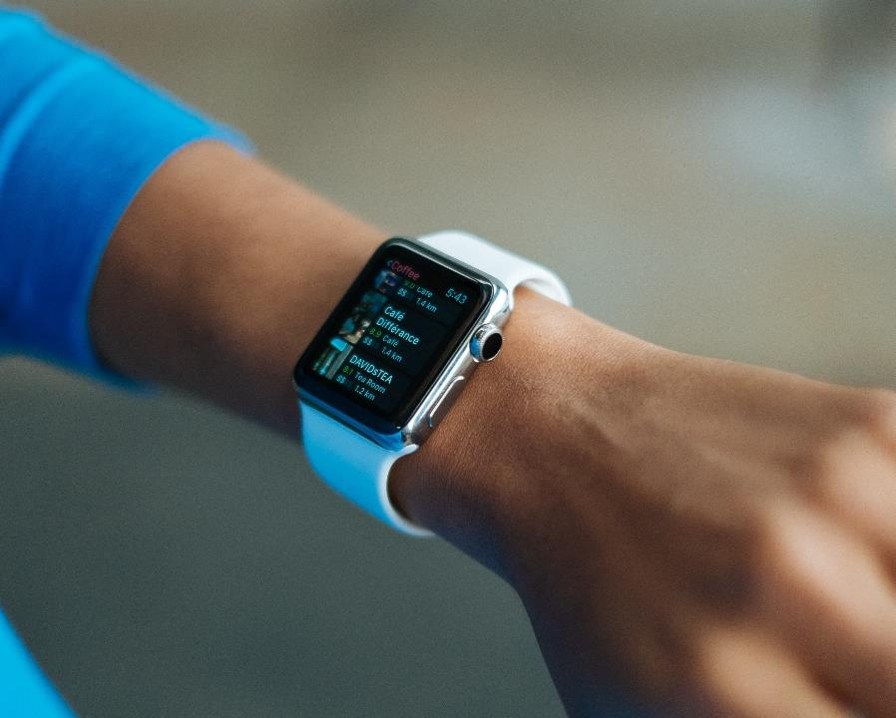
Utilisation and Recommendations of Communication Channel used and need to be used by the Organisation
Unilever is able to communicate with each other over the phone and get comments.
Unilever PLC also uses notes, letters, and e-mails to communicate.
Workers will be able to have a better understanding of the company's strategy through reading various streams of information.
Notes:
Unilever utilises telephones to interact with each other since they are an international company. They are able to communicate with each other over the phone and get comments. Faster decision-making and a smoother functioning may be achieved by exchanging communications over the phone. Unilever PLC also uses notes, letters, and e-mails to communicate (Iankova et al., 2019). Workers will be able to have a better understanding of the company's strategy through reading various streams of information. These networks might be more successful if there was a big list of instructions to be sent to staff. Everything in written will make it easier for them to follow the rules.
Face-to-face meetings are often considered to be the most beneficial method for teams to communicate. This is because it allows for nonverbal cues, facial emotions, and other nonverbal signals, reducing the risk of misinterpretation. Video conferencing solutions may be incredibly useful for real-time cooperation, even if they cost Unilever money. Team members may simply open a new tab on their laptops to join a video chat and share their screens (Smith, Patmos and Pitts, 2018). Because of their greater security, emails are a fantastic substitute for old-fashioned written interaction techniques like letters and notes. A team member who wants to send a confidential document but doesn't want to drop it on someone else's desk should use this method.

Slide 7
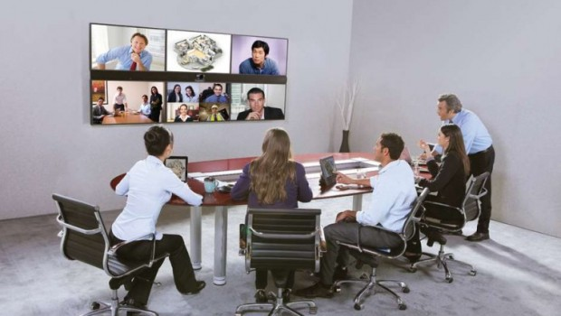
These networks might be more successful if there was a big list of instructions to be sent to staff​
Face-to-face meetings are often considered to be the most beneficial method for teams to communicate.​
Video conferencing solutions may be incredibly useful for real-time cooperation, even if they cost Unilever money.​
This Photo by Unknown author is licensed under CC BY-SA-NC.

Slide 8

Identification of Different Types of Barriers that can Prevent Effective Communication among Organisation and their External Stakeholders
Overload of information sometimes distract the receiver to get important and emergency information and data regarding the team.
Generally, both the sender and receiver need to be open to speak and listen.
Sometimes the teammates in Unilever always are not able to collect information from the credible sources regarding their business.
Notes:
Filtering: Due to doing filtering during the communication, a team member not provide appropriate information to his or her teammates due to getting scolded by its teammate (Auschra, 2018).
Selective Perception: Moreover, the selective perception also create misconception among the mind of the teammates within the organisational culture of Unilever (Blanco-Portela et al., 2017).
Information Overload: Overload of information sometimes distract the receiver to get important and emergency information and data regarding the team (Auschra, 2018).
Emotional Disconnects: Generally, both the sender and receiver need to be open to speak and listen (Blanco-Portela et al., 2017). However, they are not being able to effectively communicate with each other due to getting upset.
Lack of Source Credibility: In addition to this, sometimes the teammates in Unilever always are not able to collect information from the credible sources regarding their business (Auschra, 2018).

Slide 9

Analysis of the Impact of Effective Communication on the Organisational Business Process
Building trust with people is much easier when Unilever is able to communicate effectively.
The most important thing is to stay cool, ensure that all sides are heard, and come up with a solution that is best for all parties.
Having a good rapport with co-workers and colleagues and relatives is also a benefit of effective communication.
Notes:
Building trust with people is much easier when Unilever is able to communicate effectively. Trust in the decision-making abilities grows when people demonstrate an ability to listen carefully and accept a wide range of viewpoints. With the leadership, this faith will spread throughout the organisational team of Unilever, allowing them to rely on each other to do their jobs and obligations. When it comes to settling disagreements and averting future ones, efficient communication is a key factor. The most important thing is to stay cool, ensure that all sides are heard, and come up with a solution that is best for all parties (Torres, Sidorova and Jones, 2018). Having a good rapport with co-workers and colleagues and relatives is also a benefit of effective communication. A person's sense of belonging and understanding is enhanced when they are given the opportunity to express themselves clearly and thoughtfully.

Slide 10
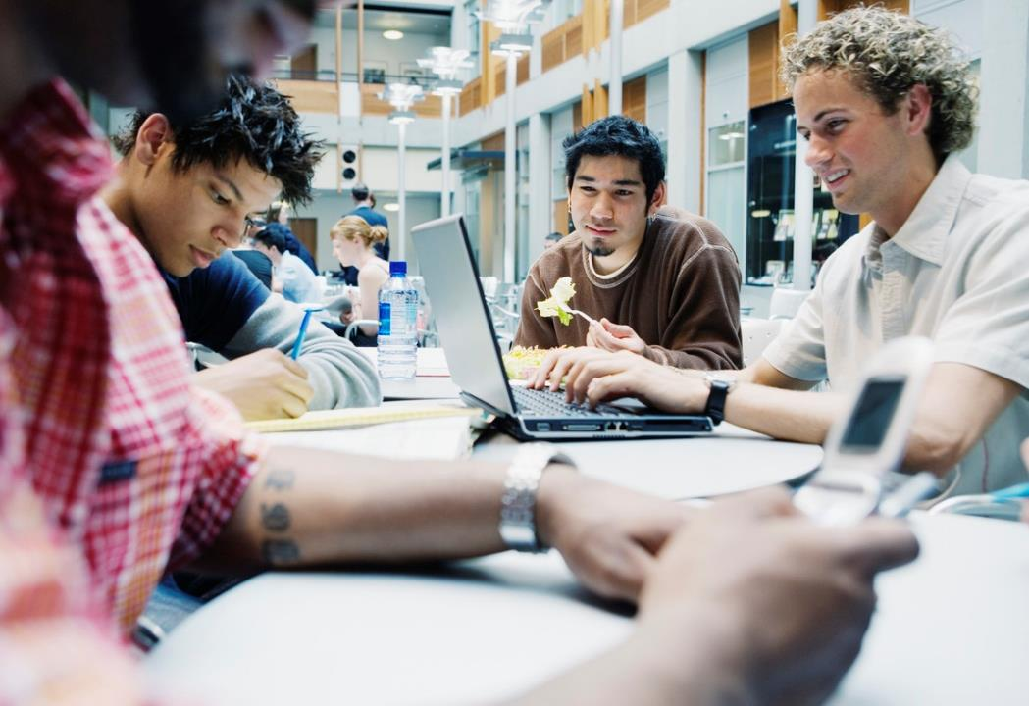
Conclusion
The review must use theories that are relevant to the inquiry.
Workers' perspectives must be considered into account.
New communication channels should be considered.
Notes:
The literature review must use theories that are relevant to the inquiry. Workers' perspectives must be considered into account when making a choice on ethical difficulties that may arise throughout the study. As part of the assessment of how to enhance the firm's interaction, new communication channels should be considered, as well as the essential channels that need to be enhanced, depending on the assessment of how to develop the worker's interaction.

Slide 11

References
Al-Qaysi, N., Mohamad-Nordin, N. and Al-Emran, M., 2020. A systematic review of social media acceptance from the perspective of educational and information systems theories and models. Journal of Educational Computing Research, 57(8), pp.2085-2109.
Auschra, C., 2018. Barriers to the integration of care in inter-organisational settings: a literature review. International journal of integrated care, 18(1).
Blanco-Portela, N., Benayas, J., Pertierra, L.R. and Lozano, R., 2017. Towards the integration of sustainability in Higher Education Institutions: A review of drivers of and barriers to organisational change and their comparison against those found of companies. Journal of Cleaner Production, 166, pp.563-578.
Dwivedi, Y.K., Rana, N.P., Jeyaraj, A., Clement, M. and Williams, M.D., 2019. Re-examining the unified theory of acceptance and use of technology (UTAUT): Towards a revised theoretical model. Information Systems Frontiers, 21(3), pp.719-734.
Freitas, A.P.N.D. and Almendra, R.A., 2021, July. What if…? Strategies to Teaching Communication, Empathy and Teamworking for Design Students by Design Students. In International Conference on Applied Human Factors and Ergonomics (pp. 148-156). Springer, Cham.
Iankova, S., Davies, I., Archer-Brown, C., Marder, B. and Yau, A., 2019. A comparison of social media marketing between B2B, B2C and mixed business models. Industrial Marketing Management, 81, pp.169-179.
Smith, S.A., Patmos, A. and Pitts, M.J., 2018. Communication and teleworking: A study of communication channel satisfaction, personality, and job satisfaction for teleworking employees. International Journal of Business Communication, 55(1), pp.44-68.
Torres, R., Sidorova, A. and Jones, M.C., 2018. Enabling firm performance through business intelligence and analytics: A dynamic capabilities perspective. Information & Management, 55(7), pp.822-839.

Slide 12
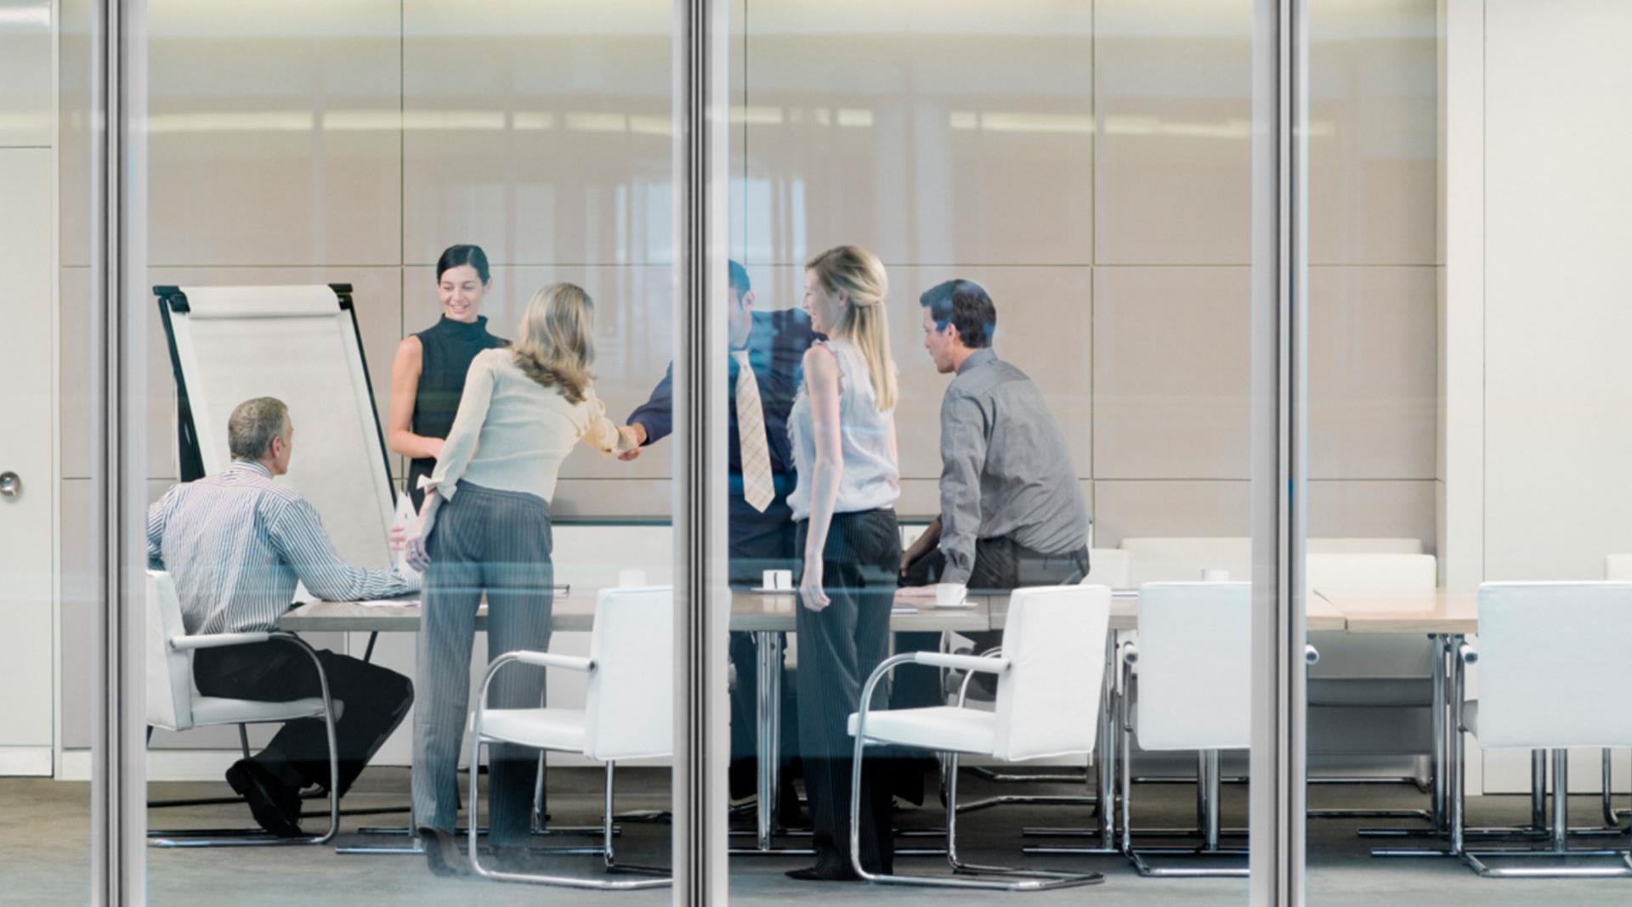
Thank You !

Slide 13
Teamwork Evaluation ​ | Team responses. ​
Who was in your team? ​ | MARTIN WILLIAM CADOGAN​ AND IULIA ELENA TISCHLER
What were the key strengths of your team? ​ ​ | The key strength of my team was the having of effective and resilient communication system and teamworking spirit.​
What were the challenges that you overcame as a team?​ ​ | The challenges within the communication system regarding filtering, hesitation to speak freely, etc. I overcame as a team.​
What would you do differently if you worked as a team again?​ ​ | I would prefer to communicate and establish a confident and trustworthy environment for sharing all information without any hesitation.​
How would you rate your team working? Out of 10? ​ | 8​

