Slide 1
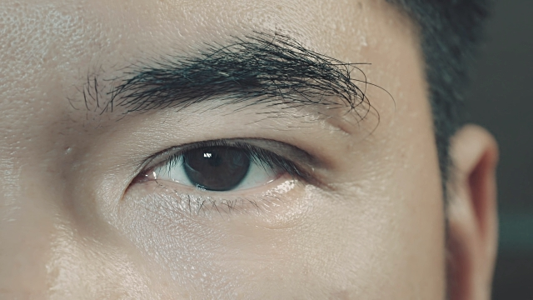
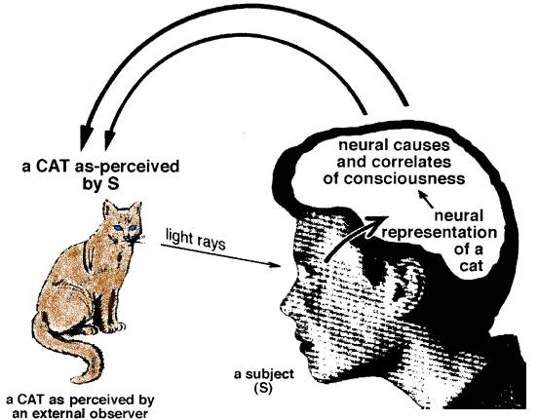
Human Vision
Human vision can be split into two stages:-
  The physical process of the eye picking up light.
  The interpretation of the image to recognise objects, distances and colours.

Slide 2
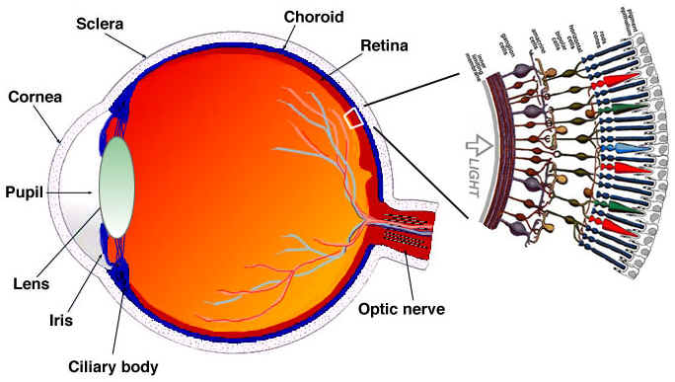
The Human Eye

Slide 3
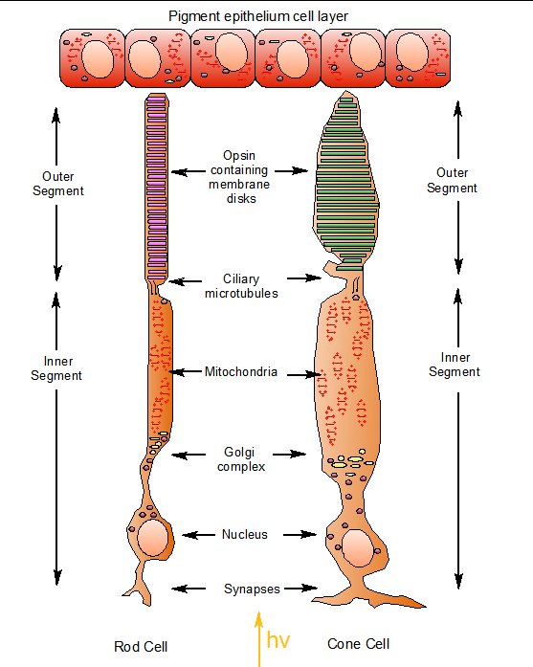
The Human Eye
The retina is a light sensitive area on the back of the eye containing two types of light sensitive cell: rods and cones.
Rods are very sensitive to light and movement, but do not pick up fine detail or colour.
  They are mostly around the edge of the retina.
  We make use of rods under poor lighting conditions and for peripheral vision.

Slide 4
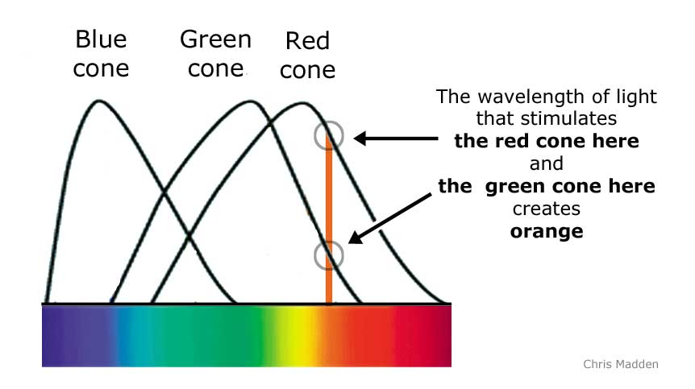
The Human Eye
Cones operate under bright lighting conditions.
There are three types of cone, sensitive to red, green and blue light, giving us colour vision. Only around 4% of cones are sensitive to blue light.
Cones are concentrated on the fovea, the central point on the retina where images are focused. .

Slide 5
Colourblindness
Around 8% of men are colourblind
The most common form is red-green
Example:
http://www.bbc.co.uk/sport/football/premier-league/table
Viewed by colour blind user:
http://wearecolorblind.com/example/bbc-online-football-tables/

Slide 6
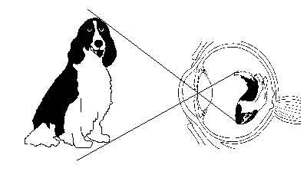
Visual Perception
There is more to vision than meets the eye.
We are given tiny, distorted, upside-down, two-dimensional images in the eyes & we see solid objects in three-dimensional space.
Optical illusions demonstrate that we are actively trying to build up a picture of objects.
Notes:
Ambiguous figures, such as the vase/faces figure & Necker's cube, show that there is more than one way of perceiving the same image on the retina.
The Muller-Lyer illusion & the Ponzo illusion demonstrate that identical lines can be perceived as having different lengths.

Slide 7
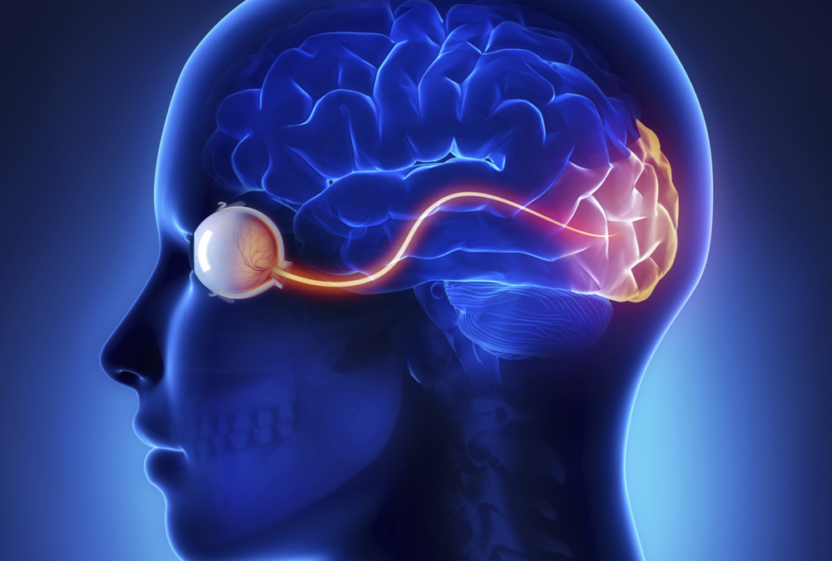
Visual Perception
More of the cortex is devoted to visual perception than for any other sense. Why?
  Vision is very important in our lives
  Visual processing is very complex

Slide 8
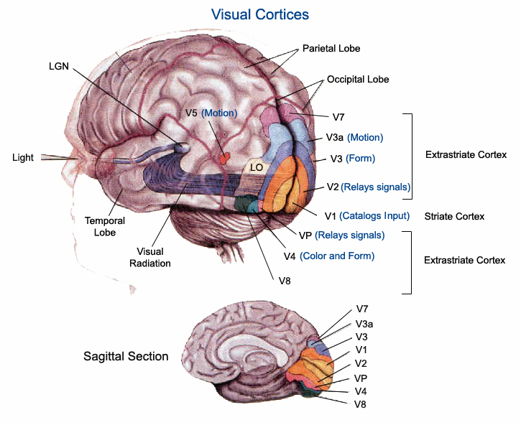
Functional Specialisation
Zeki’s (1993) functional specialisation theory states that different parts of the cortex are specialised for different visual functions
  Initial processing: colour and shape
  Shape
  Colour and orientation
  Motion

Slide 9
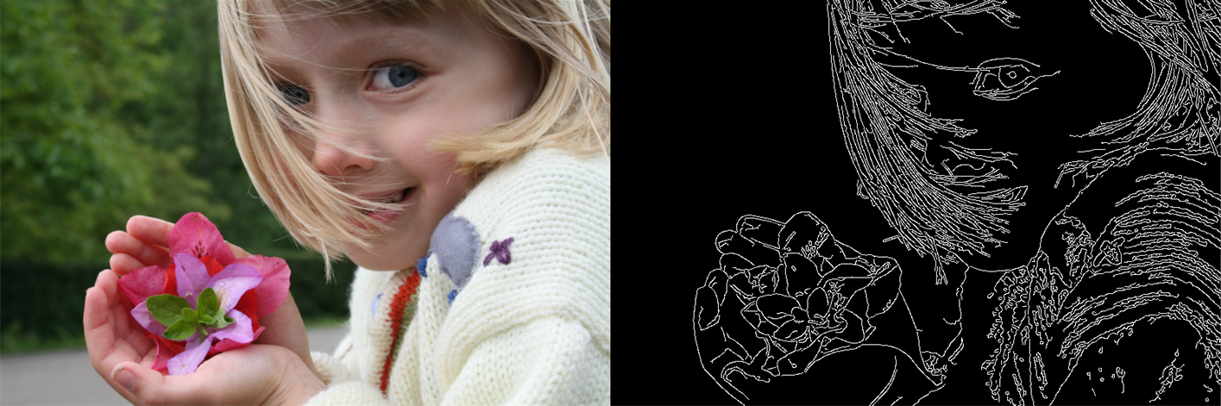
Edge Perception
Edges define where objects meet in the visual field
We heighten the contrast between objects at edges to enhance object perception.

Slide 10
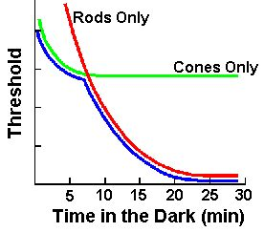
Dark Adaptation
Increased visual sensitivity which occurs over time in darkened conditions
Sensitivity to light can increase 100,000 times during dark adaptation
Adaptation involves
  Dilation of pupil
  Changes in sensitivity of rod and cone cells

Slide 11
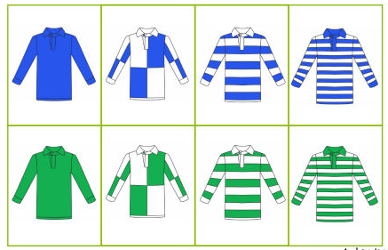
Cognitive Neuroscience and Vision
Evidence on colour vision
  Patients with damage to area V4 of the visual cortex often are unable to name colour of objects, but have normal perception of shape and movement
  What would happen if one of these patients is given green and blue object to sort?
  They can sort the objects correctly, but cannot explain why.
  Conscious processing of colour is carried out in area V4

Slide 12

Cognitive Neuroscience and Vision
Motion
  Patients with damage to area V5 of the visual cortex develop akinetopia
  Stationary objects are seen as normal, but moving objects become invisible.

Slide 13
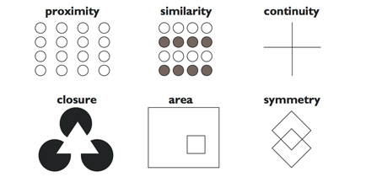
Gestalt Theory of Perception
Organisation of perception depends on laws of grouping
Gestalt theory gave impetus to later research into perception, but some aspects have been disproved experimentally

Slide 14
Constructivist Theory
Perception is an active process influenced by observers’ expectations and knowledge
Incorrect expectations can lead to perceptual errors, eg Ames room
Bruner & Goodman’s experiment with coin sizes (Pound coin exercise)

Slide 15
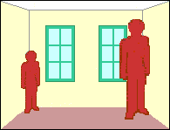

Slide 16

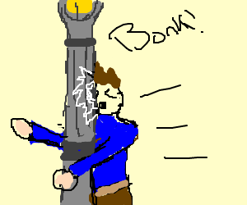
Evaluation of Constructivist Theory
A criticism of constructivist theory is that the experiments involved artificial situations
It is hard to prove what subjects’ expectations are
Constructivist Theory would predict many errors in perception, but usually we are accurate

Slide 17
Direct Perception Theory
Gibson (1989)
The pattern of light reaching the eye is an optic array
The optic array gives unambiguous information about the layout of objects in space
Perception involves ‘picking up’ the rich information provided by the optic array directly, with little processing

Slide 18
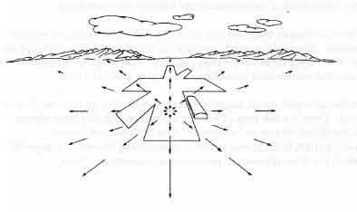
Example
A pilot landing a plane sees an ‘optic flow pattern’. The point toward which the plane is moving is motionless, with the rest of the visual field seeming to move away from that point – the further away, the faster they move. These optic flow patterns give the pilot unambiguous information about direction, speed and altitude.

Slide 19
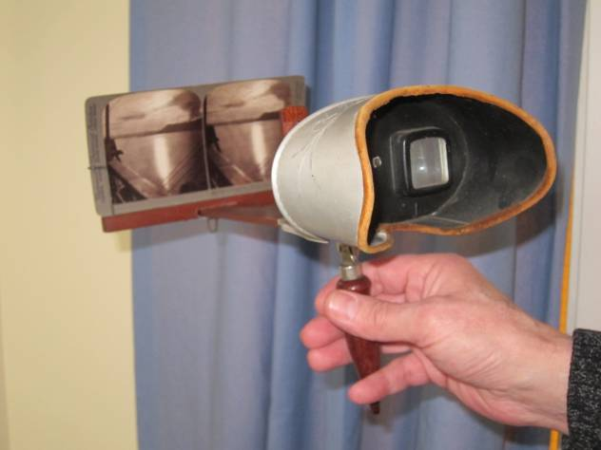
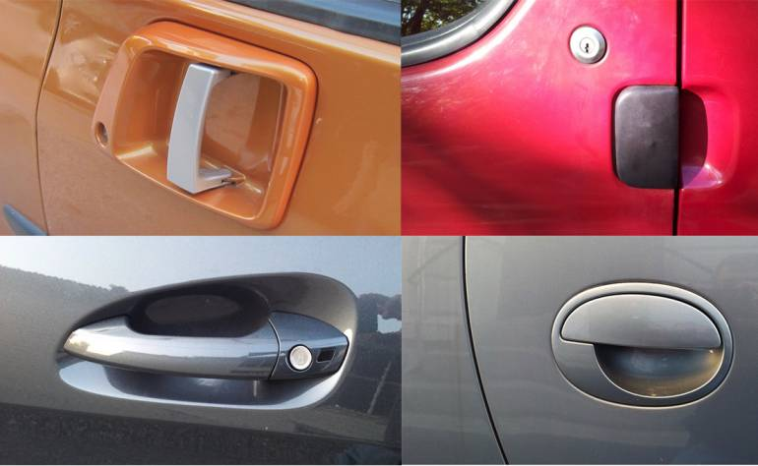
Affordances
Gibson claimed that potential uses of an object are directly perceivable
For example, a chair ‘affords’ sitting, a ladder ‘affords’ climbing

Slide 20

Resonance
Gibson believed that observers can pick up information almost automatically if they are ‘attuned’ to it
Analogy with a radio

Slide 21
Evaluation of Direct Approach
The rich visual world, usually in motion, differs from the simplified, static experimental example. Inaccurate perceptions often involve very artificial stimuli.
Gibson probably underestimated the complexity of visual processing
He did not believe that we use internal representations (sketches). Simple experiments show that we do use them

Slide 22


Constructivist and Direct Approaches to Perception
Constructivist Theory – Top Down
Direct Perception Theory – Bottom Up
In reality both approaches are used
  Top down in poor viewing conditions
  Bottom up in good viewing conditions

Slide 23
Examples
Look at the first two images. Can you see anything in the ‘random’ shapes?
The second two images can be interpreted in two different ways
Does your perception experience seem to support Constructivist or Direct Perception Theory?

Slide 24
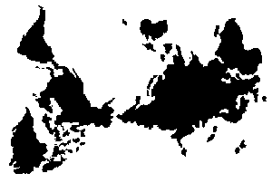

Slide 25
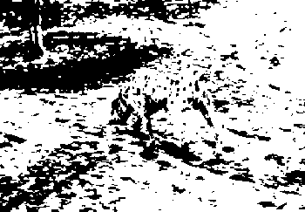

Slide 26
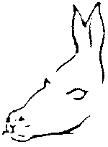

Slide 27


