Slide 1


Slide 2
Fund raising for start - ups –challenges and opportunities
Submitted by group 06:-
Meetkumar Patel - 2210109
Jayvirkumar Patel - 2210454
Rupal Patel - 2133400
Dhruv shukla - 2210110

Slide 3
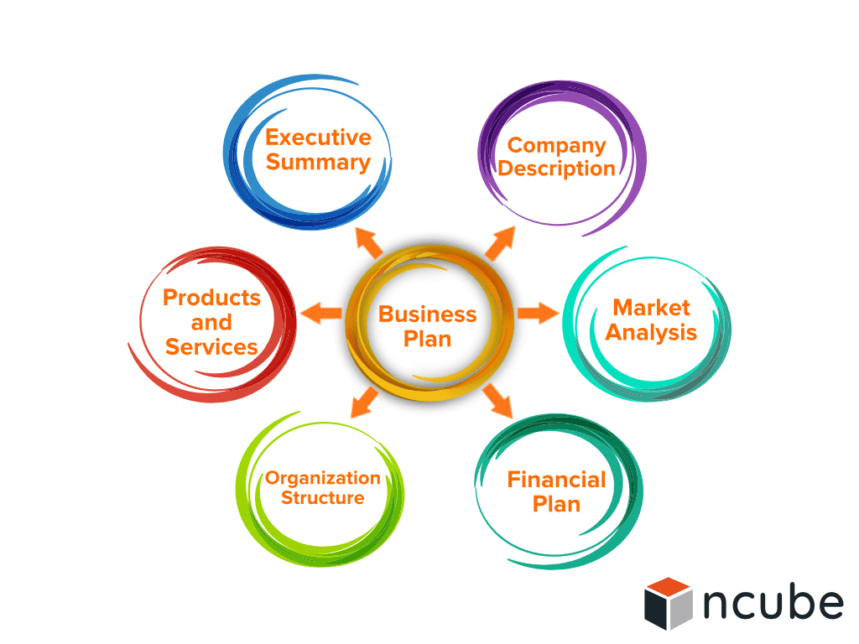
Critical analysis of the meaning of a start-up business
Meaning of start-up
● Business start-up refers to establishing a new business or engaging in a new venture
● It is an organisation or project, adopted by entrepreneurs to develop, validate and scale a business
Factors influencing start-ups
● Market opportunity and demand
● Generation of new ideas and individual mindset

Slide 4

Resource required for business start-up
● In terms of effectively starting up a business, it is essential for a business to meet different requirements, which include
○ Market knowledge
○ Startup blueprint
○ Accounting and finance
○ Human resource management
○ Investor relationship management
○ Tools and technologies

Slide 5
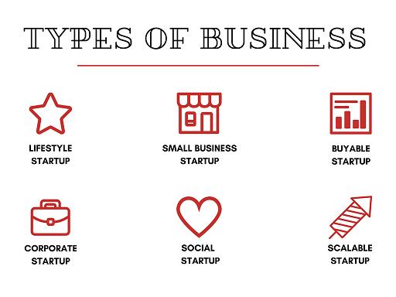
Types of start-ups
Different type of start-up business includes
  Small business start-up
  Buyable start up
  Social start-up
  Large company start-up
  Scalable start up

Slide 6
Fund Raising for Start-up: Challenges
Finding investors at an early stage
Pasumarti and Patnaik (2020) stated that it is very difficult for a company to find investors at the start of the business other than friends and family members.
Selecting the right funding option
On the other hand, Oranburg (2020) explained that currently there are many funding options available for start-ups, like equity funding, bootstrapping, crowdfunding, etc.

Slide 7
Fund Raising for Start-up: Challenges
Unsure about the funding needs
An entrepreneur may risk raising the fund if he/she is unsure about how much fund is needed to start a business.
Raising maximum funds
Although raising more funds can aid in growing the business, sometimes it can be a disadvantage as it may increase the liability of the startup business and may decrease its future valuation.

Slide 8
Fund Raising for Start-up: Challenges
Giving an impressive presentation
Anita and Veena (2022) explained that when introducing a start-up, some entrepreneurs may miss the opportunity to win the potential investors with their presentation.
Developing a scalable business model
Bednar, et al. (2018) illustrated that in the absence of a scalable business model, it may be challenging for an entrepreneur to get the attention of the investors and to secure funds, the start-up should have a scalable business model.

Slide 9
Fund Raising for Start-up: Challenges
Lack of skilled leaders
Oranburg (2020) claimed that raising funds for start-ups can be challenging if the entrepreneur lacks essential leadership and business skills. Lack of detailed business plan
According to Kalyani (2020), sometimes start-up entrepreneurs may function their business based on their personal experience and may lack a well-structured business plan highlighting operational and financial details, and marketing and management strategies.

Slide 10
Fund Raising for Start-up: Opportunities
An entrepreneur has an opportunity to either choose start-up partnerships to raise funds or look for different investors who can give funds. A start-up may have different types of partnership opportunities. These are:
Joint ventures
A start-up can form a joint venture or a collaborative partnership with another company/companies in order to raise funds and to achieve a common goal, like creating a niche market or accessing the distribution network.

Slide 11
Fund Raising for Start-up: Opportunities
Strategic partnership
This type of partnership is beneficial for start-ups when it comes to raising funds, gaining resources, making quick revenues, and boosting business growth.
Private equity partnerships
Private equity (PE) partnerships can be a good source of raising funds for start-ups.

Slide 12
Fund Raising for Start-up: Opportunities
Besides partners, there are different types of investors that start-ups can look up when it comes to raising funds. These are:
Friends and family
They are the first source of fund raising for any start-ups as they can be easily accessed from personal contacts.
Business angels or Angel investors
According to Barringer and Ireland (2016), they are people who invest their personal funds in start-ups.

Slide 13
Fund Raising for Start-up: Opportunities
Banks and Government grants
As explained by Cremades (2019), start-ups have an opportunity to raise funds through traditional sources, like banks and government agencies.
Venture Capitalists (VCs)
As stated by Barringer and Ireland (2016), VCs invest or fund in start-ups that have increasing potential for growth.

Slide 14
Fund Raising
Fund-raising is the process of seeking and gathering voluntary financial contributions by engaging individuals, businesses, charitable foundations, or governmental agencies. Although fundraising typically refers to efforts to gather money for organization , it is sometimes used to refer to the identification and solicitation of investors.

Slide 15
Atoa
One of the most promising UK startups, Atoa was established in 2022 and serves the Fintech industry.
The startup wants to address a significant issue for merchants, namely the high costs associated with accepting payments through card readers.
Atoa combats this issue by assessing a fixed cost that is 70% less expensive than those card readers.
Additionally, rather than having to wait days for their money to arrive, merchants may access it right away.
Customers like the extra flexibility of Atoa's solution because there are no setup costs for hardware and a pay-as-you-go strategy in place of binding contracts. Additional security measures further reduce the possibility of chargeback fraud, which can be a major issue for businesses that use card readers.

Slide 16
References
avazov,N.and Mahmudov,N.,2020.Invesment as a source of finding. Архив научных исследований(24).
Mc mahan,K.stouts, S., Turner, S . And Valero, j.,2022.sratagic fund rising for a nonprofit startup.
Anitha, M. and Veena, M. (2022) ‘Challenges Faced by Startup Entrepreneurs- A Review Study’, EPRA International Journal of Multidisciplinary Research (IJMR), 8(4), pp.188-190.
Bednar, R., Tariskova, N. and Zagorsek, B. (2018) ‘Startup revenue model failures’, Montenegrin Journal of Economics, 14(4), pp.141-157.
Kalyani, P. (2020) ‘Startups Fund Raising–Options and Challenges’, BSSS Journal of Commerce, 12 (1), pp. 102-117.
Presenting to win: the art of telling your story. 2nd edition. New Delhi: Pearson Education, Inc.

Slide 17
Business Canvas Model on NothingTech
NothingTech is UK based Consumer Electronics Startup
Founded in 2020
Founded By Carl pei one of co-founder of OnePlus
Nothing has raised a total of $150.2M in funding over 6 rounds. Their latest funding was raised on Apr 5, 2022 from a Equity Crowdfunding round.

Slide 18
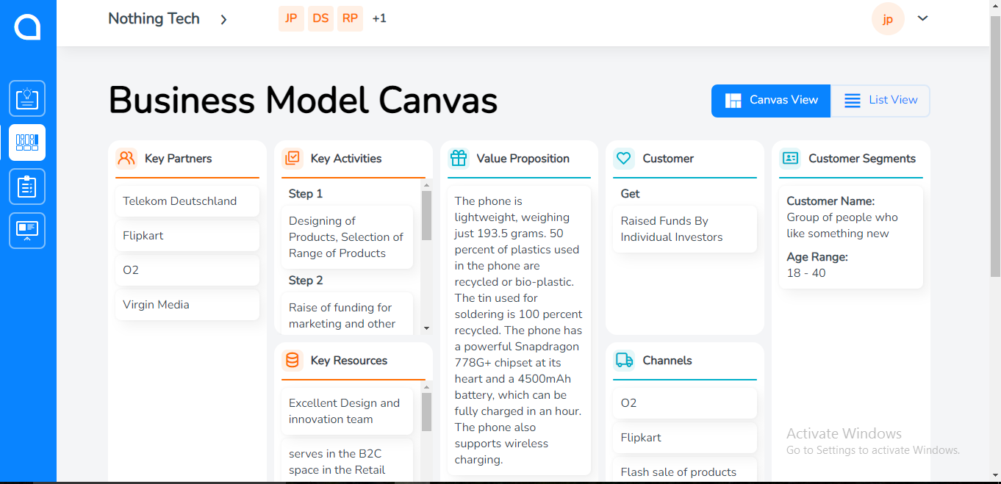

Slide 19
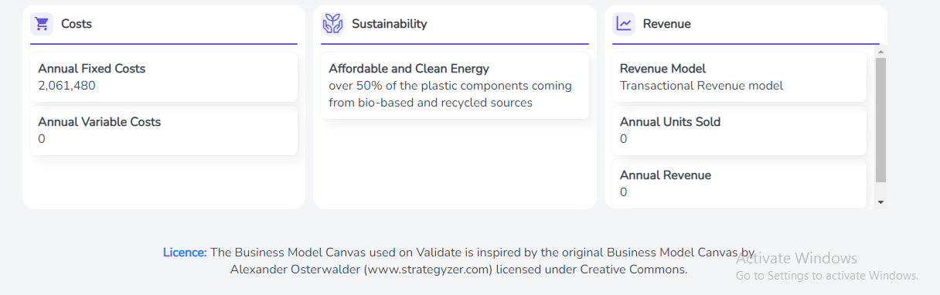

Slide 20


