Slide 1

Major Project Research Proposal
Glenys Benford-Lewis 1704552

Slide 2
Hidden Pain - Hidden Shame
Research Question: An analysis of how the stigma around
suicide impacts on families and the wider community.

Slide 3
Aims & Objectives
Aim
To understand how the stigma around suicide impacts on families and the wider community
Objectives
To review the literature surrounding suicide with the focus on the stigma attached
To raise awareness of how society’s views can have a detrimental effect on how the individual, families and communities go through the grieving process
To inform and develop better practice within counselling and psychotherapy

Slide 4
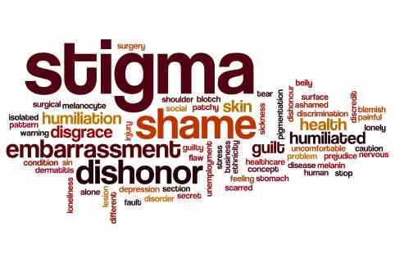
Key Words
Stigma
Suicide
Community
Family
Bereavement Process
Shame
Complex Grief
www.shutterstock.com

Slide 5
Why Suicide and Stigma?
  Supported three, sometimes four, generations of people impacted by suicide
  Seen the impact of an individual suicide on the wider community
  Interest in the way in which stigma can be reduced
  Desire to inform and develop better practice within counselling

Slide 6
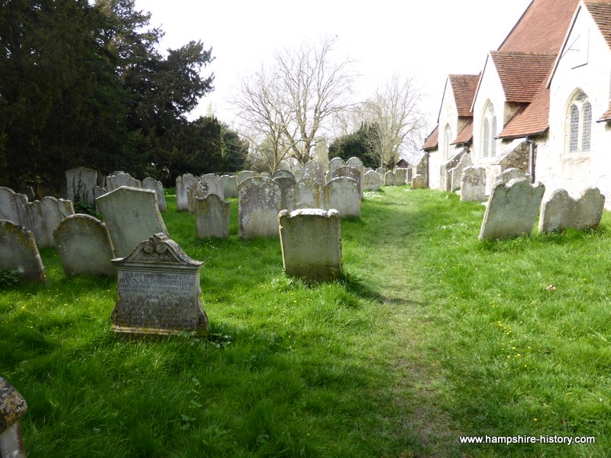
Background
Historical review of stigma around suicide – then and now
Social and cultural factors – while suicide is no longer a criminal offence, ongoing stigma means suicide verdicts are sometimes less likely to be given – particularly if there are cultural or religious taboos around suicide (Samaritans, 2018)
www.google.com

Slide 7
Audience Participation:
How many suicides were there in the UK in 2018?
(a) 4,256
(b) 6,507
(c) 8,625
What percentage of suicides in the UK are males?
(a) 45%
(b) 65%
(c) 75%
What percentage of suicides in Wales are females?
(a) 28%
(b) 38%
(c) 58%
6,507
75%
28%
(Samaritans, 2018)

Slide 8
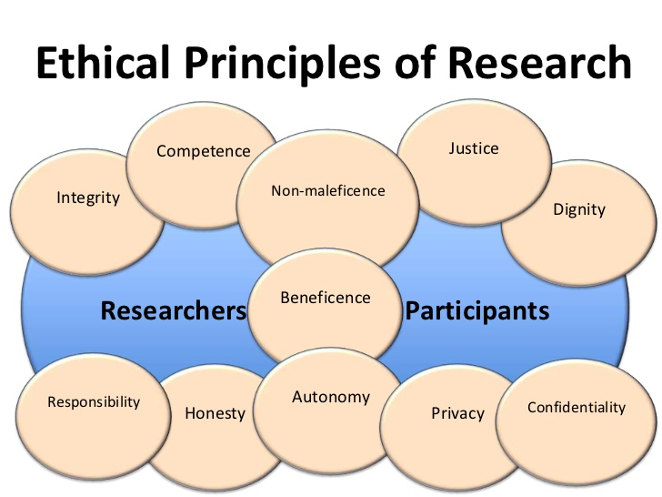
Methodology
Social Constructivism approach
Critical review of relevant literature
Establish and identify current practice,
evaluate whether it has been effective
Make recommendations for the future
Avoiding bias
Ethical research practice
www.expressdissertation.com

Slide 9
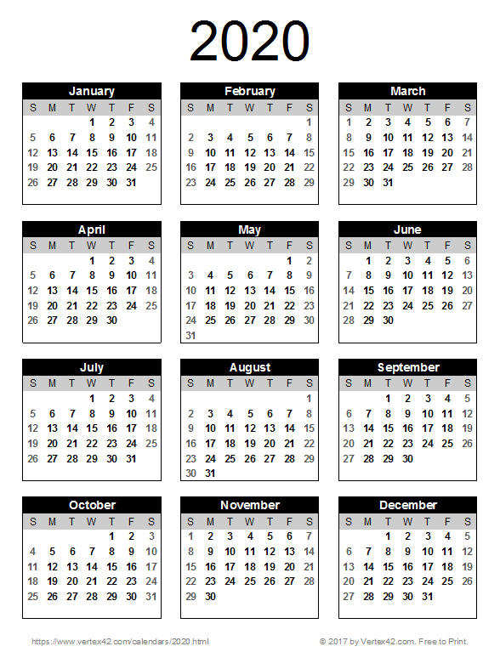
Timetable for research
Oct – deciding what to do
Nov- deciding on methodology of research
Dec – presenting project proposal
Jan – attending drop-in sessions and workshops
Feb – meeting with supervisor for individual tutorials
March – planning write up
April – final write up
May- review, check, clarify, hand in completed work
www.pngall.com

Slide 10

Method
Desktop research
Library search
Databases - Psych Articles, Mediline, Prime Academic, Ebsco Host
Credible newspaper articles
Peer reviewed journals
Date limited (1999-2019)
www.pinclipart.com

Slide 11
Authors Under Consideration
Robert Neimeyer – Professor of Psychology
Researcher: Reconstruction of Meaning; Bereavement
Chris Shields – Clinical Psychologist
Researcher: Mental Health; Suicide Ideation
Ann John – Professor in Public Health and Psychiatry
      Researcher: Translation of Research into Evidence Based Policy
      and Practice; Suicide and Self Harm

Slide 12
Potential Arguments
Three main themes:
  Loss and loss of a lived life
  Impact of stigma
  Need for support/ direction during the grief journey
Difficulty of separating internalised stigma from public stigma – Fielden (2003); Begley and Quayle (2007); Baddeley and Singer (2009); Maple et al (2010); Smith et al (2011); Shields et al (2017)
Disagreement between researchers and research outcomes about whether bereavement through suicide is different or not to other forms of bereavement – Clark (2001); Cvinar (2005); Sveen and Walby (2008); Shields et al (2017)

Slide 13
Ethical Considerations
Lone working
Triggered by research findings
Personal therapy
Supervision
Ergonomics
Self-care

Slide 14
Challenges, Strengths & Limitations
Challenges:
  No participant interaction – no phenomenological contact
  Staying narrow and deep
Strengths:
  Deepening knowledge and understanding to inform practice
Limitations:
  Current research papers - Journals within 10 year time span
  Lack of good quality peer reviewed journals
  Word count and time limitation

Slide 15
Identifying gaps in current research.
Research tends to be time limited - Linde et al (2017), Shields et al (2017).
Research participants tend to be from limited population: mainly white, female, middle aged and self selecting - Linde et al (2017), Shields et al (2017).
All research focuses on individual or small social groups experience of stigma: rather than research on wider social attitudes towards suicide survivors - Linde et al (2017), Shields et al (2017).

Slide 16

Implications for Practice
Better informed counsellors and psychotherapists
Importance of counsellors and psychotherapist being well supported
Education for other agencies – GPs
Increased awareness of implications of suicide
www.psychologytoday.com/

Slide 17
Personal Reflection
I have enjoyed the research I have done so far on this topic as it has fuelled my passion to want to make a difference to people bereaved by suicide.
My experience supporting those left behind after a suicide has shown me that one of the biggest blockers to effectively processing grief is stigma.

Slide 18

Hope is being able to
see that there is light
despite all of the darkness.
Desmond Tutu.
www.hopeafterloss.org

Slide 19
ANY QUESTIONS?
?
?
?
?

Slide 20
References
Baddeley, J. & Singer, J. (2009) A Social International Model of Bereavement Narrative Disclosure. Review of General Psychology, 13(3), pp. 202-218.
Begley, M. & Quayle, E. (2007) The Lived Experience of Adults Bereaved by Suicide: A Phenomenological Study. Crisis: The Journal of Crisis Intervention and Suicide Prevention, 28(1), pp. 26-34.
Clark, S. (2001) Bereavement after suicide - how far have we come and where do we go from here?. Crisis: The Journal of Crisis Intervention and Suicide Prevention, 22(3), pp. 102-108.
Cvinar, J. (2005) Do Suicide Survivors Suffer Social Stigma: A Review of the Literature. Perspectives in Psychiatric Care, 41(1), p. 14.
Fielden, J. (2003) Grief as a transformative experience: weaving through different lifeworlds after a loved one has completed suicide. International Journal of Mental Health Nursing, 12(1), pp. 74-85.
John, A. et al. (2017) Newspaper Reporting on a Cluster of Suicides in the UK: A Study of Article Characteristics Using PRINTQUAL. Crisis, 38(1), pp. 17-25.
Linde, K. et al. (2017) Grief Interventions for People Bereaved by Suicide: A Systematic Review. PLOS One, 12(6), pp. 1-20.

Slide 21
References
Maple, M., Plummer, D., Edwards, H. & Minichiello, V. (2010) Silenced voices: hearing the stories of parents bereaved through suicide death of a young adult child. Health and Social Care in the Community, 18(3), pp. 241-248.
Neimeyer, R. & Cerei, J. (2015) Surviving Suicide Loss: Recommendations for Research. Acta Universitaria, 25(2), pp. 5-9.
Samaritans, 2019. Suicide Statistics Report. [Online]
Available at: https://www.samaritans.org/wales/about-samaritans/research-policy/suicide-facts-and-figures/
[Accessed 1 12 2019].
Shields, C., Kavanagh, M. & Russo, K. (2017) A Qualitative Systematic Review of the Bereavement Process Following Suicide. Journal of Death and Dying, 74(4), pp. 426-454.
Smith, A., Joseph, S. & Das Nair, R. (2011) An interpretative phenomenological analysis of posttraumatic growth in adults bereaved by suicide. Journal of Loss and Trauma, 16(5), pp. 413-430.
Sveen, C. & Walby, F. (2008) Suicide survivors' mental health and grief reactions: A systemic review of controlled studies. Suicide and Life-Threatening Behavior, 38(1), pp. 13-29.

