Slide 1
Module Title: Professional Career Development within H&SC
Module Number: LCHS 4009 (LON)
Assignment No: ASSIGNMENT 1
Student Name: Adriana Alina Bujorean
Student ID: 2430470
Lecturer’s Name: Amitave Banik

Slide 2
Acknowledge use of AI
On this page state whether you have or have not used AI. Include the AI source if you have!

Slide 3
Overview
Introduction 4
SWOT Analysis and its importance in personal and professional development 5
Description of Personal Strengths, Weaknesses, Opportunities, and Threats 6
Processes to leverage personal strengths to overcome weaknesses and minimise threats, with examples 7
Available opportunities and processes to utilise them, aligning with personal strengths 8
Conclusion 9
References List 10

Slide 4

Introduction
This study will elaborate on the concept and importance of SWOT analysis in recognising, strengths, threats, opportunities and weaknesses.
I want to become an efficient health care manager.
Notes:
This assessment will focus on the personal analysis to identify strengths, threats, opportunities and weaknesses. The concept and importance of SWOT analysis have been demonstrated. Efficient strategies to utilise personal strengths and mitigate weak areas will be illustrated. In addition, processes to utilise opportunities through personal strengths will be provided. These will help me to enhance my knowledge, recognising strengths and utilising and gaining opportunities.

Slide 5
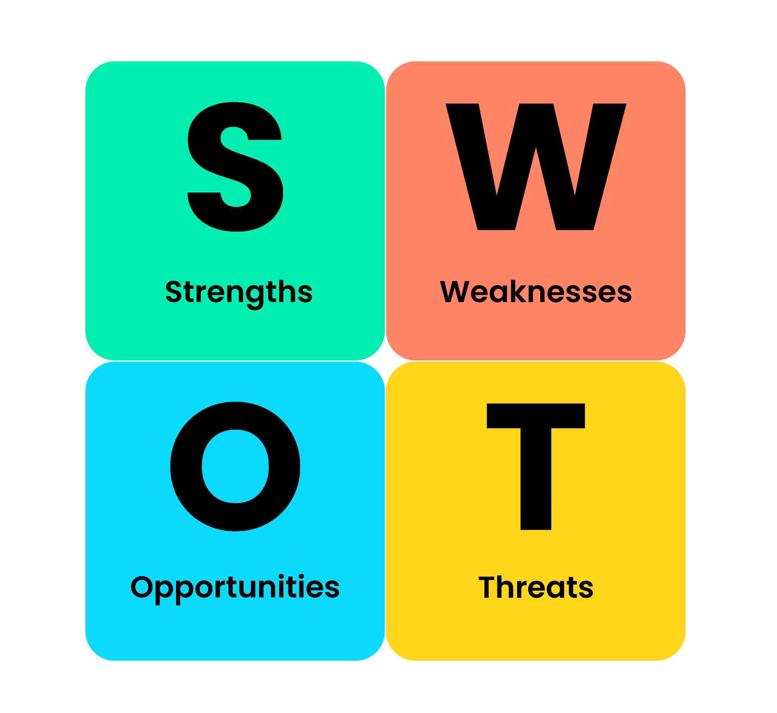
SWOT Analysis and its importance in personal and professional development
SWOT analysis helps in building a plan for personal development based on the recognised strengths and threats.
This framework includes four internal key factors to guide towards the right direction to gain opportunities (Gurl, 2017).
Notes:
SWOT analysis plays a pivotal role in detecting strengths and weaknesses. Also, this helps in structuring plans to drive and utilise opportunities through strengths. Also, these fostered plans help in interpreting all the potential threats and identifying the weak areas to be reduced and mitigated (Sammut-Bonnici and Galea, 2015). This model can help me to drive several opportunities and grow my career by reducing and mitigating my weak areas. I can also prepare suitable plans to combat predicted threats.

Slide 6
Description of Personal Strengths, Weaknesses, Opportunities, and Threats
STRENGTHS
Developed time management skills
Improved communication skills
WEAKNESSES
A lack of critical thinking
A lack of decision-making skills
OPPORTUNITIES
Understanding patient demands
Organised work and avoiding delays
THREATS
Delayed decision-making
A lack of technological knowledge
Notes:
I have developed and acquired various crucial skills to improve my performance and increase my employability to get a wide range of opportunities. I have improved time management and communication skills. Improved time management skills help in prioritising important tasks to accomplish operations and meet deadlines. Also, I am efficient in multitasking (Crenshaw, 2021). Effective interactions help in understanding patient requirements to meet their expectations and lead to satisfaction (Handayani and Widagdo, 2024). I lack critical thinking and decision-making skills. I am inefficient in making decisions quickly. Also, I lack technological knowledge, which is a threat to my career development, as modern technologies have become an integral part of the health and social care department.

Slide 7

Processes to leverage personal strengths to overcome weaknesses and minimise threats, with examples
I need to consider and analyse all the important aspects to interpret all the possible consequences to improve critical thinking skills.
Time management skills can help in completing tasks within deadlines and making suitable decisions.
Notes:
I need to broaden my perspectives through open communication. I have gathered knowledge on modern technologies through open discussion. Also, time management can help in making decisions by covering all the tasks and observing their outcomes.

Slide 8

Available opportunities and processes to utilise them, aligning with personal strengths
I can gain various opportunities as I am efficient in understanding patient demands.
I am efficient in conducting multiple tasks and meeting deadlines.
Notes:
I can meet patient expectations by aligning their choices and changing demands with the help of open communication. Also, I can handle the pressure of executing multiple tasks within deadlines in an organised way with the help of improved time management skills.

Slide 9
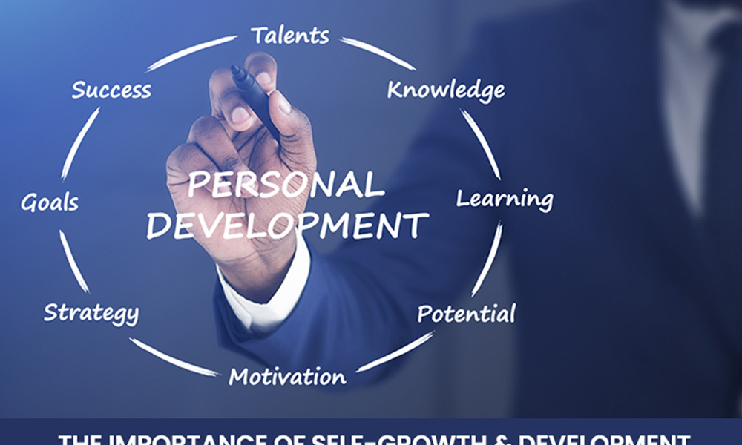
Conclusion
This assessment has discussed the personal strengths and challenges through SWOT analysis.
The strategies to utilise personal strengths to resolve threats have been analysed.
Notes:
This study has depicted the idea and significance of SWOT analysis. Personal strengths, opportunities, threats and weaknesses have been illustrated. The strategies of utilising strengths to drive opportunities have been provided.

Slide 10
References List
Crenshaw, D., (2021). The Myth of Multitasking: How “Doing It All” Gets Nothing Done (Project Management and Time Management Skills). Mango Media Inc..
Gurl, E., (2017). SWOT analysis: A theoretical review. https://demo.dspacedirect.org/server/api/core/bitstreams/c5fcc52d-13fe-4a94-ae78-24f2a820a312/content
Handayani, Y.I. and Widagdo, S., (2024). Young Generation Ready to Work: Communication Skills Enhancement Training Model to Attract Customers. TGO Journal of Community Development, 2(1), pp.69-75. https://www.researchgate.net/publication/391286062_Young_Generation_Ready_to_Work_Communication_Skills_Enhancement_Training_Model_to_Attract_Customers
Sammut-Bonnici, T. and Galea, D., (2015). SWOT analysis. Wiley Encyclopedia of management, 12(1), pp.1-8. https://kobbytamakloe.wordpress.com/wp-content/uploads/2020/07/swot-analysis-kjm.pdf

