Slide 1
Declining Profitability at T M Lewin
Module: Problem Solving and Decision Making
Module Code: BMSW4004
Lecturer Name: Chijioke Uba
Student Name: Irina Roxana Ioana
Student ID number: 2130080

Slide 2


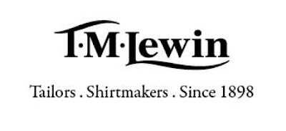
Introduction
.
The presentation contains the following :
• A research-informed discussion on the nature and impact of the complex problem on employees and their organisations.
• A PESTLE analysis of the macro-environmental factors contributing to the complex problem.
• A research-informed cause-and-effect analysis, using Fishbone Diagram, of the complex problem.
• An evaluation of alternative solutions to the problem with an aim of choosing the most appropriate solution among these alternatives.
This Photo by Unknown Author is licensed under CC BY-NC-ND
This Photo by Unknown Author is licensed under CC BY-NC-ND
This Photo by Unknown Author is licensed under CC BY-NC-ND

Slide 3

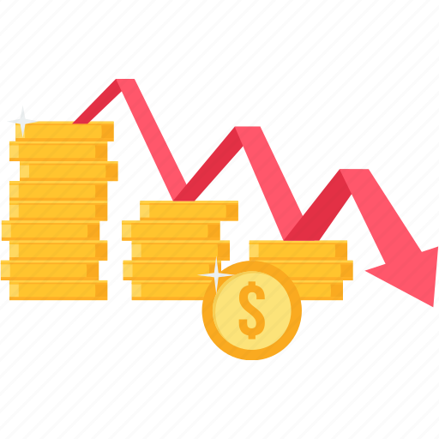
Understanding the nature and impact of Profit Decline at T M Lewin
A problem is :
A perceived gap between the existing state and a desired state, or a deviation from a norm, standard, or status quo. (Business dictionary, 2020).
A matter or situation regarded as unwelcome or harmful and needing to be dealt with and overcome. (Oxford dictionaries, 2020).
Every business suffers losses on their assets from time to time . (Dan Schendel, G. R. Patton, James Riggs, 1976). Environmental changes can be accompanied by significant declines. Lockdown and restricted access to retail outlets have significantly reduced consumption ,creating problems related to excess of inventory,reduced sales and disposal of unused goods.
T M Lewin is facing the problem of declining profitability caused by the fall of formal shirt purchases as the pandemic made consumers work from home and there are restrictions on large events and the impact on this brand has been severe.
jpg (5696×3520) (pxhere.com)
https://cdn1.iconfinder.com/data/icons/office-business-special-set-2/145/54-512.png

Slide 4
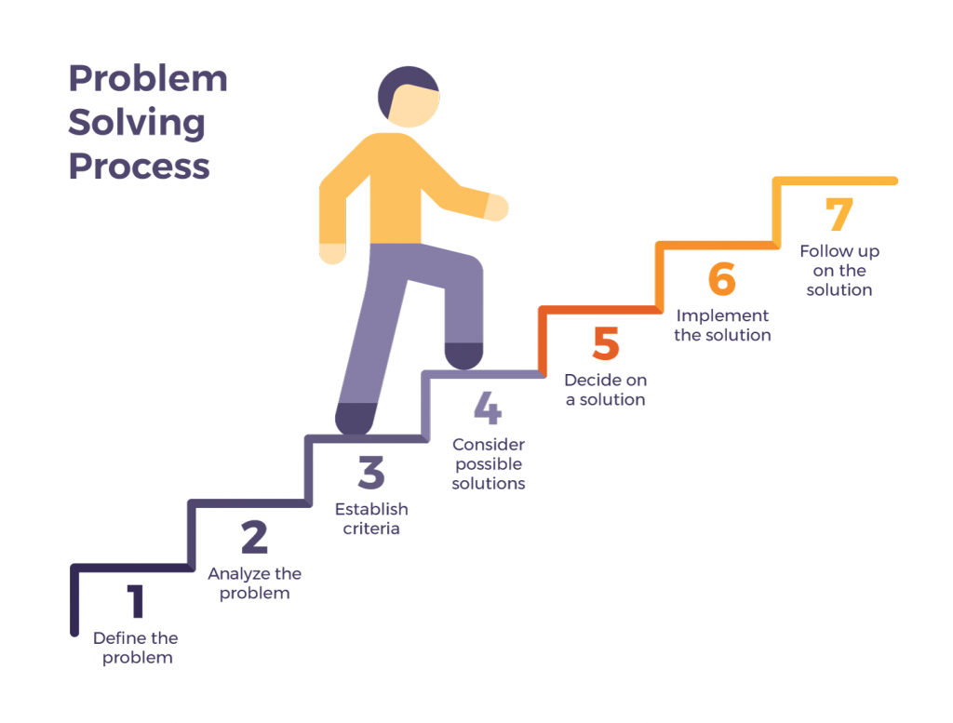

The impact of Profit Decline at T M Lewin and on employees
The impact on employees has been a very serious one making some of them them losing their jobs ,some working from home , struggling with the cost-of-living.
Nick Fisher, the vice president of Insolvency said economic conditions are tougher in many industries. Consumers are now increasingly wary of rising economic ,personal finance and cost of living, spending money in a variety of ways. (The Guardian, 2021).
To solve any problem , the causes must be identified. In this case, PESTEL and Fishbone have been used to identify the causes and then to choose the appropriate solution to solve the complex problem.
This Photo by Unknown Author is licensed under CC BY-SA
This Photo by Unknown Author is licensed under CC BY-NC-ND

Slide 5
PESTEL Analysis
I am going to use PESTEL Analysis.
PESTEL is an acronym - political (P), economic (E), socio-cultural / social (S), technological (T), environmental (E) and legal (L).
PESTEL is a useful framework that helps to identify the external factors that affect an organisation.
I’m gonna use PESTEL Analysis to identify the external environmental causes of Profit Decline in T M Lewin.
P | E | S | T | E | L
Lockdown restrictions | Rising inflation Collapse of many major retailers Cost of living squeeze | consumer purchase intention and behaviours Safety;social distancing |  |  | Restrictions on large events

Slide 6
Cause and Effect Analysis
Cause and Effect Analysis is a technique for identifying all the possible causes (inputs) associated with a particular problem / effect (output) before narrowing down to the small number of main, root causes which need to be addressed.
Cause and Effect diagram it’s known as Fishbone diagram and was developed by Prof. Kaoru Ishikawa.
Fishbone was also done to have a detailed understanding of the the causes of profit decline at T M Lewin.

Slide 7


Identifying possible solutions in T M Lewin
PESTEL and Fishbone were introduced and used to identify the causes of profit decline at T M Lewin and they highlight the main causes:
Supply chain issues
Rising inflation
Cost of living squeeze
The following solutions that target these main solutions are:
Create a new product (classic wear)
Raise price
Price control
This Photo by Unknown Author is licensed under CC BY-ND
This Photo by Unknown Author is licensed under CC BY-NC

Slide 8
Evaluating the possible solutions at T M Lewin
The alternative solutions were identified .
To choose the appropriate solution , an evaluation will be made using the decision making tool: Grid Analysis.
Grid Analysis is a useful technique using when make a decision. It is most effective where we have a number of good alternatives and many factors (criteria) to take into account.
Factors: | Cost | Consumer spending | Consumer purchase intention | Sales rate
Weights | 2 | 3 | 4 | 5
Create new products (Classic wear) | 1 2 | 1 3 | 2 8 | 1 5
Raise Prices | 3 6 | 0 0 | 0 0 | 0 0
Price control | 2 4 | 2 6 | 3 12 | 3 15
Total
18
6
37

Slide 9
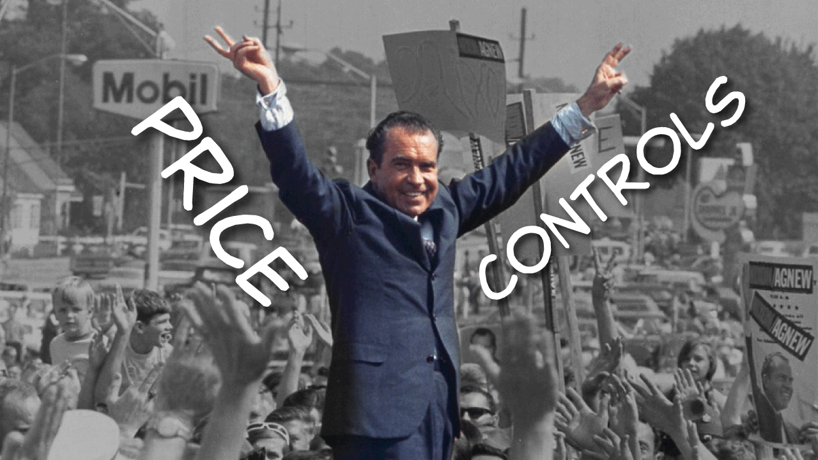
Conclusion
After evaluating the alternative solutions using the decision making tool , Grid Analysis, the appropriate solution for profit decline at T M Lewin is the price control to prevent also sales reduction that may lead to closing the company.
This Photo by Unknown Author is licensed under CC BY-ND

Slide 10
Reference List
Schendel, D., Patton, G. R., & Riggs, J. (1976). Corporate Turnaround Strategies: A Study of Profit Decline and Recovery. Journal of General Management, 3(3), 3–11. https://doi.org/10.1177/030630707600300301
Dictionaries, O., 2020. Collaboration.
Dictionary, C., 2020. Influencer. Business Dictionary,[Online]. Available: http://www. businessdictionary. com/definition/influencers. html.
Fisher,N. (2021) . More than 1.400 firms went bust last month in England and Wales, figures show. The Guardian, paragraph11-12. https://www.theguardian.com/business/2021/oct/15/more-than-1400-firms-went-bust-last-month-in-england-and-wales-figures-show
Leal Filho, W., Dinis, M.A.P., do Paço, A., Herédia-Colaço, V., Veiga Avila, L., Dennis, K., Tyler, D., Neiva, S. and Liakh, O., 2022. COVID-19 and sustainability in textile, apparel and fashion use: an assessment of trends. Textile Research Journal, p.00405175221114167.

