Slide 1
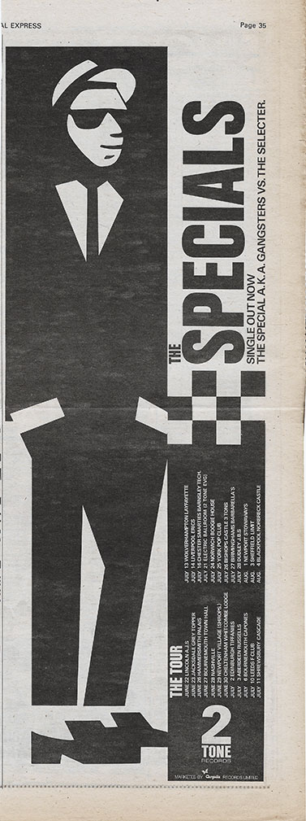
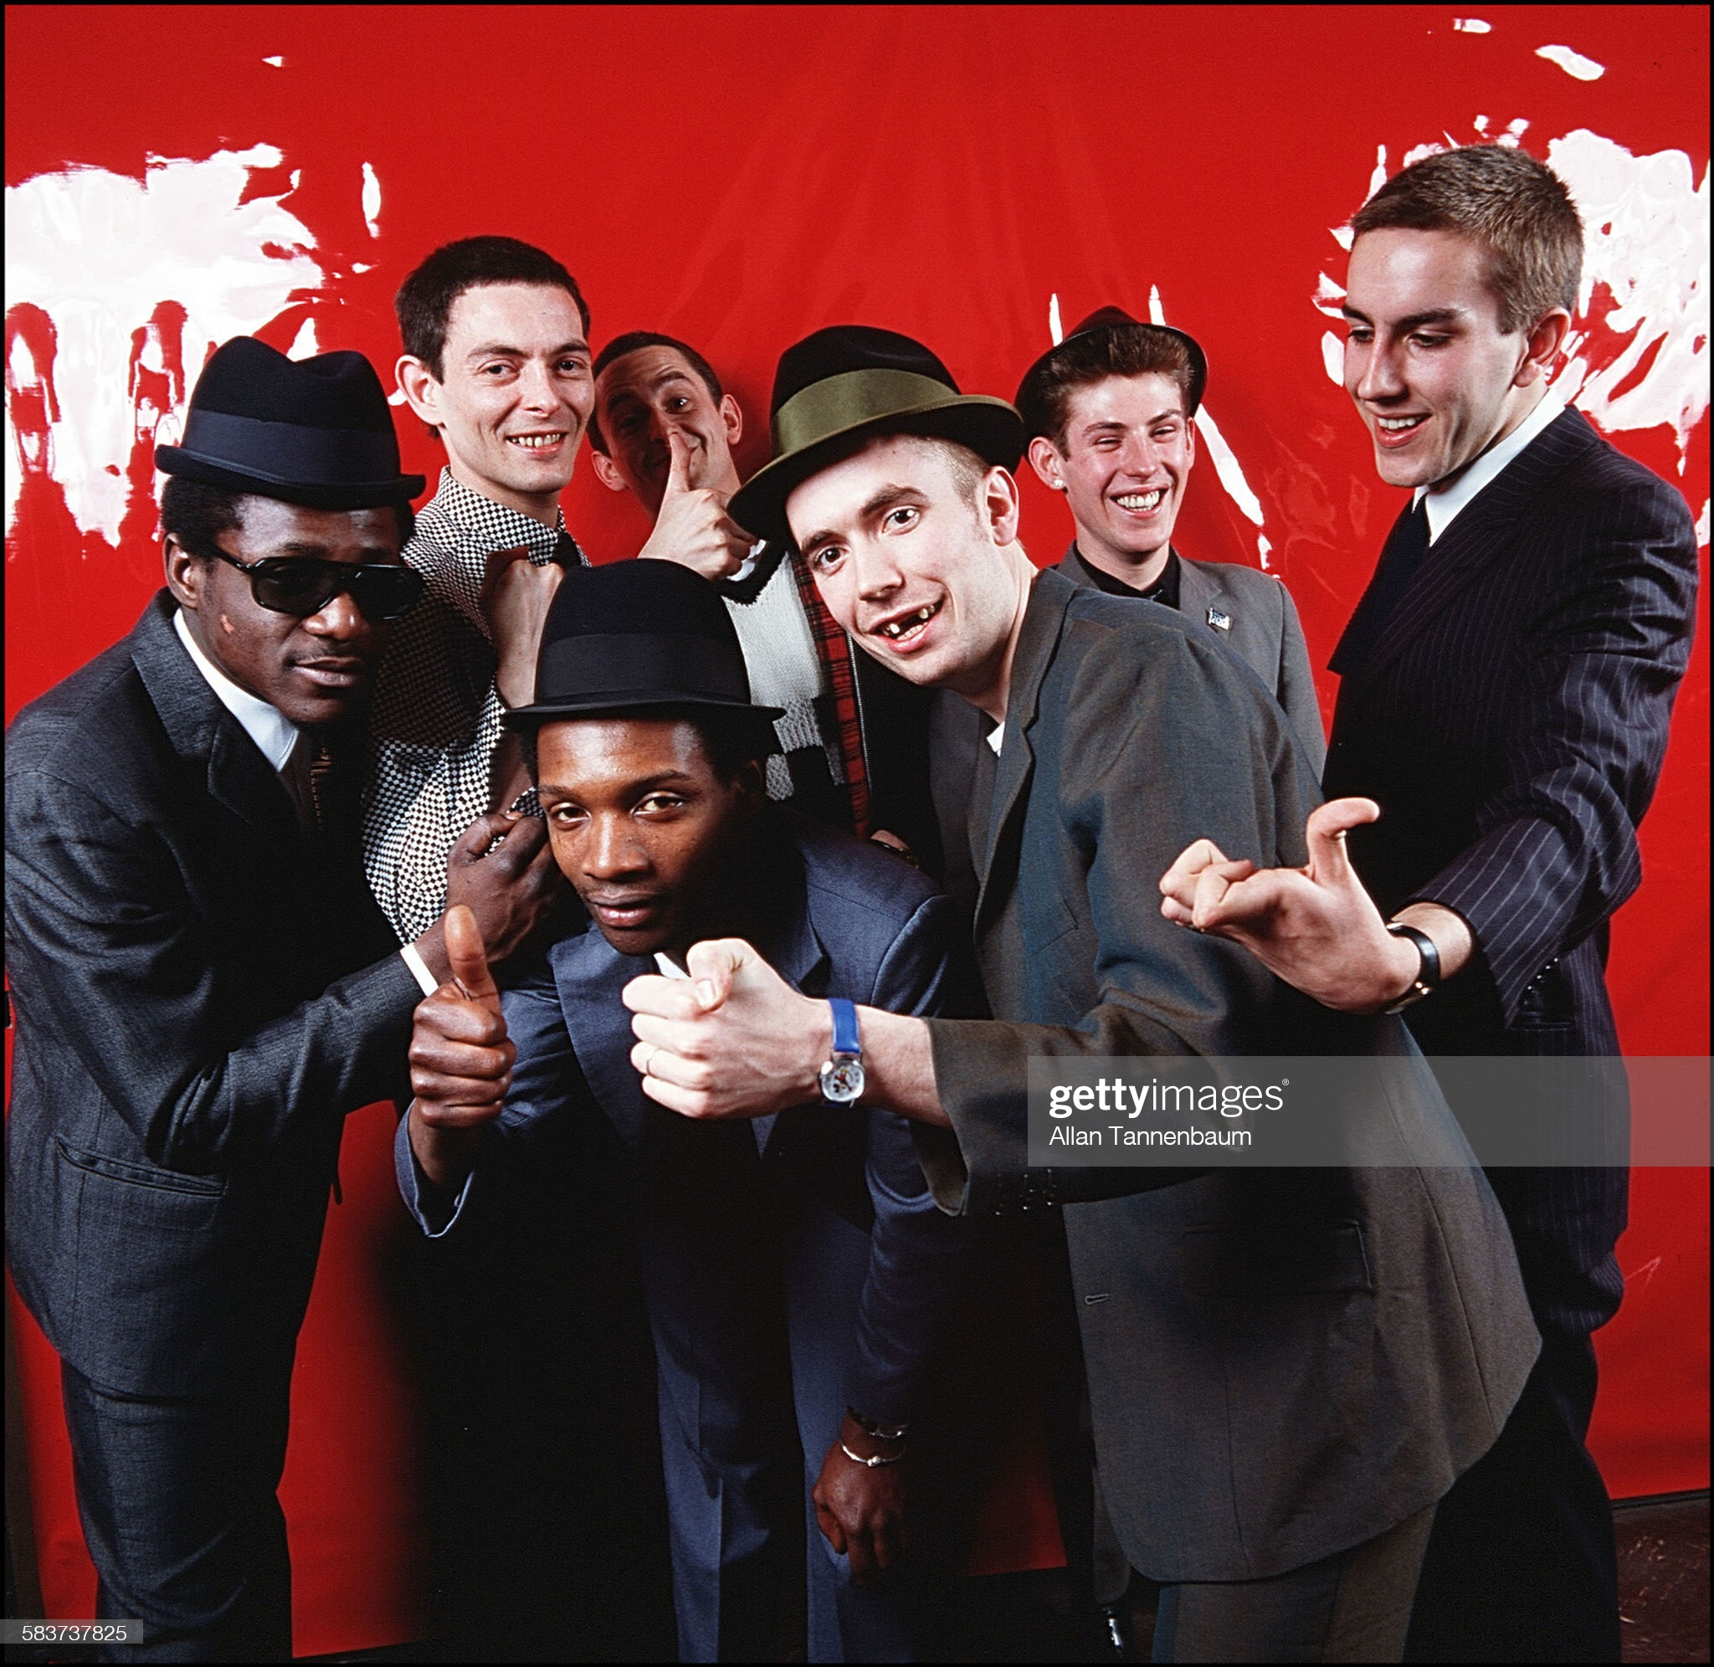
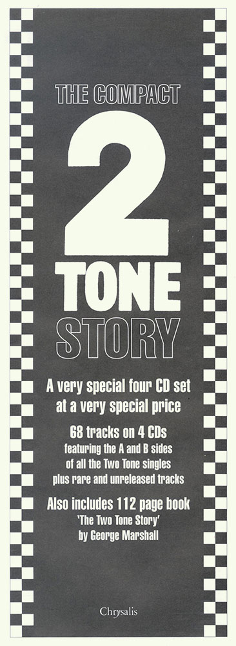
2
TONE

Slide 2
Why I have chosen this genre? What is the cultural significance of two tone?
The first mixed raced bands in the UK
The combination of old jamaican ska and British punk music
A cultural revolution with a soundtrack
Influenced and inspired a new generation of Britians

Slide 3
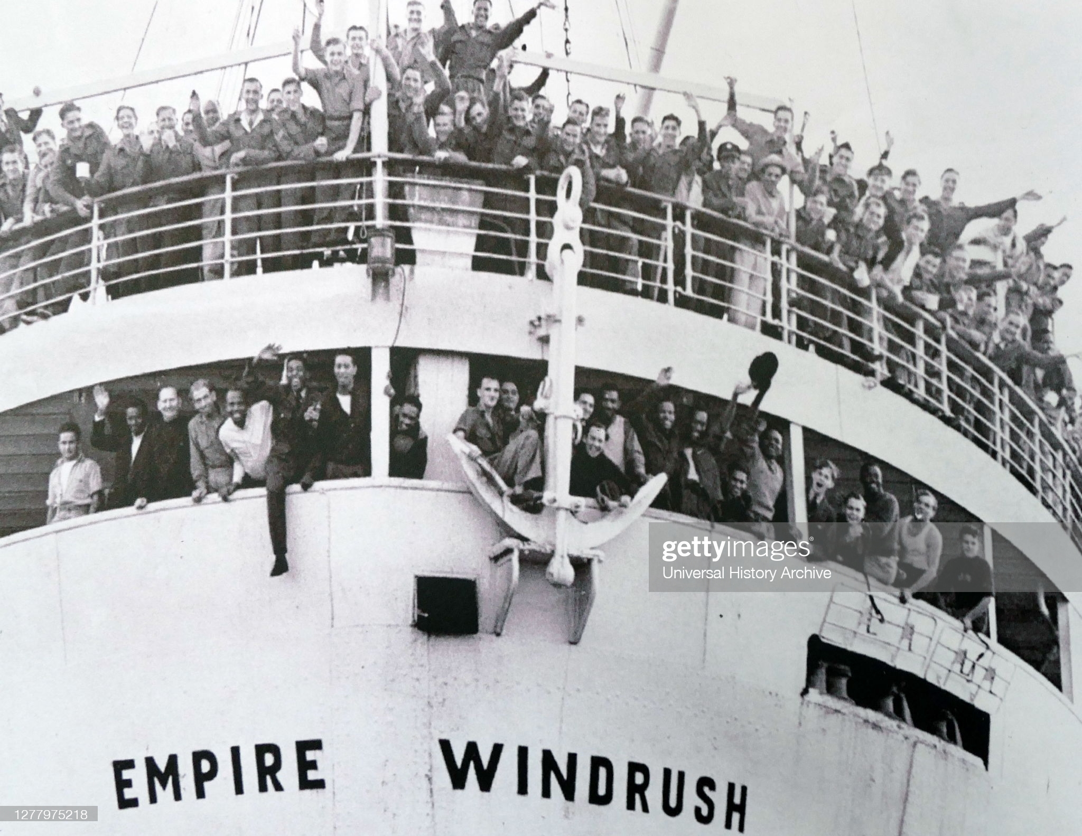
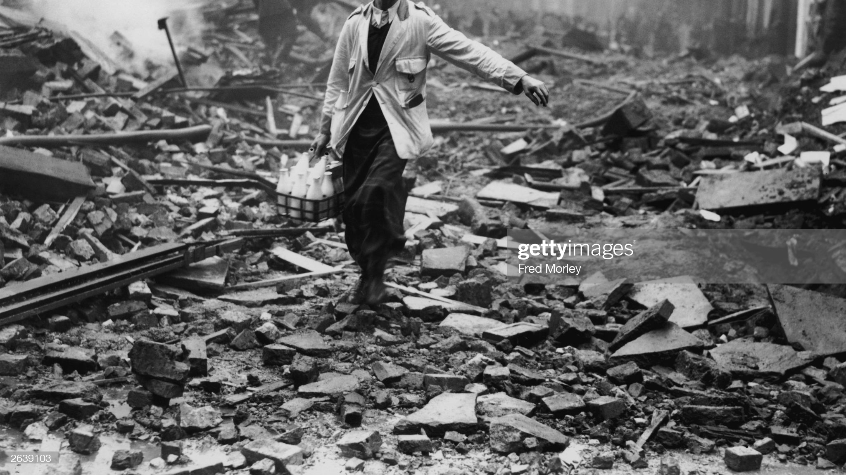
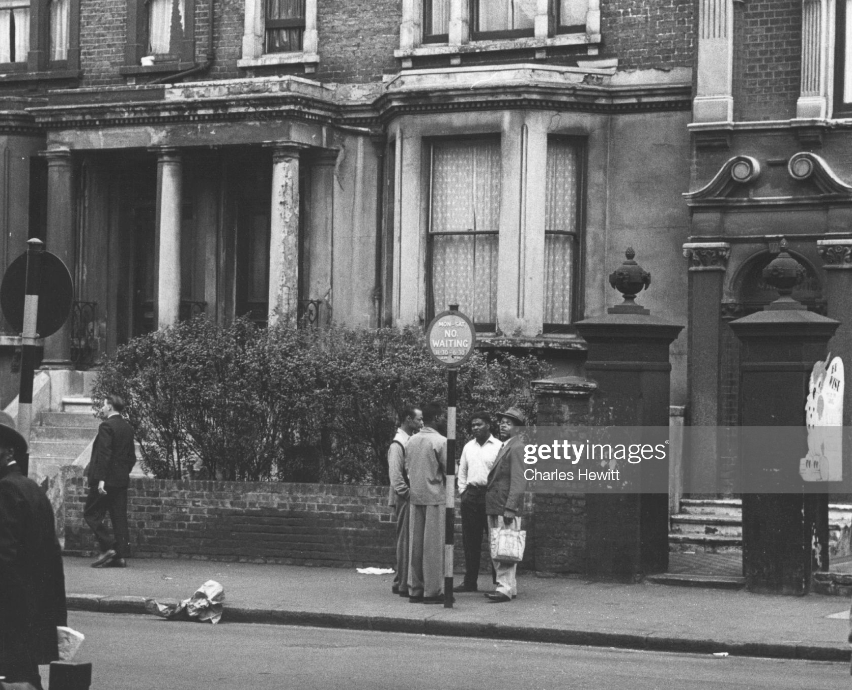
Setting the scene
Windrush passenger ship arrived in Britain in 1948 it became the flag ship for postwar immigration ₁
The British Carabian population grew to over 100,000 by 1961 ₁
Post war Britain was recovering from world war two with many buildings having been bombed and housing destroyed ₂
Many of the immigrants suffered racism and discrimination which was not illegal in Britain until 1965. and finding work or housing was tough ₃
Jamaican immigrant brought over a culture of Sound Systems with them from Jamaica in the 1950s which had originated in Kingston in the 1940s ₄

Slide 4
Trojan Records
Launched in the summer of 1958
It was the first record label to bring the sounds of Jamaica to britain
Enjoyed growth and success eventually bringing about Ska
The Afro-Carabian music scene started to interest the working class youth of britain.
One of the best known expressions of Afro-Carabian British culture is Nottinghill Carnival which started in 1959 as a direct response to the Race riots of 1958 ₅
The 1960s saw a period a rapid change in Britain
Moving away from the grey hopelessness of the 1950’s
Drugs, Music, Art and fashion were paving the way for change
https://youtu.be/NM3qb_R_7sg

Slide 5
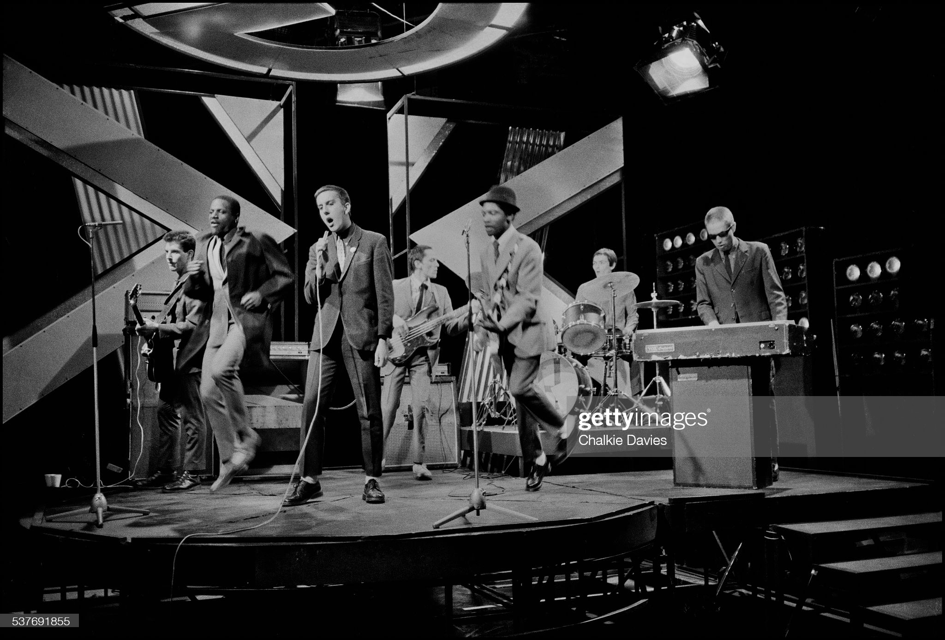
1979 – 2 TONE MUSIC TAKES OVER TOP OF THE POPS!
Top of the pops saw record viewers reaching 19 million
Single sales were at their highest at 79 million
“In November, in what is remembered as the 2 Tone edition, all three of the label's new acts - Madness, Specials and Selecter - appeared on one historic night and took the show by storm, with Madness capping off their performance of One Step Beyond by leading a 'nutty train' conga through the studio.”₆
GANGSTERS – THE SPECIAL AKA VS THE SELECTOR https://youtu.be/Q-0SOrh4d7s
THE PRINCE – MADNESS https://youtu.be/USb-56G5wwI
ON MY RADIO – THE SELECTOR https://youtu.be/PT4k1qgpWoI

Slide 6
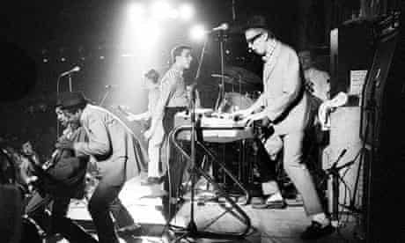
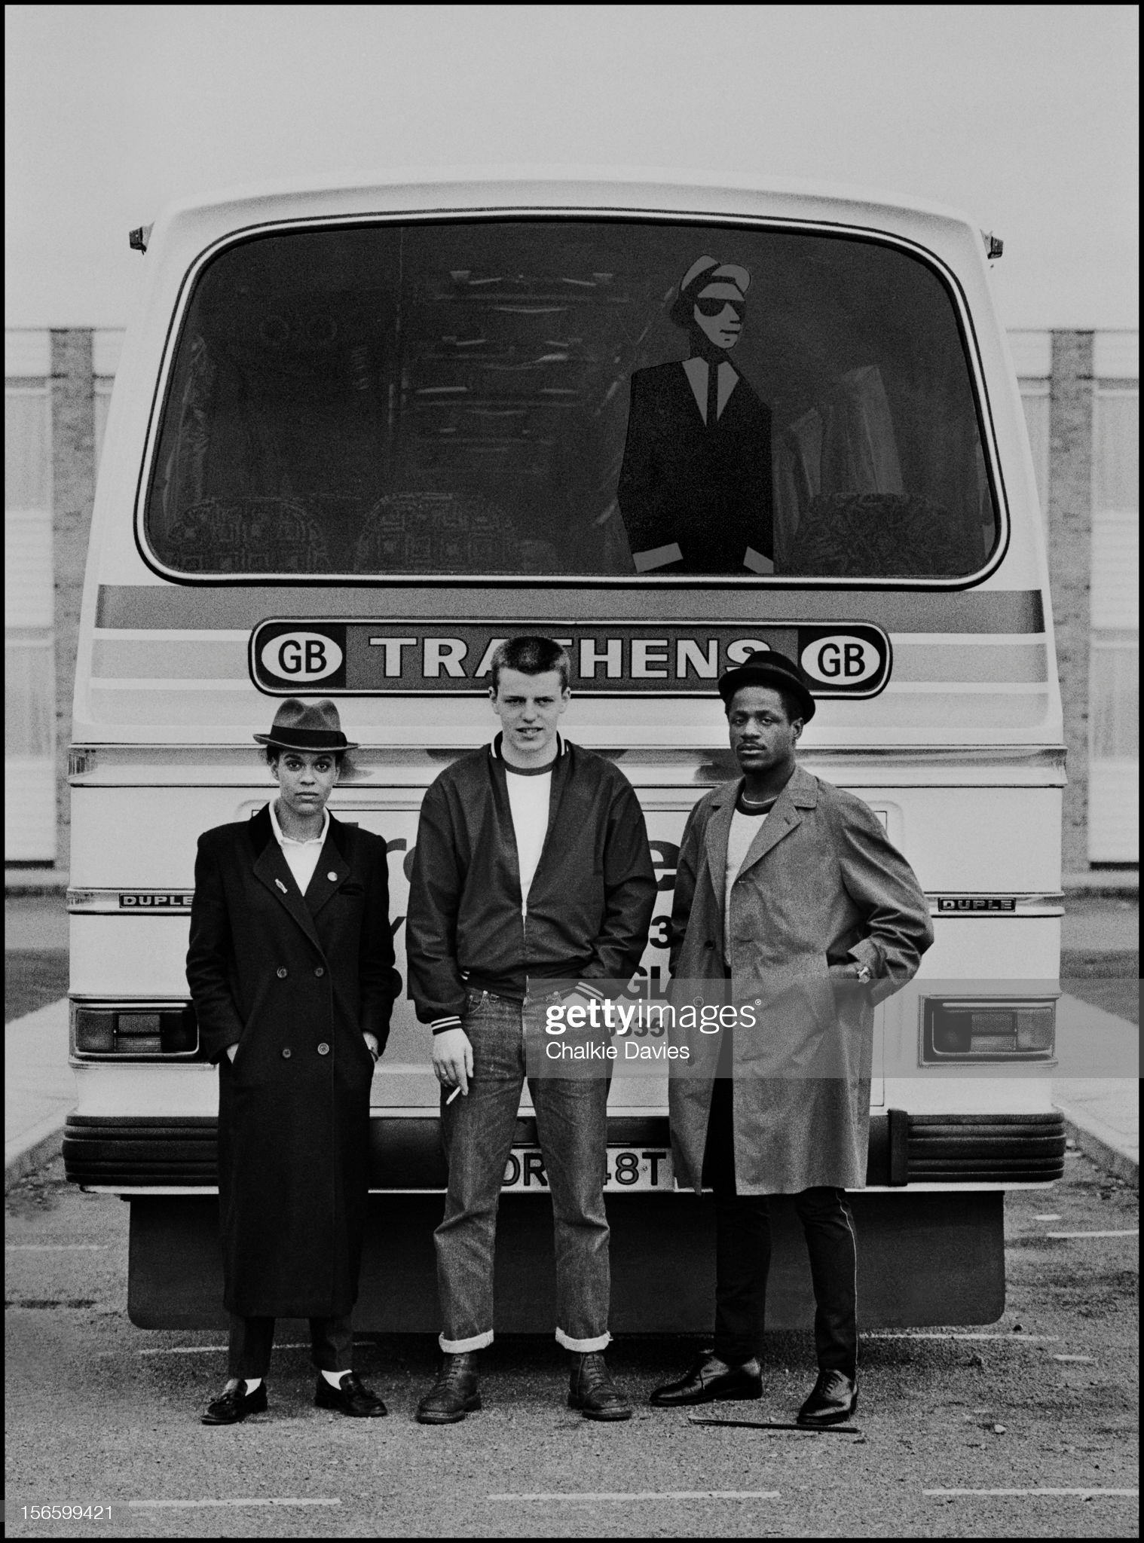
Fashion, Dance and music.
They were dressing differently
The type of dancing
The beat and tempo of Ska
Too much, too young ... 2 Tone treasures the Specials. Photograph: Ray Stevenson/Rex Features
Pauline Black of The Selecter, Suggs of Madness and Neville Staple of The Specials pose behind the tour bus at the first date of the 2 Tone Tour in Brighton, United Kingdom in October 1979. The 2 Tone Records 'Walt Jabsco' logo is visible in the bus window. (Photo by Chalkie Davies/Getty Images

Slide 7
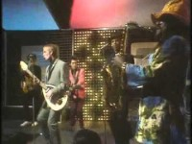
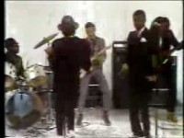
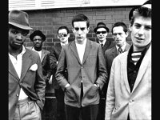
Some of my favourite songs of the 80’s include:
Tears Of A Clown – The Beat
Three Minute Hero – The Selector
Too Much Too Young – The Special AKA

Slide 8
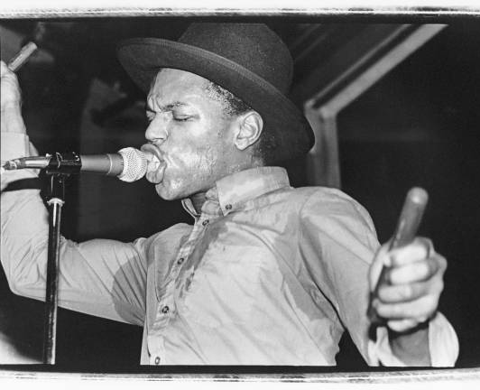
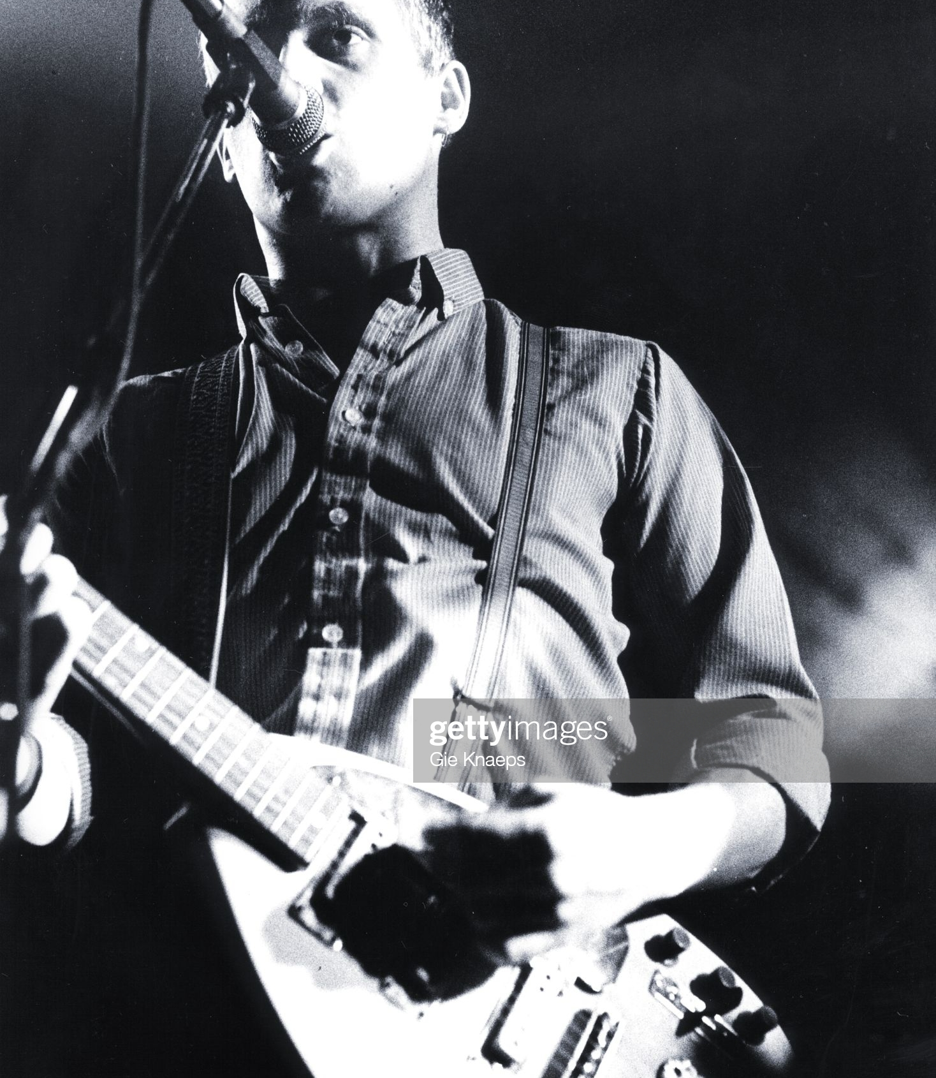
The Beat
Original Line Up
Dave Wakeling (vocals, guitar), Ranking Roger (vocals), Andy Cox (guitar), David Steele (bass), Everett Morton (drums), and Saxa a.k.a. Lionel Augustus Martin (saxophone
My Favourite songs include:
Tears Of A Clown
Hands Off She’s Mine
Mirror In The Bathroom

Slide 9
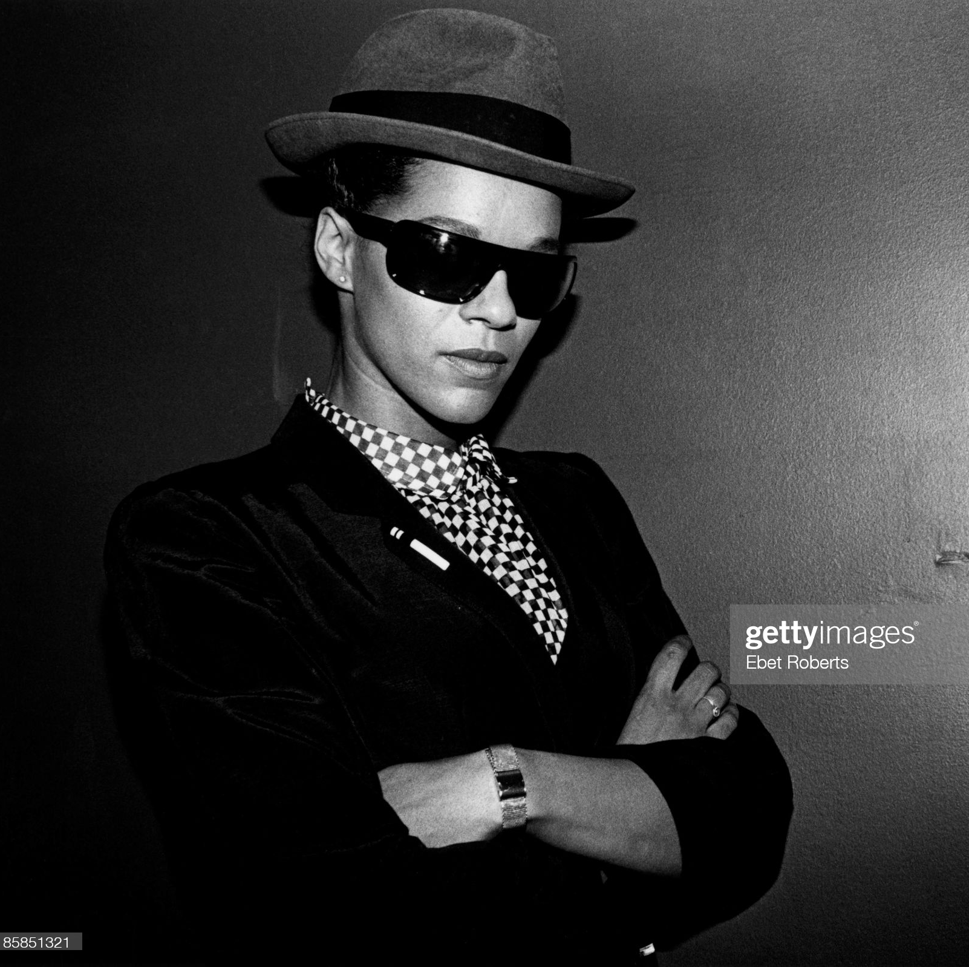
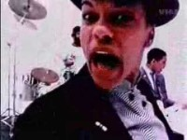
The Selector
Neol Davies – Rhythm/Lead Guitar
Pauline Black – Vocals
Arthur ‘Gaps’ Hendrickson – Vocals
Compton Amanor – Rhythm/Lead Guitar
Charley ‘H’ Bembridge – Drums
Desmond Brown* – Keyboards
Charley Anderson* – Bass
Missing Words – The selctor

Slide 10
CONCLUSION – MULTICULTURAL MUSIC - A LASTING CONVERSATION
Promoted respect and understanding
Challenged the politics and the status quo
Had a lasting impact on art and fashion
Much has changed since the 1980’s but SKA, 2 TONE and the desire for the harmonious race relations is a legacy that is still popular today.

Slide 11
REFERNCES - BIBLIOGRAPHY
1 – https://www.blackpast.org/global-african-history/notting-hill-riots-1958/
2 - https://www.bbc.co.uk/newsround/43793769
3 - https://historicengland.org.uk/research/inclusive-heritage/another-england/a-brief-history/racism-and-resistance/
4 - https://www.bl.uk/windrush/articles/sound-systems
5 - https://www.theguardian.com/uk/2002/aug/24/artsandhumanities.nottinghillcarnival2002
6 -https://www.bbc.co.uk/programmes/b03mpphw#:~:text=1979%20may%20be%20the%20most,all%20making%20the%20top%20five.&text=The%20most%20popular%20musical%20styles,2%20Tone%2C%20reggae%20and%20disco.

