Slide 1

Independent Project
An introduction to the Independent Project module

Slide 2
The aim of this lesson is to….
Introduce you to the Module
Ensure that you are clear about Module content, context and assignments
Consider the Ethics of your research
Enable you to begin work immediately on your research

Slide 3
ASSIGNMENT BRIEF
Write a critical literature review pertaining to your chosen field
N.B. To satisfy the learning outcomes for this module you will need to attend your supervisory meetings with your supervisor.
5,000 – 6,000 words

Slide 4
WORKSHOPS
Writing WORKSHOPS, not lectures
You will therefore need to prepare for these
Core and supplementary

Slide 5
SUPERVISION SESSIONS
3 or 4 sessions over the life of this module
Use effectively
Slots will be made available on Moodle or in conjunction with your allocated supervisor

Slide 6
The importance of ethics
Applying for ethical approval

Slide 7
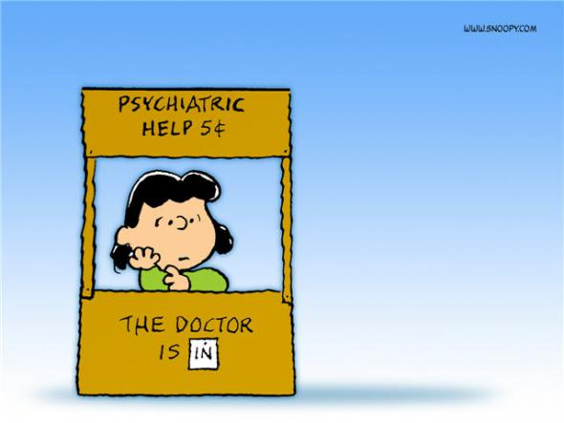
Independent Project- An overview
This project draws upon your academic ability and judgement. Tutorial support is available BUT the finished piece will be the product of your own judgement.
Criteria:
The application of multiple perspectives to Counselling/Psychology issues, inclusive of theory, practice and reflection
The work must communicate authoritatively within the field of COUNSELLING and or PSYCHOLOGY.

Slide 8
So, lets break the criteria down. Multiple perspectives to counselling issues: this means that when you choose an issue, say dementia, you will begin a literature search which observes the issue from more than one viewpoint. By gathering sources from different viewpoints, you will begin to build a bank of literature which inherently offers a critique.

Slide 9
An example of inclusion of multiple perspectives:
‘There are several reviews in which a summary of psychosocial interventions for dementia sufferers have been presented (e.g., Ayalon, Gum, Feliciano and Arean, 2006; Teri, Mckenzie and LaFazia, 2005 and Van Mierlo et al., 2010) however, there is a paucity of critical reviews in which the efficacy of these approaches is synthesised in order to offer a more transparent view of the current situation’
This brings in literature within the field as well as identifying a gap in the literature

Slide 10
ILLUSTRATING THE GAP IN KNOWLEDGE:
This gives a taste of theory, practice (interventions) and to an extent, a reflection in terms of the gap in the research

Slide 11

Authoritatively Communicating
This is where you have the opportunity to let your academic judgement shine!
Using the literature, you may use an authoritative voice to convey a key point.
E.g., ‘In light of this, the ensuing legal, ethical and clinical dilemmas associated with both the pre-assessment period as well as the aftermath of a diagnosis provides a persuasive argument for the necessity of provision of therapy for these individuals’

Slide 12
Do’s and Don’ts
Don’t use headings- your work should be one continuous narrative (other than the title)
Do choose a title appropriate for your research (you can be a bit creative here)
Don’t surround yourself with too much literature; once you have decided upon your sources, stick to them and bring in others if absolutely necessary
Do ensure academic conventions such as citing and referencing are appropriately applied

Slide 13
Presentation
Lots of marks can be unnecessarily lost by poor attention to detail. As you are producing your piece, keep the Independent Project Handbook by your side and check your work is reflective of what is required.
Requirements are:
The front page will have the title clearly stated
2. The work will be in Times New Roman, font 12 and double spaced
3. A complete reference list will be included at the end of the piece

Slide 14
Structure
Introduction
Body of work: analysis, discussion
Conclusion/inference/evaluation
Implications for the field of psychology / counselling
In our next lesson, we will focus upon the Introduction, as well as taking a broad look at referencing and appropriate sources

Slide 15
Have The aims of this lesson been met?????????????
Introduce you to the Module
Ensure that you are clear about Module content, context and assignments
Enable you to begin work immediately on your research

