Slide 1
Welcome to
BMGM4000
Effective Management

Slide 2
Lecture Preparation
Last week you were asked to come prepared to share your findings about -
Safer Food Better Business Recording Process in Wales

Slide 3


Slide 4
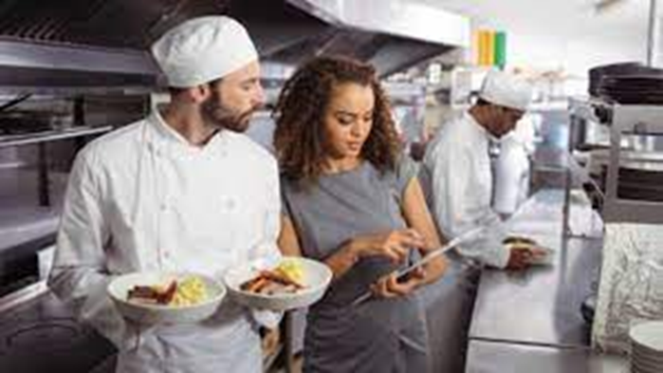
Lets recap on what you think a restaurant manager does…
Why is SFBB important to them?

Slide 5


Slide 6
In the video the pre-shift briefing was mentioned-
Why do this?
What benefit would there be as a team member?
What else might you find out or notice during the briefing as the manager?

Slide 7
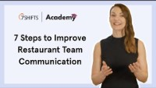

Slide 8
It is very likely that during your work within a restaurant you will have to handle complaints
What have you experienced so far during placement?

Slide 9


Slide 10
Assessment - Submission Date 17th March 2023
Portfolio 4 elements
1500 words
Section 1 – Safer Food Better Business
Section 2 – Budgets
Section 3 – Marketing
Section 4 – Human Resources

Slide 11
Writing your portfolio what you will be expected to include
Essay
Report
Reflection
Staff training plan

Slide 12
Any questions so far?

Slide 13


Slide 14
You are starting your shift at 10:00 as a waiter within a busy high street restaurant.
There are 60 diners already booked but there is the capacity for another 40 walk ins
You have 4 waiters working with you.
Today you are the most senior member of staff front of house.
How do you prepare for the service?
What will your role be during service?
What will you do at the end of service
Prepare your plan for the service in writing
Accompanied by 2 PowerPoint slides to illustrate your plan
- you will then share this plan with the group, and answer questions about it.

Slide 15
We will start our next session with
Your presentation and service delivery management plan

