Slide 1

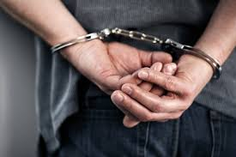

Welcome back to Part two!
Criminal Litigation – Introduction

Slide 2

Classification of Offences
Magistrates’ Court Act 1980 (MCA 1980) provides that all criminal offences fall into one of three categories:
Indictable-only;
Either way; or
Summary offences.

Slide 3
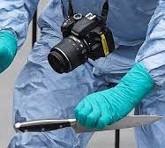
Indictable Only Offences
Most serious form of criminal offence.
Dealt with by the Crown Court.
Examples include murder, rape and robbery.

Slide 4

Either-way Offences
These offences can be dealt with either by the Magistrates’ Court or by the Crown Court.
Magistrates may decide that the case is too serious for them to deal with.
Defendants can choose whether to go to the Crown Court for trial.
Examples include theft, assault occasioning actual bodily harm and burglary.

Slide 5
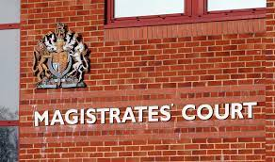
Summary Offences
Least serious forms of criminal offences
Examples include, common assault and road traffic offences.

Slide 6
Tasks
List five safeguards in the criminal justice system for persons accused of a crime.
Which rights under ECHR are likely to be invoked in criminal matters?
You are consulted by Phil James. He has been charged in connection with careless driving which is a summary only offence. Phil wants to know which court will hear his case. What do you tell him?
Assume Phil has been charged with theft which is an either-way offence. He intends to plead not guilty. Explain which court he may be tried in.
Assume Phil has been charged with murder. Explain which court he will be tried in.

Slide 7

Key Personnel of the Criminal Justice System
Can you name some of the key players in the CJS?

Slide 8

Defence Solicitors
Defendants can represent themselves; however, it is likely that they will be represented by a solicitor/lawyer.
Solicitors provide advice and assistance to a suspect in the police station, before the suspect is charged with an offence.
If the suspect is charged, the solicitor will then represent the person in proceedings before the Magistrates’ Court (and if necessary, the Crown Court.)
At Crown Court the solicitor will instruct a barrister or solicitor advocate to act as the client’s advocate in court.

Slide 9
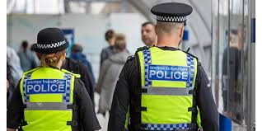
The Police
Responsible for the investigation of suspected criminal offences
Apprehending suspects
Police possess a wide range of powers which we will discuss in week 2.
Although the police investigate the majority of alleged offences, other agencies exist to investigate particular types of crime (e.g. HMRC, Health and Safety Executive)
National Crime Agency (NCA) established to prevent and investigate serious, organised and complex crime. (e.g. drug importation, firearms, cybercrime, exploitation of children and human trafficking)

Slide 10

The CPS
The Crown Prosecution Service (CPS) is responsible for prosecuting individuals charged with having committed a criminal offence.
Head of the CPS is the Director of Public Prosecutions.
Responsible for deciding whether to charge a suspect.
CPS prosecutes the case in court and will collate evidence to be presented at trial.
It is independent from the police.

Slide 11
The Magistrates’ Court
After a suspect has been charged with an offence, they will make a first appearance in court before the Magistrates’ Court (MC)
If under the age of 17 the suspect will appear in the Youth Court
Depending on the offence, the case may either remain in the MC or be sent to the Crown Court for trial.
Approximately 95% of criminal cases are dealt with the MC.
Summary offences tried in MC and some either-way offences
Deal with bail applications
No jury – only magistrates and legal advisor (clerk to the justices)

Slide 12
The Crown Court
The CC is the venue that deals with offenders charged with the most serious types of criminal offences.
Main functions of the court are:
-to conduct the trial and to sentence the offenders if convicted of all indictable only and some either-way offences
To determine the question of bail, appeals against the refusal of bail at the Magistrates’ Court.
To hear appeals against convictions and/or sentence from the Magistrates’ Court.
Judges and juries.

Slide 13

The Probation Service
A representative from the PS will always be present in court when a case is being heard.
PS responsible for compiling reports on defendants who have been convicted (pre-sentence reports). These reports focus on the defendant’s background, previous convictions and likelihood of re-offending.
Also responsible for the administration of various types of community order which may be imposed by the court as per of the sentence the defendant receives.

Slide 14

Criminal Legal Aid
Since 1 April 2013, the funding for legal services for those suspected of having committed a criminal offence or facing criminal proceedings is administered by the Legal Aid Agency (LAA)
Provides funding for defendants

Slide 15

Any Questions?

Slide 16
Next Steps
Next week we will be looking at Police Powers
Listen in advance to the recorded lectures once available and read up on the subject in readiness for the session.

