Slide 1

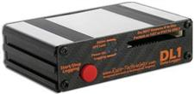
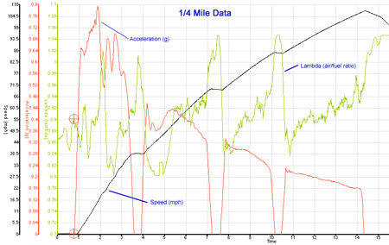
Data Acquisition
Handling and steering
Level : Bsc Level 3
Lecturer :Tim Tudor

Slide 2
Handling and steering
Introduction
Gap between expectation and the reality of what a logger can do
New users expect to plot a few key channels and see immediately what's going on
This takes experience and effort!
First indicators can be observed by looking at general parameters which describe how well the car handles.

Slide 3
Handling and steering
Overall handling measures
Speed – If a greater speed is carried through a corner this generally points to either
    Increased grip (Mechanical or Aero)
    Better balance
    Better driver!
Lateral (& Longitudinal) Acceleration – Lateral acceleration indicates the magnitude of the forces accelerating the car around an arc. Higher acceleration points to increased grip or improved balance
Steering input – This input gives insight into how much input is required by a driver to maintain balance of the car. Indicates overall handling balance.

Slide 4
Handling and steering
Overall handling measures – Outing Reports
May want to display table showing following parameters for each lap and outing/configuration
  Max speed
  Min speed
  Average speed
  Max Lat Acceleration
  Min Lat Acceleration
Values allow comparison between runs
  Increased average lat acceleration points to increased grip
  Increased average speed again points to increased grip or power or braking potential

Slide 5
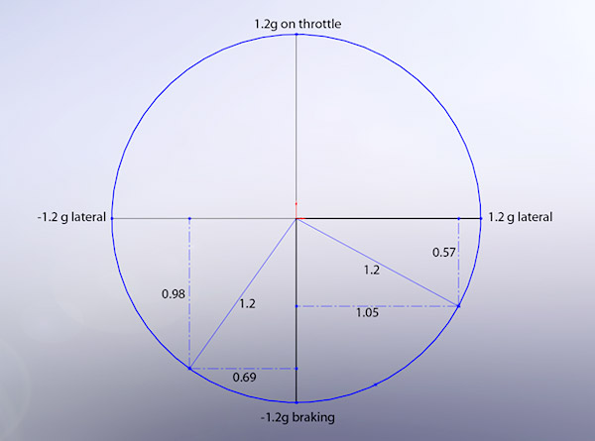
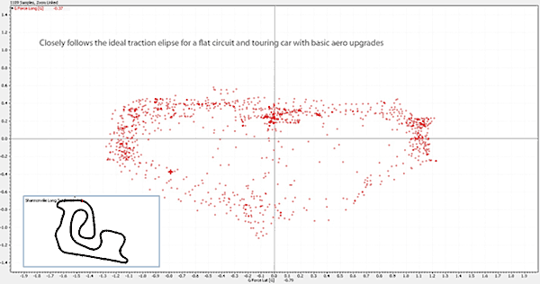
Handling and steering
G-G Diagram
G-G Diagram is a plot of lateral acceleration versus longitudinal acceleration
Total acceleration available is limited by grip from tyres. Actually forms an ellipse
During cornering less grip available for longitudinal acceleration
Larger ellipse size indicates increase in grip.
Consistent near limit indicates well balanced car and good driver!

Slide 6
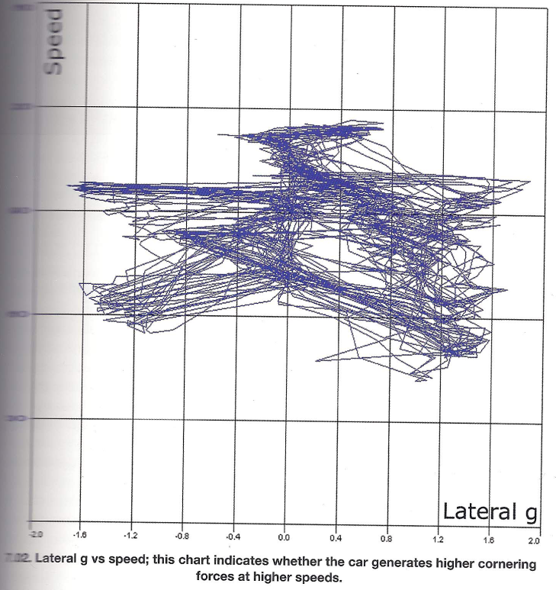
Handling and steering
Speed V Lateral Acceleration
Speed on y axis
Lat Acceleration on x axis
Car has no wings just a reasonable body shape
Stretch out to around +/- 1.6G – Not bad for this type of car.
As speed increases so does maximum lateral acceleration → Downforce

Slide 7
Handling and steering
Speed V Lateral Acceleration
2 LH bends are quite distinct.
One taken at around 60mph and the other at 100mph.
  60mph → ~-1.5G
  100mph→ ~1.6G
Generally this type of graph will resemble an inverted triangle where there is more Downforce, more rectangular for less Downforce.

Slide 8
Handling and steering
Simple analysis possible
Although complex math channels can be created to help analyse handling, basic channels offer allot of information
Oversteering car may show
    Jagged lateral acceleration trace
    Jagged steering trace (opposite lock etc)
Understeer is not as dramatic
    May be a desperate Scandinavian flick in attempt to get car to turn in?
    Lateral acceleration trace gives clues.

Slide 9
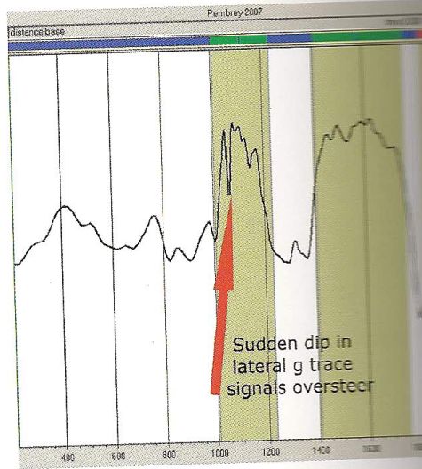
Handling and steering
Recognizing under steer and over steer
Lateral G trace is starting point for handling analysis
Understeer and oversteer effects are subtle and hence may be easily confused.
Oversteer-
  Sudden loss of rear grip
  Rapid dip in lateral acceleration
  Drivers response causes sudden return to previous levels.
  Dip and climb → spike in data

Slide 10
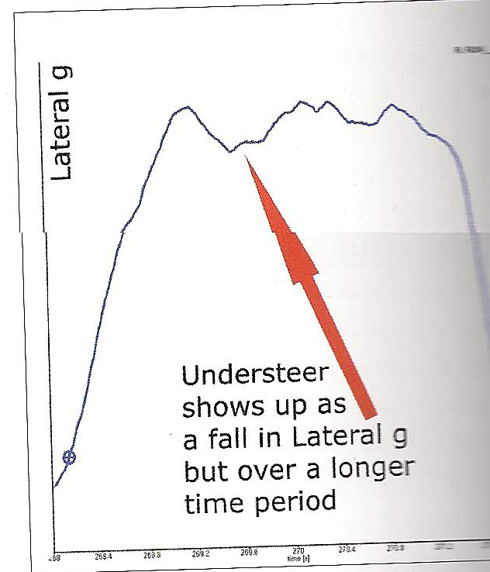
Handling and steering
Recognizing under steer and over steer
Understeer-
  More Subtle
  Can show up as a sudden dip in lateral acceleration
  Dip is shallower and lasts for longer than oversteer
  Shallower because even when the front end of a car lets go there is still more cornering power than when the rear lets go.
  Correction lasts longer as driver has to lift throttle, reduce steering angle and wait.

Slide 11
Handling and steering
Recognizing under steer and over steer
Understeer in chart is sudden and significant caused by a wet track.
Reluctance to turn in shows as a slow and hesitant increase in lateral acceleration
Mid corner understeer is hard to spot with a lat accel trace on its own.
Corner exit understeer shows as flattening out of lateral acceleration on exit .

Slide 12
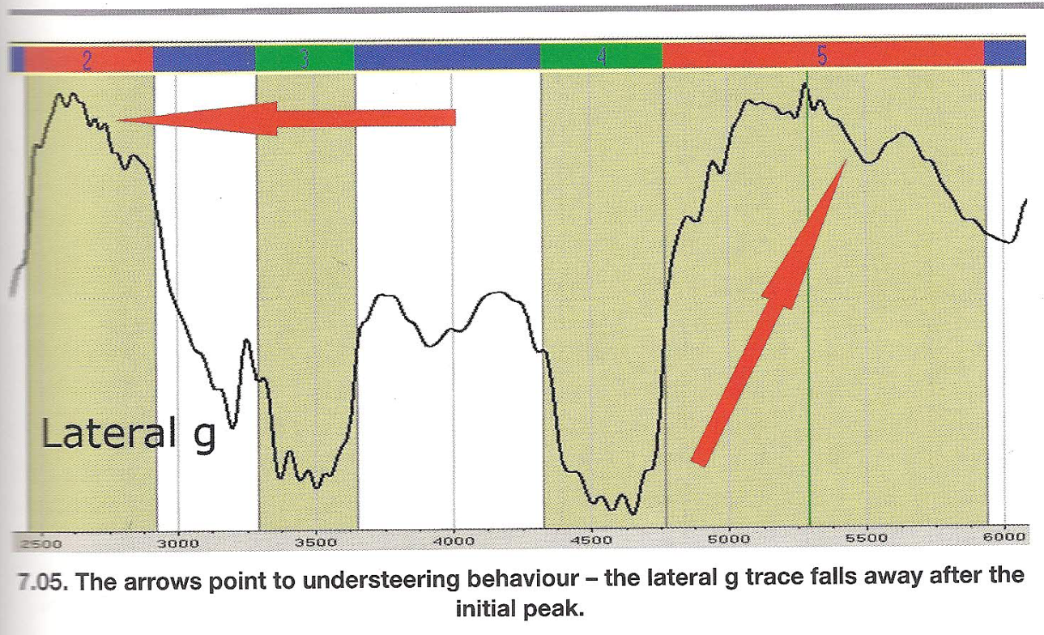
Handling and steering
Understeer

Slide 13
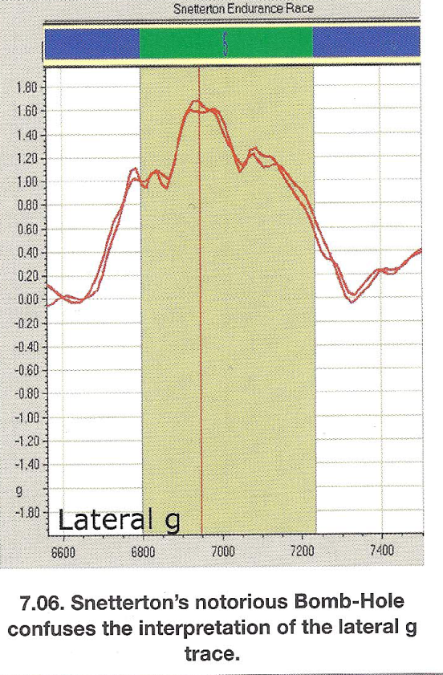
Handling and steering
Lateral acceleration and under/oversteer
Bumps in track surface can mask under and oversteer characteristics
Trace on RHS shows a trace which appears to exhibit signs of understeer at beginning and end of corner.
In fact there is a dip in the track which causes the driver to tighten the line significantly in the middle of the turn.
This would be evident from the steering trace.

Slide 14
Handling and steering
Steering traces
Combining steering and lateral acceleration gives much clearer picture of handling.
  Steering – Drivers Request
  Lat Acceleration – Vehicle response
Not worth not running steering and throttle sensors as
  They make analysis much clearer
  Are inexpensive
  Are easy to fit
Previous under/oversteer traces shown on next slide. Steering trace gives much clearer picture.

Slide 15
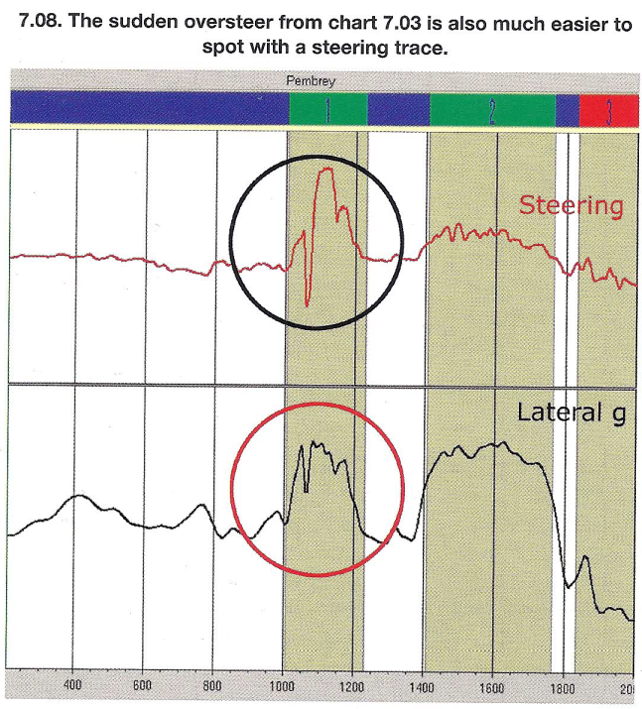
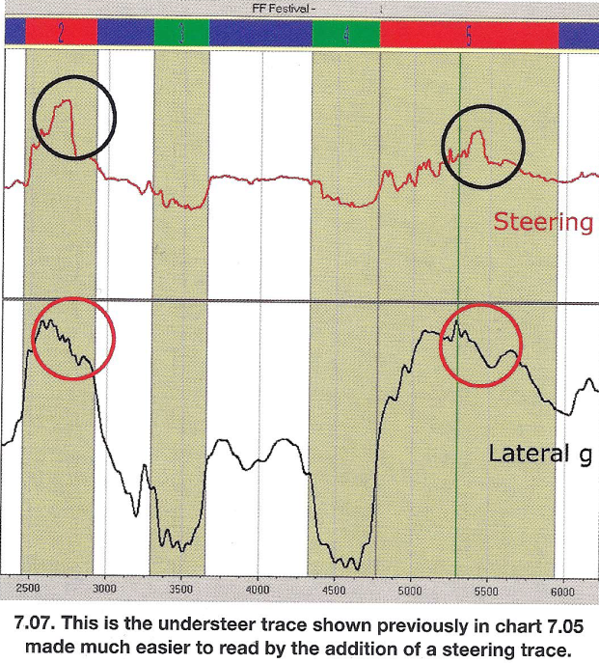
Handling and steering
Combining steering and lat acceleration traces
Speed

Slide 16
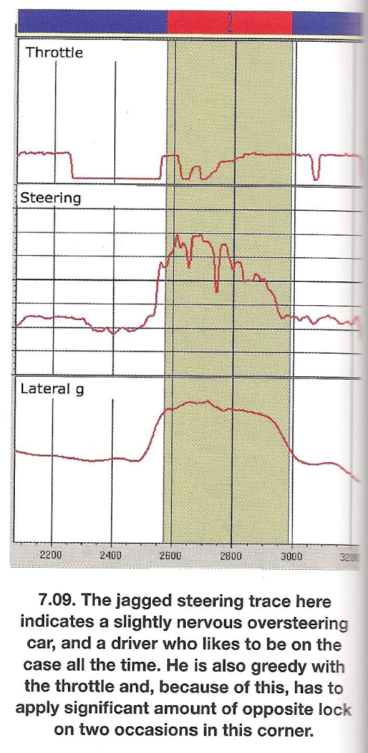
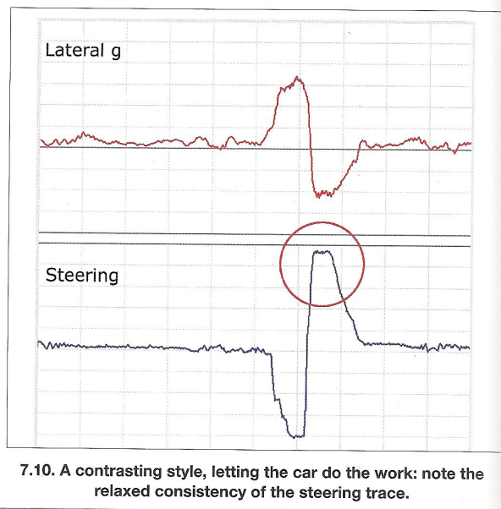
Handling and steering
Driver effects on traces

Slide 17
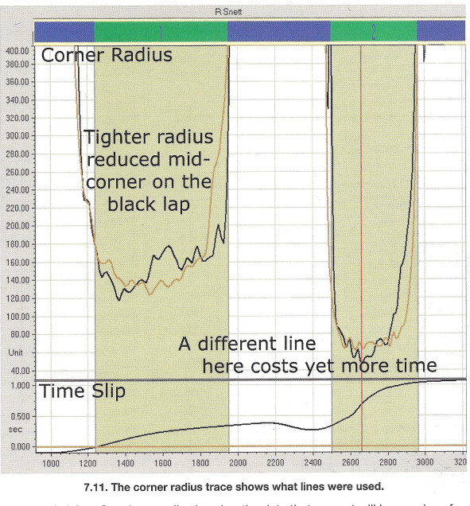
Handling and steering
Corner Radius
Calculating and plotting corner radius as a maths channel can be helpful.
Allows comparison of different corners between different circuits.
Can predict cornering speeds.
Required to calculate under/oversteer channel

Slide 18
Handling and steering
Corner Radius
Can help identify what the driver should be doing. (How much steering should be applied)
  Large Radius → settle car and back on throttle
  Small radius→ requires more careful application of throttle
Also may indicate different lines .
  Sharp turn in → Sudden drop in trace
  Consistent radius → Flat bottom to curve
Step up mid corner of black trace could be due to understeer

Slide 19
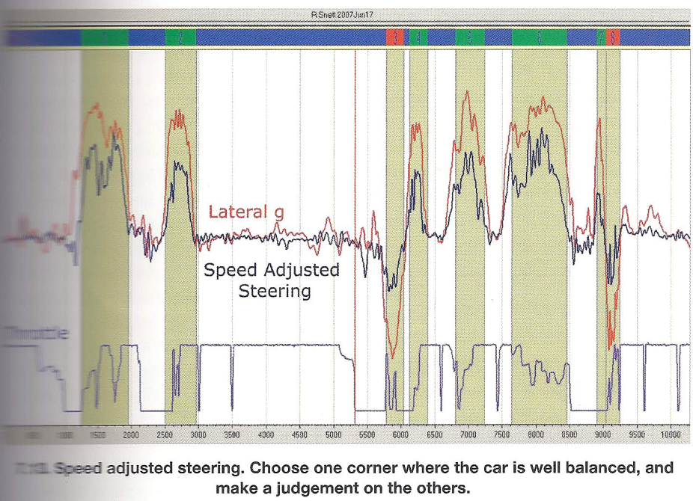
Handling and steering
Speed adjusted steering
Problem with using steering and lateral acceleration traces combined is that the two do not move in unison.
A car with no aerodynamic can be expected to reach the same maximum lateral acceleration around a 30mph corner as a 100mph corner. Max lateral acceleration is independent of corner radius.
Steering is not. Large radius = small steer angle
We can use speed adjusted steering approximation

Slide 20
Handling and steering
Speed adjusted steering
As SAS is only an approximation you can only use it for comparative work.
First identify a corner where the car was well balanced
Identify the relationship between SAS and lat accel.
Whatever the relationship, you would expect it to be repeated in all corners where the car is well balanced.
If trace is shorter than expected → Driver using less than expected steering→ oversteer
Taller than expected → driver using more steering than expected → Understeer

Slide 21
Handling and steering
Speed adjusted steering
Trace
  Balanced in turn 2
  Oversteer in turn 3
  Understeer in turns 1 and 6

Slide 22
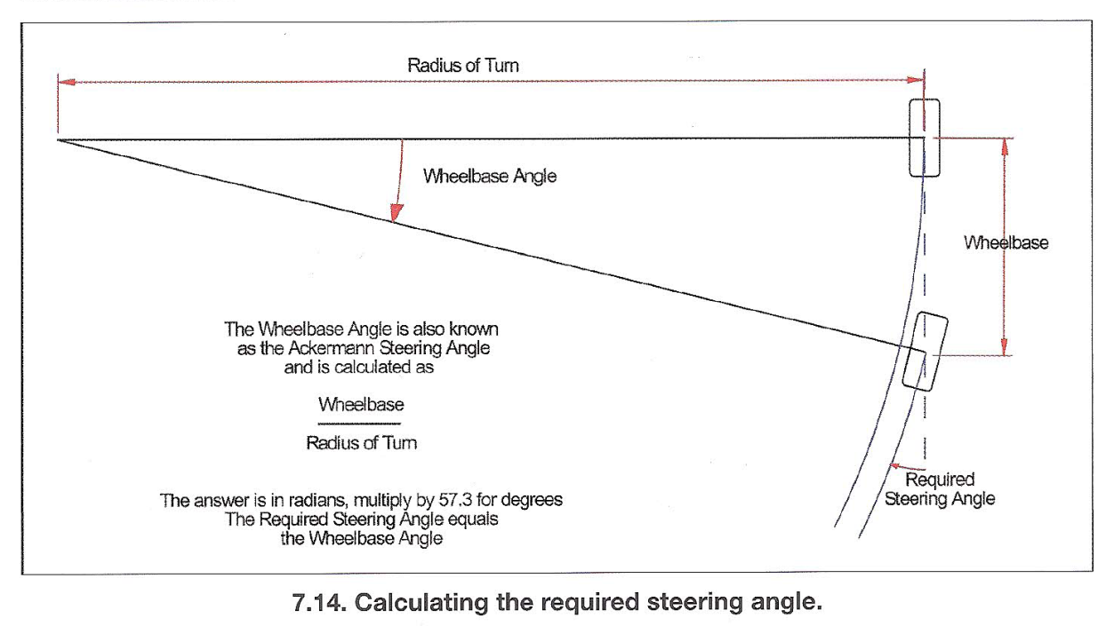
Handling and steering
Required Steering
Required steering is described by the formula
Which is derived from geometric analysis of the diagram on the right

Slide 23
Handling and steering
Required Steering
Useful as it describes the theoretical steering associated with the actual path of the car.
If compared with steering trace we can identify under/oversteer
Only works properly if steering channel calibrated in terms of road wheel movement.
Handling channel can be created by subtracting required steering from actual steering

Slide 24
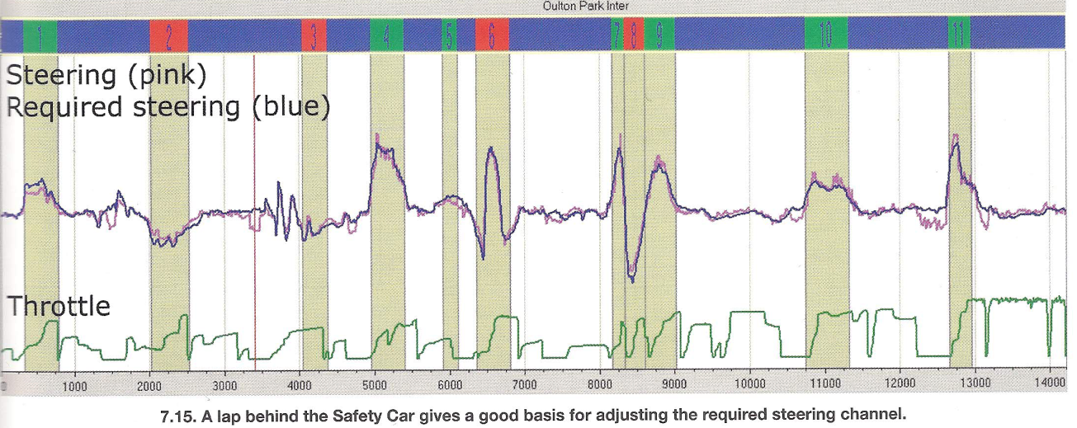
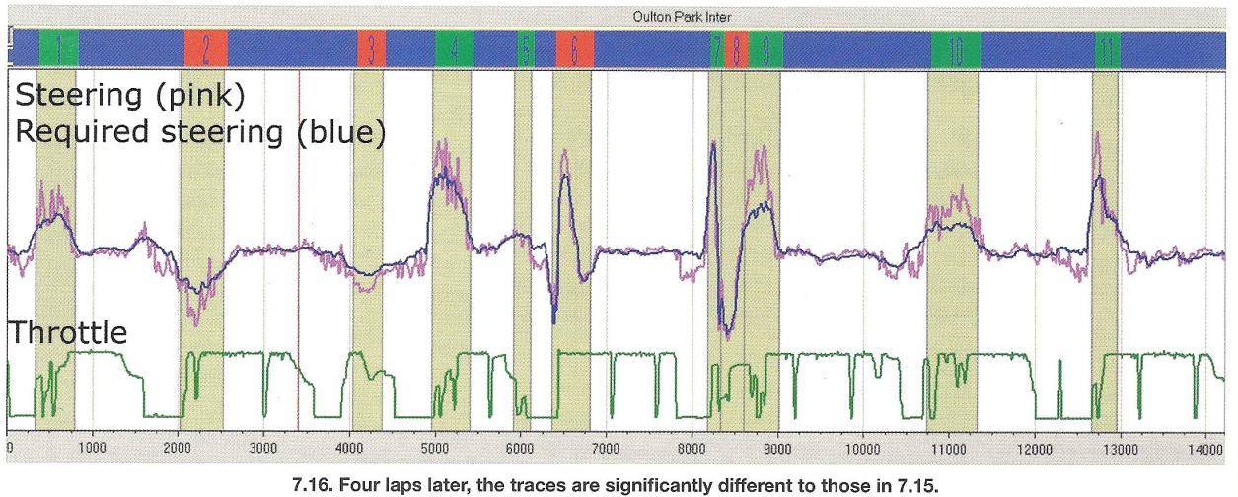
Handling and steering
Required Steering Versus actual steering

Slide 25
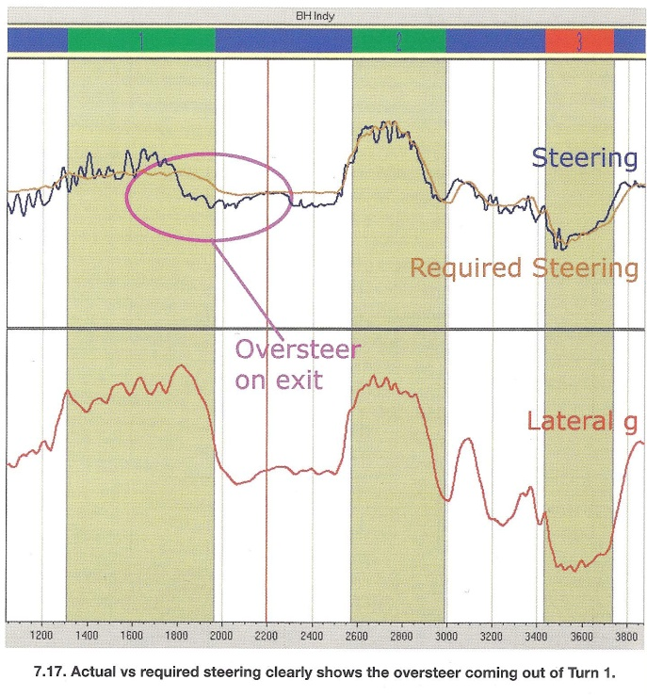
Handling and steering
Required Steering Versus actual steering

