Slide 1
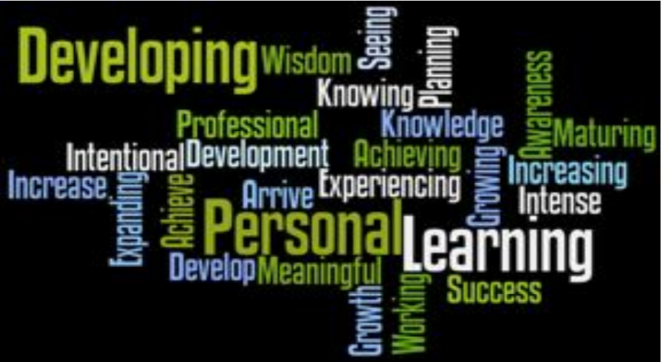
Personal Development Plan
Dr Ewa Kazimierska

Slide 2
Introduction
Thinking about and creating a Personal Development Plan 'PDP' (if you are in employment, this may already be in place)
Thinking about and creating an 'e-portfolio’
Constructing a system that can contain these, as well as potentially other important information you hold in a digital format.
The 'system' needs to be easy to use. Easy to back up. Easy to access. Expandable over time and preferably needs to keep on being usable for decades to come.

Slide 3
Personal Development Plan, PDP
PDP (Personal Development Plan) is:
'a structured and supported process undertaken by an individual to reflect upon their own learning, performance and/or achievement and to plan for their personal, educational and career development’
The Higher Education Academy (HEA)
Why Personal Development Planning (PDP) Matters - career-advice.jobs.ac.uk

Slide 4
PDP as an action plan
PDP is an action plan that you can use to:
clarify goals and specify what you want to achieve.
record strengths and weaknesses.
highlight the areas you need to improve and develop to meet your goals.
realize what you need to do to achieve your goals.
specify anything that could hinder your progress.
understand what and how you are learning
bring together information for your CV
“if you fail to plan, you are planning to fail”. Benjamin Franklin

Slide 5
Benefits of a PDP
It defines your clear goals.
It helps you to recognise your strengths and weaknesses.
It improves your performance.
It increases your motivation.
It helps track your progress.
It improves your sense of purpose.
It enhances your mental wellbeing and reduces stress.
PDP gives you the best possible chance for success and maximises your potential.

Slide 6
SWOT Analysis
A SWOT analysis aims to:
promote your S trengths
reduce your W eaknesses
exploit the O pportunities available to you.
minimise T hreats to your success.
0
https://www.cipd.co.uk/knowledge/strategy/organisational-development/swot-analysis-factsheet

Slide 7
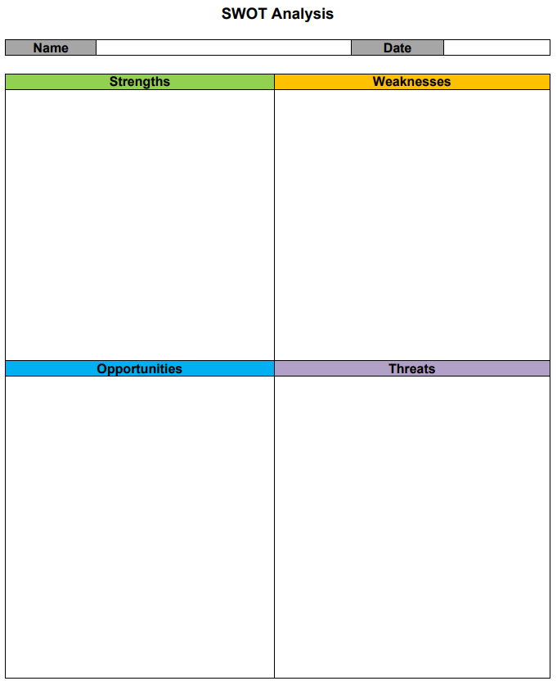
SWOT analysis
What am I good at?
What makes me stand out from the crowd?
What are my hobbies and special interests?
What do others say about my strengths?
What achievements am I proud of?
What are my weak skills?
What areas do I need to improve upon?
What holds me back?
Do I have any negative traits?
Do I lack the confidence to start certain tasks?
What do others say about my weaknesses?
Is the university/job in a promising position for me?
Are there people around me who could assist me?
What strengths can I turn into opportunities?
Is there a course/training I can sign up for that will help me develop different skills?
What could interfere with achieving my success? E.g. competition, finances, changes in technology, etc.
Could my weaknesses become threats?
Are there any external changes beyond my control that could be a threat?

Slide 8
SWOT analysis - example
Strengths | I have very good attention to detail, which allows me to identify things that others miss.
Weaknesses | I find it difficult to speak in public, particularly larger audiences, and I will try and avoid it when I can.
Opportunities | There is a networking event next month, which will allow me to gain some new contacts. It will also help me with my communication skills.
Threats | As my role requires training, my lack of confidence in public speaking could hinder my progress and even threaten my position.
What is a personal development plan? | SWOT Analysis, How To Write (cpdonline.co.uk)

Slide 9
Class exercise
Take few minutes to prepare your SWOT analysis.
List one strength, one weakness, one opportunity and one threat

Slide 10
How to write a PDP?
Complete a SWOT analysis where you stand now, where your interests lie, what your strengths and weaknesses are, the improvements you would like to achieve
THINKING
Assessing your progress reviewing your academic achievements and deciding on further areas for personal, academic and career development.
REVIEW and
REFLECTION
PLANING
Set your goals
where you want to go, what skills and knowledge you need to get there and how you might acquire them.
Create your action plan and Detail the strategies and resources for achieving your goals
setting yourself goals and specific targets and monitoring your progress towards them.
ACTION
and
RECORD

Slide 11
What to reflect on?
‘In the PDP context reflection is the process of looking back over past events; analysing how you have learned and developed as a person and your feelings about this, and re-evaluating your experience on the basis of your thoughts’
K.McMillan, J.Wayers (2012)
Learning Styles,
Setting Goals,
Successful self-management at university (time, money, stress),
Developing a variety of skills and responding to the feedback you receive from your professors.
“There is only one corner of the universe you can be certain of improving, and that's your own self.” Aldous Huxley
Notes:
Reflecting

Slide 12
Engaging with the PDP process
Clarify your personal career goals;
Understand more fully what and how you are learning, what your strengths and weakness are and how to get better results;
Take responsibility for your own development by setting yourself personal and academic targets and evaluating progress towards these;
Improve your employability;
Start the process of continuing professional development in your chosen career area.

Slide 13
Aim, Goal and Objective
Aim:
A broad statement of what you want to achieve overall
  Focus: The general direction or purpose of your work.
  Example:
    To become a competent and employable software developer.
    To build strong technical and problem-solving skills for a career in cybersecurity.
Think of it as the big picture, what you hope to accomplish in the long term.

Slide 14
Aim, Goal and Objective
Goal:
A specific result you want to reach that supports your aim.
  Focus: More concrete than an aim, but still not too detailed.
  Example:
    To develop proficiency in Python and Java within the next academic year.
    To gain work experience through an industry placement before graduation.
    To achieve at least a 2:1 classification in my Computing degree.
Goals make the aim more measurable and actionable, often linked to outcomes.

Slide 15
Aim, Goal and Objective
Objective:
Detailed, measurable steps you will take to achieve your goal.
  Focus: Short-term and specific actions.
  Example:
    To complete one online Python project by the end of this semester.
    To attend at least two networking or tech meet-up events this term.
    Objectives are usually SMART

Slide 16

Setting Goals
Specific
Measurable
Attainable
Realistic
Time-Limited

Slide 17
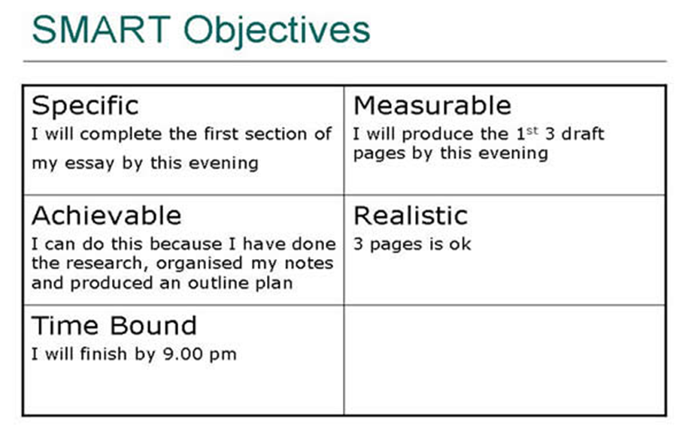

Slide 18
Student Task
Example. You decide to improve your health and fitness (AIM), so your GOAL is to ‘Get fit, eat healthily and lose some weight’
You now need to break this general aim down into more specific objectives that follow SMART

Slide 19
Example
‘Get fit, eat healthily and lose some weight’
Specific objectives:
1) Perform research to discover what constitutes an optimal diet. Devise a shopping list, clear out all the old junk in the cupboards so that by December 1st, the new diet can start.

Slide 20
Example
‘Get fit, eat healthily and lose some weight’
Specific objectives:
2) join the ‘park run’ scheme by the end of the week. Read the ‘couch to 5K’ training schemes. Use Google calendar to schedule the training runs so that I will do my first 5K run in the 1st week of January.
Keep training to achieve a sub 30 min 5K by April next and sub 20 min within 12 months of starting.

Slide 21
Example
‘Get fit, eat healthily and lose some weight’
Specific objectives:
3) Weight is 100Kg now. Weigh at the end of every week. Keep a record in the form of am excel spreadsheet. Aim to get to 90Kg by June 1st next summer.
(perhaps produce a more detailed breakdown of your goals for a weekly/daily food plan to do this?)

Slide 22
Student Task
Understand what motivates you - why are you here? What do you ultimately want out of life?
Identify 2 or 3 short/medium term goals that you want to implement
Break down your goal(s) into small chunks, small stepping stones that will help you plan the steps needed to achieve these goals. Produce an action plan, with enough detail and timescales to let you achieve these goals – remember to use S.M.A.R.T

Slide 23
Short term goals/tasks
Think of the things you need and want to do this semester.
What are your deadlines?
Do your short term tasks align with or support your long term goals?
Do you need to prioritise?

Slide 24
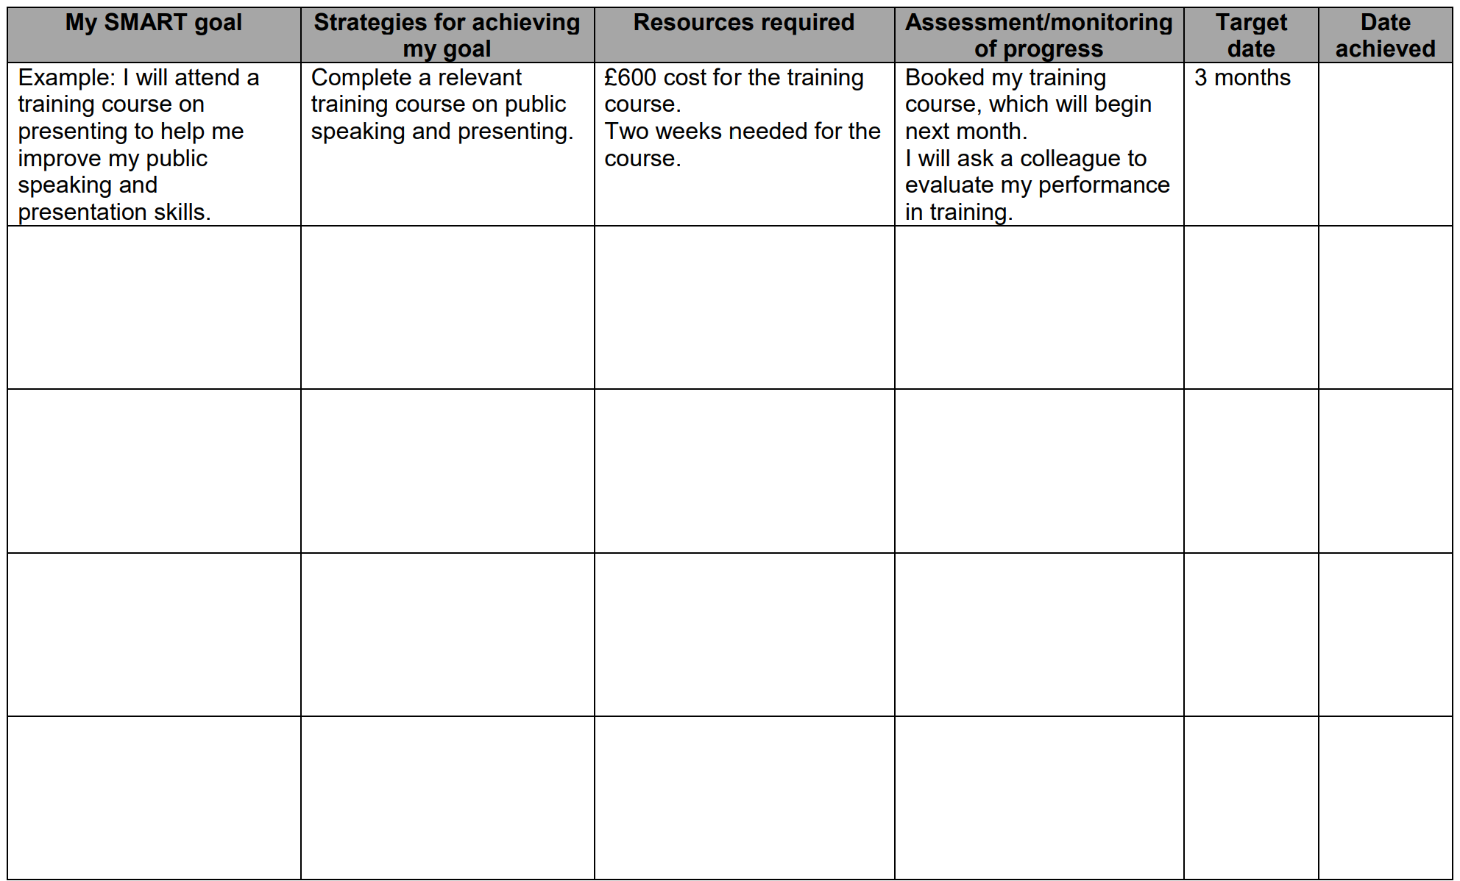
PDP sample action plan
I will attend a photography course to learn new technics for taking photos
Complete an appropriate training course on new technics for taking photos
£200 tuition
Three consecutive weekends
Booked and paid for the course.
I will ask my friend to evaluate my pictures
2 months
Adapt it to fit your needs !!!

Slide 25

DON’T BE BORING!
BE CREATIVE AND IMAGINATIVE WITH YOUR PDP

Slide 26
Class exercise
Quietly and without influence from others ask yourself and answer the following questions:
1. Goals & Direction Ask Yourself:
  What is my Heart's desire?
  What type of person do I want to be in life?
  What do I want to do in Life?
  What do I want to achieve in Life?
  How am I going to achieve it?
The above exercise will help you to complete the next activity.
2. Reflect on your answers and write down your:
  `Future Long-term goals
  Current Short-term goals.
Tip: Do your short-term tasks align with and support your long-term goals?

Slide 27
E-portfolio
'e-Portfolio’ or progress files- Personal Learning Space that:
provides an access to review, update, and log your Personal, Academic and Professional achievements, certificates awards and rewards.
collection of evidence to support your PDP and CV; can be used as part of the process of reflection on your achievements and goals and to demonstrate your skills and abilities
is an exercise in structuring your thoughts & ideas, goals & dreams.
allows you to clarify your Goals, jot-down ideas, reflect and journal, solve problems, find solutions to any life challenges.
It is dynamic and fluid and changes as you learn grow and change though-out your life.

Slide 28
E-portfolio Tools
WordPress (WordPress.com)
highly customisable
can create a professional website-style portfolio
supports plugins (on paid tiers) for galleries, code embeds, CV layouts
Best for: students wanting a polished, long-term portfolio
https://wordpress.com/
Google Sites
free and very easy to use
integrates well with Google Drive
good for showcasing projects, reports, coding portfolios, and media
clean, professional templates
Best for: beginners, students wanting simplicity
https://sites.google.com/
Mahara
purpose-built for academic e-portfolios
supports reflections, competencies, modules, file uploads
often integrates with Moodle
Best for: formal academic portfolios
https://mahara.org/
Adobe Portfolio
part of the Adobe Creative Cloud
clean layouts, especially for design, media or UX portfolios
Best for: students with access to Adobe tools
https://portfolio.adobe.com/

Slide 29
New folder/section: e-Portfolio
Sub-folder: Personal development
  File: Reflective Journal
    This section is where you turn into your own Guide, where you can jot down your reflections about how things are going in life. Very flexible and fluid that simply include your personal Notes. Notes thoughts and feelings about how things are going, things you would like to improve or change. Can be organised like a diary by date but this optional.
  File: Goals
    Section: Short-term
    Section: Long-term
  File: About Me
    Section: Summary
    Section: Hobbies/Interests
Section: Values https://www.wikihow.com/Define-Your-Personal-Values
CareerPath_Final2 (cmu.edu)
    Sub-folder: Professional development
  File: Personal Statement
  File: CV (Inc. Qualifications, Work Experience, Projects)
  File: Job Sites
  Sub-folder: Self-Evaluation
    files: Positive Qualities/Strengths/Virtues & Areas to enhance.
Sub-folder: Academic development
  Sub-folder & files: Skills Evaluation
  Sub-folder & files: Assignments
    Tip: Create a sub-folder for each Module.
  File: Publications.
DO NOT COPY IT!
MAKE YOUR OWN!

Slide 30
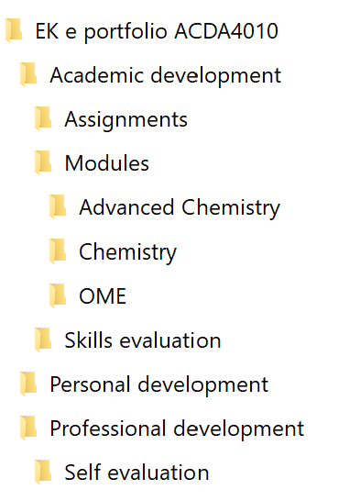
Fo: e-Portfolio
fi: Personal Statement (few paragraphs)
fi: CV (2 page summary)
fi: Goals
fo: Education & CPD Training
  fi: Qualifications & Skills gained
  fo: Assignments
fo: Experience
  fi: Work Experience & Skills gained
  fo: Project files
fo: Self Awareness
  fi: Journal
  fi: Employability Skills
  fi: Positive attributes
  fi: Values
  fi: Personality Type
fi: Interests / Hobbies
Linkedin (Public Profile)

Slide 31
Final tips:
All of this information is supposed to be a long term resource - think in terms of decades!
You may want to consider creating your initial structure in a format that has maximum longevity, e.g. as a Windows directory structure, and the information itself in .doc type files. Here you can store EVERYTHING, including personal goals etc.
You can then easily extract this information to cut, paste and create other presentation formats or platforms such as a web based tool for public viewing.
(hint - seriously consider sticking to standard file formats such as .doc etc, and create the structure using a normal windows tree/hierarchical based directory method)

Slide 32
Class Activity:
Visit How to Define Your Personal Values: 13 Steps (with Pictures) (wikihow.com) and the link within it to CareerPath_Final2 (cmu.edu) to help you think about and perhaps understand more about yourself.
Use these thoughts to help formulate an initial goals list. What exactly do you want to do in, with, and get out of, life?
Make some notes, so you can include them when you start to create your PDP.
Take this seriously. Thinking about and setting goals can be a life-changing experience!
YOU WILL NEED IT FOR YOUR PRESENTATION AND FINAL ASSESSMENT !!!

Slide 33
At home:
Re-read the PDP/ePortfolio notes and think about the various sections and items you should, and would like to, include.
Structure your e-portfolio and organise your current work in the correct files

